Slide 1


Diabetes and Pregnancy
2018 Clinical Practice Guidelines
Chapter 36
Denice S Feig MD FRCPC, Howard Berger MD, Lois Donovan MD FRCPC, Ariane Godbout MD FRCPC, Tina Kader MD FRCPC, Erin Keely MD FRCPC, Rema Sanghera MA RD

Slide 2
Disclaimer
All Content contained on this slide deck is the property of Diabetes Canada, its content suppliers or its licensors as the case may be, and is protected by Canadian and international copyright, trademark, and other applicable laws. Diabetes Canada grants personal, limited, revocable, non-transferable and non-exclusive license to access and read content in this slide deck for personal, non-commercial and not-for-profit use only. The slide deck is made available for lawful, personal use only and not for commercial use.
The unauthorized reproduction, distribution of this copyrighted work is not permitted.
For permission to use this slide deck for commercial or any use other than personal, please contact guidelines@diabetes.ca

Slide 3

Pregnancy Chapter
2018 Diabetes Canada CPG – Chapter 36. Diabetes and Pregnancy
2018
Longest chapter
Most recommendations (n=42)

Slide 4
Diabetes in Pregnancy: 2 Categories
2018 Diabetes Canada CPG – Chapter 36. Diabetes and Pregnancy
Pregestational diabetes | Gestational diabetes
Pregnancy in pre-existing diabetes Type 1 diabetes Type 2 diabetes | Diabetes diagnosed in pregnancy

Slide 5
Diabetes in Pregnancy: Consider Phases
2018 Diabetes Canada CPG – Chapter 36. Diabetes and Pregnancy
Pregestational diabetes | Gestational diabetes
1. Preconception counseling | 1. Prevention, Screening & Diagnosis
2. Management during pregnancy | Management during Pregnancy
3. Management in labour | 3. Management in labour
4. Postpartum considerations | 4. Postpartum considerations

Slide 6
Diabetes in Pregnancy: Consider Phases
2018 Diabetes Canada CPG – Chapter 36. Diabetes and Pregnancy
Pregestational diabetes | Gestational diabetes
1. Preconception counseling | 1. Prevention, Screening & Diagnosis
2. Management during pregnancy | 2. Management during Pregnancy
3. Management in labour | 3. Management in labour
4. Postpartum considerations | 4. Postpartum considerations

Slide 7
Dysglycemia in Pregnancy can Result in Adverse Pregnancy Outcome
2018 Diabetes Canada CPG – Chapter 36. Diabetes and Pregnancy
Elevated glucose levels can have adverse effects on the fetus
  1st trimester → ↑ fetal malformations
  2nd and 3rd trimester: ↑ risk of macrosomia and metabolic complications

Slide 8
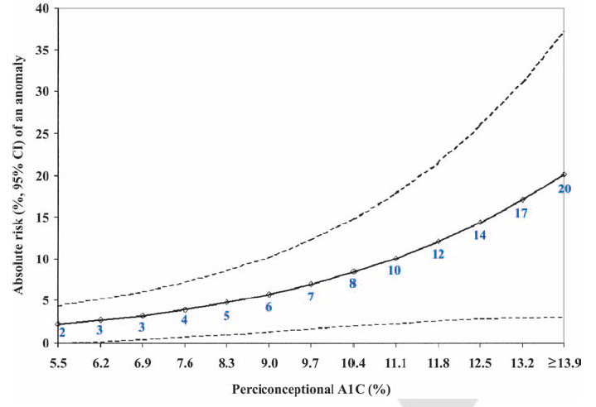
Risk of Fetal Anomaly Relative to Periconceptional A1C
2018 Diabetes Canada CPG – Chapter 36. Diabetes and Pregnancy
Glycemic control pre-conception = essential
Guerin A et al. Diabetes Care 2007;30:1-6.

Slide 9
Preconception Counseling for Pregestational Diabetes
2018 Diabetes Canada CPG – Chapter 36. Diabetes and Pregnancy
Advise reproductive age women with diabetes about reliable birth control
  NOTE: Metformin in PCOS may improve fertility → need to warn about possible pregnancy
  Metformin safe for ovulation induction in PCOS
Achieving a healthy weight is essential – obesity associated with adverse pregnancy outcomes
PCOS, polycystic ovary syndrome

Slide 10
Screen for Complications:
Pre-pregnancy and Intrapartum
2018 Diabetes Canada CPG – Chapter 36. Diabetes and Pregnancy
Screening for:
Retinopathy: Need ophthalmological evaluation
Nephropathy: Assess creatinine + urine albumin to creatinine ratio (ACR)
  Women with albuminuria or overt nephropathy are at ↑ risk for hypertension and preeclampsia

Slide 11
Preconception Checklist for
Women with Pre-existing Diabetes
2018 Diabetes Canada CPG – Chapter 36. Diabetes and Pregnancy
2018
Use reliable birth control until adequate glycemic control
Attain a preconception A1C of ≤7.0% (≤ 6.5% if safe)
May remain on metformin + glyburide until pregnancy, otherwise switch to insulin
Assess for and manage any diabetes complications
Folic Acid 1 mg/d: 3 months pre-conception to 12 weeks post-conception
Discontinue potential embryopathic meds:
  ACE inhibitors / ARB (prior to or upon detection of pregnancy in those with significant proteinuria)
  Statin therapy
ACE, angiotensin converting enzyme; ARB, angiotensin receptor blocker
Notes:
Script:

Slide 12
Recommendation 1
2018 Diabetes Canada CPG – Chapter 36. Diabetes and Pregnancy
Pre-existing Diabetes
Preconception care
All women of reproductive age with type 1 or type 2 diabetes should receive ongoing counselling on reliable birth control, the importance of glycemic control prior to pregnancy, the impact of BMI on pregnancy outcomes, the need for folic acid and the need to stop potentially embryopathic drugs prior to pregnancy [Grade D, Level 4]
BMI, body mass index

Slide 13
Recommendation 2
2018 Diabetes Canada CPG – Chapter 36. Diabetes and Pregnancy
Pre-existing Diabetes
Preconception care
2. Women with type 2 diabetes with irregular menses/PCOS who lose significant weight or are started on metformin or a TZD should be advised that fertility may improve and be counselled regarding possible pregnancy and receive preconception counseling [Grade D, Consensus]
PCOS, polycystic ovary syndrome; TZD, thiazolidinedione

Slide 14
Recommendation 3
2018 Diabetes Canada CPG – Chapter 36. Diabetes and Pregnancy
Pre-existing Diabetes
Preconception care
3. Before attempting to become pregnant, women with type 1 or type 2 diabetes should:
  Receive preconception counselling that includes optimal diabetes management, including nutrition, preferably in consultation with an interprofessional pregnancy team to optimize maternal and neonatal outcomes [Grade C, Level 3]

Slide 15
Recommendation 3 (cont’d)
2018 Diabetes Canada CPG – Chapter 36. Diabetes and Pregnancy
Pre-existing Diabetes
Preconception care
  Strive to attain a preconception A1C ≤7.0% (or A1C ≤6.5% if can safely be achieved) to decrease the risk of:
    Spontaneous abortion [Grade C, Level 3]
    Congenital anomalies [Grade C, Level 3]
    Preeclampsia [Grade C, Level 3]
    Progression of retinopathy in pregnancy [Grade A, Level 1 for type 1 diabetes; Grade D, Consensus for type 2 diabetes]
    Stillbirth [Grade C, Level 3]

Slide 16
Recommendation 3 (cont’d)
2018 Diabetes Canada CPG – Chapter 36. Diabetes and Pregnancy
Pre-existing Diabetes
Preconception care
  Supplement their diet with multivitamins containing 1 mg of folic acid at least 3 months preconception and continuing until at least 12 weeks of gestation to prevent congenital anomalies [Grade D, Level 4]

Slide 17
Recommendation 3 (cont’d)
2018 Diabetes Canada CPG – Chapter 36. Diabetes and Pregnancy
Pre-existing Diabetes
Preconception care
  d). Discontinue medications that are potentially embryopathic, including any from the following classes:
    ACE inhibitors and ARBs
      prior to conception in women with hypertension alone [Grade C, Level 3]
      upon detection of pregnancy in women with CKD [Grade D, Consensus]
    Statins [Grade D, Level 4]
ACE, angiotensin converting enzyme; CKD, chronic kidney disease

Slide 18
Recommendation 4
2018 Diabetes Canada CPG – Chapter 36. Diabetes and Pregnancy
2018
Pre-existing Diabetes
Preconception care
4. Women on metformin and/or glyburide preconception may continue on these agents if glycemic control is adequate until pregnancy is achieved [Grade C, Level 3]. Women on other antihyperglycemic agents, should switch to insulin prior to conception as there are no safety data for the use of other antihyperglycemic agents in pregnancy [Grade D, Consensus]

Slide 19
Recommendation 5
2018 Diabetes Canada CPG – Chapter 36. Diabetes and Pregnancy
2018
Pre-existing Diabetes
Assessment and management of complications
5. Women should undergo an ophthalmological evaluation by a vision care specialist during pregnancy planning, the first trimester, as needed during pregnancy after that and, again, within the ﬁrst year postpartum in order to identify progression of retinopathy [Grade B, Level 1 for type 1 diabetes; Grade D, Consensus for type 2 diabetes]. More frequent retinal surveillance during pregnancy as determined by the vision care specialist should be performed for women with more severe pre-existing retinopathy and poor glycemic control, especially those with the greatest anticipatory reductions in A1C during pregnancy, in order to reduce progression of retinopathy [Grade B, Level 1 for type 1 diabetes; Grade D, Consensus for type 2 diabetes]

Slide 20
Recommendation 6
2018 Diabetes Canada CPG – Chapter 36. Diabetes and Pregnancy
2018
Pre-existing Diabetes
Assessment and management of complications
6. Women with albuminuria or CKD should be followed closely for the development of hypertension and preeclampsia [Grade D, Consensus]
CKD, chronic kidney disease

Slide 21
Diabetes in Pregnancy: Consider Phases
2018 Diabetes Canada CPG – Chapter 36. Diabetes and Pregnancy
Pregestational diabetes | Gestational diabetes
1. Preconception counseling | 1. Prevention, Screening & Diagnosis
2. Management during pregnancy | 2. Management during Pregnancy
3. Management in labour | 3. Management in labour
4. Postpartum considerations | 4. Postpartum considerations

Slide 22
Pregnancy Management for Pre-existing Diabetes
2018 Diabetes Canada CPG – Chapter 36. Diabetes and Pregnancy
Type 1 diabetes: Basal-bolus insulin therapy (3-4 injections per day) or continuous subcutaneous insulin infusion (CSII)
Type 2 diabetes: Switch to insulin (MiTy study will determine if efficacious to add metformin)
Individualize insulin therapy with close monitoring
  Bolus insulin: May use aspart or lispro instead of regular insulin
  Basal insulin: May use detemir or glargine as alternative to NPH (type 2 diabetes: NPH is acceptable)
Notes:
Script: Patients need individualized insulin therapy with close monitoring, especially across trimesters as insulin resistance changes. It is essential to avoid hypoglycemia while maintaining euglycemia. For prandial insulin, one can use aspart or lispro instead of regular insulin especially to improve glycemic control and avoid hypoglycemia. For Basal insulin, Detemir or Glargine may be used instead of NPH.
Encourage patients SMBG pre- and postprandially to achieve glycemic targets and improve pregnancy outcomes.
The target glucose levels in pregnancy: listed above. The limiting factor when seeking euglycemia in women with pregestational diabetes is the increased risk of hypoglycemia during pregnancy, particularly in the first trimester

Slide 23
Pregnancy Management for Pre-existing Diabetes
2018 Diabetes Canada CPG – Chapter 36. Diabetes and Pregnancy
Perform SMBG pre- and postprandially
Aim for A1C ≤6.5% (≤6.1% if possible)
  Lower late stillbirth & infant death
Individualize targets in those with severe hypoglycemia/unawareness
Target BG values
Fasting and pre-prandial BG <5.3 mmol/L
1h postprandial BG <7.8 mmol/L
2h postprandial BG <6.7 mmol/L
BG, blood glucose; SMBG, self-monitoring of blood glucose

Slide 24
Pregnancy Management for Pre-existing Diabetes
2018 Diabetes Canada CPG – Chapter 36. Diabetes and Pregnancy
Type 1 diabetes: Continuous glucose monitoring should be considered in all women
  ⬇ LGA, NICU >24 hrs, neonatal hypoglycemia, infant length of hospital stay
Encourage weight gain according to Institute of Medicine recommendations
ASA to reduce the risk of pre-eclampsia, starting at 12-16 weeks gestational age
  LGA, large for gestational age; NICU, neonatal intensive care unit; ASA, acetylsalicylic acid
  CONCEPTT trial, Lancet 2017;390:2347-2359.
Notes:
Script: Patients need individualized insulin therapy with close monitoring, especially across trimesters as insulin resistance changes. It is essential to avoid hypoglycemia while maintaining euglycemia. For prandial insulin, one can use aspart or lispro instead of regular insulin especially to improve glycemic control and avoid hypoglycemia. For Basal insulin, Detemir or Glargine may be used instead of NPH.
Encourage patients SMBG pre- and postprandially to achieve glycemic targets and improve pregnancy outcomes.
The target glucose levels in pregnancy: listed above. The limiting factor when seeking euglycemia in women with pregestational diabetes is the increased risk of hypoglycemia during pregnancy, particularly in the first trimester

Slide 25
Institute of Medicine Guidelines for Gestational Weight Gain
2018 Diabetes Canada CPG – Chapter 36. Diabetes and Pregnancy
Pre-Pregnancy BMI (kg/m²) | Recommended range of total weight gain (kg) | Recommended range of total weight gain (lb)
BMI <18.5 | 12.5 – 18.0 | 28 – 40
BMI 18.5 - 24.9 | 11.5 – 16.0 | 25 – 35
BMI 25.0 - 29.9 | 7.0 – 11.5 | 15 – 23
BMI >30 | 5.0 – 9.0 | 11 – 20
Recommended rate of weight gain and total weight gain for singleton
Pregnancies according to pre-pregnancy BMI
Institute of Medicine. Weight gain during pregnancy: reexamining the guidelines. Consensus Report. May 2009. The National Academies Press. Washington, DC.
BMI, body mass index

Slide 26
Pregnancy Management for Pre-existing Diabetes
2018 Diabetes Canada CPG – Chapter 36. Diabetes and Pregnancy
Retinopathy Surveillance
  one visit in first trimester
  visits thereafter: as needed
  more often in:
    more severe retinopathy
    large drop in A1C
    poor glycemic control
Nephropathy
  Good BP control
  Watch for hypertension, preeclampsia
BP, blood pressure

Slide 27
Management of pregnant women with diabetes on insulin receiving betamethasone
2018 Diabetes Canada CPG – Chapter 36. Diabetes and Pregnancy
Following the first dose of betamethasone
Day 1 | Increase the night insulin dose by 25%
Days 2 & 3 | Increase all insulin doses by 40%
Day 4 | Increase all insulin doses by 20%
Day 5 | Increase all insulin doses by 10 to 20%
Days 6 & 7 | Gradually taper insulin doses to pre-betamethasone doses
Mathiesen et al Acta Obstet Gynecol Scand 2002;1:835-839

Slide 28
Pregnancy Management for Pre-existing Diabetes:
Fetal Surveillance & Delivery
2018 Diabetes Canada CPG – Chapter 36. Diabetes and Pregnancy
Fetal surveillance should be started at 30-32 wks gestational age, then weekly from 34-36 wks until delivery
Earlier onset and/or more frequent: those at highest risk
Uncomplicated: induce 38-39 wks gestational age to decrease stillbirth
Induction prior to 38 wks for other fetal/maternal indications

Slide 29
Recommendation 7
2018 Diabetes Canada CPG – Chapter 36. Diabetes and Pregnancy
2018
Pre-existing Diabetes
Management in pregnancy
7. Once pregnant, women with pre-existing diabetes should receive care by an interprofessional diabetes health-care team, including diabetes educators (nurse and dietitian), obstetrical care provider, and physician/nurse practitioner, with expertise in diabetes and pregnancy to minimize maternal and fetal risks [Grade C, Level 3]

Slide 30
Recommendation 8
2018 Diabetes Canada CPG – Chapter 36. Diabetes and Pregnancy
2018
Pre-existing Diabetes
Management in pregnancy
8. Once pregnant, women with type 2 diabetes should be switched to insulin for glycemic control [Grade D, Consensus]. Non-insulin antihyperglycemic agents should only be discontinued once insulin is started [Grade D, Consensus]

Slide 31
Recommendation 9
2018 Diabetes Canada CPG – Chapter 36. Diabetes and Pregnancy
2018
Pre-existing Diabetes
Management in pregnancy
9. Pregnant women with pre-existing diabetes should:
  Receive an individualized insulin regimen and glycemic targets typically using intensive insulin therapy by basal-bolus injection therapy [Grade A, Level 1B, for type 1 diabetes; Grade A, Level 1 for type 2 diabetes] or CSII [Grade C, Level 3 for type 1 diabetes]
  Strive for target BG values [Grade D, Consensus for all values]:
    Fasting and preprandial <5.3 mmol/L
    1-hour postprandial <7.8 mmol/L
    2-hour postprandial <6.7 mmol/L
  Aim for an A1C of ≤6.5% during pregnancy (≤6.1% if possible), if can be achieved safely, to lower the risk of late stillbirth and infant death [Grade D, Level 4]
  Be prepared to raise BG and A1C targets in the presence of severe hypoglycemia during pregnancy [Grade D, Consensus]
  Perform SMBG, both pre- and postprandially, to improve pregnancy outcomes [Grade C, Level 3]
BG, blood glucose; CSII, continuous subcutaneous insulin infusion; SMBG, self-monitoring of blood glucose

Slide 32
Recommendation 10
2018 Diabetes Canada CPG – Chapter 36. Diabetes and Pregnancy
2018
Pre-existing Diabetes
Management in pregnancy
10. Health-care providers should discuss appropriate weight gain at the initial visit and regularly throughout pregnancy [Grade D, Consensus]. Recommendations for weight gain during pregnancy should be individualized based on the Institute of Medicine guidelines by pre-pregnancy BMI to lower the risk of LGA infants [Grade B, Level 2]
BMI, body mass index; LGA, large for gestational age

Slide 33
Recommendation 11
2018 Diabetes Canada CPG – Chapter 36. Diabetes and Pregnancy
2018
Pre-existing Diabetes
Management in pregnancy
11. Aspart, lispro or glulisine may be used in women with pre-existing diabetes to improve postprandial BG [Grade C, Level 2 for aspart; Grade C, Level 3 for lispro; Grade D, Level 4 for glulisine] and reduce the risk of severe maternal hypoglycemia [Grade C, Level 3 for aspart and lispro; Grade D, Consensus for glulisine] compared with human regular insulin
BG, blood glucose

Slide 34
Recommendation 12
2018 Diabetes Canada CPG – Chapter 36. Diabetes and Pregnancy
Pre-existing Diabetes
Management in pregnancy
12. Detemir [Grade B, Level 2] or glargine [Grade C, Level 3] may be used in women with pre-existing diabetes as an alternative to NPH and is associated with similar perinatal outcomes

Slide 35
Recommendation 13
2018 Diabetes Canada CPG – Chapter 36. Diabetes and Pregnancy
2018
Pre-existing Diabetes
Management in pregnancy
13. Women with pre-existing diabetes should start ASA 81 mg daily at 12-16 weeks gestation to reduce the risk of preeclampsia [Grade D, Level 4]

Slide 36
Recommendation 14
2018 Diabetes Canada CPG – Chapter 36. Diabetes and Pregnancy
2018
Pre-existing Diabetes
Management in pregnancy
14. Women with type 1 and insulin-treated type 2 diabetes who receive antenatal corticosteroids to improve fetal lung maturation should follow a protocol which increases insulin doses proactively to prevent hyperglycemia [Grade D, Level 4] and DKA [Grade D, Consensus]
DKA, diabetic ketoacidosis

Slide 37
Recommendation 15
2018 Diabetes Canada CPG – Chapter 36. Diabetes and Pregnancy
2018
Pre-existing Diabetes
Management in pregnancy
15. Women with type 1 diabetes in pregnancy should be offered use of CGM to improve glycemic control and reduce neonatal complications [Grade B, Level 2]
CGM, continuous glucose monitoring

Slide 38
Recommendation 16
2018 Diabetes Canada CPG – Chapter 36. Diabetes and Pregnancy
2018
Pre-existing Diabetes
Fetal surveillance and timing of delivery
16. In women with pre-existing diabetes, assessment of fetal well-being should be performed at 30-32 weeks gestation and performed weekly starting at 34-36 weeks gestation and continued until delivery [Grade D, Consensus]. Earlier onset and/or more frequent fetal health surveillance is recommended in those considered at highest risk [Grade D, Consensus]

Slide 39
Recommendation 17
2018 Diabetes Canada CPG – Chapter 36. Diabetes and Pregnancy
2018
Pre-existing Diabetes
Fetal surveillance and timing of delivery
17. In women with uncomplicated pre-existing diabetes, induction should be considered between 38-39 weeks of gestation to reduce risk of stillbirth [Grade D, Consensus]. Induction prior to 38 weeks of gestation should be considered when other fetal or maternal indications exist such as poor glycemic control [Grade D, Consensus]. The potential benefit of early term induction needs to be weighed against the potential for increased neonatal complications

Slide 40
Diabetes in Pregnancy: Consider Phases
2018 Diabetes Canada CPG – Chapter 36. Diabetes and Pregnancy
Pregestational diabetes | Gestational diabetes
1. Preconception counseling | 1. Prevention, Screening & Diagnosis
2. Management during pregnancy | 2. Management during Pregnancy
3. Management in labour | 3. Management in labour
4. Postpartum considerations | 4. Postpartum considerations

Slide 41
Pregnancy Management for Pre-existing Diabetes:
Intrapartum Glucose Management
2018 Diabetes Canada CPG – Chapter 36. Diabetes and Pregnancy
Monitor closely. Keep blood glucose 4.0-7.0 mmol/L to reduce neonatal hypoglycemia
CSII can be continued in women who choose to stay on their pump, and they or their partner can independently manage the pump
CSII, continuous subcutaneous insulin infusion

Slide 42
Recommendation 18
2018 Diabetes Canada CPG – Chapter 36. Diabetes and Pregnancy
Pre-existing Diabetes
Intrapartum glucose management
18. Women should be closely monitored during labour and delivery, and maternal blood glucose levels should be kept between 4.0-7.0 mmol/L in order to minimize the risk of neonatal hypoglycemia [Grade D, Consensus]

Slide 43
Recommendation 19
2018 Diabetes Canada CPG – Chapter 36. Diabetes and Pregnancy
2018
Pre-existing Diabetes
Intrapartum glucose management
19. CSII may be continued in women with pre-existing diabetes during labour and delivery if the women or their partners can independently and safely manage the insulin pump [Grade C, Level 3 for type 1 diabetes; Grade D, Consensus for type 2 diabetes]
CSII, continuous subcutaneous insulin infusion

Slide 44
Diabetes in Pregnancy: Consider Phases
2018 Diabetes Canada CPG – Chapter 36. Diabetes and Pregnancy
Pregestational diabetes | Gestational diabetes
1. Preconception counseling | 1. Prevention, Screening & Diagnosis
2. Management during pregnancy | 2. Management during Pregnancy
3. Management in labour | 3. Management in labour
4. Postpartum considerations | 4. Postpartum considerations

Slide 45
Postpartum care for pre-existing diabetes
2018 Diabetes Canada CPG – Chapter 36. Diabetes and Pregnancy
Adjust insulin → at risk of hypoglycemia
Encourage women to breastfeed:
  Reduce neonatal hypoglycemia, offspring obesity
Metformin and glyburide may be used during breast-feeding → no long term data but appears safe
Screen for postpartum thyroiditis in type 1 diabetes → check TSH at 2-4 months postpartum
TSH, thyroid stimulating hormone
Notes:
Women with pregestational diabetes should be carefully monitored postpartum as they have a high risk of hypoglycemia with loss of placental insulin resistance. All women should be encouraged to breast-feed, since this may reduce offspring obesity, especially in the setting of maternal obesity. Metformin and glyburide may be used during breast-feeding as appears to be safe, but no long-term data available.
It’s essential to screen for postpartum thyroiditis – need to check TSH at 6-8 weeks postpartum.

Slide 46
Recommendation 20
2018 Diabetes Canada CPG – Chapter 36. Diabetes and Pregnancy
2018
Pre-existing Diabetes
Postpartum
20. Insulin doses should be decreased immediately after delivery below prepregnant doses and titrated as needed to achieve good glycemic control [Grade D, Consensus]

Slide 47
Recommendation 21
2018 Diabetes Canada CPG – Chapter 36. Diabetes and Pregnancy
2018
Pre-existing Diabetes
Postpartum
21. Women with pre-existing diabetes should have frequent blood glucose monitoring in the first days postpartum, as they have a high risk of hypoglycemia [Grade D, Consensus]

Slide 48
Recommendation 22
2018 Diabetes Canada CPG – Chapter 36. Diabetes and Pregnancy
2018
Pre-existing Diabetes: Postpartum
22. For women with pre-existing diabetes, early neonatal feeding should be encouraged immediately postpartum to reduce neonatal hypoglycemia [Grade C, Level 3]. Breast feeding should be encouraged for a minimum of 4 months to reduce offspring obesity [Grade D, Consensus] and later risk of developing diabetes [Grade C, Level 3]. Women with pre-existing diabetes should receive assistance and counseling on the benefits of breastfeeding, in order to improve breastfeeding rates, especially in the setting of maternal obesity [Grade D, Consensus]

Slide 49
Recommendation 23
2018 Diabetes Canada CPG – Chapter 36. Diabetes and Pregnancy
Pre-existing Diabetes
Postpartum
23. Women with type 1 diabetes should be screened for postpartum thyroiditis with a TSH test at 2-4 months postpartum [Grade D, Consensus]
TSH, thyroid stimulating hormone

Slide 50
Recommendation 24
2018 Diabetes Canada CPG – Chapter 36. Diabetes and Pregnancy
2018
Pre-existing Diabetes
Postpartum
24. Metformin and/or glyburide may be used during breastfeeding [Grade C, Level 3 for metformin; Grade D, Level 4 for glyburide]. Other non-insulin antihyperglycemic agents should not be used during breastfeeding as safety data do not exist for these agents [Grade D, Consensus]

Slide 51
Diabetes in Pregnancy: Consider Phases
2018 Diabetes Canada CPG – Chapter 36. Diabetes and Pregnancy
Pregestational diabetes | Gestational diabetes
1. Preconception counseling | 1. Prevention, Screening & Diagnosis
2. Management during pregnancy | 2. Management during Pregnancy
3. Management in labour | 3. Management in labour
4. Postpartum considerations | 4. Postpartum considerations

Slide 52
Gestational Diabetes (GDM) Prevention
2018 Diabetes Canada CPG – Chapter 36. Diabetes and Pregnancy
In women at high risk for GDM based on pre-existing risk factors, nutritional counseling should be provided re: healthy eating and prevention of excess weight gain to reduce risk of developing GDM

Slide 53
Gestational Diabetes (GDM) Screening
2018 Diabetes Canada CPG – Chapter 36. Diabetes and Pregnancy
Universal screening for GDM
@ 24-28 weeks gestational age
Screen earlier if risk factors for GDM (see next slide)
Notes:
2 shorter lists
53

Slide 54
Early Screening for Women at High Risk for Type 2 Diabetes
2018 Diabetes Canada CPG – Chapter 36. Diabetes and Pregnancy
Women at high risk of type 2 diabetes
Screen with A1C (or FPG if A1C unreliable) in first trimester
A1C ≥6.5% or FPG ≥7.0 mmol/L → treat like type 2 diabetes
Confirm diagnosis post-partum
FPG, fasting plasma glucose

Slide 55
Why Diagnose and Treat GDM?
2018 Diabetes Canada CPG – Chapter 36. Diabetes and Pregnancy
Macrosomia
Shoulder dystocia and nerve injury
Neonatal hypoglycemia
Preterm delivery
Hyperbilirubinemia
Caesarian section
Offspring obesity
Offspring diabetes
Notes:
55

Slide 56
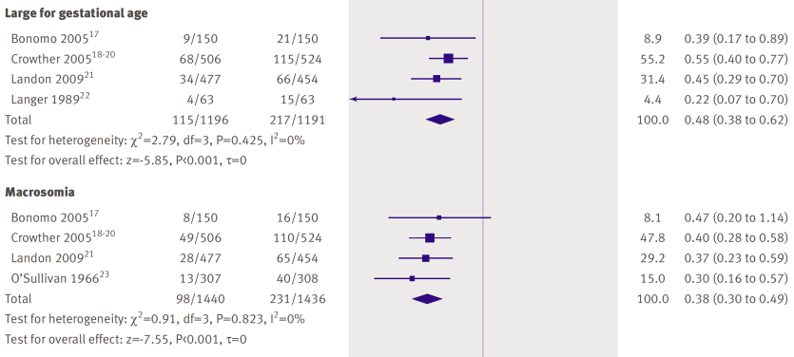
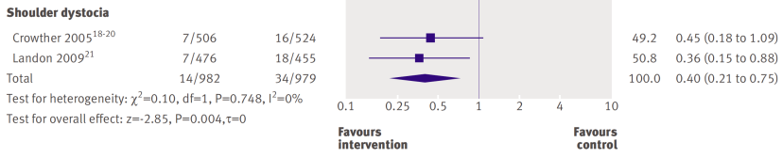
Benefits of Treatment of Gestational Diabetes
2018 Diabetes Canada CPG – Chapter 36. Diabetes and Pregnancy
Horvath K et al. BMJ 2010;340:c1935
Notes:
BMJ. 2010 Apr 1;340:c1395. doi: 10.1136/bmj.c1395.
Effects of treatment in women with gestational diabetes mellitus: systematic review and meta-analysis.
Horvath K, Koch K, Jeitler K, Matyas E, Bender R, Bastian H, Lange S, Siebenhofer A.
Source
EBM Review Center, Medical University of Graz, Auenbruggerplatz 15, 8036 Graz, Austria. Karl.Horvath@medunigraz.at
Abstract
OBJECTIVE:
To summarise the benefits and harms of treatments for women with gestational diabetes mellitus.
DESIGN:
Systematic review and meta-analysis of randomised controlled trials.
DATA SOURCES:
Embase, Medline, AMED, BIOSIS, CCMed, CDMS, CDSR, CENTRAL, CINAHL, DARE, HTA, NHS EED, Heclinet, SciSearch, several publishers' databases, and reference lists of relevant secondary literature up to October 2009. Review methods Included studies were randomised controlled trials of specific treatment for gestational diabetes compared with usual care or "intensified" compared with "less intensified" specific treatment.
RESULTS:
Five randomised controlled trials matched the inclusion criteria for specific versus usual treatment. All studies used a two step approach with a 50 g glucose challenge test or screening for risk factors, or both, and a subsequent 75 g or 100 g oral glucose tolerance test. Meta-analyses did not show significant differences for most single end points judged to be of direct clinical importance. In women specifically treated for gestational diabetes, shoulder dystocia was significantly less common (odds ratio 0.40, 95% confidence interval 0.21 to 0.75), and one randomised controlled trial reported a significant reduction of pre-eclampsia (2.5 v 5.5%, P=0.02). For the surrogate end point of large for gestational age infants, the odds ratio was 0.48 (0.38 to 0.62). In the 13 randomised controlled trials of different intensities of specific treatments, meta-analysis showed a significant reduction of shoulder dystocia in women with more intensive treatment (0.31, 0.14 to 0.70).
CONCLUSIONS:
Treatment for gestational diabetes, consisting of treatment to lower blood glucose concentration alone or with special obstetric care, seems to lower the risk for some perinatal complications. Decisions regarding treatment should take into account that the evidence of benefit is derived from trials for which women were selected with a two step strategy (glucose challenge test/screening for risk factors and oral glucose tolerance test).

Slide 57
Are there clear threshold glucose levels above which the risk of adverse neonatal or maternal outcomes increases?
2018 Diabetes Canada CPG – Chapter 36. Diabetes and Pregnancy
Diagnosis of Gestational Diabetes
Notes:
57

Slide 58
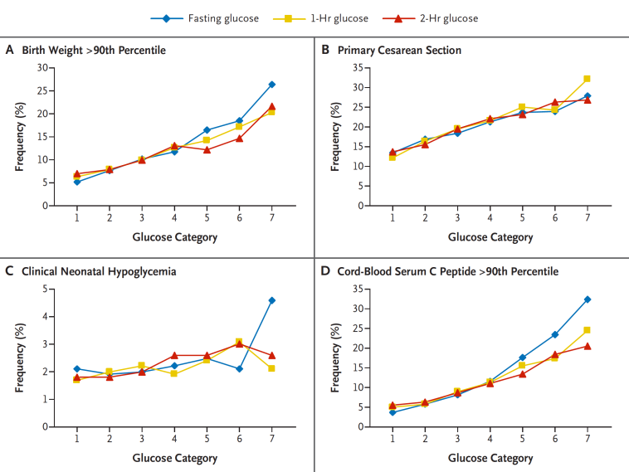
2018 Diabetes Canada CPG – Chapter 36. Diabetes and Pregnancy
HAPO: Incidence of Adverse Outcomes Increases Along Continuum – No Threshold
Metzger BE, et al. HAPO. NEJM 2008;358(19):1991-2002.
Notes:
N Engl J Med. 2008 May 8;358(19):1991-2002. doi: 10.1056/NEJMoa0707943.
Hyperglycemia and adverse pregnancy outcomes.
HAPO Study Cooperative Research Group, Metzger BE, Lowe LP, Dyer AR, Trimble ER, Chaovarindr U, Coustan DR, Hadden DR, McCance DR, Hod M, McIntyre HD, Oats JJ, Persson B, Rogers MS, Sacks DA.
Source
Northwestern University Feinberg School of Medicine, Chicago, IL 60611, USA. bem@northwestern.edu
Abstract
BACKGROUND:
It is controversial whether maternal hyperglycemia less severe than that in diabetes mellitus is associated with increased risks of adverse pregnancy outcomes.
METHODS:
A total of 25,505 pregnant women at 15 centers in nine countries underwent 75-g oral glucose-tolerance testing at 24 to 32 weeks of gestation. Data remained blinded if the fasting plasma glucose level was 105 mg per deciliter (5.8 mmol per liter) or less and the 2-hour plasma glucose level was 200 mg per deciliter (11.1 mmol per liter) or less. Primary outcomes were birth weight above the 90th percentile for gestational age, primary cesarean delivery, clinically diagnosed neonatal hypoglycemia, and cord-blood serum C-peptide level above the 90th percentile. Secondary outcomes were delivery before 37 weeks of gestation, shoulder dystocia or birth injury, need for intensive neonatal care, hyperbilirubinemia, and preeclampsia.
RESULTS:
For the 23,316 participants with blinded data, we calculated adjusted odds ratios for adverse pregnancy outcomes associated with an increase in the fasting plasma glucose level of 1 SD (6.9 mg per deciliter [0.4 mmol per liter]), an increase in the 1-hour plasma glucose level of 1 SD (30.9 mg per deciliter [1.7 mmol per liter]), and an increase in the 2-hour plasma glucose level of 1 SD (23.5 mg per deciliter [1.3 mmol per liter]). For birth weight above the 90th percentile, the odds ratios were 1.38 (95% confidence interval [CI], 1.32 to 1.44), 1.46 (1.39 to 1.53), and 1.38 (1.32 to 1.44), respectively; for cord-blood serum C-peptide level above the 90th percentile, 1.55 (95% CI, 1.47 to 1.64), 1.46 (1.38 to 1.54), and 1.37 (1.30 to 1.44); for primary cesarean delivery, 1.11 (95% CI, 1.06 to 1.15), 1.10 (1.06 to 1.15), and 1.08 (1.03 to 1.12); and for neonatal hypoglycemia, 1.08 (95% CI, 0.98 to 1.19), 1.13 (1.03 to 1.26), and 1.10 (1.00 to 1.12). There were no obvious thresholds at which risks increased. Significant associations were also observed for secondary outcomes, although these tended to be weaker.
CONCLUSIONS:
Our results indicate strong, continuous associations of maternal glucose levels below those diagnostic of diabetes with increased birth weight and increased cord-blood serum C-peptide levels.

Slide 59
2018 Diabetes Canada CPG – Chapter 36. Diabetes and Pregnancy
HAPO: Incidence of Adverse Outcomes for Glucose Categories (OR 1.75 or OR 2.0 )
Metzger BE, et al. HAPO. NEJM 2008;358(19):1991-2002.
Notes:
N Engl J Med. 2008 May 8;358(19):1991-2002. doi: 10.1056/NEJMoa0707943.
Hyperglycemia and adverse pregnancy outcomes.
HAPO Study Cooperative Research Group, Metzger BE, Lowe LP, Dyer AR, Trimble ER, Chaovarindr U, Coustan DR, Hadden DR, McCance DR, Hod M, McIntyre HD, Oats JJ, Persson B, Rogers MS, Sacks DA.
Source
Northwestern University Feinberg School of Medicine, Chicago, IL 60611, USA. bem@northwestern.edu
Abstract
BACKGROUND:
It is controversial whether maternal hyperglycemia less severe than that in diabetes mellitus is associated with increased risks of adverse pregnancy outcomes.
METHODS:
A total of 25,505 pregnant women at 15 centers in nine countries underwent 75-g oral glucose-tolerance testing at 24 to 32 weeks of gestation. Data remained blinded if the fasting plasma glucose level was 105 mg per deciliter (5.8 mmol per liter) or less and the 2-hour plasma glucose level was 200 mg per deciliter (11.1 mmol per liter) or less. Primary outcomes were birth weight above the 90th percentile for gestational age, primary cesarean delivery, clinically diagnosed neonatal hypoglycemia, and cord-blood serum C-peptide level above the 90th percentile. Secondary outcomes were delivery before 37 weeks of gestation, shoulder dystocia or birth injury, need for intensive neonatal care, hyperbilirubinemia, and preeclampsia.
RESULTS:
For the 23,316 participants with blinded data, we calculated adjusted odds ratios for adverse pregnancy outcomes associated with an increase in the fasting plasma glucose level of 1 SD (6.9 mg per deciliter [0.4 mmol per liter]), an increase in the 1-hour plasma glucose level of 1 SD (30.9 mg per deciliter [1.7 mmol per liter]), and an increase in the 2-hour plasma glucose level of 1 SD (23.5 mg per deciliter [1.3 mmol per liter]). For birth weight above the 90th percentile, the odds ratios were 1.38 (95% confidence interval [CI], 1.32 to 1.44), 1.46 (1.39 to 1.53), and 1.38 (1.32 to 1.44), respectively; for cord-blood serum C-peptide level above the 90th percentile, 1.55 (95% CI, 1.47 to 1.64), 1.46 (1.38 to 1.54), and 1.37 (1.30 to 1.44); for primary cesarean delivery, 1.11 (95% CI, 1.06 to 1.15), 1.10 (1.06 to 1.15), and 1.08 (1.03 to 1.12); and for neonatal hypoglycemia, 1.08 (95% CI, 0.98 to 1.19), 1.13 (1.03 to 1.26), and 1.10 (1.00 to 1.12). There were no obvious thresholds at which risks increased. Significant associations were also observed for secondary outcomes, although these tended to be weaker.
CONCLUSIONS:
Our results indicate strong, continuous associations of maternal glucose levels below those diagnostic of diabetes with increased birth weight and increased cord-blood serum C-peptide levels.

Slide 60
Considerations for Diabetes Canada Adopting the OR 1.75 (IADPSG) vs OR 2.0 Thresholds
2018 Diabetes Canada CPG – Chapter 36. Diabetes and Pregnancy
How can we select an odds ratio threshold in the absence of a true threshold in the data?
What is the impact on the patient and workload of increasing the prevalence of gestational diabetes?
Do we have sufficient evidence with respect to treatment benefit at the various thresholds to make an informed decision?
In the absence of clear benefit, should the diagnostic criteria be changed from 2013?

Slide 61
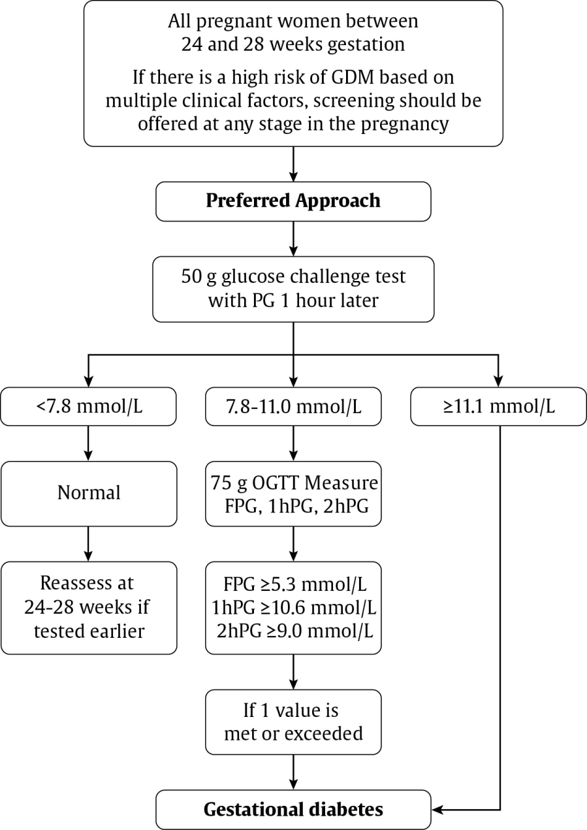
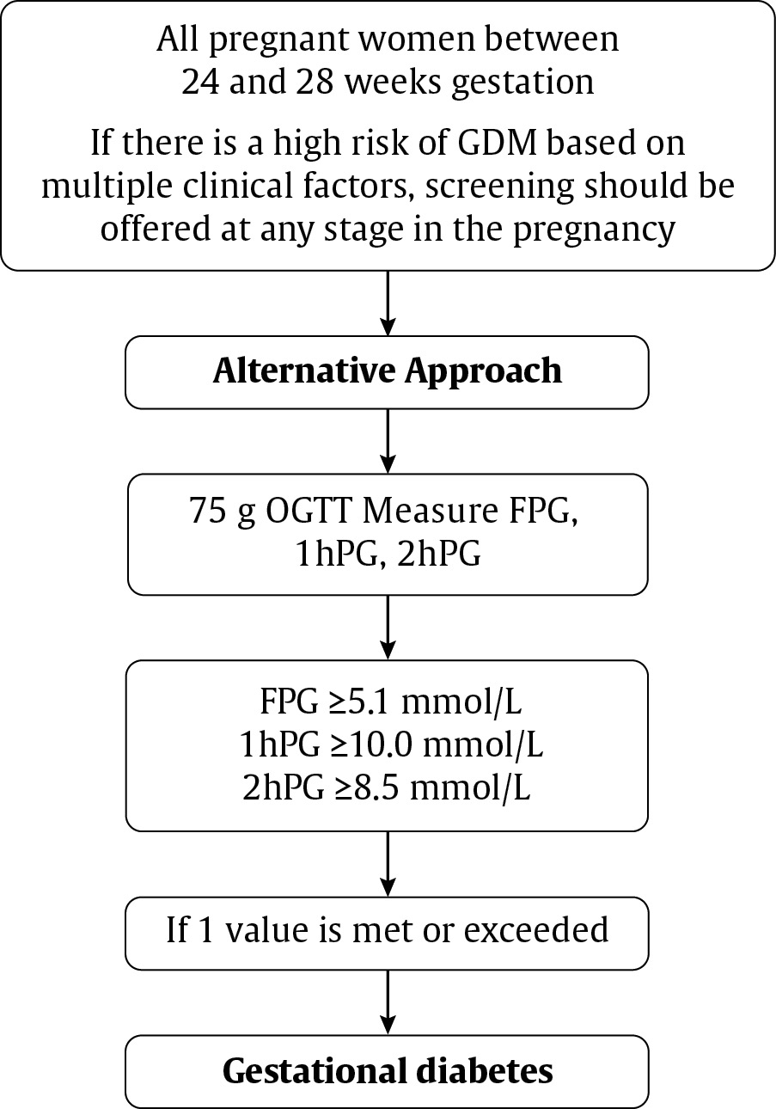
2018 Diabetes Canada CPG – Chapter 36. Diabetes and Pregnancy
2018 GDM Diagnosis: Two Approaches

Slide 62
2018 Diabetes Canada CPG – Chapter 36. Diabetes and Pregnancy
Odds Ratio (OR) of 1.75 vs. 2.0 for Primary Outcome in HAPO
Threshold glucose levels (mmol/L) after a 75g OGTT | OR 1.75 | OR 2.0
Fasting plasma glucose | 5.1 | 5.3
1-h plasma glucose | 10.0 | 10.6
2-h plasma glucose | 8.5 | 9.0
% of cohort that met ≥ 1 threshold above | 16.1% | 8.8%
OGTT, Oral Glucose Tolerance Test
HAPO, Hyperglycemia and Adverse Pregnancy Outcomes study
IADPSG. Diabetes Care 2010;22:676-682
Notes:
However, since OR 1.75 was an arbitrary selection, here are the thresholds if an OR of 2.0 was selected instead. These values are very similar to the diagnostic criteria that CDA recommended in 2008.

Slide 63
Recommendation 25
2018 Diabetes Canada CPG – Chapter 36. Diabetes and Pregnancy
2018
Gestational Diabetes
Prevention
25. In women at high risk for GDM based on pre-existing risk factors, nutrition counseling should be provided on healthy eating and prevention of excessive gestational weight gain in early pregnancy, ideally before 15 weeks of gestation, to reduce the risk of GDM [Grade B, Level 2]
GDM, gestational diabetes

Slide 64
Recommendation 26
2018 Diabetes Canada CPG – Chapter 36. Diabetes and Pregnancy
Gestational Diabetes
Diagnosis
26. All pregnant women not known to have pre-existing diabetes should be screened for GDM at 24-28 weeks of gestation [Grade C, Level 3]
GDM, gestational diabetes

Slide 65
Recommendation 27
2018 Diabetes Canada CPG – Chapter 36. Diabetes and Pregnancy
Gestational Diabetes: Diagnosis
27. The preferred approach for the screening and diagnosis of GDM at 24-28 weeks is the following [Grade D, Consensus]:
  Screening for GDM should be conducted using the 50 g GCT administered in the nonfasting state with PG glucose measured 1 hour later [Grade D, Level 4]. A PG >7.8 mmol/L at 1 hour is a positive screen and is an indication to proceed to the 75 g OGTT [Grade C, Level 2]. A PG >11.1 mmol/L is diagnostic of gestational diabetes and does not require a 75 g OGTT for confirmation [Grade D, Level 4]
  If the GCT screen is positive, a 75 g OGTT should be performed as the diagnostic test for GDM using the 1 of the following criteria:
    Fasting PG >5.3 mmol/L OR
    1 hour PG >10.6 mmol/L OR
    2 hours PG >9.0 mmol/L [Grade B, Level 1]
GCT, glucose challenge test; GDM, gestational diabetes; OGTT, oral glucose tolerance test; PG, plasma glucose

Slide 66
Recommendation 28
2018 Diabetes Canada CPG – Chapter 36. Diabetes and Pregnancy
Gestational Diabetes
Diagnosis
28. An alternative approach to screen and diagnose GDM is the 1-step approach: a 75 g OGTT should be performed (with no prior screening 50 g GCT) as the diagnostic test for GDM using the 1 of the following criteria :
  Fasting PG >5.1 mmol/L OR
  1 hour PG >10.0 mmol/L OR
  2 hours PG >8.5 mmol/L [Grade B, Level 1]
GCT, glucose challenge test; GDM, gestational diabetes; OGTT, oral glucose tolerance test; PG, plasma glucose

Slide 67
Recommendation 29
2018 Diabetes Canada CPG – Chapter 36. Diabetes and Pregnancy
2018
Gestational Diabetes: Diagnosis
Women identified as being at high risk for type 2 diabetes should be offered earlier screening with an A1C test at the first antenatal visit to identify diabetes which may be pre-existing [Grade D, Consensus]. For those women with a hemoglobinopathy or renal disease, the A1C test may not be reliable and screening should be performed with a FPG [Grade D, Consensus]. If the A1C is ≥6.5% or the FPG is ≥7.0 mmol/L, the woman should be considered to have diabetes in pregnancy and the same management recommendations for pre-existing diabetes should be followed [Grade D, Consensus]
  If the initial screening is performed before 24 weeks of gestation and is negative, the woman should be rescreened as outlined in recommendation 27 or 28 between 24-28 weeks of gestation [Grade D, Consensus]
FPG, fasting plasma glucose

Slide 68
Diabetes in Pregnancy: Consider Phases
2018 Diabetes Canada CPG – Chapter 36. Diabetes and Pregnancy
Pregestational diabetes | Gestational diabetes
1. Preconception counseling | 1. Prevention, Screening & Diagnosis
2. Management during pregnancy | 2. Management during Pregnancy
3. Management in labour | 3. Management in labour
4. Postpartum considerations | 4. Postpartum considerations

Slide 69
GDM: Management During Pregnancy
2018 Diabetes Canada CPG – Chapter 36. Diabetes and Pregnancy
Receive nutrition counseling by registered dietician to achieve their nutrition, weight and blood glucose goals
Eat healthy diet and Replace high-Glycemic Index foods with low-Glycemic Index foods to reduce need for insulin initiation and decrease birthweight
Discuss appropriate weight gain and healthy lifestyle interventions throughout pregnancy
Recommend weight gain according to IOM recommendations based on prepregnancy BMI interventions to reduce LGA, C-section
BMI, body mass index; IOM, Institute of Medicine; LGA, large for gestational age

Slide 70
Institute of Medicine Guidelines for Gestational Weight Gain
2018 Diabetes Canada CPG – Chapter 36. Diabetes and Pregnancy
Pre-Pregnancy BMI (kg/m²) | Recommended range of total weight gain (Kg) | Recommended range of total weight gain (lb)
BMI <18.5 | 12.5 – 18.0 | 28 – 40
BMI 18.5 - 24.9 | 11.5 – 16.0 | 25 – 35
BMI 25.0 - 29.9 | 7.0 – 11.5 | 15 – 23
BMI >30 | 5.0 – 9.0 | 11 – 20
Recommended rate of weight gain and total weight gain for singleton
Pregnancies according to pre-pregnancy BMI
Institute of Medicine. Weight gain during pregnancy: reexamining the guidelines. Consensus Report. May 2009. The National Academies Press. Washington, DC.
BMI, body mass index

Slide 71
GDM: Management During Pregnancy
2018 Diabetes Canada CPG – Chapter 36. Diabetes and Pregnancy
Perform SMBG fasting and postprandially
Glycemic targets during pregnancy:
  If glycemic targets not achieved within 1-2 weeks, initiate pharmacologic therapy
Target BG values
Fasting and preprandial BG <5.3 mmol/L
1h postprandial BG <7.8 mmol/L
2h postprandial BG <6.7 mmol/L
BG, blood glucose; SMBG, self-monitoring of blood glucose
Notes:
Perform SMBG, both fasting and postprandially to achieve glycemic targets and improve pregnancy outcomes

Slide 72
GDM: Management During Pregnancy
2018 Diabetes Canada CPG – Chapter 36. Diabetes and Pregnancy
Insulin first-line
  May use aspart, lispro, glulisine: perinatal outcomes similar
Metformin may be used as an alternative to insulin
  Good safety data in pregnancy
  Evidence of less maternal weight gain, less large-for-gestational-age, less neonatal hypoglycemia
  Women should be informed that it crosses the placenta
  Safety data in offspring postpartum up to 2 years
  Insulin necessary in 40% on metformin
Glyburide may be used in women who refuse insulin and not well controlled on metformin

Slide 73
GDM: Fetal Surveillance
2018 Diabetes Canada CPG – Chapter 36. Diabetes and Pregnancy
Increased surveillance should be considered in women poorly controlled and/or with comorbidities
Offer induction 38-40 weeks GA to potentially reduce stillbirth and C-section
Earlier or later induction should be considered based on glycemic control and presence of other comorbidities
GA, gestational age; GDM, gestational diabetes

Slide 74
Recommendation 31
2018 Diabetes Canada CPG – Chapter 36. Diabetes and Pregnancy
2018
Gestational Diabetes
Management during pregnancy
31. Health-care providers should discuss appropriate weight gain and healthy lifestyle interventions regularly throughout pregnancy [Grade D, Consensus]. Recommendations for weight gain for women with GDM should be individualized based on Institute of Medicine guidelines by pre-pregnancy BMI to prevent excessive gestational weight gain and reduce the risk of LGA [Grade B, Level 2], macrosomia and caesarean sections [Grade B, Level 2]
BMI, body mass index; LGA, large for gestational age

Slide 75
Recommendation 32
2018 Diabetes Canada CPG – Chapter 36. Diabetes and Pregnancy
2018
Gestational Diabetes
Management during pregnancy
32. Nutritional counseling by a registered dietitian should be provided to women with GDM to help them achieve their nutrition, weight and blood glucose goals [Grade D, Level 4]. Women with GDM should be encouraged to eat a healthy diet for pregnancy and to replace high GI foods with low GI foods to reduce the need for insulin initiation and decrease birth weight [Grade C, Level 3]
GDM, gestational diabetes; GI, glycemic index

Slide 76
Recommendation 33
2018 Diabetes Canada CPG – Chapter 36. Diabetes and Pregnancy
2018
Gestational Diabetes: Management during pregnancy
33. If women with GDM do not achieve glycemic targets within 1-2 weeks with nutritional therapy and physical activity, pharmacologic therapy should be initiated [Grade D, Consensus].
  Insulin in the form of basal-bolus injection therapy may be used as first line therapy [Grade A, Level 1 for insulin]
  Rapid-acting analogue insulin aspart, lispro or glulisine may be used over regular insulin for postprandial glucose control, although perinatal outcomes are similar [Grade B, Level 2 for aspart and lispro; Grade D, Consensus for glulisine]
  Metformin may be used as an alternative to insulin [Grade A, Level 1A for metformin]; however, women should be informed that metformin crosses the placenta, longer-term studies are not yet available, and the addition of insulin is necessary in approximately 40% to achieve adequate glycemic control [Grade D, Consensus]
GDM, gestational diabetes

Slide 77
Recommendation 34
2018 Diabetes Canada CPG – Chapter 36. Diabetes and Pregnancy
2018
Gestational Diabetes
Management during pregnancy
34. In women with GDM who decline insulin and do not tolerate or are inadequately controlled on metformin, glyburide may be used [Grade B, Level 2]
GDM, gestational diabetes

Slide 78
Recommendation 35
2018 Diabetes Canada CPG – Chapter 36. Diabetes and Pregnancy
2018
Gestational Diabetes
Fetal surveillance and timing of delivery in GDM
35. Increased frequency of fetal assessment should be considered in women with GDM that is poorly controlled and/or associated with comorbid conditions [Grade D, Consensus]
GDM, gestational diabetes

Slide 79
Recommendation 36
2018 Diabetes Canada CPG – Chapter 36. Diabetes and Pregnancy
2018
Gestational Diabetes
Fetal surveillance and timing of delivery in GDM
36. Women with GDM can be offered induction of labour between 38-40 weeks gestation to potentially reduce the risk of stillbirth [Grade D, Consensus] and the risk of caesarean section [Grade C, Level 2]. Earlier or later induction of labour should be considered based on glycemic control and the presence or absence of other comorbid conditions [Grade D, Consensus]
GDM, gestational diabetes

Slide 80
Diabetes in Pregnancy: Consider Phases
2018 Diabetes Canada CPG – Chapter 36. Diabetes and Pregnancy
Pregestational diabetes | Gestational diabetes
1. Preconception counseling | 1. Prevention, Screening & Diagnosis
2. Management during pregnancy | 2. Management during Pregnancy
3. Management in labour | 3. Management in labour
4. Postpartum considerations | 4. Postpartum considerations

Slide 81
GDM: Glycemic Management During Labour and Delivery
2018 Diabetes Canada CPG – Chapter 36. Diabetes and Pregnancy
Keep maternal blood glucose between 4.0 and 7.0 mmol/L → reduce risk of neonatal hypoglycemia

Slide 82
Recommendation 37
2018 Diabetes Canada CPG – Chapter 36. Diabetes and Pregnancy
Gestational Diabetes
Intrapartum glucose management
37. Women with GDM should be monitored during labour and delivery, and maternal blood glucose levels should be kept between 4.0-7.0 mmol/L in order to minimize the risk of neonatal hypoglycemia [Grade D, Consensus]
GDM, gestational diabetes

Slide 83
Diabetes in Pregnancy: Consider Phases
2018 Diabetes Canada CPG – Chapter 36. Diabetes and Pregnancy
Pregestational diabetes | Gestational diabetes
1. Preconception counseling | 1. Prevention, Screening & Diagnosis
2. Management during pregnancy | 2. Management during Pregnancy
3. Management in labour | 3. Management in labour
4. Postpartum considerations | 4. Postpartum considerations

Slide 84
GDM: Postpartum Management
2018 Diabetes Canada CPG – Chapter 36. Diabetes and Pregnancy
Encourage Breastfeeding
  Reduce neonatal hypoglycemia, childhood obesity & diabetes, AND maternal risk of diabetes & hypertension
75 g OGTT between 6 weeks - 6 months postpartum to detect prediabetes or diabetes. Suggest phone calls/email reminders to improve testing rates
Notes:
Script:

Slide 85
GDM: Postpartum OGTT
2018 Diabetes Canada CPG – Chapter 36. Diabetes and Pregnancy
75 g oral glucose tolerance test
6 weeks to 6 months
If diagnosed with diabetes early in pregnancy, do FPG or OGTT at 6-8 weeks postpartum
Normal
Impaired glucose tolerance
Type 2 diabetes
Healthy behaviour interventions
Healthy behaviour interventions +/- metformin
Healthy behaviour interventions +/- metformin +/- insulin
FPG, fasting plasma glucose; OGTT, oral glucose tolerance test

Slide 86
Recommendation 38
2018 Diabetes Canada CPG – Chapter 36. Diabetes and Pregnancy
2018
Gestational Diabetes
Postpartum
38. Women with GDM should be encouraged to breastfeed immediately after delivery in order to avoid neonatal hypoglycemia [Grade D, Consensus] and to continue for at least 3-4 months postpartum in order to prevent childhood obesity [Grade C, Level 3] and diabetes in the offspring [Grade D, Level 4] and to reduce risk of type 2 diabetes and hypertension in the mother [Grade C, Level 3]
GDM, gestational diabetes

Slide 87
Recommendation 39
2018 Diabetes Canada CPG – Chapter 36. Diabetes and Pregnancy
2018
Gestational Diabetes
Postpartum
39. Women should be screened with a 75 g OGTT between 6 weeks to 6 months postpartum to detect prediabetes and diabetes [Grade D, Consensus]. Methods to improve postpartum testing such as phone calls or email reminders to women with a history of GDM should be employed to improve screening rates [Grade C, Level 3]
GDM, gestational diabetes; OGTT, oral glucose tolerance test

Slide 88
Recommendation 40
2018 Diabetes Canada CPG – Chapter 36. Diabetes and Pregnancy
2018
Gestational Diabetes
Postpartum
40. In women who were diagnosed with diabetes in early pregnancy based on A1C (see recommendation 29), if ongoing hyperglycemia is not evident postpartum, a confirmatory test for diabetes with a FPG or 75 g OGTT should be done at 6 to 8 weeks postpartum [Grade D, Consensus]
FPG, fasting plasma glucose; OGTT, oral glucose tolerance test

Slide 89
Recommendation 41
2018 Diabetes Canada CPG – Chapter 36. Diabetes and Pregnancy
2018
Gestational Diabetes
Postpartum
41. Women with prior GDM should receive counseling regarding healthy behaviour interventions to reduce the recurrence rate in subsequent pregnancies and reduce their increased risk of type 2 diabetes [Grade C, Level 3]
GDM, gestational diabetes

Slide 90
Recommendation 42
2018 Diabetes Canada CPG – Chapter 36. Diabetes and Pregnancy
2018
Gestational Diabetes
Postpartum
42. In women with prior GDM who has IGT on postpartum screening, healthy behaviour interventions with or without metformin can be used in women to prevent/delay the onset of diabetes [Grade B, Level 2]
GDM, gestational diabetes; IGT, impaired glucose tolerance

Slide 91

Visit guidelines.diabetes.ca

Slide 92


Or download the App

Slide 93
Diabetes Canada Clinical Practice Guidelines
www.guidelines.diabetes.ca – for health-care providers
1-800-BANTING (226-8464)
www.diabetes.ca – for people with diabetes
Notes:
93

