Slide 1

Remission of Type 2 Diabetes
Presented by: Dylan MacKay, PhD
November 2022

Slide 2
PROGRAM DISCLOSURE OF COMMERCIAL SUPPORT
I have relationships with for-profit and not-for-profit organizations over the past two years:
NATURE OF RELATIONSHIP | NAME OF THE FOR-PROFIT OR NOT-FOR-PROFIT ORGANIZATION | DESCRIPTION OF RELATIONSHIP
Any direct financial payments including receipt of honoraria | Diabetes Canada | Honoraria for speaker’s fees
Membership on advisory boards or speakers’ bureaus | — | —
Funded grants of clinical trials | CIHR, KFOC, Pepsico | Clinical trial research activities
Patents on a drug, product or device | — | —
All other investments/relationship that could be seen as having the potential to influence the content of the educational activity | Dexcom, Novo Nordisk, Insulet | Personal user of products for type 1 diabetes
Notes:
Lock these boxes for formatting!

Slide 3
MITIGATION OF BIAS
POTENTIAL SOURCE OF BIAS | MEASURES TAKEN TO MITIGATE BIAS
#1: Industry/Not-for-profit biases | CPGs developed in line with Conflict-Of-Interest disclosure and management policies of Diabetes Canada
#2: Personal biases | Diverse membership of chapter revision authors and steering committee membership
 | Clinical Practice Guidelines are based on independent critical appraisal of published evidence
 | All support used in justification of clinical care recommendations conform to generally accepted standard, clinical practice guidelines and consensus statements
Notes:
Lock these boxes for formatting!

Slide 4
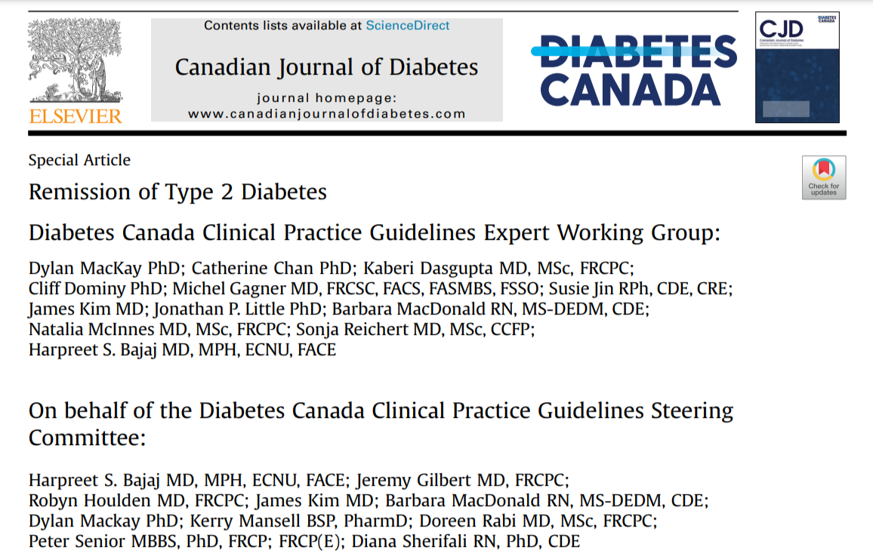

Slide 5
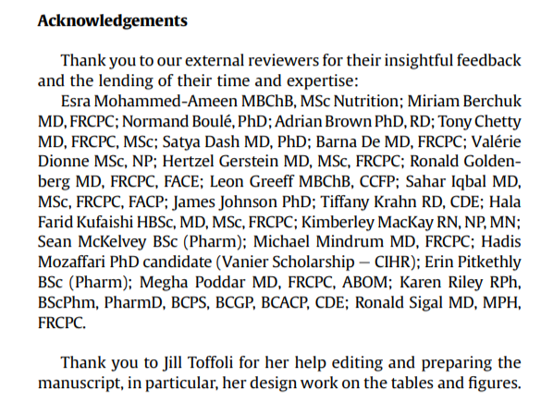

Slide 6
Potential goals and approaches for type 2 diabetes
Type 2 diabetes diagnosis
Multifactorial management (ABCDES³) to prevent/delay diabetes complications
Diabetes prevention
Beta-cell
function (%)
Diabetes remission
potential?
Reduce progression
Individualize approach (behaviour + pharmacotherapy) and targets
Duration of type 2 diabetes
Notes:
Data from UKPDS, etc. show beta-cell death of around 6% per year following diagnosis of type 2 diabetes. Diabetes remission is not a permanent cure and not for everyone.
Certain people with recent diagnosis of type 2 diabetes may have the best chance of diabetes remission

Slide 7
The origins of type 2 diabetes remission
In the 1990s, case reports started to emerge of individuals with type 2 diabetes achieving non-diabetes range glucose values without antihyperglycemic agents after bariatric surgery
Randomized controlled trials have demonstrated that bariatric
surgery can lead to diabetes remission.
More recently, trials examining lifestyle-based interventions for type 2 diabtes have reported remission in many participants.

Slide 8
DC terminology and definitions
Type 2 diabetes remission - no antihyperglycemic medication for at least 3
consecutive months and achieving an A1C threshold as listed below
Remission categories:
remission to normal glucose levels (A1C <6.0%)
remission to prediabetes (A1C between 6.0% and 6.4%)
Type 2 diabetes relapse - subsequent A1C > 6.5%
Pharmacologically-managed diabetes (if currently on antihyperglycemic medications)

Slide 9
Approaches to type 2 diabetes remission
Surgical interventions - all interventions with
surgery, whether or not they also involved behavioural interventions
or pharmacological agents
Pharmacological interventions - all interventions which added 1 or more pharmacological agents in the intervention, whether or not they also involved
behavioural interventions
Notes:
What are the considerations when initiating a discussion about remission of type 2 diabetes with Mary?

Slide 10
Approaches to type 2 diabetes remission
Health behavioural interventions – all interventions involving diet and/or physical activity or other health-related behaviours, but not surgery or pharmacological interventions
Digital technology interventions - a subset of health behavioural
interventions where digital platforms and tools, such as smartphones/
watches, mobile and web applications, glucose-sensing and
related technologies, were a central part of the intervention
Notes:
Harpreet will have already introduced this slide, so I won’t be speaking to it, except to touch on the 2 points

Slide 11
Chapter recommendations criteria
In an effort to minimize bias, recall or reporting errors, it was prespecified that recommendations for this new chapter were only formulated if supported by a high level of evidence (Level 1 or Level 2 only)
Based on the literature searches and grading by the McMaster Evidence Review and Synthesis Team (MERST), no recommendations were made for pharmacological or digital technology interventions because the level of evidence for these interventions did not meet this prespecified criteria
Notes:
What are the considerations when initiating a discussion about remission of type 2 diabetes with Mary?
Note: Mary is not on insulin

Slide 12
Recommendations
General recommendations
1. Following a thorough discussion outlining the concept of remission and its limitations, a therapeutic goal of diabetes remission may be considered for individuals with type 2 diabetes who are interested in attempting remission; do not have significant eating or mental health disorders; do not have a compelling indication for antihyperglycemic agent(s) for renal or cardiovascular benefit; and meet the specified criteria outlined in the following intervention-based recommendations, to eliminate the need for antihyperglycemic therapy [Grade D, Consensus].

Slide 13
Recommendations
General recommendations
2. The approach to deprescribing antihyperglycemic agents should be individualized and incorporate the principles of minimizing the risk for hypoglycemia and avoiding medications with potential for weight gain/regain [Grade D, Consensus]
3. If type 2 diabetes remission criteria are met, A1C (or, if A1C unreliable, FPG or OGTT) should be performed at a minimum interval of every 6 months to assess persistence of diabetes remission or relapse of diabetes [Grade D, Consensus]

Slide 14
Recommendations
Bariatric surgery
4. Bariatric surgery should be recommended to nonpregnant adults with type 2 diabetes and a BMI >35 kg/m² as an option to potentially induce type 2 diabetes remission [Grade A, Level 1A]
Ding et al. Obesity Reviews 2020;21(8):e13030
Cui et al. Surg Obes Relat Dis 2021 Jul; 17(7):1334e43.
Khorgami et al.. Obes Surg 2019 Mar;29(3):964e74.

Slide 15
Recommendations
Behavioral interventions
5. Low-energy (800 to 850 kcal/day) diets with meal replacement products for 3 to 5 months aimed at achieving >15 kg body weight loss, followed by structured food reintroduction and increased physical activity for weight loss maintenance, should be recommended as an option to potentially induce
type 2 diabetes remission to selected nonpregnant adults with a BMI between 27 and 45 kg/m²; type 2 diabetes duration <6 years, A1C <12% and not using insulin [Grade A, Level 1A]
Lean et al. Lancet Diabetes Endocrinol 2019;7(5):344e55
Taheri S et al. Lancet Diabetes Endocrinol 2020;8(6):477e89

Slide 16
Recommendations
Behavioral interventions
6. Exercise training (aiming for 240 to 420 min/week of structured physical activity spread over 5 days per week) combined with an energy-restricted diet to promote modest weight loss (5% to 7% of initial body weight), may be recommended as an option to potentially induce type 2 diabetes remission to
selected nonpregnant adults with a BMI >25 kg/m², type 2 diabetes duration <10 years, A1C <9% and not using insulin [Grade C, Level 2]
Ried-Larsen et al. Diabetes Obes Metab 2019;21(10):2257e66.

Slide 17
Key Messages for HCPs
The target of remission may be considered as an option for individuals with type 2 diabetes with overweight or obesity
Current evidence suggests remission may be possible in a subset of these individuals through a variety of interventions, including bariatric surgery
and low-calorie meal plans under the supervision of a trained dietitian or other health-care professional
Sustained weight loss of >15 kg of initial body weight is associated with the greatest probability of type 2 diabetes remission

Slide 18
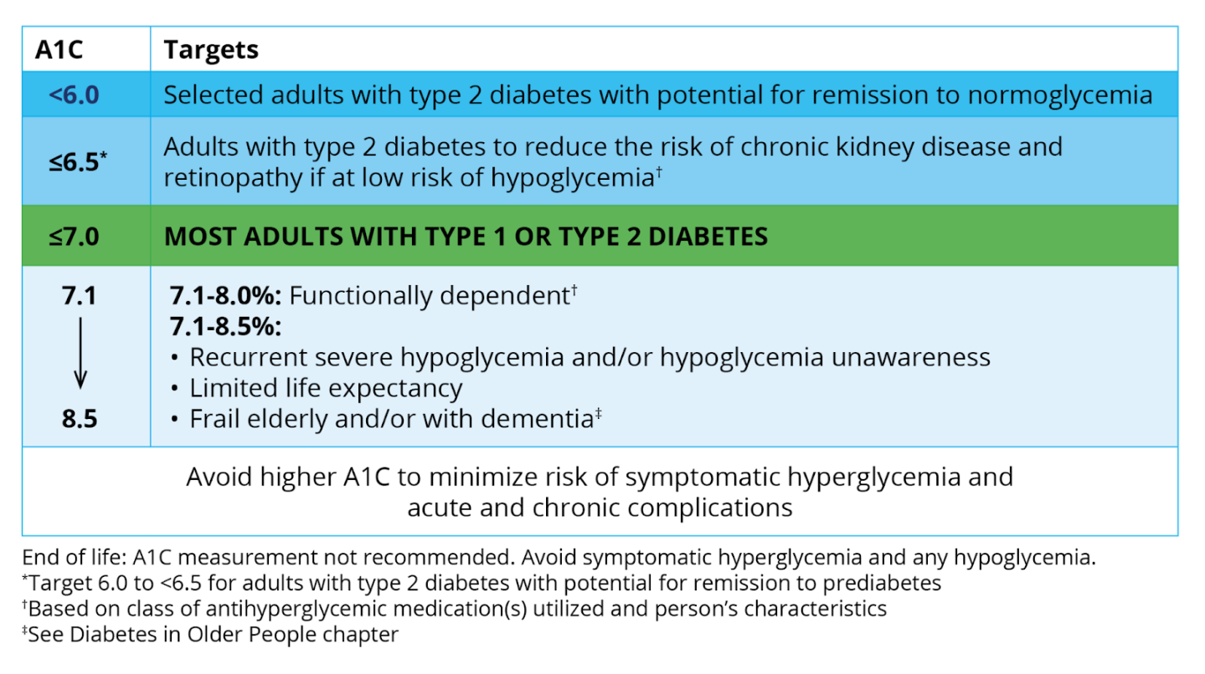
A1C Targets Expanded with
Type 2 Diabetes Remission
2022
NEW
NEW
Notes:
Amalgamation with 2018

Slide 19
Key Messages for People With Diabetes
Remission of type 2 diabetes is possible for some individuals.
Remission is more likely for individuals:
diagnosed with type 2 diabetes for a shorter time (<6 years)
with overweight or obesity, who are able and inclined to lose weight
with blood glucose levels that not that elevated (A1C <12%)
who do not take insulin

Slide 20
THANK YOU!

