Slide 1
Dyslipidemia
2018 Clinical Practice Guidelines
Chapter 25
G. B. John Mancini MD FRCPC FACP FACC, Robert A. Hegele MD FRCPC FACP FAHA FCHAS FCCS, Lawrence A. Leiter MD FRCPC FACP FACE FAHA

Slide 2
Disclaimer
All Content contained on this slide deck is the property of Diabetes Canada, its content suppliers or its licensors as the case may be, and is protected by Canadian and international copyright, trademark, and other applicable laws. Diabetes Canada grants personal, limited, revocable, non-transferable and non-exclusive license to access and read content in this slide deck for personal, non-commercial and not-for-profit use only. The slide deck is made available for lawful, personal use only and not for commercial use.
The unauthorized reproduction, distribution of this copyrighted work is not permitted.
For permission to use this slide deck for commercial or any use other than personal, please contact guidelines@diabetes.ca

Slide 3
Key Changes
2018 Diabetes Canada CPG – Chapter 25. Dyslipidemia
2018
New recommendations on
  Supporting either a fasting or non-fasting (in those without hypertriglyceridemia) lipid profile
  New lipid targets for people with diabetes with indications for lipid-lowering therapy
  LDL-C consistently <2.0 mmol/L (formerly <2.0) or >50% reduction from baseline
  Alternate targets identified of apo B <0.8 g/L or non-HDL-C <2.6 mmol/L
  Role of PCSK9 inhibitors

Slide 4
Dyslipidemia Checklist
2018 Diabetes Canada CPG – Chapter 25. Dyslipidemia
CHECK lipid profile at diagnosis then yearly or every 3-6 months when on treatment
USE statins as first-line therapy
ADD second line agent only when LDL-C is not at target despite statin therapy
USE fibrate when TG >10.0 mmol/L
TG, triglycerides
Notes:
4

Slide 5
Measure Lipids at Diagnosis
2018 Diabetes Canada CPG – Chapter 25. Dyslipidemia
Repeat yearly if treatment not started
Repeat q3-6mos if on treatment
Fasting (8-hr) profile:
  Total cholesterol, TG, HDL-C, LDL-C
or
Non-fasting profile:
  ApoB
  Non-HDL-C (TC minus non-HDL)
TC, total cholesterol; TG, triglycerides
Notes:
5

Slide 6
Dyslipidemia components associated with type 2 diabetes and metabolic syndrome
2018 Diabetes Canada CPG – Chapter 25. Dyslipidemia
Increased TG and TG-rich lipoproteins
Increased postprandial TG
Low HDL-C
Low apo A-I
Decreased small HDL, prebeta-1 HDL, alpha-3 HDL
Increased apo B
Increased LDL particle number
Increased small, dense LDL
Increased apo C-III
Increased non-HDL-C
Increased oxidized and glycated lipids
TG, triglycerides

Slide 7
Who should receive statin therapy?
2018 Diabetes Canada CPG – Chapter 25. Dyslipidemia
Notes:
7

Slide 8
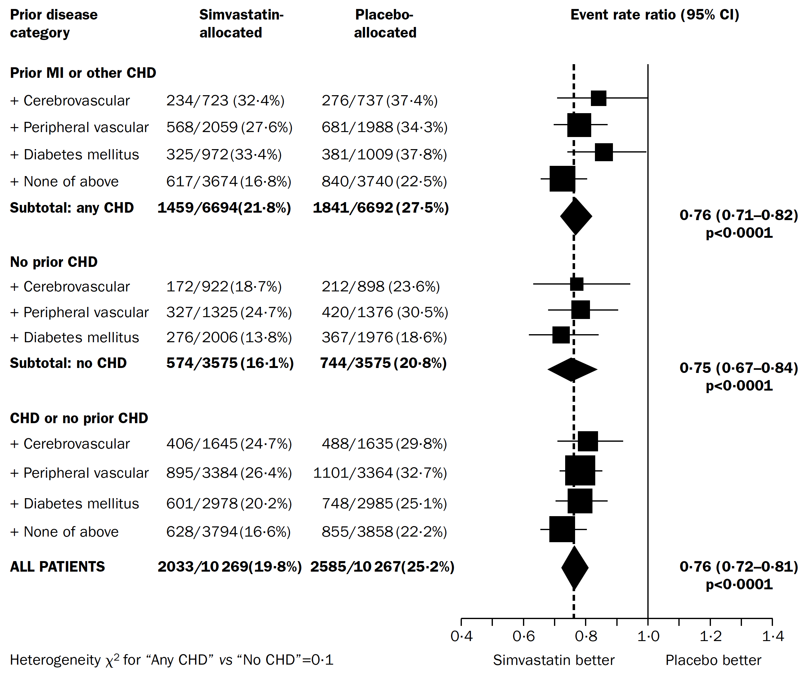
2018 Diabetes Canada CPG – Chapter 25. Dyslipidemia
HPS: Statin Therapy Beneficial Among Patients with Diabetes
N= 20 536 adults with CAD
DM = 5693 (28%)
T1D = 615 (3%)
T2D = 5348 (26%)
HPS = Heart Protection Study; DM = diabetes mellitus; T1D = type 1 diabetes; T2D = type 2 diabetes
HPS Lancet 2002;360:7-22. ; HPS Lancet 2003:361:2005-16.
Notes:
8
Lancet. 2002 Jul 6;360(9326):7-22.
MRC/BHF Heart Protection Study of cholesterol lowering with simvastatin in 20,536 high-risk individuals: a randomised placebo-controlled trial.
Heart Protection Study Collaborative Group.
Abstract
BACKGROUND:
Throughout the usual LDL cholesterol range in Western populations, lower blood concentrations are associated with lower cardiovascular disease risk. In such populations, therefore, reducing LDL cholesterol may reduce the development of vascular disease, largely irrespective of initial cholesterol concentrations.
METHODS:
20,536 UK adults (aged 40-80 years) with coronary disease, other occlusive arterial disease, or diabetes were randomly allocated to receive 40 mg simvastatin daily (average compliance: 85%) or matching placebo (average non-study statin use: 17%). Analyses are of the first occurrence of particular events, and compare all simvastatin-allocated versus all placebo-allocated participants. These "intention-to-treat" comparisons assess the effects of about two-thirds (85% minus 17%) taking a statin during the scheduled 5-year treatment period, which yielded an average difference in LDL cholesterol of 1.0 mmol/L (about two-thirds of the effect of actual use of 40 mg simvastatin daily). Primary outcomes were mortality (for overall analyses) and fatal or non-fatal vascular events (for subcategory analyses), with subsidiary assessments of cancer and of other major morbidity.
FINDINGS:
All-cause mortality was significantly reduced (1328 [12.9%] deaths among 10,269 allocated simvastatin versus 1507 [14.7%] among 10,267 allocated placebo; p=0.0003), due to a highly significant 18% (SE 5) proportional reduction in the coronary death rate (587 [5.7%] vs 707 [6.9%]; p=0.0005), a marginally significant reduction in other vascular deaths (194 [1.9%] vs 230 [2.2%]; p=0.07), and a non-significant reduction in non-vascular deaths (547 [5.3%] vs 570 [5.6%]; p=0.4). There were highly significant reductions of about one-quarter in the first event rate for non-fatal myocardial infarction or coronary death (898 [8.7%] vs 1212 [11.8%]; p<0.0001), for non-fatal or fatal stroke (444 [4.3%] vs 585 [5.7%]; p<0.0001), and for coronary or non-coronary revascularisation (939 [9.1%] vs 1205 [11.7%]; p<0.0001). For the first occurrence of any of these major vascular events, there was a definite 24% (SE 3; 95% CI 19-28) reduction in the event rate (2033 [19.8%] vs 2585 [25.2%] affected individuals; p<0.0001). During the first year the reduction in major vascular events was not significant, but subsequently it was highly significant during each separate year. The proportional reduction in the event rate was similar (and significant) in each subcategory of participant studied, including: those without diagnosed coronary disease who had cerebrovascular disease, or had peripheral artery disease, or had diabetes; men and, separately, women; those aged either under or over 70 years at entry; and--most notably--even those who presented with LDL cholesterol below 3.0 mmol/L (116 mg/dL), or total cholesterol below 5.0 mmol/L (193 mg/dL). The benefits of simvastatin were additional to those of other cardioprotective treatments. The annual excess risk of myopathy with this regimen was about 0.01%. There were no significant adverse effects on cancer incidence or on hospitalisation for any other non-vascular cause.
INTERPRETATION:
Adding simvastatin to existing treatments safely produces substantial additional benefits for a wide range of high-risk patients, irrespective of their initial cholesterol concentrations. Allocation to 40 mg simvastatin daily reduced the rates of myocardial infarction, of stroke, and of revascularisation by about one-quarter. After making allowance for non-compliance, actual use of this regimen would probably reduce these rates by about one-third. Hence, among the many types of high-risk individual studied, 5 years of simvastatin would prevent about 70-100 people per 1000 from suffering at least one of these major vascular events (and longer treatment should produce further benefit). The size of the 5-year benefit depends chiefly on such individuals' overall risk of major vascular events, rather than on their blood lipid concentrations alone.

Slide 9
CARDS: Effect of Statin for PRIMARY Prevention in Type 2 Diabetes
2018 Diabetes Canada CPG – Chapter 25. Dyslipidemia
n = 2838
Age 40-75, no history of CVD
Type 2 diabetes plus one or more:
  Retinopathy
  Albuminuria
  Hypertension
  Smoking
Intervention: Atorvastatin 10 mg vs. placebo
Outcome: ACS, revascularization, stroke
Colhoun HM, et al. Lancet 2004;364:685
ACS, acute coronary syndrome; CVD, cardiovascular disease.
Notes:
Lancet. 2004 Aug 21-27;364(9435):685-96.
Primary prevention of cardiovascular disease with atorvastatin in type 2 diabetes in the Collaborative Atorvastatin Diabetes Study (CARDS): multicentre randomised placebo-controlled trial.
Colhoun HM, Betteridge DJ, Durrington PN, Hitman GA, Neil HA, Livingstone SJ, Thomason MJ, Mackness MI, Charlton-Menys V, Fuller JH; CARDS investigators.
Source
EURODIAB, Department of Epidemiology and Public Health, Royal Free and University College Medical School, London, UK. helen.colhoun@ucd.ie
Abstract
BACKGROUND:
Type 2 diabetes is associated with a substantially increased risk of cardiovascular disease, but the role of lipid-lowering therapy with statins for the primary prevention of cardiovascular disease in diabetes is inadequately defined. We aimed to assess the effectiveness of atorvastatin 10 mg daily for primary prevention of major cardiovascular events in patients with type 2 diabetes without high concentrations of LDL-cholesterol.
METHODS:
2838 patients aged 40-75 years in 132 centres in the UK and Ireland were randomised to placebo (n=1410) or atorvastatin 10 mg daily (n=1428). Study entrants had no documented previous history of cardiovascular disease, an LDL-cholesterol concentration of 4.14 mmol/L or lower, a fasting triglyceride amount of 6.78 mmol/L or less, and at least one of the following: retinopathy, albuminuria, current smoking, or hypertension. The primary endpoint was time to first occurrence of the following: acute coronary heart disease events, coronary revascularisation, or stroke. Analysis was by intention to treat.
FINDINGS:
The trial was terminated 2 years earlier than expected because the prespecified early stopping rule for efficacy had been met. Median duration of follow-up was 3.9 years (IQR 3.0-4.7). 127 patients allocated placebo (2.46 per 100 person-years at risk) and 83 allocated atorvastatin (1.54 per 100 person-years at risk) had at least one major cardiovascular event (rate reduction 37% [95% CI -52 to -17], p=0.001). Treatment would be expected to prevent at least 37 major vascular events per 1000 such people treated for 4 years. Assessed separately, acute coronary heart disease events were reduced by 36% (-55 to -9), coronary revascularisations by 31% (-59 to 16), and rate of stroke by 48% (-69 to -11). Atorvastatin reduced the death rate by 27% (-48 to 1, p=0.059). No excess of adverse events was noted in the atorvastatin group.
INTERPRETATION:
Atorvastatin 10 mg daily is safe and efficacious in reducing the risk of first cardiovascular disease events, including stroke, in patients with type 2 diabetes without high LDL-cholesterol. No justification is available for having a particular threshold level of LDL-cholesterol as the sole arbiter of which patients with type 2 diabetes should receive statins. The debate about whether all people with this disorder warrant statin treatment should now focus on whether any patients are at sufficiently low risk for this treatment to be withheld.
9

Slide 10
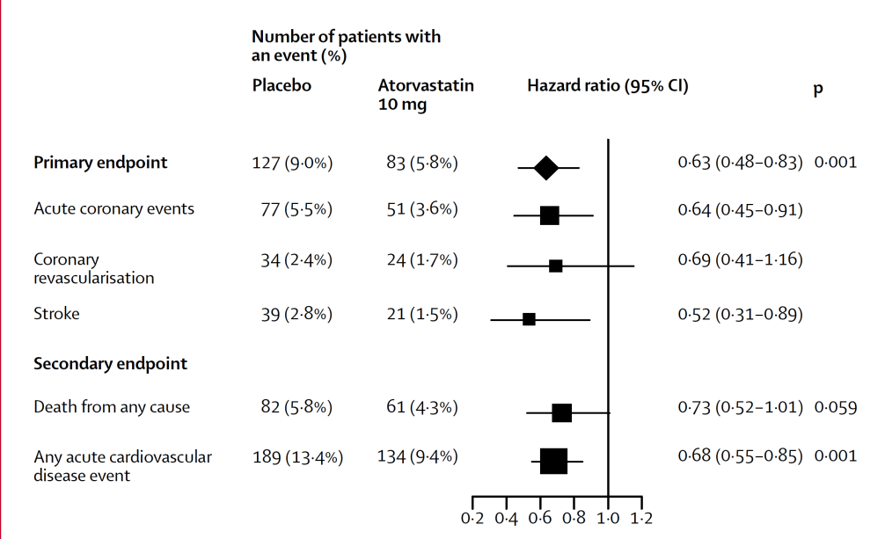
CARDS: Statins Reduced CVD in People w/ Type 2 Diabetes
2018 Diabetes Canada CPG – Chapter 25. Dyslipidemia
Colhoun HM, et al. Lancet 2004;364:685.
Notes:
Lancet. 2004 Aug 21-27;364(9435):685-96.
Primary prevention of cardiovascular disease with atorvastatin in type 2 diabetes in the Collaborative Atorvastatin Diabetes Study (CARDS): multicentre randomised placebo-controlled trial.
Colhoun HM, Betteridge DJ, Durrington PN, Hitman GA, Neil HA, Livingstone SJ, Thomason MJ, Mackness MI, Charlton-Menys V, Fuller JH; CARDS investigators.
Source
EURODIAB, Department of Epidemiology and Public Health, Royal Free and University College Medical School, London, UK. helen.colhoun@ucd.ie
Abstract
BACKGROUND:
Type 2 diabetes is associated with a substantially increased risk of cardiovascular disease, but the role of lipid-lowering therapy with statins for the primary prevention of cardiovascular disease in diabetes is inadequately defined. We aimed to assess the effectiveness of atorvastatin 10 mg daily for primary prevention of major cardiovascular events in patients with type 2 diabetes without high concentrations of LDL-cholesterol.
METHODS:
2838 patients aged 40-75 years in 132 centres in the UK and Ireland were randomised to placebo (n=1410) or atorvastatin 10 mg daily (n=1428). Study entrants had no documented previous history of cardiovascular disease, an LDL-cholesterol concentration of 4.14 mmol/L or lower, a fasting triglyceride amount of 6.78 mmol/L or less, and at least one of the following: retinopathy, albuminuria, current smoking, or hypertension. The primary endpoint was time to first occurrence of the following: acute coronary heart disease events, coronary revascularisation, or stroke. Analysis was by intention to treat.
FINDINGS:
The trial was terminated 2 years earlier than expected because the prespecified early stopping rule for efficacy had been met. Median duration of follow-up was 3.9 years (IQR 3.0-4.7). 127 patients allocated placebo (2.46 per 100 person-years at risk) and 83 allocated atorvastatin (1.54 per 100 person-years at risk) had at least one major cardiovascular event (rate reduction 37% [95% CI -52 to -17], p=0.001). Treatment would be expected to prevent at least 37 major vascular events per 1000 such people treated for 4 years. Assessed separately, acute coronary heart disease events were reduced by 36% (-55 to -9), coronary revascularisations by 31% (-59 to 16), and rate of stroke by 48% (-69 to -11). Atorvastatin reduced the death rate by 27% (-48 to 1, p=0.059). No excess of adverse events was noted in the atorvastatin group.
INTERPRETATION:
Atorvastatin 10 mg daily is safe and efficacious in reducing the risk of first cardiovascular disease events, including stroke, in patients with type 2 diabetes without high LDL-cholesterol. No justification is available for having a particular threshold level of LDL-cholesterol as the sole arbiter of which patients with type 2 diabetes should receive statins. The debate about whether all people with this disorder warrant statin treatment should now focus on whether any patients are at sufficiently low risk for this treatment to be withheld.
10

Slide 11
Who Should Receive Statins?
(regardless of baseline LDL-C)
2018 Diabetes Canada CPG – Chapter 23. Cardiovascular Protection in People with Diabetes
Clinical CVD or
Age ≥40 yrs or
Microvascular complications or
Diabetes >15 yrs duration and age >30 yr or
Warrants therapy based on the 2016 Canadian Cardiovascular Society Guidelines for the Diagnosis and Treatment of Dyslipidemia
Among women with childbearing potential, statins should only be used in the presence of proper preconception counselling & reliable contraception. Stop statins prior to conception.
CVD, cardiovascular disease
Notes:
11

Slide 12
What if baseline LDL-C <2.0 mmol/L?
2018 Diabetes Canada CPG – Chapter 25. Dyslipidemia
Within CARDS and HPS, subgroups that started with lower baseline LDL-C still benefited to the same relative degree as the whole population
If the person with diabetes qualifies for statin therapy based on the algorithm, use statin regardless of the baseline LDL-C and then target an LDL-C reduction of >50%
HPS Lancet 2002;360:7-22
Colhoun HM, et al. Lancet 2004;364:685.

Slide 13
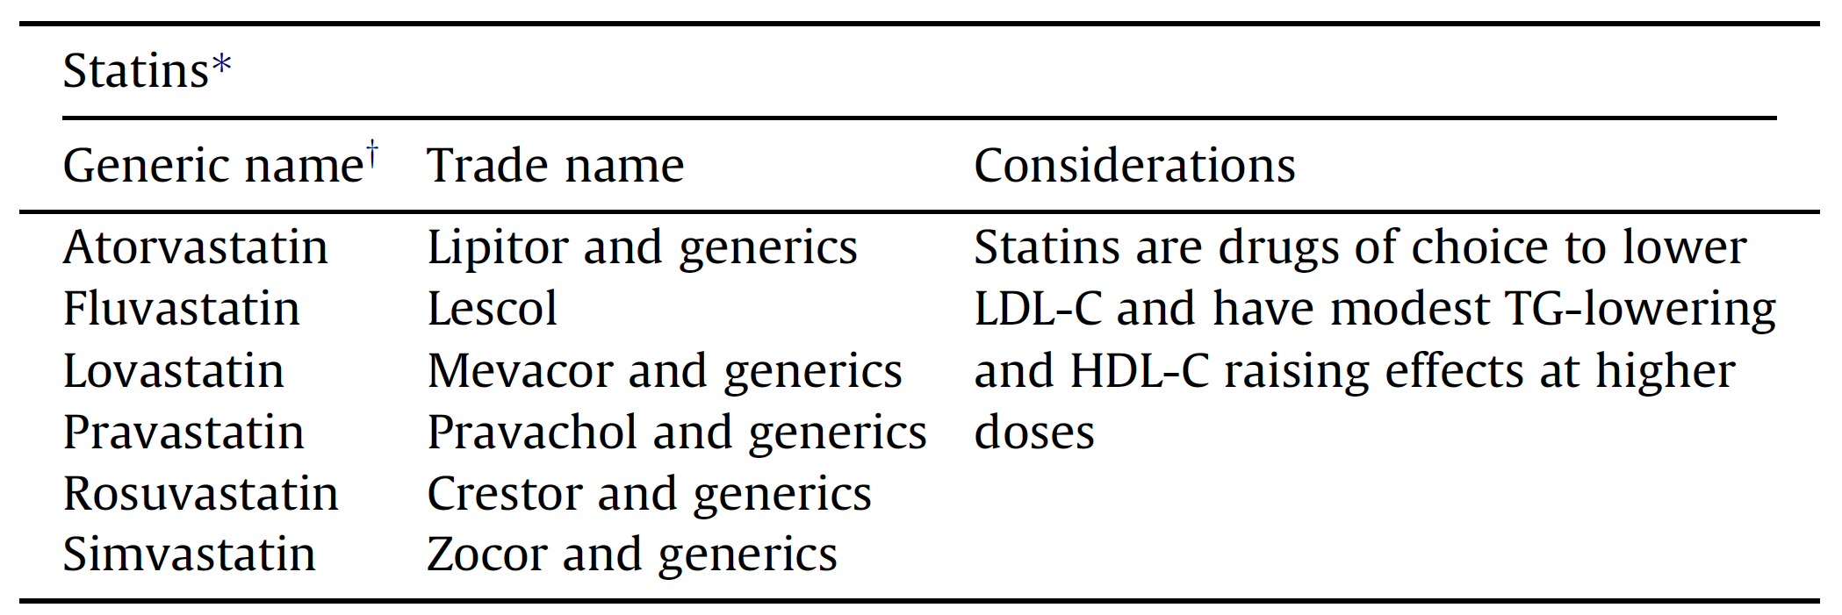
Statin Options
2018 Diabetes Canada CPG – Chapter 25. Dyslipidemia
Notes:
13

Slide 14
If on therapy, target
LDL consistently
<2.0 mmol/L
2018 Diabetes Canada CPG – Chapter 25. Dyslipidemia
Notes:
14

Slide 15
Statin Therapy Should be Concomitant with Healthy Behaviour Interventions
2018 Diabetes Canada CPG – Chapter 25. Dyslipidemia
Smoking cessation
Energy-restricted diet
Dietary patterns
  Low saturated and trans fatty acids
  Low refined carbohydrates
  Include viscous fibres, plant sterols, nuts, soy proteins
  Alcohol in moderation
Physical activity
Notes:
15

Slide 16
Second- Line Agents: Only if LDL-C Target not Reached with Statin
2018 Diabetes Canada CPG – Chapter 25. Dyslipidemia
Bile acid sequestrants
Cholesterol absorption inhibitors
Fibrates
Nicotinic acid
PCSK9 inhibitor
Notes:
16

Slide 17
Second-line lipid-modifying medications
Drug class* Generic name* (tradename) | Principal effects | Other considerations
Bile acid sequestrants (BAS) Cholestyramine resin Colesevelam Colestipol HCl | Lowers LDL-C | GI intolerability, which worsens with increasing doses May elevate TG Colesevelam has A1C lowering effect
Cholesterol absorption inhibitor Ezetimibe | Lowers LDL-C | Less effective than statins as monotherapy Effective when used in combination with a statin to further lower LDL-C
Fibrates Bezafibrate Fenofibrate Gemfibrozil | Lowers TG Variable effect on LDL-C Highly variable effect on HDL-C (more effective at raising HDL-C when baseline TG is high) | May increase creatinine and homocysteine levels; however, favorable effects on renal function have been noted with long-term fenofibrate treatment; possible benefit of fenofibrate on retinopathy Do not use gemfibrozil in combination with a statin due to increased risk of myopathy and rhabdomyolysis
Nicotinic acid Extended-release niacin Immediate-release niacin ) Long-acting (e.g. “no-flush”) not recommended | Raises HDL-C Lowers TG Lowers LDL-C Lowers Lp(a) | To be used selectively and cautiously but not to be used prior to trials of ezetimibe or BAS Can cause dose-related deterioration of glycemic control Long-acting niacin should not be used due to increased hepatotoxicity and decreased efficacy
PCSK9 Inhibitor Alirocumab Evolocumab | Lowers LDL-C Lowers Lp(a) | Injection site reactions CV risk reduction shown in one randomized clinical trial of secondary prevention, including in a subset with type 2 diabetes

Slide 18
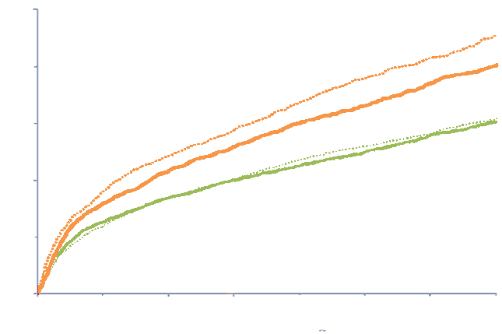
IMPROVE-IT: Ezetimibe add-on to statin reduced CV events in people with ACS and diabetes
CV death, MI, UA requiring re-hospitalization, coronary revascularization (≥30 days), or stroke
50%
With Diabetes 7 yr KM rate
Placebo/Simva 45.5%
EZE/Simva 40.0%
HR 0.85 (0.78, 0.94)
40%
P_{int}=0.023
30%
20%
Without Diabetes 7 yr KM rate
Placebo/Simva 30.8%
EZE/Simva 30.2%
HR 0.98 (0.91, 1.04)
10%
0%
0
1
2
3
4
5
6
7
Years after Randomization
Notes:
Benefit of Adding Ezetimibe to Statin Therapy on Cardiovascular Outcomes and Safety in Patients With vs. Without Diabetes: Results from IMPROVE-IT.
Giugliano RP¹, Cannon CP², Blazing MA³, Nicolau JC⁴, Corbalan R⁵, Spinar J⁶, Park JG², White JA³, Bohula E², Braunwald E²; IMPROVE-IT (IMProved Reduction of Outcomes: Vytorin Efficacy International Trial) Investigators.
Author information
Abstract
Background -Ezetimibe, when added to simvastatin, reduces cardiovascular events following acute coronary syndrome (ACS); we explored outcomes stratified by diabetes mellitus (DM). Methods -In IMPROVE-IT, 18,144 patients post ACS with LDL-C 50-125 mg/dL were randomized to ezetimibe/simvastatin-40mg (E/S) or placebo/simvastatin-40mg (P/S). The primary composite endpoint was cardiovascular death, major coronary events, and stroke. DM was a prespecified subgroup. Results -The 4933 (27%) patients with DM were more often older, female, with prior MI and revascularization, and presented more frequently with non-ST segment elevation ACS compared to non-DM (each p<0.001). The median admission LDL-C was lower among patients with DM (89 vs. 97 mg/dL, p<0.001). E/S achieved a significantly lower median time-weighted average LDL-C compared to P/S, irrespective of DM (DM: 49 vs. 67 mg/dL; No DM: 55 vs. 71 mg/dL, both P<0.001). In DM patients, E/S reduced the 7-year Kaplan-Meier primary endpoint event rate by 5.5% absolute (HR 0.85; 95% CI, 0.78-0.94); in non-DM patients the absolute difference was 0.7% (HR 0.98; 95% CI, 0.91-1.04; Pinteraction=0.02). The largest relative reductions in DM patients were in MI (24%) and ischemic stroke (39%). No differences in safety outcomes by treatment were present regardless of DM. When stratified further by age, patients ≥75 years had a 20% relative reduction in the primary endpoint regardless of DM (Pinteraction=0.91), while patients <75 years with DM had greater benefit than those without (Pinteraction=0.011). When stratified by the TIMI risk score for Secondary Prevention, all patients with DM demonstrated benefit with E/S regardless of risk. In contrast, among non-diabetics, patients with a high risk score experienced a significant 18% relative reduction in the composite of cardiovascular death, MI, and ischemic stroke with E/S compared to P/S, whereas non-diabetics at low or moderate risk demonstrated no benefit with the addition of ezetimibe to simvastatin (Pinteraction 0.034). Conclusions -In IMPROVE-IT the benefit of adding ezetimibe to statin was enhanced in patients with DM and in high-risk non-diabetics. Clinical Trial Registration -URL: https://clinicaltrials.gov Unique Identifier: NCT00202878.

Slide 19
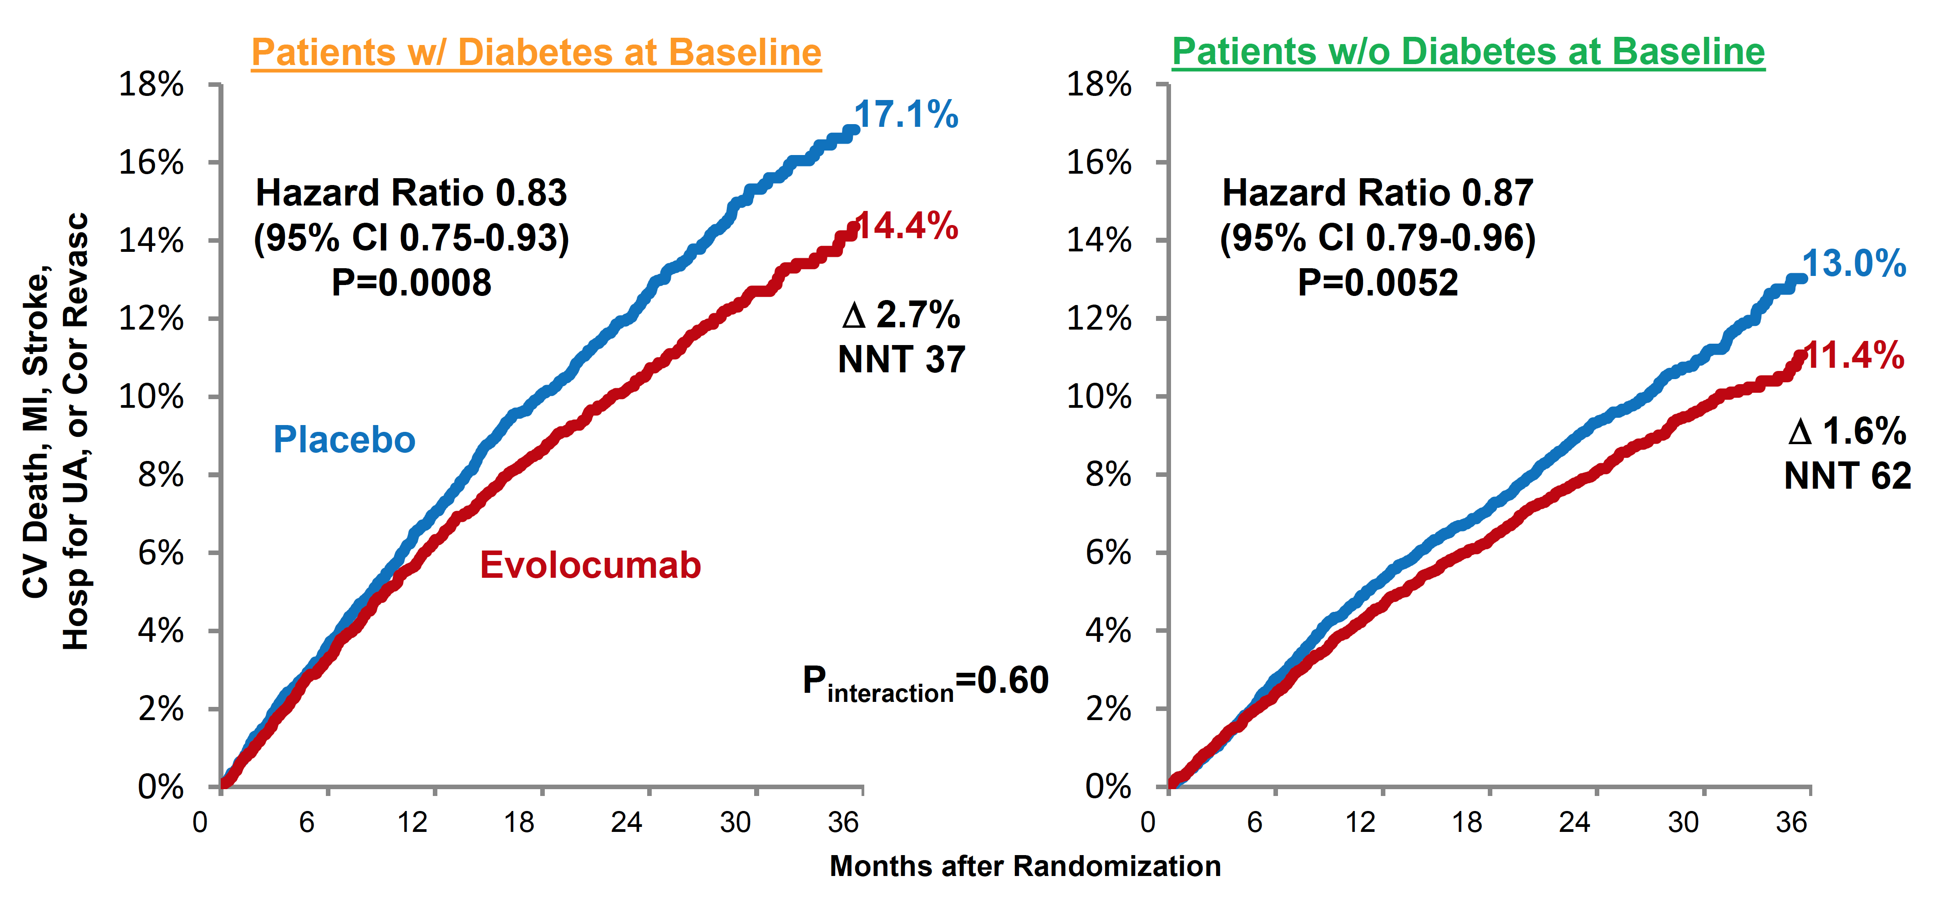
FOURIER: Evolocumab add-on to statin reduced CV events
Sabatine MS, et al. Lancet Diab Endocrinol 2017; 5(12):941-950
Notes:
Abstract
BACKGROUND:
The proprotein convertase subtilisin/kexin type 9 (PCSK9) inhibitor evolocumab reduced LDL cholesterol and cardiovascular events in the FOURIER trial. In this prespecified analysis of FOURIER, we investigated the efficacy and safety of evolocumab by diabetes status and the effect of evolocumab on glycaemia and risk of developing diabetes.
METHODS:
FOURIER was a randomised trial of evolocumab (140 mg every 2 weeks or 420 mg once per month) versus placebo in 27 564 patients with atherosclerotic disease who were on statin therapy, followed up for a median of 2·2 years. In this prespecified analysis, we investigated the effect of evolocumab on cardiovascular events by diabetes status at baseline, defined on the basis of patient history, clinical events committee review of medical records, or baseline HbA1c of 6·5% (48 mmol/mol) or greater or fasting plasma glucose (FPG) of 7·0 mmol/L or greater. The primary endpoint was a composite of cardiovascular death, myocardial infarction, stroke, hospital admission for unstable angina, or coronary revascularisation. The key secondary endpoint was a composite of cardiovascular death, myocardial infarction, or stroke. We also assessed the effect of evolocumab on glycaemia, and on the risk of new-onset diabetes among patients without diabetes at baseline. HbA1c was measured at baseline then every 24 weeks and FPG was measured at baseline, week 12, week 24, and every 24 weeks thereafter, and potential cases of new-onset diabetes were adjudicated centrally. In a post-hoc analysis, we also investigated the effects on glycaemia and diabetes risk in patients with prediabetes (HbA1c 5·7-6·4% [39-46 mmol/mol] or FPG 5·6-6·9 mmol/L) at baseline. FOURIER is registered with ClinicalTrials.gov, number NCT01764633.
FINDINGS:
At study baseline, 11 031 patients (40%) had diabetes and 16 533 (60%) did not have diabetes (of whom 10 344 had prediabetes and 6189 had normoglycaemia). Evolocumab significantly reduced cardiovascular outcomes consistently in patients with and without diabetes at baseline. For the primary composite endpoint, the hazard ratios (HRs) were 0·83 (95% CI 0·75-0·93; p=0·0008) for patients with diabetes and 0·87 (0·79-0·96; p=0·0052) for patients without diabetes (p_{interaction}=0·60). For the key secondary endpoint, the HRs were 0·82 (0·72-0·93; p=0·0021) for those with diabetes and 0·78 (0·69-0·89; p=0·0002) for those without diabetes (p_{interaction}=0·65). Evolocumab did not increase the risk of new-onset diabetes in patients without diabetes at baseline (HR 1·05, 0·94-1·17), including in those with prediabetes (HR 1·00, 0·89-1·13). Levels of HbA_{1c} and FPG were similar between the evolocumab and placebo groups over time in patients with diabetes, prediabetes, or normoglycaemia. Among patients with diabetes at baseline, the proportions of patients with adverse events were 78·5% (4327 of 5513 patients) in the evolocumab group and 78·3% (4307 of 5502 patients) in the placebo group; among patients without diabetes at baseline, the proportions with adverse events were 76·8% (6337 of 8256 patients) in the evolocumab group and 76·8% (6337 of 8254 patients) in the placebo group.
INTERPRETATION:
PCSK9 inhibition with evolocumab significantly reduced cardiovascular risk in patients with and without diabetes. Evolocumab did not increase the risk of new-onset diabetes, nor did it worsen glycaemia. These data suggest evolocumab use in patients with atherosclerotic disease is efficacious and safe in patients with and without diabetes.

Slide 20
If Triglycerides >10.0 mmol/L…
2018 Diabetes Canada CPG – Chapter 25. Dyslipidemia
Use a FIBRATE to reduce the risk of pancreatitis
Optimize glycemic control
Implement healthy behaviour interventions
  Weight loss
  Optimal dietary strategies
  Reduce alcohol
Notes:
20

Slide 21
Recommendation 1
2018 Diabetes Canada CPG – Chapter 25. Dyslipidemia
2018
A lipid profile (i.e., TC, HDL-C, TG, calculated LDL-C and/or apo B, or non-HDL-C), fasting or non-fasting , should be measured routinely. In those with known triglycerides >4.5 mmol/L, a fasting (>8-hour fast) lipid profile should be performed. If lipid-lowering treatment is not initiated, a lipid profile should be repeated every 1 to 3 years based on CV risk. Repeat testing should be performed 3 to 6 months after treatment for dyslipidemia is initiated to verify lipid targets are being met [Grade D, Consensus for all statements]
CV, cardiovascular; TC, total cholesterol; TG, triglycerides

Slide 22
Recommendation 2
2018 Diabetes Canada CPG – Chapter 25. Dyslipidemia
2018
2. For people with diabetes with indications for lipid-lowering therapy (see Cardiovascular Protection in People with Diabetes chapter), treatment should be initiated with a statin [Grade A, Level 1] to achieve LDL-C consistently <2.0 mmol/L [Grade C, Level 3] or >50% reduction of LDL-C from baseline [Grade D, Consensus]. Alternative targets and respective goals are apo B <0.8 g/L and non-HDL-C <2.6 mmol/L [Grade C, Level 3]

Slide 23
Recommendation 3
2018 Diabetes Canada CPG – Chapter 25. Dyslipidemia
CV, cardiovascular
3. In people with diabetes achieving LDL-C goal with statin therapy, the routine addition of fibrates or niacin for the sole purpose of further reducing CV risk should not be used [Grade A, Level 1]

Slide 24
Recommendation 4
2018 Diabetes Canada CPG – Chapter 25. Dyslipidemia
2018
4. For individuals not at LDL-C goal despite statin therapy as described above, a combination of statin therapy with second-line agents may be used to achieve the goal and the agent used should be selected based upon the size of the existing gap to LDL-C goal [Grade D, Consensus]. Generally, ezetimibe should be considered [Grade D, Consensus]. In people with diabetes who also have concomitant clinical CVD, ezetimibe or evolocumab may be used to further reduce major adverse cardiac events [Grade A, Level 1], and they should also be considered in those with concomitant familial hypercholesterolemia [Grade D, Consensus for ezetimibe and PCSK9 inhibitor]
CVD, cardiovascular disease

Slide 25
Recommendation 5
2018 Diabetes Canada CPG – Chapter 25. Dyslipidemia
TG, triglycerides
5. For individuals with diabetes with fasting serum TG >10.0 mmol/L, a fibrate should be used to reduce the risk of pancreatitis [Grade D, Consensus] while also optimizing glycemic control and implementing healthy behaviour interventions (e.g., weight management, optimal dietary strategies, reduction of alcohol) [Grade D, Consensus]

Slide 26
Key Messages
2018 Diabetes Canada CPG – Chapter 25. Dyslipidemia
The beneficial effects of lowering LDL-C with statin therapy apply equally well to people with diabetes as to those without the disease
The primary treatment goal for people with diabetes is LDL-C consistently <2.0 mmol/L or >50% reduction from baseline. Alternative targets and goals are non-HDL-C <2.6 mmol/L or apo B <0.8 g/L.
Achievement of the primary goal may require intensification of healthy behaviour interventions with statin monotherapy.
On occasion, the addition of other lipid-lowering medications may be required

Slide 27
Key Messages for People with Diabetes
2018 Diabetes Canada CPG – Chapter 25. Dyslipidemia
Most adults with diabetes are at greater risk for cardiovascular diseases, such as heart attack and stroke
People with diabetes have an increased risk of cardiovascular diseases even if their LDL-cholesterol is “normal”. They have an even higher risk if their LDL-cholesterol is elevated
Adults with diabetes should have their cholesterol tested yearly or as indicated by your healthcare provider. More frequent testing may be necessary for people taking cholesterol medications
Always discuss your cholesterol results with your physician or nurse practitioner and other members of your health-care team

Slide 28

Visit guidelines.diabetes.ca

Slide 29


Or download the App

Slide 30
Diabetes Canada Clinical Practice Guidelines
www.guidelines.diabetes.ca – for health-care providers
1-800-BANTING (226-8464)
www.diabetes.ca – for people with diabetes
Notes:
30

