Slide 1
Chronic Kidney Disease in Diabetes
Update
Dr. Sheldon Tobe
Notes:
It is my pleasure and honour to present the 2025 Diabetes Canada update for the Chronic Kidney Disease in Diabetes Clinical Practice Guideline. Many of these slides are from our presentation at the Diabetes Canada meeting in Halifax in November 2024. Our guideline has now been published in the Canadian Medical Association Journal in May of 2025.

Slide 2

Objectives
The main objective is to raise awareness about the new Diabetes Canada Chapter on Chronic Kidney Disease.
To describe new therapies to prevent progression of diabetic nephropathy toward end stage kidney disease
To describe new continuing education programs designed to support the C-CHANGE clinical practice guideline
www.cchangeguidelines.com
www.chepplus.com
Notes:
Once you are familiar with the new practice recommendations from our guideline, if you would like more information in a continuing professional education format, to help you change your clinical practice to come in line with the new guideline directed medical therapy outlined here, please visit these websites.

Slide 3
PROGRAM DISCLOSURE OF COMMERCIAL SUPPORT
I have/do not have relationships with for-profit and not-for-profit organizations over the past two years: Tobe
NATURE OF RELATIONSHIP | NAME OF THE FOR-PROFIT OR NOT-FOR-PROFIT ORGANIZATION | DESCRIPTION OF RELATIONSHIP
Any direct financial payments including receipt of honoraria | CHEP+, LIV, | Speaker for accredited CPD
Membership on advisory boards or speakers’ bureaus | KVR | Ad-board for desmopressin for kidney biopsy
Funded grants of clinical trials | CIHR, CFREF | Research
Patents on a drug, product or device | n/a
All other investments/relationship that could be seen as having the potential to influence the content of the educational activity | CHEP+ | Physician organization creates CPD in support of C-CHANGE clinical practice guideline
[presentation title] [speaker]
Notes:
These are my disclosures

Slide 4
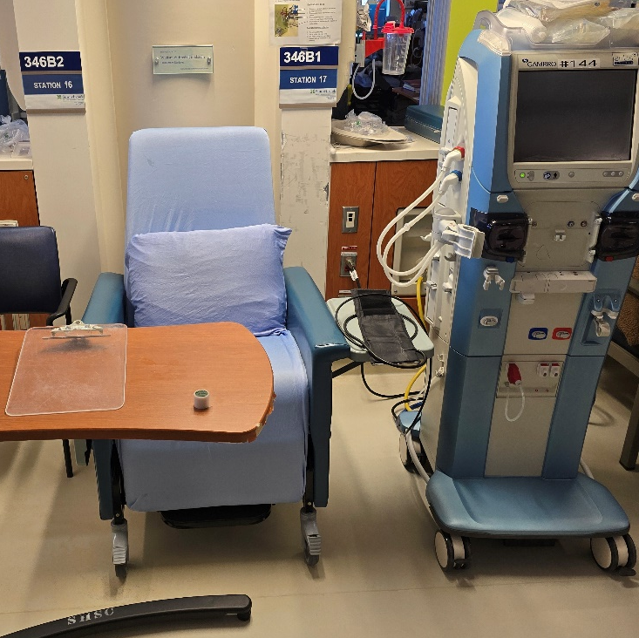
Aspirational Messaging
Our expectation is that implementation of the recommendations of this chapter with the new pharmacotherapy chapter, will dramatically change the natural history of diabetic nephropathy for the better
Notes:
Please look at this picture of a recent day in the dialysis unit midway through my morning dialysis shift. What do you notice? (read the message)

Slide 5
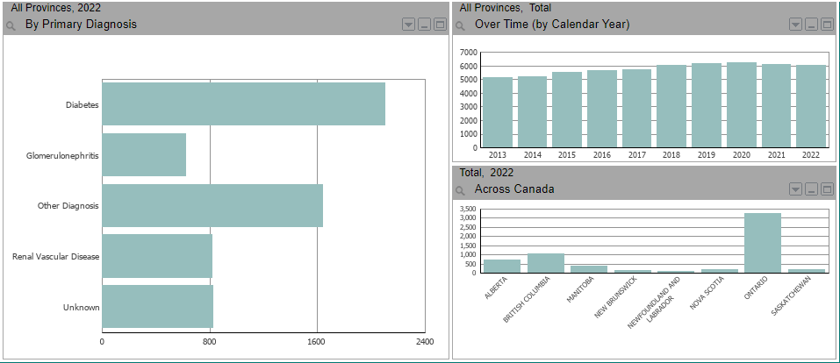
Canadian Data now shows a reduction of Incident End-Stage Kidney Disease by Primary Diagnosis 2013 - 2022
Canadian Organ Renal Registry, Run date July 10, 2024, www.CIHI.CA/en
Notes:
Rates of progression to ESRD peaked in Canada and the US in 2020. The impact of the pandemic, or possibly the introduction of SGLT2i?

Slide 6
CKD – Diagnostics – Screening for CKD
Notes:
Lets start with an update on screening recommendations for kidney disease in people with diabetes

Slide 7
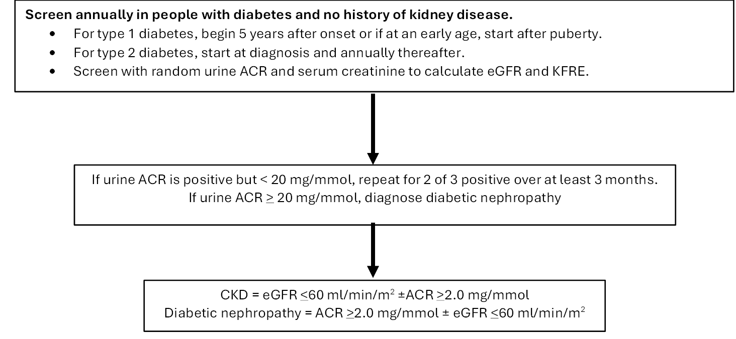
Existing Screening recommendation for finding kidney disease in people with diabetes
Notes:
Our screening recommendations are so important because identifying an individual early on in the development of kidney disease, allows you to change the trajectory of their disease progression. If you find out late that there is heavy proteinuria, and a low eGFR, therapy will be helpful in slowing progression, buying that individual extra years before needing dialysis. If you find out early that there is new albuminuria and start therapy, you will buy that individual extra decades before needing dialysis!
Screen all your patients with diabetes every year to look for the new onset of abnormal albuminuria. Also measure the serum creatinine so that the eGFR can be calculated. Your lab will report on the KFRE, which we will talk about shortly. Knowing these numbers provides an on-ramp for kidney and heart protection. Miss the on-ramp, and time is lost. Time is kidney function lost unnecessarily.
If the patient has abnormal albuminuria in the A2 range (up to 20 mg/mmol for the ACR, then 2 of 3 tests are needed over at least 3 months, to rule out a false positive for diabetic nephropathy. If the proteinuria is already in the A3 range (an ACR of 20 mg/mmol or greater), then you can make the diagnosis of diabetic nephropathy right away.
If there is a low eGFR, below 60 ml/min, then that patient has chronic kidney disease. If there is abnormal albuminuria in the A2 or A3 range, then there that individual has diabetic nephropathy. People with diabetic nephropathy have a chronic kidney disease even if their eGFR is in the normal range.
Having an eGFR less than 60 ml/min with A1 or normal urine albumin levels is less common than diabetic nephropathy and was less well understood. Fortunately those people were included in the EMPA Kidney study, and now have an indication for an SGLT2i. We will discuss this later.

Slide 8
New follow-up kidney screening recommendation for people with diabetes and kidney disease
Individuals with diabetes and CKD should have their eGFR and spot urine ACR assessed at least annually with more frequent testing (every 3 to 6 months) when the eGFR is < 60 ml/min/1.73m², or the uACR is > 20 mg/mmol [Grade 1A, Level 2]
Assess more frequently for stage 3 or 4 CKD, and if uACR is A3
Notes:
If an individual with diabetes is found to have chronic kidney disease or diabetic nephropathy, then they should have follow-up testing annually. If the eGFR is less than 60 ml/min, and the UACR is over 20 mg/mmol, consider testing more frequently, every 6 months, or every 4 months, or even every quarter.

Slide 9
ACR Thresholds
ACR Normal Range
Healthy < 1.0
Diabetes Canada <2.0
Europe, ORN <3.0
Notes:
When we looked at the data, because people with ACR’s from 2.0 to 2.9 have much greater risk of progression then people with ACR < 2.0, it would mean that waiting until their ACR rose to 3.0 or higher, that they would miss out on time on therapy. The earlier we can alter the trajectory of the decline of kidney function the better. Moving the ACR level higher, would not make anyone better, and in fact, would make people who on screening have ACR levels from 2.0 to 2.9 worse off. Therefore, we left the ACR threshold for normal for people with diabetes in Canada at less than 2.0 mg/mmol.

Slide 10
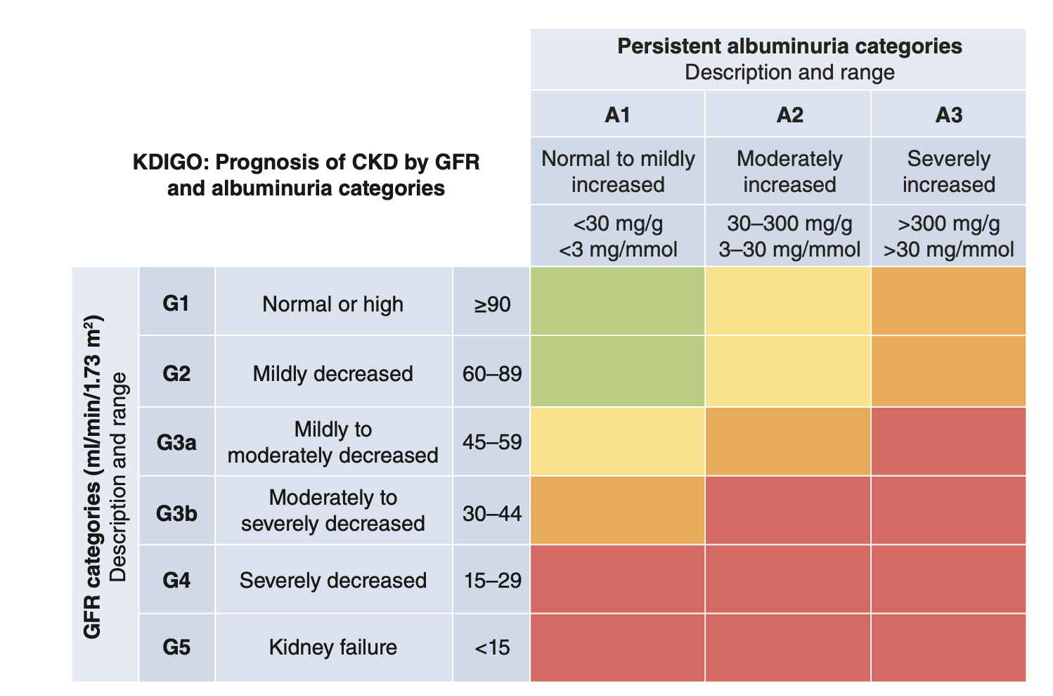
CKD CLASSIFICATION - KDIGO
Notes:
Here is the KDIGO (kidney disease, improving global outcomes) classification of kidney disease. On the left, you can see the column from G1 to G5. That signifies different levels of kidney function, based on the estimated glomerular filtration rate. Normal is 60 and above. Stage 3 is broken into a and b, but is an eGFR from 30 to 60 ml/min. Less than 30 ml/min, or stage 4 is when Nephrologists want to see the patient, and less than 15 is time to consider renal replacement therapies like dialysis or kidney transplantation.
At the top on the right, are the columns designating the levels of albuminuria. A1 is normal, A2 is what we used to call microalbuminuria, and A3 is what we used to call macro albuminuria, or overt nephropathy. A2 and A3 are abnormal levels of albuminuria, and people with diabetes in that range have diabetic nephropathy.
Looking at the heat map, the lower the GFR, and the greater the amount of albuminuria, the greater the risk of progressive kidney disease. Also the greater the risk of cardiovascular disease. These patients need closer and more frequent follow up in clinic.

Slide 11
CKD – Diagnostics – KFRE
Notes:
Lets talk about this new term, the KFRE. It stands for Kidney Failure Risk Equation . Our co-author Dr. Nav Tangri almost single handedly researched and promoted the use of the KFRE, so successfully, that your lab should included it on your patients results if you have measured the urine ACR and the serum creatinine.

Slide 12
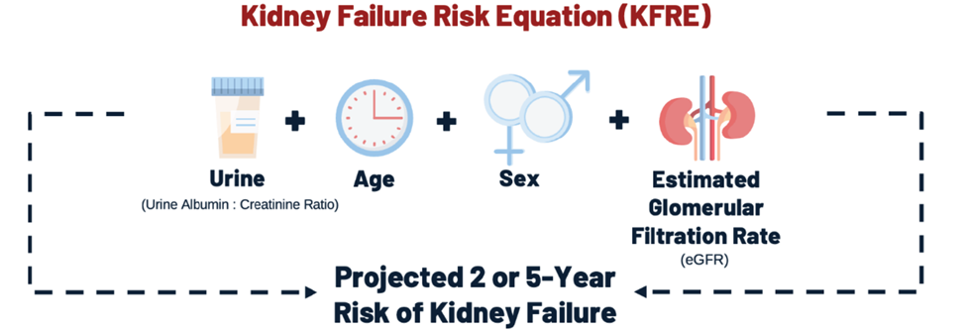
Kidney Failure Risk Equation Variables
Tangri Nav, And Diabetes and Endo Today, 2024; 2(1): 5-10
Notes:
KFRE is a formula that predicts the risk of kidney failure over time. Nephrologists use the KFRE2 or the risk of end stage kidney disease in 2 years. The KFRE5 is for primary care. It is the risk of ending up on dialysis in the next 5 years. All you have to remember is that if the KFRE is 5 or over, then that person has a risk of needing dialysis in the next 5 years. The significance, is that a KFRE of 5 or greater identifies when a referral to your local nephrologist is needed.
The components of the KFRE are shown above. Each of these is available to the lab when you order a urine ACR and a serum creatinine.

Slide 13
New advice on management of hyperkalemia
For adults with diabetes, mild hyperkalemia (defined by potassium levels between the upper limit of normal and 5.4 mmol/L) with dietary intervention. For moderate hyperkalemia (defined by potassium levels between 5.4 mmol/L and 5.9 mmol/L) it is recommended to initiate medical therapy to increase potassium excretion through the GI tract or in the urine. For severe hyperkalemia (defined by potassium 6.0 mmol/L or higher) it is suggested to hold RAASi and nsMRA medications and refer to an emergency room for management [Grade D, Consensus for recommendation #11].
Notes:
For the first time, we have a recommendation about the management of hyperkalemia. In addition to the CKD guideline publication, there is a supplement included that outlines the management of hyperkalemia including picture sheets that can be given to patients along with dietary advice.
We have simplified the classification of hyperkalemia. However, we have made your job a little harder. That is because we want you to continue kidney protection medications that may be raising the potassium if the potassium level is less than 6. We have a table of advice for keeping the potassium under control, as well as the information in the hyperkalemia management supplement. It is only when the potassium is 6 or higher, that the patient’s RAASi should be held, and they should be sent to the ER for emergency management.
So remember, mild or moderate hyperkalemia, need to be managed, at the same time that you keep the patient on RAASi and their kidney protective medications.

Slide 14
Hyperkalemia
Notes:
Here is a checklist of foods I like to ask the patient about when the lab reports a high potassium level. Bananas, oranges, orange juice, tomatoes, tomato juice, highly refined foods etc.

Slide 15
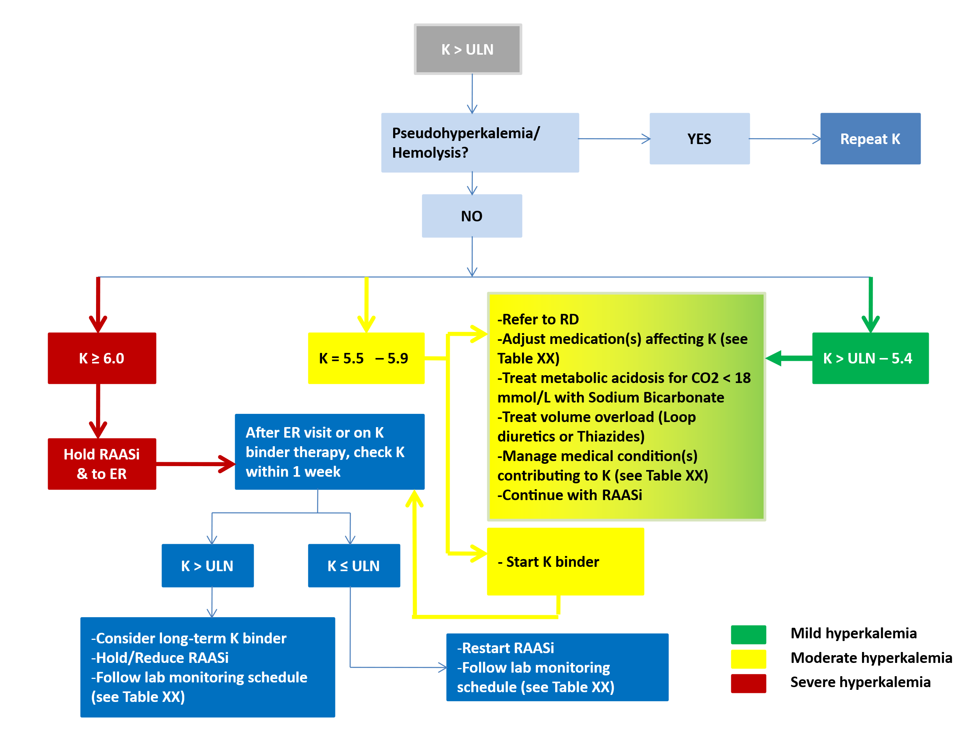
Hyperkalemia – Algorithm
Notes:
This algorithm takes you through the management of hyperkalemia. If the potassium is 6 or above, stop the RAASi, and send to the ER. After the patient has returned to normal, don’t forget to restart RAASi.
If the potassium is elevated but < 6.0, then look at our supplement table. Consider diet, if there is a metabolic acidosis with low level of bicarbonate, then treat it with sodium bicarbonate 500 mg bid.
Consider adding a diuretic. SGLT2i’s lower potassium. Even consider a potassium binder like the new lokelma or patiromer that are safe and effective, but very pricey if the patient does not have private coverage.

Slide 16
Hyperkalemia – When to test
Medication Change | Suggested timeframe for K recheck
Initiation or doubling of dose of: ARB, ACEi, MRA nsMRA | 1 – 2 weeks 4 weeks
After K binder therapy/ER visit for hyperkalemia | within 1 week
Regular follow-up | Q 3 – 6 months
Notes:
This table provides guidance on when to test potassium levels after starting RAASi, and note the relaxed timeframe for the nsMRA finerenone (Kerendia) which is 4 weeks, as there is less hyerkalemia. After an ER visit, when the patient’s RAASi has been held, we recommend retesting potassium in a week, and if under control, for example 4.8 or less, to restart RAASi, and have a discussion about limiting dietary potassium, potential with one of the potassium related patient handouts from the supplement.

Slide 17
Therapies to prevent or slow progression of CKD
ACEi or ARB remain foundational therapy
Notes:
This is a reminder that, use of ACEi or ARB is foundational for kidney and heart protection .

Slide 18
Therapies to prevent or slow progression of CKD – SGLT2i
Notes:
All the newer therapies for kidney and heart protection, are added to the background of ACEi or ARB. SGLT2i therapy was initially added to the CKD chapter in 2018, when it was just for patients with CKD and a history of CAD or many CAD risk factors. Then in 2020, it was included specifically for patient’s with diabetes and kidney disease.

Slide 19
Strengthened and broadened recommendation for using SGLT2i for people with diabetes
Adults with type 2 diabetes and CKD defined by eGFR between 20 and 45 ml/min/1.73m² regardless of uACR, or eGFR between 45 and 90 ml/min/1.73m² with uACR >20 mg/mmol, on maximally tolerated, or maximally prescribed doses of RAASi should be recommended an SGLT2i to delay progression of CKD, progression to dialysis, and to reduce cardiovascular events [Grade A, Level 1A ].
Notes:
Here is the recommendation for the use of SGLT2i for kidney protection. I have simplified the wording from the actual manuscript to make this recommendation more implementable.
For adults with type 2 diabetes, and CKD on RAASi, if their eGFR is < 60 ml/min, they have an indication for SGLT2i, with or without abnormal urine albumin levels. If the eGFR is 60 or more, the indication for SGLT2 is for patients with A3 albuminuria. It is quite reasonable to extrapolate this recommendation to start and SGLT2i earlier when the ACR is in the A2 range.

Slide 20
New therapies to prevent or slow progression of CKD – nsMRA, GLP1-RA
Notes:
It is so exciting that we now have 4 therapies for kidney and heart protection for people with diabetes and kidney disease. It is just a short time again, that all we had was blood pressure control and RAASi. Now we have SGLT2i, and two additional drug classes. Next I will discuss the two new therapies.

Slide 21
Therapies to prevent or slow progression of CKD – GLP1ra

Slide 22
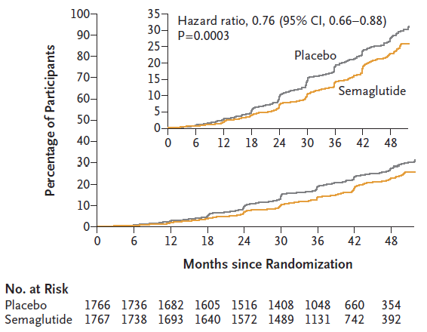
First Major Kidney Disease End Point – FLOW Study
Perkovic V, NEJM, May 2024, DOI: 10.1056/NEJMoa2403347
Notes:
Subcutaneous semaglutide (Ozempic) was studied in people with type 2 diabetes and A2 and A3 albuminuria in the FLOW study. In this analysis, subcutaneous semaglutide demonstrated a 24% improvement in the composite kidney outcome and also cardiovascular benefit. This is on top of existing RAASi therapy and blood pressure control.

Slide 23
Therapies to prevent or slow progression of CKD – nsMRA

Slide 24
New recommendation for GLP1-RA for people with diabetic nephropathy for kidney protection
Adults with type 2 diabetic nephropathy defined by A2 or A3 albuminuria and eGFR 25 ml/min/1.73m² and above, on maximally tolerated, or maximally prescribed doses of RAASi, should be recommended a GLP1-RA (subcutaneous semaglutide) with proven kidney benefit to reduce proteinuria and the risk of worsening kidney function.
Notes:
Here is the recommendation for the use of subcutaneous semaglutide for kidney protection. I have simplified the wording from the actual manuscript to make this recommendation more implementable.
For adults with type 2 diabetes, and CKD on RAASi, if their eGFR is 25 ml/min or greater, and they have abnormal albuminuria, then they have an indication for subcutaneous semaglutide.

Slide 25
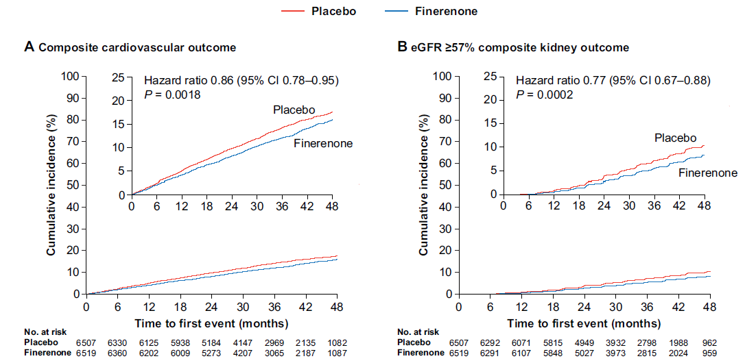
Composite CV and Kidney Outcome – FIDELITY Analysis
Agarwal R, Eur Heart J 2021 https://doi.org/10.1093/eurheartj/ehab777
Notes:
The non-steroid mineralocorticoid receptor antagonist or nsMRA finerenone (Kerendia) was studied in people with type 2 diabetes and A2 and A3 albuminuria in the FIGARO and FIDELIO studies. A pre-planned analysis put the two studies together in a pooled analysis called FIDELITY. In this analysis, finerenone demonstrated a 23% improvement in the composite kidney outcome and a 14% improvement in the cardiac outcome. Remember, this is on top of existing RAASi therapy and blood pressure control.

Slide 26
New recommendation for nsMRA for people with diabetic nephropathy for kidney and heart protection
Adults with type 2 diabetic nephropathy defined by A2 or A3 albuminuria and eGFR between 25 and 75 ml/min/1.73m², on maximally tolerated, or maximally prescribed doses of RAASi, with serum potassium < 4.8 mmol/L, should be recommended a nsMRA with proven efficacy alongside potassium monitoring, to improve kidney and cardiovascular outcomes).
Notes:
Here is the recommendation for the use of the nsMRA finerenone for kidney protection. I have simplified the wording from the actual manuscript to make this recommendation more implementable.
For adults with type 2 diabetes, and CKD on RAASi, if their eGFR is 25 ml/min or greater, and they have abnormal albuminuria, then they have an indication for finerenone if their potassium level is < 4.8 mmol/L.

Slide 27
Therapies to prevent or slow progression of CKD – Selecting/Sequencing
Notes:
Now that we have four therapies for protecting the kidneys and heart in people with diabetic nephropathy, you may wonder what order is best to use for adding these agents, and how many should be added.
The first question is easiest. We should try to start with RAASi, for example starting an ACEi or an ARB. This is on the background of blood pressure control to < 130/80 mmHg.
When it comes to the second class of drug to add, we feel it is best to consider a patient’s values and preferences.

Slide 28
Selecting/Sequencing of Therapeutics in DM-CKD
Patient Preference | SGLT2i | nsMRA | GLP1ra
Weight Loss | + | 0 | ++
Avoidance of hyperkalemia | + | - | 0
Glycemic control | + | 0 | ++
Avoidance of genital infections | - | 0 | 0
Avoidance of injections | ++ | ++ | -
Notes:
Thanks to Phil McFarlane for the concept of this table. We have listed five patient preferences on the left column, and how that is reflected in appropriateness or not of adding to RAASi with an SGLT2i, and nsMRA, or GLP 1-RA.
If weight loss is the patient’s goal, an SGLT2i possibly with the addition of a GLP1-RA makes sense.
If hyperkalemia has been a problem, then an SGLT2i is helpful to reduce the potassium level.
If the patient has had previous genital mycotic infections, then they may want to avoid an SLT2i, I should add that it seems that SGLT2is, while increasing the risk for yeast infections, do not increase the risk of typical urinary track infections, so a previous UTI is not a contraindication for an SGLTi2,
What about adding more than one of the new therapies to an ACEi or ARB? Presently there is not sufficient evidence to recommend adding more than one to baseline RAASi. A network meta-analysis suggests that they will have added benefit, and to consider adding if the urine ACR does not drop down to < 2 mg/mmol.
Again, we do not have sufficient evidence to recommend this. Do I as a Nephrologists do this in clinic.. Yes I do, but my patients are much further along the pathway to dialysis then in primary care. New evidence is coming in regularly, and we will update you if this advice changes.

Slide 29
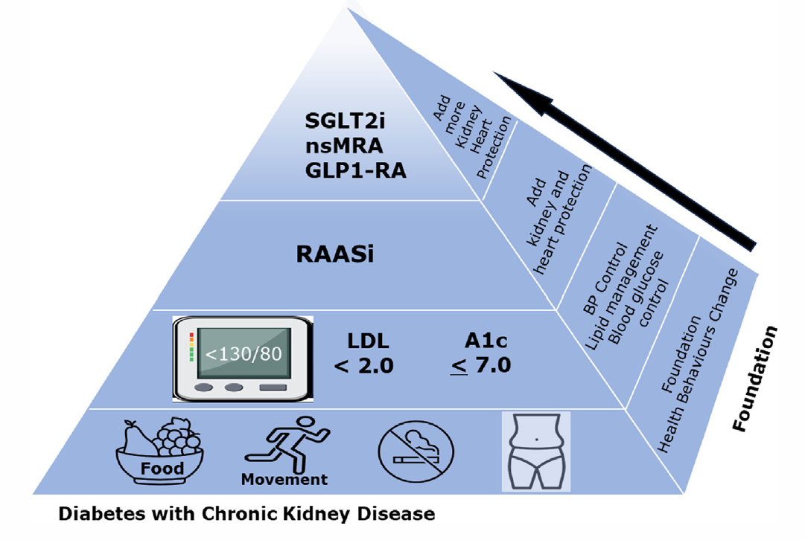
Management of individuals with diabetic kidney disease, Adapted from KDIGO 2023
Notes:
Finally, I adapted the approach to overall manage diabetic nephropathy from the KDIGO 2023 guideline. On the bottom layer, foundational to our management is control of food intake, physical activity, smoking cessation, and maintaining a healthy weight.
Next, we have three levers that we can control. Lets get the blood pressure to target, the LDL cholesterol < 2.0 for primary prevention, and maintain blood pressure control.
An ACEi or ARB will be used for blood pressure control if possible.
Now if there is abnormal albuminuria, we should be adding an SGLT2i, or GLP1-RA, or nsMRA , based on a patient’s values and preferences.
This is a huge step forward to our 2001 recommendation to add RAASi to blood pressure control. We are now finally making inroads to preventing progression to end stage kidney disease. My goal as a nephrologist has always been to put myself out of business in the dialysis unit, before I retire. If you follow the recommendations outlined in this chapter, in particular staring early in the setting of diabetic nephropathy, without waiting for the urine ACR to be > 20, of the GFR falling below 60 ml/min, your patient should have a good chance of never needing dialysis in their lifetimes as a result of diabetes induced kidney disease.

Slide 30
THANK YOU!
For further information please go to the Diabetes Canada website: diabetes.ca
For accredited education programs to facilitate update of this new guideline for clinicians, please go to:
cchangeguidelines.com and chepplus.com

