Slide 1
Nutrition Therapy
2018 Clinical Practice Guidelines
Chapter 11
John L. Sievenpiper MD PhD FRCPC, Catherine B. Chan PhD, Paula D. Dworatzek PhD RD, Catherine Freeze MEd RD CDE, Sandra L. Williams MEd RD CDE

Slide 2
Disclaimer
All Content contained on this slide deck is the property of Diabetes Canada, its content suppliers or its licensors as the case may be, and is protected by Canadian and international copyright, trademark, and other applicable laws. Diabetes Canada grants personal, limited, revocable, non-transferable and non-exclusive license to access and read content in this slide deck for personal, non-commercial and not-for-profit use only. The slide deck is made available for lawful, personal use only and not for commercial use.
The unauthorized reproduction, distribution of this copyrighted work is not permitted.
For permission to use this slide deck for commercial or any use other than personal, please contact guidelines@diabetes.ca

Slide 3
Key Changes
2018 Diabetes Canada CPG – Chapter 11. Nutrition
2018
Reinforcement of the important role of the Registered Dietitian in diabetes management
New information on
  The importance of using a transcultural approach to nutrition therapy with the goal of providing culturally congruent nutrition counselling
  Role of various dietary patterns
  Ramadan fasting and diabetes

Slide 4
Nutrition Checklist
2018 Diabetes Canada CPG – Chapter 11. Nutrition
REFER for nutrition counseling by a registered dietitian
FOLLOW Eating Well with Canada’s Food Guide
INDIVIDUALIZE dietary advice based on preferences and treatment goals
CHOOSE low glycemic index carbohydrate food sources
Notes:
4

Slide 5
Nutrition Checklist (cont’d)
2018 Diabetes Canada CPG – Chapter 11. Nutrition
KNOW alternative dietary patterns for type 2 diabetes
ENCOURAGE matching of insulin to carbohydrate in type 1 diabetes
ENCOURAGE nutritionally balanced, calorie-reduced diet in patients with overweight or obesity

Slide 6

Encourage patients to follow Eating Well with Canada’s Food Guide in order to meet their nutritional needs
http://www.hc-sc.gc.ca/fn-an/food-guide-aliment/index-eng.php
Notes:
6

Slide 7

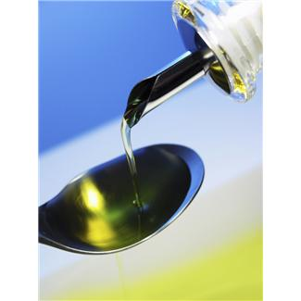

Macronutrient Distribution
(% Total Energy)
2018 Diabetes Canada CPG – Chapter 11. Nutrition
 | Carbohydrates | Protein | Fat
% of total energy | 45-60% | 15-20% (or 1-1.5g /kg BW) | 20-35%
Calories per gram | 4 | 4 | 9
Grams for 2000 calorie/day | 225-300 | 75-100 | 44-78
BW = body weight
Notes:
Protein: 1-1.5 g/kg body weight/day is usual representing 15-20%, but this intake in grams/kg/day should be maintained or increased in energy reduced diets.
7

Slide 8
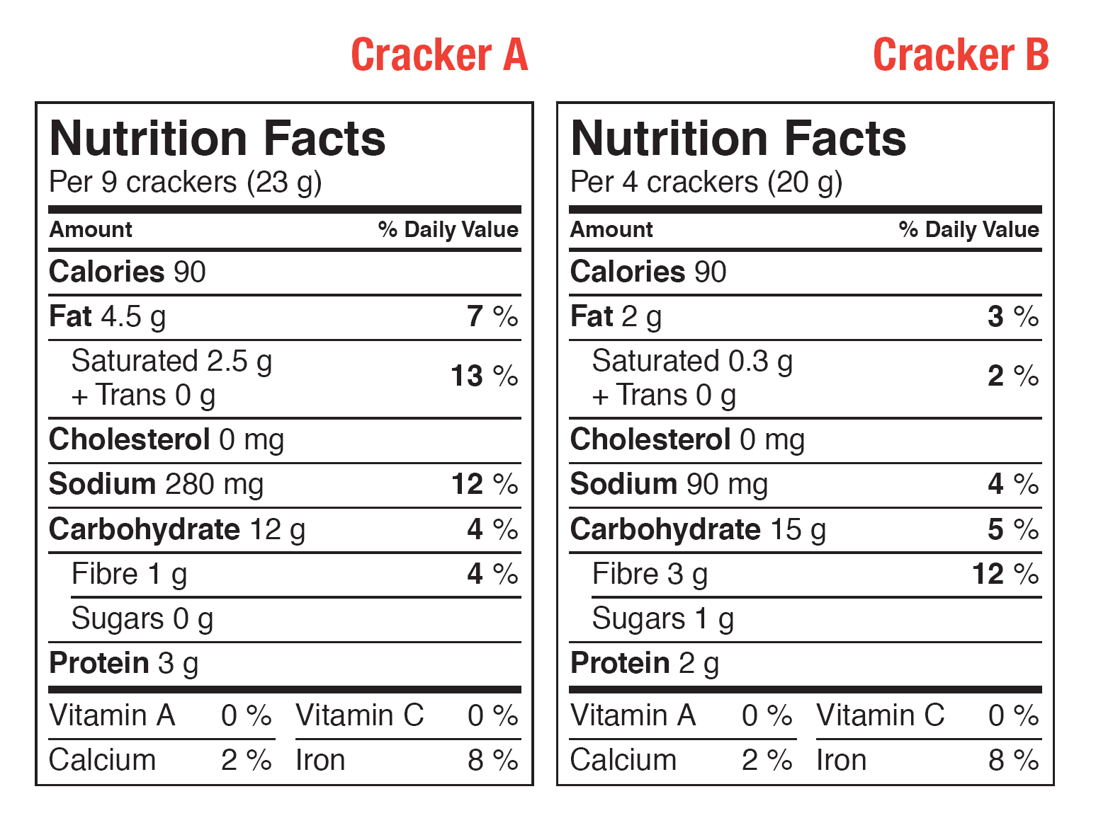
2018 Diabetes Canada CPG – Chapter 11. Nutrition
Choose Foods Using % Daily Value
Daily Values > 15% = a lot Daily Value < 5% = a little
http://www.hc-sc.gc.ca/fn-an/label-etiquet/nutrition/cons/fact-fiche-eng.php
Notes:
8

Slide 9
Choose “healthy” fats
2018 Diabetes Canada CPG – Chapter 11. Nutrition
FAT
AVOID trans-fatty acids
Saturated fatty acids to <9% of energy intake*
*REPLACE with polyunsaturated fatty acids (PUFAs) from mixed n-3/n-6 sources (e.g. nuts, canola oil, soybean oil, flaxseed), monounsaturated fatty acids (MUFAs) from plant sources (e.g. extra virgin olive oil, high oleic oils, avocados), whole grains, or low-GI carbohydrates (see slide 10)

Slide 10


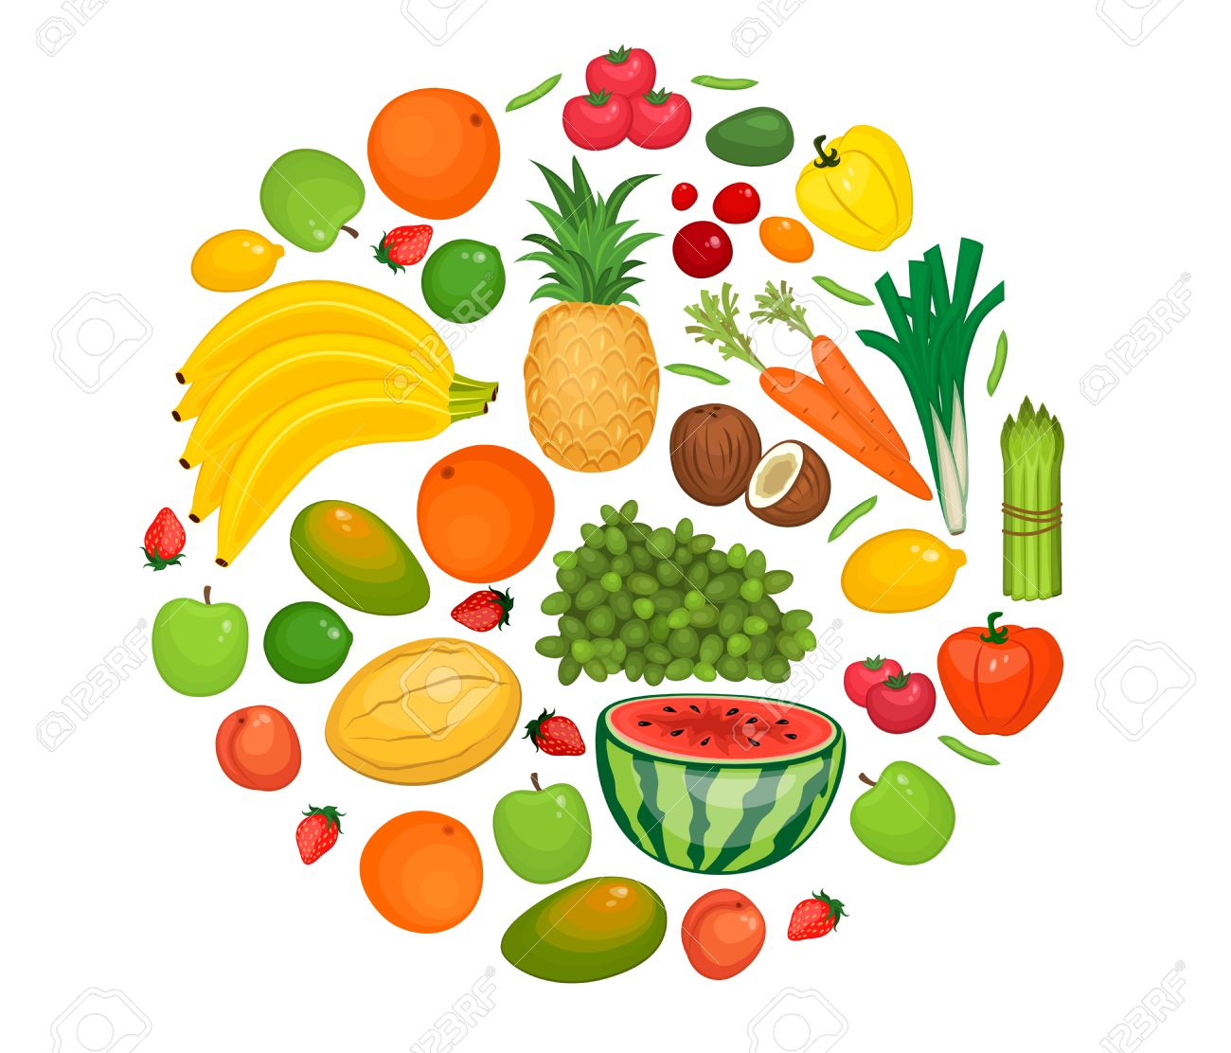
Choose “healthy” carbohydrates
2018 Diabetes Canada CPG – Chapter 11. Nutrition
DIETARY FIBRE
FOOD-BASED
Total fibre to 30-50 g per day
>1/3 (10-20 g per day) from viscous soluble fibre*
⬆Pulses
(e.g. beans, peas,
chickpeas, lentils)
⬆Whole grains
(e.g. oats and barley)
*CHOOSE oats (e.g. steel-cut oats, oat bran cereals/breads), barley (e.g. barley soups, pot barley), psyllium (e.g. All-bran BudsTM, psyllium husk, Metamucil®), konjac mannan (e.g. konjac noodles), pulses (e.g. beans, peas, chickpeas, lentils), vegetables (e.g. eggplant, okra), and fruit (e.g. apples, berries, citrus fruit)
⬆Fruit &
vegetables

Slide 11
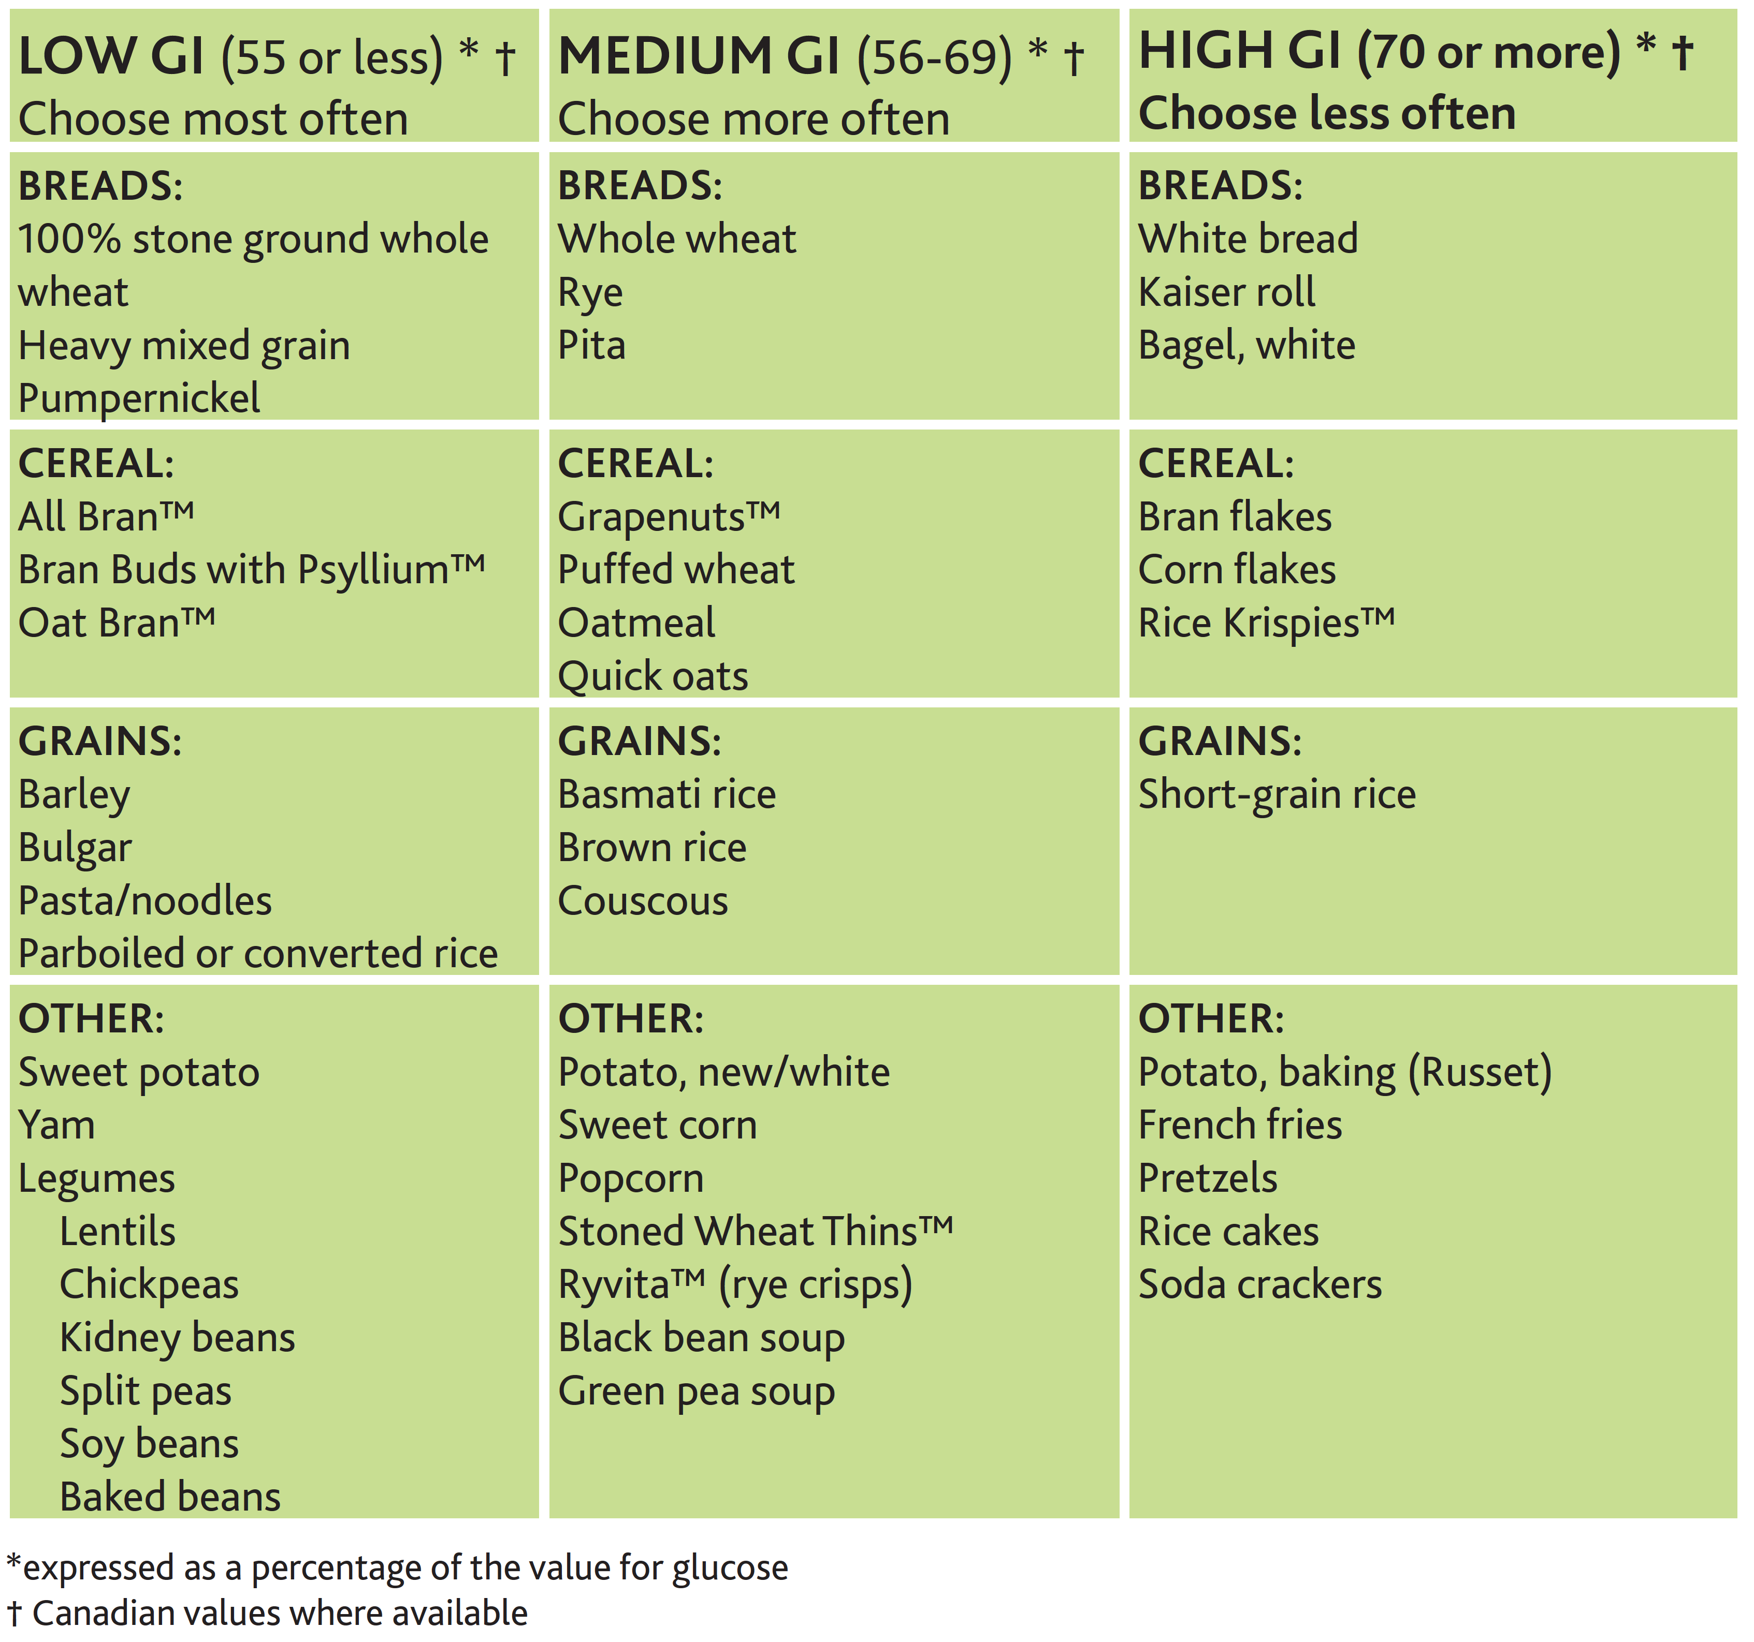
Choose low glycemic index carbohydrates
2018 Diabetes Canada CPG – Chapter 11. Nutrition
www.guidelines.diabetes.ca
Notes:
11

Slide 12
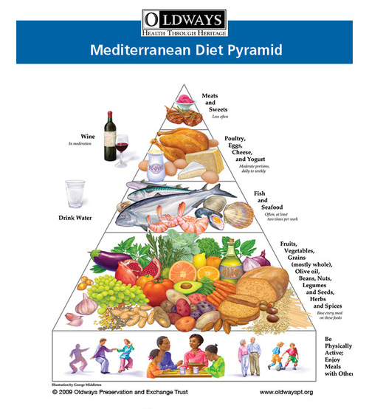
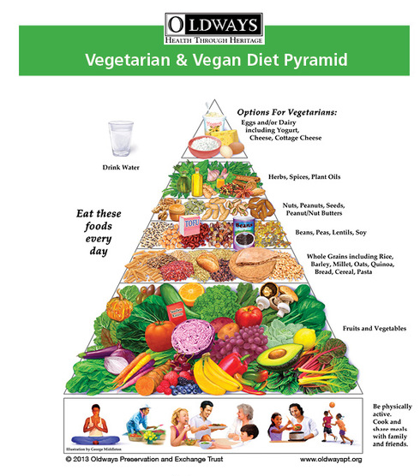
Choose “healthy” dietary patterns
2018 Diabetes Canada CPG – Chapter 11. Nutrition
Mediterranean diet
Vegetarian diet
https://oldwayspt.org/traditional-diets/mediterranean-diet
https://oldwayspt.org/traditional-diets/vegetarian-vegan-diet
Notes:
12

Slide 13
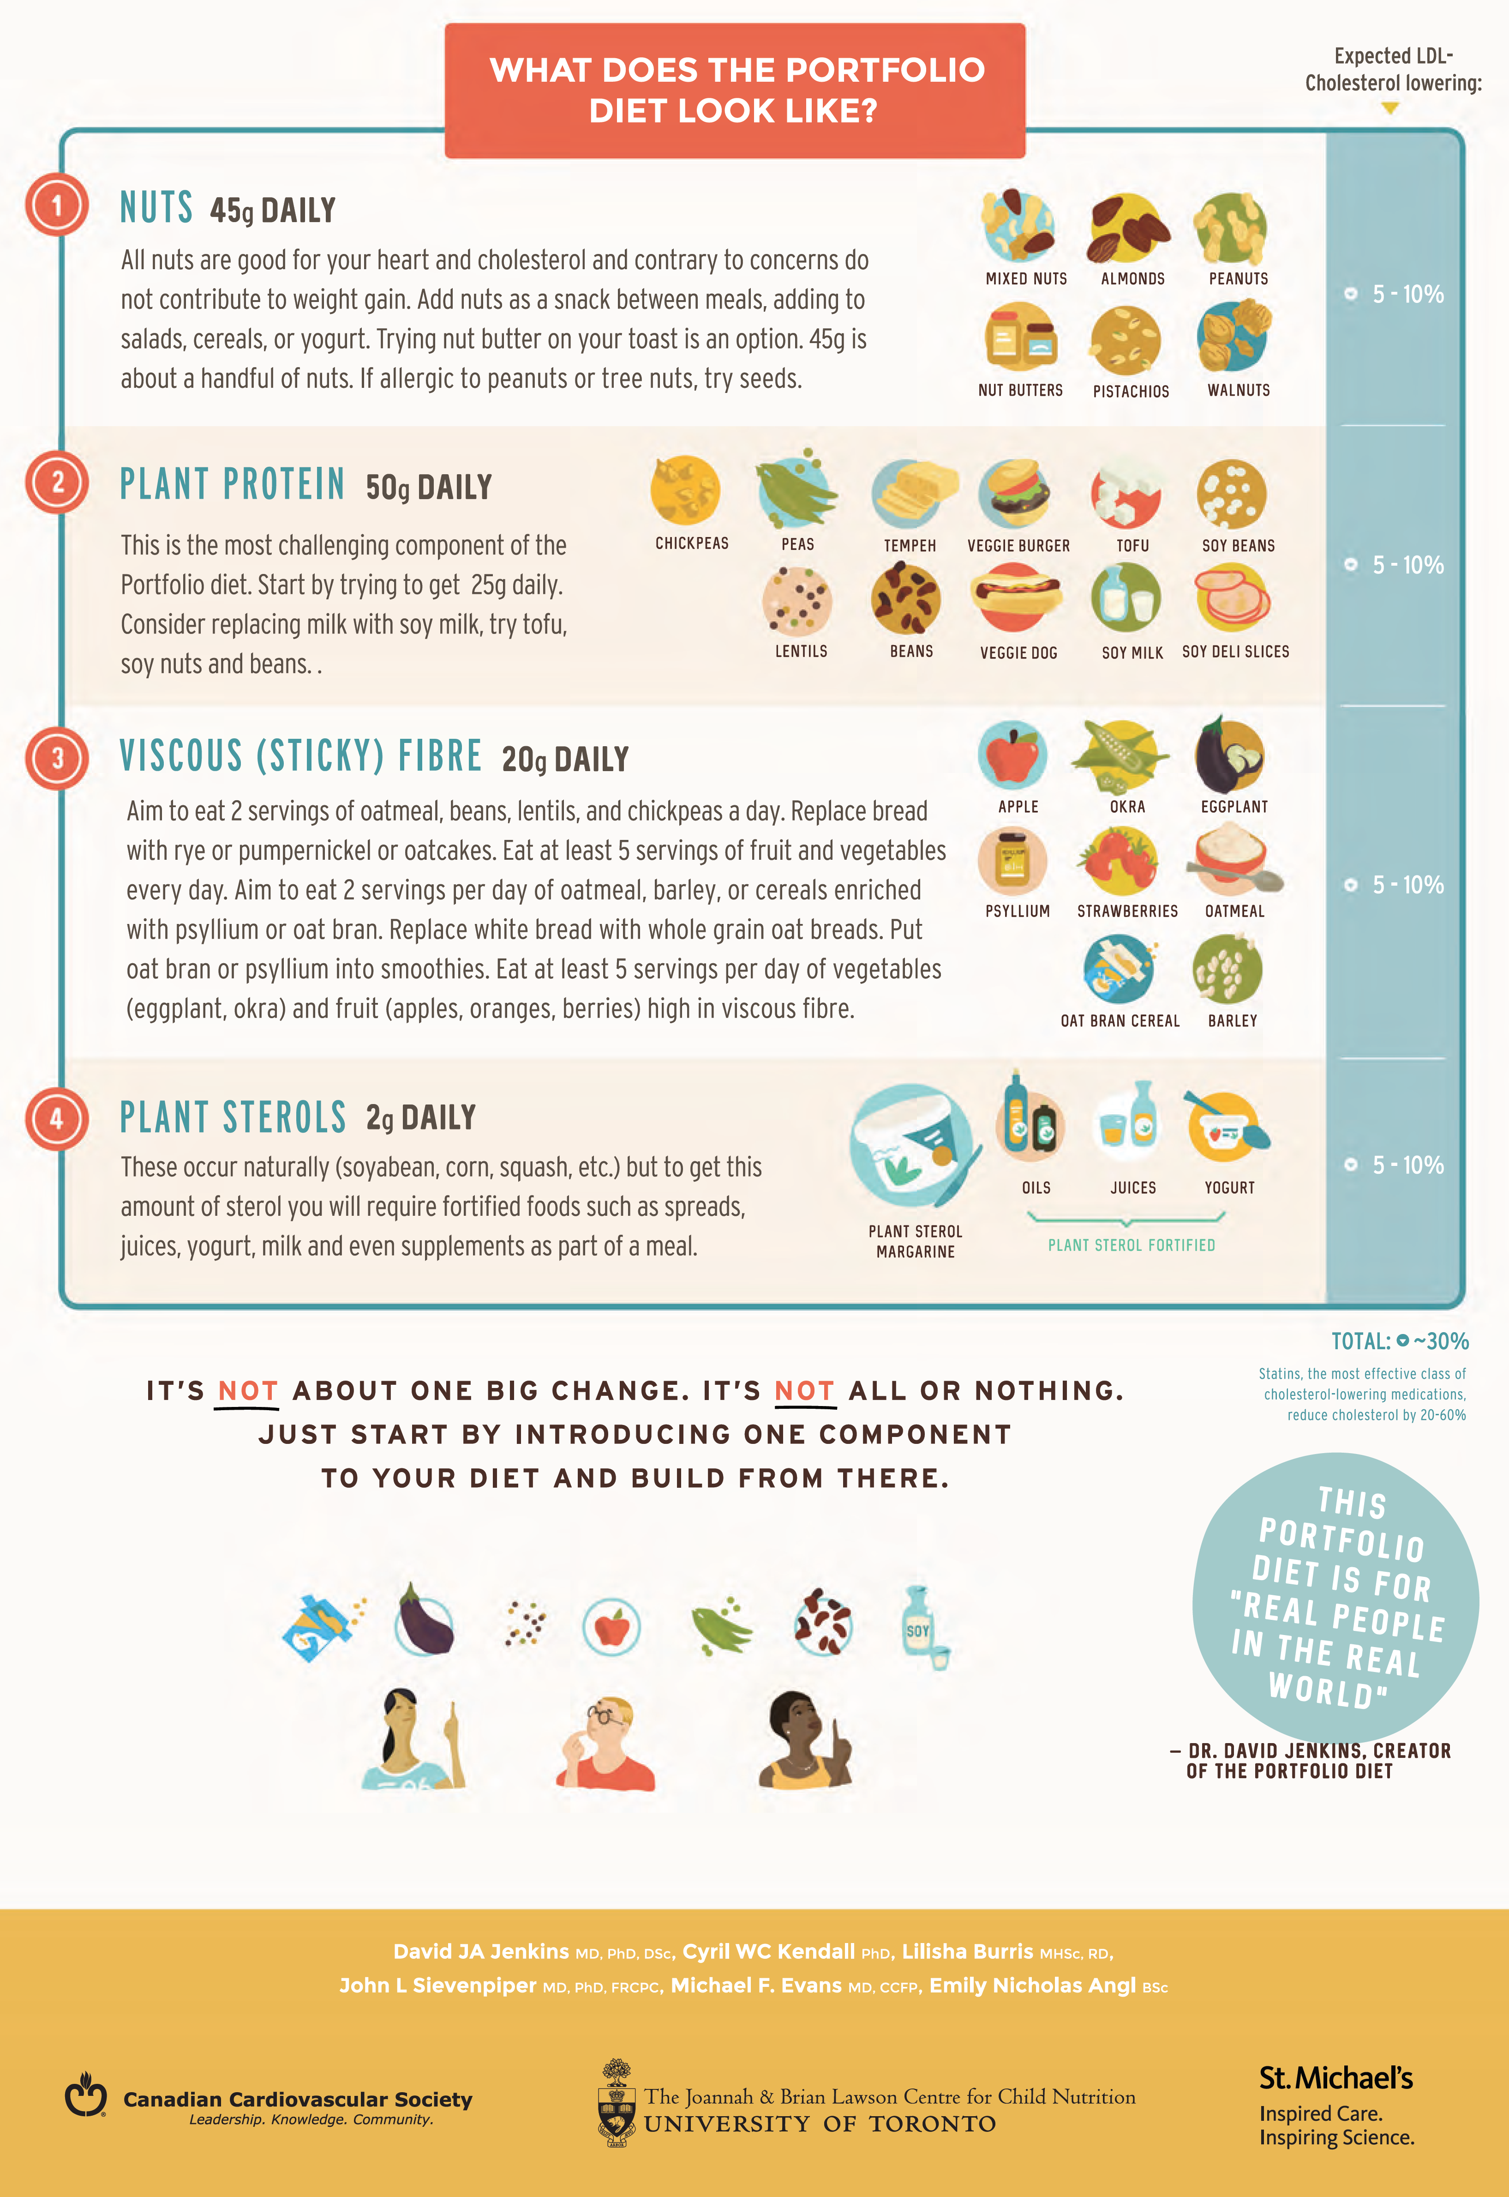
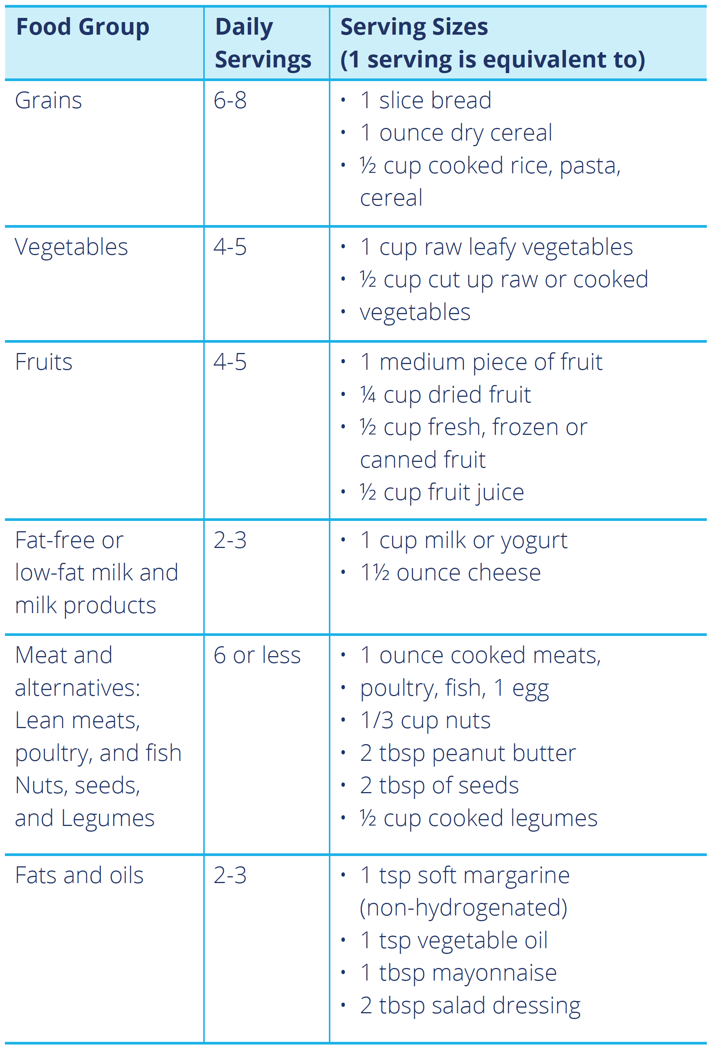
Choose “healthy” dietary patterns
2018 Diabetes Canada CPG – Chapter 11. Nutrition
Portfolio diet
DASH diet
http://guidelines.diabetes.ca/cdacpg/media/documents/patient-resources/high-blood-pressure-and-diabetes.pdf
https://www.ccs.ca/images/Images_2017/Portfolio_Diet_Scroll_eng.pdf
Notes:
13

Slide 14
For People with BMI ≥25 kg/m²…
2018 Diabetes Canada CPG – Chapter 11. Nutrition
Nutritionally balanced, calorie-reduced diet should be followed to achieve and maintain a lower, healthier body weight
Weight loss of 5-10% of initial body weight
Improved insulin sensitivity, glycemic control, blood pressure control, lipid levels
Notes:
14

Slide 15
Nutritional management of hyperglycemia in type 2 diabetes
2018 Diabetes Canada CPG – Chapter 11. Nutrition
Clinical assessment
Healthy behaviour interventions by Registered Dietitan
Initiate intensive healthy behaviour interventions or energy restriction and increased physical activity to achieve/maintain a healthy body weight
Provide counselling on a diet best suited to the individual based on values, preferences, and treatment goals using the advantages/disadvantages listed in Table 1
If not at target
Continue healthy behaviour interventions and add pharmacotherapy
Timely adjustments to healthy behaviour interventions and/or pharmacotherapy should be made to attain A1C within 2 to 3 months for healthy behaviour interventions alone or 3 to 6 months for any combination with pharmacotherapy

Slide 16
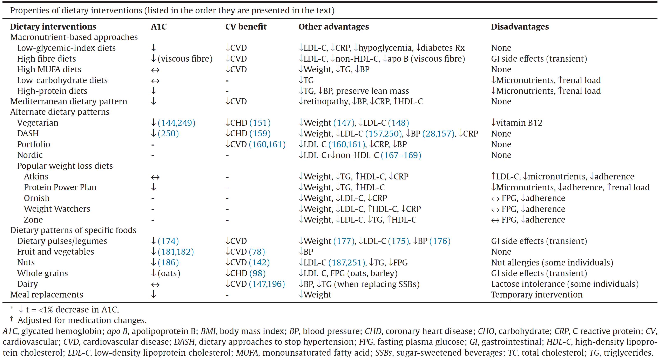
Table 1. Properties of dietary interventions

Slide 17
Stage-Targeted Strategies for Type 2 diabetes
Prediabetes | Early type 2 diabetes | Not on insulin | On basal insulin only
Weight loss or maintenance* Portion control Guidance to include low GI CHO and reduce refined CHO Physical activity | Weight loss or maintenance* Portion control Low GI CHO High fibre CHO distribution Dietary pattern of choice ** Physical activity | Weight loss or maintenance* Portion control CHO distribution Low GI CHO High fibre Dietary pattern of choice ** Physical activity | Portion control Weight loss or maintenance* CHO consistency Low GI CHO High fibre Dietary pattern of choice ** Physical activity
 |  |  | On basal-bolus therapy
 |  |  | Portion control Weight loss or maintenance* CHO consistency initially then learn CHO counting Low GI CHO High fibre Dietary pattern of choice ** Physical activity
*as appropriate
**dietary patterns include Mediterranean, vegetarian, DASH, Portfolio and Nordic dietary patterns, as well as diets emphasizing specific foods (i.e. dietary pulses, fruits and vegetables, nuts, whole grains and dairy products), which have evidence of benefit for people with diabetes

Slide 18
Recommendations 1-2
2018 Diabetes Canada CPG – Chapter 11. Nutrition
People with diabetes should receive nutrition counselling by a registered dietitian to lower A1C levels [Grade B, Level 2], for those with type 2 diabetes; Grade D, Consensus, for type 1 diabetes] and to reduce hospitalization rates [Grade C, Level 3]
Nutrition education may be delivered in either small group or one-on-one setting [Grade B, Level 2]. Group education should incorporate adult education principles, such as hands-on activities, problem solving, role playing and group discussions [Grade B, Level 2]

Slide 19
Recommendations 3-5
2018 Diabetes Canada CPG – Chapter 11. Nutrition
Individuals with diabetes should be encouraged to follow Eating Well with Canada's Food Guide in order to meet their nutritional needs [Grade D, Consensus]
In people with overweight or obesity with diabetes, a nutritionally balanced, calorie-reduced diet should be followed to achieve and maintain a lower, healthier body weight [Grade A, Level 1A]
An intensive healthy behaviour intervention program, combining dietary modification and increased physical activity, may be used to achieve weight loss, improve glycemic control and reduce CV risk [Grade A, Level 1A]
CV, cardiovascular

Slide 20
Recommendations 6-7
2018 Diabetes Canada CPG – Chapter 11. Nutrition
In adults with diabetes, the macronutrient distribution as a percentage of total energy can range from 45 to 60% carbohydrate, 15 to 20% protein and 20 to 35% fat to allow for individualization of nutrition therapy based on preferences and treatment goals [Grade D, Consensus]
People with type 2 diabetes should maintain regularity in timing and spacing of meals to optimize glycemic control [Grade D, Level 4]

Slide 21
Recommendation 8
2018 Diabetes Canada CPG – Chapter 11. Nutrition
2018
8. To reduce the risk of CVD, adults with diabetes should avoid trans fatty acids (TFA) [Grade D, Level 4] and consume less than 9% of total daily energy from saturated fatty acids (SFA) [Grade C, Level 2] replacing these fatty acids with polyunsaturated fatty acids (PUFA) particularly mixed n-3/n-6 sources [Grade C, Level 3], monounsaturated fatty acids (MUFA) from plant sources, whole grains [Grade D, Consensus], or low GI carbohydrates [Grade D, Consensus]
CVD, cardiovascular disease; GI, glycemic index

Slide 22
Recommendation 9
2018 Diabetes Canada CPG – Chapter 11. Nutrition
9. Adults with diabetes may substitute added sugars (sucrose, high fructose corn syrup, fructose, glucose) with other carbohydrates as part of mixed meals up to a maximum of 10% of total daily energy intake, provided adequate control of BG, lipids, and body weight is maintained [Grade C, Level 3]
BG, blood glucose

Slide 23
Recommendation 10
2018 Diabetes Canada CPG – Chapter 11. Nutrition
2018
10. Adults with type 1 and type 2 diabetes may aim to consume 30 to 50 g/day of dietary fibre with a third or more (10 to 20 g/day) coming from soluble dietary fibre to improve glycemic control [Grade C, Level 3], and LDL-C [Grade C, Level 3], and reduce CV risk [Grade D, Level 4]

Slide 24
Recommendation 11
2018 Diabetes Canada CPG – Chapter 11. Nutrition
2018
CV, cardiovascular; GI, glycemic index
11. Adults with diabetes should select carbohydrate food sources with a low GI to help optimize glycemic control [Grade B, Level 2 for type 1 diabetes; Grade B, Level 2 for type 2 diabetes, to improve LDL-C [Grade C, Level 3], and to decrease CV risk [Grade D, Level 4]

Slide 25
Recommendation 12
2018 Diabetes Canada CPG – Chapter 11. Nutrition
2018
12. The following dietary patterns may be considered in people with type 2 diabetes incorporating patient preferences including:
  Mediterranean-style dietary pattern to reduce major CV events [Grade A, Level 1A] and improve glycemic control [Grade B, Level 2]
  Vegan or vegetarian dietary pattern to improve glycemic control [Grade B, Level 2], body weight [Grade C, Level 3], and blood lipids including LDL-C [Grade B, Level 2], and reduce myocardial infarction [Grade B, Level 2]
  Dietary Approaches to Stop Hypertension (DASH) dietary pattern to improve glycemic control [Grade C, Level 2], BP [Grade D, Level 4], and LDL-C [Grade B, Level 2], and reduce major CV events [Grade B, Level 3]
  Dietary patterns emphasizing dietary pulses (e.g., beans, peas, chickpeas, lentils) to improve glycemic control [Grade B, Level 2], systolic BP [Grade C, Level 2] and body weight [Grade B, Level 2]
  Dietary patterns emphasizing fruit and vegetables to improve glycemic control [Grade B, Level 2] and reduce CV mortality [Grade C, Level 3]
  Dietary patterns emphasizing nuts to improve glycemic control [Grade B, Level 2], and LDL-C [Grade B, Level 2]
CV, cardiovascular

Slide 26
Recommendation 13-14
2018 Diabetes Canada CPG – Chapter 11. Nutrition
People with type 1 diabetes may be taught how to match insulin to carbohydrate quantity and quality [Grade C, Level 2] or they may maintain consistency in carbohydrate quantity and quality [Grade D, Consensus]
People with diabetes using insulin and/or insulin secretagogues should be educated about the risk of hypoglycemia resulting from alcohol [Grade C, Level 3], and should be advised on preventive actions such as carbohydrate intake and/or insulin dose adjustments and increased BG monitoring [Grade D, Consensus]
BG, blood glucose

Slide 27
Key Messages
2018 Diabetes Canada CPG – Chapter 11. Nutrition
People with diabetes should receive nutrition counselling by a registered dietitian
Nutrition therapy can reduce A1C by 1.0% to 2.0% and, when used with other components of diabetes care, can further improve clinical and metabolic outcomes
Reduced caloric intake to achieve and maintain a healthier body weight should be a treatment goal for people with diabetes with overweight or obesity
The macronutrient distribution is flexible within recommended ranges and will depend on individual treatment goals and preferences

Slide 28
Key Messages
2018 Diabetes Canada CPG – Chapter 11. Nutrition
Replacing high glycemic index carbohydrates with low glycemic index carbohydrates in mixed meals has a clinically significant benefit for glycemic control in people with type 1 and type 2 diabetes
Consistency in spacing and intake of carbohydrate and in spacing and regularity in meal consumption may help control blood glucose and weight
Intensive healthy behaviour interventions in people with type 2 diabetes can produce improvements in weight management, fitness, glycemic control and CV risk factors
CV, cardiovascular

Slide 29
Key Messages
2018 Diabetes Canada CPG – Chapter 11. Nutrition
A variety of dietary patterns and specific foods have been shown to be of benefit in people with type 1 and type 2 diabetes
People with diabetes should be encouraged to choose the dietary pattern that best aligns with their values, preferences, and treatment goals, allowing them to achieve the greatest adherence over the long term

Slide 30
Key Messages for People with Diabetes
2018 Diabetes Canada CPG – Chapter 11. Nutrition
It is natural to have questions about what food to eat. A registered dietitian can help you develop a personalized meal plan that considers your culture and nutritional preferences to help you achieve your blood glucose and weight management goals
Food is key in the management of diabetes and reducing the risk of heart attack and stroke

Slide 31
Key Messages for People with Diabetes
Try to prepare more of your meals at home and use fresh unprocessed ingredients
Try to prepare meals and eat together as a family. This is a good way to model healthy food behaviours to children and teenagers which could help reduce their risk of becoming overweight or developing diabetes

Slide 32
Key Messages for People with Diabetes
2018 Diabetes Canada CPG – Chapter 11. Nutrition
With prediabetes and recently diagnosed type 2 diabetes, weight loss is the most important and effective dietary strategy if you are overweight or obese. A weight loss of 5% to 10% of your body weight may help normalize blood glucose levels
There are many strategies that can help with weight loss. The best strategy is one that you are able to maintain long term

Slide 33

Visit guidelines.diabetes.ca

Slide 34


Or download the App

Slide 35
Diabetes Canada Clinical Practice Guidelines
http://guidelines.diabetes.ca – for health-care providers
1-800-BANTING (226-8464)
http://diabetes.ca – for people with diabetes

