Slide 1
Neuropathy
2018 Clinical Practice Guidelines
Chapter 31
Vera Bril MD FRCPC, Ari Breiner MD FRCPC,
Bruce Perkins MD MPH FRCPC, Douglas Zochodne MD FRCPC

Slide 2
Disclaimer
All Content contained on this slide deck is the property of Diabetes Canada, its content suppliers or its licensors as the case may be, and is protected by Canadian and international copyright, trademark, and other applicable laws. Diabetes Canada grants personal, limited, revocable, non-transferable and non-exclusive license to access and read content in this slide deck for personal, non-commercial and not-for-profit use only. The slide deck is made available for lawful, personal use only and not for commercial use.
The unauthorized reproduction, distribution of this copyrighted work is not permitted.
For permission to use this slide deck for commercial or any use other than personal, please contact guidelines@diabetes.ca

Slide 3
Key Changes
2018 Diabetes Canada CPG – Chapter 31. Neuropathy
2018
New information on
  Diagnosis and management of diabetic autonomic neuropathy

Slide 4
Neuropathy Checklist
2018 Diabetes Canada CPG – Chapter 31. Neuropathy
PREVENT with blood glucose control
SCREEN with monofilament or tuning fork
TREAT pain symptoms with anticonvulsants or antidepressants
Notes:
Use Geetha’s check marks
4

Slide 5
40-50% of People with Diabetes will have Detectable Neuropathy within 10 years
2018 Diabetes Canada CPG – Chapter 31. Neuropathy
Sensorimotor poly- or mono-neuropathy
Increased risk for:
  Foot ulceration and amputation
  Neuropathic pain
  Significant morbidity
  Usage of healthcare resources
Notes:
5

Slide 6
Risk Factors
2018 Diabetes Canada CPG – Chapter 31. Neuropathy
Elevated blood glucose
Elevated triglycerides
High BMI
Smoking
Hypertension
BMI, body mass index
Notes:
6

Slide 7
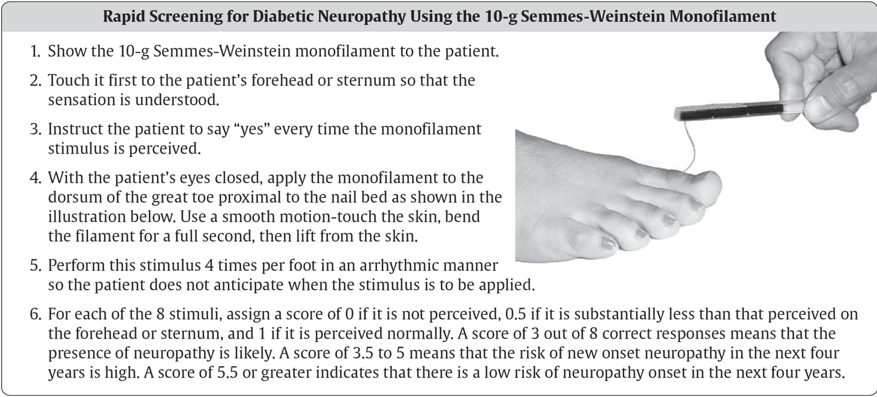
Screening for Diabetic Neuropathy
2018 Diabetes Canada CPG – Chapter 31. Neuropathy
Refer to neurology if non-diabetic neuropathy is suspected
Notes:
7

Slide 8
Alternative Screening for Protective Sensation Using The 10 gram Monofilament
How to perform the sensory examination:
Conduct in a quiet and relaxed setting.
Begin by applying the monofilament to the hands, elbow or forehead so that patient what to expect.
Ensure that the patient can not see whether or where the monofilament is being applied.
Test the three sites on both feet shown in the figure.
Modified from: Schaper NC, Van Netten JJ, Apelqvist J, Lipsky BA, Bakker K; International Working Group on the Diabetic Foot. Prevention and management of foot problems in diabetes: A Summary Guidance for Daily Practice 2015, based on IWGDF Guidance Documents. Diabetes Metab Res Rev 2016;32 Suppl 1:7-15

Slide 9
Alternative Screening for Protective Sensation Using The 10 gram Monofilament
A
B
How to Apply the monofilament:
Repeat this application twice at the same site, but alternate this with at least one ‘mock’ application in which no filament is applied (total three questions per site). Protective sensation is present at each site if the patient correctly answers two out of three applications. Incorrect answers – the patient is then considered to be Protective sensation is absent with two out of three at risk of ulceration.
Modified from: Schaper NC, Van Netten JJ, Apelqvist J, Lipsky BA, Bakker K; International Working Group on the Diabetic Foot. Prevention and management of foot problems in diabetes: A Summary Guidance for Daily Practice 2015, based on IWGDF Guidance Documents. Diabetes Metab Res Rev 2016;32 Suppl 1:7-15

Slide 10
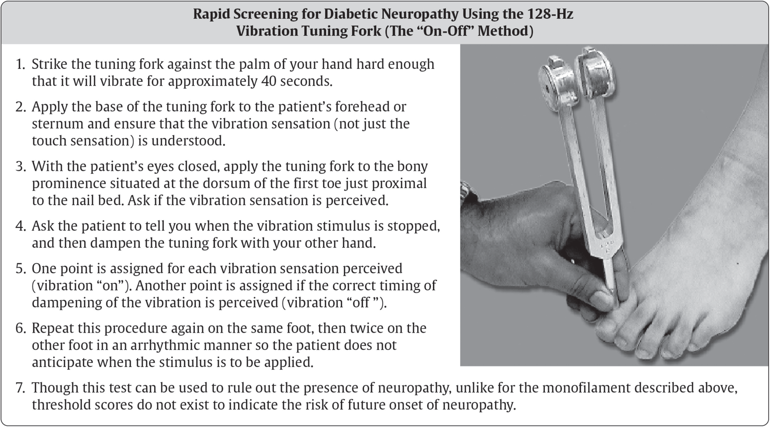
Screening for Diabetic Neuropathy
2018 Diabetes Canada CPG – Chapter 31. Neuropathy
Refer to neurology if non-diabetic neuropathy is suspected
Notes:
10

Slide 11
Glycemic Control is the Only Disease-Modifying Treatment
2018 Diabetes Canada CPG – Chapter 31. Neuropathy
Glycemic control is effective for
  Primary prevention
  Secondary intervention (type 1 diabetes)
Notes:
11

Slide 12
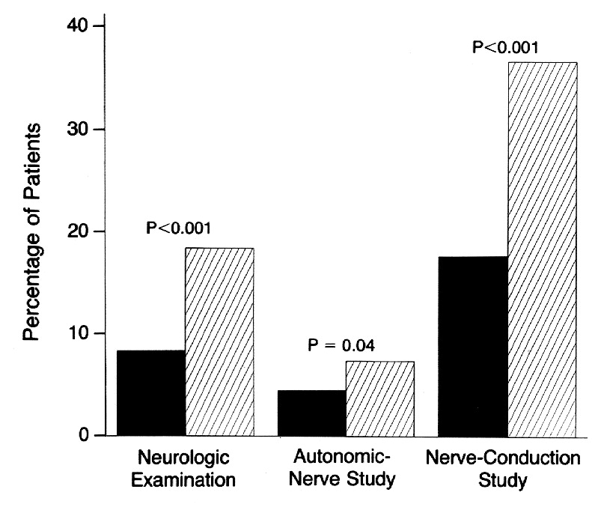
Reduction in Neuropathy with Intensive Glycemic Control
2018 Diabetes Canada CPG – Chapter 31. Neuropathy
Intensive
Standard
The Diabetes Control and Complications Trial Research Group. N Engl J Med 1993;329:977-986.
Notes:
N Engl J Med. 1993 Sep 30;329(14):977-86.
The effect of intensive treatment of diabetes on the development and progression of long-term complications in insulin-dependent diabetes mellitus. The Diabetes Control and Complications Trial Research Group.
[No authors listed]
Abstract
BACKGROUND:
Long-term microvascular and neurologic complications cause major morbidity and mortality in patients with insulin-dependent diabetes mellitus (IDDM). We examined whether intensive treatment with the goal of maintaining blood glucose concentrations close to the normal range could decrease the frequency and severity of these complications.
METHODS:
A total of 1441 patients with IDDM--726 with no retinopathy at base line (the primary-prevention cohort) and 715 with mild retinopathy (the secondary-intervention cohort) were randomly assigned to intensive therapy administered either with an external insulin pump or by three or more daily insulin injections and guided by frequent blood glucose monitoring or to conventional therapy with one or two daily insulin injections. The patients were followed for a mean of 6.5 years, and the appearance and progression of retinopathy and other complications were assessed regularly.
RESULTS:
In the primary-prevention cohort, intensive therapy reduced the adjusted mean risk for the development of retinopathy by 76 percent (95 percent confidence interval, 62 to 85 percent), as compared with conventional therapy. In the secondary-intervention cohort, intensive therapy slowed the progression of retinopathy by 54 percent (95 percent confidence interval, 39 to 66 percent) and reduced the development of proliferative or severe nonproliferative retinopathy by 47 percent (95 percent confidence interval, 14 to 67 percent). In the two cohorts combined, intensive therapy reduced the occurrence of microalbuminuria (urinary albumin excretion of > or = 40 mg per 24 hours) by 39 percent (95 percent confidence interval, 21 to 52 percent), that of albuminuria (urinary albumin excretion of > or = 300 mg per 24 hours) by 54 percent (95 percent confidence interval 19 to 74 percent), and that of clinical neuropathy by 60 percent (95 percent confidence interval, 38 to 74 percent). The chief adverse event associated with intensive therapy was a two-to-threefold increase in severe hypoglycemia.
CONCLUSIONS:
Intensive therapy effectively delays the onset and slows the progression of diabetic retinopathy, nephropathy, and neuropathy in patients with IDDM.
12

Slide 13
Many Treatment Options Exist for Neuropathic Pain
2018 Diabetes Canada CPG – Chapter 31. Neuropathy
Treatment for Neuropathic Pain
First Line | Anticonvulsants Antidepressants
Second Line | Opioids*
Other | Topical nitrate Capsaicin Transcutaneous electrical nerve stimulation
* Opioid use should be selective, after other options have failed to be effective, and clinicians must be aware of the risks of tolerance, abuse, dependency and addiction
Notes:
13

Slide 14
Anticonvulsants for Neuropathic Pain
2018 Diabetes Canada CPG – Chapter 31. Neuropathy
Medication | Starting Dose | Titration | Maximal Dose | Starting Cost
Gabapentin‡ [Grade B, Level 2] | 300 mg bid or qhs | 600 mg qid | 3,600 mg/d | BID: $24.34/mo QD: $18.32
Pregabalin [Grade A, Level 1] | 75 mg bid | 300 mg bid | 600 mg/d | $98.77/mo
Valproate‡ [Grade B, Level 2] | 250 mg bid | 500 mg bid | 1,500 mg/d | $12.37/mo
‡This drug is not currently approved by Health Canada for the management of neuropathic pain associated with diabetic peripheral neuropathy.
Backonja M, JAMA 1998; Gilron J, NEJM 2005; Rosenstock J, Pain 2004; Lesser H, Neur 2004; Richter RW, J Pain 2005; Satoh J, Diabetic Med 2011; Kochar DK Acta Neurol Scand 2002; Kochar DK, QJM 2004
Notes:
14

Slide 15
Antidepressants for Neuropathic Pain
2018 Diabetes Canada CPG – Chapter 31. Neuropathy
Medication | Starting Dose | Titration | Maximal Dose | Starting Cost
Amitriptyline‡ [Grade B, Level 2] | 10 mg qhs | 100 mg qhs | 150 mg/d | $14.49/mo
Duloxetine [Grade B, Level 2] | 30 mg od | 60 mg po od | 120 mg/d | $28.22/mo
Venlafaxine‡ [Grade B, Level 2] | 37.5 mg bid | 150 mg po bid | 300 mg/d | $23.16/mo
‡This drug is not currently approved by Health Canada for the management of neuropathic pain associated with diabetic peripheral neuropathy.
Max MB, Neurology 1987; Max MB, NEJM 1992; Raskin J, Pain Med 2005; Yasuda H, J Diab Inv 2011; Rowbotham MC Pain 2004.
Notes:
15

Slide 16
Opioids for Neuropathic Pain
2018 Diabetes Canada CPG – Chapter 31. Neuropathy
Although the following agents have demonstrated efficacy for neuropathic pain, their use should be selective, after other options have failed to be effective, and clinicians must be aware of the risks of tolerance, abuse, dependency and addiction. The limited use of these agents should follow the principles of the 2017 Canadian Guidelines for Opioids for Chronic Non-Cancer Pain
Medication | Starting Dose | Titration | Maximal Dose | Starting Cost
Dextromethorphan [Grade B, Level 2] | 100 mg qid | 200 mg qid | 960 mg/d | Requires compounding
Morphine SR [Grade B, Level 2] | 15 mg bid | 60 mg bid | 180 mg/d | $27.61/ mo
Oxycodone ER [Grade B, Level 2] | 10 mg bid | 40 mg bid | 160 mg/d | $42.60/ mo
Tapentadol ER [Grade B, Level 2] | 100 mg bid | 250 mg bid | 500 mg/d | $118.49
Tramadol [Grade B, Level 2] | 50 mg qid | 50 mg qid | 400 mg/d | $100.45/ mo
Sang CN Anesthesiology 2002; Gilron I, NEJM 2005; Gimbel JS Neurology 2003; Harati Y, Neurology 1998.
Notes:
16

Slide 17
Other Treatments for Neuropathic Pain
Medication | Starting Dose | Titration | Maximal Dose | Starting Cost
Topical nitrate sprays [Grade B, Level 2] | 30 mg spray to legs QHS | 30 mg spray to legs bid | 60 mg/d
Capsaicin cream | 0.075% cream applied tid-qid | 5-6 times per day | 5-6 times /day | $17.99
Transcutaneous electrical nerve stimulation | - | - | - | -
Yuen KC Diabetes Care 2002; Agrawal RP Diabetes Res Clin Pract 2007; Agrawal RP Diabetes Res Clin Pract 2009; Low PA Pain 1995; Capsaicin Group Arch Intern Med 1991; Hamza MA, Diabetes Care 2000.
Notes:
17

Slide 18


Treatments for Neuropathic Pain have Limited Effects
2018 Diabetes Canada CPG – Chapter 31. Neuropathy
Few patients have complete relief
30-50% reduction in pain considered to be clinically meaningful
Pain Reduction
Minimum Pain
Maximum Pain
-50%
-30%
Notes:
18

Slide 19
Recommendation 1
2018 Diabetes Canada CPG – Chapter 31. Neuropathy
In people with type 2 diabetes, screening for peripheral neuropathy should begin at diagnosis of diabetes and occur annually thereafter [Grade D, Consensus]. In people with type 1 diabetes, annual screening should commence after 5 years’ post-pubertal duration of diabetes [Grade D, Consensus]

Slide 20
Recommendation 2
2018 Diabetes Canada CPG – Chapter 31. Neuropathy
2. Screening for peripheral neuropathy should be conducted by assessing loss of sensitivity to the 10-g monoﬁlament or loss of sensitivity to vibration at the dorsum of the great toe [Grade A, Level 1] (see Appendix. Rapid Screening for Diabetic Neuropathy)

Slide 21
Recommendation 3
2018 Diabetes Canada CPG – Chapter 31. Neuropathy
People with diabetes should be treated with intensified glycemic control to prevent the onset and progression of neuropathy [Grade A, Level 1A for type 1 diabetes; Grade B, Level 2 for type 2 diabetes]

Slide 22
Recommendation 4
2018 Diabetes Canada CPG – Chapter 31. Neuropathy
2018
4. The following agents may be used alone or in combination for relief of painful peripheral neuropathy:
  Anticonvulsants (pregabalin [Grade A, Level 1], gabapentin* [Grade B, Level 2], valproate* [Grade B, Level 2]
  Antidepressants (amitriptyline*, duloxetine, venlafaxine*) [Grade B, Level 2]
  Topical nitrate spray* [Grade B, Level 2]
  In people not responsive to the above agents, opioid analgesics (tramadol, tapentadol ER, oxycodone ER) may be used [Grade B, Level 2]. Prescribers should be cautious due to risks of abuse, dependency and tolerance, and follow the recommendations of the 2017 Canadian Guidelines for Opioids for Chronic Non-Cancer Pain [Grade D, Consensus]
*Denotes that this drug is not currently approved by Health Canada for the management of neuropathic pain associated specifically with diabetic peripheral neuropathy

Slide 23
Key Messages
2018 Diabetes Canada CPG – Chapter 31. Neuropathy
Elevated blood glucose levels, elevated triglycerides, high body mass index, smoking and hypertension are risk factors for neuropathy
Intensive glycemic control is effective for the primary prevention or secondary intervention of neuropathy in people with type 1 diabetes

Slide 24
Key Messages
2018 Diabetes Canada CPG – Chapter 31. Neuropathy
In people with type 2 diabetes, lower blood glucose levels are associated with a reduced frequency of neuropathy
Simple physical examination screening tests, such as the 10-g monoﬁlament (on the dorsal aspect of the great toe bilaterally) and vibration perception (with 128-Hz tuning fork), perform reasonably well for the identiﬁcation of neuropathy and prediction of its future onset

Slide 25
Key Messages for People with Diabetes
2018 Diabetes Canada CPG – Chapter 31. Neuropathy
Exposure to high blood glucose levels over an extended period of time can cause diabetic peripheral neuropathy or damage to the nerves that go to the feet, legs, and when markedly advanced, to the hands and arms
The most common symptoms of diabetic peripheral neuropathy are loss of sensations in the toes and feet, and presence of symptoms, such as sharp shooting pains, burning, tingling, a feeling of being pricked with pins, throbbing, and numbness

Slide 26
Key Messages for People with Diabetes
2018 Diabetes Canada CPG – Chapter 31. Neuropathy
Diabetic peripheral neuropathy increases the risk for foot ulcers and amputation
Your health-care provider or foot care specialist can test for diabetic peripheral neuropathy by lightly pressing a thin nylon rod (10-gram monofilament) and by using the 128-Hz tuning fork on the top surface of your big toe

Slide 27
Key Messages for People with Diabetes
2018 Diabetes Canada CPG – Chapter 31. Neuropathy
Although there is no cure, there are many ways you can effectively manage diabetic peripheral neuropathy, including:
  Proper foot care including daily foot inspection
  Effective blood glucose control
  Medications that may help with nerve pain

Slide 28
Key Messages for People with Diabetes
2018 Diabetes Canada CPG – Chapter 31. Neuropathy
Diabetic autonomic neuropathies affect the part of the nervous system responsible for control of internal body functions and may target the heart (cardiac autonomic neuropathy; CAN), gastrointestinal tract, and genitourinary system, and can cause sexual dysfunction

Slide 29

Visit guidelines.diabetes.ca

Slide 30


Or download the App

Slide 31
Diabetes Canada Clinical Practice Guidelines
www.guidelines.diabetes.ca – for health-care providers
1-800-BANTING (226-8464)
www.diabetes.ca – for people with diabetes
Notes:
31

