Slide 1
2018 Clinical Practice Guidelines
Pharmacologic Glycemic Management of Type 2 Diabetes
Chapter 13
Updated: April 27, 2018
Notes:
Welcome to the Pharmacologic Glycemic Management of Type 2 Diabetes chapter of the 2018 Diabetes Canada Clinical Practice Guidelines. My name is Dr. Robyn Houlden. I am professor and chair of the Division of Endocrinology at Queen’s University and had the pleasure of serving as chair of the 2018 Guidelines.
1

Slide 2
Disclaimer
All Content contained on this slide deck is the property of Diabetes Canada, its content suppliers or its licensors as the case may be, and is protected by Canadian and international copyright, trademark, and other applicable laws. Diabetes Canada grants personal, limited, revocable, non-transferable and non-exclusive license to access and read content in this slide deck for personal, non-commercial and not-for-profit use only. The slide deck is made available for lawful, personal use only and not for commercial use.
The unauthorized reproduction, distribution of this copyrighted work is not permitted.
For permission to use this slide deck for commercial or any use other than personal, please contact guidelines@diabetes.ca

Slide 3
Authorship
2018 Diabetes Canada CPG – Chapter 13. Pharmacologic Glycemic Management of Type 2 Diabetes
2013 Guideline 2015 Update | March 2016 Update | November 2016 Update | April 2018
William Harper | Ronald Goldenberg | Gillian Booth | Lorraine Lipscombe
Maureen Clement | Maureen Clement | Lorraine Lipscombe | Gillian Booth
Ronald Goldenberg | Amir Hanna | Kaberi Dasgupta | Sonia Butalia
Amir Hanna | William Harper | Dean Eurich | Kaberi Dasgupta
Andrea Main | Andrea Main | Ronald Goldenberg | Dean T Eurich
Ravi Retnakaran | Ravi Retnakaran | Nadia Khan | Ronald Goldenberg
Diana Sherafali | Diana Sherafali | Lori McCallum | Nadia Khan
Vincent Woo | Vincent Woo | Baiju Shah | Lori MacCallum
Jean-François Yale | Jean-François Yale | Scot Simpson | Baiju Shah
Alice Y. Y. Cheng | Alice Y.Y. Cheng | Robyn Houlden | Scot Simpson
Notes:
This version of this chapter used material from previous iterations, and this slide acknowledges authorship for the latest version as well as the 2013 guidelines and 2015 and 2016 updates. I would like to thank lead author Dr. Lorraine Lipscombe and her co-authors Gillian Booth, Sonia Butalia, Kaberi Dasgupta, Dean Eurich, Ron Goldenberg, Nadia Khan, Lori MacCallum, Baiju Shah, and Scot Simpson for their hard work.

Slide 4
Key Changes
2018 Diabetes Canada CPG – Chapter 13. Pharmacologic Glycemic Management of Type 2 Diabetes
2018
CV, cardiovascular
Updated algorithm on management of hyperglycemia in type 2 diabetes
New information and recommendations on
  Antihyperglycemic agents released after 2013
  CV outcome studies
Updated figure and appendix on antihyperglycemic agents and renal function
Notes:
Key changes in the 2018 chapter include
An updated algorithm on management of hyperglycemia in type 2 diabetes
New information and recommendations on
Antihyperglycemic agents released after 2013
CV outcome studies, as well as an
Updated figure and appendix on antihyperglycemic agents and renal function

Slide 5
Pharmacotherapy in Type 2 Diabetes Checklist
2018 Diabetes Canada CPG – Chapter 13. Pharmacologic Glycemic Management of Type 2 Diabetes
CHOOSE initial therapy based on glycemia
START with metformin +/- others
INDIVIDUALIZE your therapy choice based on characteristics of the person with diabetes and the agent
REACH TARGET within 3-6 months of diagnosis
Notes:
This slide shows a checklist illustrating some of the key principles in pharmacotherapy for glycemic management of type 2 diabetes.
These include
CHOOSE initial therapy based on degree of glycemia
START with metformin +/- other antihyperglycemic agents
INDIVIDUALIZE therapy based on characteristics of the person with diabetes and the antihyperglycemic agent
Make timely adjustments to attain target A1C within 3-6 months of diagnosis
5

Slide 6
Initial choice of therapy
2018 Diabetes Canada CPG – Chapter 13. Pharmacologic Glycemic Management of Type 2 Diabetes
Initiate healthy behavior interventions and start metformin if not at target in 3 months
OR
Start metformin with healthy behavior interventions
A1C <1.5% over target
Start metformin with healthy behavior interventions
AND
Consider second concurrent agent
A1C ≥ 1.5% over target
Notes:
A change from the 2013 guidelines is the next step is based on the patients individualized A1C target rather than an absolute value.
If the A1C is less than 1.5% above the patient’s individualized target A1C, initiate healthy behavior interventions and start metformin if not at target in 3 months
OR Start metformin with healthy behavior interventions
If the A1C is greater than or equal to 1.5% above the patient’s individualized target A1C, start metformin with healthy behaviour interventions
AND consider a second concurrent agent

Slide 7
Initial choice of therapy
2018 Diabetes Canada CPG – Chapter 13. Pharmacologic Glycemic Management of Type 2 Diabetes
Symptomatic Hyperglycemia
and/or
Metabolic Decompensation
Polyuria
Polydipsia
Weight loss
Volume depletion
Start INSULIN +/- metformin
Notes:
If the patient has symptomatic hyperglycemia and/or metabolic decompensation, insulin should be initiated alone or in combination with metformin. This includes patients with polyuria, polydipsia, weight loss, or volume depletion, or post treatment of diabetic ketoacidosis or hyperosmolar hyperglycemic state.

Slide 8
GET TO TARGET WITHIN
3-6 MONTHS
OF DIAGNOSIS
2018 Diabetes Canada CPG – Chapter 13. Pharmacologic Glycemic Management of Type 2 Diabetes
Notes:
A key message is to make timely adjustments to attain the patient’s individualized target A1C within 3-6 months of diagnosis
8

Slide 9
2018
AT DIAGNOSIS OF TYPE 2 DIABETES
HEALTHY BEHAVIOUR INTERVENTIONS
Start healthy behaviour interventions
(nutritional therapy, weight management, physical activity) +/- metformin
A1C <1.5% above target
A1C ≥1.5% above target
Symptomatic hyperglycemia and/or metabolic decompensation
If not at glycemic target within 3 months, start/increase metformin
Start metformin immediately
Consider a second concurrent antihyperglycemic agent
Initiate insulin +/-
metformin
If not at glycemic target
If not at glycemic target
Clinical CVD?
YES
NO
Start antihyperglycemic agent with demonstrated CV benefit
empagliflozin (Grade A, Level 1A)
liraglutide (Grade A, Level 1A)
canagliflozin* (Grade C, Level 2)
If not at glycemic target
See next page
* Avoid in people with prior lower extremity amputation
Notes:
This is the updated algorithm for management of type 2 diabetes in people with type 2 diabetes.
At the time of diagnosis of type 2 diabetes, healthy behaviour interventions should be initiated. This is new preferred term over “lifestyle modification”. These include nutritional therapy, weight management, and physical activity. This is also an option to start metformin.
A change from the 2013 guidelines is the next step is based on the patients individualized A1C target rather than an absolute value.
If the A1C is less than 1.5% above the patient’s target A1C, if they are not at glycemic target within 3 months of healthy behaviour interventions, metformin should be started or increased.
If the A1C is greater than or equal to 1.5% above target A1C, metfomin should be started immediately. A second concurrent antihyperglycemmic agent antihyperglycemic agent should be considered.
If the patient has symptomatic hyperglycemia and/or metabolic decompensation, insulin should be initiated alone or in combination with metformin. This includes patients with dehydration, diabetic ketoacidosis or hyperosmolar hyperglycemic state.
If the patient remains not at glycemic target, the first question to ask in choosing the second antihyperglycemic agent is whether the patient has clinical cardiovascular disease. Clinical cardiovascular disease is defined as history of myocardial infarction, coronary artery disease on angiography, unstable angina, stroke, peripheral artery disease)
If the patient has clinical cardiovascular disease, an antihyperglycemic agent with demonstrated CV benefit should be added. This recommendation is based on several cardiovascular safety outcome studies.
9

Slide 10
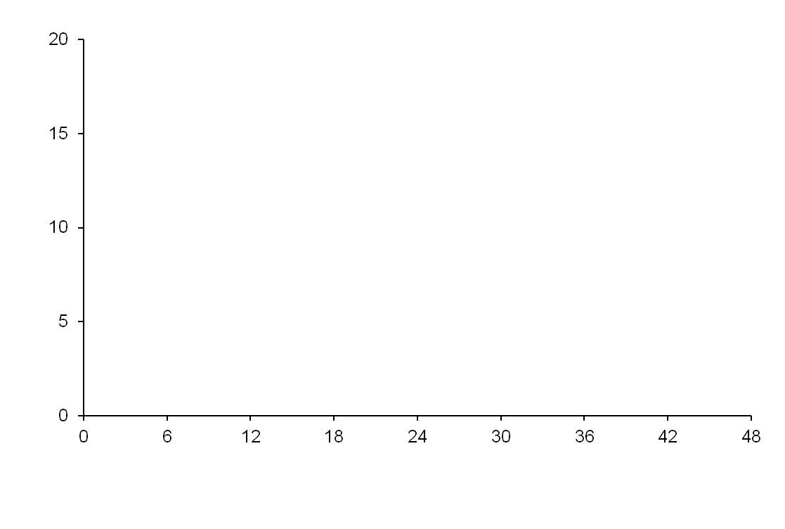
Empagliflozin reduced CV events
CV death, non-fatal MI, or non-fatal stroke
2018 Diabetes Canada CPG – Chapter 13. Pharmacologic Glycemic Management of Type 2 Diabetes
 | PBO | EMPA | HR | P | NNT3
CV death, MI, stroke (%) | 12.1 | 10.5 | 0.86 | 0.04 | 63
CV deaths (%) | 5.9 | 3.7 | 0.62 | <0.001 | 46
Nonfatal MI (%) | 5.2 | 4.5 | 0.87 | 0.22
Nonfatal stroke (%) | 2.6 | 3.2 | 1.24 | 0.16
Hosp. heart failure (%) | 4.1 | 2.7 | 0.65 | 0.002 | 72
All-cause mortality (%) | 8.3 | 5.7 | 0.68 | <0.001 | 39
Placebo
Empagliflozin
Patients with event (%)
HR 0.86
95.02% CI (0.74, 0.99)
P < 0.001 for non-inferiority
p=0.04 for superiority
Months
No. of patients
Empagliflozin | 4687 | 4580 | 4455 | 4328 | 3851 | 2821 | 2359 | 1534 | 370
Placebo | 2333 | 2256 | 2194 | 2112 | 1875 | 1380 | 1161 | 741 | 166
Zinman B et al. N Engl J Med 2015; DOI: 10.1056/NEJMoa1504720
Notes:
The EMPA-REG outcome study included 7020 people with type 2 diabetes and clinical cardiovascular disease. Those treated with empagliflozin had significantly fewer cardiovascular events compared to placebo after 3.1 years of followup, which was driven by a significant decrease in cardiovascular mortality as nonfatal events were not significantly reduced.
N Engl J Med. 2015 Nov 26;373(22):2117-28. doi: 10.1056/NEJMoa1504720. Epub 2015 Sep 17.
Empagliflozin, Cardiovascular Outcomes, and Mortality in Type 2 Diabetes.
Zinman B, Wanner C, Lachin JM, Fitchett D, Bluhmki E, Hantel S, Mattheus M, Devins T, Johansen OE, Woerle HJ, Broedl UC, Inzucchi SE; EMPA-REG OUTCOME Investigators.
Collaborators (705)
Abstract
BACKGROUND:
The effects of empagliflozin, an inhibitor of sodium-glucose cotransporter 2, in addition to standard care, on cardiovascular morbidity and mortality in patients with type 2 diabetes at high cardiovascular risk are not known.
METHODS:
We randomly assigned patients to receive 10 mg or 25 mg of empagliflozin or placebo once daily. The primary composite outcome was death from cardiovascular causes, nonfatal myocardial infarction, or nonfatal stroke, as analyzed in the pooled empagliflozin group versus the placebo group. The key secondary composite outcome was the primary outcome plus hospitalization for unstable angina.
RESULTS:
A total of 7020 patients were treated (median observation time, 3.1 years). The primary outcome occurred in 490 of 4687 patients (10.5%) in the pooled empagliflozin group and in 282 of 2333 patients (12.1%) in the placebo group (hazard ratio in the empagliflozin group, 0.86; 95.02% confidence interval, 0.74 to 0.99; P=0.04 for superiority). There were no significant between-group differences in the rates of myocardial infarction or stroke, but in the empagliflozin group there were significantly lower rates of death from cardiovascular causes (3.7%, vs. 5.9% in the placebo group; 38% relative risk reduction), hospitalization for heart failure (2.7% and 4.1%, respectively; 35% relative risk reduction), and death from any cause (5.7% and 8.3%, respectively; 32% relative risk reduction). There was no significant between-group difference in the key secondary outcome (P=0.08 for superiority). Among patients receiving empagliflozin, there was an increased rate of genital infection but no increase in other adverse events.
CONCLUSIONS:
Patients with type 2 diabetes at high risk for cardiovascular events who received empagliflozin, as compared with placebo, had a lower rate of the primary composite cardiovascular outcome and of death from any cause when the study drug was added to standard care. (Funded by Boehringer Ingelheim and Eli Lilly; EMPA-REG OUTCOME ClinicalTrials.gov number, NCT01131676.).
10

Slide 11
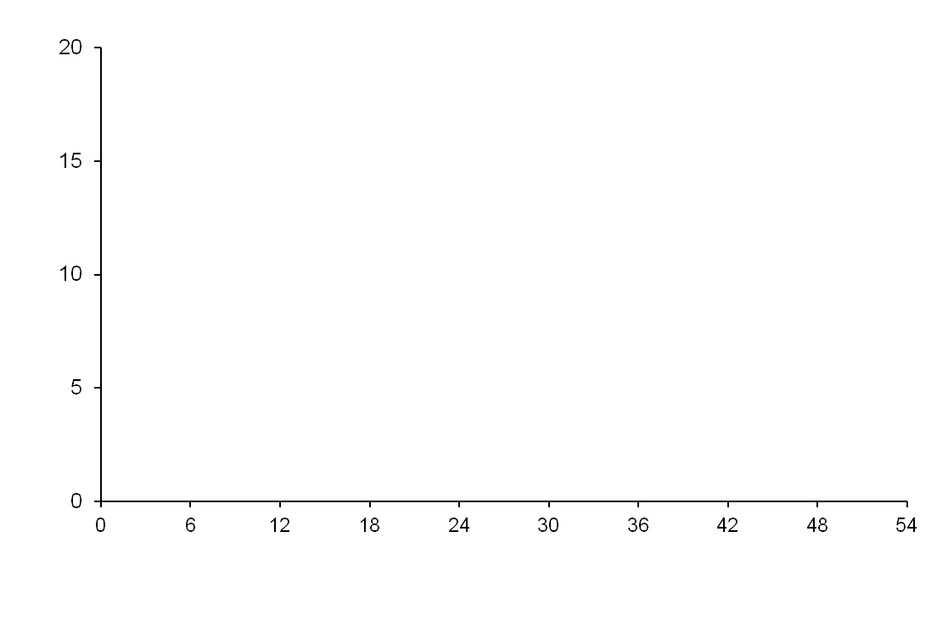
2018 Diabetes Canada CPG – Chapter 13. Pharmacologic Glycemic Management of Type 2 Diabetes
Liraglutide reduced CV events
CV death, non-fatal MI, or non-fatal stroke
 | PBO | LIRA | HR | P | NNT4
CV death, MI, stroke (%) | 14.9 | 13.0 | 0.87 | 0.01 | 53
CV death (%) | 6.0 | 4.7 | 0.78 | 0.007 | 77
Nonfatal MI (%) | 6.8 | 6.0 | 0.88 | 0.11
Nonfatal stroke (%) | 3.8 | 3.4 | 0.89 | 0.30
Hosp. heart failure (%) | 5.3 | 4.7 | 0.87 | 0.14
All-cause mortality (%) | 9.6 | 8.2 | 0.85 | 0.02 | 72
Placebo
Patients with event (%)
Liraglutide
HR 0.87
95.02% CI (0.78, 0.97)
P < 0.001 for non-inferiority
p=0.01 for superiority
Time from randomization (months)
Patients at risk
Liraglutide | 4668 | 4593 | 4496 | 4400 | 4280 | 4172 | 4072 | 3982 | 1562 | 424
Placebo | 4672 | 4588 | 4473 | 4352 | 4237 | 4123 | 4010 | 3914 | 1543 | 407
Marso SP et al. N Engl J Med 2016;375(4):311-22.
Notes:
The LEADER trial enrolled 9340 participants with type 2 diabetes and high CV risk. The majority of participants were 50 years of age or older and had at least 1 cardiovascular condition including coronary heart disease, cerebrovascular disease, peripheral arterial disease, congestive heart failure or stage 3 or higher chronic kidney disease. Over a median followup of 3.8 years, fewer participants in the liraglutide arm had the primary endpoint of cardiovascular death, nonfatal MI or nonfatal stroke. While the LEADER trial included some people with cardiovascular risk factors only, over 80% of participants had cardiovascular disease and only 10.5% of the primary events occurred in those without clinical disease. Therefore results are most applicable to people with clinical cardiovascular disease requiring add-on antihyperglycemic therapy.
N Engl J Med. 2016 Jul 28;375(4):311-22. doi: 10.1056/NEJMoa1603827. Epub 2016 Jun 13.
Liraglutide and Cardiovascular Outcomes in Type 2 Diabetes.
Marso SP, Daniels GH, Brown-Frandsen K, Kristensen P, Mann JF, Nauck MA, Nissen SE, Pocock S, Poulter NR, Ravn LS, Steinberg WM, Stockner M, Zinman B, Bergenstal RM, Buse JB; LEADER Steering Committee; LEADER Trial Investigators.
Collaborators (2302)
Abstract
BACKGROUND:
The cardiovascular effect of liraglutide, a glucagon-like peptide 1 analogue, when added to standard care in patients with type 2 diabetes, remains unknown.
METHODS:
In this double-blind trial, we randomly assigned patients with type 2 diabetes and high cardiovascular risk to receive liraglutide or placebo. The primary composite outcome in the time-to-event analysis was the first occurrence of death from cardiovascular causes, nonfatal myocardial infarction, or nonfatal stroke. The primary hypothesis was that liraglutide would be noninferior to placebo with regard to the primary outcome, with a margin of 1.30 for the upper boundary of the 95% confidence interval of the hazard ratio. No adjustments for multiplicity were performed for the prespecified exploratory outcomes.
RESULTS:
A total of 9340 patients underwent randomization. The median follow-up was 3.8 years. The primary outcome occurred in significantly fewer patients in the liraglutide group (608 of 4668 patients [13.0%]) than in the placebo group (694 of 4672 [14.9%]) (hazard ratio, 0.87; 95% confidence interval [CI], 0.78 to 0.97; P<0.001 for noninferiority; P=0.01 for superiority). Fewer patients died from cardiovascular causes in the liraglutide group (219 patients [4.7%]) than in the placebo group (278 [6.0%]) (hazard ratio, 0.78; 95% CI, 0.66 to 0.93; P=0.007). The rate of death from any cause was lower in the liraglutide group (381 patients [8.2%]) than in the placebo group (447 [9.6%]) (hazard ratio, 0.85; 95% CI, 0.74 to 0.97; P=0.02). The rates of nonfatal myocardial infarction, nonfatal stroke, and hospitalization for heart failure were nonsignificantly lower in the liraglutide group than in the placebo group. The most common adverse events leading to the discontinuation of liraglutide were gastrointestinal events. The incidence of pancreatitis was nonsignificantly lower in the liraglutide group than in the placebo group.
CONCLUSIONS:
In the time-to-event analysis, the rate of the first occurrence of death from cardiovascular causes, nonfatal myocardial infarction, or nonfatal stroke among patients with type 2 diabetes mellitus was lower with liraglutide than with placebo. (Funded by Novo Nordisk and the National Institutes of Health; LEADER ClinicalTrials.gov number, NCT01179048.).
11

Slide 12
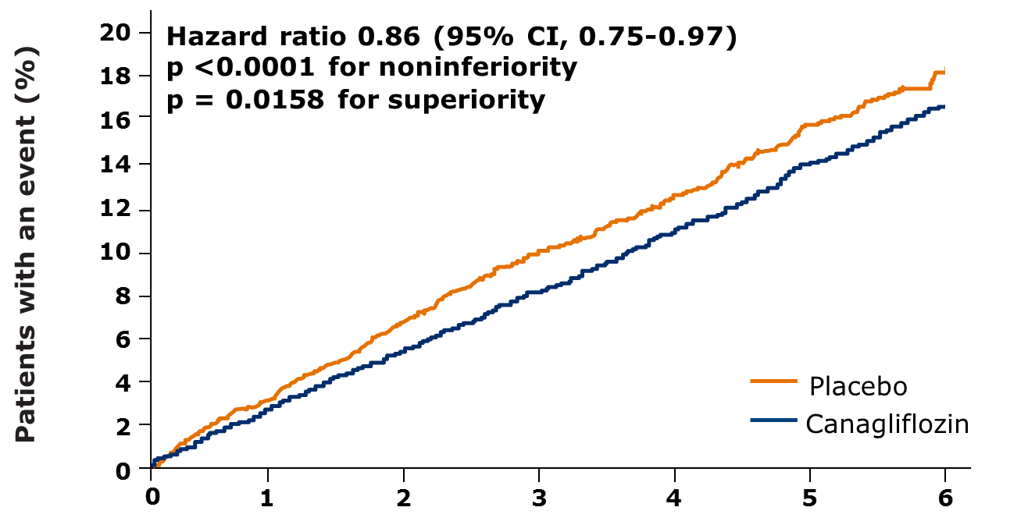
2018 Diabetes Canada CPG – Chapter 13. Pharmacologic Glycemic Management of Type 2 Diabetes
Canagliflozin reduced CV events
CV death, non-fatal MI, or non-fatal stroke
Outcome (per 1000 pt-y) | PBO | CANA | HR | P or 95% CI | NNT 5
CV death, MI, stroke | 31.5 | 26.9 | 0.86 | 0.02 | 44
CV deaths | 12.8 | 11.6 | 0.87 | (0.72-1.06)
Nonfatal MI | 11.6 | 9.7 | 0.85 | (0.69-1.05)
Nonfatal stroke | 8.4 | 7.1 | 0.90 | (0.71-1.15)
Hosp. heart failure | 8.7 | 5.5 | 0.67 | (0.52-0.87) | 63
All-cause mortality | 19.5 | 17.3 | 0.87 | (0.74-1.01)
Placebo
Canagliflozin
HR 0.86
95% CI (0.75, 0.97)
P < 0.001 for non-inferiority
p=0.02 for superiority
No. of patients
Canagliflozin | 5795 | 5566 | 4343 | 2555 | 2460 | 2363 | 1661
Placebo | 4347 | 4153 | 2942 | 1240 | 1187 | 1120 | 789
Neal B et al. N Engl J Med 2017; DOI:10.1056/NEJMoa1611925
Notes:
The CANVAS program which integrated findings from 2 placebo-controlled trials enrolled 10142 participants with type 2 diabetes who were 30 years or older with symptomatic cardiovascular disease OR 50 years of older with at least 2 cardiovascular risk factors. Over a median followup of 2.4 years, significantly fewer persons randomized to canagliflozin had the primary outcome of cardiovascular death, nonfatal MI, or nonfatal stroke. There were no statistical differences in the individual components of the composite outcome. While 1/3rd of participants did not have cardiovascular disase, a significant decrease in the primary endpoint was only found in those without cardiovascular disease. Therefore, as with other cardiovascular outcome trials, these results largely apply to people with type 2 diabetes requiring add-on antihyperglycemic therapy who have established cardiovascular disease.
Format: Abstract
Send to
N Engl J Med. 2017 Aug 17;377(7):644-657. doi: 10.1056/NEJMoa1611925. Epub 2017 Jun 12.
Canagliflozin and Cardiovascular and Renal Events in Type 2 Diabetes.
Neal B, Perkovic V, Mahaffey KW, de Zeeuw D, Fulcher G, Erondu N, Shaw W, Law G, Desai M, Matthews DR; CANVAS Program Collaborative Group.
Collaborators (711)
Abstract
Background Canagliflozin is a sodium-glucose cotransporter 2 inhibitor that reduces glycemia as well as blood pressure, body weight, and albuminuria in people with diabetes. We report the effects of treatment with canagliflozin on cardiovascular, renal, and safety outcomes. Methods The CANVAS Program integrated data from two trials involving a total of 10,142 participants with type 2 diabetes and high cardiovascular risk. Participants in each trial were randomly assigned to receive canagliflozin or placebo and were followed for a mean of 188.2 weeks. The primary outcome was a composite of death from cardiovascular causes, nonfatal myocardial infarction, or nonfatal stroke. Results The mean age of the participants was 63.3 years, 35.8% were women, the mean duration of diabetes was 13.5 years, and 65.6% had a history of cardiovascular disease. The rate of the primary outcome was lower with canagliflozin than with placebo (occurring in 26.9 vs. 31.5 participants per 1000 patient-years; hazard ratio, 0.86; 95% confidence interval [CI], 0.75 to 0.97; P<0.001 for noninferiority; P=0.02 for superiority). Although on the basis of the prespecified hypothesis testing sequence the renal outcomes are not viewed as statistically significant, the results showed a possible benefit of canagliflozin with respect to the progression of albuminuria (hazard ratio, 0.73; 95% CI, 0.67 to 0.79) and the composite outcome of a sustained 40% reduction in the estimated glomerular filtration rate, the need for renal-replacement therapy, or death from renal causes (hazard ratio, 0.60; 95% CI, 0.47 to 0.77). Adverse reactions were consistent with the previously reported risks associated with canagliflozin except for an increased risk of amputation (6.3 vs. 3.4 participants per 1000 patient-years; hazard ratio, 1.97; 95% CI, 1.41 to 2.75); amputations were primarily at the level of the toe or metatarsal. Conclusions In two trials involving patients with type 2 diabetes and an elevated risk of cardiovascular disease, patients treated with canagliflozin had a lower risk of cardiovascular events than those who received placebo but a greater risk of amputation, primarily at the level of the toe or metatarsal. (Funded by Janssen Research and Development; CANVAS and CANVAS-R ClinicalTrials.gov numbers, NCT01032629 and NCT01989754 , respectively.).
12

Slide 13
2018
AT DIAGNOSIS OF TYPE 2 DIABETES
HEALTHY BEHAVIOUR INTERVENTIONS
Start healthy behaviour interventions
(nutritional therapy, weight management, physical activity) +/- metformin
A1C <1.5% above target
A1C ≥1.5% above target
Symptomatic hyperglycemia and/or metabolic decompensation
If not at glycemic target within 3 months, start/increase metformin
Start metformin immediately
Consider a second concurrent antihyperglycemic agent
Initiate insulin +/-
metformin
If not at glycemic target
If not at glycemic target
Clinical CVD?
YES
NO
Start antihyperglycemic agent with demonstrated CV benefit
empagliflozin (Grade A, Level 1A)
liraglutide (Grade A, Level 1A)
canagliflozin* (Grade C, Level 2)
If not at glycemic target
See next page
* Avoid in people with prior lower extremity amputation
Notes:
Going back to the Management of type 2 diabetes treatment algorithm, for people with clinical cardiovascular disease not reaching glycemic target OR for people without clinical cardiovascular not at target, the choice of the next antihyperglycemic agent is outlined on the next slide.
13

Slide 14
2018
Clinical CVD?
NO
Add additional antihyperglycemic agent best suited to the individual based on the following
CLINICAL CONSIDERATIONS
CHOICE OF AGENT
Avoidance of hypoglycemia and/or weight gain with adequate glycemic efficacy
DPP-4 inhibitor, GLP-1 receptor agonist or SGLT2 inhibitor
Other considerations:
Reduced eGFR and/or albuminuria
Clinical CVD or CV risk factors
Degree of hyperglycemia
Other comorbidities (CHF, hepatic
disease)
Planning pregnancy
Cost/coverage
Patient preference
see Renal Impairment Appendix
See Table Below

Slide 15
Add additional antihyperglycemic agent best suited to the individual by prioritizing patient characteristics (agents listed in alphabetical order by CV outcome data):
Class | Effect on CVD Outcomes | Hypo- glycemia | Weight | Relative A1C Lowering when added to metformin | Other therapeutic considerations | Cost
GLP-1R agonists | lira: Superiority in T2DM with clinical CVD exenatide LAR & lixi: Neutral | Rare | ↓↓ | ↓↓ to ↓↓↓ | GI side-effects, Gallstone disease Contraindicated with personal / family history of medullary thyroid cancer or MEN 2 Requires subcutaneous injection | $$$$
SGLT2 inhibitors | Cana & empa: Superiority in T2DM patients with clinical CVD | Rare | ↓↓ | ↓↓ to ↓↓↓ | Genital infections, UTI, hypotension, dose-related changes in LDL-C. Caution with renal dysfunction, loop diuretics, in the elderly. Dapagliflozin not to be used if bladder cancer. Rare diabetic ketoacidosis (may occur with no hyperglycemia). Increased risk of fractures and amputations with canagliflozin. Reduced progression of nephropathy & CHF hospitalizations with empagliflozin and canagliflozin in those with clinical CVD | $$$
DPP-4 Inhibitors | alo, saxa, sita: Neutral | Rare | Neutral | ↓↓ | Caution with saxagliptin in heart failure Rare joint pain | $$$
Insulin | glar: Neutral degludec: noninferior to glar | Yes | ↑↑ | ↓↓↓↓ | No dose ceiling, flexible regimens Requires subcutaneous injection | $- $$$$
Thiazolidinediones | Neutral | Rare | ↑↑ | ↓↓ | CHF, edema, fractures, rare bladder cancer (pioglitazone), cardiovascular controversy (rosiglitazone), 6-12 weeks for maximal effect | $$
α-glucosidase inhibitor (acarbose) |  | Rare | Neutral | ↓ | GI side-effects common Requires 3 times daily dosing | $$
Insulin secretagogue: Meglitinide Sulfonylurea |  | Yes Yes | ↑ ↑ | ↓↓ ↓↓ | More rapid BG-lowering response Reduced postprandial glycemia with meglitinides but usually requires 3 to 4 times daily dosing. Gliclazide and glimepiride associated with less hypoglycemia than glyburide. Poor durability | $$ $
Weight loss agent (orlistat) |  | None | ↓ | ↓ | GI side effects Requires 3 times daily dosing | $$$
Notes:
This table looks different from the 2013 version. A major change is the placement of the effect on cardiovascular disease outcome column as the first one to emphasize the importance of starting an agent with demonstrated cardiovascular outcome benefit in patients with clinical cardiovascular disease. The agents are not listed alphabetically but are listed by CV outcome data.
15

Slide 16
Add additional antihyperglycemic agent best suited to the individual by prioritizing patient characteristics (agents listed in alphabetical order by CV outcome data):
Class | Effect on CVD Outcomes | Hypo- glycemia | Weight | Relative A1C Lowering when added to metformin | Other therapeutic considerations | Cost
GLP-1R agonists | lira: Superiority in T2DM with clinical CVD exenatide LAR & lixi: Neutral | Rare | ↓↓ | ↓↓ to ↓↓↓ | GI side-effects, Gallstone disease Contraindicated with personal / family history of medullary thyroid cancer or MEN 2 Requires subcutaneous injection | $$$$
SGLT2 inhibitors | Cana & empa: Superiority in T2DM patients with clinical CVD | Rare | ↓↓ | ↓↓ to ↓↓↓ | Genital infections, UTI, hypotension, dose-related changes in LDL-C. Caution with renal dysfunction, loop diuretics, in the elderly. Dapagliflozin not to be used if bladder cancer. Rare diabetic ketoacidosis (may occur with no hyperglycemia). Increased risk of fractures and amputations with canagliflozin. Reduced progression of nephropathy & CHF hospitalizations with empagliflozin and canagliflozin in those with clinical CVD | $$$
DPP-4 Inhibitors | alo, saxa, sita: Neutral | Rare | Neutral | ↓↓ | Caution with saxagliptin in heart failure Rare joint pain | $$$
Insulin | glar: Neutral degludec: noninferior to glar | Yes | ↑↑ | ↓↓↓↓ | No dose ceiling, flexible regimens Requires subcutaneous injection | $- $$$$
Thiazolidinediones | Neutral | Rare | ↑↑ | ↓↓ | CHF, edema, fractures, rare bladder cancer (pioglitazone), cardiovascular controversy (rosiglitazone), 6-12 weeks for maximal effect | $$
α-glucosidase inhibitor (acarbose) |  | Rare | Neutral | ↓ | GI side-effects common Requires 3 times daily dosing | $$
Insulin secretagogue: Meglitinide Sulfonylurea |  | Yes Yes | ↑ ↑ | ↓↓ ↓↓ | More rapid BG-lowering response Reduced postprandial glycemia with meglitinides but usually requires 3 to 4 times daily dosing. Gliclazide and glimepiride associated with less hypoglycemia than glyburide. Poor durability | $$ $
Weight loss agent (orlistat) |  | None | ↓ | ↓ | GI side effects Requires 3 times daily dosing | $$$
Notes:
The next column outlines the risk of hypoglycemia with the different classes of antihyperglycemic agents. As you can see, the risk is highest with insulin and insulin secretagogues.
16

Slide 17
Add additional antihyperglycemic agent best suited to the individual by prioritizing patient characteristics (agents listed in alphabetical order by CV outcome data):
Class | Effect on CVD Outcomes | Hypo- glycemia | Weight | Relative A1C Lowering when added to metformin | Other therapeutic considerations | Cost
GLP-1R agonists | lira: Superiority in T2DM with clinical CVD exenatide LAR & lixi: Neutral | Rare | ↓↓ | ↓↓ to ↓↓↓ | GI side-effects, Gallstone disease Contraindicated with personal / family history of medullary thyroid cancer or MEN 2 Requires subcutaneous injection | $$$$
SGLT2 inhibitors | Cana & empa: Superiority in T2DM patients with clinical CVD | Rare | ↓↓ | ↓↓ to ↓↓↓ | Genital infections, UTI, hypotension, dose-related changes in LDL-C. Caution with renal dysfunction, loop diuretics, in the elderly. Dapagliflozin not to be used if bladder cancer. Rare diabetic ketoacidosis (may occur with no hyperglycemia). Increased risk of fractures and amputations with canagliflozin. Reduced progression of nephropathy & CHF hospitalizations with empagliflozin and canagliflozin in those with clinical CVD | $$$
DPP-4 Inhibitors | alo, saxa, sita: Neutral | Rare | Neutral | ↓↓ | Caution with saxagliptin in heart failure Rare joint pain | $$$
Insulin | glar: Neutral degludec: noninferior to glar | Yes | ↑↑ | ↓↓↓↓ | No dose ceiling, flexible regimens Requires subcutaneous injection | $- $$$$
Thiazolidinediones | Neutral | Rare | ↑↑ | ↓↓ | CHF, edema, fractures, rare bladder cancer (pioglitazone), cardiovascular controversy (rosiglitazone), 6-12 weeks for maximal effect | $$
α-glucosidase inhibitor (acarbose) |  | Rare | Neutral | ↓ | GI side-effects common Requires 3 times daily dosing | $$
Insulin secretagogue: Meglitinide Sulfonylurea |  | Yes Yes | ↑ ↑ | ↓↓ ↓↓ | More rapid BG-lowering response Reduced postprandial glycemia with meglitinides but usually requires 3 to 4 times daily dosing. Gliclazide and glimepiride associated with less hypoglycemia than glyburide. Poor durability | $$ $
Weight loss agent (orlistat) |  | None | ↓ | ↓ | GI side effects Requires 3 times daily dosing | $$$
Notes:
The next column outlines the effect of weight. GLP-1 receptors and SGLT2 inhibitors are associated with weight loss. DPP-4 inhibitors are weight neutral. Insulin, TZD’s and insulin secretatogues are associated with weight gain.
17

Slide 18
Add additional antihyperglycemic agent best suited to the individual by prioritizing patient characteristics (agents listed in alphabetical order by CV outcome data):
Class | Effect on CVD Outcomes | Hypo- glycemia | Weight | Relative A1C lowering when added to metformin | Other therapeutic considerations | Cost
GLP-1R agonists | lira: Superiority in T2DM with clinical CVD exenatide LAR & lixi: Neutral | Rare | ↓↓ | ↓↓ to ↓↓↓ | GI side-effects, Gallstone disease Contraindicated with personal / family history of medullary thyroid cancer or MEN 2 Requires subcutaneous injection | $$$$
SGLT2 inhibitors | Cana & empa: Superiority in T2DM patients with clinical CVD | Rare | ↓↓ | ↓↓ to ↓↓↓ | Genital infections, UTI, hypotension, dose-related changes in LDL-C. Caution with renal dysfunction, loop diuretics, in the elderly. Dapagliflozin not to be used if bladder cancer. Rare diabetic ketoacidosis (may occur with no hyperglycemia). Increased risk of fractures and amputations with canagliflozin. Reduced progression of nephropathy & CHF hospitalizations with empagliflozin and canagliflozin in those with clinical CVD | $$$
DPP-4 Inhibitors | alo, saxa, sita: Neutral | Rare | Neutral | ↓↓ | Caution with saxagliptin in heart failure Rare joint pain | $$$
Insulin | glar: Neutral degludec: noninferior to glar | Yes | ↑↑ | ↓↓↓↓ | No dose ceiling, flexible regimens Requires subcutaneous injection | $- $$$$
Thiazolidinediones | Neutral | Rare | ↑↑ | ↓↓ | CHF, edema, fractures, rare bladder cancer (pioglitazone), cardiovascular controversy (rosiglitazone), 6-12 weeks for maximal effect | $$
α-glucosidase inhibitor (acarbose) |  | Rare | Neutral | ↓ | GI side-effects common Requires 3 times daily dosing | $$
Insulin secretagogue: Meglitinide Sulfonylurea |  | Yes Yes | ↑ ↑ | ↓↓ ↓↓ | More rapid BG-lowering response Reduced postprandial glycemia with meglitinides but usually requires 3 to 4 times daily dosing. Gliclazide and glimepiride associated with less hypoglycemia than glyburide. Poor durability | $$ $
Weight loss agent (orlistat) |  | None | ↓ | ↓ | GI side effects Requires 3 times daily dosing | $$$
Notes:
The next column outlines relative A1C lowering when added to metformin. The greatest reductions are seen with GLP-1 receptor agonists, SGLT2 inhibitors and insulin.
18

Slide 19
Add additional antihyperglycemic agent best suited to the individual by prioritizing patient characteristics (agents listed in alphabetical order by CV outcome data):
Class | Effect on CVD Outcomes | Hypo- glycemia | Weight | Relative A1C Lowering when added to metformin | Other therapeutic considerations | Cost
GLP-1R agonists | lira: Superiority in T2DM with clinical CVD exenatide LAR & lixi: Neutral | Rare | ↓↓ | ↓↓ to ↓↓↓ | GI side-effects, Gallstone disease Contraindicated with personal / family history of medullary thyroid cancer or MEN 2 Requires subcutaneous injection | $$$$
SGLT2 inhibitors | Cana & empa: Superiority in T2DM patients with clinical CVD | Rare | ↓↓ | ↓↓ to ↓↓↓ | Genital infections, UTI, hypotension, dose-related changes in LDL-C. Caution with renal dysfunction, loop diuretics, in the elderly. Dapagliflozin not to be used if bladder cancer. Rare diabetic ketoacidosis (may occur with no hyperglycemia). Increased risk of fractures and amputations with canagliflozin. Reduced progression of nephropathy & CHF hospitalizations with empagliflozin and canagliflozin in those with clinical CVD | $$$
DPP-4 Inhibitors | alo, saxa, sita: Neutral | Rare | Neutral | ↓↓ | Caution with saxagliptin in heart failure Rare joint pain | $$$
Insulin | glar: Neutral degludec: noninferior to glar | Yes | ↑↑ | ↓↓↓↓ | No dose ceiling, flexible regimens Requires subcutaneous injection | $- $$$$
Thiazolidinediones | Neutral | Rare | ↑↑ | ↓↓ | CHF, edema, fractures, rare bladder cancer (pioglitazone), cardiovascular controversy (rosiglitazone), 6-12 weeks for maximal effect | $$
α-glucosidase inhibitor (acarbose) |  | Rare | Neutral | ↓ | GI side-effects common Requires 3 times daily dosing | $$
Insulin secretagogue: Meglitinide Sulfonylurea |  | Yes Yes | ↑ ↑ | ↓↓ ↓↓ | More rapid BG-lowering response Reduced postprandial glycemia with meglitinides but usually requires 3 to 4 times daily dosing. Gliclazide and glimepiride associated with less hypoglycemia than glyburide. Poor durability | $$ $
Weight loss agent (orlistat) |  | None | ↓ | ↓ | GI side effects Requires 3 times daily dosing | $$$
Notes:
Other therapeutic considerations are listed in this column such as common side effects and dosing information.
19

Slide 20
Add additional antihyperglycemic agent best suited to the individual by prioritizing patient characteristics (agents listed in alphabetical order by CV outcome data):
Class | Effect on CVD Outcomes | Hypo- glycemia | Weight | Relative A1C Lowering when added to metformin | Other therapeutic considerations | Cost
GLP-1R agonists | lira: Superiority in T2DM with clinical CVD exenatide LAR & lixi: Neutral | Rare | ↓↓ | ↓↓ to ↓↓↓ | GI side-effects, Gallstone disease Contraindicated with personal / family history of medullary thyroid cancer or MEN 2 Requires subcutaneous injection | $$$$
SGLT2 inhibitors | Cana & empa: Superiority in T2DM patients with clinical CVD | Rare | ↓↓ | ↓↓ to ↓↓↓ | Genital infections, UTI, hypotension, dose-related changes in LDL-C. Caution with renal dysfunction, loop diuretics, in the elderly. Dapagliflozin not to be used if bladder cancer. Rare diabetic ketoacidosis (may occur with no hyperglycemia). Increased risk of fractures and amputations with canagliflozin. Reduced progression of nephropathy & CHF hospitalizations with empagliflozin and canagliflozin in those with clinical CVD | $$$
DPP-4 Inhibitors | alo, saxa, sita: Neutral | Rare | Neutral | ↓↓ | Caution with saxagliptin in heart failure Rare joint pain | $$$
Insulin | glar: Neutral degludec: noninferior to glar | Yes | ↑↑ | ↓↓↓↓ | No dose ceiling, flexible regimens Requires subcutaneous injection | $- $$$$
Thiazolidinediones | Neutral | Rare | ↑↑ | ↓↓ | CHF, edema, fractures, rare bladder cancer (pioglitazone), cardiovascular controversy (rosiglitazone), 6-12 weeks for maximal effect | $$
α-glucosidase inhibitor (acarbose) |  | Rare | Neutral | ↓ | GI side-effects common Requires 3 times daily dosing | $$
Insulin secretagogue: Meglitinide Sulfonylurea |  | Yes Yes | ↑ ↑ | ↓↓ ↓↓ | More rapid BG-lowering response Reduced postprandial glycemia with meglitinides but usually requires 3 to 4 times daily dosing. Gliclazide and glimepiride associated with less hypoglycemia than glyburide. Poor durability | $$ $
Weight loss agent (orlistat) |  | None | ↓ | ↓ | GI side effects Requires 3 times daily dosing | $$$
Notes:
The last column outlines relative cost of the agents to each other.
20

Slide 21
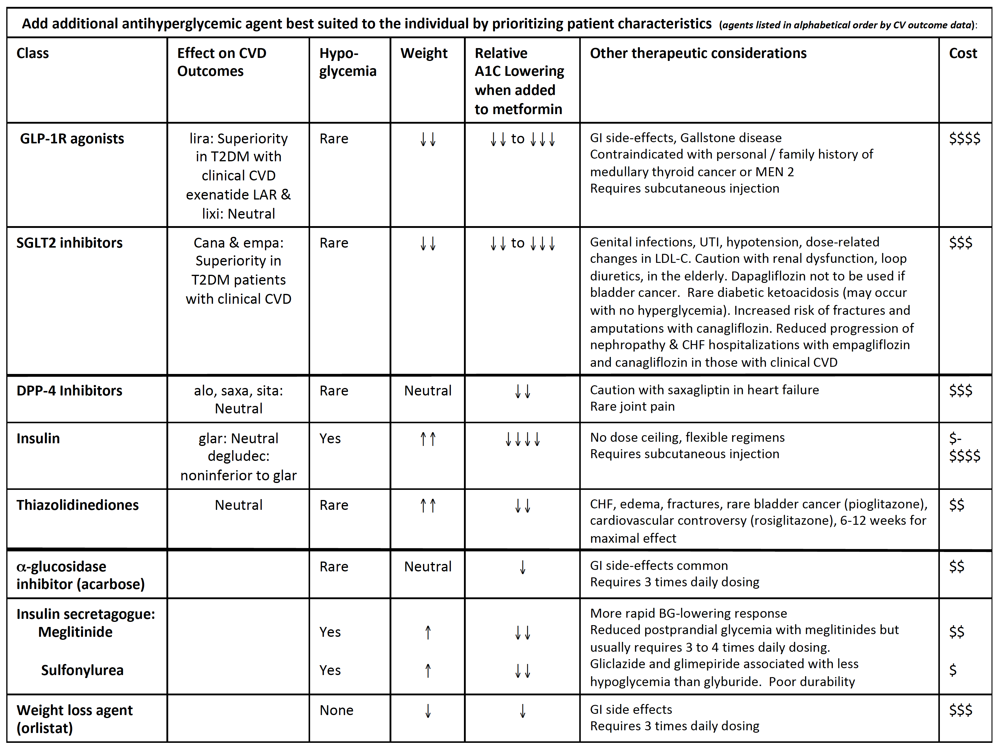
2018 Diabetes Canada CPG – Chapter 13. Pharmacologic Glycemic Management of Type 2 Diabetes
2018
If not at glycemic targets
Add another antihyperglycemic agent from a different class and/or add/intensify insulin regimen
Make timely adjustments to attain target A1C within 3-6 months
Notes:
It is important that if glycemic targets are not met, that other antihyperglycemic agents from a different class are added and/or an insulin regimen is added or intensified. Timely adjustments should be made to attain target A1C levels within 3 to 6 months.

Slide 22
Antihyperglycemic Agents and Renal Function
2018 Diabetes Canada CPG – Chapter 13. Pharmacologic Glycemic Management of Type 2 Diabetes
CKD Stage
5
4
3b
3a
1 or 2
eGFR (mL/min/1.73 m²):
<15
15–29
30–44
45-59
≥ 60
Alpha-glucosidase Inhibitors
Acarbose
30
Biguanides
Metformin
30
500-1000 mg daily
45
Alogliptin
6.25 mg daily
30
12.5 mg daily
60
Linagliptin
15
DPP-4 Inhibitors
15
2.5 mg daily
50
Saxagliptin
30
Sitagliptin
25 mg daily
50 mg daily
50
Dulaglutide
15
GLP-1 Receptor Agonists
Exenatide
30
50
Exenatide QW
30
50
Liraglutide
15
Lixisenatide
30
Gliclazide
30
60
Glimepiride
30
60
Insulin Secretagogues
60
Glyburide
Repaglinide
60
25
45
60
Canagliflozin*
45
100 mg daily
SGLT2 Inhibitors
Dapagliflozin
60
Empagliflozin
30
45
Pioglitazone
60
Thiazolidinediones
Rosiglitazone
Fluid retention
60
Insulins
30
Use alternative agent
Dose adjustment required
Caution
Do not initiate
Dose adjustment not required
* May be used for cardiorenal benefits in those with clinical CVD, A1C above target and eGFR >30 mL/min/1.73m²

Slide 23
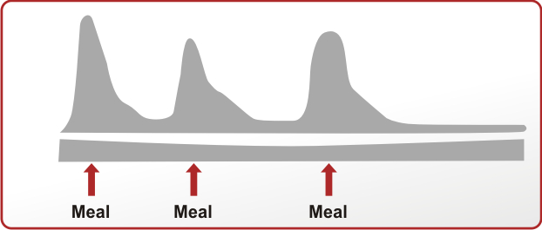
2018 Diabetes Canada CPG – Chapter 13. Pharmacologic Glycemic Management of Type 2 Diabetes
Serum Insulin Level
Time
Human Basal
Human Bolus
Analogue Basal
Analogue Bolus
guidelines.diabetes.ca | 1-800-BANTING (226-8464) | diabetes.ca
Notes:
Insulin treatment for type 2 diabetes includes
Human or intermediate-acting insulin basal insulin
Long-acting analogue basal insulin
Both of which may be given once or twice daily for basal glycemic control
Human or short-acting bolus insulin
Rapid-acting analogue bolus insulin
Both of which are given at mealtimes for prandial glycemic control
23

Slide 24
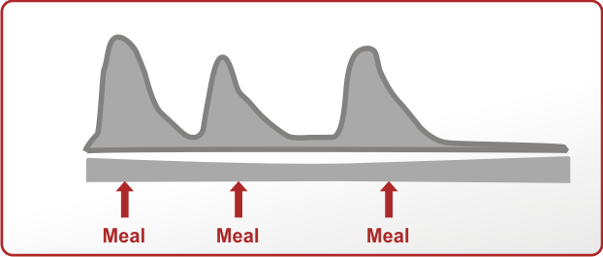
2018 Diabetes Canada CPG – Chapter 13. Pharmacologic Glycemic Management of Type 2 Diabetes
Serum Insulin Level
Human Premixed
Analogue Premixed
guidelines.diabetes.ca | 1-800-BANTING (226-8464) | diabetes.ca
Notes:
Premixed insulin is also available containing mixtures of human basal and bolus insulin
Or
Analogue basal and bolus insulin
24

Slide 25
Types of insulin
Insulin type (trade name) | Onset | Peak | Duration
BOLUS (prandial or mealtime) insulins
Rapid-acting insulin analogues (clear) Insulin aspart (NovoRapid®) Insulin glulisine (Apidra®) Insulin lispro (Humalog®) U-100 U-200 Faster-acting insulin aspart (Fiasp®) | 9–20min 10–15min 10–15min 4min | 1–1.5h 1–1.5h 1–2h 0.5-1.5h | 3–5h 3.5–5h 3–4.75h 3-5h
Short-acting insulins (clear) Insulin regular (Humulin®-R, Novolin® ge Toronto) Insulin regular U-500 (Entuzity® (U-500) | 30min 15min | 2–3h 4-8h | 6.5h 17-24h
BASAL insulins
Intermediate-acting (cloudy) Insulin neutral protamine Hagedorn (Humulin® N, Novolin® ge NPH) | 1–3h | 5–8h | Up to 18h
Long-acting insulin (clear) Insulin detemir (Levemir®) Insulin glargine U-100 (Lantus®) Insulin glargine U-300 (Toujeo®) Insulin glargine biosimilar (Basaglar®) Insulin degludec U-100, U-200 (Tresiba®) | 90min | Not applicable | U-100 glargine 24h, detemir 16–24h U-300 glargine >30h degludec 42h
PREMIXED insulins
Premixed regular insulin –NPH (cloudy) Humulin® 30/70 Novolin® ge 30/70, 40/60, 50/50 | A single vial or cartridge contains a fixed ratio of insulin (% of rapid-acting or short-acting insulin to % of intermediate-acting insulin)
Premixed insulin analogues (cloudy) Biphasic insulin aspart (NovoMix® 30) Insulin lispro/lispro protamine (Humalog® Mix25 and Mix50)
Notes:
The table outlining the types of insulin has been updated with information on new types of insulin. It is important to acknowledge that the data represents estimations derived from pooled data analysis using various experimental conditions.

Slide 26
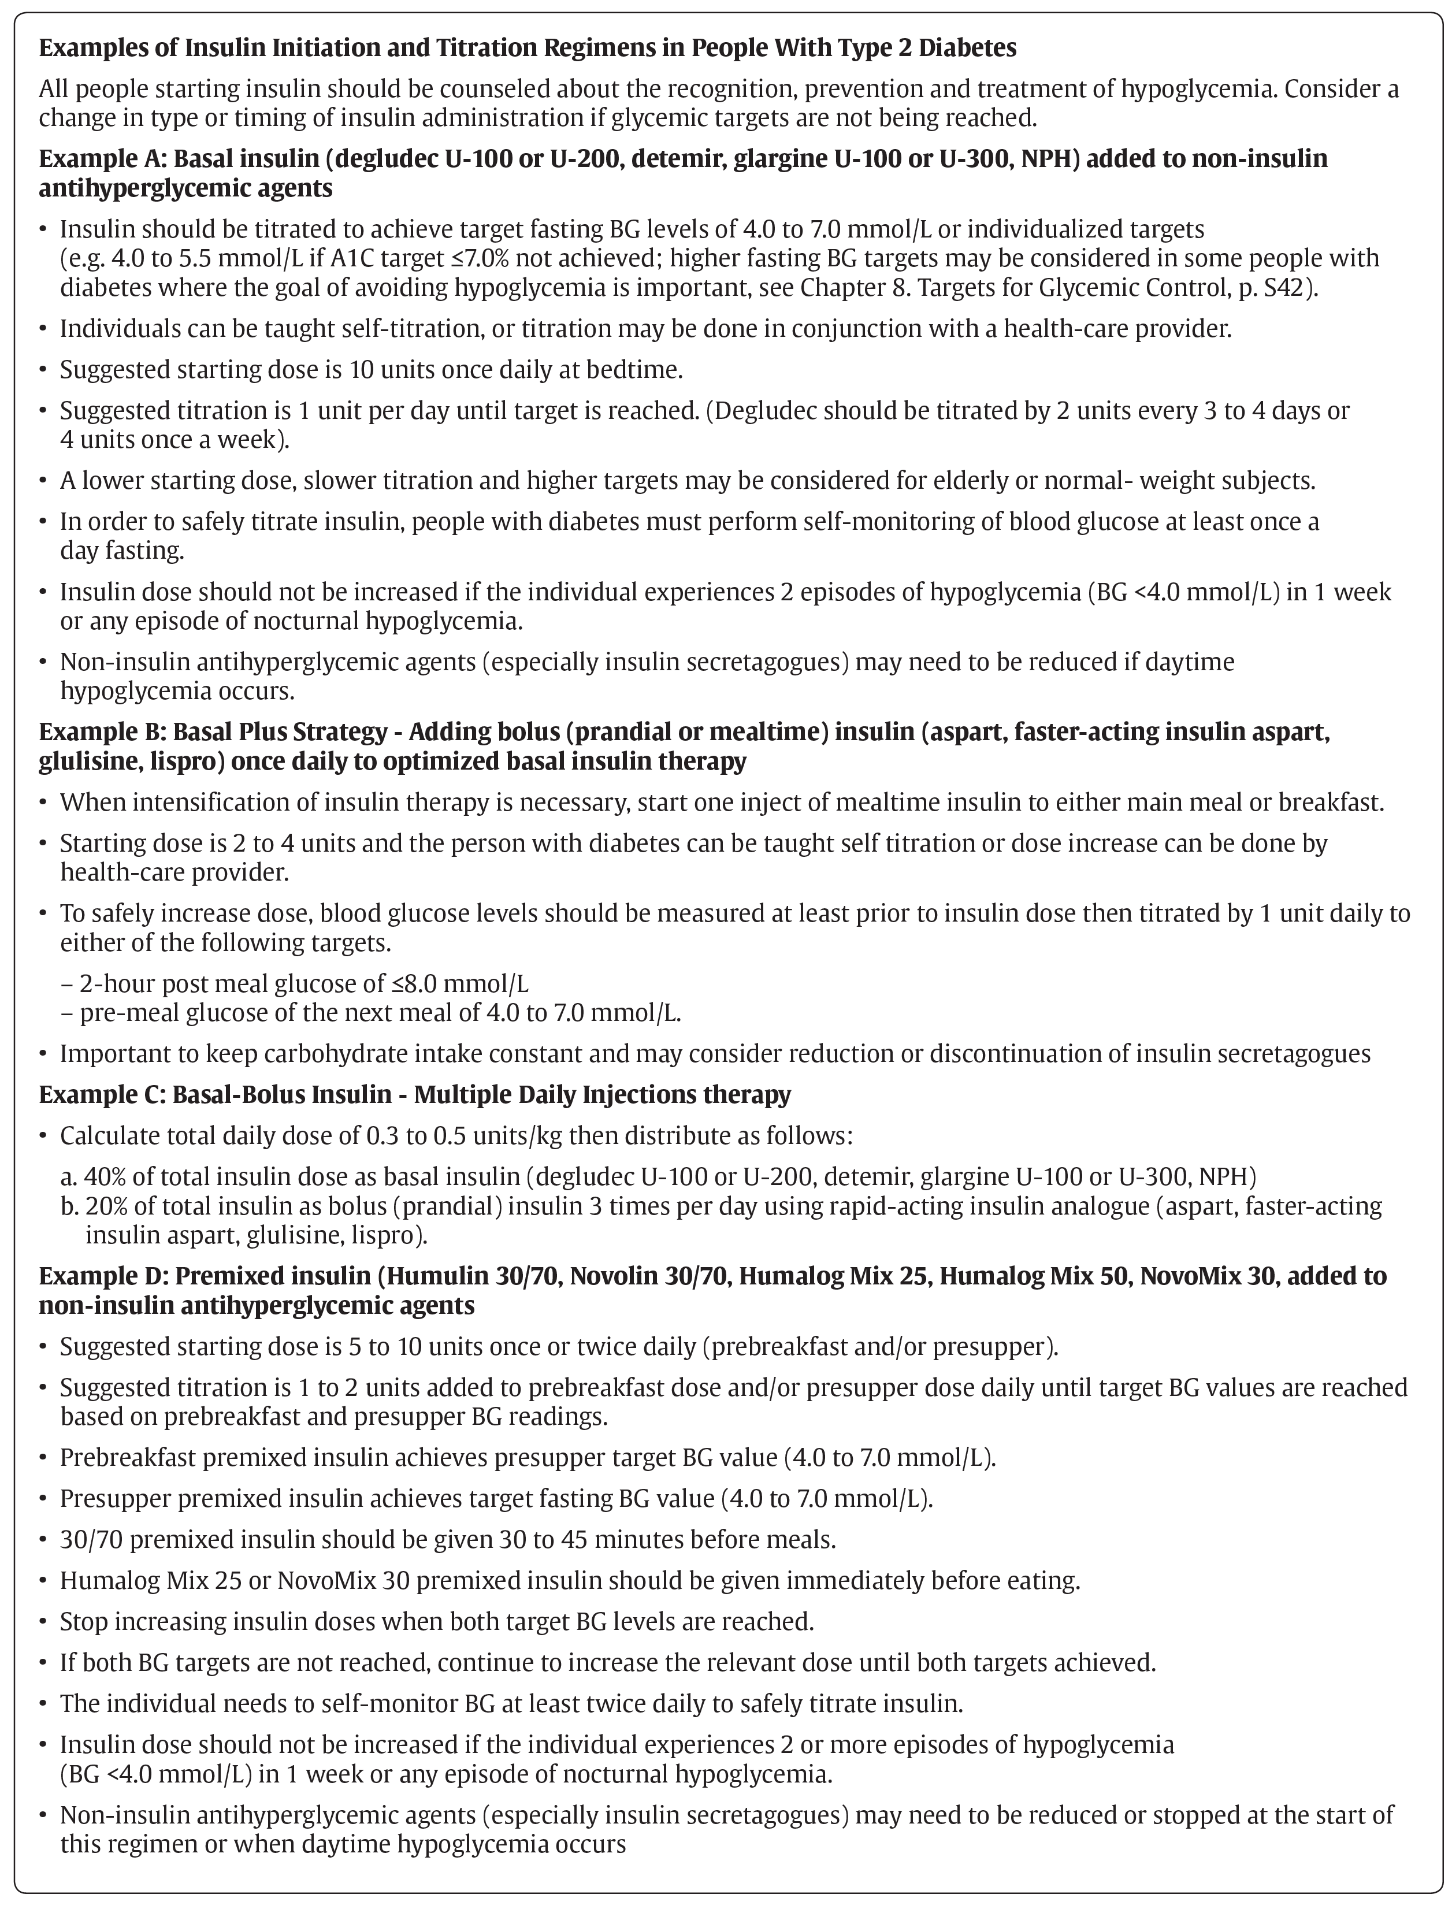
Notes:
The 2018 guidelines contain an Appendix entitled Examples of Insulin Initiation and Titration Regimens which provides useful guidelines on starting and titrating
Basal insulin
Basal plus insulin
Basal-bolus insulin or multiple daily injections therapy, and
Pre-mixed insulin

Slide 27
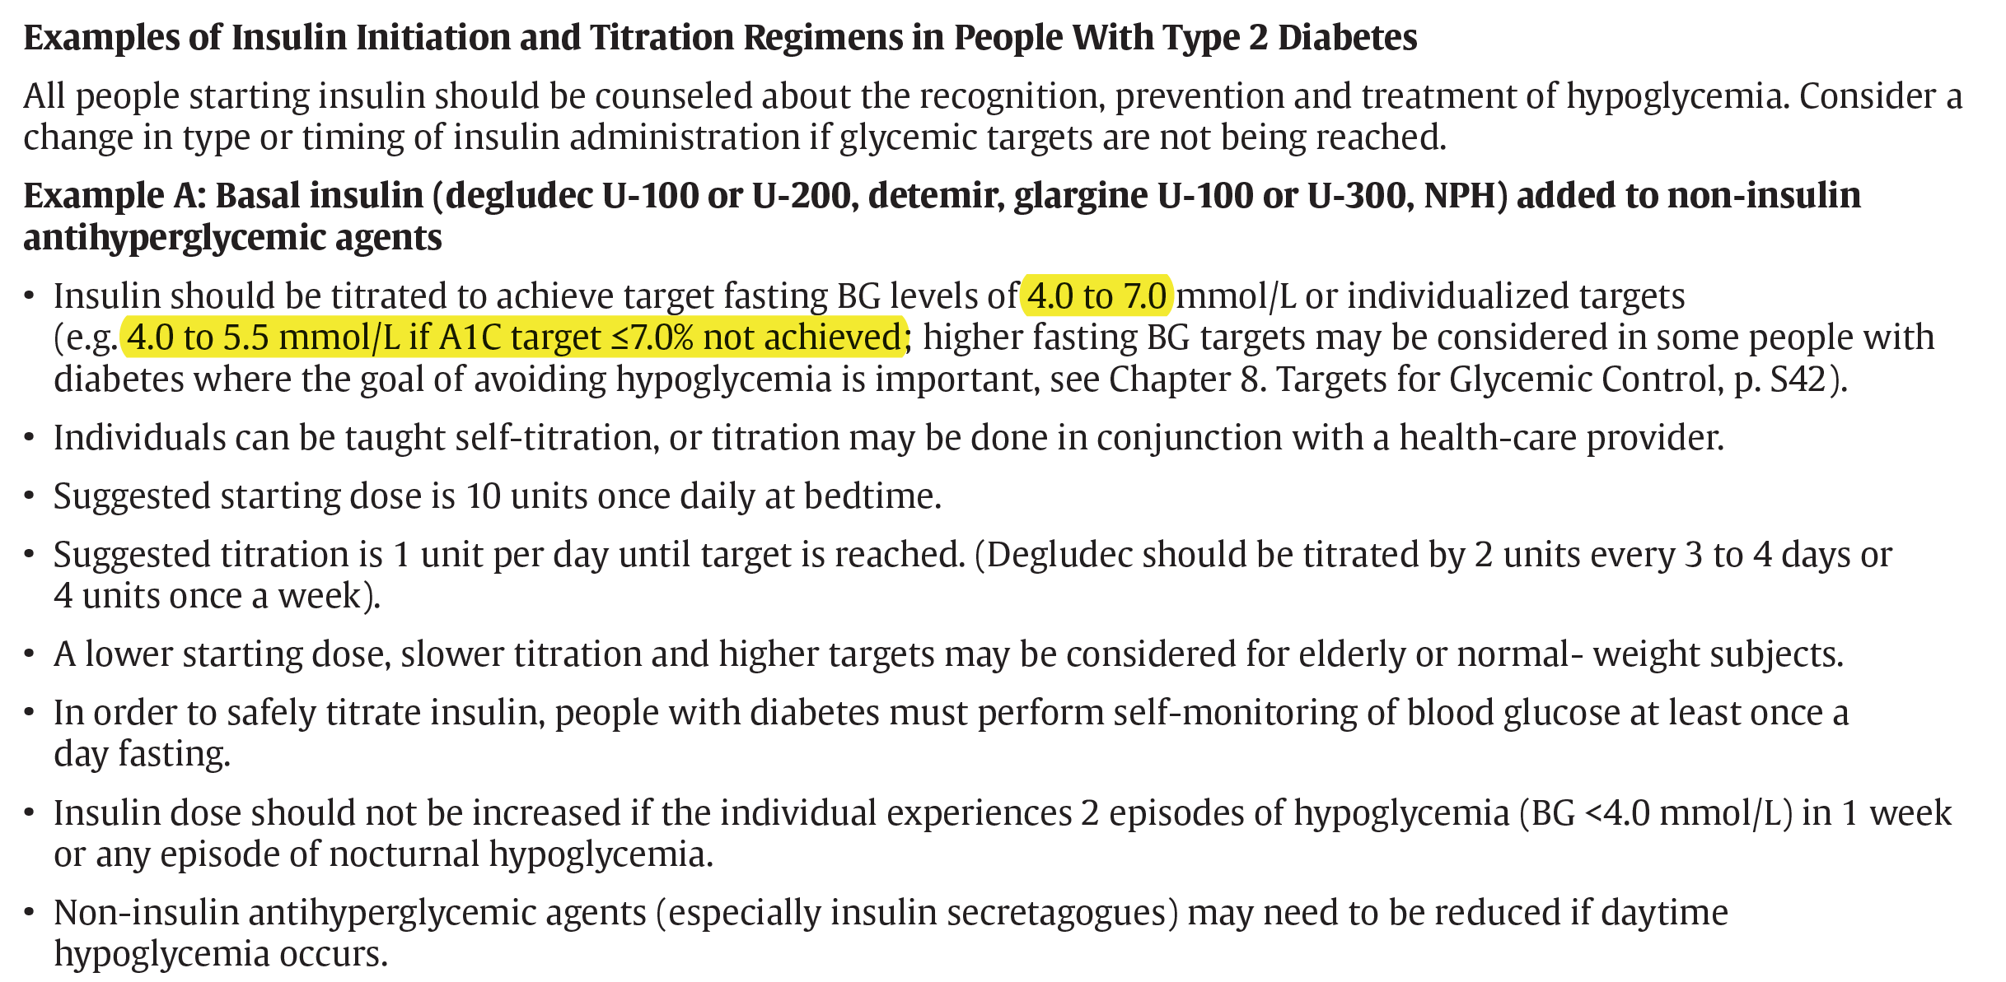

2018 Diabetes Canada CPG – Chapter 13. Pharmacologic Glycemic Management of Type 2 Diabetes
2018
Notes:
The Targets for Glycemic Control chapter contains a new recommendation that is shown in this Appendix entitled Examples of Insulin Initiation and Titration Regimens
Like the 2013 guidelines, the first part states “In order to achieve an A1C less than or equal to 7%, people with diabetes should aim for a fasting or preprandial plasma glucose target of 4 to 7 mmol/L and a 2 hour postprandial plasma glucose target of 5 to 10 mmol/L.
However a part (b) has been added in the 2018 guidelines to reflect evidence from several insulin treat-to-target trials that have safely used dose titration protocols in individuals not at target A1C to reach lower than traditional fasting plasma glucose and postprandial plasma glucose targets. The recommendation states that if an A1C target of less than or equal to 7% cannot be achieved with a fasting plasma glucose target of 4 to 7 mmol/L and a postprandial plasma glucose target of 5 to 10 mmol/L, further fasting plasma glucose lowering to 4 to 5.5 mmol/L and/or postprandial plasma glucose lowering to 5 to 8 mmol/L may be considered but must be balanced against the risk of hypoglycemia

Slide 28
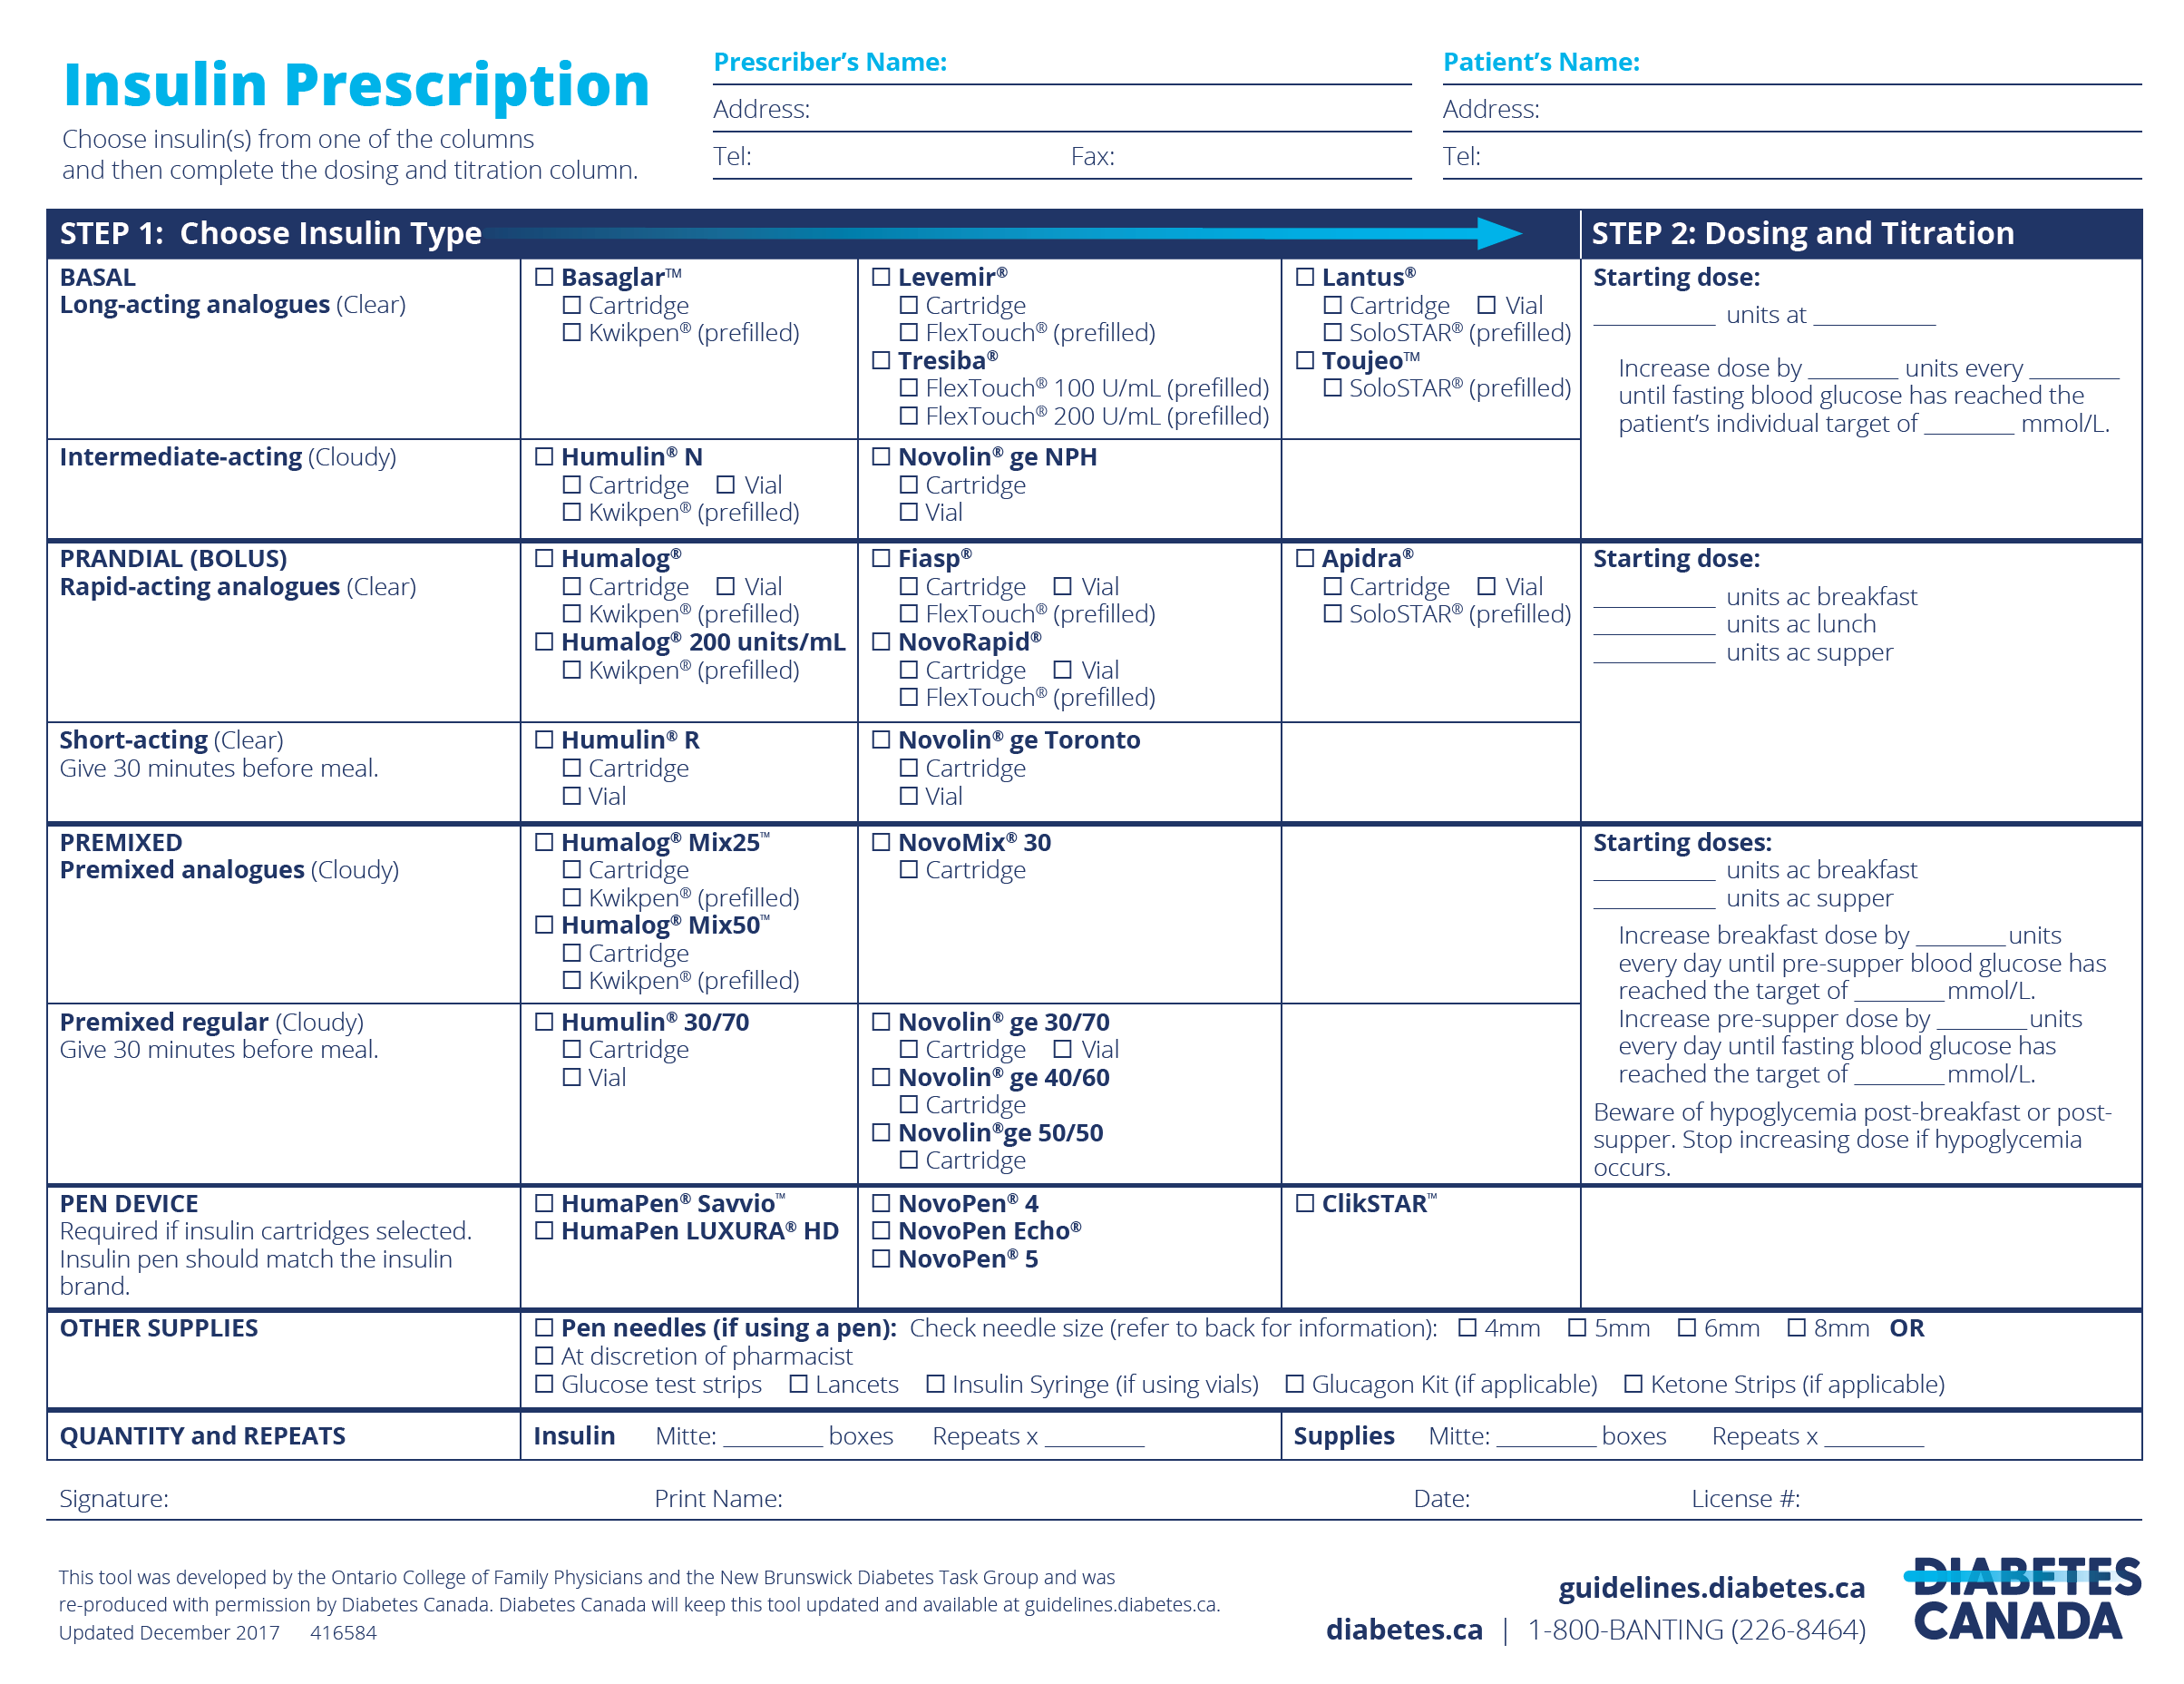
CHOOSE AN INSULIN TYPE
CHOOSE A BRAND
DOSING
SEE REVERSE FOR TIPS
SELECT PEN DEVICE
CHECK OFF SUPPLIES
QUANTITY & REPEATS
SIGN AND DATE
Notes:
This popular insulin prescription tool has been updated on the Diabetes Canada guidelines website.
Choose an insulin type including basal, prandial or bolus and premixed.
Choose a brand.
Review dosing guidelines.
Select a pen device
Check off supplies
Specify quantity and repeats
Sign and date.
28

Slide 29
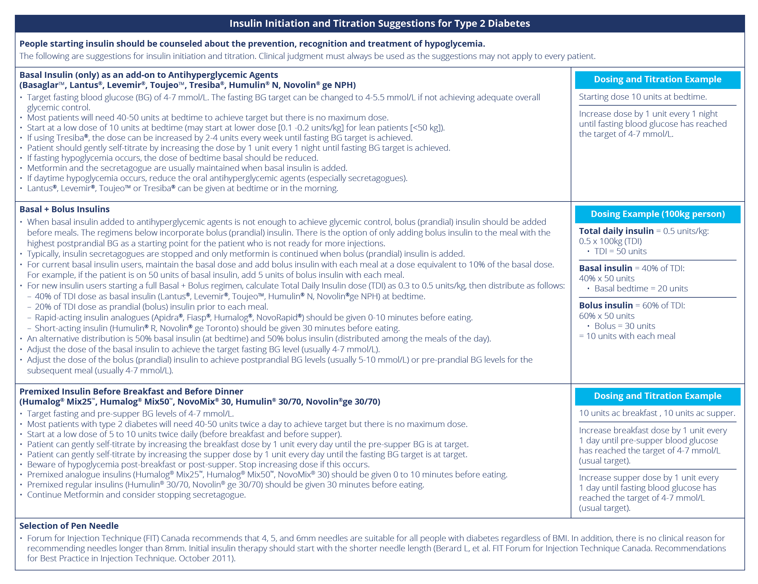
guidelines.diabetes.ca/BloodGlucoseLowering/InsulinPrescriptionTool
Notes:
The reverse side provides detailed guidance on dosing and titration.
29

Slide 30
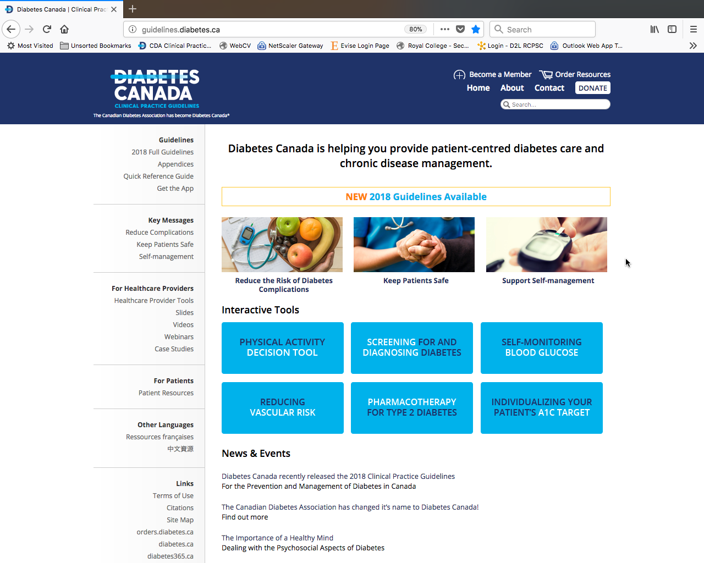
Visit guidelines.diabetes.ca

Slide 31
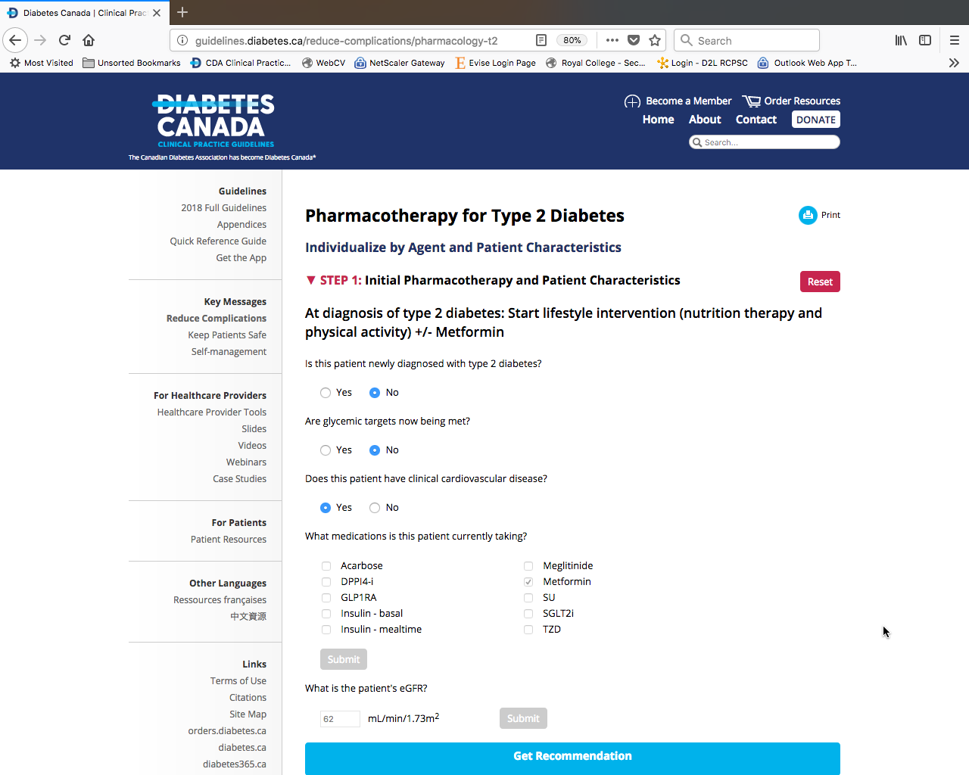

Slide 32
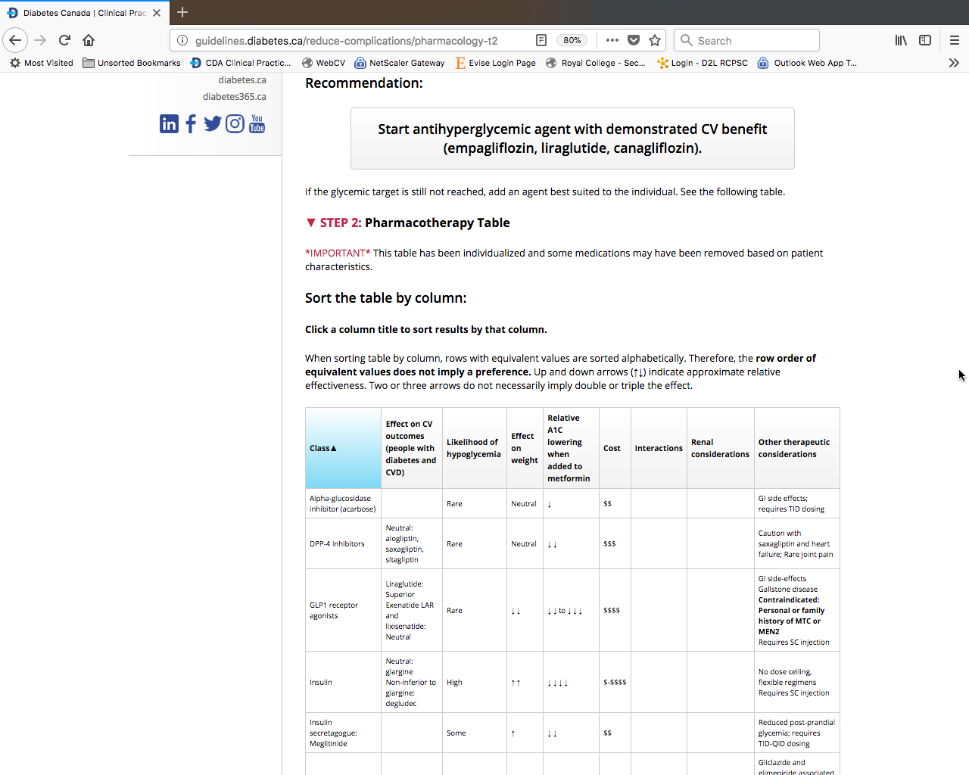

Slide 33
Recommendations 1
2018 Diabetes Canada CPG – Chapter 13. Pharmacologic Glycemic Management of Type 2 Diabetes
Treatment of Newly Diagnosed People with Type 2 Diabetes
Healthy behaviour interventions should be initiated at diagnosis [Grade B, Level 2]. Metformin may be used at the time of diagnosis, in conjunction with healthy behaviour interventions [Grade D, Consensus]
Notes:
Let’s now review each of the recommendations contained in this chapter.

Slide 34
Recommendations 2
2018 Diabetes Canada CPG – Chapter 13. Pharmacologic Glycemic Management of Type 2 Diabetes
Treatment of Newly Diagnosed People with Type 2 Diabetes
2. If glycemic targets are not achieved using healthy behaviour interventions alone within 3 months, antihyperglycemic therapy should be added to reduce the risk of microvascular complications [Grade A, Level 1A]. Metformin should be chosen over other agents due to its low risk of hypoglycemia and weight gain [Grade A, Level 1A], and long-term experience [Grade D, Consensus].

Slide 35
Recommendations 3-4
2018 Diabetes Canada CPG – Chapter 13. Pharmacologic Glycemic Management of Type 2 Diabetes
2018
Treatment of Newly Diagnosed People with Type 2 Diabetes
If A1C values are ≥1.5% above target at diagnosis, initiating metformin in combination with a second antihyperglycemic agent should be considered to increase the likelihood of reaching target [Grade B, Level 2]
Individuals with metabolic decompensation (e.g., marked hyperglycemia, ketosis or unintentional weight loss) should receive insulin with or without metformin to correct the relative insulin deficiency [Grade D, Consensus]

Slide 36
Recommendation 5
2018 Diabetes Canada CPG – Chapter 13. Pharmacologic Glycemic Management of Type 2 Diabetes
2018
Treatment Advancement in People with Type 2 Diabetes in whom Glycemic Targets are not achieved with Existing Antihyperglycemic Medication
Dose adjustments to and/or addition of antihyperglycemic medications should be made in order to attain target A1C within 3 to 6 months [Grade D, Consensus]

Slide 37
Recommendation 6
2018 Diabetes Canada CPG – Chapter 13. Pharmacologic Glycemic Management of Type 2 Diabetes
If glycemic targets are not achieved with existing antihyperglycemic medication(s), other classes of agents should be added to improve glycemic control. The choice should be individualized taking into account the information in Figure 1 and Table 1 [Grade B, Level 2]

Slide 38
Recommendation 7
2018 Diabetes Canada CPG – Chapter 13. Pharmacologic Glycemic Management of Type 2 Diabetes
2018
In adults with type 2 diabetes with clinical CVD in whom glycemic targets are not achieved with existing antihyperglycemic medication(s) and with eGFR >30 mL/min/1.73m², an antihyperglycemic agent with demonstrated CV outcome benefit should be added to reduce the risk of:
  major CV events [Grade A, Level 1A for empagliflozin; Grade A, Level 1A for liraglutide; Grade C, Level 2 for canagliflozin]
  heart failure hospitalization [Grade B, Level 2 for empagliflozin; Grade C, Level 2 for canagliflozin],
  progression of nephropathy [Grade B, Level 2 for empagliflozin; Grade C, Level 3 for canagliflozin]
CV, cardiovascular; CVD, cardiovascular disease; eGFR, estimated glomerular filtration rate

Slide 39
Recommendation 8
2018 Diabetes Canada CPG – Chapter 13. Pharmacologic Glycemic Management of Type 2 Diabetes
2018
In adults with type 2 diabetes without clinical CVD in whom glycemic targets are not achieved with existing antihyperglycemic medication(s), incretin agents (DPP-4 inhibitors or GLP-1 receptor agonists) and/or SGLT2 inhibitors should be considered as add-on medication over insulin secretagogues, insulin and TZDs to improve glycemic control, if lower risk of hypoglycemia and/or weight gain are priorities [Grade A, Level 1A]

Slide 40
Recommendation 9
2018 Diabetes Canada CPG – Chapter 13. Pharmacologic Glycemic Management of Type 2 Diabetes
2018
For adults with type 2 diabetes with metabolic decompensation (e.g., marked hyperglycemia, ketosis or unintentional weight loss), insulin should be used [Grade D, Consensus]

Slide 41
Recommendation 10
2018 Diabetes Canada CPG – Chapter 13. Pharmacologic Glycemic Management of Type 2 Diabetes
2018
Insulin may be used at any time in the course of type 2 diabetes [Grade D, Consensus] (see Appendix. Examples of Insulin Initiation and Titration in People with Type 2 Diabetes). In people not achieving glycemic targets on existing noninsulin antihyperglycemic medication(s), the addition of an once daily basal insulin regimen should be considered over premixed insulin or bolus only regimens, if lower risk of hypoglycemia and/or weight gain are priorities [Grade B, Level 2]

Slide 42
Recommendation 11
2018 Diabetes Canada CPG – Chapter 13. Pharmacologic Glycemic Management of Type 2 Diabetes
2018
In adults with type 2 diabetes treated with basal insulin therapy, if lower risk of hypoglycemia is a priority:
  Long-acting insulin analogues (insulin glargine U-100, glargine U-300, detemir, degludec) should be considered over NPH insulin to reduce the risk of nocturnal and symptomatic hypoglycemia [Grade A, Level 1A]
  Insulin degludec may be considered over insulin glargine U-100 to reduce overall and nocturnal hypoglycemia [Grade B, Level 2 for patients with ≥1 risk factor for hypoglycemia, Grade C, Level 3 for others and severe hypoglycemia in patients at high CV risk [Grade C, Level 3]
  Insulin glargine U-300 may be considered over insulin glargine U-100 to reduce overall and nocturnal hypoglycemia [Grade C, Level 3]
CV, cardiovascular

Slide 43
Recommendation 12
2018 Diabetes Canada CPG – Chapter 13. Pharmacologic Glycemic Management of Type 2 Diabetes
2018
In adults with type 2 diabetes receiving insulin, doses should be adjusted and/or additional antihyperglycemic medication(s) (noninsulin and/or bolus insulin) should be added if glycemic targets are not achieved [Grade D, Consensus]
  A GLP-1 receptor agonist should be considered as add-on therapy [Grade A, Level 1A], before initiating bolus insulin or intensifying insulin to improve glycemic control with weight loss and a lower hypoglycemia risk compared to single or multiple bolus insulin injections [Grade A, Level 1A]
  An SGLT2 inhibitor should be considered as add-on therapy to improve glycemic control with weight loss and lower hypoglycemic risk compared to additional insulin [Grade A, Level 1A]
  A DPP-4 inhibitor may be considered as add-on therapy to improve glycemic control without weight gain or increased hypoglycemia risk compared to additional insulin [Grade B, Level 2]

Slide 44
Recommendations 13-14
2018 Diabetes Canada CPG – Chapter 13. Pharmacologic Glycemic Management of Type 2 Diabetes
2018
When bolus insulin is added to antihyperglycemic agents, rapid-acting analogues may be used instead of short-acting (regular) insulin to improve glycemic control [Grade B, Level 2]
14. Bolus insulin may be initiated using a stepwise approach (starting with 1 injection at one meal and additional mealtime injections as needed) to achieve similar A1C reduction with lower hypoglycemia risk compared to initiating a full basal-bolus injection regimen [Grade B, Level 2]

Slide 45
Recommendation 15
2018 Diabetes Canada CPG – Chapter 13. Pharmacologic Glycemic Management of Type 2 Diabetes
All individuals with type 2 diabetes currently using or starting therapy with insulin or insulin secretagogues should be counselled about the prevention, recognition and treatment of hypoglycemia [Grade D, Consensus]

Slide 46
Recommendation 16
2018 Diabetes Canada CPG – Chapter 13. Pharmacologic Glycemic Management of Type 2 Diabetes
2018
Metformin, insulin secretagogues and SGLT2 inhibitors should be temporarily withheld during acute illnesses associated with reduced oral intake or dehydration [Grade D, Consensus]

Slide 47
Recommendation 17
2018 Diabetes Canada CPG – Chapter 13. Pharmacologic Glycemic Management of Type 2 Diabetes
2018
SGLT2 inhibitors should be temporarily withheld prior to major surgical procedures, and during acute infections and serious illness to reduce the risk of ketoacidosis [Grade D, Consensus]

Slide 48
Key Messages
2018 Diabetes Canada CPG – Chapter 13. Pharmacologic Glycemic Management of Type 2 Diabetes
Healthy behaviour interventions should be initiated in people newly diagnosed with type 2 diabetes
If glycemic targets are not achieved within 3 months of initiating healthy behaviour interventions, antihyperglycemic pharmacotherapy should be added
Dose adjustments and/or additional agents should be instituted to achieve target A1C within 3 to 6 months
Notes:
The key messages for health-care providers in this chapter include

Slide 49
Key Messages
2018 Diabetes Canada CPG – Chapter 13. Pharmacologic Glycemic Management of Type 2 Diabetes
In people with type 2 diabetes with A1C <1.5% above the person’s individualized target, antihyperglycemic pharmacotherapy should be added if glycemic targets are not achieved within 3 months of initiating healthy behaviour interventions
In people with type 2 diabetes with A1C ≥1.5% above target, antihyperglycemic agents should be initiated concomitantly with healthy behaviour interventions, and consideration could be given to initiating combination therapy with 2 agents

Slide 50
Key Messages
2018 Diabetes Canada CPG – Chapter 13. Pharmacologic Glycemic Management of Type 2 Diabetes
Insulin should be initiated immediately in individuals with metabolic decompensation and/or symptomatic hyperglycemia
Otherwise, metformin should be the initial agent of choice in people with newly diagnosed with type 2 diabetes, unless contraindicated
Choice of second-line antihyperglycemic agents should be made based on individual patient characteristics, patient preferences, any contraindications to the drug, glucose lowering efficacy, risk of hypoglycemia, affordability/access, effect on body weight, and other factors

Slide 51
Key Messages
2018 Diabetes Canada CPG – Chapter 13. Pharmacologic Glycemic Management of Type 2 Diabetes
In people with clinical CVD in whom A1C targets are not achieved with existing pharmacotherapy, an antihyperglycemic agent with demonstrated CV outcome benefit should be added to antihyperglycemic therapy to reduce CV risk
CV, cardiovascular; CVD, cardiovascular disease

Slide 52
Key Messages
2018 Diabetes Canada CPG – Chapter 13. Pharmacologic Glycemic Management of Type 2 Diabetes
In people without clinical CVD in whom A1C target is not achieved with current therapy, if affordability and access are not barriers, people with type 2 diabetes and their providers who are concerned about hypoglycemia and weight gain may prefer an incretin agent (DPP-4 inhibitor or GLP-1 receptor agonist) and/or an SGLT2 inhibitor to other agents as they improve glycemic control with a low risk of hypoglycemia and weight gain
CVD, cardiovascular disease

Slide 53
Key Messages
2018 Diabetes Canada CPG – Chapter 13. Pharmacologic Glycemic Management of Type 2 Diabetes
In people receiving an antihyperglycemic regimen containing insulin, in whom glycemic targets are not achieved, the addition of a GLP-1 receptor agonist, DPP-4 inhibitor, or SGLT2 inhibitor may be considered before adding or intensifying prandial insulin therapy to improve glycemic control with less weight gain and comparable or lower hypoglycemia risk

Slide 54
Key Messages for People with Diabetes
2018 Diabetes Canada CPG – Chapter 13. Pharmacologic Glycemic Management of Type 2 Diabetes
Some people who have type 2 diabetes can achieve their target blood glucose levels with nutrition guidance and physical activity alone, but most also need glucose lowering medications. The decision about which medications are best for you depends on many factors, including your blood glucose level, symptoms, and any other health problems you have. Your health-care provider may even combine medications that act differently on your body to help you control your blood glucose
Notes:
The key messages directed for people with diabetes include

Slide 55
Key Messages for People with Diabetes
2018 Diabetes Canada CPG – Chapter 13. Pharmacologic Glycemic Management of Type 2 Diabetes
First-line glucose-lowering medication:
Metformin:
  generally the first choice for people with type 2 diabetes because of its safety, low cost, and possible heart benefits
  It works by making your body respond better to insulin so that your body uses insulin more effectively
  Metformin also lowers glucose production from the liver
  Nausea and diarrhea are possible side effects and usually go away within 1 to 2 weeks as your body gets used to the medicine
  It is associated with a low risk of hypoglycemia and does not cause weight gain

Slide 56
Key Messages for People with Diabetes
2018 Diabetes Canada CPG – Chapter 13. Pharmacologic Glycemic Management of Type 2 Diabetes
If metformin and healthy behaviour changes are not enough to control your blood glucose level, other medications can be added.
Second-line glucose lowering medication:
DPP-4 inhibitors:
  These medications work to lower blood glucose by increasing insulin levels after meals and lowering glucagon levels (a hormone that raises blood glucose)
  They do not cause weight gain and are associated with a low risk of hypoglycemia

Slide 57
Key Messages for People with Diabetes
2018 Diabetes Canada CPG – Chapter 13. Pharmacologic Glycemic Management of Type 2 Diabetes
Second-line glucose lowering medication cont’d:
GLP-1 receptor agonists:
  These injectable medications act when blood glucose increases after eating
  They increase insulin levels which helps lower blood glucose and lower glucagon levels (a hormone that raises blood glucose)
  They also slow digestion and reduce appetite
  Possible side effects include nausea, which is usually goes away with time
  Their use is often associated with some weight loss
  They are associated with low risk of hypoglycemia

Slide 58
Key Messages for People with Diabetes
2018 Diabetes Canada CPG – Chapter 13. Pharmacologic Glycemic Management of Type 2 Diabetes
Second-line glucose lowering medication cont’d:
SGLT2 inhibitors:
  These medications work by eliminating glucose into the urine
  Side effects may include genital yeast infections, urinary tract infections, increased urination and low blood pressure
  They are associated with weight loss and a low risk of hypoglycemia

Slide 59
Key Messages for People with Diabetes
2018 Diabetes Canada CPG – Chapter 13. Pharmacologic Glycemic Management of Type 2 Diabetes
Second-line glucose lowering medication cont’d:
Insulin secretagogues (meglitinides, sulfonylureas):
  These medications help your pancreas release more insulin
  Possible side effects include hypoglycemia and weight gain

Slide 60
Key Messages for People with Diabetes
2018 Diabetes Canada CPG – Chapter 13. Pharmacologic Glycemic Management of Type 2 Diabetes
Second-line glucose lowering medication cont’d:
Thiazolidinediones:
  Like metformin, these medications make the body's tissues more sensitive to insulin
  Side effects include weight gain and an increased risk of heart failure and fractures

Slide 61
Key Messages for People with Diabetes
2018 Diabetes Canada CPG – Chapter 13. Pharmacologic Glycemic Management of Type 2 Diabetes
Second-line glucose lowering medication cont’d:
Insulin therapy:
  Some people who have type 2 diabetes need insulin therapy as well
  Depending on your needs, your healthcare provider may prescribe a mixture of insulin types to use throughout the day and night
  Often, people with type 2 diabetes start insulin use with one injection of long-acting insulin at night

Slide 62
Key Messages for People with Diabetes
2018 Diabetes Canada CPG – Chapter 13. Pharmacologic Glycemic Management of Type 2 Diabetes
Discuss the pros and cons of different treatment plans with your health-care provider. Together, you can decide which medication is best for you after considering many factors, including costs and other aspects of your health

Slide 63
Visit guidelines.diabetes.ca

Slide 64


Or download the App
Notes:
The same information may also be obtained by downloading the app.

Slide 65
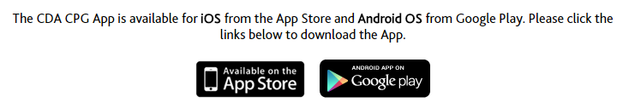
Diabetes Canada Clinical Practice Guidelines
http://guidelines.diabetes.ca – for health-care providers
1-800-BANTING (226-8464)
http://diabetes.ca – for people with diabetes
Notes:
65

