Slide 1
Cardiovascular Protection in People with Diabetes
2018 Clinical Practice Guidelines
Chapter 23
James A. Stone MD PhD FRCPC, Robyn L. Houlden MD FRCPC, Peter Lin MD CCFP, Jacob A. Udell MD MPH FRCPC, Subodh Verma MD PhD FRCSC

Slide 2
Disclaimer
All Content contained on this slide deck is the property of Diabetes Canada, its content suppliers or its licensors as the case may be, and is protected by Canadian and international copyright, trademark, and other applicable laws. Diabetes Canada grants personal, limited, revocable, non-transferable and non-exclusive license to access and read content in this slide deck for personal, non-commercial and not-for-profit use only. The slide deck is made available for lawful, personal use only and not for commercial use.
The unauthorized reproduction, distribution of this copyrighted work is not permitted.
For permission to use this slide deck for commercial or any use other than personal, please contact guidelines@diabetes.ca

Slide 3
Key Changes
2018 Diabetes Canada CPG – Chapter 23. Cardiovascular Protection in People with Diabetes
2018
New recommendations:
    Second-line lipid lowering
    Antihyperglycemic agents with CV benefit
    ACE-inhibitor and ARB use clarified

Slide 4
Vascular Protection Checklist
2018 Diabetes Canada CPG – Chapter 23. Cardiovascular Protection in People with Diabetes
A • A1C – optimal glycemic control (usually ≤7%)
B • BP – optimal blood pressure control (<130/80)
C • Cholesterol – LDL-C < 2.0 mmol/L or >50%
reduction if treatment indicated
D • Drugs to protect the heart
    A – ACEi or ARB │ S – Statin │ A – ASA if indicated │SGLT2i / GLP-1RA with demonstrated CV benefit if type 2 DM with CVD and A1C not at target
E • Exercise / Healthy Eating
S • Smoking cessation
ACEi, angiotensin converting enzyme inhibitor; ARB, angiotension receptor blocker; CV, cardiovascular; CVD, cardiovascular disease; DM, diabetes mellitus
Notes:
4

Slide 5
Absolute Risk of MI is Higher in People with Diabetes
2018 Diabetes Canada CPG – Chapter 23. Cardiovascular Protection in People with Diabetes
Diabetes n = 379,003 No Diabetes n = 9,018,082 Database 1994-2000
3.0
Diabetes
Men
Women
2.5
2.0
No diabetes
Men
Women
1.5
No. events per 100 person- years
1.0
0.5
0
Age group
MI = myocardial infarction
All lines fitted according to a polynomial equation; R²= 0.99–1.00 for each
Booth GL, et al. Lancet 2006;368:29-
Notes:
5
The ICES study was a population-based retrospective cohort study using provincial health claims. It identified all adults with (n=379 003) and without (n=9 018 082) diabetes mellitus living in Ontario, Canada, on April 1, 1994. Individuals were followed up to record CVD events until March 31, 2000.
In both populations, the rate of AMI rose with age. Diabetes was associated with earlier CVD; diabetic men and women were about 15 years younger than those without diabetes in the same risk category.
Reference:
Booth GL, et al. Lancet 2006;368:29-36.

Slide 6
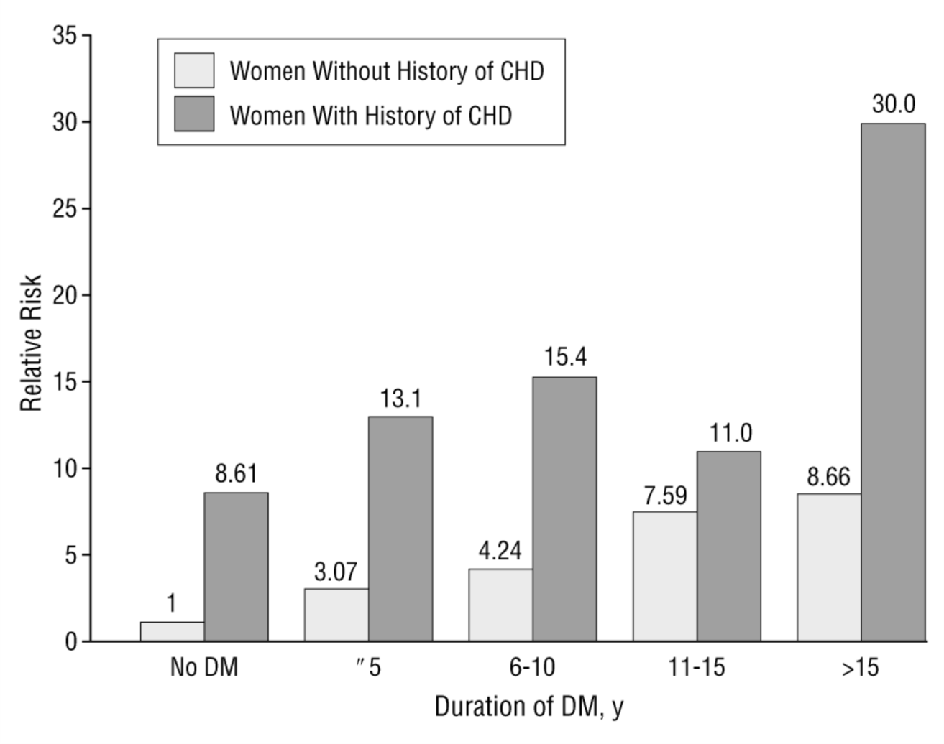
Type 2 Diabetes for >15 Years Duration Confers a Similar Risk of Fatal CHD as Prior CHD and No Diabetes
2018 Diabetes Canada CPG – Chapter 23. Cardiovascular Protection in People with Diabetes
20 year follow-up of 121,046 women aged 30 to 55 years in Nurses’ Health Study
Hu F, et al. Arch Intern Med. 2001;161:1717-1723.
CHD, coronary heart disease

Slide 7
Multifaceted Management is Essential for Type 2 Diabetes
2018 Diabetes Canada CPG – Chapter 23. Cardiovascular Protection in People with Diabetes
Intensive multifaceted care lowers mortality
Multifaceted treatment strategy includes:
  Glucose, lipid, BP control
  Healthy behaviour optimization
  CV protective medications
BP, blood pressure; CV, cardiovascular
Notes:
7

Slide 8
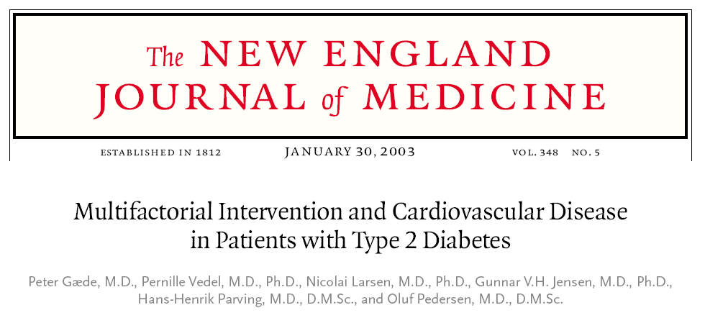
STENO-2
2018 Diabetes Canada CPG – Chapter 23. Cardiovascular Protection in People with Diabetes
Notes:
8

Slide 9
STENO-2: Multifaceted Approach for CVD Prevention Among People with Type 2 diabetes
2018 Diabetes Canada CPG – Chapter 23. Cardiovascular Protection in People with Diabetes
  Intensive Arm
  Therapies to achieve targets in glycemia, lipids, BP and albuminuria
  Multidisciplinary care q3mo
  ASA and ACE inhibitors
  (independent of BP)
Type 2 Diabetes
+
Microalbuminuria
n = 160
Conventional Arm
MD follows clinical practice guidelines
8-year follow-up composite outcome:
CV death, MI, CABG, PCI, Stroke, Amputation, or PVD surgery
Gaede et al. NEJM. 2003: 348;383-393
BP, blood pressure; CV, cardiovascular; CABG, coronary artery bypass grafting; MI, myocardial infarction; PCI, percutaneous coronary intervention; PVD, peripheral vascular disease
Notes:
The STENO 2 study, published in the New England Journal of Medicine in 2003, tested the hypothesis that patients receiving intensive multifaceted diabetes care delivered in a diabetes clinic would have better clinical outcomes than patients receiving conventional diabetes care.
In the Intensive group, aggressive control targets were set for major diabetes parameters (glycaemia, lipids, blood pressure), and a stepwise approach was used to try to bring as many patients to target as possible using lifestyle and pharmacologic interventions. All patients were given an ACE inhibitor, regardless of BP. An ARB was used if the patient was ACE inhibitor intolerant.
In the conventional care group, diabetes care was primarily delivered by the family doctor, with specialist involvement at their discretion. Treatment was guided by the Danish Medical Association’s national guidelines, set in 1998.
Patients were followed for 8 years and they examined a composite outcome of CV death, MI, CABG, PCI, Stroke, Amputation, or PVD surgery
TTT: Slide illustrates the design of STENO-2 trial.

Slide 10
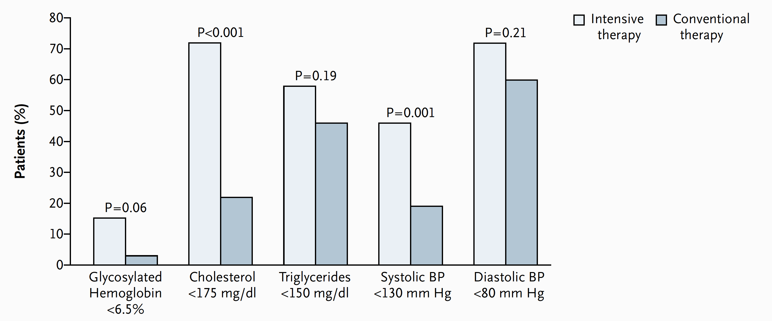
2018 Diabetes Canada CPG – Chapter 23. Cardiovascular Protection in People with Diabetes
STENO-2: Intensive Group Achieved Targets
Gaede et al. NEJM. 2003: 348;383-393
Notes:
Patients in the intensive arm significantly achieved targets for glycemia (A1c<6.5%), cholesterol < 175 mg/dL, SBP < 130 and DBP < 80 compared to the conventional arm in the study.

Slide 11
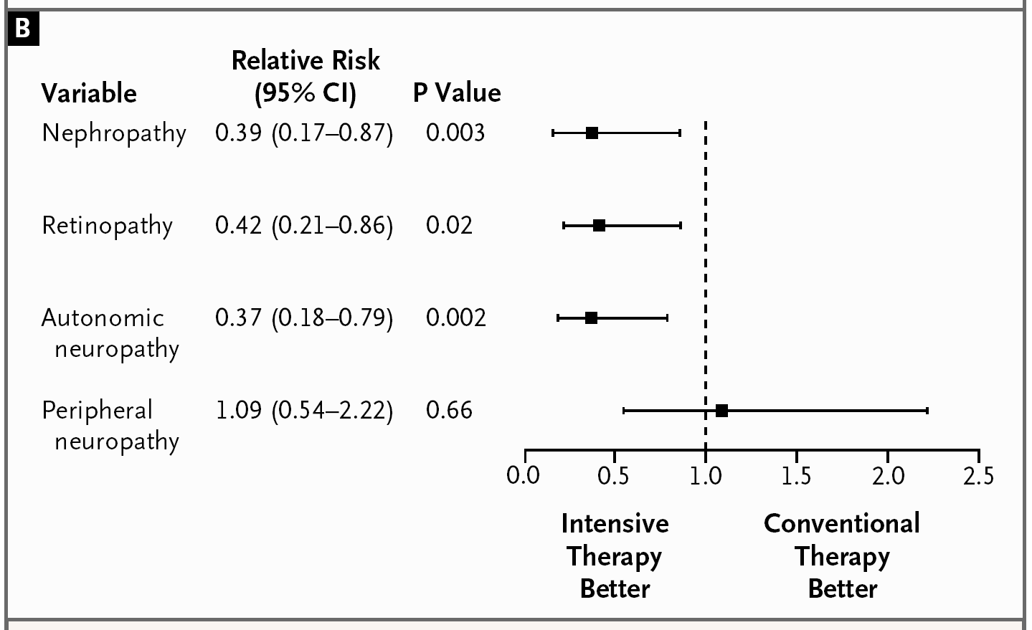
STENO 2 – Microvascular Disease Reduced
2018 Diabetes Canada CPG – Chapter 23. Cardiovascular Protection in People with Diabetes
Gaede et al. NEJM. 2003: 348;383-393
Notes:
11

Slide 12
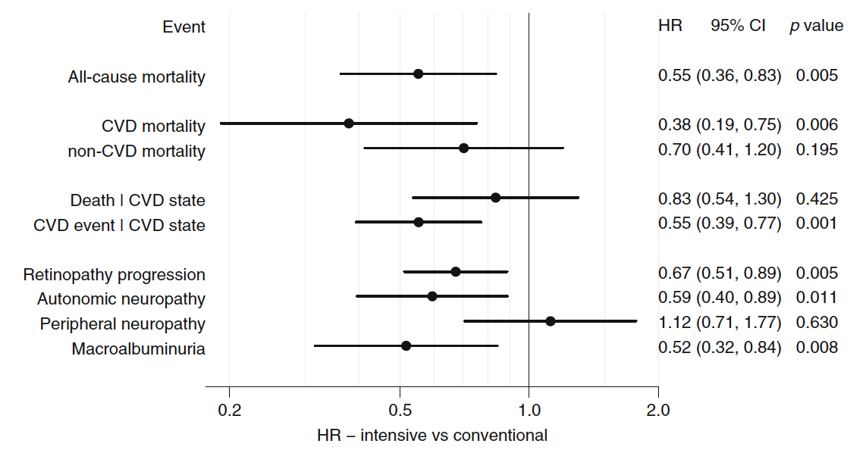
STENO-2: 21-years follow up
2018 Diabetes Canada CPG – Chapter 23. Cardiovascular Protection in People with Diabetes
Gaede et al. Diabetologia 2016;59(11):2298-2307
Notes:
Abstract
AIMS/HYPOTHESIS:
The aim of this work was to study the potential long-term impact of a 7.8 years intensified, multifactorial intervention in patients with type 2 diabetes mellitus and microalbuminuria in terms of gained years of life and years free from incident cardiovascular disease.
METHODS:
The original intervention (mean treatment duration 7.8 years) involved 160 patients with type 2 diabetes and microalbuminuria who were randomly assigned (using sealed envelopes) to receive either conventional therapy or intensified, multifactorial treatment including both behavioural and pharmacological approaches. After 7.8 years the study continued as an observational follow-up with all patients receiving treatment as for the original intensive-therapy group. The primary endpoint of this follow-up 21.2 years after intervention start was difference in median survival time between the original treatment groups with and without incident cardiovascular disease. Non-fatal endpoints and causes of death were adjudicated by an external endpoint committee blinded for treatment allocation.
RESULTS:
Thirty-eight intensive-therapy patients vs 55 conventional-therapy patients died during follow-up (HR 0.55 [95% CI 0.36, 0.83], p = 0.005). The patients in the intensive-therapy group survived for a median of 7.9 years longer than the conventional-therapy group patients. Median time before first cardiovascular event after randomisation was 8.1 years longer in the intensive-therapy group (p = 0.001). The hazard for all microvascular complications was decreased in the intensive-therapy group in the range 0.52 to 0.67, except for peripheral neuropathy (HR 1.12).
CONCLUSIONS/INTERPRETATION:
At 21.2 years of follow-up of 7.8 years of intensified, multifactorial, target-driven treatment of type 2 diabetes with microalbuminuria, we demonstrate a median of 7.9 years of gain of life. The increase in lifespan is matched by time free from incident cardiovascular disease.
TRIAL REGISTRATION:
ClinicalTrials.go

Slide 13



Use a Multifaceted Vascular Protection Strategy
2018 Diabetes Canada CPG – Chapter 23. Cardiovascular Protection in People with Diabetes
Healthy
Behaviours/weight management
Smoking Cessation
Physical
Activity
BP <130/80 mmHg
A1C ≤7%
Rx:
Statins
ACEi/ARB
Certain Antihyperglycemic Agents
Notes:
13

Slide 14
Cardiovascular protective medications
2018 Diabetes Canada CPG – Chapter 23. Cardiovascular Protection in People with Diabetes
Statins
ACE-inhibitors or Angiotensin receptor blockers (ARB)
Certain antihyperglycemic agents
ASA selective use
Notes:
14

Slide 15
2018 Diabetes Canada CPG – Chapter 23. Cardiovascular Protection in People with Diabetes
HPS: Statin Therapy Beneficial Among Patients with Diabetes
SIMVASTATIN
PLACEBO
Rate ratio & 95% CI
(10269)
(10267)
STATIN better
PLACEBO better
Previous MI
999
(23.5%)
1250
(29.4%)
Other CHD (not MI)
460
(18.9%)
591
(24.2%)
No prior CHD
CVD
172
(18.7%)
212
(23.6%)
PVD
327
(24.7%)
420
(30.5%)
Diabetes
276
(13.8%)
367
(18.6%)
ALL PATIENTS
2033
(19.8%)
2585
(25.2%)
24%
reduction
(P<0.00001)
HPS: Heart protection study
0.4
0.6
0.8
1.0
1.2
1.4
HPS Lancet 2002;360:7-22
Notes:
15
Lancet. 2002 Jul 6;360(9326):7-22.
MRC/BHF Heart Protection Study of cholesterol lowering with simvastatin in 20,536 high-risk individuals: a randomised placebo-controlled trial.
Heart Protection Study Collaborative Group.
Abstract
BACKGROUND:
Throughout the usual LDL cholesterol range in Western populations, lower blood concentrations are associated with lower cardiovascular disease risk. In such populations, therefore, reducing LDL cholesterol may reduce the development of vascular disease, largely irrespective of initial cholesterol concentrations.
METHODS:
20,536 UK adults (aged 40-80 years) with coronary disease, other occlusive arterial disease, or diabetes were randomly allocated to receive 40 mg simvastatin daily (average compliance: 85%) or matching placebo (average non-study statin use: 17%). Analyses are of the first occurrence of particular events, and compare all simvastatin-allocated versus all placebo-allocated participants. These "intention-to-treat" comparisons assess the effects of about two-thirds (85% minus 17%) taking a statin during the scheduled 5-year treatment period, which yielded an average difference in LDL cholesterol of 1.0 mmol/L (about two-thirds of the effect of actual use of 40 mg simvastatin daily). Primary outcomes were mortality (for overall analyses) and fatal or non-fatal vascular events (for subcategory analyses), with subsidiary assessments of cancer and of other major morbidity.
FINDINGS:
All-cause mortality was significantly reduced (1328 [12.9%] deaths among 10,269 allocated simvastatin versus 1507 [14.7%] among 10,267 allocated placebo; p=0.0003), due to a highly significant 18% (SE 5) proportional reduction in the coronary death rate (587 [5.7%] vs 707 [6.9%]; p=0.0005), a marginally significant reduction in other vascular deaths (194 [1.9%] vs 230 [2.2%]; p=0.07), and a non-significant reduction in non-vascular deaths (547 [5.3%] vs 570 [5.6%]; p=0.4). There were highly significant reductions of about one-quarter in the first event rate for non-fatal myocardial infarction or coronary death (898 [8.7%] vs 1212 [11.8%]; p<0.0001), for non-fatal or fatal stroke (444 [4.3%] vs 585 [5.7%]; p<0.0001), and for coronary or non-coronary revascularisation (939 [9.1%] vs 1205 [11.7%]; p<0.0001). For the first occurrence of any of these major vascular events, there was a definite 24% (SE 3; 95% CI 19-28) reduction in the event rate (2033 [19.8%] vs 2585 [25.2%] affected individuals; p<0.0001). During the first year the reduction in major vascular events was not significant, but subsequently it was highly significant during each separate year. The proportional reduction in the event rate was similar (and significant) in each subcategory of participant studied, including: those without diagnosed coronary disease who had cerebrovascular disease, or had peripheral artery disease, or had diabetes; men and, separately, women; those aged either under or over 70 years at entry; and--most notably--even those who presented with LDL cholesterol below 3.0 mmol/L (116 mg/dL), or total cholesterol below 5.0 mmol/L (193 mg/dL). The benefits of simvastatin were additional to those of other cardioprotective treatments. The annual excess risk of myopathy with this regimen was about 0.01%. There were no significant adverse effects on cancer incidence or on hospitalisation for any other non-vascular cause.
INTERPRETATION:
Adding simvastatin to existing treatments safely produces substantial additional benefits for a wide range of high-risk patients, irrespective of their initial cholesterol concentrations. Allocation to 40 mg simvastatin daily reduced the rates of myocardial infarction, of stroke, and of revascularisation by about one-quarter. After making allowance for non-compliance, actual use of this regimen would probably reduce these rates by about one-third. Hence, among the many types of high-risk individual studied, 5 years of simvastatin would prevent about 70-100 people per 1000 from suffering at least one of these major vascular events (and longer treatment should produce further benefit). The size of the 5-year benefit depends chiefly on such individuals' overall risk of major vascular events, rather than on their blood lipid concentrations alone.

Slide 16
CARDS: Effect of Statin for PRIMARY Prevention in Diabetes
2018 Diabetes Canada CPG – Chapter 23. Cardiovascular Protection in People with Diabetes
n = 2838
Age 40-75, no history of CVD
Type 2 diabetes plus one or more:
  Retinopathy
  Albuminuria
  Hypertension
  Smoking
Intervention: Atorvastatin 10 mg vs. Placebo
Outcome: ACS, revascularization, stroke
Colhoun HM, et al. Lancet 2004;364:685
ACS, acute coronary syndrome; CVD, cardiovascular disease
Notes:
Lancet. 2004 Aug 21-27;364(9435):685-96.
Primary prevention of cardiovascular disease with atorvastatin in type 2 diabetes in the Collaborative Atorvastatin Diabetes Study (CARDS): multicentre randomised placebo-controlled trial.
Colhoun HM, Betteridge DJ, Durrington PN, Hitman GA, Neil HA, Livingstone SJ, Thomason MJ, Mackness MI, Charlton-Menys V, Fuller JH; CARDS investigators.
Source
EURODIAB, Department of Epidemiology and Public Health, Royal Free and University College Medical School, London, UK. helen.colhoun@ucd.ie
Abstract
BACKGROUND:
Type 2 diabetes is associated with a substantially increased risk of cardiovascular disease, but the role of lipid-lowering therapy with statins for the primary prevention of cardiovascular disease in diabetes is inadequately defined. We aimed to assess the effectiveness of atorvastatin 10 mg daily for primary prevention of major cardiovascular events in patients with type 2 diabetes without high concentrations of LDL-cholesterol.
METHODS:
2838 patients aged 40-75 years in 132 centres in the UK and Ireland were randomised to placebo (n=1410) or atorvastatin 10 mg daily (n=1428). Study entrants had no documented previous history of cardiovascular disease, an LDL-cholesterol concentration of 4.14 mmol/L or lower, a fasting triglyceride amount of 6.78 mmol/L or less, and at least one of the following: retinopathy, albuminuria, current smoking, or hypertension. The primary endpoint was time to first occurrence of the following: acute coronary heart disease events, coronary revascularisation, or stroke. Analysis was by intention to treat.
FINDINGS:
The trial was terminated 2 years earlier than expected because the prespecified early stopping rule for efficacy had been met. Median duration of follow-up was 3.9 years (IQR 3.0-4.7). 127 patients allocated placebo (2.46 per 100 person-years at risk) and 83 allocated atorvastatin (1.54 per 100 person-years at risk) had at least one major cardiovascular event (rate reduction 37% [95% CI -52 to -17], p=0.001). Treatment would be expected to prevent at least 37 major vascular events per 1000 such people treated for 4 years. Assessed separately, acute coronary heart disease events were reduced by 36% (-55 to -9), coronary revascularisations by 31% (-59 to 16), and rate of stroke by 48% (-69 to -11). Atorvastatin reduced the death rate by 27% (-48 to 1, p=0.059). No excess of adverse events was noted in the atorvastatin group.
INTERPRETATION:
Atorvastatin 10 mg daily is safe and efficacious in reducing the risk of first cardiovascular disease events, including stroke, in patients with type 2 diabetes without high LDL-cholesterol. No justification is available for having a particular threshold level of LDL-cholesterol as the sole arbiter of which patients with type 2 diabetes should receive statins. The debate about whether all people with this disorder warrant statin treatment should now focus on whether any patients are at sufficiently low risk for this treatment to be withheld.
16

Slide 17
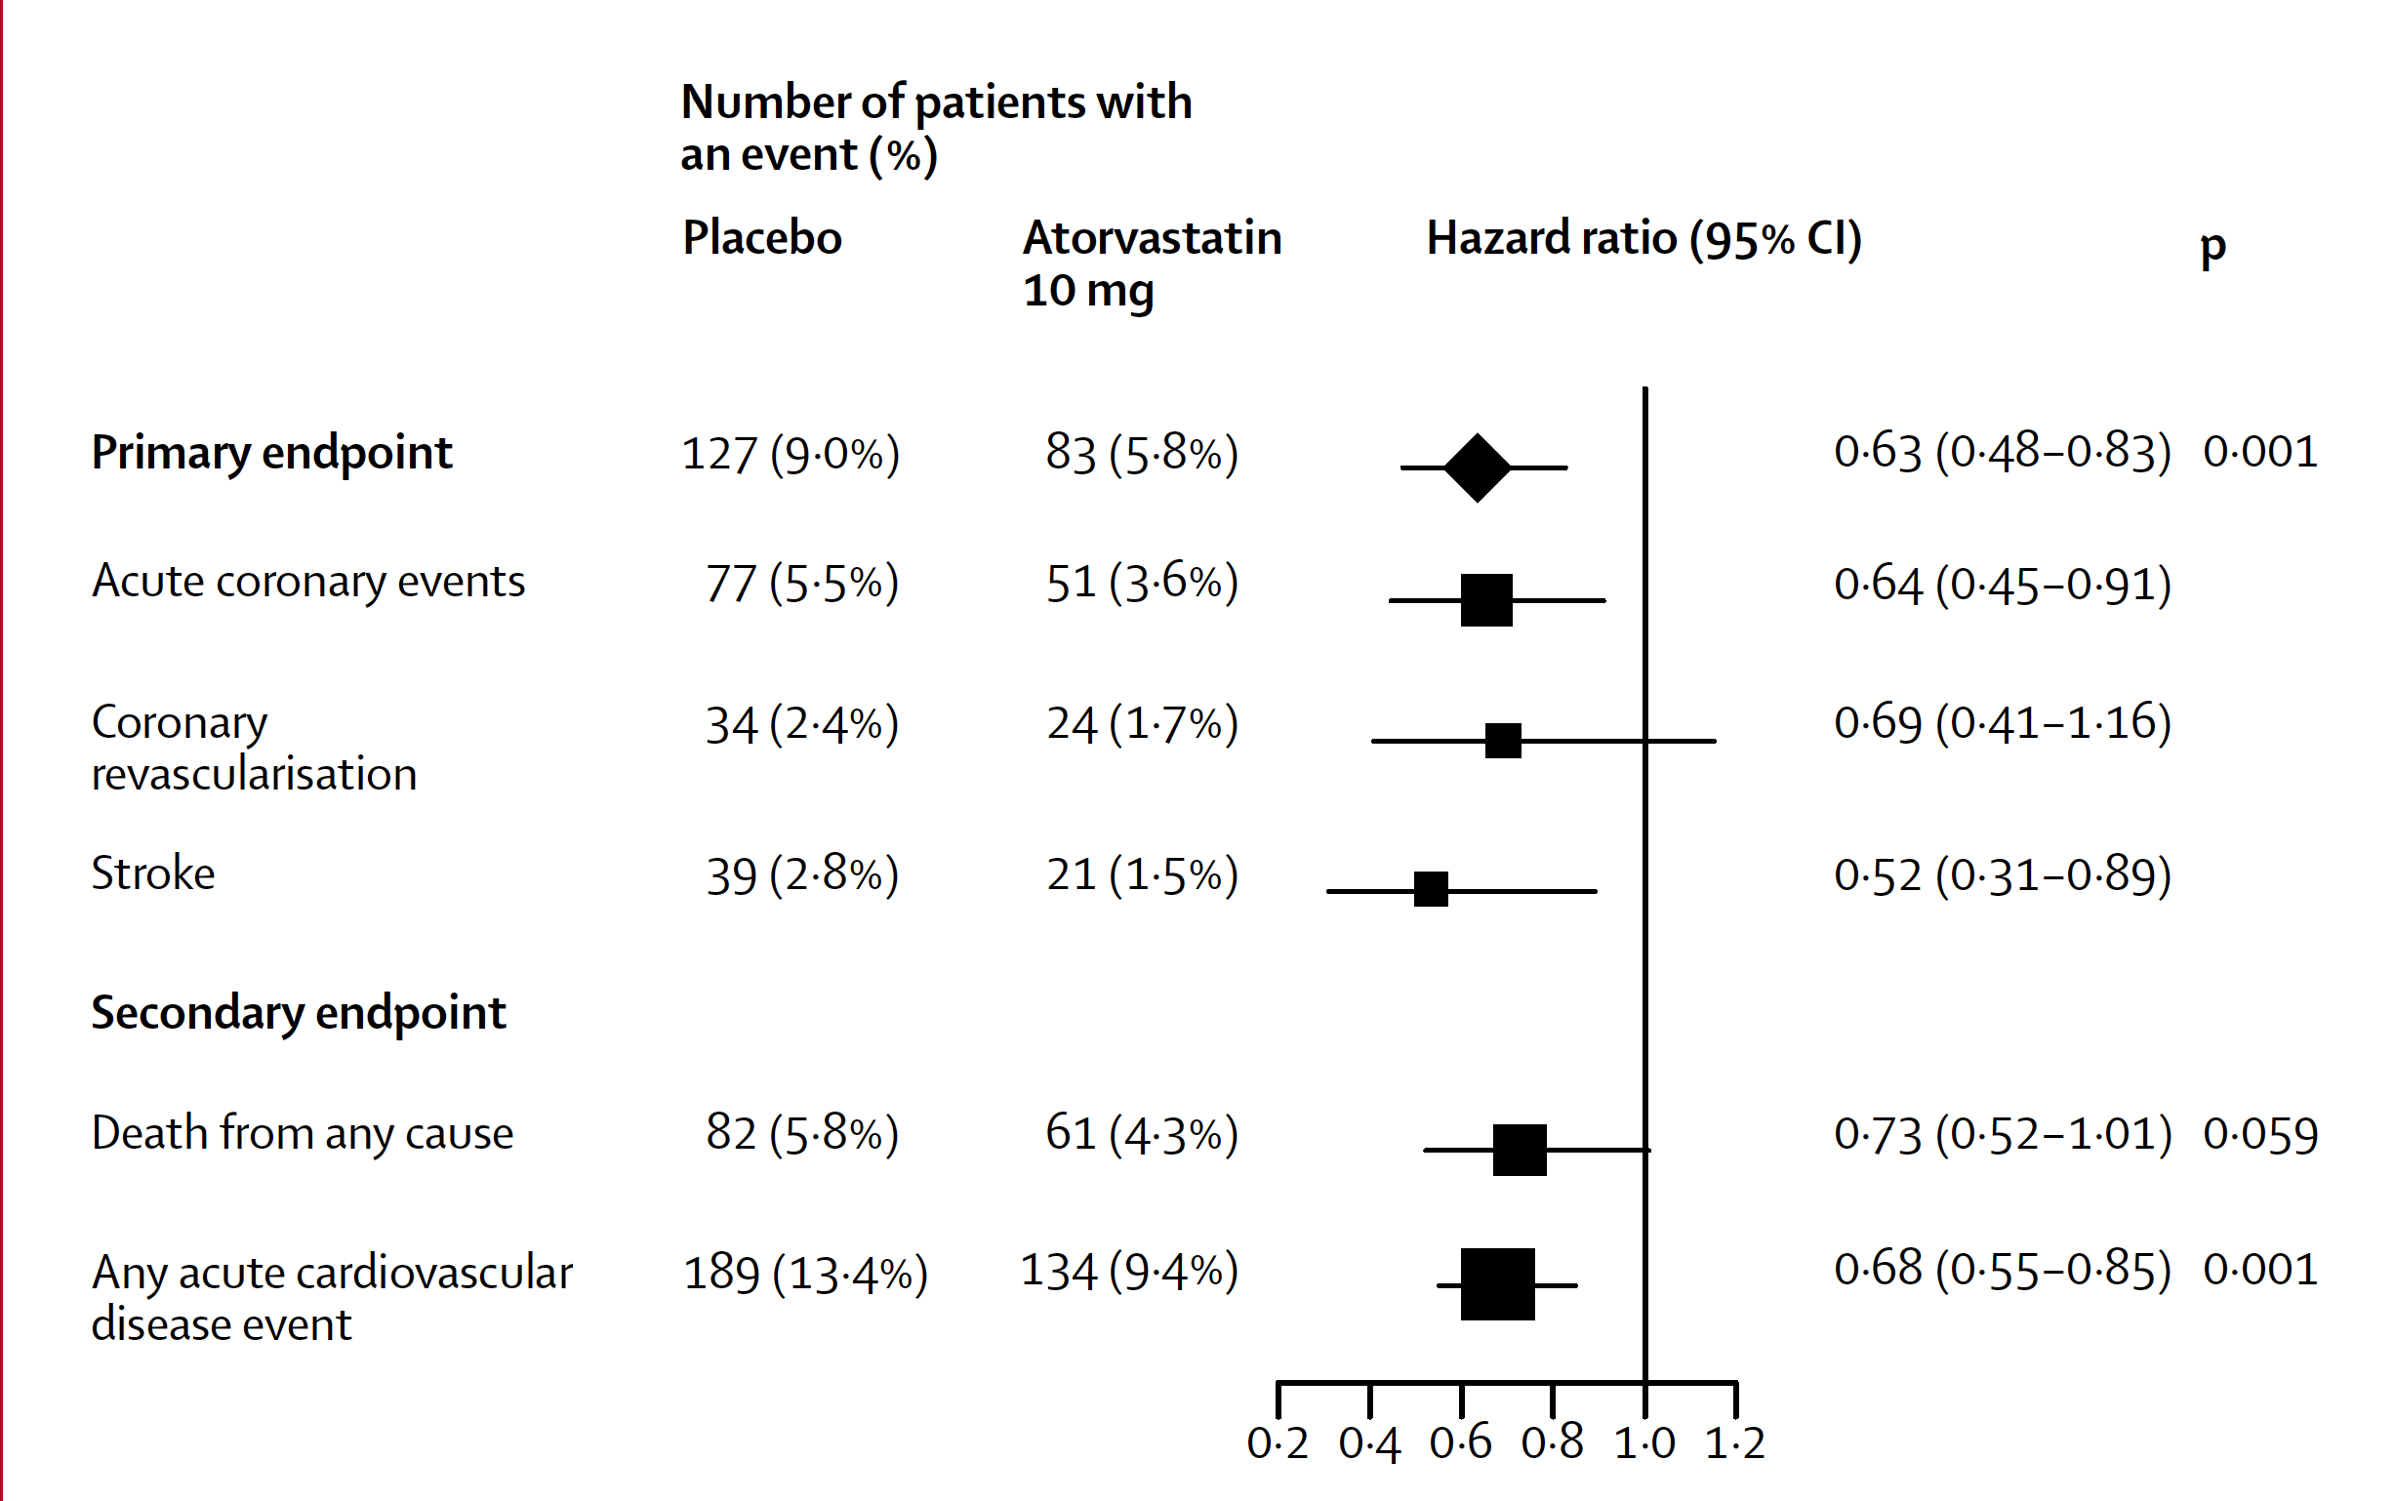
CARDS: Statin Reduced CVD in People with Diabetes
2018 Diabetes Canada CPG – Chapter 23. Cardiovascular Protection in People with Diabetes
Colhoun HM, et al. Lancet 2004;364:685.
Notes:
Lancet. 2004 Aug 21-27;364(9435):685-96.
Primary prevention of cardiovascular disease with atorvastatin in type 2 diabetes in the Collaborative Atorvastatin Diabetes Study (CARDS): multicentre randomised placebo-controlled trial.
Colhoun HM, Betteridge DJ, Durrington PN, Hitman GA, Neil HA, Livingstone SJ, Thomason MJ, Mackness MI, Charlton-Menys V, Fuller JH; CARDS investigators.
Source
EURODIAB, Department of Epidemiology and Public Health, Royal Free and University College Medical School, London, UK. helen.colhoun@ucd.ie
Abstract
BACKGROUND:
Type 2 diabetes is associated with a substantially increased risk of cardiovascular disease, but the role of lipid-lowering therapy with statins for the primary prevention of cardiovascular disease in diabetes is inadequately defined. We aimed to assess the effectiveness of atorvastatin 10 mg daily for primary prevention of major cardiovascular events in patients with type 2 diabetes without high concentrations of LDL-cholesterol.
METHODS:
2838 patients aged 40-75 years in 132 centres in the UK and Ireland were randomised to placebo (n=1410) or atorvastatin 10 mg daily (n=1428). Study entrants had no documented previous history of cardiovascular disease, an LDL-cholesterol concentration of 4.14 mmol/L or lower, a fasting triglyceride amount of 6.78 mmol/L or less, and at least one of the following: retinopathy, albuminuria, current smoking, or hypertension. The primary endpoint was time to first occurrence of the following: acute coronary heart disease events, coronary revascularisation, or stroke. Analysis was by intention to treat.
FINDINGS:
The trial was terminated 2 years earlier than expected because the prespecified early stopping rule for efficacy had been met. Median duration of follow-up was 3.9 years (IQR 3.0-4.7). 127 patients allocated placebo (2.46 per 100 person-years at risk) and 83 allocated atorvastatin (1.54 per 100 person-years at risk) had at least one major cardiovascular event (rate reduction 37% [95% CI -52 to -17], p=0.001). Treatment would be expected to prevent at least 37 major vascular events per 1000 such people treated for 4 years. Assessed separately, acute coronary heart disease events were reduced by 36% (-55 to -9), coronary revascularisations by 31% (-59 to 16), and rate of stroke by 48% (-69 to -11). Atorvastatin reduced the death rate by 27% (-48 to 1, p=0.059). No excess of adverse events was noted in the atorvastatin group.
INTERPRETATION:
Atorvastatin 10 mg daily is safe and efficacious in reducing the risk of first cardiovascular disease events, including stroke, in patients with type 2 diabetes without high LDL-cholesterol. No justification is available for having a particular threshold level of LDL-cholesterol as the sole arbiter of which patients with type 2 diabetes should receive statins. The debate about whether all people with this disorder warrant statin treatment should now focus on whether any patients are at sufficiently low risk for this treatment to be withheld.
17

Slide 18
Who Should Receive Statins?
(regardless of baseline LDL-C)
2018 Diabetes Canada CPG – Chapter 23. Cardiovascular Protection in People with Diabetes
Clinical CVD or
Age ≥40 yrs or
Microvascular complications or
Diabetes >15 yrs duration and age >30 yr or
Warrants therapy based on the 2016 Canadian Cardiovascular Society Guidelines for the Diagnosis and Treatment of Dyslipidemia
Among women with childbearing potential, statins should only be used in the presence of proper preconception counselling & reliable contraception. Stop statins prior to conception.
CVD, cardiovascular disease
Notes:
18

Slide 19
What if baseline LDL-C <2.0 mmol/L?
2018 Diabetes Canada CPG – Chapter 23. Cardiovascular Protection in People with Diabetes
Irrespective of initial LDL-C
  Patients obtain similar benefit
If a person with diabetes qualifies for statins;
  <2.0 mmol/L;
  Target reduction of ≥50% in LDL-C
HPS Lancet 2002;360:7-22
Colhoun HM, et al. Lancet 2004;364:685.

Slide 20
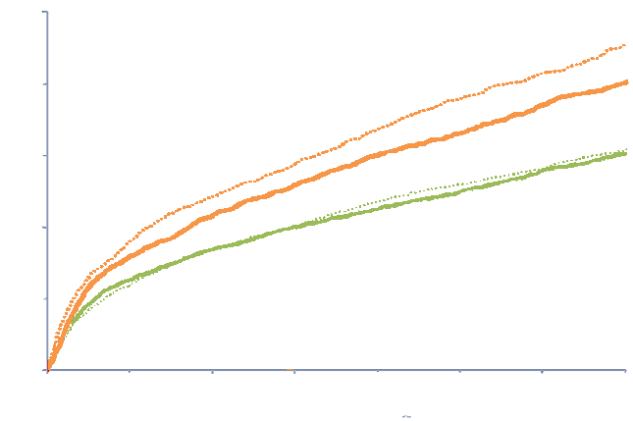
IMPROVE-IT: Ezetimibe add-on to statin reduced CV events in people with ACS and diabetes
CV death, MI, UA requiring re-hospitalization, coronary revascularization (≥30 days), or stroke
50%
With Diabetes 7 yr KM rate
Placebo/Simva 45.5%
EZE/Simva 40.0%
HR 0.85 (0.78, 0.94)
40%
P_{int}=0.023
30%
20%
Without Diabetes 7 yr KM rate
Placebo/Simva 30.8%
EZE/Simva 30.2%
HR 0.98 (0.91, 1.04)
10%
0%
0
1
2
3
4
5
6
7
Years after Randomization
Notes:
Benefit of Adding Ezetimibe to Statin Therapy on Cardiovascular Outcomes and Safety in Patients With vs. Without Diabetes: Results from IMPROVE-IT.
Giugliano RP¹, Cannon CP², Blazing MA³, Nicolau JC⁴, Corbalan R⁵, Spinar J⁶, Park JG², White JA³, Bohula E², Braunwald E²; IMPROVE-IT (IMProved Reduction of Outcomes: Vytorin Efficacy International Trial) Investigators.
Author information
Abstract
Background -Ezetimibe, when added to simvastatin, reduces cardiovascular events following acute coronary syndrome (ACS); we explored outcomes stratified by diabetes mellitus (DM). Methods -In IMPROVE-IT, 18,144 patients post ACS with LDL-C 50-125 mg/dL were randomized to ezetimibe/simvastatin-40mg (E/S) or placebo/simvastatin-40mg (P/S). The primary composite endpoint was cardiovascular death, major coronary events, and stroke. DM was a prespecified subgroup. Results -The 4933 (27%) patients with DM were more often older, female, with prior MI and revascularization, and presented more frequently with non-ST segment elevation ACS compared to non-DM (each p<0.001). The median admission LDL-C was lower among patients with DM (89 vs. 97 mg/dL, p<0.001). E/S achieved a significantly lower median time-weighted average LDL-C compared to P/S, irrespective of DM (DM: 49 vs. 67 mg/dL; No DM: 55 vs. 71 mg/dL, both P<0.001). In DM patients, E/S reduced the 7-year Kaplan-Meier primary endpoint event rate by 5.5% absolute (HR 0.85; 95% CI, 0.78-0.94); in non-DM patients the absolute difference was 0.7% (HR 0.98; 95% CI, 0.91-1.04; Pinteraction=0.02). The largest relative reductions in DM patients were in MI (24%) and ischemic stroke (39%). No differences in safety outcomes by treatment were present regardless of DM. When stratified further by age, patients ≥75 years had a 20% relative reduction in the primary endpoint regardless of DM (Pinteraction=0.91), while patients <75 years with DM had greater benefit than those without (Pinteraction=0.011). When stratified by the TIMI risk score for Secondary Prevention, all patients with DM demonstrated benefit with E/S regardless of risk. In contrast, among non-diabetics, patients with a high risk score experienced a significant 18% relative reduction in the composite of cardiovascular death, MI, and ischemic stroke with E/S compared to P/S, whereas non-diabetics at low or moderate risk demonstrated no benefit with the addition of ezetimibe to simvastatin (Pinteraction 0.034). Conclusions -In IMPROVE-IT the benefit of adding ezetimibe to statin was enhanced in patients with DM and in high-risk non-diabetics. Clinical Trial Registration -URL: https://clinicaltrials.gov Unique Identifier: NCT00202878.

Slide 21
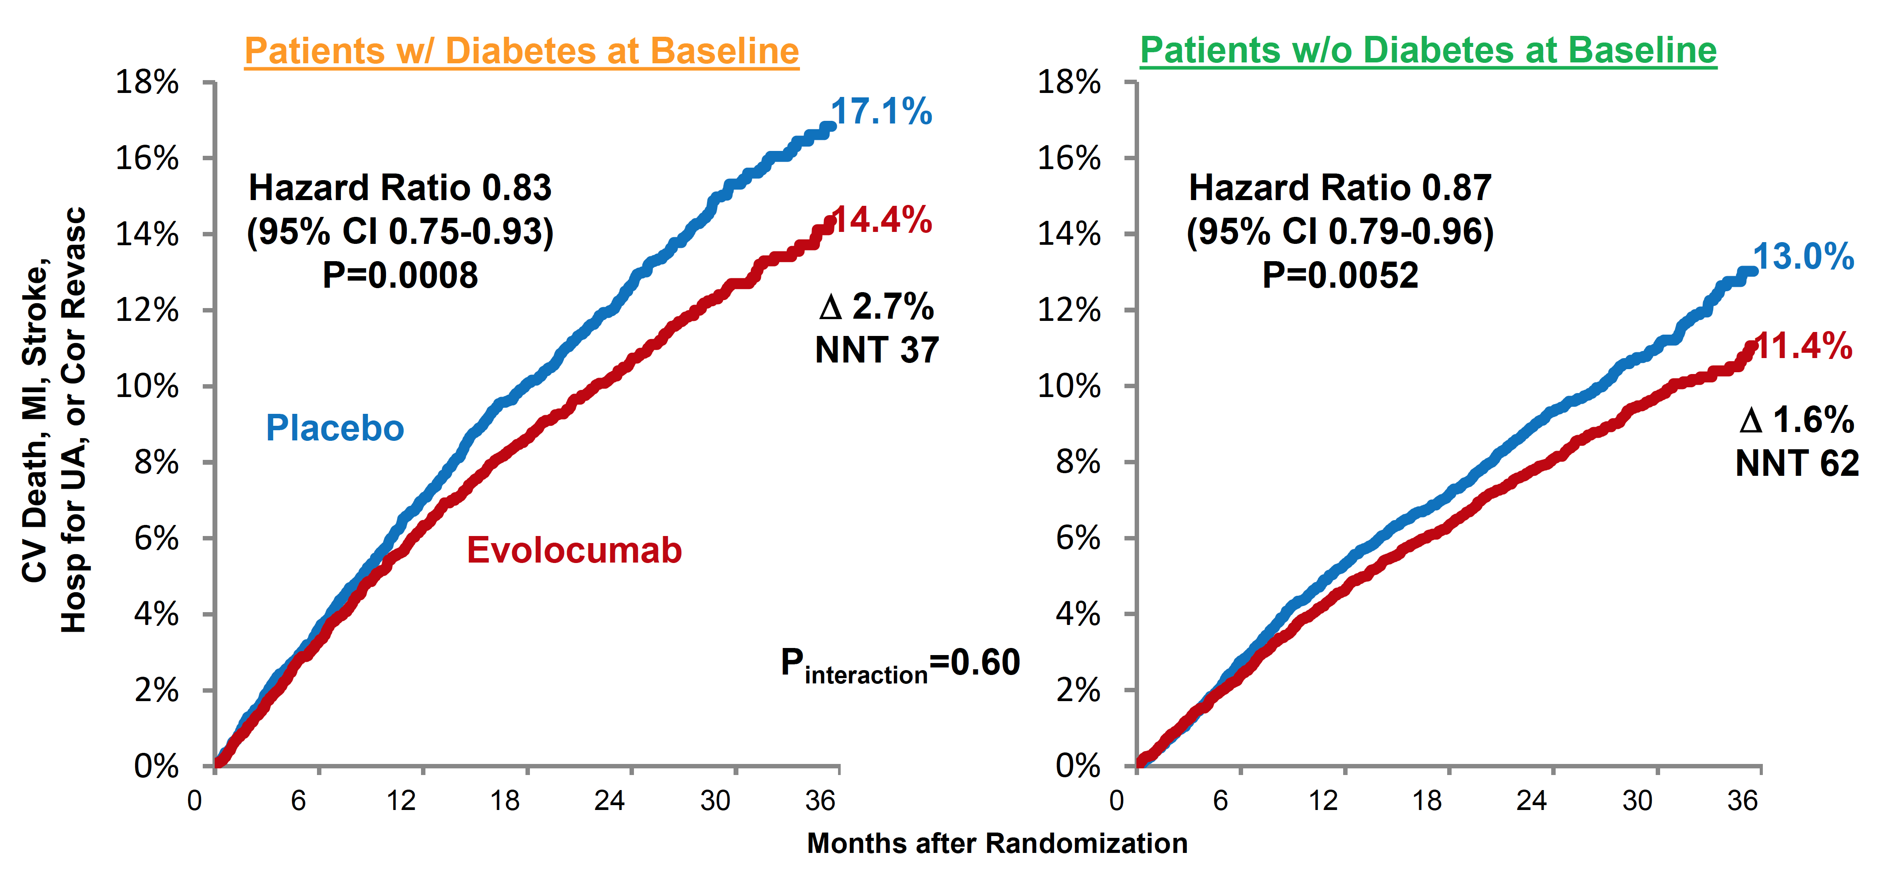
FOURIER: Evolocumab add-on to statin reduced CV events
Sabatine MS, et al. Lancet Diab Endocrinol 2017; 5(12):941-950
Notes:
Abstract
BACKGROUND:
The proprotein convertase subtilisin/kexin type 9 (PCSK9) inhibitor evolocumab reduced LDL cholesterol and cardiovascular events in the FOURIER trial. In this prespecified analysis of FOURIER, we investigated the efficacy and safety of evolocumab by diabetes status and the effect of evolocumab on glycaemia and risk of developing diabetes.
METHODS:
FOURIER was a randomised trial of evolocumab (140 mg every 2 weeks or 420 mg once per month) versus placebo in 27 564 patients with atherosclerotic disease who were on statin therapy, followed up for a median of 2·2 years. In this prespecified analysis, we investigated the effect of evolocumab on cardiovascular events by diabetes status at baseline, defined on the basis of patient history, clinical events committee review of medical records, or baseline HbA1c of 6·5% (48 mmol/mol) or greater or fasting plasma glucose (FPG) of 7·0 mmol/L or greater. The primary endpoint was a composite of cardiovascular death, myocardial infarction, stroke, hospital admission for unstable angina, or coronary revascularisation. The key secondary endpoint was a composite of cardiovascular death, myocardial infarction, or stroke. We also assessed the effect of evolocumab on glycaemia, and on the risk of new-onset diabetes among patients without diabetes at baseline. HbA1c was measured at baseline then every 24 weeks and FPG was measured at baseline, week 12, week 24, and every 24 weeks thereafter, and potential cases of new-onset diabetes were adjudicated centrally. In a post-hoc analysis, we also investigated the effects on glycaemia and diabetes risk in patients with prediabetes (HbA1c 5·7-6·4% [39-46 mmol/mol] or FPG 5·6-6·9 mmol/L) at baseline. FOURIER is registered with ClinicalTrials.gov, number NCT01764633.
FINDINGS:
At study baseline, 11 031 patients (40%) had diabetes and 16 533 (60%) did not have diabetes (of whom 10 344 had prediabetes and 6189 had normoglycaemia). Evolocumab significantly reduced cardiovascular outcomes consistently in patients with and without diabetes at baseline. For the primary composite endpoint, the hazard ratios (HRs) were 0·83 (95% CI 0·75-0·93; p=0·0008) for patients with diabetes and 0·87 (0·79-0·96; p=0·0052) for patients without diabetes (p_{interaction}=0·60). For the key secondary endpoint, the HRs were 0·82 (0·72-0·93; p=0·0021) for those with diabetes and 0·78 (0·69-0·89; p=0·0002) for those without diabetes (p_{interaction}=0·65). Evolocumab did not increase the risk of new-onset diabetes in patients without diabetes at baseline (HR 1·05, 0·94-1·17), including in those with prediabetes (HR 1·00, 0·89-1·13). Levels of HbA_{1c} and FPG were similar between the evolocumab and placebo groups over time in patients with diabetes, prediabetes, or normoglycaemia. Among patients with diabetes at baseline, the proportions of patients with adverse events were 78·5% (4327 of 5513 patients) in the evolocumab group and 78·3% (4307 of 5502 patients) in the placebo group; among patients without diabetes at baseline, the proportions with adverse events were 76·8% (6337 of 8256 patients) in the evolocumab group and 76·8% (6337 of 8254 patients) in the placebo group.
INTERPRETATION:
PCSK9 inhibition with evolocumab significantly reduced cardiovascular risk in patients with and without diabetes. Evolocumab did not increase the risk of new-onset diabetes, nor did it worsen glycaemia. These data suggest evolocumab use in patients with atherosclerotic disease is efficacious and safe in patients with and without diabetes.

Slide 22
Cardiovascular protective medications
2018 Diabetes Canada CPG – Chapter 23. Cardiovascular Protection in People with Diabetes
Statins
ACE-inhibitors or Angiotensin receptor blockers (ARB)
Certain antihyperglycemic agents
ASA selective use
Notes:
22

Slide 23
Association of SBP and CV Mortality in Men With Type 2 Diabetes
2018 Diabetes Canada CPG – Chapter 23. Cardiovascular Protection in People with Diabetes
250
No diabetes
Diabetes
200
150
CV mortality rate
Per 10,000 person-years
100
50
0
<120
120-139
140-159
160-179
180-199
≥200
SBP (mmHg)
Stamler J, et al. Diabetes Care. 1993;16:434-444.
CV, cardiovascular; SBP, systolic blood pressure
Notes:
23
The presence of diabetes further increases the already elevated risk associated with hypertension for CV mortality. The higher the systolic blood pressure (SBP), the greater the absolute excess risk for cardiovascular (CV) mortality among diabetic patients.
In the large cohort of men screened for MRFIT (the Multiple Risk Factor Intervention Trial), the relationship of SBP and other CV risk factors to CV mortality was compared in men with diabetes (n=5163) and in men without diabetes (n=342,815).
The absolute risk of CV death was 3 times higher for men with diabetes than for men without diabetes after adjusting for age, race, income, serum cholesterol, SBP, and cigarette smoking (P<0.0001).
SBP had a positive relationship with the risk of CV death, with a significant trend in subjects with or without diabetes (P<0.001).
At every SBP level, CV death was much greater for men with diabetes than for men without diabetes.
With higher SBP levels, the CV mortality rate increased more steeply in men with diabetes than in men without diabetes.
The combination of diabetes and hypertension thus dramatically increases CV risk.
References
Stamler J, Vaccaro O, Neaton JD, et al. Diabetes, other risk factors, and 12-yr cardiovascular mortality for men screened in the Multiple Risk Factor Intervention Trial. Diabetes Care. 1993;16:434-444.

Slide 24
UKPDS: Hypertension in Diabetes
2018 Diabetes Canada CPG – Chapter 23. Cardiovascular Protection in People with Diabetes
50
40
30
20
10
0
Less tight control (mean BP 154/87 mmHg)
Tight control (mean BP 144/82 mmHg)
Patients with CV events (%)
Tight BP control:
24% reduction of CV events
(95% CI 8-38)
0
1
2
3
4
5
6
7
8
9
Years from randomization
UKPDS Study Group. BMJ 1998; 317:703-13.
BP, blood pressure; CV, cardiovascular
Notes:
In the UKPDS study, tight BP control aimed to reduce BP to less than 140/80 mmHg. The achieved BP was 144/82 mmHg. In the usual-care control, the achieved BP was 154/87 mmHg.
Cardiovascular events were reduced 24% by enhanced BP control. In addition, death due to diabetes, and the incidence of heart failure, stroke, and microvascular disease were significantly reduced.
Reference:
UKPDS Study Group. Tight blood pressure control and risk of macrovascular and microvascular complications in type 2 diabetes: UKPDS 38. BMJ 1998; 317:703-13.
24

Slide 25
2018 Diabetes Canada CPG – Chapter 23. Cardiovascular Protection in People with Diabetes
HOT: BP Control Reduces CV Events
Diabetes Subgroup
30
P<0.005
25
24.4
Goal of therapy: target diastolic BP
20
18.8
≤ 90 mm Hg (n=501)
MI, stroke, CV mortality/1000 pt-y
≤ 85 mm Hg (n=501)
15
≤ 80 mm Hg (n=499)
11.9
10
5
0
Hansson et al. Lancet. 1998;351:1755.
BP, blood pressure; CV, cardiovascular; MI, myocardial infarct
Notes:
25
Lancet. 1998 Jun 13;351(9118):1755-62.
Effects of intensive blood-pressure lowering and low-dose aspirin in patients with hypertension: principal results of the Hypertension Optimal Treatment (HOT) randomised trial. HOT Study Group.
Hansson L, Zanchetti A, Carruthers SG, Dahlöf B, Elmfeldt D, Julius S, Ménard J, Rahn KH, Wedel H, Westerling S.
Source
University of Uppsala, Department of Public Health and Social Sciences, Clinical Hypertension Research, Sweden.
Abstract
BACKGROUND:
Despite treatment, there is often a higher incidence of cardiovascular complications in patients with hypertension than in normotensive individuals. Inadequate reduction of their blood pressure is a likely cause, but the optimum target blood pressure is not known. The impact of acetylsalicylic acid (aspirin) has never been investigated in patients with hypertension. We aimed to assess the optimum target diastolic blood pressure and the potential benefit of a low dose of acetylsalicylic acid in the treatment of hypertension.
METHODS:
18790 patients, from 26 countries, aged 50-80 years (mean 61.5 years) with hypertension and diastolic blood pressure between 100 mm Hg and 115 mm Hg (mean 105 mm Hg) were randomly assigned a target diastolic blood pressure. 6264 patients were allocated to the target pressure < or =90 mm Hg, 6264 to < or =85 mm Hg, and 6262 to < or =80 mm Hg. Felodipine was given as baseline therapy with the addition of other agents, according to a five-step regimen. In addition, 9399 patients were randomly assigned 75 mg/day acetylsalicylic acid (Bamycor, Astra) and 9391 patients were assigned placebo.
FINDINGS:
Diastolic blood pressure was reduced by 20.3 mm Hg, 22.3 mm Hg, and 24.3 mm Hg, in the < or =90 mm Hg, < or =85 mm Hg, and < or =80 mm Hg target groups, respectively. The lowest incidence of major cardiovascular events occurred at a mean achieved diastolic blood pressure of 82.6 mm Hg; the lowest risk of cardiovascular mortality occurred at 86.5 mm Hg. Further reduction below these blood pressures was safe. In patients with diabetes mellitus there was a 51% reduction in major cardiovascular events in target group < or =80 mm Hg compared with target group < or =90 mm Hg (p for trend=0.005). Acetylsalicylic acid reduced major cardiovascular events by 15% (p=0.03) and all myocardial infarction by 36% (p=0.002), with no effect on stroke. There were seven fatal bleeds in the acetylsalicylic acid group and eight in the placebo group, and 129 versus 70 non-fatal major bleeds in the two groups, respectively (p<0.001).
INTERPRETATION:
Intensive lowering of blood pressure in patients with hypertension was associated with a low rate of cardiovascular events. The HOT Study shows the benefits of lowering the diastolic blood pressure down to 82.6 mm Hg. Acetylsalicylic acid significantly reduced major cardiovascular events with the greatest benefit seen in all myocardial infarction. There was no effect on the incidence of stroke or fatal bleeds, but non-fatal major bleeds were twice as common.
Hansson L, Zanchetti A, Carruthers SG, et al. Effects of intensive blood-pressure lowering and low-dose aspirin in patients with
hypertension: principal results of the Hypertension Optimal Treatment (HOT) randomised trial. Lancet. 1998;351:1755-1762.

Slide 26
2018 Diabetes Canada CPG – Chapter 23. Cardiovascular Protection in People with Diabetes
Micro-HOPE (ACEi): CV Benefits
Primary Outcome (NNT 22)
0.16
All Mortality
(NNT 31)
0.2
Placebo
Ramipril 10 mg
0.08
0.1
RR = 0.75 (0.64-0.88)
p = 0.0004
RR = 0.76 (0.63-0.92)
p = 0.004
0
0
0
400
800
1200
0
400
800
1200
1600
Kaplan-Meier rates
1600
0.16
0.08
Stroke
(NNT 53)
0.12
MI
(NNT 37)
CV Death
(NNT 29)
0.08
0.04
0.06
RR = 0.78 (0.64-0.94)
p = 0.01
RR = 0.67 (0.5-0.9)
p = 0.0074
RR = 0.63 (0.49-0.79)
p = 0.001
0
0
0
0
1000
2000
0
1000
2000
0
1000
2000
Duration of follow-up (days)
HOPE study investigators. Lancet. 2000;355:253-59.
Notes:
26
The illustrated results and relative risks are for the 3577 people with diabetes who were allocated to ramipril or placebo.
Ramipril had a clear and consistent protective effect on the primary outcome as well as on each component of the composite primary outcome.
Not shown is the fact that the benefit was consistent across every clinical subgroup (type 1 vs. type 2 diabetes, men vs. women, microalbuminuria vs. no microalbuminuria, previous CV disease vs. no previous CV disease, and insulin therapy vs. no insulin.
Also not shown is the fact that the BP reduction with ramipril was 1.9 mm systolic and 3.3 mm diastolic, vs. a rise in the placebo group of 0.55 mm systolic and a fall of 2.3 mm diastolic. This change in blood pressure is much too small to account for the CV benefits that were observed. That is, from epidemiologic studies a BP fall of 10 mm systolic and 5 mm diastolic is needed to effect a 38% reduction in stroke and a 16% reduction in CHD. In this study, risk reductions of > 20% for both these outcomes were noted for much more modest blood pressure effects.

Slide 27
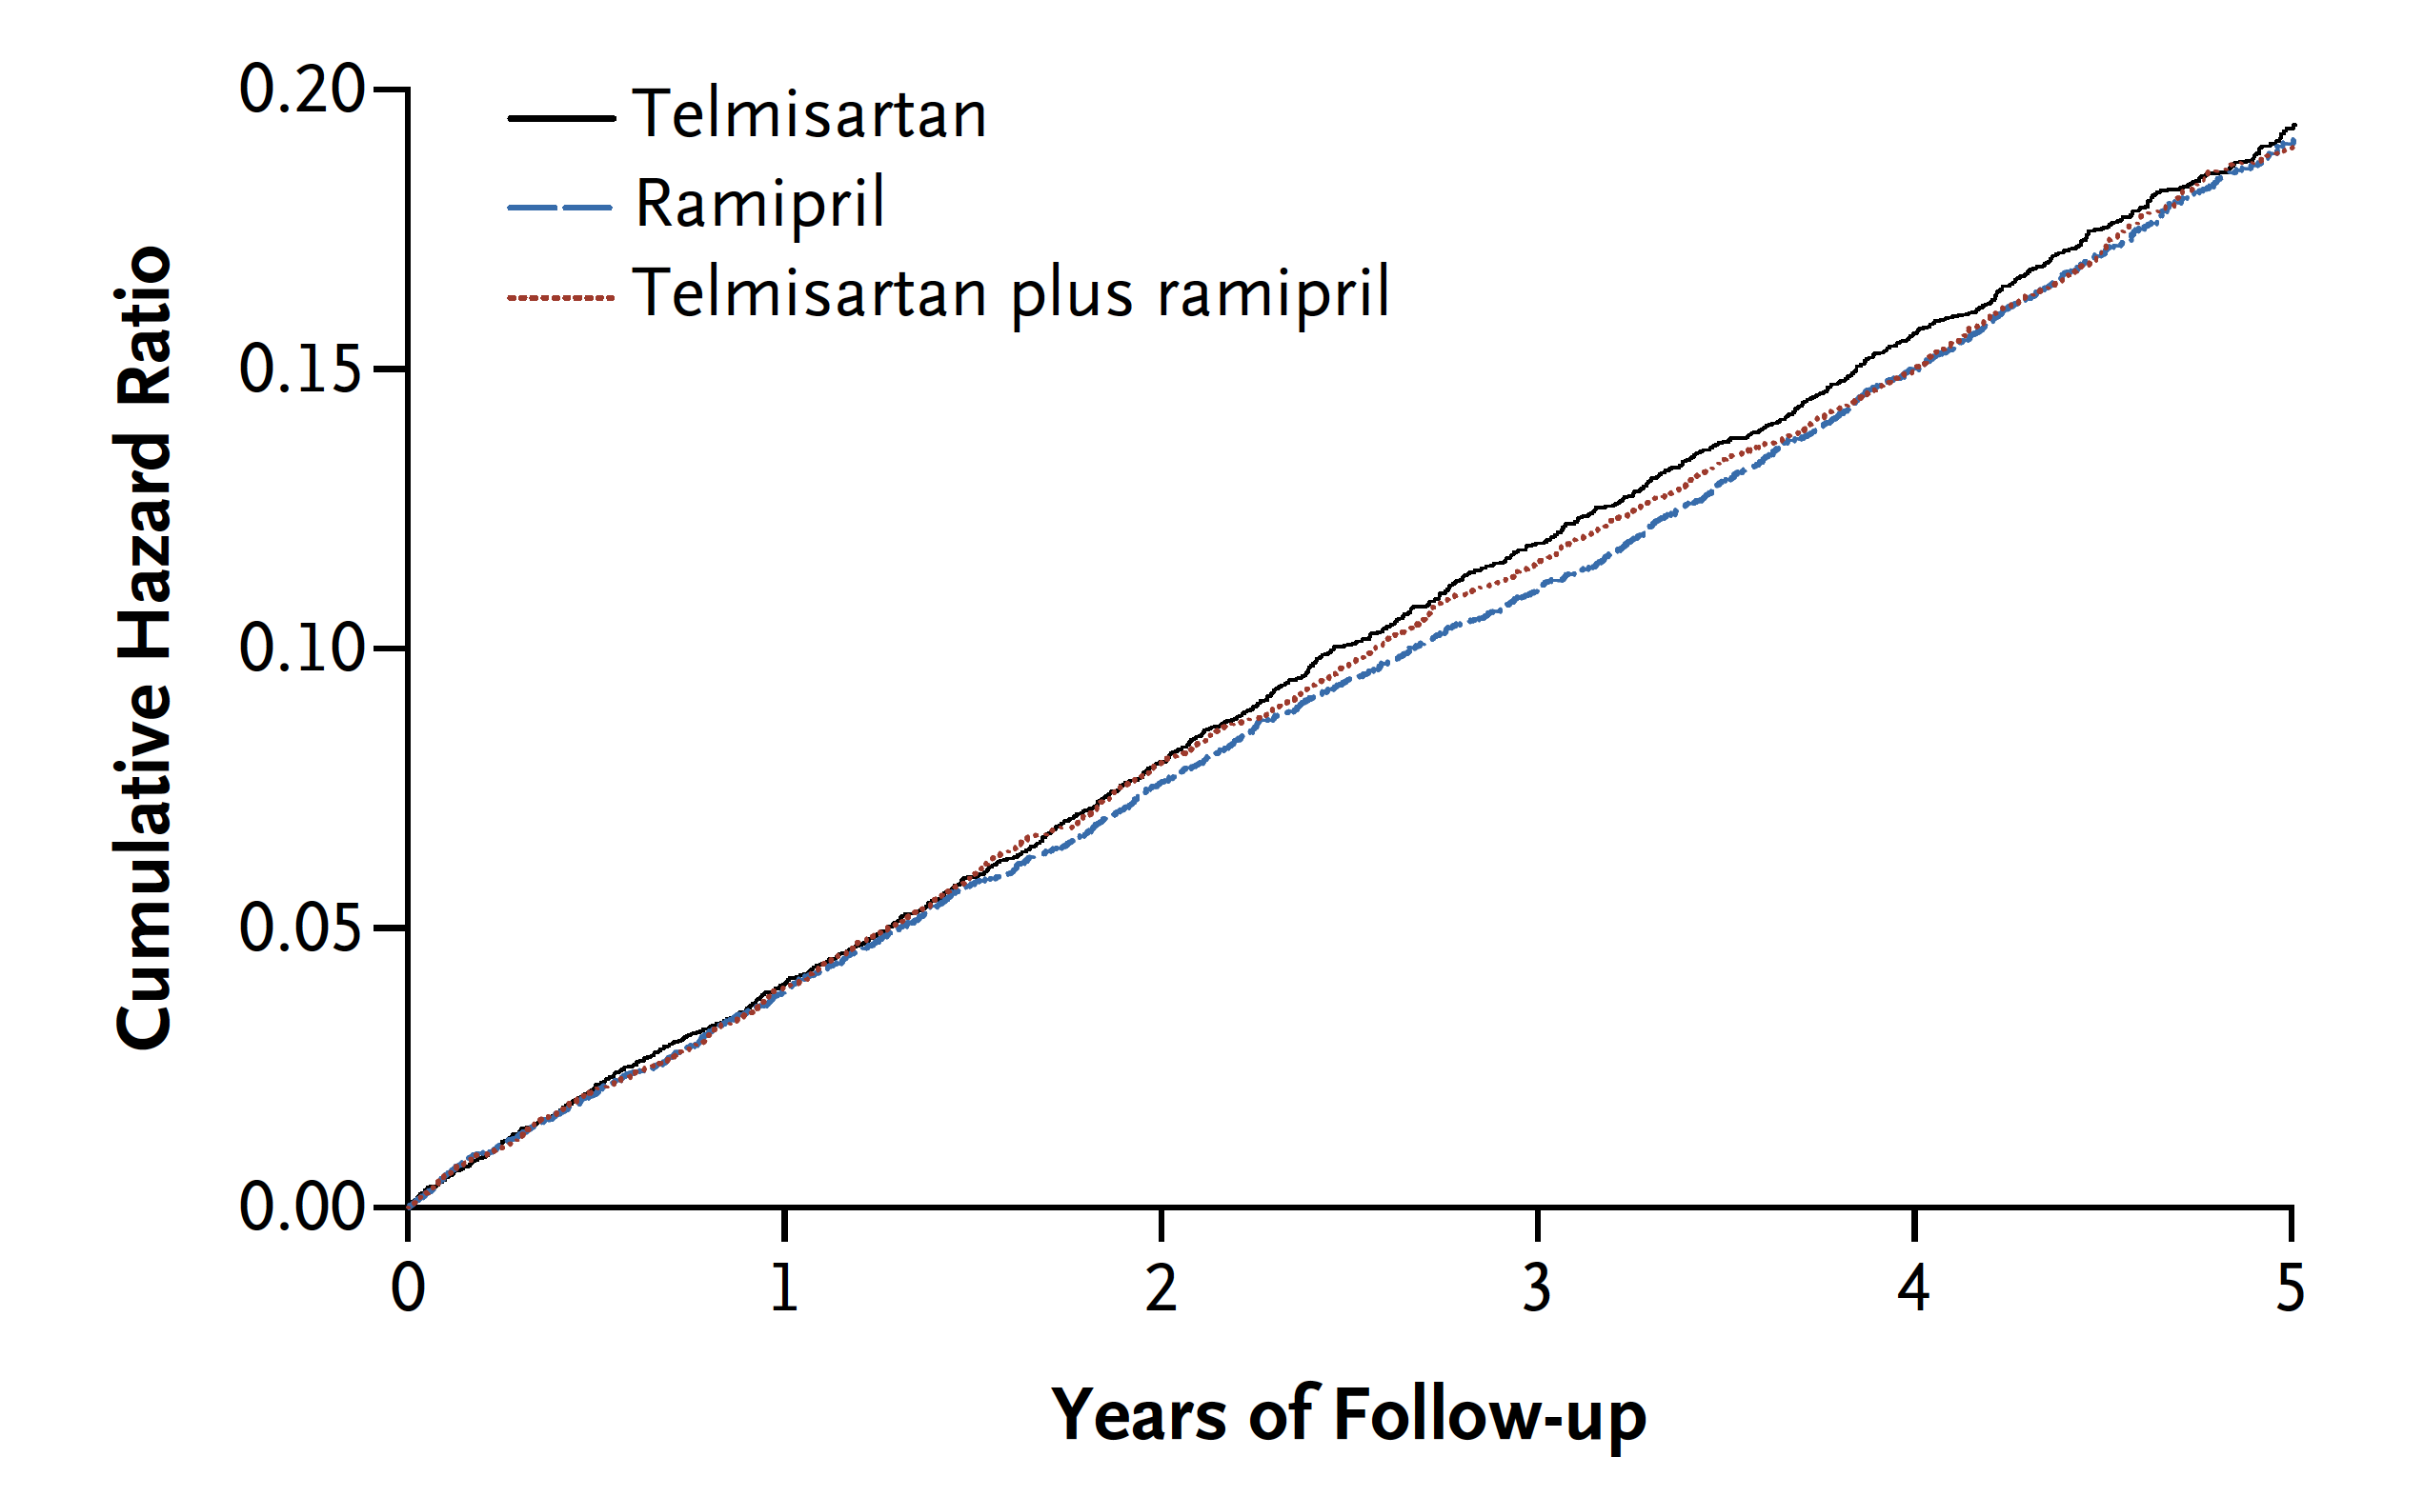
ONTARGET: ARB Therapy is as Effective as ACEi for CVD Prevention
2018 Diabetes Canada CPG – Chapter 23. Cardiovascular Protection in People with Diabetes
ONTARGET study investigators. NEJM. 2008:358:1547-59.
CVD, cardiovascular disease
Notes:
N Engl J Med. 2008 Apr 10;358(15):1547-59. doi: 10.1056/NEJMoa0801317. Epub 2008 Mar 31.
Telmisartan, ramipril, or both in patients at high risk for vascular events.
ONTARGET Investigators, Yusuf S, Teo KK, Pogue J, Dyal L, Copland I, Schumacher H, Dagenais G, Sleight P, Anderson C.
The following toggler user interface control may not be accessible. Tab to the next button to revert the control to an accessible version.
Destroy user interface controlCollaborators (969)
Source
Population Health Research Institute, McMaster University and Hamilton Health Sciences, Hamilton, ON, Canada. yusufs@mcmaster.ca
Abstract
BACKGROUND:
In patients who have vascular disease or high-risk diabetes without heart failure, angiotensin-converting-enzyme (ACE) inhibitors reduce mortality and morbidity from cardiovascular causes, but the role of angiotensin-receptor blockers (ARBs) in such patients is unknown. We compared the ACE inhibitor ramipril, the ARB telmisartan, and the combination of the two drugs in patients with vascular disease or high-risk diabetes.
METHODS:
After a 3-week, single-blind run-in period, patients underwent double-blind randomization, with 8576 assigned to receive 10 mg of ramipril per day, 8542 assigned to receive 80 mg of telmisartan per day, and 8502 assigned to receive both drugs (combination therapy). The primary composite outcome was death from cardiovascular causes, myocardial infarction, stroke, or hospitalization for heart failure.
RESULTS:
Mean blood pressure was lower in both the telmisartan group (a 0.9/0.6 mm Hg greater reduction) and the combination-therapy group (a 2.4/1.4 mm Hg greater reduction) than in the ramipril group. At a median follow-up of 56 months, the primary outcome had occurred in 1412 patients in the ramipril group (16.5%), as compared with 1423 patients in the telmisartan group (16.7%; relative risk, 1.01; 95% confidence interval [CI], 0.94 to 1.09). As compared with the ramipril group, the telmisartan group had lower rates of cough (1.1% vs. 4.2%, P<0.001) and angioedema (0.1% vs. 0.3%, P=0.01) and a higher rate of hypotensive symptoms (2.6% vs. 1.7%, P<0.001); the rate of syncope was the same in the two groups (0.2%). In the combination-therapy group, the primary outcome occurred in 1386 patients (16.3%; relative risk, 0.99; 95% CI, 0.92 to 1.07); as compared with the ramipril group, there was an increased risk of hypotensive symptoms (4.8% vs. 1.7%, P<0.001), syncope (0.3% vs. 0.2%, P=0.03), and renal dysfunction (13.5% vs. 10.2%, P<0.001).
CONCLUSIONS:
Telmisartan was equivalent to ramipril in patients with vascular disease or high-risk diabetes and was associated with less angioedema. The combination of the two drugs was associated with more adverse events without an increase in benefit. (ClinicalTrials.gov number, NCT00153101 [ClinicalTrials.gov].).
27

Slide 28
Who Should Receive ACEi or ARB Therapy?
(regardless of baseline blood pressure)
2018 Diabetes Canada CPG – Chapter 23. Cardiovascular Protection in People with Diabetes
2018
  Clinical CVD
  Age >55 years with an additional CV risk factor or end organ damage (albuminuria, retinopathy, left ventricular hypertrophy)
  Microvascular complications
At doses that have shown vascular protection [perindopril 8 mg daily (EUROPA), ramipril 10 mg daily (HOPE), telmisartan 80 mg daily (ONTARGET)]
Among women with childbearing potential, ACEi or ARB should only be used in the presence of proper preconception counselling & reliable contraception. Stop ACEi or ARB either prior to conception or immediately upon detection of pregnancy.
EUROPA Investigators, Lancet 2003;362(9386):782-788.
HOPE study investigators. Lancet. 2000;355:253-59.
ONTARGET study investigators. NEJM. 2008:358:1547-59
Notes:
28

Slide 29
RAAS blockade in diabetes
2018 Diabetes Canada CPG – Chapter 23. Cardiovascular Protection in People with Diabetes
Without hypertension or other CVD risk factors:
  Emerging uncertainty whether RAAS blockade is beneficial
Importantly,
  Majority of persons with diabetes > age 55:
    Require > 1 BP medication to get below target
    Most will end up on a RAAS agent to achieve BP target
Regularly evaluate CVD event risk and the need for ACE-inhibition or ARB therapy
Bangalore S, et al. BMJ. 2016; 352:i438.
BP, blood pressure; CVD, cardiovascular disease, RAAS, renin angiotensin aldosterone system
Notes:
emerging uncertainty whether RAAS blockade in people with diabetes but without hypertension or CV risk factors derive a CV event reduction benefit (1)
However, the majority of people with diabetes have additional compelling indications to be on RAAS inhibitors by age 55, require multiple medications to achieve BP targets, and have suboptimal BP control
Therefore, it is highly likely that people will end up on RAAS inhibition
Clinicians should regularly evaluate CV risk in all persons with diabetes to ensure people that would benefit from RAAS blockade are identified and treated

Slide 30
Cardiovascular protective medications
2018 Diabetes Canada CPG – Chapter 23. Cardiovascular Protection in People with Diabetes
Statins
ACE-inhibitors or Angiotensin receptor blockers (ARB)
Certain antihyperglycemic agents
ASA selective use
Notes:
30

Slide 31
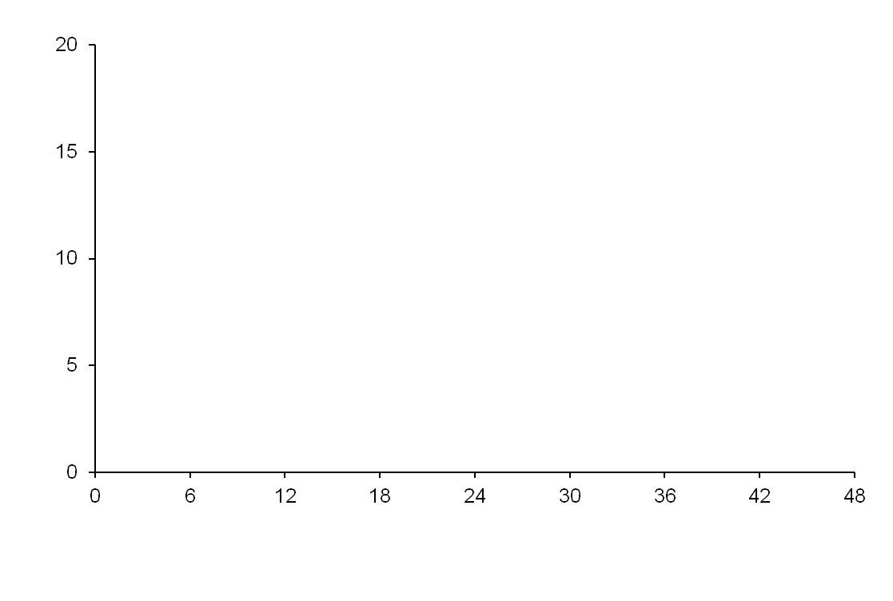
Empagliflozin reduced CV events
CV death, non-fatal MI, or non-fatal stroke
2018 Diabetes Canada CPG – Chapter 23. Cardiovascular Protection in People with Diabetes
 | PBO | EMPA | HR | P | NNT3
CV death, MI, stroke (%) | 12.1 | 10.5 | 0.86 | 0.04 | 63
CV deaths (%) | 5.9 | 3.7 | 0.62 | <0.001 | 46
Nonfatal MI (%) | 5.2 | 4.5 | 0.87 | 0.22
Nonfatal stroke (%) | 2.6 | 3.2 | 1.24 | 0.16
Hosp. heart failure (%) | 4.1 | 2.7 | 0.65 | 0.002 | 72
All-cause mortality (%) | 8.3 | 5.7 | 0.68 | <0.001 | 39
Placebo
Empagliflozin
Patients with event (%)
HR 0.86
95.02% CI (0.74, 0.99)
P < 0.001 for non-inferiority
p=0.04 for superiority
Months
No. of patients
Empagliflozin | 4687 | 4580 | 4455 | 4328 | 3851 | 2821 | 2359 | 1534 | 370
Placebo | 2333 | 2256 | 2194 | 2112 | 1875 | 1380 | 1161 | 741 | 166
Zinman B et al. N Engl J Med 2015; DOI: 10.1056/NEJMoa1504720
Notes:
N Engl J Med. 2015 Nov 26;373(22):2117-28. doi: 10.1056/NEJMoa1504720. Epub 2015 Sep 17.
Empagliflozin, Cardiovascular Outcomes, and Mortality in Type 2 Diabetes.
Zinman B, Wanner C, Lachin JM, Fitchett D, Bluhmki E, Hantel S, Mattheus M, Devins T, Johansen OE, Woerle HJ, Broedl UC, Inzucchi SE; EMPA-REG OUTCOME Investigators.
Collaborators (705)
Abstract
BACKGROUND:
The effects of empagliflozin, an inhibitor of sodium-glucose cotransporter 2, in addition to standard care, on cardiovascular morbidity and mortality in patients with type 2 diabetes at high cardiovascular risk are not known.
METHODS:
We randomly assigned patients to receive 10 mg or 25 mg of empagliflozin or placebo once daily. The primary composite outcome was death from cardiovascular causes, nonfatal myocardial infarction, or nonfatal stroke, as analyzed in the pooled empagliflozin group versus the placebo group. The key secondary composite outcome was the primary outcome plus hospitalization for unstable angina.
RESULTS:
A total of 7020 patients were treated (median observation time, 3.1 years). The primary outcome occurred in 490 of 4687 patients (10.5%) in the pooled empagliflozin group and in 282 of 2333 patients (12.1%) in the placebo group (hazard ratio in the empagliflozin group, 0.86; 95.02% confidence interval, 0.74 to 0.99; P=0.04 for superiority). There were no significant between-group differences in the rates of myocardial infarction or stroke, but in the empagliflozin group there were significantly lower rates of death from cardiovascular causes (3.7%, vs. 5.9% in the placebo group; 38% relative risk reduction), hospitalization for heart failure (2.7% and 4.1%, respectively; 35% relative risk reduction), and death from any cause (5.7% and 8.3%, respectively; 32% relative risk reduction). There was no significant between-group difference in the key secondary outcome (P=0.08 for superiority). Among patients receiving empagliflozin, there was an increased rate of genital infection but no increase in other adverse events.
CONCLUSIONS:
Patients with type 2 diabetes at high risk for cardiovascular events who received empagliflozin, as compared with placebo, had a lower rate of the primary composite cardiovascular outcome and of death from any cause when the study drug was added to standard care. (Funded by Boehringer Ingelheim and Eli Lilly; EMPA-REG OUTCOME ClinicalTrials.gov number, NCT01131676.).

Slide 32
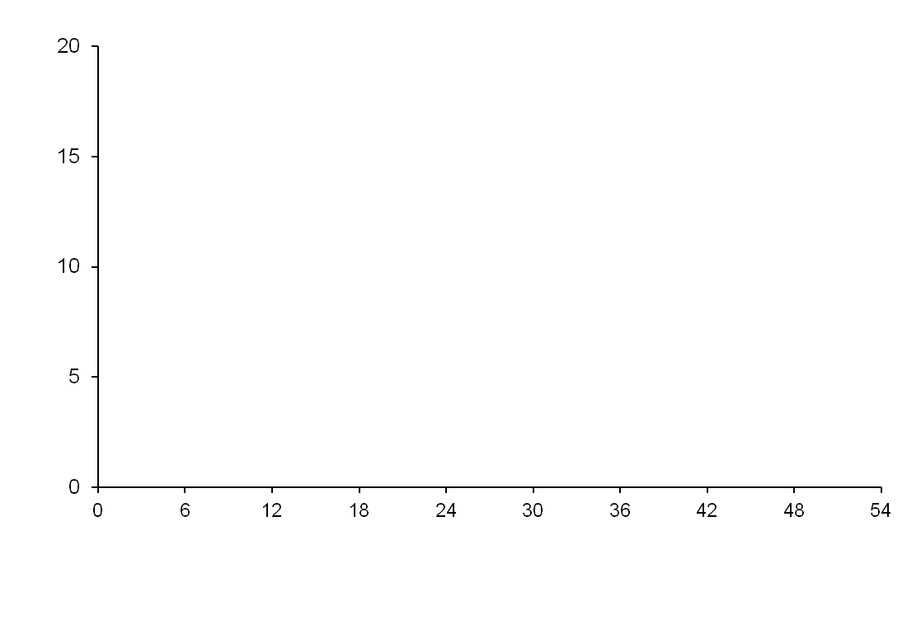
2018 Diabetes Canada CPG – Chapter 23. Cardiovascular Protection in People with Diabetes
Liraglutide reduced CV events
CV death, non-fatal MI, or non-fatal stroke
 | PBO | LIRA | HR | P | NNT4
CV death, MI, stroke (%) | 14.9 | 13.0 | 0.87 | 0.01 | 53
CV death (%) | 6.0 | 4.7 | 0.78 | 0.007 | 77
Nonfatal MI (%) | 6.8 | 6.0 | 0.88 | 0.11
Nonfatal stroke (%) | 3.8 | 3.4 | 0.89 | 0.30
Hosp. heart failure (%) | 5.3 | 4.7 | 0.87 | 0.14
All-cause mortality (%) | 9.6 | 8.2 | 0.85 | 0.02 | 72
Placebo
Patients with event (%)
Liraglutide
HR 0.87
95.02% CI (0.78, 0.97)
P < 0.001 for non-inferiority
p=0.01 for superiority
Time from randomization (months)
Patients at risk
Liraglutide | 4668 | 4593 | 4496 | 4400 | 4280 | 4172 | 4072 | 3982 | 1562 | 424
Placebo | 4672 | 4588 | 4473 | 4352 | 4237 | 4123 | 4010 | 3914 | 1543 | 407
Marso SP et al. N Engl J Med 2016;375(4):311-22.
Notes:
N Engl J Med. 2016 Jul 28;375(4):311-22. doi: 10.1056/NEJMoa1603827. Epub 2016 Jun 13.
Liraglutide and Cardiovascular Outcomes in Type 2 Diabetes.
Marso SP, Daniels GH, Brown-Frandsen K, Kristensen P, Mann JF, Nauck MA, Nissen SE, Pocock S, Poulter NR, Ravn LS, Steinberg WM, Stockner M, Zinman B, Bergenstal RM, Buse JB; LEADER Steering Committee; LEADER Trial Investigators.
Collaborators (2302)
Abstract
BACKGROUND:
The cardiovascular effect of liraglutide, a glucagon-like peptide 1 analogue, when added to standard care in patients with type 2 diabetes, remains unknown.
METHODS:
In this double-blind trial, we randomly assigned patients with type 2 diabetes and high cardiovascular risk to receive liraglutide or placebo. The primary composite outcome in the time-to-event analysis was the first occurrence of death from cardiovascular causes, nonfatal myocardial infarction, or nonfatal stroke. The primary hypothesis was that liraglutide would be noninferior to placebo with regard to the primary outcome, with a margin of 1.30 for the upper boundary of the 95% confidence interval of the hazard ratio. No adjustments for multiplicity were performed for the prespecified exploratory outcomes.
RESULTS:
A total of 9340 patients underwent randomization. The median follow-up was 3.8 years. The primary outcome occurred in significantly fewer patients in the liraglutide group (608 of 4668 patients [13.0%]) than in the placebo group (694 of 4672 [14.9%]) (hazard ratio, 0.87; 95% confidence interval [CI], 0.78 to 0.97; P<0.001 for noninferiority; P=0.01 for superiority). Fewer patients died from cardiovascular causes in the liraglutide group (219 patients [4.7%]) than in the placebo group (278 [6.0%]) (hazard ratio, 0.78; 95% CI, 0.66 to 0.93; P=0.007). The rate of death from any cause was lower in the liraglutide group (381 patients [8.2%]) than in the placebo group (447 [9.6%]) (hazard ratio, 0.85; 95% CI, 0.74 to 0.97; P=0.02). The rates of nonfatal myocardial infarction, nonfatal stroke, and hospitalization for heart failure were nonsignificantly lower in the liraglutide group than in the placebo group. The most common adverse events leading to the discontinuation of liraglutide were gastrointestinal events. The incidence of pancreatitis was nonsignificantly lower in the liraglutide group than in the placebo group.
CONCLUSIONS:
In the time-to-event analysis, the rate of the first occurrence of death from cardiovascular causes, nonfatal myocardial infarction, or nonfatal stroke among patients with type 2 diabetes mellitus was lower with liraglutide than with placebo. (Funded by Novo Nordisk and the National Institutes of Health; LEADER ClinicalTrials.gov number, NCT01179048.).

Slide 33
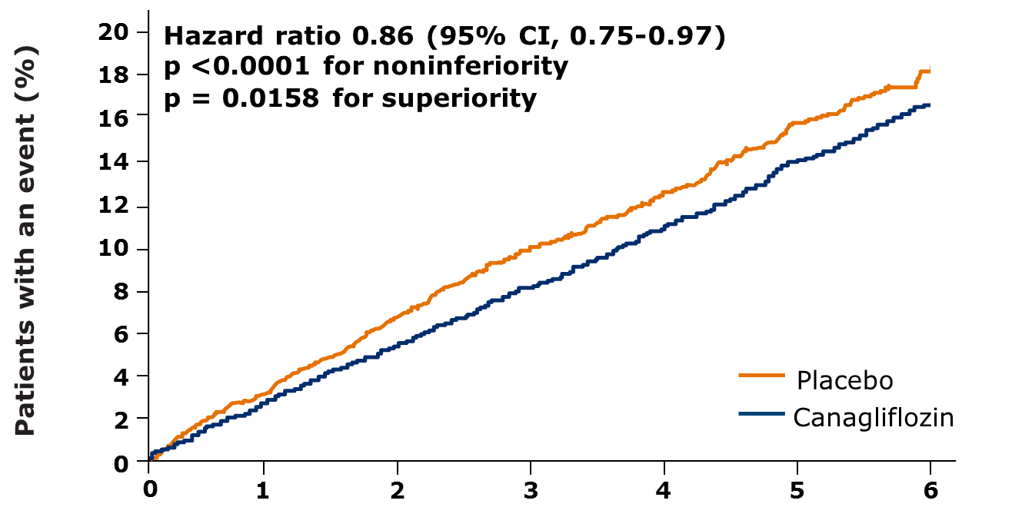
2018 Diabetes Canada CPG – Chapter 23. Cardiovascular Protection in People with Diabetes
Canagliflozin reduced CV events
CV death, non-fatal MI, or non-fatal stroke
Outcome (per 1000 pt-y) | PBO | CANA | HR | P or 95% CI | NNT 5
CV death, MI, stroke | 31.5 | 26.9 | 0.86 | 0.02 | 44
CV deaths | 12.8 | 11.6 | 0.87 | (0.72-1.06)
Nonfatal MI | 11.6 | 9.7 | 0.85 | (0.69-1.05)
Nonfatal stroke | 8.4 | 7.1 | 0.90 | (0.71-1.15)
Hosp. heart failure | 8.7 | 5.5 | 0.67 | (0.52-0.87) | 63
All-cause mortality | 19.5 | 17.3 | 0.87 | (0.74-1.01)
Placebo
Canagliflozin
HR 0.86
95% CI (0.75, 0.97)
P < 0.001 for non-inferiority
p=0.02 for superiority
No. of patients
Canagliflozin | 5795 | 5566 | 4343 | 2555 | 2460 | 2363 | 1661
Placebo | 4347 | 4153 | 2942 | 1240 | 1187 | 1120 | 789
Neal B et al. N Engl J Med 2017; DOI:10.1056/NEJMoa1611925
Notes:
Format: Abstract
Send to
N Engl J Med. 2017 Aug 17;377(7):644-657. doi: 10.1056/NEJMoa1611925. Epub 2017 Jun 12.
Canagliflozin and Cardiovascular and Renal Events in Type 2 Diabetes.
Neal B, Perkovic V, Mahaffey KW, de Zeeuw D, Fulcher G, Erondu N, Shaw W, Law G, Desai M, Matthews DR; CANVAS Program Collaborative Group.
Collaborators (711)
Abstract
Background Canagliflozin is a sodium-glucose cotransporter 2 inhibitor that reduces glycemia as well as blood pressure, body weight, and albuminuria in people with diabetes. We report the effects of treatment with canagliflozin on cardiovascular, renal, and safety outcomes. Methods The CANVAS Program integrated data from two trials involving a total of 10,142 participants with type 2 diabetes and high cardiovascular risk. Participants in each trial were randomly assigned to receive canagliflozin or placebo and were followed for a mean of 188.2 weeks. The primary outcome was a composite of death from cardiovascular causes, nonfatal myocardial infarction, or nonfatal stroke. Results The mean age of the participants was 63.3 years, 35.8% were women, the mean duration of diabetes was 13.5 years, and 65.6% had a history of cardiovascular disease. The rate of the primary outcome was lower with canagliflozin than with placebo (occurring in 26.9 vs. 31.5 participants per 1000 patient-years; hazard ratio, 0.86; 95% confidence interval [CI], 0.75 to 0.97; P<0.001 for noninferiority; P=0.02 for superiority). Although on the basis of the prespecified hypothesis testing sequence the renal outcomes are not viewed as statistically significant, the results showed a possible benefit of canagliflozin with respect to the progression of albuminuria (hazard ratio, 0.73; 95% CI, 0.67 to 0.79) and the composite outcome of a sustained 40% reduction in the estimated glomerular filtration rate, the need for renal-replacement therapy, or death from renal causes (hazard ratio, 0.60; 95% CI, 0.47 to 0.77). Adverse reactions were consistent with the previously reported risks associated with canagliflozin except for an increased risk of amputation (6.3 vs. 3.4 participants per 1000 patient-years; hazard ratio, 1.97; 95% CI, 1.41 to 2.75); amputations were primarily at the level of the toe or metatarsal. Conclusions In two trials involving patients with type 2 diabetes and an elevated risk of cardiovascular disease, patients treated with canagliflozin had a lower risk of cardiovascular events than those who received placebo but a greater risk of amputation, primarily at the level of the toe or metatarsal. (Funded by Janssen Research and Development; CANVAS and CANVAS-R ClinicalTrials.gov numbers, NCT01032629 and NCT01989754 , respectively.).

Slide 34
2018
AT DIAGNOSIS OF TYPE 2 DIABETES
HEALTHY BEHAVIOUR INTERVENTIONS
Start healthy behaviour interventions
(nutritional therapy, weight management, physical activity) +/- metformin
A1C <1.5% above target
A1C ≥1.5% above target
Symptomatic hyperglycemia and/or metabolic decompensation
If not at glycemic target within 3 months, start/increase metformin
Start metformin immediately
Consider a second concurrent antihyperglycemic agent
Initiate insulin +/-
metformin
If not at glycemic target
If not at glycemic target
Clinical CVD?
YES
NO
Start antihyperglycemic agent with demonstrated CV benefit
empagliflozin (Grade A, Level 1A)
liraglutide (Grade A, Level 1A)
canagliflozin* (Grade C, Level 2)
If not at glycemic target
See next page
* Avoid in people with prior lower extremity amputation

Slide 35
Cardiovascular protective medications
2018 Diabetes Canada CPG – Chapter 23. Cardiovascular Protection in People with Diabetes
Statins
ACE-inhibitors or Angiotensin receptor blockers (ARB)
Certain antihyperglycemic agents
ASA selective use
Notes:
35

Slide 36
What About ASA for 1⁰ Prevention of CVD?
2018 Diabetes Canada CPG – Chapter 23. Cardiovascular Protection in People with Diabetes
Included: Six studies, n = 10,117 participants
De Berardis G et al. BMJ 2009;339:b4531
Notes:
36

Slide 37
ASA for 1⁰
Prevention in Diabetes
Meta analysis of 6 studies
(n = 10,117)
No. of events/No. in group
ASA
Control/placebo
RR (95% CI)
RR (95% CI)
Major CV events
JPAD
POPADAD
WHS
PPP
ETDRS
Total
68/1262
105/638
58/514
20/519
350/1856
601/4789
86/1277
108/638
62/513
22/512
379/1855
657/4795
0.80 (0.59-1.09)
0.97 (0.76-1.24)
0.90 (0.63-1.29)
0.90 (0.50-1.62)
0.90 (0.78-1.04)
0.90 (0.81-1.00)
Myocardial infarction
JPAD
POPADAD
WHS
PPP
ETDRS
PHS
Total
28/1262
90/638
36/514
5/519
241/1856
11/275
395/5064
14/1277
82/638
24/513
10/512
283/1855
26/258
439/5053
0.87 (0.40-1.87)
1.10 (0.83-1.45)
1.48 (0.88-2.49)
0.49 (0.17-1.43)
0.82 (0.69-0.98)
0.40 (0.20-0.79)
0.86 (0.61-1.21)
No overall benefit for:
Major CV events
MI
Stroke
CV mortality
All-cause mortality
Stroke
JPAD
POPADAD
WHS
PPP
ETDRS
Total
12/1262
37/638
15/514
9/519
92/1856
181/4789
32/1277
50/638
31/513
10/512
78/1855
201/4795
0.89 (0.54-1.46)
0.74 (0.49-1.12)
0.46 (0.25-0.85)
0.89 (0.36-2.17)
1.17 (0.87-1.58)
0.83 (0.60-1.14)
Death from CV causes
JPAD
POPADAD
PPP
ETDRS
Total
1/1262
43/638
10/519
244/1856
298/4275
10/1277
35/638
8/512
275/1855
328/4282
0.10 (0.01-0.79)
1.23 (0.80-1.89)
1.23 (0.49-3.10)
0.87 (0.73-1.04)
0.94 (0.72-1.23)
JPAD = Japanese Primary Prevention of Atherosclerosis with Aspirin for Diabetes
POPADAD = Prevention of Progression of Arterial Disease and Diabetes
PPP = Primary Prevention Project
ETDRS = Early Treatment Diabetic Retinopathy Study
PHS = Physicians’ Health Study
WHS = Women’s Health Study
De Beradis G, et al. BMJ 2009; 339:b4531.
All-cause mortality
JPAD
POPADAD
PPP
ETDRS
Total
34/1262
94/638
25/519
340/1856
493/4275
38/1277
101/638
20/512
366/1855
525/4282
0.90 (0.57-1.14)
0.93 (0.72-1.21)
1.23 (0.69-2.19)
0.91 (0.78-1.06)
0.93 (0.82-1.05)
0.03
0.125
0.5
2
1
8
Favors ASA
Favors control/placebo
Notes:
This meta-analysis examined whether ASA is beneficial for patients with diabetes who have no clinical evidence of CVD. Of 6 eligible studies included in the meta-analysis of over 10,000 participants, there is no statistically significant reduction in the risk of Major CV events, MI, stroke, CV mortality or all-cause mortality when ASA was compared with placebo for primary prevention among patients with diabetes.
Of 157 studies in the literature searches, six were eligible (10,117 participants). When ASA was compared with placebo, there was no statistically significant reduction in the risk of major CV events (five studies, 9,584 participants; RR 0.90; 95% CI 0.81-1.00), CV mortality (four studies, 8,557 participants; RR 0.94; 95% CI 0.72-1.23), or all-cause mortality (four studies, 8,557 participants; RR 0.93; 95% CI 0.82-1.05).
Significant heterogeneity was found in the analyses for MI (I² = 62.2%; p = 0.02) and stroke (I² = 52.5%; p = 0.08). ASA significantly reduced the risk of MI in men (RR 0.57; 95% CI 0.34-0.94) but not in women (RR 1.08; 95% CI 0.71-1.65; p for interaction = 0.056). Evidence relating to harms was inconsistent.
These authors concluded that a clear benefit of ASA in the primary prevention of major CV events in people with diabetes remains unproved, that sex may be an important effect modifier, and that toxicity is to be explored further.
The analysis shows ASA has benefit for men in prevention of MI but not for stroke prevention, but no benefit in women for either MI or stroke prevention
Reference:
De Berardis G, Sacco M, Strippoli GF, et al. Aspirin for primary prevention of cardiovascular events in people with diabetes: meta-analysis of randomised controlled trials. BMJ 2009; 339:b4531.

Slide 38
2018 Diabetes Canada CPG – Chapter 23. Cardiovascular Protection in People with Diabetes
ASA Not Routinely Recommended for 1⁰ Prevention of CVD Among People with Diabetes
Insufficient evidence to support use of ASA for primary prevention
Risk of bleeding CVD protection
CVD, cardiovascular disease
Notes:
There is insufficient evidence at this time to support routine use of ASA in primary prevention
Need to balance the risk of bleeding vs CVD protection from ASA therapy
Will need to await until results of clinical trials such as Aspirin and Simvastatin Combination for Cardiovascular Events Prevention Trial in Diabetes (ACCEPT-D) and ASCEND Collaborative Group to shed light on the role of ASA for primary prevention
38

Slide 39

Don’t Forget To…………..
2018 Diabetes Canada CPG – Chapter 23. Cardiovascular Protection in People with Diabetes
          Multifaceted approach
          +
          Individualize therapy
Do your part
Protect their heart
Notes:
39

Slide 40
Recommendation 1
2018 Diabetes Canada CPG – Chapter 23. Cardiovascular Protection in People with Diabetes
All individuals with diabetes should follow a comprehensive, multifaceted approach to reduce CV risk, including:
  A1C ≤7.0% implemented early in the course of diabetes [Grade C, Level 3]
  Systolic BP of <130 mmHg [Grade C, Level 3] and diastolic BP of <80 mmHg [Grade B, Level 1] (see Treatment of Hypertension chapter)
  Additional vascular protective medications in the majority of adult people with diabetes (see recommendations below) [Grade A, Level 1 for those with type 2 diabetes age >40 years with albuminuria; Grade D, Consensus for those with type 1 diabetes]
  Achievement and maintenance of healthy weight goals [Grade D, Consensus]
  Healthy eating (see Nutrition Therapy Chapter for specific dietary recommendations)
  Regular physical activity [Grade D, Consensus]
  Smoking cessation [Grade C, Level 3]

Slide 41
Recommendation 2
2018 Diabetes Canada CPG – Chapter 23. Cardiovascular Protection in People with Diabetes
2. Statin therapy should be used to reduce CV risk in adults with type 1 or type 2 diabetes with any of the following features:
  Clinical CVD [Grade A, Level 1]
  Age ≥40 years [Grade A, Level 1 for type 2 diabetes; Grade D, Consensus for type 1 diabetes]
  Age <40 years and 1 of the following:
  Diabetes duration >15 years and age >30 years [Grade D, Consensus]
  Microvascular complications [Grade D, Consensus]
  Warrants therapy based on the presence of other risk factors according to the 2016 Canadian Cardiovascular Society Guidelines for the Diagnosis and Treatment of Dyslipidemia [Grade D, Consensus]
CVD, cardiovascular disease

Slide 42
Recommendation 3
2018 Diabetes Canada CPG – Chapter 23. Cardiovascular Protection in People with Diabetes
2018
3. For individuals not at LDL-C goal despite statin therapy, a combination of statin therapy with second-line agents may be used to achieve the goal and the agent used should be selected based upon the size of the existing gap to LDL-C goal [Grade D, Consensus]. Generally, ezetimibe should be considered [Grade D, Consensus]. In people with diabetes who also have concomitant clinical CVD, a PCSK9 inhibitor may be used [Grade A, Level 1] (see Dyslipidemia Chapter)

Slide 43
Recommendation 4
2018 Diabetes Canada CPG – Chapter 23. Cardiovascular Protection in People with Diabetes
2018
4. ACE inhibitor or ARB, at doses that have demonstrated vascular protection, should be used to reduce CV risk in adults with type 1 or type 2 diabetes with any of the following:
  Clinical CVD [Grade A, Level 1]
  Age >55 years with an additional CV risk factor or end organ damage (albuminuria, retinopathy, left ventricular hypertrophy) [Grade A, Level 1]
  Microvascular complications [Grade D, Consensus].
Note: Among women with childbearing potential, ACE inhibitors, ARBs or statins should only be used if there is reliable contraception
CVD, cardiovascular disease

Slide 44
Recommendations 5-7
2018 Diabetes Canada CPG – Chapter 23. Cardiovascular Protection in People with Diabetes
In people with established CVD, low-dose ASA therapy (81-162 mg) should be used to prevent CV events [Grade B, Level 2]
ASA should not be used routinely for the primary prevention of CVD in people with diabetes [Grade A, Level 1A]. ASA may be used in the presence of additional CV risk factors [Grade D, Consensus]
Clopidogrel 75 mg may be used in people unable to tolerate ASA [Grade D, Consensus
CV, cardiovascular; CVD, cardiovascular disease

Slide 45
Recommendation 8
2018 Diabetes Canada CPG – Chapter 23. Cardiovascular Protection in People with Diabetes
2018
CV, cardiovascular; CVD, cardiovascular disease
8. In adults with type 2 diabetes with clinical CVD in whom glycemic targets are not achieved with existing antihyperglycemic medication(s) and with an eGFR > 30 mL/min/1.73 m², an antihyperglycemic agent with demonstrated CV outcome benefit should be added to reduce the risk of major CV events [Grade A, Level 1A for empagliflozin; Grade A, Level 1A for liraglutide; Grade C, Level 2 for canagliflozin (see Pharmacologic Glycemic Management of Type 2 Diabetes in Adults chapter)

Slide 46
Key Messages
2018 Diabetes Canada CPG – Chapter 23. Cardiovascular Protection in People with Diabetes
Diabetes rapidly accelerates CVD
Healthy behaviours and pharmacological approaches can induce significant declaration
CVD, cardiovascular disease
Notes:
Diabetes significantly accelerates the development and natural history of cardiovascular disease compared to individuals without diabetes
Healthy behaviour interventions and pharmacological approaches aimed at cardiovascular disease risk reduction can significantly reduce morbidity and mortality, and are an important cornerstone of the management of diabetes

Slide 47
Key Messages
2018 Diabetes Canada CPG – Chapter 23. Cardiovascular Protection in People with Diabetes
Persons with diabetes <30 yrs:
  Low 10 year CVD risk
  But, still >> than persons without diabetes at a similar age
Historically, pharmacological vascular protection:
  Focused on
    LDL- C
    BP
  Now includes
    antihyperglycemic agents with demonstrated CV outcome benefit
BP, blood pressure; CV, cardiovascular; CVD, cardiovascular disease
Notes:
Although young people with diabetes rarely have a high proximate (<10 year) risk for cardiovascular disease events, they have a relative proximate risk many fold greater than individuals of similar age without diabetes
Historically, pharmacological cardiovascular protection approaches have focused on low density lipoprotein cholesterol and blood pressure reduction, and have demonstrated significant and clinically meaningful cardiovascular risk reduction. Recent data has indicated that certain antihyperglycemic agents are also cardioprotective

Slide 48
Key Messages
2018 Diabetes Canada CPG – Chapter 23. Cardiovascular Protection in People with Diabetes
All pharmacological CV protection therapies:
  Should consider CVD event risk both:
    Proximate
    Lifetime
Heart failure, even without MI/CVD:
  Important cause of morbidity and mortality in diabetes
CV, cardiovascular; CVD, cardiovascular disease; MI, myocardial infarct

Slide 49
Key Messages for People with Diabetes
2018 Diabetes Canada CPG – Chapter 23. Cardiovascular Protection in People with Diabetes
Ask your doctor about the ABCDEs to reduce your risk of heart attack and stroke:
A = A1C – Blood glucose control. The target is usually 7% or less
B = BP – Blood pressure control (less than 130/80 mm Hg)
C = Cholesterol – LDL-cholesterol less than 2.0 mmol/L. Your physician or nurse practitioner may advise you to start cholesterol lowering medication
D = Drugs to protect your heart: These include blood pressure pills (“ACE inhibitors or ARBs), cholesterol lowering medication (“statins”), and in people with existing cardiovascular disease, certain blood glucose lowering medications. These blood glucose lowering medications can protect your heart even if your blood pressure and/or LDL-cholesterol are already at target
E = Exercise /Eating – Regular physical activity which includes healthy eating, and achievement and maintenance of a healthy body weight
S = Stop smoking and manage stress

Slide 50
Vascular Protection Checklist
2018 Diabetes Canada CPG – Chapter 23. Cardiovascular Protection in People with Diabetes
A • A1C – optimal glycemic control (usually ≤7%)
B • BP – optimal blood pressure control (<130/80)
C • Cholesterol – LDL-C < 2.0 mmol/L or >50%
reduction if treatment indicated
D • Drugs to protect the heart
    A – ACEi or ARB │ S – Statin │ A – ASA if indicated │SGLT2i / GLP-1RA with demonstrated CV benefit if type 2 DM with CVD and A1C not at target
E • Exercise / Healthy Eating
S • Smoking cessation
ACEi, angiotensin converting enzyme inhibitor; ARB, angiotension receptor blocker; CV, cardiovascular; CVD, cardiovascular disease; DM, diabetes mellitus
Notes:
50

Slide 51

Visit guidelines.diabetes.ca

Slide 52


Or download the App

Slide 53
Diabetes Canada Clinical Practice Guidelines
www.guidelines.diabetes.ca – health-care providers
1-800-BANTING (226-8464)
www.diabetes.ca – for people with diabetes
Notes:
53

