Slide 1
Screening for Diabetes in Adults
2018 Clinical Practice Guidelines
Chapter 4
Jean-Marie Ekoe MD CSPQ PD,
Ronald Goldenberg MD FRCPC FACE,
Pamela Katz MD FRCPC

Slide 2
Disclaimer
All Content contained on this slide deck is the property of Diabetes Canada, its content suppliers or its licensors as the case may be, and is protected by Canadian and international copyright, trademark, and other applicable laws. Diabetes Canada grants personal, limited, revocable, non-transferable and non-exclusive license to access and read content in this slide deck for personal, non-commercial and not-for-profit use only. The slide deck is made available for lawful, personal use only and not for commercial use.
The unauthorized reproduction, distribution of this copyrighted work is not permitted.
For permission to use this slide deck for commercial or any use other than personal, please contact guidelines@diabetes.ca

Slide 3
Key Changes
2018 Diabetes Canada CPG – Chapter 4. Screening for Diabetes in Adults
2018
Reinforcement of the importance of screening for diabetes using FPG and/or A1C every 3 years in individuals ≥40 years of age or at high risk using a risk calculator
New information on
  De-emphasized role for screening with the 75 g oral glucose tolerance test
  Arab population added as high-risk for type 2 diabetes

Slide 4
Screening Checklist
2018 Diabetes Canada CPG – Chapter 4. Screening for Diabetes in Adults
ASSESS all adults clinically every year for risk of type 2 diabetes
SCREEN every 3 years if ≥ 40 yrs or high risk on risk calculator
SCREEN earlier and more frequently if very high risk on risk calculator or additional risk factors present
USE FPG and/or A1C as initial screening tests
A1C, glycated hemoglobin; FPG, fasting plasma glucose
Notes:
4

Slide 5
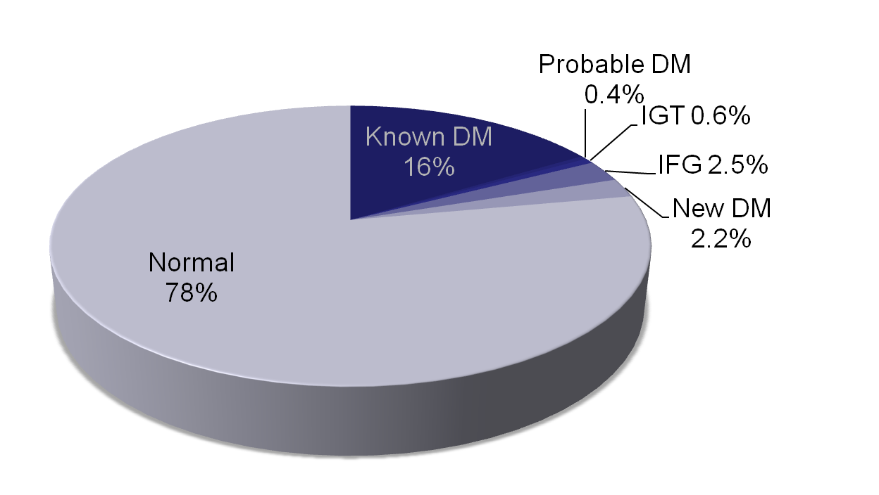
DIASCAN: Canadian Screening for Type 2 diabetes in those age >40 yrs in Primary Care
5.7% undiagnosed glucose abnormalities
Leiter LA et al. Diabetes Care 2001;24:1038-43.
DM; diabetes mellitus; IFG, impaired fasting glucose; IGT, impaired glucose tolerance
Notes:
Diabetes Care. 2001 Jun;24(6):1038-43.
Diabetes Screening in Canada (DIASCAN) Study: prevalence of undiagnosed diabetes and glucose intolerance in family physician offices.
Leiter LA, Barr A, Bélanger A, Lubin S, Ross SA, Tildesley HD, Fontaine N; Diabetes Screening in Canada (DIASCAN) Study.
Source
St. Michael's Hospital and University of Toronto, 61 Queen St. E., M4V 2L5 Toronto, Ontario, Canada. leiter@smh.toronto.on.ca
Abstract
OBJECTIVE:
To assess the prevalence of undiagnosed diabetes and glucose intolerance in individuals > or =40 years of age who contacted their family physician for routine care.
RESEARCH DESIGN AND METHODS:
The study used a stratified randomized selection of family physicians across Canada that was proportional to provincial and urban/rural populations based on Statistics Canada Census data (1996). Consecutive patients > or =40 years of age were screened for diabetes. If a casual fingerprick blood glucose was >5.5 mmol/l, the patient returned for a fasting venous blood glucose test. If the fasting blood glucose was 6.1-6.9 mmol/l, a 2-h 75-g post-glucose load venous blood glucose was obtained. Results of these tests were used to classify patients in diagnostic categories.
RESULTS:
Data were available for 9,042 patients. Previously undiagnosed diabetes was discovered in 2.2% of the patients, and new glucose intolerance was found in an additional 3.5% of patients. Overall, 16.4% of patients had previously known diabetes. The decrease in fasting plasma glucose criterion from 7.8 to 7.0 mmol/l resulted in a 2.2% versus a 1.6% prevalence of new diabetes. Several risk factors were reported in a significantly greater proportion of patients with new glucose intolerance and either new and known diabetes compared with the normal glucose tolerance group of patients.
CONCLUSIONS:
Routine screening for diabetes by family physicians is justified in patients > or =40 years of age, given the finding of previously undiagnosed diabetes in 2.2% of these patients and newly diagnosed glucose intolerance in an additional 3.5% of these patients. Another 16.4% of primary care patients > or =40 years of age have known diabetes. This has important implications regarding health resources and physician education.
5

Slide 6
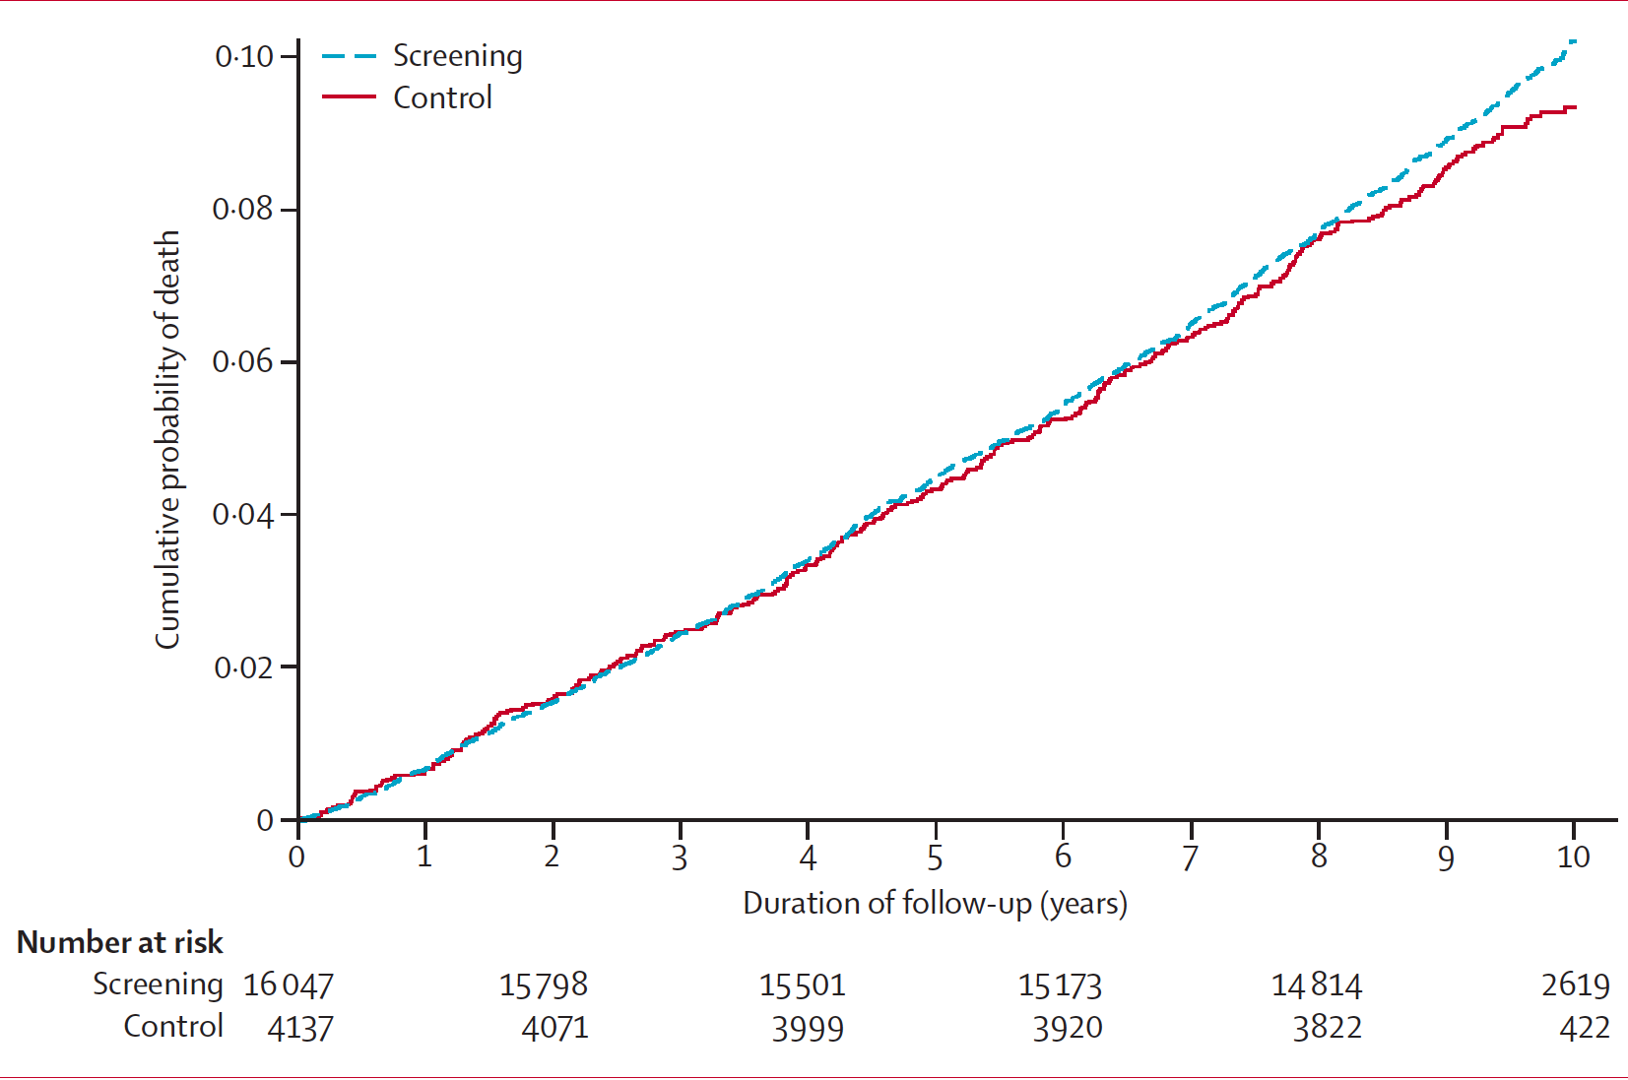
ADDITION-Cambridge:
No Mortality Benefit of Screening for Type 2 diabetes in United Kingdom
Simmons RK et al. Lancet 2012;380:1741-48.
Notes:
Lancet. 2012 Nov 17;380(9855):1741-8. doi: 10.1016/S0140-6736(12)61422-6. Epub 2012 Oct 4.
Screening for type 2 diabetes and population mortality over 10 years (ADDITION-Cambridge): a cluster-randomised controlled trial.
Simmons RK, Echouffo-Tcheugui JB, Sharp SJ, Sargeant LA, Williams KM, Prevost AT, Kinmonth AL, Wareham NJ, Griffin SJ.
Source
MRC Epidemiology Unit, Cambridge, UK.
Abstract
BACKGROUND:
The increasing prevalence of type 2 diabetes poses a major public health challenge. Population-based screening and early treatment for type 2 diabetes could reduce this growing burden. However, uncertainty persists around the benefits of screening for type 2 diabetes. We assessed the effect of a population-based stepwise screening programme on mortality.
METHODS:
In a pragmatic parallel group, cluster-randomised trial, 33 general practices in eastern England were randomly assigned by the method of minimisation in an unbalanced design to: screening followed by intensive multifactorial treatment for people diagnosed with diabetes (n=15); screening plus routine care of diabetes according to national guidelines (n=13); and a no-screening control group (n=5). The study population consisted of 20,184 individuals aged 40-69 years (mean 58 years), at high risk of prevalent undiagnosed diabetes, on the basis of a previously validated risk score. In screening practices, individuals were invited to a stepwise programme including random capillary blood glucose and glycated haemoglobin (HbA(1c)) tests, a fasting capillary blood glucose test, and a confirmatory oral glucose tolerance test. The primary outcome was all-cause mortality. All participants were flagged for mortality surveillance by the England and Wales Office of National Statistics. Analysis was by intention-to-screen and compared all-cause mortality rates between screening and control groups. This study is registered, number ISRCTN86769081.
FINDINGS:
Of 16,047 high-risk individuals in screening practices, 15,089 (94%) were invited for screening during 2001-06, 11,737 (73%) attended, and 466 (3%) were diagnosed with diabetes. 4137 control individuals were followed up. During 184,057 person-years of follow up (median duration 9·6 years [IQR 8·9-9·9]), there were 1532 deaths in the screening practices and 377 in control practices (mortality hazard ratio [HR] 1·06, 95% CI 0·90-1·25). We noted no significant reduction in cardiovascular (HR 1·02, 95% CI 0·75-1·38), cancer (1·08, 0·90-1·30), or diabetes-related mortality (1·26, 0·75-2·10) associated with invitation to screening.
INTERPRETATION:
In this large UK sample, screening for type 2 diabetes in patients at increased risk was not associated with a reduction in all-cause, cardiovascular, or diabetes-related mortality within 10 years. The benefits of screening might be smaller than expected and restricted to individuals with detectable disease.
FUNDING:
Wellcome Trust; UK Medical Research Council; National Health Service research and development support; UK National Institute for Health Research; University of Aarhus, Denmark; Bio-Rad.
Copyright © 2012 Elsevier Ltd. All rights reserved.
6

Slide 7
ADDITION-Cambridge: Prevalence of Diabetes
Prevalence of diabetes only 3.0-3.3% in this study
Prevalence of diabetes in Canada 6.8%
Can the results of ADDITION-Cambridge be applied to Canada?
Public Health Agency of Canada. Diabetes in Canada: Facts and figures from a public health perspective. Ottawa, 2011.
Simmons RK et al. Lancet 2012;380:1741-48.
Notes:
7

Slide 8

Diabetes in Canada: Prevalence by Province and Territory
Age-standardized† prevalence of diagnosed DM among individuals ≥ 1 year, 2008/09
< 5.0
5.0 < 5.5
5.5 < 6.0
6.0 < 6.5
≥ 6.5
YT
5.4%
NT
5.5%
NU
4.4%
NL
6.5%
BC
5.4%
AB
4.9%
MB
5.9%
SK
5.4%
QC
5.1%
PE
5.6%
ON
6.0%
NS
6.1%
NB
5.9%
† Age-standardized to the 1991 Canadian population.
NL, NS and ON had the highest prevalence, while NU, AB and QC had the lowest.
Public Health Agency of Canada. Diabetes in Canada: Facts and figures from a public health perspective. Ottawa, 2011.
Notes:
Source: Public Health Agency of Canada (September 2011); using 2008/09 data from the Canadian Chronic Disease Surveillance System (Public Health Agency of Canada).
8

Slide 9
Risk factors for type 2 diabetes
2018 Diabetes Canada CPG – Chapter 4. Screening for Diabetes in Adults
Age ≥40 years
First-degree relative with type 2 diabetes
Member of high-risk population (e.g., African, Arab, Asian, Hispanic, Indigenous or South Asian descent, low socioeconomic status)
History of prediabetes (lGT, lFG or A1C 6.0%-6.4%)*
History of GDM
History of delivery of a macrosomic infant
Presence of end organ damage associated with diabetes:
  Microvascular (retinopathy, neuropathy, nephropathy)
  CV (coronary, cerebrovascular, peripheral)
A1C, glycated hemoglobin; CV, cardiovascular; GDM, gestational diabetes mellitus; IFG, impaired fasting glucose; IGT, impaired glucose tolerance

Slide 10
Risk factors for type 2 diabetes (cont’d)
2018 Diabetes Canada CPG – Chapter 4. Screening for Diabetes in Adults
HDL-C, high density lipoprotein cholesterol; TG, triglycerides
Presence of vascular risk factors:
  HDL-C <1.0 mmol/L in males, <1.3 mmol/L in females
  TG ≥1.7 mmol/L
  Hypertension
  Overweight
  Abdominal obesity
  Smoking

Slide 11
Risk factors for type 2 diabetes (cont’d)
2018 Diabetes Canada CPG – Chapter 4. Screening for Diabetes in Adults
Presence of associated diseases:
  History of pancreatitis
  Polycystic ovary syndrome
  Acanthosis nigricans
  Hyperuricemia/gout
  Non-alcoholic steatohepatitis
  Psychiatric disorders (bipolar disorder, depression, schizophrenia)
  HlV infection
  Obstructive sleep apnea
  Cystic fibrosis
HIV, human immunodeficiency virus-1

Slide 12
Risk factors for type 2 diabetes (cont’d)
2018 Diabetes Canada CPG – Chapter 4. Screening for Diabetes in Adults
Use of drugs associated with diabetes:
  Glucocorticoids
  Atypical antipsychotics
  Statins
  Highly active antiretroviral therapy
  Anti-rejection drugs
  Other
Other secondary causes

Slide 13
If you choose to use a diabetes risk calculator …
2018 Diabetes Canada CPG – Chapter 4. Screening for Diabetes in Adults
Public Health Agency of Canada CANRISK calculator For people 40 - 74 yrs
Components
  Age, sex, BMI, waist circumference
  Physical activity level, eating veg and fruits
  Hypertension, history of dysglycemia (GDM, acute illness etc.) macrosomia
  Family history, ethnicity, level of education
Calculates low, moderate or high risk groups
BMI, body mass index; GDM, gestational diabetes
Notes:
13

Slide 14
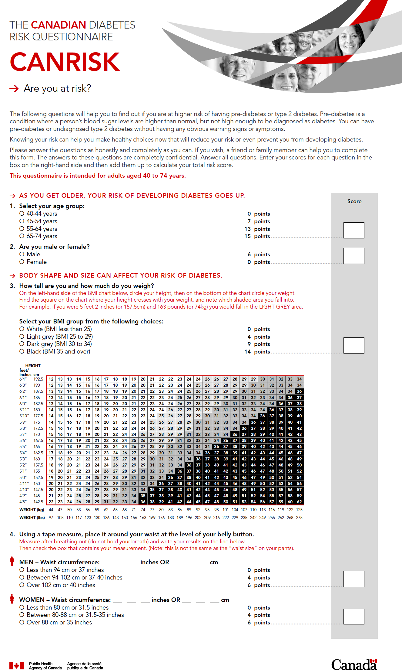
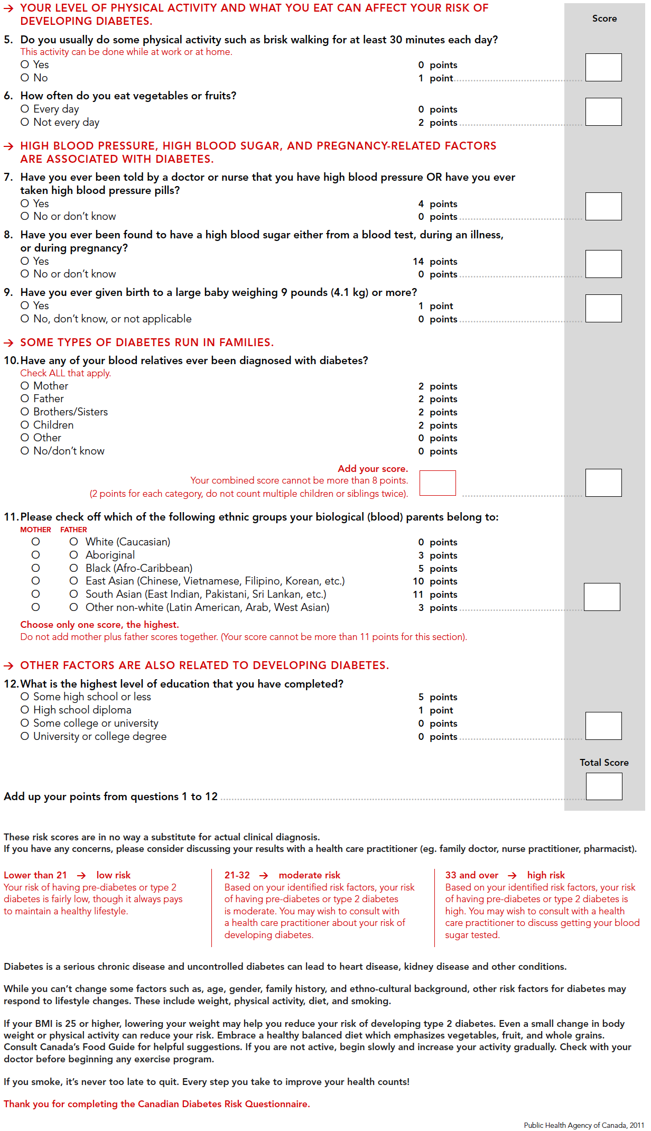
Notes:
14

Slide 15
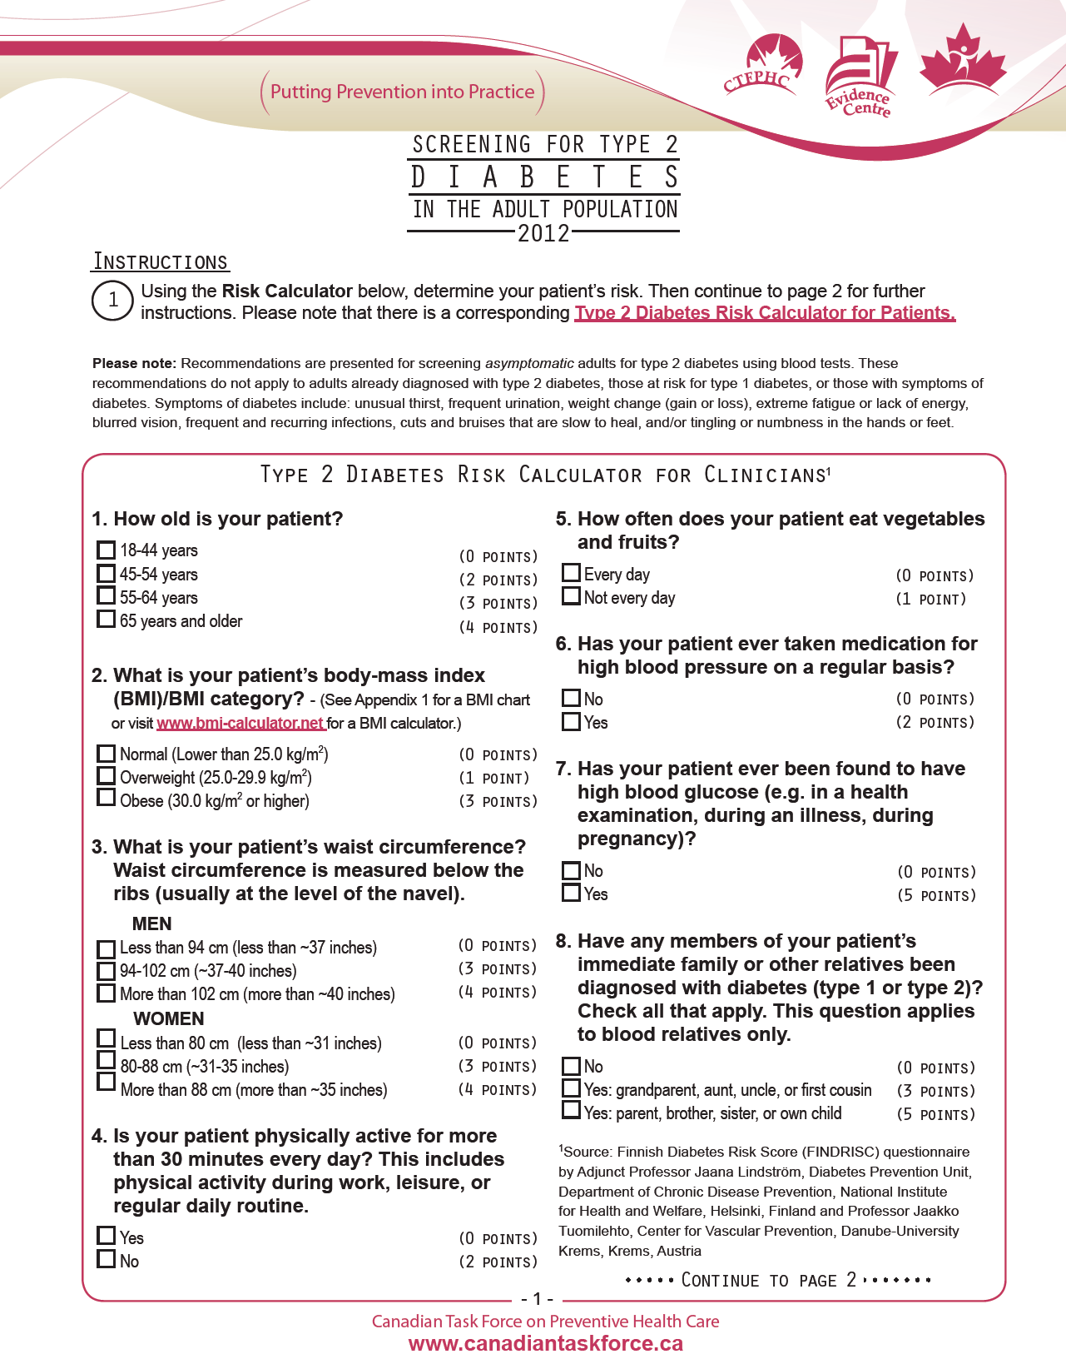
FINRISK calculator
Similar to CANRISK
Does not include:
  Macrosomia
  Ethnicity
  Level of education
Risk categories differ:
  Low-moderate
  High
  Very high
http://canadiantaskforce.ca/guidelines/2012-diabetes/
Notes:
15

Slide 16
Screening for type 2 diabetes in adults
2018 Diabetes Canada CPG – Chapter 4. Screening for Diabetes in Adults
2018
Screen every 3 years in individuals ≥40 years of age or in individuals at high risk using a risk calculator.
Screen earlier and/or more frequently (every 6 to 12 months) in people with additional risk factors for diabetes or for those at very high risk using a risk calculator
FPG <5.6 mmol/L and/or A1C <5.5%
FPG 5.6-6.0 mmol/L and/or A1C 5.5-5.9%*
FPG 6.1-6.9 mmol/L and/or A1C 6.0-6.4%**
FPG ≥7.0 mmol/L and/or A1C ≥6.5%
Normal
Recreen as recommended
At Risk
Rescreen more often
Prediabetes
Rescreen more often
Diabetes
If both FPG and A1C are available, but discordant, use the test that appears furthest to the right side of the algorithm.
*Consider 75-g OGTT if 1 risk factors; ** Consider 75-g OGTT

Slide 17
Do we need to screen for Type 1 diabetes (T1DM)?
2018 Diabetes Canada CPG – Chapter 4. Screening for Diabetes in Adults
NO
There is insufficient evidence for interventions to prevent or delay type 1 diabetes
Notes:
17

Slide 18
Recommendation 1
2018 Diabetes Canada CPG – Chapter 4. Screening for Diabetes in Adults
All individuals should be evaluated annually for type 2 diabetes risk on the basis of demographic and clinical criteria [Grade D, Consensus]

Slide 19
Recommendation 2
2018 Diabetes Canada CPG – Chapter 4. Screening for Diabetes in Adults
Screening for diabetes using FPG and/or A1C should be performed every 3 years in individuals ≥40 years of age or at high risk using a risk calculator [Grade D, Consensus]. Earlier testing and/or more frequent follow-up (every 6 to 12 months) with either FPG and/or A1C should be considered in those at very high risk using a risk calculator or in people with additional risk factors for diabetes [Grade D, Consensus]

Slide 20
Key Messages
2018 Diabetes Canada CPG – Chapter 4. Screening for Diabetes in Adults
In the absence of evidence for interventions to prevent or delay type 1 diabetes, routine screening for type 1 diabetes is not recommended

Slide 21
Key Messages
2018 Diabetes Canada CPG – Chapter 4. Screening for Diabetes in Adults
Screen for type 2 diabetes using a FPG and/or A1C every 3 years in individuals ≥40 yrs or in individuals at high risk on a risk calculator (33% chance of developing diabetes over 10 years)
Diagnose diabetes in the absence of symptomatic hyperglycemia if A1C is ≥6.5% on two tests, FPG ≥7.0 mmol/L on two tests, or A1C ≥6.5% and FPG ≥7.0 mmol/L
A1C, glycated hemoglobin; FPG, fasting plasma glucose

Slide 22
Key Messages for People with Diabetes
2018 Diabetes Canada CPG – Chapter 4. Screening for Diabetes in Adults
If you are age 40 years or over, you are at risk for type 2 diabetes and should be tested at least every 3 years
If you have risk factors that increase the likelihood of developing type 2 diabetes, you should be tested more frequently or start regular screening earlier. Some of the risk factors include family history of diabetes; being a member of a high-risk population; history of prediabetes or gestational diabetes; and being overweight

Slide 23
Key Messages for People with Diabetes
2018 Diabetes Canada CPG – Chapter 4. Screening for Diabetes in Adults
You can use the Canadian Diabetes Risk (CANRISK) calculator to assess your risk for diabetes
Several methods for screening for diabetes are available. Usually two abnormal blood tests are needed to make a diagnosis of diabetes
The earlier you are diagnosed, the sooner you can take action to stay well

Slide 24

Visit guidelines.diabetes.ca

Slide 25


Or download the App

Slide 26
Diabetes Canada Clinical Practice Guidelines
http://guidelines.diabetes.ca – for health-care providers
1-800-BANTING (226-8464)
http://diabetes.ca – for people with diabetes

