Slide 1
2018 Clinical Practice Guidelines
Hyperglycemic Emergencies in Adults
Chapter 15
Jeannette Goguen MD MEd FRCPC
Jeremy Gilbert MD FRCPC
Notes:
1

Slide 2
Disclaimer
All Content contained on this slide deck is the property of Diabetes Canada, its content suppliers or its licensors as the case may be, and is protected by Canadian and international copyright, trademark, and other applicable laws. Diabetes Canada grants personal, limited, revocable, non-transferable and non-exclusive license to access and read content in this slide deck for personal, non-commercial and not-for-profit use only. The slide deck is made available for lawful, personal use only and not for commercial use.
The unauthorized reproduction, distribution of this copyrighted work is not permitted.
For permission to use this slide deck for commercial or any use other than personal, please contact guidelines@diabetes.ca

Slide 3
Key Changes
2018 Diabetes Canada CPG – Chapter 15. Hyperglycemic Emergencies in Adults
2018
New information on
  Diabetic ketoacidosis with SGLT2 inhibitor therapy

Slide 4
Hyperglycemic Emergencies
2018 Diabetes Canada CPG – Chapter 15. Hyperglycemic Emergencies in Adults
DKA = Diabetic Ketoacidosis
HHS = Hyperosmolar Hyperglycemic State
Common features:
  Insulin deficiency → hyperglycemia → urinary loss of water and electrolytes
  → Volume depletion + electrolyte deficiency +
  hyperosmolarity
  Insulin deficiency (absolute) + increased glucagon
  → Ketoacidosis (in DKA)
Notes:
4

Slide 5
2018 Diabetes Canada CPG – Chapter 15. Hyperglycemic Emergencies in Adults
Suspect DKA or HHS in an ILL Patient with Hyperglycemia (usually)
DKA
HHS
Ketoacidosis
ECFV contraction
Milder hyperosmolarity
Normal to high glucose
May have ⬇LOC
Beware hypokalemia
Must use insulin
Absolute insulin deficiency + increased glucagon
Minimal acid-base problem
ECFV contraction
Hyperosmolarity
Marked hyperglycemia
Marked ⬇⬇LOC
Beware hypokalemia
May need insulin
Relative insulin deficiency
DKA, diabetic ketoacidosis; ECFV, extracellular fluid volume; HHS, hyperosmolar hyperglycemic state; LOC, level of consciousness
Notes:
5

Slide 6
Suspect DKA if……
2018 Diabetes Canada CPG – Chapter 15. Hyperglycemic Emergencies in Adults
pH ≤7.3
Bicarbonate ≤15 mmol/L
Anion gap >12 mmol/L
  = Serum sodium – (chloride + bicarbonate)
Positive serum or urine ketones
Plasma glucose ≥14 mmol/L (but may be lower)
Precipitating factor
DKA, diabetic ketoacidosis
Notes:
DKA or HHS must be suspected in all patients with diabetes presenting with hyperglycemia.
6

Slide 7
2018 Diabetes Canada CPG – Chapter 15. Hyperglycemic Emergencies in Adults
Clinical presentation of DKA
 | Symptoms | Signs
Hyperglycemia | polyuria, polydipsia, weakness | ECFV contraction
Acidosis | air hunger, nausea, vomiting and abdominal pain altered sensorium | Kussmaul respiration, acetone-odoured breath altered sensorium
Precipitating condition | See list of conditions Slide 20
DKA, diabetic ketoacidosis

Slide 8
Be Aware of Conditions that may make DKA Diagnosis Difficult
2018 Diabetes Canada CPG – Chapter 15. Hyperglycemic Emergencies in Adults
Conditions that ⬆ bicarbonate (eg. vomiting)
Pregnancy
SGLT2 inhibitor
Significant osmotic diuresis
β-hydroxy
butyrate
Negative serum ketones
Loss of keto anions
Mixed acid-base so pH not as low
Normal or mildly ⬆ glucose (euglycemic DKA)
Order serum
β-hydroxy
butyrate
Normal anion gap
DKA, diabetic ketoacidosis
Notes:
8

Slide 9
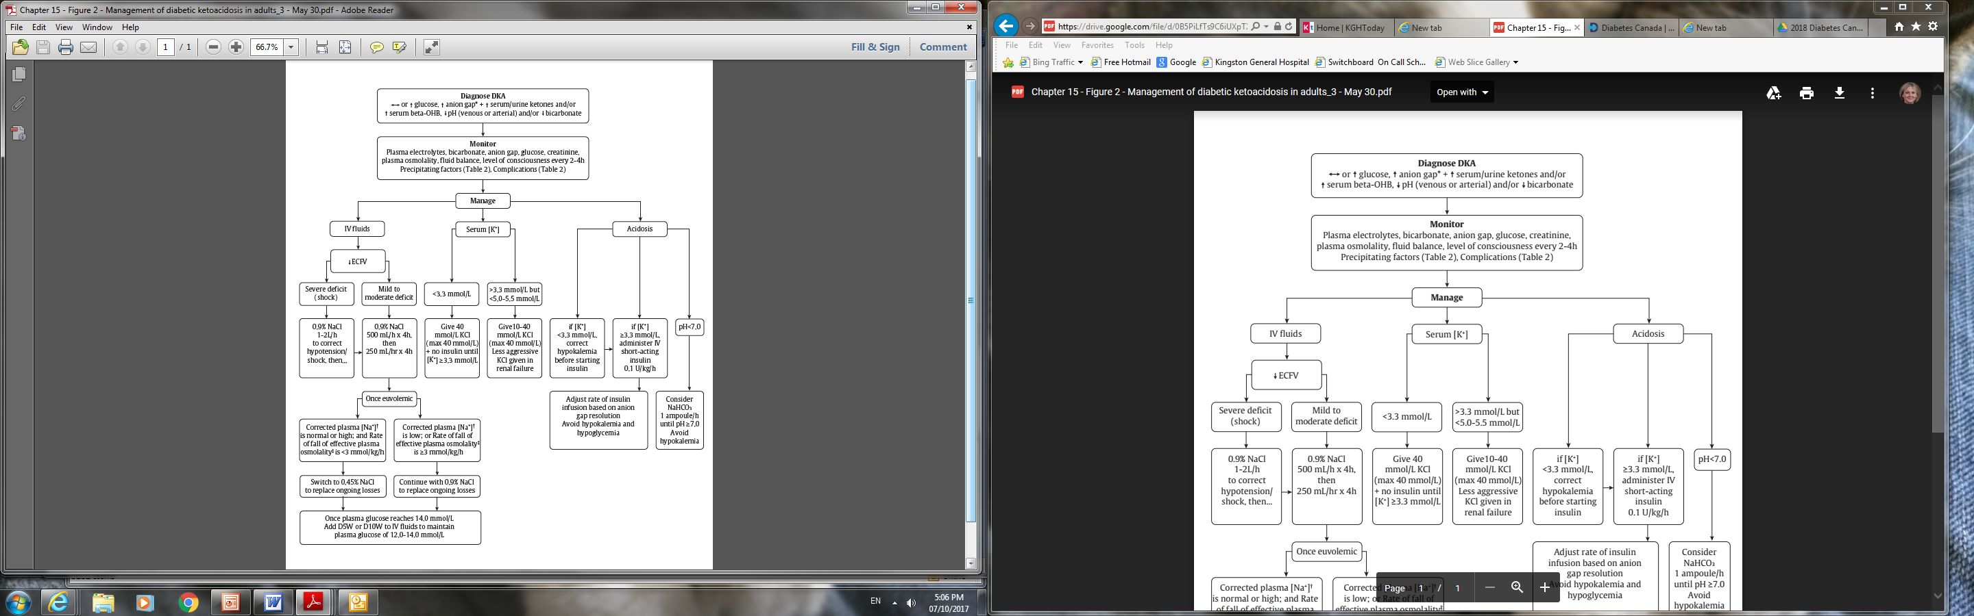
Management of DKA in Adults
2018 Diabetes Canada CPG – Chapter 15. Hyperglycemic Emergencies in Adults
DKA, diabetic ketoacidosis

Slide 10
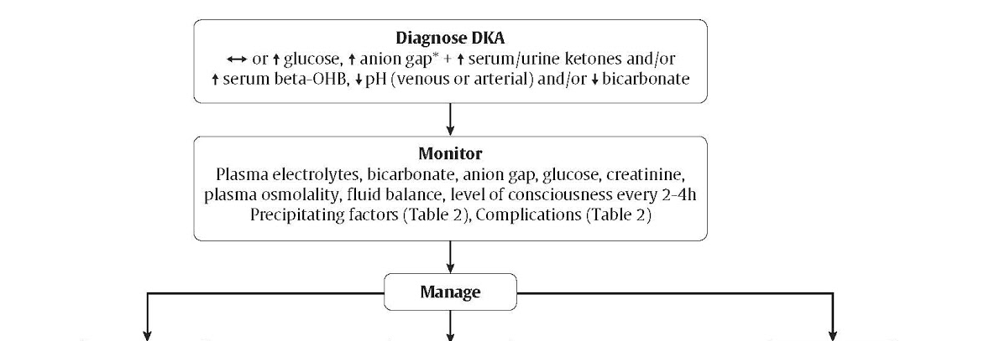
Fluids, Potassium, Acidosis are the Pillars of Treatment
2018 Diabetes Canada CPG – Chapter 15. Hyperglycemic Emergencies in Adults
IV fluids
Serum Potassium
Acidosis
Notes:
3 urgent priorities: restoring ECF volume, resolution of acidosis, replacement of potassium and electrolyte balance
Monitoring of volume status (including fluid intake and output), vital signs, neurologic status, plasma concentrations of electrolytes, anion gap, osmolality, and glucose need to be monitored closely, initially as often as every 2 hours
10

Slide 11
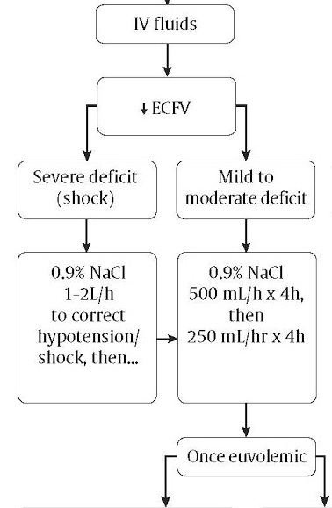
Replace Fluids with IV 0.9% NaCl until Euvolemic
Notes:
11

Slide 12
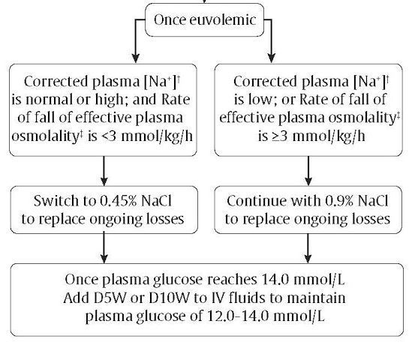
Once euvolemic, consider plasma Na⁺ and glucose to determine IV fluid type
Notes:
12

Slide 13
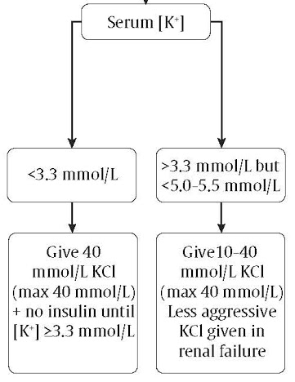
Replace Potassium: Hypokalemia is an avoidable cause of death in DKA
Correct K⁺ first THEN
start insulin
Notes:
Phosphate repletion if severe hypophosphatemia
13

Slide 14
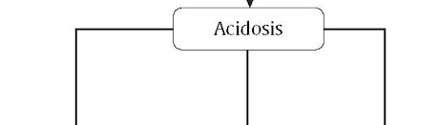
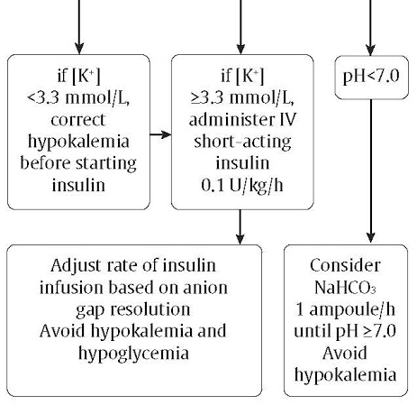
Management of Acidosis with Insulin
Insulin should be maintained until the anion gap normalizes
Insulin used to treat the acidosis, not the glucose!
Notes:
No insulin bolus ; some cases of HHS may respond to initial volume (no insulin needed)
Do not tailor insulin to glucose: once BG <14, add D5W to solution
Can use continuous IV insulin or q1-2 hourly SC insulin: no difference in resolution of ketoacidosis or hypoglycemia risk
14

Slide 15
Identify and Treat the Precipitating Factor
2018 Diabetes Canada CPG – Chapter 15. Hyperglycemic Emergencies in Adults
Insulin omission – MOST COMMON CAUSE of DKA
New diagnosis of diabetes
Infection / Sepsis
Myocardial infarction
  Small rise in troponin may occur without overt ischemia
  ECG changes may reflect hyperkalemia
Thyrotoxicosis
Drugs
DKA, diabetic ketoacidosis
Notes:
15

Slide 16
Prevention of DKA / HHS
2018 Diabetes Canada CPG – Chapter 15. Hyperglycemic Emergencies in Adults
Type 1 diabetes
  Education around sick day management
  Continuation of insulin even when not eating
  Frequent monitoring when ill
Type 2 diabetes
  Education around sick day management
  Frequent monitoring when ill
DKA, diabetic ketoacidosis;, HHS, hyperosmolar hyperglycemic state
Notes:
16

Slide 17
2018 Diabetes Canada CPG – Chapter 15. Hyperglycemic Emergencies in Adults
Priorities* to be addressed in the management of adults presenting with hyperglycemic emergencies
Metabolic | Precipitating cause of DKA/HHS | Other complications of DKA/HHS
ECFV contraction Potassium deficit and abnormal concentration Metabolic acidosis Hyperosmolality (water deficit leading to increased corrected sodium concentration plus hyperglycemia) | New diagnosis of diabetes Insulin omission Infection Myocardial infarction Stroke ECG changes may reflect hyperkalemia A small increase in troponin may occur without overt ischemia Thyrotoxicosis Trauma Drugs | Hyper/hypokalemia ECFV overexpansion Cerebral edema Hypoglycemia Pulmonary emboli Aspiration Hypocalcemia (if phosphate used) Stroke Acute renal failure Deep vein thrombosis
*Severity of issue will dictate priority of action
DKA, diabetic ketoacidosis; ECFV, extracellular fluid volume; HHS, hyperosmolar hyperglycemic state

Slide 18
Recommendation 1
2018 Diabetes Canada CPG – Chapter 15. Hyperglycemic Emergencies in Adults
In adults with DKA or HHS, a protocol should be followed that incorporates the following principles of treatment fluid resuscitation, avoidance of hypokalemia, insulin administration, avoidance of rapidly falling serum osmolality, and search for precipitating cause (as illustrated in Figure 1) [Grade D, Consensus]
DKA, diabetic ketoacidosis; HHS, hyperosmolar hyperglycemic state

Slide 19
Recommendation 2
2018 Diabetes Canada CPG – Chapter 15. Hyperglycemic Emergencies in Adults
2. Point-of-care capillary beta-hydroxybutyrate may be measured in the hospital or outpatient setting [Grade D, Level 4] in adults with type 1 diabetes with CBG >14.0 mmol/L to screen for DKA, and a beta-hydroxybutyrate >1.5 mmol/L warrants further testing for DKA [Grade B, Level 2]. Negative urine ketones should not be used to rule out DKA [Grade D, Level 4]
CBG, capillary blood glucose; DKA, diabetic ketoacidosis

Slide 20
Recommendation 3
2018 Diabetes Canada CPG – Chapter 15. Hyperglycemic Emergencies in Adults
3. In adults with DKA, intravenous 0.9% sodium chloride should be administered initially at 500 mL/h for 4 hours, then 250 mL/h for 4 hours [Grade B, Level 2] with consideration of a higher initial rate (1-2 L/h) in the presence of shock [Grade D, Consensus]. For adults with HHS, intravenous fluid administration should be individualized [Grade D, Consensus]
DKA, diabetic ketoacidosis; HHS, hyperosmolar hyperglycemic state

Slide 21
Recommendation 4
2018 Diabetes Canada CPG – Chapter 15. Hyperglycemic Emergencies in Adults
4. In adults with DKA, an infusion of short-acting intravenous insulin of 0.10 units/kg/h should be used [Grade B, Level 2]. The insulin infusion rate should be maintained until the resolution of ketosis [Grade B, Level 2] as measured by the normalization of the plasma anion gap [Grade D, Consensus]. Once the PG concentration falls to 14.0 mmol/L, intravenous dextrose should be started to avoid hypoglycemia [Grade D, Consensus]
DKA, diabetic ketoacidosis; PG, plasma glucose

Slide 22
Recommendation 5
2018 Diabetes Canada CPG – Chapter 15. Hyperglycemic Emergencies in Adults
2018
DKA, diabetic ketoacidosis
5. Individuals treated with SGLT2 inhibitors with symptoms of DKA should be assessed for this condition even if BG is not elevated [Grade D, Consensus]

Slide 23
Key Messages
2018 Diabetes Canada CPG – Chapter 15. Hyperglycemic Emergencies in Adults
Diabetic ketoacidosis (DKA) and hyperosmolar hyperglycemic state (HHS) should be suspected in ill persons with diabetes. If either DKA or HHS is diagnosed, precipitating factors must be sought and treated
DKA and HHS are medical emergencies that require treatment and monitoring for multiple metabolic abnormalities and vigilance for complications

Slide 24
Key Messages
2018 Diabetes Canada CPG – Chapter 15. Hyperglycemic Emergencies in Adults
A normal or mildly elevated blood glucose does not rule out diabetic ketoacidosis in certain conditions such as pregnancy or with SGLT2 inhibitor use

Slide 25
Key Messages
2018 Diabetes Canada CPG – Chapter 15. Hyperglycemic Emergencies in Adults
DKA requires intravenous insulin administration (0.1 units/kg/h) for resolution; bicarbonate therapy may be considered only for extreme acidosis (pH ≤7.0)
DKA, diabetic ketoacidosis

Slide 26
Key Messages for People with Diabetes
2018 Diabetes Canada CPG – Chapter 15. Hyperglycemic Emergencies in Adults
When you are sick, your blood glucose levels may fluctuate and be unpredictable:
  During these times, it is a good idea to check your blood glucose levels more often than usual (for example, every 2 to 4 hours)
  Drink plenty of sugar-free fluids or water
  If you have type 1 diabetes with blood glucose levels remaining over 14 mmol/L before meals, or if you have symptoms of diabetic ketoacidosis (see chapter) check for ketones by performing a urine ketone test or blood ketone test. Blood ketone testing is preferred over urine testing

Slide 27
Key Messages for People with Diabetes
2018 Diabetes Canada CPG – Chapter 15. Hyperglycemic Emergencies in Adults
Develop a “Sick Day” plan with your diabetes healthcare team. This should include information on:
  which diabetes medications you should continue and which ones you should temporarily stop;
  guidelines for insulin adjustment if you are on insulin; and
  advice on when to contact your health-care provider or go to the emergency room

Slide 28

Visit guidelines.diabetes.ca

Slide 29


Or download the App

Slide 30
Diabetes Canada Clinical Practice Guidelines
http://guidelines.diabetes.ca – for health-care providers
1-800-BANTING (226-8464)
http://diabetes.ca – for people with diabetes

