Slide 1
Introduction
20
2018 Clinical Practice Guidelines
Chapter 1
Robyn L. Houlden MD, FRCPC
Chair, 2018 Diabetes Canada CPG
Notes:
Welcome to Introduction to the 2018 Diabetes Canada Clinical Practice guidelines for the Prevention and Management of Diabetes in Canada.

Slide 2
Disclaimer
All Content contained on this slide deck is the property of Diabetes Canada, its content suppliers or its licensors as the case may be, and is protected by Canadian and international copyright, trademark, and other applicable laws. Diabetes Canada grants personal, limited, revocable, non-transferable and non-exclusive license to access and read content in this slide deck for personal, non-commercial and not-for-profit use only. The slide deck is made available for lawful, personal use only and not for commercial use.
The unauthorized reproduction, distribution of this copyrighted work is not permitted.
For permission to use this slide deck for commercial or any use other than personal, please contact guidelines@diabetes.ca

Slide 3
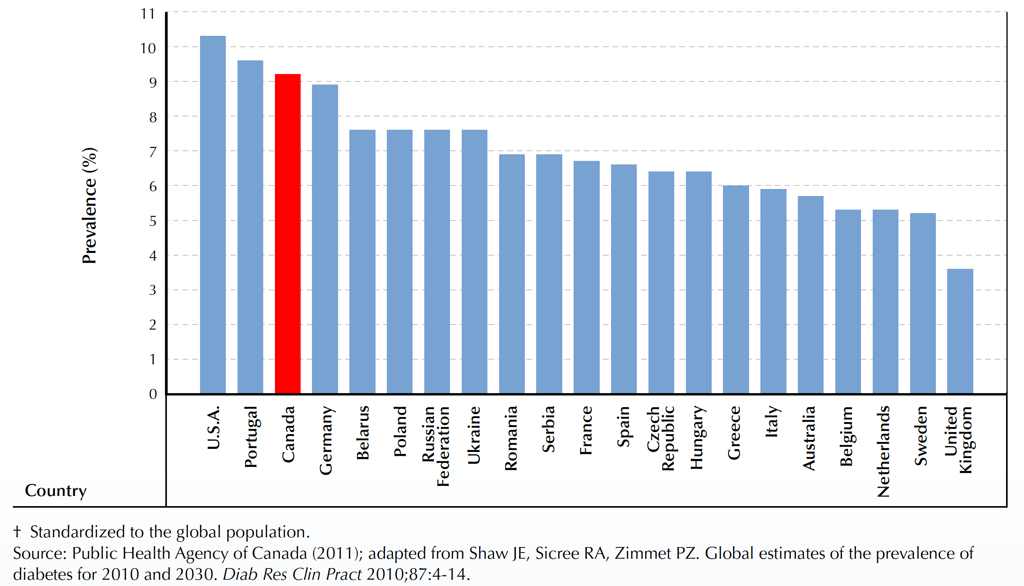
Prevalence of Diabetes among Individuals aged 20-79 years, Europe, North America, Oceania, 2010
Notes:
The International Diabetes Federation has identified diabetes as one of the largest global health emergencies of the 21st century. Each year, more and more people worldwide are diagnosed with this serious chronic condition with potentially devastating complications that affects all age groups. In 2015, the IDF estimated that 415 millions adults currently had diabetes and 318 million adults had impaired glucose tolerance, putting them at high risk of developing the disease in the future.
In the study shown in this slide, compared with the prevalence of diabetes in European, American and Oceania countries, the rate for Canada was the third highest at 9.2%.

Slide 4

Diabetes in Canada: Prevalence by Province and Territory
Age-standardized† prevalence of diagnosed DM among individuals ≥ 1 year, 2008/09
< 5.0
5.0 < 5.5
5.5 < 6.0
6.0 < 6.5
≥ 6.5
YT
5.4%
NT
5.5%
NU
4.4%
NL
6.5%
BC
5.4%
AB
4.9%
MB
5.9%
SK
5.4%
QC
5.1%
PE
5.6%
ON
6.0%
NS
6.1%
NB
5.9%
† Age-standardized to the 1991 Canadian population.
NL, NS and ON had the highest prevalence, while NU, AB and QC had the lowest.
Public Health Agency of Canada. Diabetes in Canada: Facts and figures from a public health perspective. Ottawa, 2011.
Notes:
The prevalence of diabetes varies across Canada. In 2008/09, after accounting for differences in age distribution among the provinces and territories, Newfoundland and Labrador, Nova Scotia, and Ontario had the highest prevalence of diagnosed diabetes, while Nunavut, Alberta, and Quebec ranked lowest
Source: Public Health Agency of Canada (September 2011); using 2008/09 data from the Canadian Chronic Disease Surveillance System (Public Health Agency of Canada).
4

Slide 5
Diabetes in Canada: Prevalence of Diagnosed Diabetes by Age and Sex
Prevalence of diagnosed diabetes among individuals aged ≥ 1 year, by age group and sex, 2008/09
30
  Overall Prevalence
  6.4%
Females
25
  7.2%
Males
20
  6.8%
Total
Prevalence (%)
15
10
5
0
Age group (years)
1-19
20-24
25-29
30-34
35-39
40-44
45-49
50-54
55-59
60-64
65-69
70-74
75-79
80-84
≥85
Canada
Prevalence increased with age. The sharpest increase occurred after age 40 years.
The highest prevalence was in the 75-79 year age group.
Public Health Agency of Canada. Diabetes in Canada: Facts and figures from a public health perspective. Ottawa, 2011.
Notes:
The proportion of people with diagnosed diabetes generally increases with age. The body's ability to produce and use insulin deteriorates as one ages, placing older adults at an elevated risk of developing type 2 diabetes. The sharpest increase in the prevalence of diabetes occurred after the age of 40 years. In 2008/09, the 75 to 79 year age group had the highest proportion of people with diagnosed diabetes (23.1% of females and 28.5% of males). Although diagnosed diabetes is more common in older age groups, more than 50% of the affected Canadian population (1.2 million) was of working age, between 25 and 64 years.
Source: Public Health Agency of Canada (July 2011); using 2008/09 data from the Canadian Chronic Disease Surveillance System (Public Health Agency of Canada).
5

Slide 6
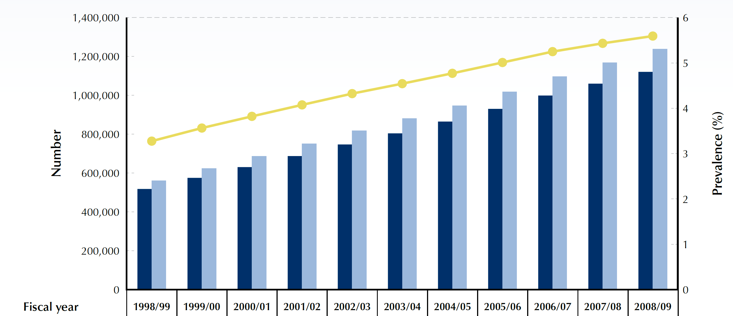
Diabetes in Canada: Prevalence of Diagnosed Diabetes 1998/99 to 2008/09
Age-standardized prevalence and number of cases of diagnosed diabetes among individuals aged ≥ 1 year, 1998/99 to 2008/09
5.6%
3.3%
Public Health Agency of Canada. Diabetes in Canada: Facts and figures from a public health perspective. Ottawa, 2011.
Notes:
The age-standardized prevalence of diagnosed diabetes among Canadians aged one year and older has increased by 70%, from 3.3% in 1998/99 to 5.6% in 2008/09. Prevalence over time was consistently higher among males than among females and increased in every age group

Slide 7


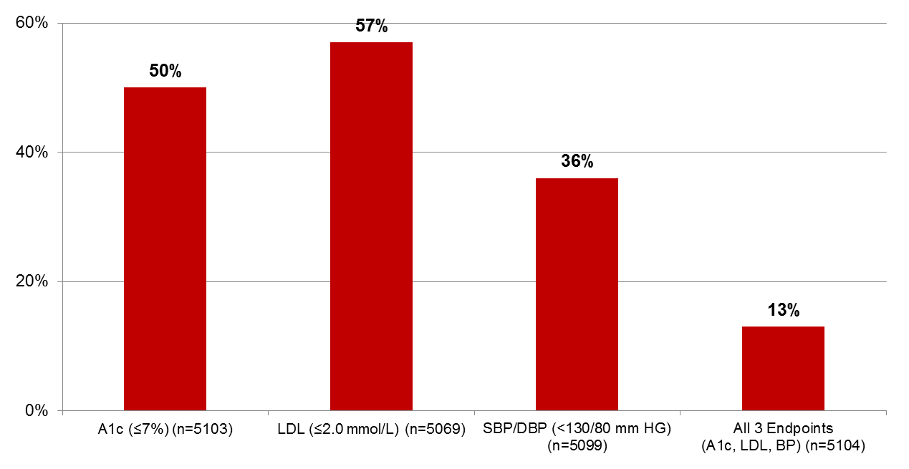
Guideline Targets Achieved
% of patients
Leiter LA et al. Can J Diabetes 2013;37:82-89.
Notes:
The DM Scan study was performed to gain insight into management of patients with type 2 diabetes mellitus by Canadian primary care physicians.
479 primary care physicians from across Canada submitted data on 5123 patients with type 2 diabetes whom they had seen on a single day on or around World Diabetes Day, November 14th, 2012.
The mean A1C was 7.4%, mean LDL-C was 2.1 mmol/L and mean blood pressure was 128/75 mmHg.
An A1C target of ≤7.0% was met by 50%. An LDL-C target of ≤2.0 mmol/L by met by 57%. A mean BP target of <130/80 mmHg was met by 36%.
The composite triple target was met by only 13% of patients.
Nutritional counselling had been offered to 38% of patients. Of the 87% prescribed
antihyperglycemic agents, 18% were on 1 non-insulin antihyperglycemic agent. For 85% this was metformin), 15% were on two agent, 6% were on 3 or more agents, 19% were on insulin only and 42% were on insulin with one or more non-insulin antihyperglycemic agent.
The DM-SCAN survey highlighted the persistent treatment gap associated with the treatment
of type 2 diabetes and the challenges faced by primary care providers to gain glycemic control and cardiovascular protection in these patients.
7

Slide 8
Clinical Practice Guidelines Objectives
Provide guidance on the most appropriate management for people with diabetes mellitus
Enhance diabetes prevention efforts with the goal of reducing the burden of diabetes related complications
Inform clinical decisions made by health-care professionals
Notes:
The Diabetes Canada Clinical Practice Guidelines are intended to
Provide guidance on the most appropriate management for people with diabetes mellitus
Enhance diabetes prevention efforts with the goal of reducing the burden of diabetes related complications
Inform clinical decisions made by health-care professionals

Slide 9
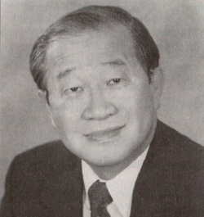
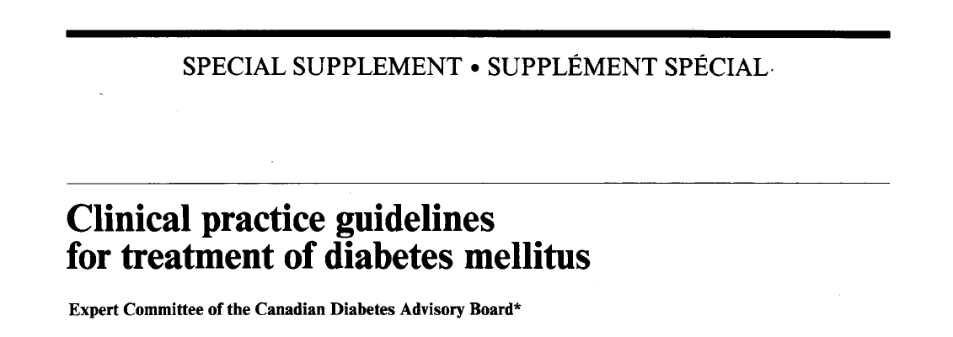

Chair: Dr. Meng-Hee Tan, Professor, Department of Medicine, Dalhousie
16 pages published in CMAJ
Expert Committee of 25 key stakeholders
No grading of recommendations
Notes:
I would like to provide a quick history of the guidelines. The first set were published in the Canadian Medical Association Journal in 1992 and were only 16 pages long. They were chaired by Dr. Meng Tan and recommendations were not graded.

Slide 10
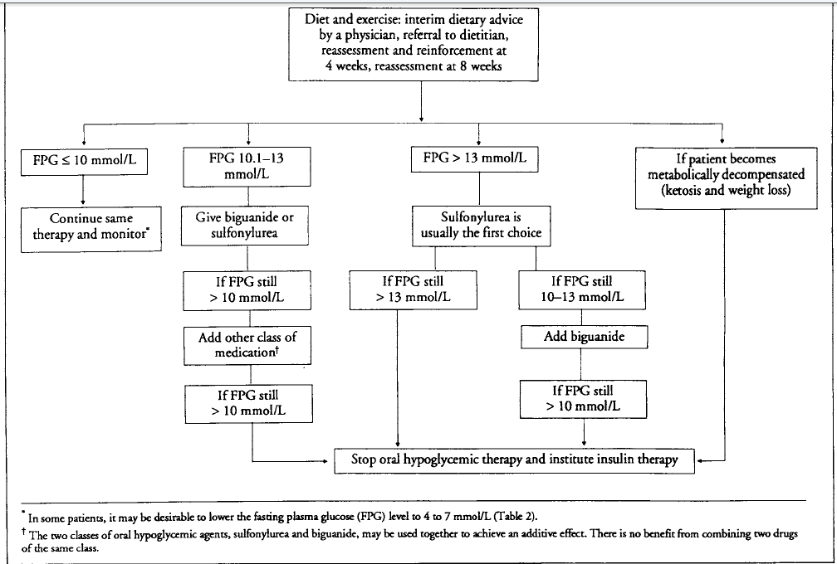
Notes:
Here is the pharmacologic glycemic management algorithm for these guidelines. The image highlights that treatment choices were limited at the time.

Slide 11

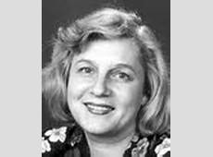

Co-Chair: Dr. Sara Meltzer, Associate Professor, Department of Medicine, McGill
Co-Chair: Dr. Lawrence Leiter, Professor, Department of Medicine, University of Toronto
29 pages published as supplement to CMAJ
Expert committee of 37 key stakeholders
93 recommendations with grading
Notes:
The next set of the guidelines were published in 1998 and were co-chaired by Dr. Sara Meltzer and Dr. Larry Leiter. They were 29 pages and contained 93 recommendations with grading.

Slide 12
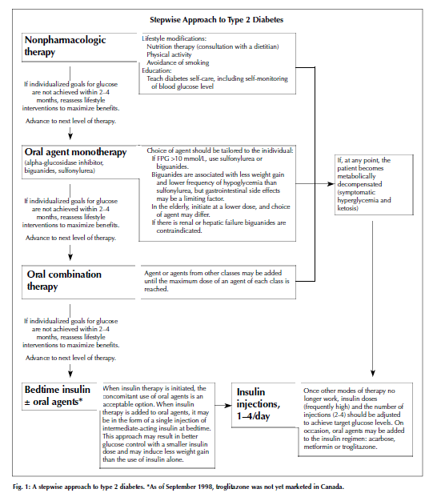
Notes:
Here is the pharmacologic glycemic management of type 2 diabetes figure. Once again, it highlights the limited treatment choices available at the time.

Slide 13

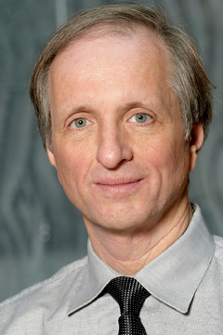
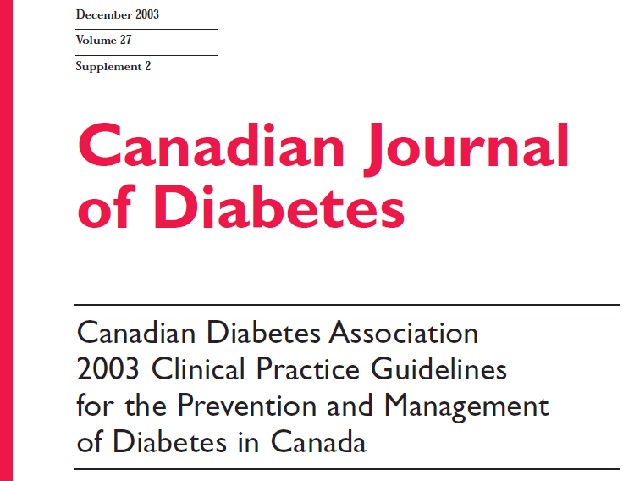
Chair: Dr. Stewart Harris, Professor Department of Family Medicine, Schulich School of Medicine, UWO
Chair, Methods: Dr. Hertzel Gerstein, Professor Department of Medicine, McMaster University
163 pages published as Supplement to Canadian Journal of Diabetes
Expert Committee of 61 key stakeholders
154 graded recommendations + practical paper tools
Notes:
The next set of guidelines were published in 2003 and were published in the Canadian Journal of Diabetes. They were chaired by Dr. Stewart Harris, and Dr. Hertzel Gerstein chaired the Methods Committee. They were 163 pages and contained 154 graded recommendations.

Slide 14
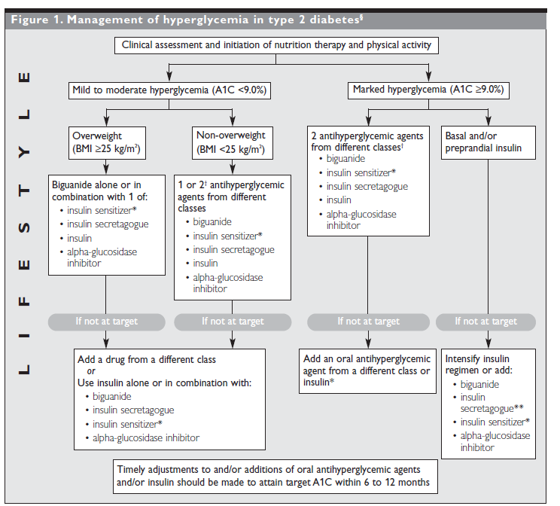
Notes:
The pharmacologic glycemic management figure shows the availability of more treatment choices and the need to make timely adjustments to therapy to reach A1C targets within 6 to 12 months.

Slide 15

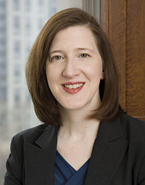
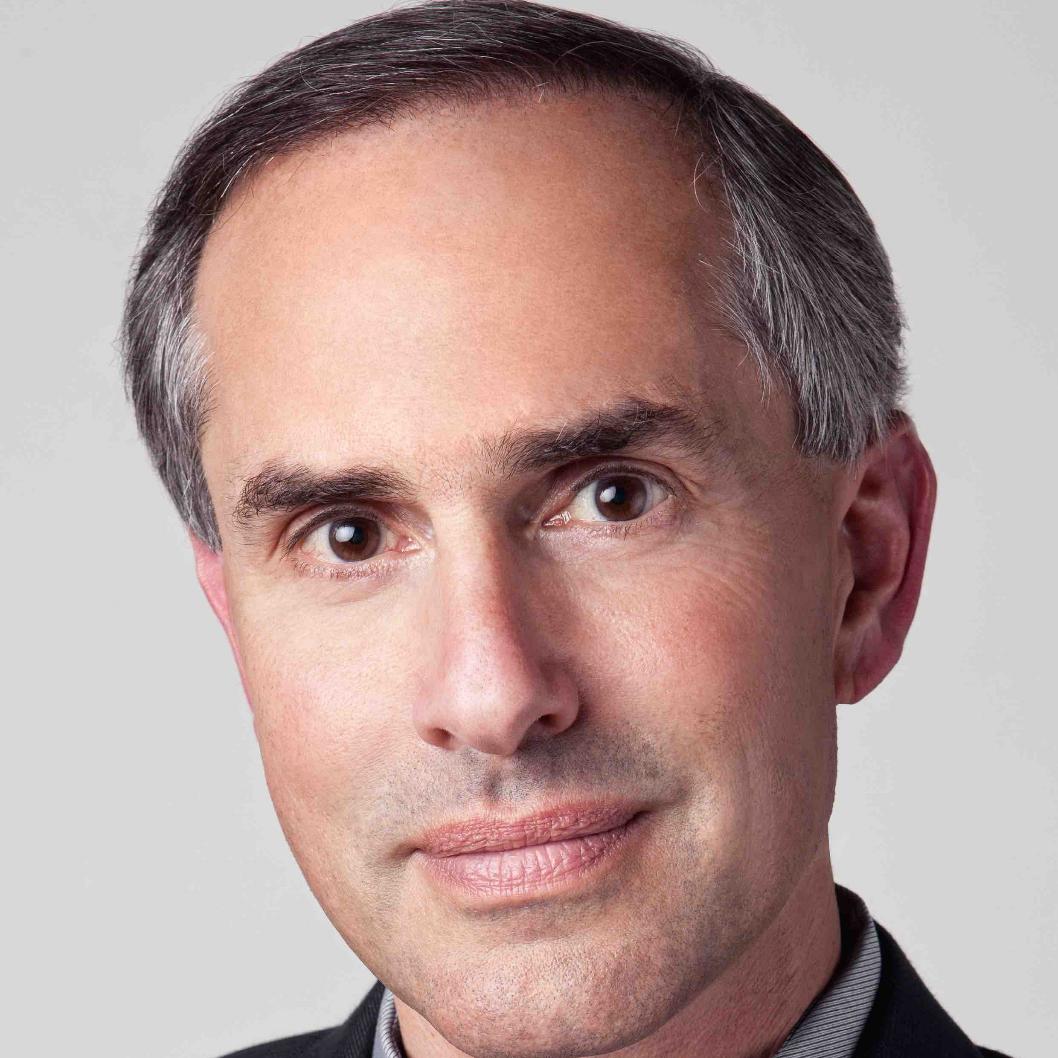

Chair: Dr. Vincent Woo, Division of Endocrinology, University of Manitoba
Chair, Methods: Dr. Gillian Booth, Associate Professor, Department of Medicine, U. of T.
Chair, Dissemination Committee: Dr. Ian Blumer, Lecturer, Department of Medicine, U. of T.
201 pages published as supplement to CJD
Expert committee of 99 key stakeholders
213 recommendations with grading + practical tools
Dissemination Committee
Notes:
The next set of guidelines were published in 2008 and were chaired by Dr. Vincent Woo. Dr. Gillian Booth chaired the Methods Committee and Dr. Ian Blumer chaired the Dissemination Committee. The guidelines were 201 pages and contained 213 recommendations.

Slide 16



Dr. Alice Cheng, Associate Professor, Department of Medicine, U.of T.
Chair, Methods: Dr. Gillian Booth, Associate Professor, Department of Medicine, U. of T.
Chair, Dissemination Committee: Dr. Catherine Yu, Assistant Professor, Department of Medicine, U. of T.
212 pages published as supplement to CJD
Expert committee of 120 key stakeholders
240 recommendations with grading + practical tools + website
Dissemination& Implementation Committee
Notes:
Dr. Alice Cheng chaired the 2013 guidelines. Dr. Gillian Booth continued in her role as chair of the Methods Committee. Dr. Catherine Yu took over the role as Chair of the Dissemination Committee. The expert committee included 120 key stakeholders and the guidelines contained 240 recommendations. This version of the guidelines saw the development of a website that housed the full text guidelines as well as many innovative practical tools.

Slide 17
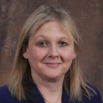
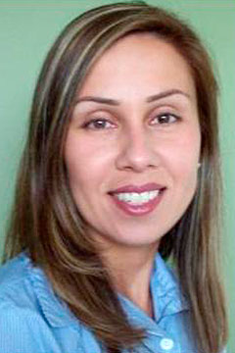
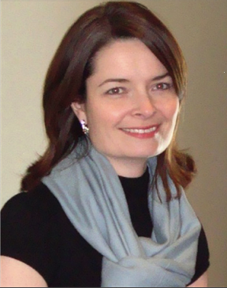

Chair: Dr. Robyn Houlden, Professor, Department of Medicine, Queen’s University
Co-Chair, Methods: Dr. Diana Sherifali, Assistant Professor, School of Nursing
Co-Chair, Methods: Dr. Doreen Rabi, Associate Professor, Department of Medicine, University of Calgary
Co-Chair, Dissemination Committee: Dr. Catherine Yu, Associate Professor, Department of Medicine, U. of T.
Co-Chair, Dissemination Committee: Dr. Noah Ivers, Assistant Professor, Department of Family Medicine, U. of T.
2018
325 pages
Expert committee of 135 key stakeholders
318 recommendations with grading + practical tools + website
Notes:
The 2018 guidelines involved 135 health-care professional volunteers from across Canada.
Dr. Diana Sherifali and Dr. Doreen Rabi acted as co-chairs for the Methods Committee. Dr. Catherine Yu continued in her role as Chair of the Dissemination Committee but was joined by co-chair, Dr. Noah Ivers.
This set of guidelines is the longest ever at 325 pages and contains 317 recommendations. The website has been enriched with even more practical tools and resources for health-care providers and people living with diabetes.

Slide 18
The 2018 guidelines were released on April 9, 2018 and are housed on the Diabetes Canada website at http://guidelines.diabetes.ca
In addition to the full guidelines, various tools and resources are present on the website and are updated regularly
Only medications with Health Canada Notice of Compliance granted by September 15, 2017 were included
Notes:
The 2018 guidelines were released on April 9, 2018 and are housed on the Diabetes Canada website at http://guidelines.diabetes.ca
In addition to the full guidelines, various tools and resources are present on the website and are updated regularly
Only medications with Health Canada Notice of Compliance granted by September 15, 2017 were included

Slide 19
Committee structure
Expert committee
DISSEMINATION AND IMPLEMENTATION COMMITTEE
External Reviewers
(National and International)
Steering committee
Independent Methods Committee
Executive
committee
Executive Editor McMaster Evidence Review and Synthesis Centre
Diabetes Canada Support Team
Notes:
This slide demonstrates the committee structure used for guideline development.
There was an Executive committee consisting of the chair, 2 past-chairs, Co-Chairs of the Methods Committee, and 3 experienced guidelines developers.
A Steering Committee consisted of members of the Executive Committee with 7 Sub-group chairs, Co-chairs of the Dissemination and Implementation Committee, 10 senior advisors representing a variety of allied health professions including Primary Care, Endocrinology, Pharmacy, Nursing, Dietitics, Cardiology, Pediatrics as well as 2 informed patients living with diabetes (one with type 1 and one with type 2 diabetes).
An Expert Committee consisted of 135 health-care professionals who were nationally recognized content experts for their chapter.
The guidelines development process was supported by an Executive Editor, Diabetes support Team and the McMaster Evidence Review and Synthesis Centre.
The guideliens underwent external review by National and International reviewers and included specialists, community primary care providers, academic Departments of Family Medicine across Canada, and specialty and disease support organizations.
An Independent Methods Review Committee ensured consistency and rigour in the recommendation development process. The IMR consisted of 9 university based clinical faculty with advanced training in research methods. The IMR provided methodological expertise and were a resource available to the expert authors throughout the development process.
A Dissemination and Implementation Committee consisting of 2 co-chairs and volunteer methods developed strategies to increase health-care practitioner implementation of the recommendations. A major activity of the guidelines was the development and maintenance of a guidelines website which hosts the full guidelines; interim updates; a quick reference guide, key messages for health-care providers and people with diabetes, health-care provider tools, slide kits, videos and webinars as well as resources for people with diabetes and their support systems in a variety of languages. Both IOS and Android apps were also developed.

Slide 20
“Neither evidence nor clinical judgment alone is sufficient.
Evidence without judgment can be applied by a technician.
Judgment without evidence can be applied by a friend.
But the integration of evidence and judgment is what the healthcare provider does in order to dispense the best clinical care.”
(Hertzel Gerstein, 2012)
Notes:
The guidelines are not meant to provide a “menu-driven” or “cookbook” approach to diabetes care where the clinician has no discretion.
In addition, they are unable to provide guidance in all circumstances and for all people with diabetes. People with diabetes
are a diverse and heterogeneous group; treatment decisions must be individualized. Guidelines are meant to aid in decision
making by providing recommendations that are informed by the best available evidence; however, therapeutic decisions are made
at the level of the relationship between the health-care provider and the individual with diabetes. That relationship, along with the
importance of clinical judgement, can never be replaced by guideline recommendations. Evidence-based guidelines try to weigh the
benefit and harm of various treatments; however, patient preferences are not always included in clinical research and, as a result,
patient values and preferences must be incorporated into clinical decision making.

Slide 21
Key Changes
2018
Expansion of the Expert Committee to include 135 health-care professional volunteers from across Canada
Broader representation from more allied health/interprofessional stakeholder groups
Expertise from diverse practice settings across the country
Professionals from family medicine, endocrinology, internal medicine, cardiology, neurology, nephrology, infectious disease, urology, psychiatry, psychology, obstetrics, ophthalmology, pediatrics, nursing, dietetics, pharmacy, chiropractics, exercise physiology and others
Notes:
Expansion of the Expert Committee to include 135 healthcare professional volunteers
Broader representation from more allied health/interprofessional stakeholder groups
Expertise from diverse practice settings across the country
Professionals from family medicine, endocrinology, internal medicine, cardiology, neurology, nephrology, infectious disease, urology, psychiatry, psychology, obstetrics, ophthalmology, pediatrics, nursing, dietetics, pharmacy, chiropractics, exercise physiology and others

Slide 22
Key Changes
2018
Inclusion and active participation of informed people with diabetes on the Expert Committee
Key messages using lay terms directed at people living with diabetes
Notes:
Inclusion and active participation of informed people with diabetes on the Expert Committee
Key messages using lay terms directed at people living with diabetes

Slide 23
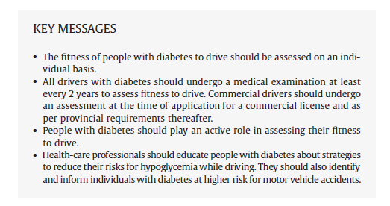
Diabetes and Driving
Notes:
Here is an example from the Diabetes and Driving chapter. These are the key messages for health-care providers.

Slide 24
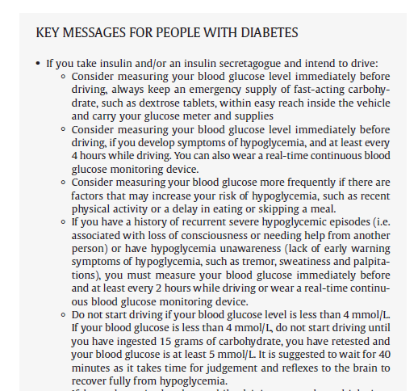
Diabetes and Driving
Notes:
Here are the some Key Messages for People with diabetes. As you can see they are written using lay terms.

Slide 25
Key Changes
2018
Increased recognition of ethnocultural diversity in Canada and its relationship with diabetes care
Increased involvement of Indigenous authors and organizations, and health-care providers working with Indigenous populations and communities in the development of recommendations related to type 2 diabetes and Indigenous peoples
Acknowledgement of the legacy of colonization and residential schools and their ongoing effects on Indigenous health, as well as the call to action of the 2015 Truth and Reconciliation Commission
Notes:
Increased recognition of ethnocultural diversity in Canada and its relationship with diabetes care
Increased involvement of Indigenous authors and organizations, and health-care providers working with Indigenous populations and communities in the development of recommendations related to type 2 diabetes and Indigenous peoples
Acknowledgement of the legacy of colonization and residential schools and their ongoing effects on Indigenous health, as well as the call to action of the 2015 Truth and Reconciliation Commission

Slide 26
Key Changes
2018
Addition of new material on diabetes and driving, and post-transplant diabetes
Introduction contains information related to Diabetes and Oral Health, and Diabetes and Cancer Screening
Notes:
Addition of new material on diabetes and driving, and post-transplant diabetes
Introduction contains information related to Diabetes and Oral Health, and Diabetes and Cancer Screening

Slide 27
Key Changes
2018
More rigorous systematic review of literature with the McMaster Evidence Review and Synthesis Centre
More rigorous review of the grading of recommendations by an Independent Methods Review Committee
Notes:
More rigorous systematic review of literature with the McMaster Evidence Review and Synthesis Centre
More rigorous review of the grading of recommendations by an Independent Methods Review Committee

Slide 28
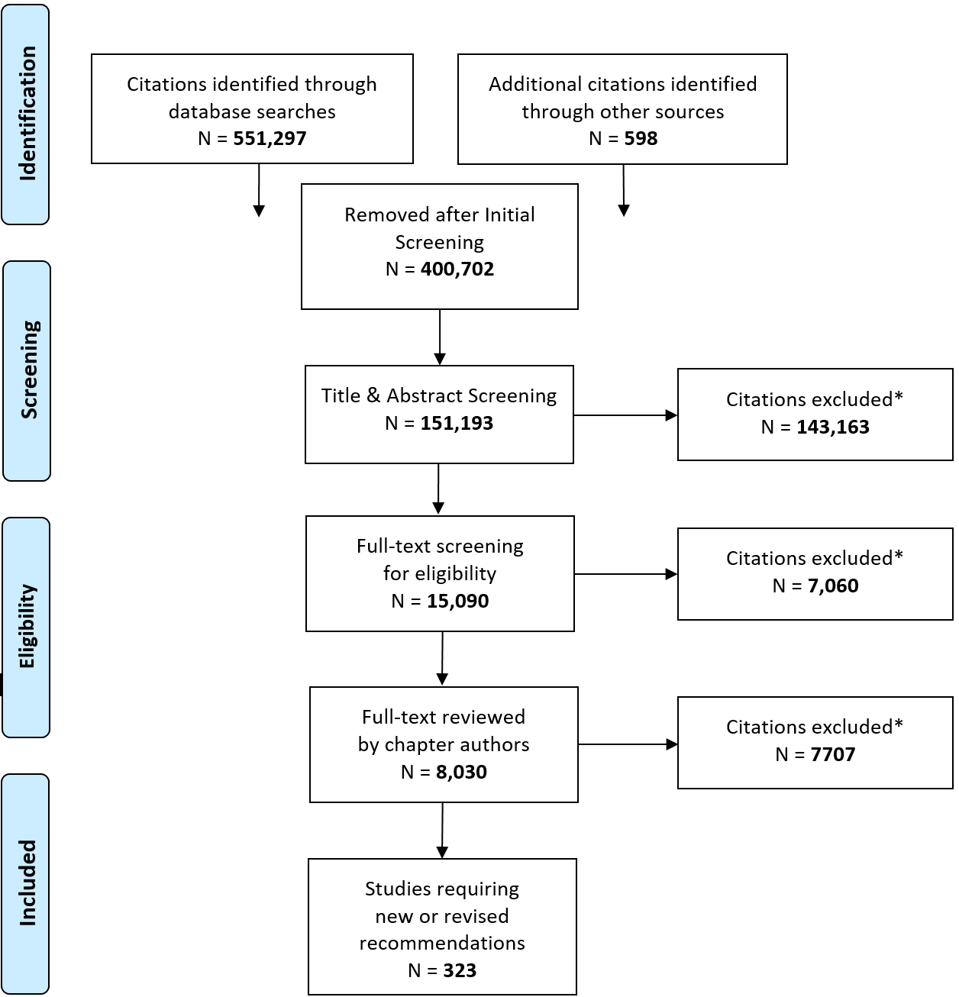
Literature Review Flow Diagram
2018 Diabetes Canada CPG – Chapter 2. Methods
2018
Notes:
At the end of each chapter is a literature review flow diagram illustrating the systematic review performed for each chapter.
This is the diagram for the entire guidelines. Over 600,000 articles were originally identified. After screening by reference librarians, 8030 articles underwent full text review by the chapter authors. The authors completed grading sheets using a program called Distiller where they had to justify why a reference was excluded or included. At the end, 323 articles were used to support new or revised recommendations.

Slide 29
Key Changes
2018
Wider external review by specialists, community primary care providers, all academic Departments of Family Medicine across Canada, and specialty and disease support organizations
Additional efforts to manage and minimize conflict of interest among all expert and steering committee members
Author disclosures listed at end of each chapter
Notes:
Wider external review by specialists, community primary care providers, all academic Departments of Family Medicine across Canada, and specialty and disease support organizations
Additional efforts to manage and minimize conflict of interest among all expert and steering committee members
Author disclosures listed at end of each chapter

Slide 30
Key Changes
2018
Expanded harmonization of recommendations through collaboration with other organizations, including the Cardiovascular Society (CCS), Hypertension Canada, and the Canadian Cardiovascular Harmonization of National Guidelines Endeavour (C-CHANGE)
Notes:
Expanded harmonization of recommendations through collaboration with other organizations, including the Cardiovascular Society (CCS), Hypertension Canada, and the Canadian Cardiovascular Harmonization of National Guidelines Endeavour (C-CHANGE)

Slide 31
Key Changes
2018
Expanded dissemination and implementation strategies to support all recommendations with increased use of web-based technology
Notes:
Expanded dissemination and implementation strategies to support all recommendations with increased use of web-based technology

Slide 32

Visit guidelines.diabetes.ca

Slide 33


Or download the App

Slide 34

Key Message
Throughout the guidelines remains the importance of individualizing therapy for the person with diabetes
Notes:
A key message throughout the guidelines remains the importance of individualizing therapy for the person with diabetes

Slide 35
Steering Committee
2018
Robyn L. Houlden MD FRCPC, Chair, Queen’s University, Kingston, ON
Lori Berard RN CDE, Advisor, Clinical Research Consultant, Winnipeg, MB
Gillian Booth MD MSc FRCPC, Advisor, University of Toronto, Toronto, ON
Alice Y.Y. Cheng MD FRCPC, Past Chair, University of Toronto , Toronto, ON
Maureen Clement MD CCFP, Advisor, University of British Columbia, BC
Kim Connelly MBBS PhD, Sub-Group Chair, Cardiovascular Complications, University of Toronto, Toronto, ON
Notes:
I will go through the next few slides quickly but want to acknowledge the hard work and support of my talent steering committee listed on the next few slides.

Slide 36
Steering Committee
2018
Denice Feig MD MSc FRCPC, Sub-Group Chair, Pregnancy, University of Toronto, Toronto, ON
Jeremy Gilbert MD FRCPC, Sub-Group Co-Chair, Management, University of Toronto, Toronto, ON
Ron Goldenberg MD FRCPC FACE, Advisor, Thornhill, ON
Noah Ivers MD PhD CCFP, Co-Chair Dissemination and Implementation Committee, University of Toronto, ON
Ram Krishna MSc (Physics) Post Graduate Dip Bus Admin, Informed Patient Representative, Toronto, ON
Peter J. Lin MD CCFP, Advisor, Toronto, ON

Slide 37
Steering Committee
2018
David Miller MD FRCPC, Advisor, Victoria, BC
Breay W. Paty MD FRCPC, Sub-Group Chair, Management, University of British Columbia, Vancouver, BC
Bruce A. Perkins MD MPH FRCPC, Sub-Group Chair, Microvascular Complications, University of Toronto, ON
Diana Provenzano BComm CPA CA, Informed Patient Representative, Toronto, ON
Doreen Rabi MD MSc FRCPC, Co-Chair, Methods, University of Calgary, Calgary, AB
Rema Sanghera RD MA CDE, Advisor, BC Women’s Hospital and Health Centre, Vancouver, BC

Slide 38
Steering Committee
2018
Peter A. Senior MBBS PhD FRCP FRCP(E), Advisor, University of Alberta, Edmonton, AB
Rick Siemens B.Sc Pharm B.Sc. Biol CDE CPT, Pharmacist Advisor, Lethbridge, AB
Diana Sherifali RN, PhD, CDE, Co-Chair, Methods, McMaster University, Hamilton, ON
Diane Wherrett MD FRCPC, Sub-Group Chair, Pediatrics, University of Toronto, Toronto, ON
Vincent Woo MD FRCPC, Past Chair, University of Manitoba, Winnipeg, MB
Jean-François Yale MD CSPQ FRCPC, Advisor, McGill University, Montreal, QC
Catherine Yu MD FRCPC MHSc, Co-Chair, Dissemination & Implementation Committee, University of Toronto, ON

Slide 39

Surround yourself with the dreamers and the doers, the believers and the thinkers
2018
Notes:
I truly did what this slide states – I surrounded myself with dreamers and doers, believers and thinkers.

Slide 40
Visit guidelines.diabetes.ca
Notes:
I encourage you once again to visit the Diabetes Canada guidelines website where you can view full versions of the guidelines, download slide kits and videos, find a variety of health-care provider tools as well as resources for your patients.

Slide 41
Or download the App
Notes:
This same material can be found by downloading the app.

Slide 42
Diabetes Canada Clinical Practice Guidelines
http://guidelines.diabetes.ca – for health-care providers
1-800-BANTING (226-8464)
http://diabetes.ca – for people with diabetes
Notes:
I would also like to thank all of the expert authors who contributed uncountable hours of work. We can all be proud of these world-class guidelines that have been created.

