Slide 1
Management of Acute Coronary Syndromes
2018 Clinical Practice Guidelines
Chapter 27
Jean-Claude Tardif MD FRCPC FACC FCAHS,
Phillipe L. L’Allier MD,
David H. Fitchett MD FRCPC

Slide 2
Disclaimer
All Content contained on this slide deck is the property of Diabetes Canada, its content suppliers or its licensors as the case may be, and is protected by Canadian and international copyright, trademark, and other applicable laws. Diabetes Canada grants personal, limited, revocable, non-transferable and non-exclusive license to access and read content in this slide deck for personal, non-commercial and not-for-profit use only. The slide deck is made available for lawful, personal use only and not for commercial use.
The unauthorized reproduction, distribution of this copyrighted work is not permitted.
For permission to use this slide deck for commercial or any use other than personal, please contact guidelines@diabetes.ca

Slide 3
Key Changes
2018 Diabetes Canada CPG – Chapter 27. Management of Acute Coronary Syndromes
2018
ACS, acute coronary syndrome
New algorithm for
  screening for diabetes in people with ACS but no history of diabetes
New recommendations on
  Use of ticagrelor for people with diabetes with ACS at high risk of recurrent ischemic events

Slide 4
Acute Coronary Syndrome Checklist
2018 Diabetes Canada CPG – Chapter 27. Management of Acute Coronary Syndromes
SCREEN for diabetes in people with ACS
USE anti-platelet therapies, prasugrel or ticagrelor, instead of clopidogrel in people with diabetes undergoing percutaneous coronary intervention (PCI)
AVOID both hyper- and hypoglycemia among people with diabetes admitted with ACS
ACS, acute coronary syndrome
Notes:
Script: The key points of the chapter includes the following: 1) 2) 3)
TT: Slide provides framework for key recommendations
4

Slide 5
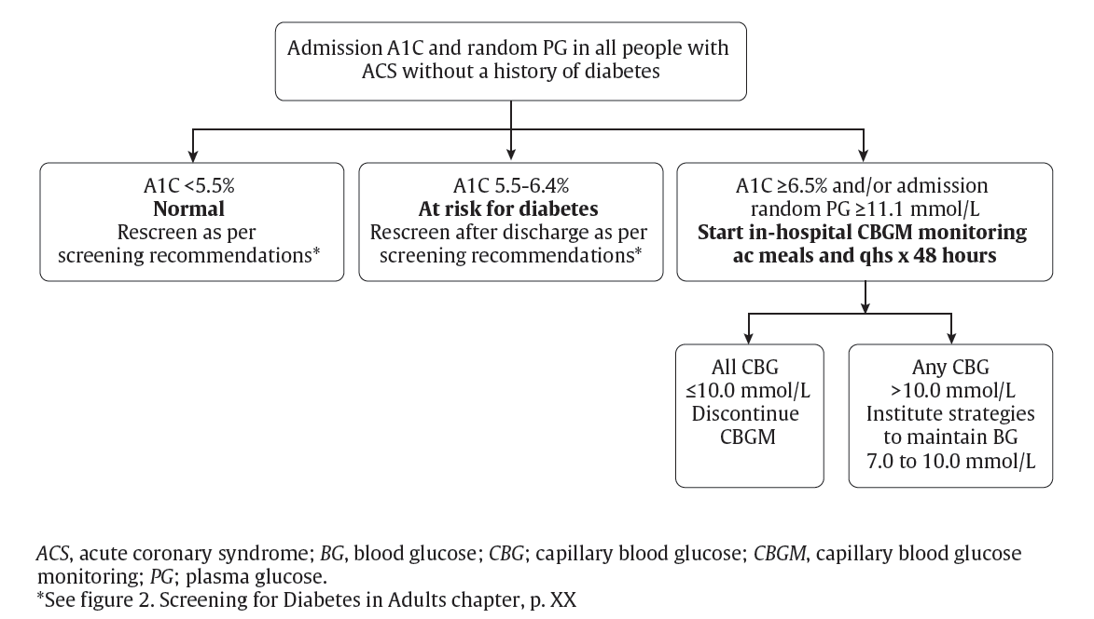
Screening for Type 2 Diabetes in Acute Coronary Syndromes
2018 Diabetes Canada CPG – Chapter 27. Management of Acute Coronary Syndromes

Slide 6
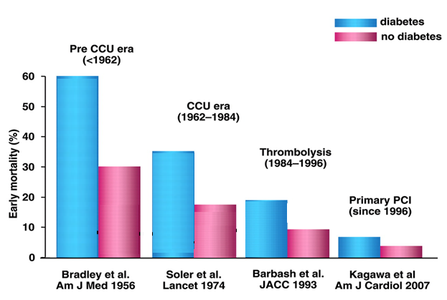
2018 Diabetes Canada CPG – Chapter 27. Management of Acute Coronary Syndromes
ACS Mortality in Diabetes vs. No Diabetes: Changes Across the Eras
Radke P W ,et al. Eur Heart J 2010;31:2971-3.
ACS, acute coronary syndrome
Notes:
Script: While there has been marked improvements in care of patients with ACS across the decades, patients with diabetes have always demonstrated a worse outcome compared to patients without diabetes.
Eur Heart J. 2010 Dec;31(24):2971-3. doi: 10.1093/eurheartj/ehq347. Epub 2010 Oct 12.
Diabetics with acute coronary syndrome: advances, challenges, and uncertainties.
Radke PW, Schunkert H.

Slide 7
All people with diabetes and ACS should receive the same treatments as those without diabetes… with some differences
2018 Diabetes Canada CPG – Chapter 27. Management of Acute Coronary Syndromes
ACS, acute coronary syndrome
Notes:
7

Slide 8
Dual Anti-platelet Therapy in Patients with Diabetes
2018 Diabetes Canada CPG – Chapter 27. Management of Acute Coronary Syndromes
Diabetes → ↑ risk of recurrent atherothrombotic events, including stent thrombosis
Low dose ASA (75-150 mg) is effective for secondary prevention
Dual anti-platelet therapy (ASA + clopidogrel) has been standard of care for non-ST elevation acute coronary syndrome (NSTE ACS) but recurrent events continue to occur, especially in diabetes
Notes:
8

Slide 9
TRITON Study: Prasugrel vs. Clopidogrel
2018 Diabetes Canada CPG – Chapter 27. Management of Acute Coronary Syndromes
n =13,608: ACS (STEMI or NSTE ACS) and Planned PCI
CV Death/MI/Stroke at 15 months
15
CLOPIDOGREL
300 mg LD/ 75 mg MD
12.1%
CV Death / MI / Stroke
10
9.9%
Prasugrel (n=6813)
PRASUGREL
60 mg LD/ 10 mg MD
% of Patients
5
HR: 0.81
(0.73-0.90) p <.001
NNT = 46
0
0
30
60
90
180
270
360
450
Days
ACS = Acute Coronary Syndrome; STEMI = ST-elevation Myocardial Infarction; NSTE ACS = Non-ST-elevation Acute coronary Syndrome; PCI = Percutaneous Coronary Intervention; LD = Loading Dose; MD = Maintenance Dose; NNT = Number Needed to Treat; CV = Cardiovascular
Modified from Wiviott SD, et al. N Engl J Med. 2007;357(20):2001-2015.
Notes:
9
Script:In the Trial to Assess Improvement in Therapeutic Outcomes by Optimizing Platelet Inhibition with Prasugrel–Thrombolysis in Myocardial Infarction, prasugrel administered at the time of coronary angioplasty in patients with ACS, reduced recurrent ischemic events, including early stent thrombosis, compared to patients receiving clopidogrel.
N Engl J Med. 2007 Nov 15;357(20):2001-15. Epub 2007 Nov 4.
Prasugrel versus clopidogrel in patients with acute coronary syndromes.
Wiviott SD, Braunwald E, McCabe CH, Montalescot G, Ruzyllo W, Gottlieb S, Neumann FJ, Ardissino D, De Servi S, Murphy SA, Riesmeyer J, Weerakkody G, Gibson CM, Antman EM; TRITON-TIMI 38 Investigators.
Source
Brigham and Women's Hospital and Harvard Medical School, Boston, MA 02115, USA.
Abstract
BACKGROUND:
Dual-antiplatelet therapy with aspirin and a thienopyridine is a cornerstone of treatment to prevent thrombotic complications of acute coronary syndromes and percutaneous coronary intervention.
METHODS:
To compare prasugrel, a new thienopyridine, with clopidogrel, we randomly assigned 13,608 patients with moderate-to-high-risk acute coronary syndromes with scheduled percutaneous coronary intervention to receive prasugrel (a 60-mg loading dose and a 10-mg daily maintenance dose) or clopidogrel (a 300-mg loading dose and a 75-mg daily maintenance dose), for 6 to 15 months. The primary efficacy end point was death from cardiovascular causes, nonfatal myocardial infarction, or nonfatal stroke. The key safety end point was major bleeding.
RESULTS:
The primary efficacy end point occurred in 12.1% of patients receiving clopidogrel and 9.9% of patients receiving prasugrel (hazard ratio for prasugrel vs. clopidogrel, 0.81; 95% confidence interval [CI], 0.73 to 0.90; P<0.001). We also found significant reductions in the prasugrel group in the rates of myocardial infarction (9.7% for clopidogrel vs. 7.4% for prasugrel; P<0.001), urgent target-vessel revascularization (3.7% vs. 2.5%; P<0.001), and stent thrombosis (2.4% vs. 1.1%; P<0.001). Major bleeding was observed in 2.4% of patients receiving prasugrel and in 1.8% of patients receiving clopidogrel (hazard ratio, 1.32; 95% CI, 1.03 to 1.68; P=0.03). Also greater in the prasugrel group was the rate of life-threatening bleeding (1.4% vs. 0.9%; P=0.01), including nonfatal bleeding (1.1% vs. 0.9%; hazard ratio, 1.25; P=0.23) and fatal bleeding (0.4% vs. 0.1%; P=0.002).
CONCLUSIONS:
In patients with acute coronary syndromes with scheduled percutaneous coronary intervention, prasugrel therapy was associated with significantly reduced rates of ischemic events, including stent thrombosis, but with an increased risk of major bleeding, including fatal bleeding. Overall mortality did not differ significantly between treatment groups. (ClinicalTrials.gov number, NCT00097591 [ClinicalTrials.gov].)

Slide 10
TRITON: Diabetes Subgroup - Prasugrel
2018 Diabetes Canada CPG – Chapter 27. Management of Acute Coronary Syndromes
n = 3146 ACS (STEMI or NSTE ACS) & Planned PCI
18
CLOPIDOGREL
17.0%
16
CV Death / MI / Stroke
30%
14
PRASUGREL
12.2%
12
Endpoint (%)
10
HR: 0.70
p <0.001
NNT 21
8
6
4
TIMI Major
Non CABG Bleeds
CLOPIDOGREL
2.6%
2
2.5%
PRASUGREL
0
0
30
60
90
180
Days
270
360
450
ACS = Acute Coronary Syndrome; STEMI = ST-elevation Myocardial Infarction; NSTE ACS = Non-ST-elevation Acute coronary Syndrome;
PCI = Percutaneous Coronary Intervention; LD = Loading Dose; MD = Maintenance Dose; NNT = Number Needed to Treat; CV = Cardiovascular
Modified from Wiviott SD et al. Circulation 10-14-2008;118:1626-1636
Notes:
10
Script: However, it is subgroup analysis, In subjects with diabetes, prasugrel treatment was associated with greater platelet inhibition and fewer poor responders. Prasugrel resulted in an important net clinical benefit in patients with diabetes due to a 30% reduction of the primary endpoint (cardiovascular death, non-fatal MI, or stroke) and no significant increase in bleeding compared to clopidogrl when added onto ASA.

Slide 11
2018 Diabetes Canada CPG – Chapter 27. Management of Acute Coronary Syndromes
PLATO Study: Ticagrelor vs. Clopidogrel
n = 18,624 ACS
12
11.7%
11
CLOPIDOGREL
10
9.8%
CV Death / MI / Stroke
9
8
TICAGRELOR
7
Cumulative incidence (%)
6
HR: 0.84 (0.77-0.92) p <0.001
5
NNT = 56
4
3
2
1
0
0
60
120
180
240
300
360
Days after Randomisation
ACS = Acute Coronary Syndrome; PCI = Percutaneous Coronary Intervention; NNT = Number Needed to Treat; CV=Cardiovascular
Modified: Wallentin et al. New Eng J Med 2009; 361(11): 1045-1057
Notes:
Script: In the PLATO study, ticagrelor compared with clopidogrel, administered early after presentation in patients with NSTE ACS or STEMI, reduced CV
death, non-fatal MI, and stroke by 16%. and stent thrombosis by 25% with no increase in overall major bleeding. In the diabetic cohort of the PLATO study , similar benefits were observed as in the overall group.
N Engl J Med. 2009 Sep 10;361(11):1045-57. doi: 10.1056/NEJMoa0904327. Epub 2009 Aug 30.
Ticagrelor versus clopidogrel in patients with acute coronary syndromes.
Wallentin L, Becker RC, Budaj A, Cannon CP, Emanuelsson H, Held C, Horrow J, Husted S, James S, Katus H, Mahaffey KW, Scirica BM, Skene A, Steg PG, Storey RF, Harrington RA; PLATO Investigators, Freij A, Thorsén M.
The following toggler user interface control may not be accessible. Tab to the next button to revert the control to an accessible version.
Destroy user interface controlCollaborators (1118)
Source
Uppsala Clinical Research Center, Uppsala, Sweden. lars.wallentin@ucr.uu.se
Abstract
BACKGROUND:
Ticagrelor is an oral, reversible, direct-acting inhibitor of the adenosine diphosphate receptor P2Y12 that has a more rapid onset and more pronounced platelet inhibition than clopidogrel.
METHODS:
In this multicenter, double-blind, randomized trial, we compared ticagrelor (180-mg loading dose, 90 mg twice daily thereafter) and clopidogrel (300-to-600-mg loading dose, 75 mg daily thereafter) for the prevention of cardiovascular events in 18,624 patients admitted to the hospital with an acute coronary syndrome, with or without ST-segment elevation.
RESULTS:
At 12 months, the primary end point--a composite of death from vascular causes, myocardial infarction, or stroke--had occurred in 9.8% of patients receiving ticagrelor as compared with 11.7% of those receiving clopidogrel (hazard ratio, 0.84; 95% confidence interval [CI], 0.77 to 0.92; P<0.001). Predefined hierarchical testing of secondary end points showed significant differences in the rates of other composite end points, as well as myocardial infarction alone (5.8% in the ticagrelor group vs. 6.9% in the clopidogrel group, P=0.005) and death from vascular causes (4.0% vs. 5.1%, P=0.001) but not stroke alone (1.5% vs. 1.3%, P=0.22). The rate of death from any cause was also reduced with ticagrelor (4.5%, vs. 5.9% with clopidogrel; P<0.001). No significant difference in the rates of major bleeding was found between the ticagrelor and clopidogrel groups (11.6% and 11.2%, respectively; P=0.43), but ticagrelor was associated with a higher rate of major bleeding not related to coronary-artery bypass grafting (4.5% vs. 3.8%, P=0.03), including more instances of fatal intracranial bleeding and fewer of fatal bleeding of other types.
CONCLUSIONS:
In patients who have an acute coronary syndrome with or without ST-segment elevation, treatment with ticagrelor as compared with clopidogrel significantly reduced the rate of death from vascular causes, myocardial infarction, or stroke without an increase in the rate of overall major bleeding but with an increase in the rate of non-procedure-related bleeding. (ClinicalTrials.gov number, NCT00391872.)
11

Slide 12
Dual Anti-platelet Therapy in People with diabetes and ACS
2018 Diabetes Canada CPG – Chapter 27. Management of Acute Coronary Syndromes
Prasugrel if
About to undergo PCI
Clopidogrel-naïve
<75 yrs of age
>65 kg weight
No history of stroke
OR
Ticagrelor if
No history of hemorrhagic stroke
No extreme bradycardia
RATHER THAN
Clopidogrel to further reduce ischemic events
ACS, acute coronary syndrome; PCI, percutaneous coronary intervention
Notes:
12

Slide 13
Comparison of Anti-platelet Therapies
2018 Diabetes Canada CPG – Chapter 27. Management of Acute Coronary Syndromes
 | Clopidogrel | Prasugrel | Ticagrelor
Dosing | Oral, once daily | Oral, once daily | Oral, twice daily
Onset | 2-6 hours | <1 hour | <1 hour
Variability | High | Low | Low
Reversible | No | No | Yes
Plt Inhibition | ~ 50% | 70% at 1 hr | 95% at 2hrs
Plt, platelet
Notes:
13
Despite dual-antiplatelet therapy with ASA and clopidogrel, recurrent atherothrombotic events continue to occur, especially in the patient with diabetes. Clopidogrel is a relatively weak inhibitor of platelet aggregation with a wide variation of inhibition of in-vitro platelet aggregation. There is a higher incidence of events in patients with residual platelet activity and patients with diabetes have higher residual platelet activity despite ASA and clopidogrel treatment. Two new antiplatelet agents, prasugrel and ticagrelor, that are more effective and predictable inhibitors of platelet aggregation, have recently become available in Canada.
13

Slide 14
Extended Dual Anti-Platelet Therapy: PEGASUS Trial
Dual antiplatelet therapy with ASA + Ticagrelor for up to 3 years beyond usual 1 year treatment
Reduced CV death/ non-fatal MI, stroke (ticagrelor 60 mg twice daily HR 0.84 95% CI 0.74-0.95)
No advantage from ticagrelor 90 mg twice daily
Major bleeding increased (placebo 1.06%, 60 mg 2.3%, 90 mg 2.6%)
Patients with diabetes had similar relative benefit but with 50% higher event rates they had a 60% greater absolute benefit compared to patients with no diabetes. Bleeding rates similar in both groups
Bonaca et al N Engl J Med 2015;372:1791
CV, cardiovascular; MI, myocardial infarct
Notes:
More prolonged duration dual anti-platelet therapy with ASA and ticagrelor in ACS patients, administered for up to 3 years beyond the usual one-year treatment, was shown in the PEGASUS trial(51) to reduce the primary endpoint of non-fatal myocardial infarction, stroke or cardiovascular death ( Placebo 9.04% Ticagrelor 60mg 7.77% (HR 0.84 (95% CI 0.74-0.95) Ticagrelor 90mg 7.85% (HR 0.85 (95% CI 0.75-0.96) There was no advantage to receiving ticagrelor 90mg twice daily rather than 60mg twice daily, and major bleeding was slightly more at the higher dose (Placebo 1.06%, 60mg 2.3%, 90mg 2.6%) . Patients with diabetes receiving ticagrelor, had a similar relative risk reduction of the primary combined endpoint as the overall group(52). However with a 50% higher event rate, those with diabetes had an 60% greater absolute benefit than the patients with no diabetes {Diabetes: Placebo 11.6%, Ticagrelor 60mg bid 10.0% HR 0.83 (95% CI 0.69-1.00) No diabetes Placebo 7.8%, Ticagrelor 6.7% HR 0.84 (95% CI 0.72-0.98)}. The increased bleeding rates with ticagrelor were similar in the patients with diabetes to those without diabetes.

Slide 15
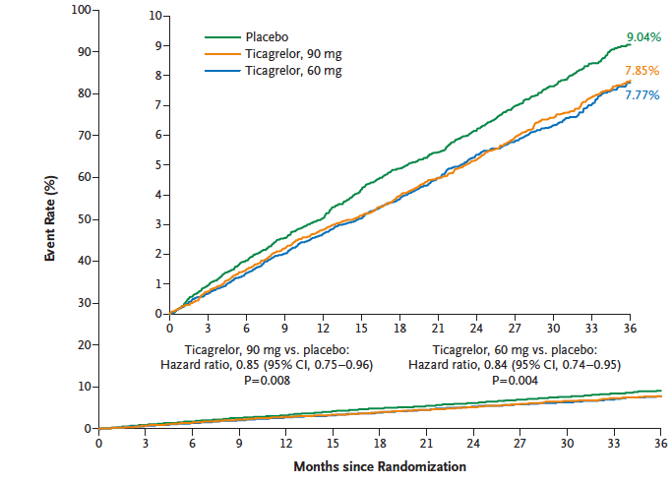
Extended Dual Anti-Platelet Therapy beyond 1 year After Myocardial Infarction (PEGASUS)
Bonaca et al N Engl J Med 2015;372:1791

Slide 16
Glycemic Control Among People with ACS
2018 Diabetes Canada CPG – Chapter 27. Management of Acute Coronary Syndromes
Hyperglycemia during the first 24 to 48 hours after admission → ↑ early mortality in patients with ACS
Evidence to support treatment of elevated BG after ACS = inconclusive
Patients with acute MI and BG on admission of >11 mmol/L → likely benefit from maintaining BG 7.0 -10.0 mmol/L
  Insulin therapy may be required
  Helpful to have protocols
ACS, acute coronary syndrome; BG, blood glucose; MI, myocardial infarction
Notes:
TT: Slide illustrates importance of maintaining inpatient glycemic control among pts with ACS.
Script: Hyperglycemia during the first 24 to 48 hours after admission is associated with an increased early mortality in patients with ACS, whether or not they have diabetes. Higher baseline glucose and a failure of glucose to decrease are independent predictors of mortality so maintaining optimal glycemic control in hospitalized pts with ACS is essential. Although elevated mean blood glucose level in the first 24 hours after onset of ACS is associated with adverse outcomes, evidence to support reducing blood glucose levels (especially to levels close to the normal range) after ACS, still remains inconclusive.
However, that being said, patients with acute MI and BG on admission of >11 mmol/L would likely benefit with taraget BG between 7.0 -10.0. To achieve this, insulin therapy may be required but it is essential to avoid overtreatment and hypoglycemia.
16

Slide 17
Recommendation 1
2018 Diabetes Canada CPG – Chapter 27. Management of Acute Coronary Syndromes
2018
In all people with ACS, a random BG and an A1C (if not done in the 3 months prior to admission) should be measured:
  For people with a history of diabetes to identify individuals that would benefit from glycemic optimization [Grade D, Consensus]
  For people without a history of diabetes, to identify individuals at risk for ongoing dysglycemia [Grade D, Consensus]
    If the A1C is ≥6.5% and/or random BG is >11.0 mmol/L, in-hospital CBGM should be initiated [Grade D, Consensus]
    If A1C is 5.5-6.4%, repeat screening for diabetes should be performed after discharge as per diabetes screening recommendations [Grade D, Consensus] ) (see Figure: Screening for Diabetes in Adults chapter)
ACS, acute coronary syndrome; BG, blood glucose; CBGM, capillary blood glucose monitoring

Slide 18
Recommendation 2
2018 Diabetes Canada CPG – Chapter 27. Management of Acute Coronary Syndromes
2. In-hospital management of diabetes in ACS should include strategies to avoid both hyperglycemia and hypoglycemia:
  People with ACS and a random BG of >11.0 mmol/L on admission may be treated to achieve BG levels in the range of 7.0-10.0 mmol/L followed by strategies to achieve recommended BG targets long term [Grade C, Level 2]. Insulin therapy may be required to achieve these targets [Grade D, Consensus]
  An appropriate protocol should be developed and staff trained to ensure the safe and effective implementation of this therapy and to minimize the likelihood of hypoglycemia [Grade D, Consensus]
ACS, acute coronary syndrome; BG, blood glucose

Slide 19
Recommendation 3
2018 Diabetes Canada CPG – Chapter 27. Management of Acute Coronary Syndromes
2018
3. People with diabetes and ACS should receive the same treatments that are recommended for people with ACS without diabetes since they benefit equally [Grade D, Consensus]
  a. In people with diabetes and ACS undergoing PCI, antiplatelet therapy with prasugrel (if clopidogrel-naïve, <75 years of age, weight >60 kg, and no history of stroke) [Grade A, Level 1] or ticagrelor [Grade B, Level 1], rather than clopidogrel, should be used to further reduce recurrent ischemic events. People with diabetes and non-STE ACS and higher risk features destined for a selective invasive strategy should receive ticagrelor, rather than clopidogrel [Grade B, Level 2]
ACS, acute coronary syndrome; PCI, percutaneous coronary intervention; STE, ST elevation

Slide 20
Recommendation 3 cont’d
2018 Diabetes Canada CPG – Chapter 27. Management of Acute Coronary Syndromes
2018
3. People with diabetes and ACS should receive the same treatments that are recommended for people with ACS without diabetes since they benefit equally [Grade D, Consensus]
  b. In people with diabetes and ACS, at very high risk of recurrent ischemic events and at average or low bleeding risk, prolonged (up to 3 years post ACS) treatment with ticagrelor 60 mg twice daily should be considered [Grade B, Level 2]
ACS, acute coronary syndrome

Slide 21
Recommendation 3 cont’d
2018 Diabetes Canada CPG – Chapter 27. Management of Acute Coronary Syndromes
2018
3. People with diabetes and ACS should receive the same treatments that are recommended for people with ACS without diabetes since they benefit equally [Grade D, Consensus]
  c. In people with diabetes and non-STE ACS and high risk features an early invasive approach, rather than a selective invasive approach to revascularization, should be used to reduce recurrent coronary events, unless contraindicated [Grade B, Level 2]
ACS, acute coronary syndrome; STE, ST elevation

Slide 22
Recommendation 3 cont’d
2018 Diabetes Canada CPG – Chapter 27. Management of Acute Coronary Syndromes
2018
3. People with diabetes and ACS should receive the same treatments that are recommended for people with ACS without diabetes since they benefit equally [Grade D, Consensus]
  d. For people with diabetes with NSTE-ACS and complex coronary anatomy, CABG should be considered rather than complex PCI [Grade A, Level 1]
  e. In people with diabetes and STE-ACS, the selection of the reperfusion modality (PPCI vs. fibrinolysis) should not differ from people with STE-ACS without diabetes; the presence of retinopathy should not be a contraindication to fibrinolysis [Grade B, Level 2]
ACS, acute coronary syndrome; CABG, coronary artery bypass grafting; PPCI, primary percutaneous coronary intervention; STE, ST elevation

Slide 23
Key Messages
2018 Diabetes Canada CPG – Chapter 27. Management of Acute Coronary Syndromes
Over the past 20 years the rates of acute MI in patients with diabetes has decreased substantially. However the burden of disease remains high because of the increased prevalence of diabetes
Diabetes and hyperglycemia are independent predictors of increased short- and long-term mortality, recurrent MI infarction, and the development of heart failure in patients with acute MI
MI, myocardial infarction

Slide 24
Key Messages
2018 Diabetes Canada CPG – Chapter 27. Management of Acute Coronary Syndromes
BG, blood glucose; MI, myocardial infarction
People with an acute MI and hyperglycemia (random BG >11.0 mmol/L) may receive antihyperglycemic therapy to maintain BG levels between 7.0 to 10.0 mmol/L

Slide 25
Key Messages
2018 Diabetes Canada CPG – Chapter 27. Management of Acute Coronary Syndromes
MI, myocardial infarction
People with diabetes are less likely to receive recommended treatment such as an early invasive strategy and revascularization, reperfusion therapy, beta blockers, or dual antiplatelet therapy than people without diabetes. Efforts should be directed at promoting adherence to existing proven therapies in the high risk person with MI and diabetes

Slide 26
Key Messages for People with Diabetes
2018 Diabetes Canada CPG – Chapter 27. Management of Acute Coronary Syndromes
A heart attack can manifest as chest discomfort or crushing pain; or as pain in the arms, back, neck, jaw and, even, the stomach. Shortness of breath, cold sweat, nausea and lightheadedness may also occur
If you are experiencing symptoms of a heart attack, you should seek medical help immediately. The faster treatment is started, the better

Slide 27

Visit guidelines.diabetes.ca

Slide 28


Or download the App

Slide 29
Diabetes Canada Clinical Practice Guidelines
www.guidelines.diabetes.ca – for health-care providers
1-800-BANTING (226-8464)
www.diabetes.ca – for people with diabetes
Notes:
29

