Slide 1
Glycemic Management of T1D Across the Lifespan

Slide 2
PROGRAM DISCLOSURE OF COMMERCIAL SUPPORT
NATURE OF RELATIONSHIP | NAME OF THE FOR-PROFIT OR NOT-FOR-PROFIT ORGANIZATION | DESCRIPTION OF RELATIONSHIP
Any direct financial payments including receipt of honoraria
Membership on advisory boards or speakers’ bureaus
Funded grants of clinical trials
Patents on a drug, product or device
All other investments/relationship that could be seen as having the potential to influence the content of the educational activity
[presentation title] [speaker]
Notes:
Lock these boxes for formatting!

Slide 3
MITIGATION OF BIAS
POTENTIAL SOURCE OF BIAS | MEASURES TAKEN TO MITIGATE BIAS
#1: Recommendations related to pump, sensor, adjunctive therapy and insulins | All recommendations are graded by MERST and agreed upon by all authors and steering committee.
#2:
#3:
#4:
#5:
[presentation title] [speaker]
Notes:
Lock these boxes for formatting!

Slide 4
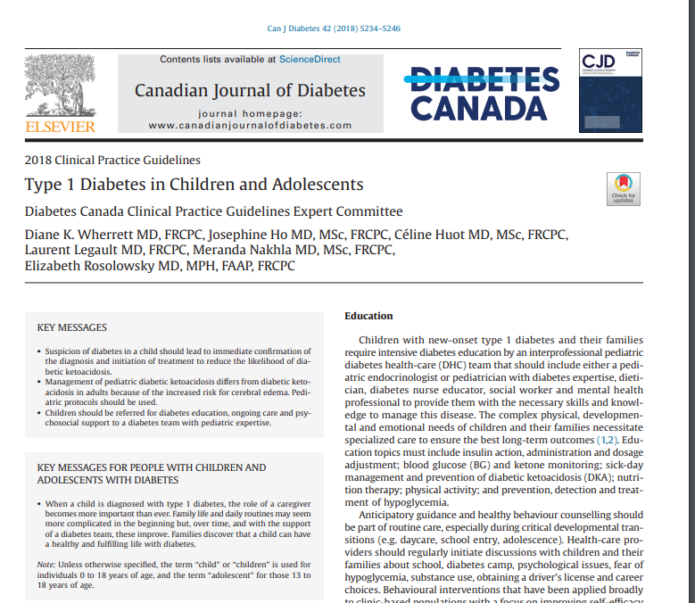
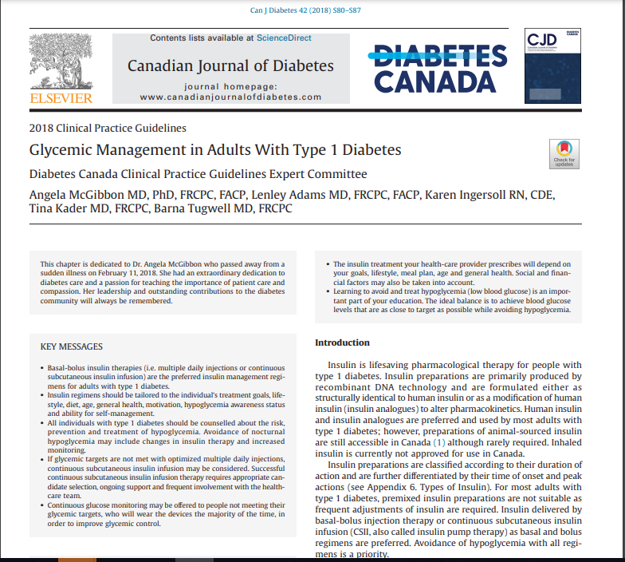
Type 1 Diabetes in the 2018 Guidelines
#34
#12
Notes:
epidemiology of type 1 diabetes
new diagnosis of type 1 diabetes
screening and prevention
glycemic targets
insulin delivery
insulin types
adjuvant therapies
transplant/stem cells
DKA
sick-day management
reproductive health
screening for complications (BP, LDL)
disordered eating
peer support/peer groups
nutrition
physical activity/exercise
substance use
transition of care from childhood to adulthood
diabetes at work/diabetes at school
120 PIC
Over 1200 papers

Slide 5
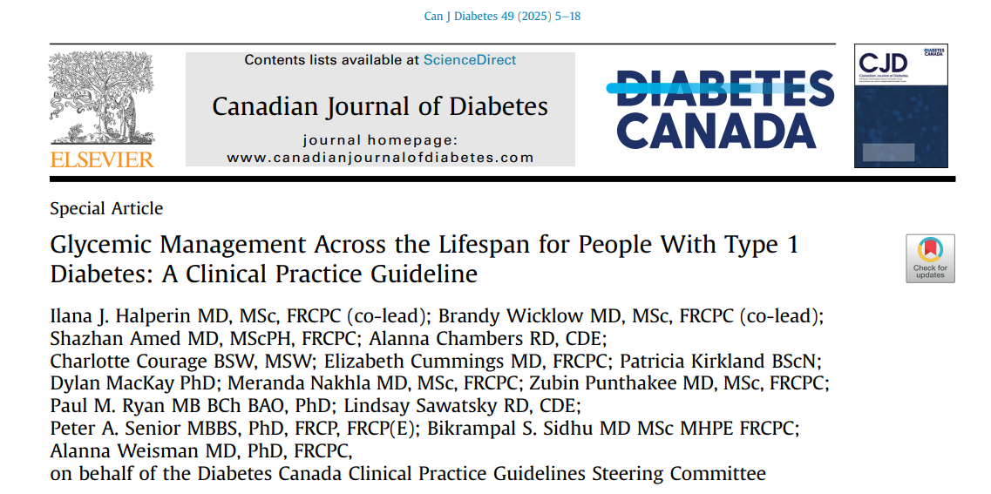
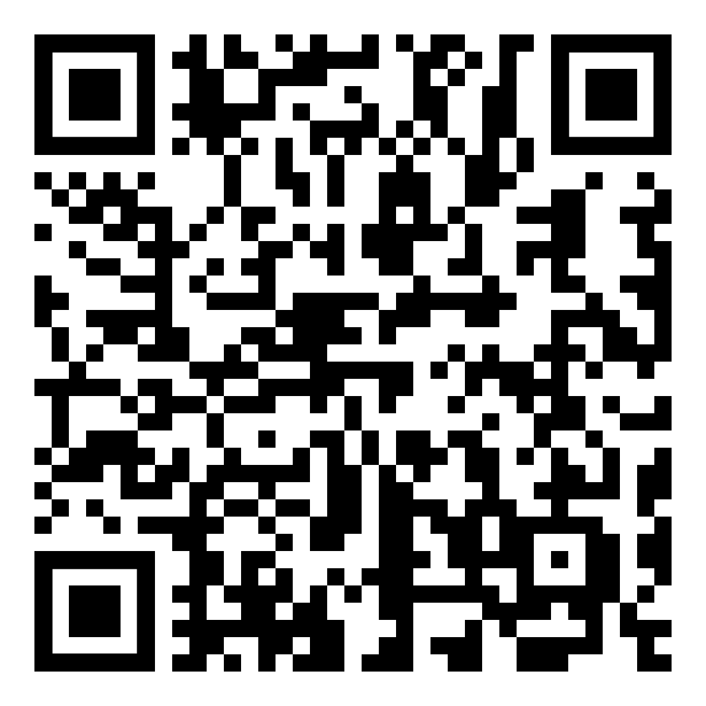
Halperin, IJ. et al. Can. J. Diabetes. 2025;49(1):1-18. doi: 10.1016/j.jcjd.2025.01.001

Slide 6
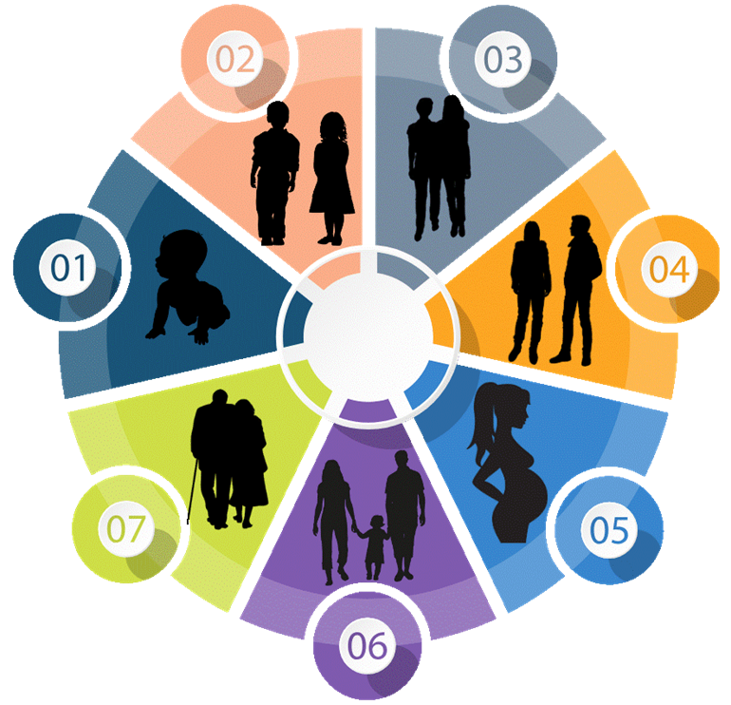
Glycemic management across most of the Lifespan
Focused on Management of Hyper and Hypoglycemia
Recommendations - Based on evidence in existing literature
Narrative - Considering the patient experience, context and environmental considerations
Does not include exercise, nutrition, mental health
Does not include workplace, daycare, school, care home
Does not include management in Pregnancy or Elderly
Does not include content in recent updates (Monitoring, Hypoglycemia in Adults)
Toddlers– Nutrition, sick day management, daycare
Childhood– DKA, sick day management, diabetes at school
Early Adolescence– Puberty, disordered eating, Peer support, Peer groups
Emerging Adulthood– Substance Use, Reproductive Health, Complication Screening, Transition of Care
Adulthood– Diabetes at Work, Diabetes and Family Life
Elderly– Hypoglycemia and Falls

Slide 7
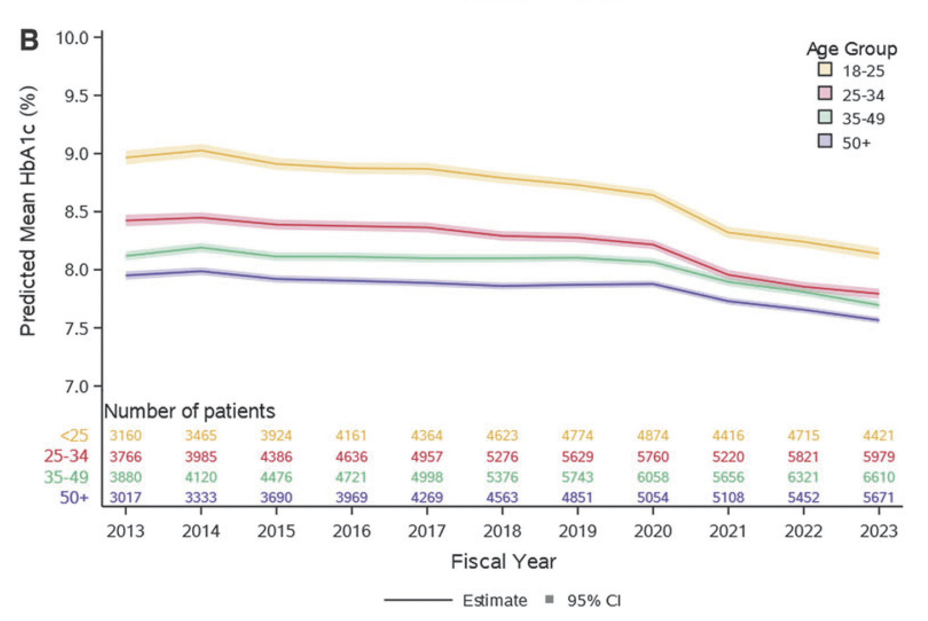
Recent Improvements to A1C Among Canadians
28,827 Adults in Ontario Living with T1D | Retrospective Cohort Study, 2024
~1/3
of adults in Ontario with T1D met the recommended A1C target of 7.0% in 2023
improvements since 2021
Increased probability of meeting
A1C target of 7.0%
22.1%
34.7%
Weisman A, Booth GL, Everett K, Tomlinson GA. Recent Improvements in Attainment of the Hemoglobin A1c Target of ≤7.0% Among Adults with Type 1 Diabetes in Ontario: A Retrospective Cohort Study. Diabetes Technol Ther. 2024 Sep;26(9):607-617. doi: 10.1089/dia.2024.0017. Epub 2024 Apr 8. PMID: 38526559.
Notes:
Weisman A, Booth GL, Everett K, Tomlinson GA. Recent Improvements in Attainment of the Hemoglobin A1c Target of ≤7.0% Among Adults with Type 1 Diabetes in Ontario: A Retrospective Cohort Study. Diabetes Technol Ther. 2024 Sep;26(9):607-617. doi: 10.1089/dia.2024.0017. Epub 2024 Apr 8. PMID: 38526559.
Abstract
Aims: We evaluated attainment of the hemoglobin A1c (HbA1c) target of £7.0%, its temporal trends, and
associated factors among adults with type 1 diabetes in Ontario, Canada, using administrative data.
Methods: We conducted a retrospective cohort study, including Ontarians with type 1 diabetes ‡18 years old
with ‡1 HbA1c test between April 1, 2012 (fiscal year 2013), and March 31, 2023. Generalized estimating
equations were used to determine probabilities of meeting the HbA1c target, as well as associations between
fiscal year and individual-, physician-, and system-level factors on odds of meeting the target.
Results: Among 28,827 adults with type 1 diabetes [14,385 (49.9%) female, 17,998 (62.4%) pump users], with
median age at index of 25 years [interquartile range (IQR) 18–37] and median diabetes duration of 12 years
[6–18], there were 474,714 HbA1c tests [median 2/individual/year (IQR: 1–3)]. The model-estimated probability
of meeting the HbA1c target of £7.0% was 22.1% (95% confidence interval, CI: 21.6 to 22.5) in 2013,
remained stable until 2020, and increased to 34.7% (95% CI: 34.3 to 35.2) in 2023. The age- and sex-adjusted
odds ratio for meeting the target in 2023 versus 2013 was 1.87 (95% CI: 1.79 to 1.96). Young adults (18–25
years), diabetic ketoacidosis, greater comorbidity, and receiving diabetes care from a nonspecialist physician
were associated with reduced odds of meeting the HbA1c target.
Conclusions: One-third of adults with type 1 diabetes in Ontario met the recommended HbA1c target of £7.0%
in 2023, with improvement noted since 2021, which may be due to advanced technologies or effects of the
COVID-19 pandemic.

Slide 8
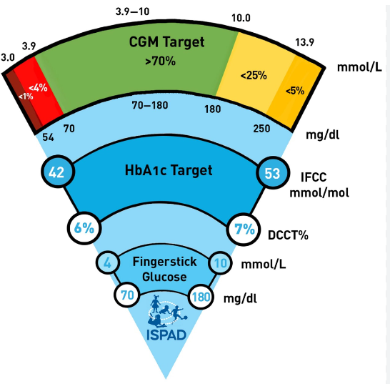

Glycemic Targets
Emphasize Individualized Targets based on Context
Adults (No Change)
A1c ≤ 7.0%
Glycemic variability ≤ 36%
Time in Range > 70%
Time Below Range < 3.0%
Time Above Range <20%
Children
A1c ≤ 7.0%
Glycemic variability ≤ 36%
Time in Range > 70%
Time Below Range < 3.0%
Time Above Range <20%
Notes:
7.1-8.5 Functionally dependent, Recurrent severe hypoglycemia or hypoglycemia unawareness, limited life expectancy, frail elderly/dementia
Children (chapter 34)- anyone under age 18 years
Individualized targets- patient and caregiver context across domains of health care access, technology, fear of hypo, mental health etc

Slide 9
Hypoglycemia in Children
Category | Level 1- Mild | Level 2- Moderate | Level 3- Severe
Description | Glucose 3.0-3.9 mmol/L Autonomic Symptoms | Glucose < 3.0 mmol/L Neuroglycopenic symptoms | Glucose low Cognitive impairment
Management | Basal Bolus Injections & Insulin Pump Therapy Oral Glucose Age < 5 yrs: 5 g Age 5-10 yrs: 10 g Age > 10 yrs: 15g Automated Insulin Delivery Systems Oral Glucose Age < 5 yrs: 5g Age 5-10 yrs: 5g Age > 10 yrs: 5-10g |  | Oral Glucose 20 g Unable to swallow Age ≥ 4 years: IN/IM/SQ glucagon Age < 4 years: SQ/IM glucagon 0.5 mg < 20 Kg 1.0 mg ≥ 20 Kg
[Grade A, Level 2]
[Grade B, Level 2]
[Grade D, Consensus]
Notes:
Oral carbohydrates 0.3 g/kg if mild or moderate
Glucose rechecked after 15 minutes and retreated if BG remains < 3.9 mmol/L

Slide 10
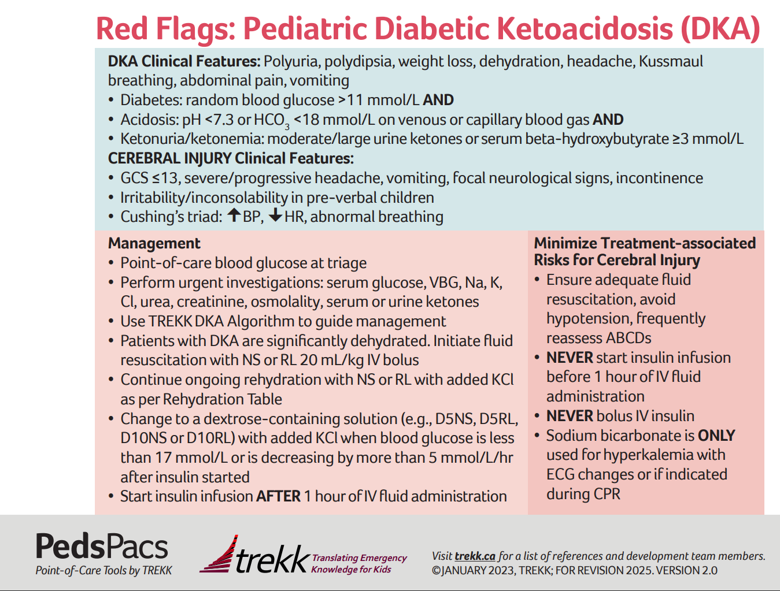
DKA Management
Mild to Moderate DKA in Children
Isotonic or Hypotonic Fluids
Isotonic Fluid Bolus 10-20 ml/Kg for rehydration without risk of cerebral edema (Grade B/Level 2)
If no IV insulin frequent subcutaneous insulin injections may be used (Grade B/Level 2)
DKA in Adults
Subcutaneous insulin for management of DKA may be considered in stable adults to reduce ICU admission (Grade B/ Level 1&3)

Slide 11
Insulin Therapy

Slide 12
Insulin Types
Insulin type (trade name) | Onset | Peak | Duration
Basal insulins
Intermediate-acting (cloudy) Insulin neutral protamine Hagedorn (Humulin®-N, Novolin® ge NPH) | 1 – 3 h | 5 – 8 h | Up to 18 h
Long-acting insulin (clear) Insulin detemir (Levemir®) Insulin glargine U-100 (Basaglar®§, Lantus®, Semglee®§) | 90 min | Not applicable | 16 – 24 h 24 h
Ultra long-acting insulin (clear) Insulin glargine U-300 (Toujeo®) Insulin degludec U-100, U-200 (Tresiba®) | 90 min | Not applicable | >30 h 42 h
Once weekly basal insulin (clear) Insulin icodec U-700 (Awiqli®) | 16 h | 2 – 4 days | >7 days
Bolus (preprandial or mealtime or correction) insulin
Short-acting insulins (clear) Insulin regular (Humulin®-R, Novolin® ge Toronto) Insulin regular (Entuzity® U-500) | 30 min 15 min | 2 – 3 h 4 – 8 h | 6.5 h 17 – 24 h
Rapid-acting insulin analogues (clear) Insulin aspart (Kirsty®†, NovoRapid®, Trurapi®†) Insulin glulisine (Apidra®) Insulin lispro U-100 (Admelog®‡, Humalog® U-100) Insulin lispro U-200 (Humalog® U-200) | 9 – 20 min 10 – 15 min 10 – 15 min 10 – 15 min | 1 – 1.5 h 1 – 1.5 h 1 – 2 h 1 – 2 h | 3 – 5 h 3.5 – 5 h 3 – 4.75 h 3 – 4.75 h
Ultra rapid-acting insulin analogues (clear) Faster-acting insulin aspart (Fiasp®) | 4 min | 0.5 – 1.5 h | 3 – 5 h

Slide 13
Insulins- Prandial
Rapid preferred over short acting insulin to
Reduce A1C in adults (Grade A, Level 1A)
Lower post prandial glucose in adolescents (Grade A, Level 1A)
Reduce A1C and hypoglycemia in young children (age 2-6) (Grade C, Level 3)
Minimize hypoglycemic in adults (Grade B, level 1A)
Minimize severe hypoglycemia in adults and adolescents using BBI (Grade B, Level 2)
Improve treatment satisfaction in parents of young children (Grade C, Level 3)
Improve A1C and hypoglycemia in all other children (Grade D, Consensus)
Notes:
LowWe continue to strongly recommend intensive insulin therapy to reduce A1C and complications, this has not really changed from previous guidelines though we will focus on what is new.
Minimize the risk of any hypoglycemia in adults [Grade B, Level 1a {21290, 21291 , 21292}] and severe hypoglycemia in adults in adolescents using basal-bolus injection therapy [Grade B, Level 2 {21292 , 21295 }; and in children [ Grade D, Consensus]
Improve treatment satisfaction in parents of preschoolers [Grade C, Level 3 {21296}]
In individuals on basal bolus injection therapy not at target to:
Improve A1C in children and adolescents [Grade A, Level 1A {19953}]
And may be used in place of rapid acting analogues to lower post prandial glucose
in children and adolescents [Grade C, Level 2 {19953}];
b. In individuals on insulin pump therapy* not at target, ultrarapid insulin analogues should be considered to:
Improve time in range and time below range in adults [Grade A, Level 1A {536}]
Lower post-prandial glucose in adults [Grade A , Level 1a {471, 563, 21293}] + {8769, 2216, 1056, 2149}
c. In automated insulin delivery systems*, ultrarapid acting insulin analogues7. be considered to:
Improve time in range in adults [Grade C, Level 3 {1056, 964} and decrease time below range in adults [ Grade C, Level 3 {964,1056}]
Decrease post-prandial glucose in adults [Grade C, Level 3 {1056}]
*some insulin pumps are not compatible with ultrarapid insulin and there is an increased risk of occlusions and pumpsite failures.

Slide 14
Insulins- Prandial
Ultrarapid insulins preferred over rapid insulin in PWD not at target to
Improved A1C in children and adolescents on BBI (Grade A, Level 1A)
Lower post prandial glucose in adults on BBI (Grade A, Level 1A)
Lower post prandial glucose in children and adolescents on BBI (Grade B, Level 2)
Improve TIR, TBR and post prandial glucose in adults on IPT (Grade A, Level 1A)
Improve TIR , TBR and post prandial glucose in adults on AID (Grade C, Level 3)
* Some insulin pumps are not compatible with the ultrapid insulin available in Canada and increased risk of occlusions and pump site failures has been reported.
Notes:
LowWe continue to strongly recommend intensive insulin therapy to reduce A1C and complications, this has not really changed from previous guidelines though we will focus on what is new.
Minimize the risk of any hypoglycemia in adults [Grade B, Level 1a {21290, 21291 , 21292}] and severe hypoglycemia in adults in adolescents using basal-bolus injection therapy [Grade B, Level 2 {21292 , 21295 }; and in children [ Grade D, Consensus]
Improve treatment satisfaction in parents of preschoolers [Grade C, Level 3 {21296}]
In individuals on basal bolus injection therapy not at target to:
Improve A1C in children and adolescents [Grade A, Level 1A {19953}]
And may be used in place of rapid acting analogues to lower post prandial glucose
in children and adolescents [Grade C, Level 2 {19953}];
b. In individuals on insulin pump therapy* not at target, ultrarapid insulin analogues should be considered to:
Improve time in range and time below range in adults [Grade A, Level 1A {536}]
Lower post-prandial glucose in adults [Grade A , Level 1a {471, 563, 21293}] + {8769, 2216, 1056, 2149}
c. In automated insulin delivery systems*, ultrarapid acting insulin analogues7. be considered to:
Improve time in range in adults [Grade C, Level 3 {1056, 964} and decrease time below range in adults [ Grade C, Level 3 {964,1056}]
Decrease post-prandial glucose in adults [Grade C, Level 3 {1056}]
*some insulin pumps are not compatible with ultrarapid insulin and there is an increased risk of occlusions and pumpsite failures.

Slide 15
Insulins- Prandial
Meal time rapid or ultrarapid insulin boluses may be delivered 10-20 minutes prior rather than immediately prior or after meals to:
Improve A1C in adults children and adolescents (Grade C, Level 3)
Decrease post-prandial glucose in adults (Grade C, Level 3); and in children and adolescents (Grade B, Level 2)
Minimize the risk of hypoglycemia in children, adolescents and adults (Grade C, Level 3)
Bolus calculators found in smartphone applications can be used to:
improve A1C, in children and adolescents on BBI (Grade B, Level 2)
assist with insulin dose decisions in all individuals on BBI (Grade D, consensus)
Notes:
LowWe continue to strongly recommend intensive insulin therapy to reduce A1C and complications, this has not really changed from previous guidelines though we will focus on what is new.
Minimize the risk of any hypoglycemia in adults [Grade B, Level 1a {21290, 21291 , 21292}] and severe hypoglycemia in adults in adolescents using basal-bolus injection therapy [Grade B, Level 2 {21292 , 21295 }; and in children [ Grade D, Consensus]
Improve treatment satisfaction in parents of preschoolers [Grade C, Level 3 {21296}]
In individuals on basal bolus injection therapy not at target to:
Improve A1C in children and adolescents [Grade A, Level 1A {19953}]
And may be used in place of rapid acting analogues to lower post prandial glucose
in children and adolescents [Grade C, Level 2 {19953}];
b. In individuals on insulin pump therapy* not at target, ultrarapid insulin analogues should be considered to:
Improve time in range and time below range in adults [Grade A, Level 1A {536}]
Lower post-prandial glucose in adults [Grade A , Level 1a {471, 563, 21293}] + {8769, 2216, 1056, 2149}
c. In automated insulin delivery systems*, ultrarapid acting insulin analogues7. be considered to:
Improve time in range in adults [Grade C, Level 3 {1056, 964} and decrease time below range in adults [ Grade C, Level 3 {964,1056}]
Decrease post-prandial glucose in adults [Grade C, Level 3 {1056}]
*some insulin pumps are not compatible with ultrarapid insulin and there is an increased risk of occlusions and pumpsite failures.

Slide 16
Insulins- Basal
Ultralong acting basal insulin analogues preferred over long acting insulin analogues to:
Minimize the risk nocturnal hypoglycemia (Grade C,Level 3) and severe hypoglycemia in all ages (Grade C, Level 2)
Reduce the risk of hyperglycemia with ketosis in children and adolescents , (Grade B, Level 2)
Reduce glycemic variability in adults prone to severe nocturnal hypoglycemia (Grade C, Level 3) and in toddlers and young children (Grade B, Level 2)
Ultralong acting daily basal insulin analogues preferred over weekly basal insulin to:
Minimize the risk of hypoglycemia in adults (Grade B, Level 2); and in children and adolescents (Grade D, Consensus)
Improve diabetes treatment satisfaction in adults (Grade B, Level 2)
Notes:
Nothing has changed with NPH? Check data on young kids?

Slide 17
Insulin Delivery

Slide 18
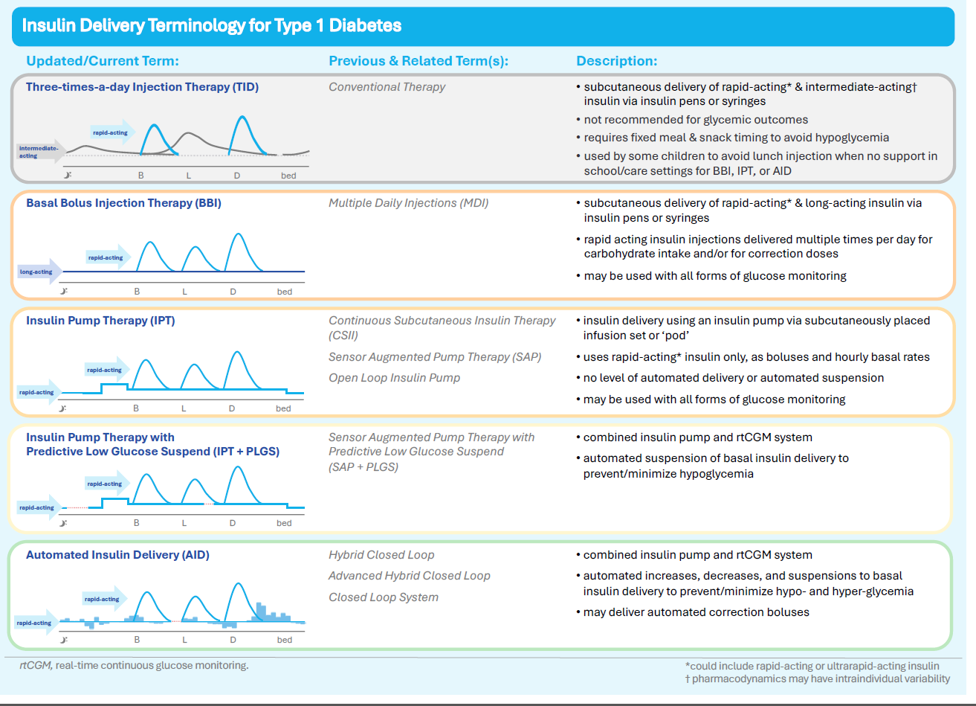

Slide 19
Insulin Delivery Device Choice:
Insulin Pump Therapy
(IPT)
Insulin Pump Therapy + Predictive Low Glucose Suspend
(IPT + PLGS)
Automated Insulin Delivery
(AID)
Adults
Should be used* to: | Improve A1C Not affect incidence of severe hypoglycemia | --- | Improve A1C & TIR Reduce hypoglycemia Reduce fear of hypoglycemia Improve unawareness of hypoglycemia Reduce diabetes distress Improve quality of life Not increase risk of DKA
May be used* to: | Allow for flexible bolus and basal dosing | Reduce frequency of hypoglycemia and severe hypoglycemia, in those who are hypoglycemia prone
Children & Adolescents
Should be used* to: | Improve A1C Not affect incidence of severe hypoglycemia or DKA | Reduce daytime and nocturnal hypoglycemia | Improve A1C & TIR Reduce hypoglycemia Reduce fear of hypoglycemia Improve unawareness of hypoglycemia Reduce diabetes distress Improve quality of life Not increase risk of DKA
May be used* to: | Allow for flexible bolus and basal dosing | --- | Improve quality of sleep for youth and their parents/caregivers
* for those willing to wear and operate the device(s)

Slide 20


Insulin Delivery
Automated insulin delivery should be used by all individuals with T1D* to improve:
A1C
TIR
hypoglycemia, fear of hypoglycemia and unawareness of hypoglycemia
diabetes distress and quality of life
Level 1A, Grade A
* for those willing to wear and operate the devices

Slide 21
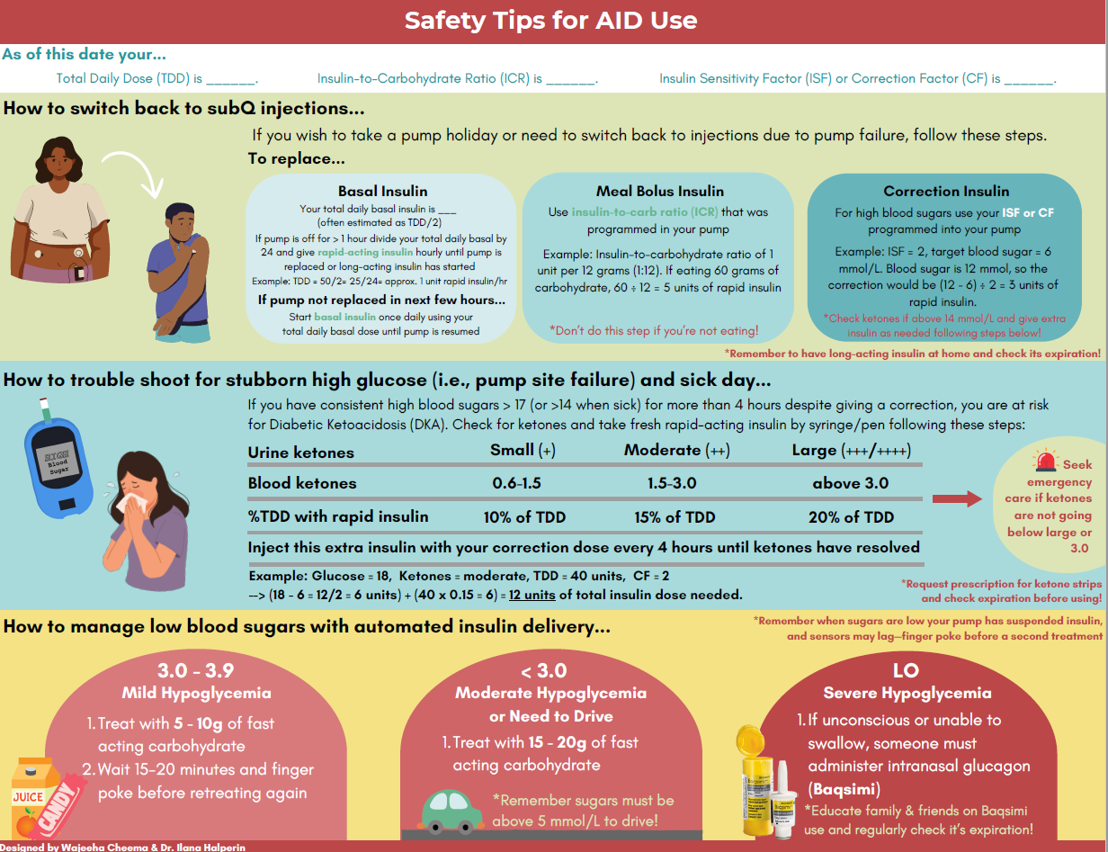
Insulin Delivery
For individuals of all ages using insulin delivery via insulin pump ( IPT +/- PLGS or AID it is important to regularly counsel on:
infusion site management including frequency of site changes, site rotation, appropriateness of infusion set type, and skin care solutions (Grade D, Consensus)
sick day management and troubleshooting in the face of pump failure and development of ketones (Grade D, Consensus)
Notes:
Wajeeha Cheema

Slide 22
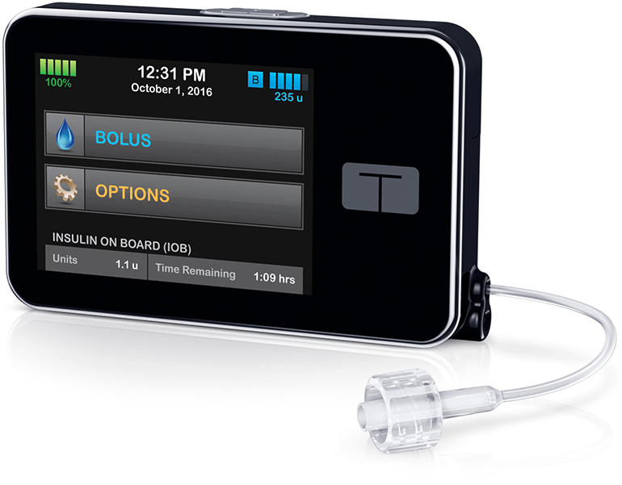
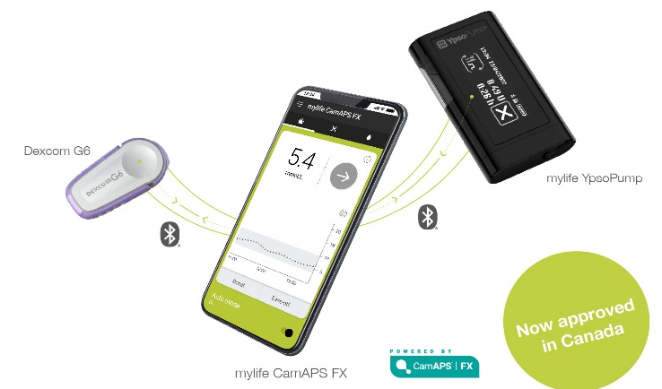
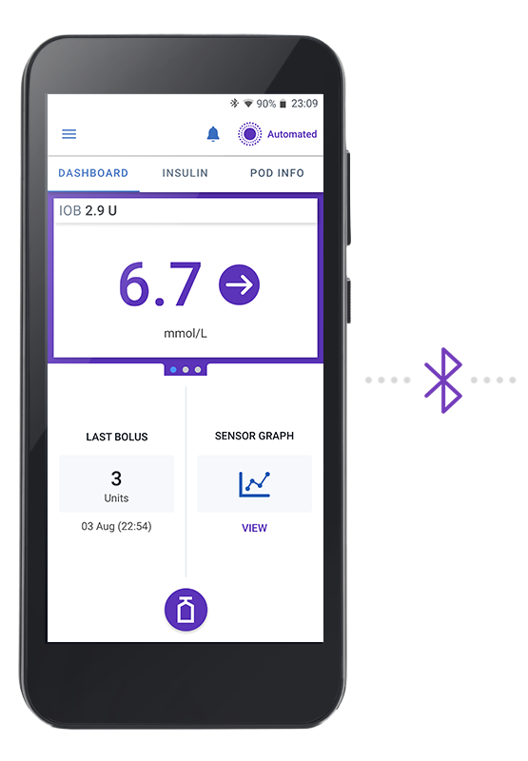

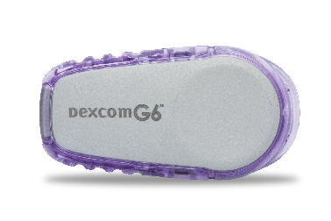
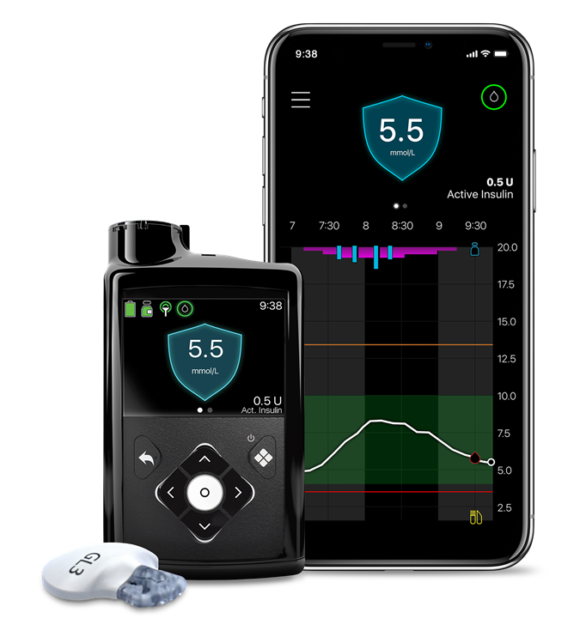
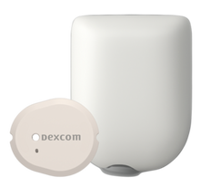
Available commercial AID systems in Canada
Tandem t:slim X2 with Control-IQ Technology and Dexcom G6/G7
Ypsomed pump and Dexcom G6 with mylife CamAPS FX App on Android Phone
Omnipod 5 with
Dexcom G6/G7
Medtronic 780g with Guardian 4
Ilana Halperin MSc MD FRCPC
Notes:
Choosing Dexcom = Choice of 3 smart pumps
Dexcom has 10+ years experience and over 40 clinical studies across AID systems ( more than any other CGM brand)
Dexcom data on file 2023.

Slide 23
 | Medtronic 780g | Tandem t:slim X2 Insulin Pump with Control-IQ Technology | Omnipod® 5 | mylife YpsoPump with mylife CamAPS FX algorithm
Age indication | 6 years to 80 years | 6 years and older | 2 years and older | 2 years and older
CGM (duration) | Guardian 4 (7 days) | Dexcom G6 & G7 (10 days) | Dexcom G6 & G7 (10 days) | Dexcom G6 (10 days)
Phone compatibility | MiniMed Mobile App (but not mobile bolus) | NA | NA | Android
Tubing | Yes | Yes | No | Yes
Battery life | 1 AA battery | 5 – 7 days (Rechargeable medical grade lithium) | Pod: up to 72 hours (disposable) Controller: Rechargeable | 30 days of average use (1 AAA alkaline battery)
Water resistant | Yes | Yes Not waterproof. Not recommended for bathing or swimming | Pod is waterproof† Controller is not | Yes
Wireless data upload | Minimed Mobile App | No | Automatic upload hourly to Glooko hourly via Wifi or SIM card (from controller) | Every hour on mylife cloud or Glooko or on demand
HCP access to AID data | Carelink | Tandem Source | Glooko | mylife cloud
Duration of infusion sets | 3 and 7 day options | 3 day | 3 day | 3 day
Ilana Halperin MSc MD FRCPC

Slide 24

It is critical to understand how different AID systems work
Each system has different levers (modifiable settings) that can be adjusted to optimize outcomes.
Ilana Halperin MSc MD FRCPC

Slide 25
Comparison of Algorithm features
 | Glucose Target | Basal Modulation | Auto corrections | Exercise or Activity | Optimize by…
Medtronic 780g | 5.5, 6.1, 6.7 | Autobasal based on TDI of last week | Every 5 min when glucose >6.7 | Temp Target to 8.3. | bolus increment 0.025 AIT 2 hrs GT 5.5
Tandem CIQ | CIQ 6.25 – 8.9 Sleep- 6.25- 6.7 | 0-4x programed basal rates | Hourly when predicted glucose is >10, target to 6.1 (not in sleep activity) | Exercise - 7.8-8.9 | CF to 90/TDI Program Basal ≥delivered
OP5 | 6.1, 6.7, 7.2,7.8, | ABR based on TDI history, updates with each pod modulates from 0-4x ABR | none | Temp target 8.3 | Manual corrections to increase TDI. Watch out for Limited Automode.
myLife Ypsomed | 4.4-11.1 | Adaptive based on TDI | none | Use “ease off” | Use boost feature to increase TDI
Ilana Halperin MSc MD FRCPC
*TDI= total daily insulin. AIT= Active Insulin Time GT= Glucose Target. CF= correction Factor ABR=adaptive basal rate

Slide 26
Modifiable settings across systems
 | Glucose Target | Active Insulin Time | Correction/ sensitivity factor | Carb Ratio | Basal rate ^
Medtronic 780g
Tandem CIQ
OP5 |  | * | *
myLife Ypsomed |  | * | *
*AIT and CF impact user initiated boluses but not the algorithm
^ all systems need a programmed basal rate to revert to if automation (sensor) fails.

Slide 27
A word about carb counting…..
Unannounced meals can be managed by the system*
Familiarity with carbohydrates helpful
  Newer systems can use preset carb amounts, user doesn’t need to enter a number
Carb counting proficiency should NOT be a barrier to starting AID
1.
* Messer LH and Breton MD. Therapy settings associated with optimal outcomes for t:slim X2 with Control-IQ technology in real world clinical care. Diabetes Technol Ther. 2023;25(12):877-882. doi: 10.1089/dia.2023.0308. Shalit R, et al. Diabetes Technol Ther. 2023;10.1089/dia.2023.0139

Slide 28
Adjunctive Therapy

Slide 29

Adjunctive Therapy
In adults with type 1 diabetes, metformin, GLP-1 RA or SGLT2i as non-insulin antihyperglycemics may be used in addition to insulin to help individuals achieve outcomes which are important to them using the principles of shared decision making, where the balance of risks, benefits, and side effects is acceptable and strategies to mitigate risks* are employed. The safety, efficacy, and tolerability of the agent should be reviewed at 3 months and annually to determine if the therapy should continue.
Grade D, Consensus

Slide 30
Adjunctive Therapy- Evidence
The evidence for adjunctive therapy for people with type 1 diabetes shows:
Metformin in addition to insulin reduces A1C (modestly), weight, and insulin dose in adults, but with an increased risk of gastrointestinal side effects
Metformin in addition to insulin reduces weight and insulin doses in adolescents, but with an increased risk of gastrointestinal side effects
Liraglutide in addition to insulin reduces A1C (modestly), weight, and insulin dose in adults, but with an increased risk of gastrointestinal side effects
SGLT2i in addition to insulin reduces A1C, glucose variability and weight, and improves treatment satisfaction in adults, but with an increased risk of euglycemic or hyperglycemic ketoacidosis and genital infections.

Slide 31
Impact of adjunctive therapies
 | Beneficial Effects (Weighted Mean Difference) |  |  | Adverse Effects (Risk Ratio)
 | A1c (%) | Weight (kg) | Insulin Dose (units/day) | Hypoglycemia | Severe Hypo | GI side effects | Ketoacidosis
Metformin | –0.29 (–0.50 to –0.08) | –2.1 (-2.8 to –1.3) | –4.8 (–7.1 to –2.6) | 1.18 (0.48-2.86) | 1.99 (0.95–4.17) | 1.69 (1.11–2.56) | 1.16 (0.38–3.48)
GLP1-RA | –0.19 (–0.29 to –0.1) | –4.8 (–5.0 to –4.6) | –5.5 (–7.8 to –3.3) | 1.03 (0.99-1.07) | 0.80 (0.58–1.1) | 2.52 (1.52–4.2) | 2.44 (0.29–20.5)
SGLT2i | –0.42 (–0.47 to –0.37) | –2.7 (–3.2 to –2.3) | –6.0 (–8.4 to –3.5) | 1.01 (0.99-1.04) | 0.94 (0.71–1.23) | 1.41 (0.83–2.39) | 4.76 (2.67–8.49)*
AGI | –0.58 (–0.82 to –0.33) | 0.9 (–0.7 to 2.5) | –0.6 (–5.1 to 4.1) | 1.60 (0.89-2.86) | 3.10 (0.13–74.6) | 2.83 (2.01–3.97) | N/A
TZD | 0.05 (–0.33 to 0.42) | 0.99 (–1.1 to 3.1) | –0.2 (–3.4 to 3.0) | 1.24 (0.83-1.83) | 0.65 (0.11–3.8) | 0.20 (0.01–3.89) | N/A
DPP4i | –0.15 (–0.34 to 0.04) | 0.1 (–0.9 to 1.1) | –2.8 (–5.8 to 0.3) | 2.00 (0.2-19.6) | 0.33 (0.01–7.9) | N/A | N/A
Adapted from Cai et al (81). Data are presented as mean weighted difference or risk ratio (95% CI). Data in bold text indicates a statistically significant difference compared with placebo at an alpha of 0.05, while italicized text indicates no significant difference. *Up to ⅓ of cases of ketoacidosis in trials were associated with glucose levels <13.9 mmol/L i.e. euglycemic ketoacidosis.

Slide 32
EASE-2 and EASE-3: Trial design
EAE
EASE-3
EASE-2
EASE-2
26 weeks
(primary endpoint)
1 week
6 weeks
2 weeks
52 weeks
3 weeks
Placebo
Screening
T1D therapy intensification
Placebo run-in
R
Empagliflozin 10 mg
Follow-up
Empagliflozin 25 mg
CGM
CGM
CGM
EASE-3
26 weeks
3 weeks
Placebo
Screening
T1D therapy intensification
Placebo run-in
R
Empagliflozin 2.5 mg
Follow-up
Empagliflozin 10 mg
Empagliflozin 25 mg
CGM*
CGM*
CGM*
Notes:
Treatment period was preceded by a 6-week lead in insulin intensification period, a 2-week placebo run-in period, and followed by a 3-week safety follow-up
design and conduct of EASE-2 and EASE-3 was identical with the exception of the following differences in EASE-3: A shorter treatment duration, the assessment of continuous glucose monitoring (CGM) as a sub-study and the inclusion of a lower dose (2.5mg).

Slide 33
Summary effects of empagliflozin over intensified insulin
Empagliflozin 10 and 25 mg :
  HbA1c (> -0.5%)
  Body weight (-3.4 kg)
  Insulin dose (-13%)
  Systolic blood pressure (-3.9 mmHg)
  Glucose time in range (+3 hrs/day)
  ≈30% reduction in daytime and nocturnal hypoglycemia
Empagliflozin 2.5 mg :
  HbA1c:-0.28% (HbA1c ≥8.0% -0.35%)
  Body weight (-1.8 kg)
  Insulin dose (-6.4%)
  Systolic blood pressure (-2.1 mmHg)
  Glucose time in range (+1 hr/day)
  ≈30% reduction in nocturnal hypoglycemia

Slide 34
Adjudication results: Certain DKA
 | Pooled* placebo (n=484) | Pooled* empa 10 mg (n=491) | Pooled* empa 25 mg (n=489) | EASE-3 placebo (n=241) | EASE-3 empa 2.5 mg (n=241)
Patients with certain DKA, n (%) | 6 (1.2) | 21 (4.3) | 16 (3.3) | 3 (1.2) | 2 (0.8)
Certain DKA events, n | 6 | 21 | 18 | 3 | 2
Incidence rate per 100 patient-years | 1.77 | 5.94 | 5.05 | 2.52 | 1.65
Events by severity, n
Severe | 1 | 2 | 6 | 1 | 0
Moderate | 4 | 13 | 8 | 1 | 0
Mild | 1 | 6 | 4 | 1 | 2
Outcome of event
Fatal | 0 | 0 | 1 | 0 | 0
Notes:
while the rate was higher in empagliflozin 10 and 25mg groups compared with placebo
Data suggest a dose dependent DKA risk;
There were few severe DKA cases overall with a trend towards more severe cases on empagliflozin 25 mg including one fatal case mainly related to delayed DKA diagnosis and treatment

Slide 35
Euglycemic DKA
Background population risk (∼5-7%), higher A1C higher risk
known mechanistic relationship between SGLTi and DKA
  Metabolism shift and decreased insulin doses → lipolysis and ketogenesis
  Hyperglucagonemia (SGLT2 expression in pancreatic alpha cells)
  [Decreased urinary ketone excretion (SLC5A8 Na+ and ketone co-transporter)]
  ~doubling of risk observed in T2D
Successfully adapted high-risk therapies into practice in the past, we can we do it with SGLT2i in T1D

Slide 36
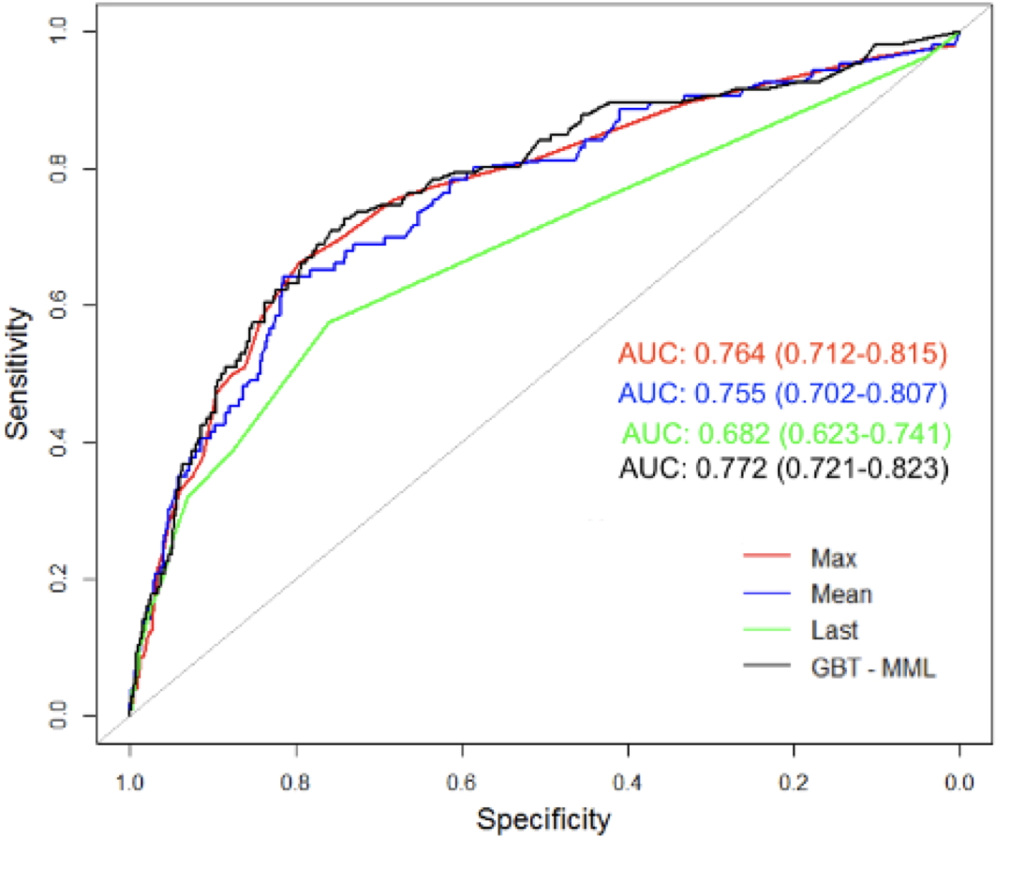

Prediction of DKA by On-therapy Ketone Levels in the EASE Program
Definition | Threshold (≥) | Sensitivity | Specificity | PPV | NPV | LR+ | LR- | DOR
Max Ketone (AUC = 0.764)
Optimal | 0.7 | 70% | 75% | 14% | 98% | 2.7 | 0.4 | 6.8
Favors sensitivity | 0.5 | 77% | 63% | 11% | 98% | 2.1 | 0.4 | 5.9
Favors specificity | 0.8 | 66% | 80% | 16% | 98% | 3.2 | 0.4 | 7.6
Non-SGLTi Users: Song et al. Diabetes Care 2023
SGLTi Uses: Bapat et al. in preparation (ADA 2024 Abstract)

Slide 37
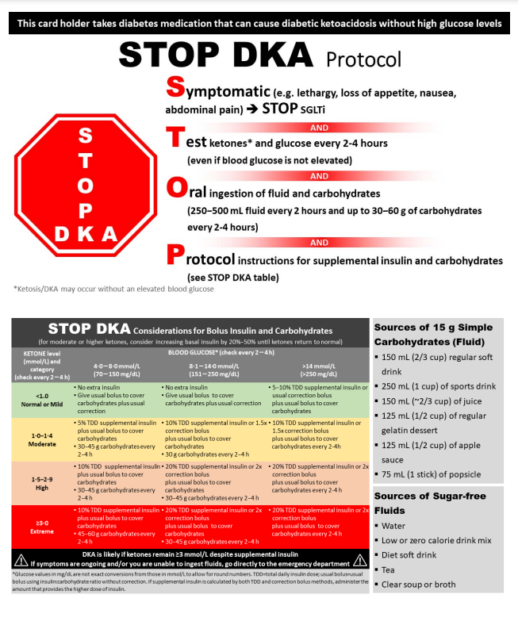
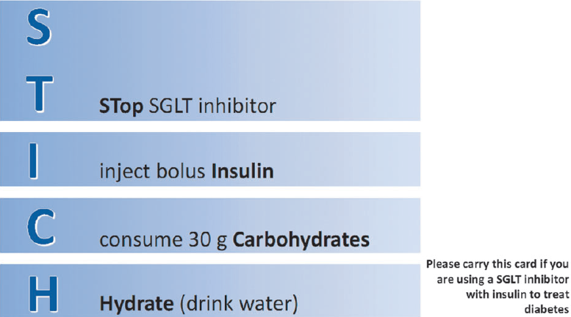
Mitigation Strategies- DKA
Explain the potential for euglycemic DKA
Review provoking factors:
  Stress
  Infection
  Procedures
  Pump or infusion set failures
Prescribe ketone testing equipment
Provide written instructions on how to treat elevated ketones with additional oral carbohydrates and insulin by injection
Consider well day fasting ketone testing before and after starting SGLT2i
  If >0.8 adjust insulin and/or diet (increase carbs)

Slide 38
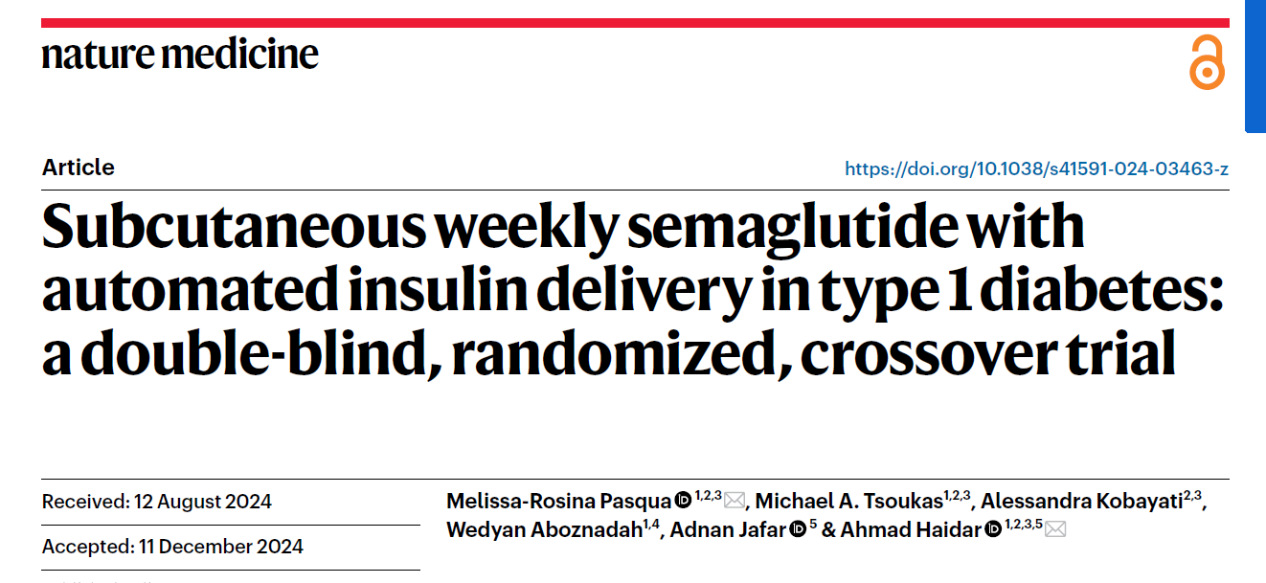
 | Placebo | Semaglutide | p value
Time 3.9–10.0 (%) | 69 | 74 | 0.006
Time >10.0 (%) | 29 | 24 | 0.006
Time <3.9 (%) | 1.1 | 1.2 | 0.19
TDD (U/day) | 62 | 46 | <0.001
 | Paired difference | p value
HbA1c (%) | -0.5 [-0.7, -0.2] | < 0.001
Weight (kg) | -5.3 (2.9) | < 0.001
Weight based TDD (U/kg/day) | -0.13 (0.16) | 0.002

Slide 39
 | Placebo (n=27) | Semaglutide (n=28)
Gastrointestinal | 14 | 72
Severe hypoglycemic | 1 | 0
Euglycemic ketosis | 0 | 2*
Diabetic ketoacidosis | 0 | 0
Serious Adverse Events | 0 | 1

Slide 40
Key Messages
Glycemic targets and management approach for all individuals living with T1DM should be individualized using a person and family centered approach to minimize the risk of long-term complications while balancing hypoglycemia and ketosis risk and burden of diabetes self-management.
Automated Insulin Delivery (AID) systems (insulin pump and connected continuous glucose monitor) are the preferred treatment method for all individuals to optimize glycemia and/or person reported outcomes, provided the individual is willing and able to wear and operate the devices.
When AID systems are not possible or chosen, CGM should be used in combination with insulin pump therapy (IPT) or basal bolus injection (BBI) therapy
BBI therapy with long acting basal analogs is preferred to conventional insulin regimens (TID or BID) using NPH because of its variable action profile and higher risk of hypoglycemia in both adults and children.
Ultra-rapid and ultra-long acting insulin analogs should be considered in place of rapid or long acting insulin analogs for BBI therapy in both adults and children to improve glycemic outcomes and minimize hypoglycemia
In adults, adjunctive therapy such as metformin, GLP RA or SGLT2i, may be considered in addition to insulin to meet individual treatment goals while employing strategies to support safety, efficacy and tolerability of these medications.
The dose of oral glucose used to treat hypoglycemia should be tailored to patient’s age and the insulin treatment regimen with lower carbohydrate requirements in those using AID.
Intranasal glucagon and instructions for use should be provided for adults and children
Newer evidence supports more aggressive fluid resuscitation is safe when managing diabetic ketoacidosis in children
Subcutaneous insulin can be safely used to manage non-severe DKA in adults.

