Slide 1
Treatment of Diabetes in People with Heart Failure
2018 Clinical Practice Guidelines
Chapter 28
Kim A. Connelly MBBS PhD,
Richard E. Gilbert MBBS PhD,
Peter Liu MD FRCPC FACC

Slide 2
Disclaimer
All Content contained on this slide deck is the property of Diabetes Canada, its content suppliers or its licensors as the case may be, and is protected by Canadian and international copyright, trademark, and other applicable laws. Diabetes Canada grants personal, limited, revocable, non-transferable and non-exclusive license to access and read content in this slide deck for personal, non-commercial and not-for-profit use only. The slide deck is made available for lawful, personal use only and not for commercial use.
The unauthorized reproduction, distribution of this copyrighted work is not permitted.
For permission to use this slide deck for commercial or any use other than personal, please contact guidelines@diabetes.ca

Slide 3
Key Changes
2018 Diabetes Canada CPG – Chapter 28. Treatment of Diabetes in People with Heart Failure
2018
CVD, cardiovascular disease
New information on
  The use of DPP4 inhibitor and GLP1 receptor agonists in people with type 2 diabetes and heart failure
  Role of SGLT2 inhibitor in patients with established CVD to reduce heart failure hospitalization
  Role of sacubritril/valsartan in patients with heart failure with reduced ejection fraction (HFrEF)

Slide 4
Diabetes in Heart Failure Checklist
2018 Diabetes Canada CPG – Chapter 28. Treatment of Diabetes in People with Heart Failure
Treat heart failure in people with diabetes the SAME as you would a person without diabetes
METFORMIN recommended if eGFR >30 mL/min/1.73 m²
If eGFR <60 mL/min, use Renin Angiotensin Aldosterone system or sacubitril/valsartan blockade carefully
Do NOT use thiazolidinediones
Avoid saxagliptin in patients with heart failure and diabetes
Notes:
4

Slide 5
Diabetes → Increased Risk of Heart Failure Independent of Ischemia
2018 Diabetes Canada CPG – Chapter 28. Treatment of Diabetes in People with Heart Failure
Diabetic cardiomyopathy
2 to 4-fold increase incidence of heart failure in diabetes
Asymptomatic abnormalities of ventricular systolic and diastolic function, independent of ischemic heart disease or systemic hypertension
Independent risk factors for heart failure
  Elevated A1C
  Albuminuria
  Underlying ischemic heart disease should be ruled out.
Notes:
It is recognized that diabetes can cause heart failure independently of ischemic heart disease by causing a diabetic cardiomyopathy.
incidence of heart failure is 2- to 4-fold higher in people with diabetes compared to those without diabetes
occurrence of asymptomatic abnormalities of ventricular systolic and diastolic function, independently from ischemic heart disease or systemic hypertension.
5

Slide 6
Use the same heart failure therapies in people with diabetes as you would in people without diabetes based on the Canadian Cardiovascular Society (CCS) Recommendations
(www.ccsguidelineprograms.ca)
2018 Diabetes Canada CPG – Chapter 28. Treatment of Diabetes in People with Heart Failure
Notes:
6

Slide 7
Use Same Treatments as in People without Diabetes…
2018 Diabetes Canada CPG – Chapter 28. Treatment of Diabetes in People with Heart Failure
Beta-blocker for systolic heart failure if indicated
Same target drug dose as indicated by CCS
If eGFR <60 mL/min/1.73 m²
  Starting dose of ACEi/ARB should be halved with gradual up-titration
  Monitor electrolytes, creatinine, BP, weight within 7-10 days of starting
ACEi, angiotensin converting enzyme inhibitor; ARB, angiotensin receptor blocker; BP, blood pressure; CCS, Canadian Cardiovascular Society
Notes:
Same therapy applies for HF in patients with diabetes or without: untreated HF has poor prognosis => do not withhold treatment. Patients with diabetes usually undertreated
Be careful of renal failure / hyperK if patients treated with RAAS blockade
3 Bb have shown to reduce mortality in patients with DM2 carvedilol, bisoprolol, and metoprolol. Also improvement of LV function
7

Slide 8
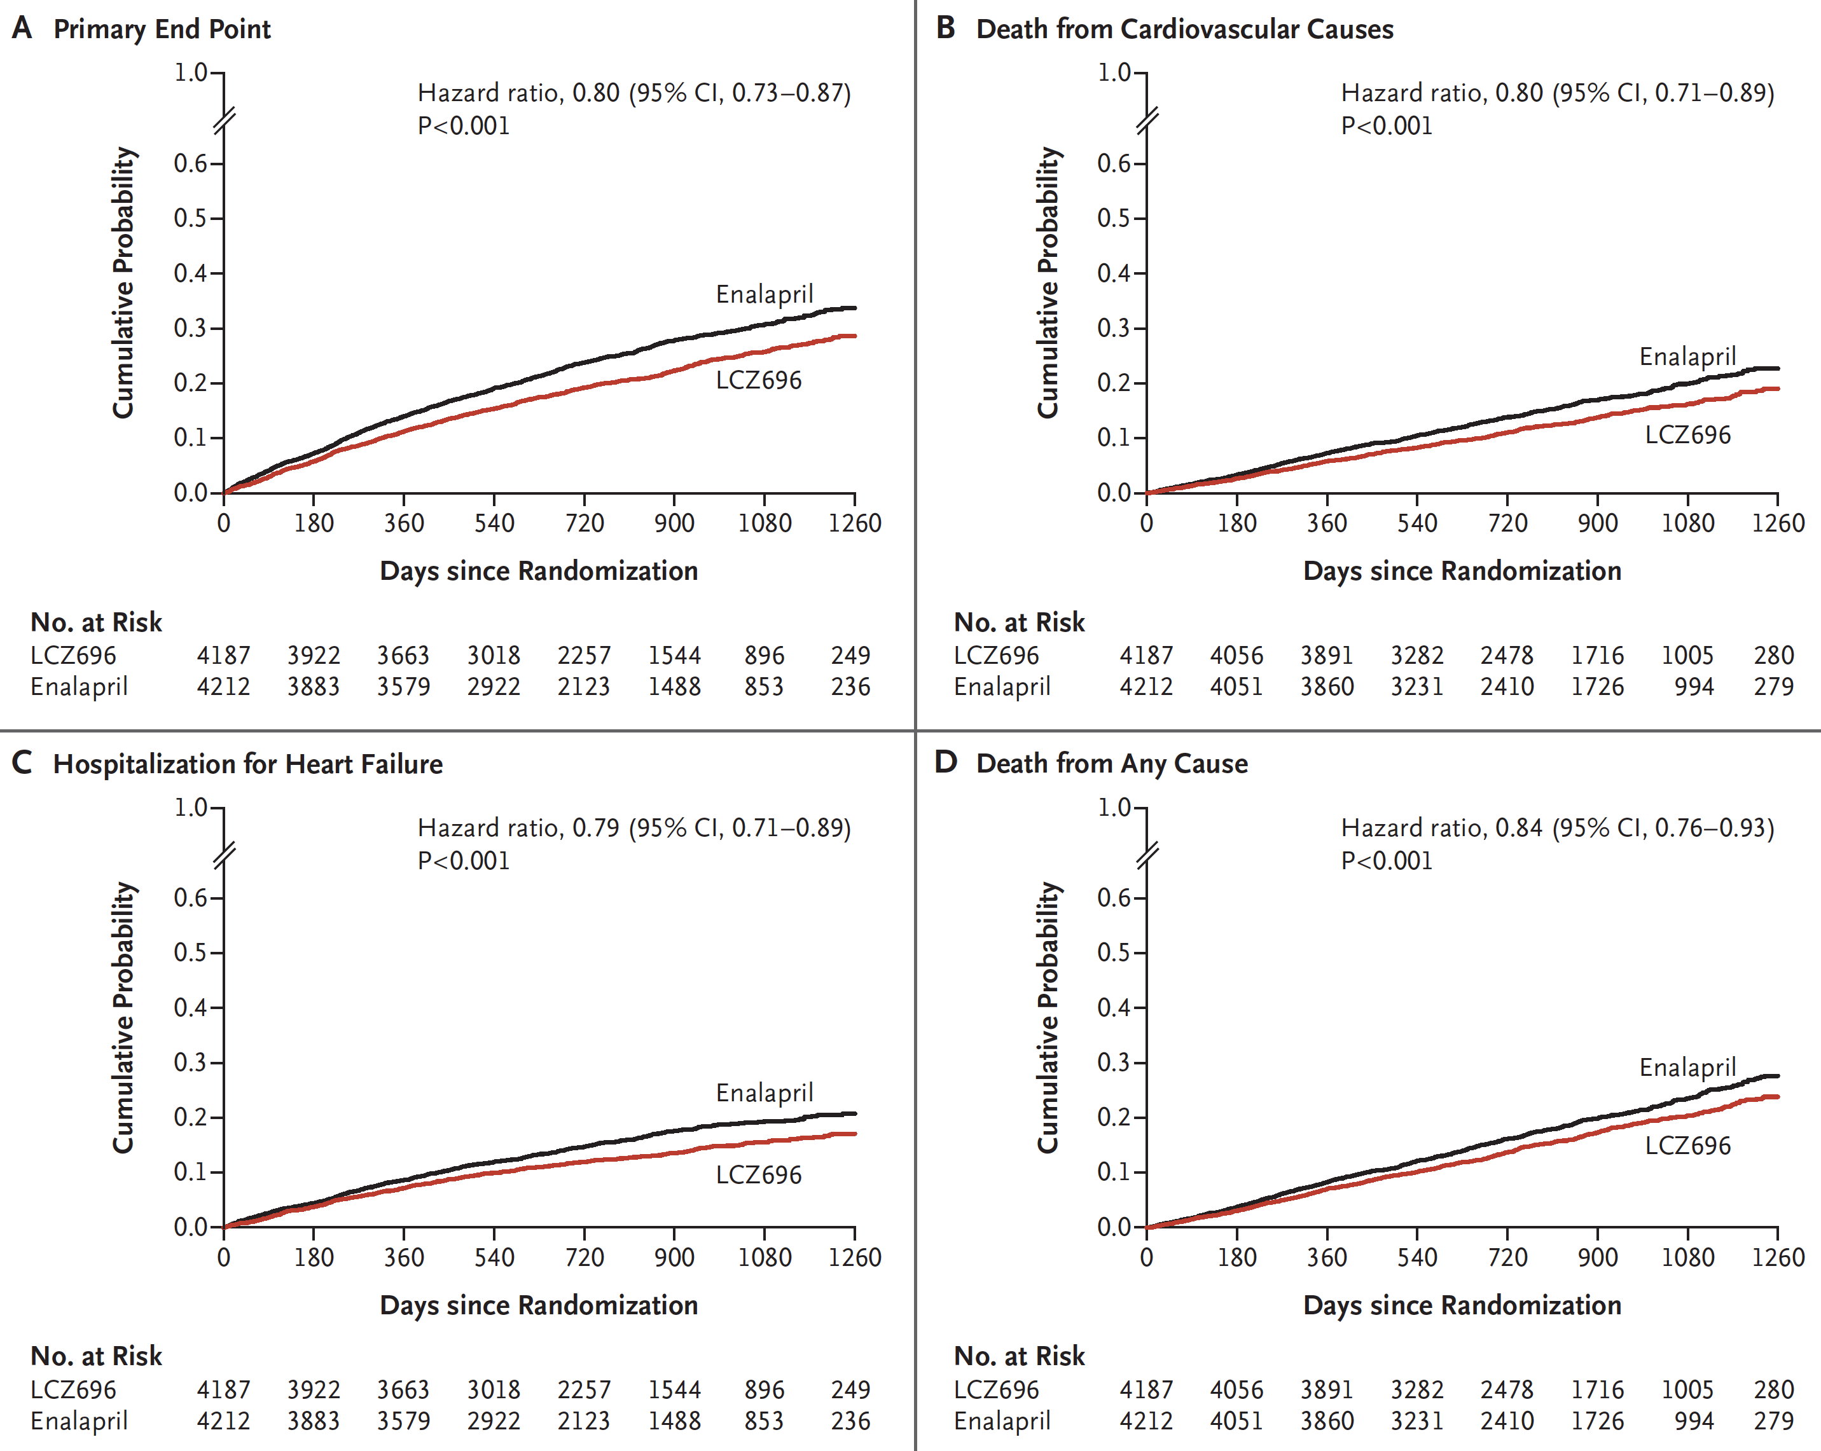
Sacubitril/valsartan (LCZ696) reduced CV outcomes in HFrEF (34% had Diabetes)
McMurray JJV et al. N Engl J Med 2014;371:993-1004.

Slide 9
Antihyperglycemic therapy in patients with diabetes with Heart Failure

Slide 10
Metformin Use in Heart Failure Patients
2018 Diabetes Canada CPG – Chapter 28. Treatment of Diabetes in People with Heart Failure
Tayside, Scotland
(population 400,000)
n=422 with CHF and diabetes
Antihyperglycemic therapy:
Metformin alone n=68
SU alone n=217
Combination n=137
1.0
0.8
0.6
Cumulative mortality
Sulfonylurea
monotherapy
0.4
Metformin
monotherapy +
combination
0.2
0
0
1000
2000
3000
4000
5000
ACEi, angiotensin converting enzyme inhibitor; CHF, congestive heart failure; MI, myocardial infarction; SU, sulfonylurea
Time (days)
Evans JM, et al. Am J Cardiol 2010;106:1006-10.
Notes:
Speaker’s Notes:
While chronic heart failure has generally been considered a contraindication for metformin, there is mounting evidence that it may actually be beneficial. The Health Informatics Centre-dispensed prescribing database for the population of Tayside, Scotland (population ∼400,000) was linked to the Diabetes Audit and Research in Tayside Scotland (DARTS) information system. Patients with diabetes and incident chronic heart failure from 1994 to 2003 receiving oral hypoglycemic agents but not insulin were identified. Of 422 study subjects 68 were taking metformin monotherapy, 217 were taking sulfonylurea monotherapy, and 137 were taking combination medication. Fewer deaths occurred in the subjects taking metformin, alone or in combination with sulfonylureas, compared with those taking sulfonylurea monotherapy.
Reference:
Evans JM, Doney AS, AlZadjali MA, et al. Effect of Metformin on mortality in patients with heart failure and type 2 diabetes mellitus. Am J Cardiol 2010;106:1006-10.
10

Slide 11
Metformin Use in Heart Failure Patients
2018 Diabetes Canada CPG – Chapter 28. Treatment of Diabetes in People with Heart Failure
Veterans Affairs
6,185 with CHF & DM
Oral antihyperglycemic:
  With metformin (n=1,561)
  Without metformin
Statistically adjusted for
co-variables
1.00
0.95
Metformin
Survival estimates
0.90
0.85
No metformin
0.80
p = 0.01
Death: 0.76 (0.63-0.92) p < 0.01
CHF hospitalization: 0.93 (0.74-1.18) p = 0.56
Total hospitalization: 0.94 (0.83-1.07) p = 0.35
0.75
0
100
200
300
400
500
600
700
Time (days)
Aguilar D, et al. Circ Heart Fail 2011;4:53-8.
ACEi, angiotensin converting enzyme inhibitor; CHF, congestive heart failure; MI, myocardial infarction; SU, sulfonylurea
Notes:
Speaker’s Notes:
The association between metformin use and clinical outcomes was examined in a cohort of 6,185 ambulatory patients with diabetes and established heart failure; 1,561 (25.2%) patients were treated with metformin. At two years of follow-up, there were 246 (15.8%) deaths among patients receiving metformin and 1,177 (25.5%) deaths among patients not receiving metformin (p < 0.001). In the propensity score-matched analysis (n = 2,874), there were 232 (16.1%) deaths among patients receiving metformin compared with 285 (19.8%) deaths among patients not receiving metformin (hazard ratio 0.76; 95% CI 0.63–0.92; p < 0.01).
Reference:
Aguilar D, Chan W, Bozkurt B, Ramasubbu K, Deswal A. Metformin use and mortality in ambulatory patients with diabetes and heart failure. Circ Heart Fail 2011;4:53-8.
11

Slide 12
Use metformin in heart failure patients when eGFR >30 mL/min/1.73 m²
2018 Diabetes Canada CPG – Chapter 28. Treatment of Diabetes in People with Heart Failure
Notes:
12

Slide 13
Hospitalization for Heart Failure:
DPP-4 inhibitors
 | Study Drug n/N (%) | Placebo n/N (%) | Hazard Ratio | 95% CI | P Value
EXAMINE¹ (alogliptin vs. placebo) | 106/2701 (3.9%) | 89/2679 (3.3%) | 1.19 | 0.90, 1.58 | 0.220
SAVOR-TIMI 53² (saxagliptin vs. placebo) | 289/8280 (3.5%) | 228/8212 (2.8%) | 1.27 | 1.07, 1.51 | 0.007
TECOS³ (sitagliptin vs. placebo) | 228/7332 (3.1%) | 229/7339 (3.1%) | 1.00 | 0.83, 1.20 | 0.983
Notes:
References:
White WB, Cannon CP, Heller SR et al. Alogliptin after acute coronary syndrome in patients with type 2 diabetes. N Engl J Med. 2013;369:1327-35.
Scirica BM, Bhatt DL, Braunwald E et al. Saxagliptin and cardiovascular outcomes in patients with type 2 diabetes mellitus. N Engl J Med. 2013;369:1317-26.
Green JB et al. Effect of Sitagliptin on Cardiovascular Outcomes in Type 2 Diabetes. N Engl J Med. 2015. doi: 10.1056/NEJMoa1501352.

Slide 14
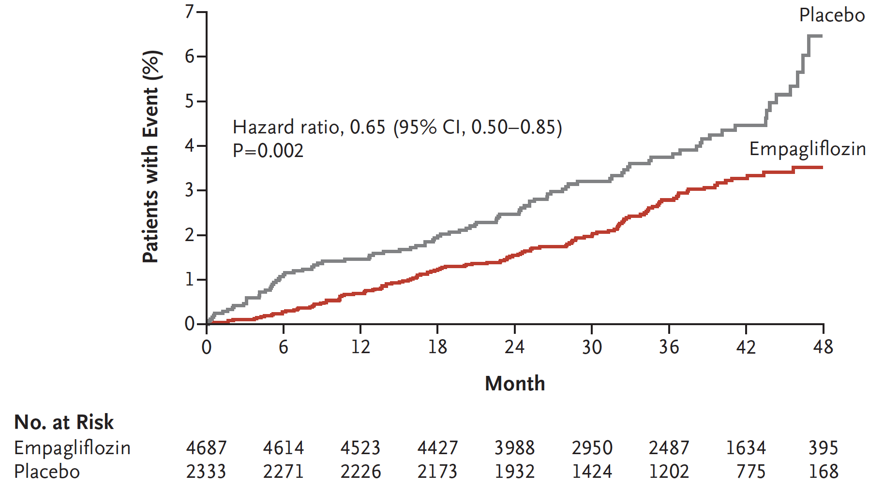
Empagliflozin reduced hospitalization for heart failure
Zinman B, N Engl J Med Sep 17, 2015.
Notes:
35% reduction of HHF
Note curves separate by 3 months and continue to diverge

Slide 15
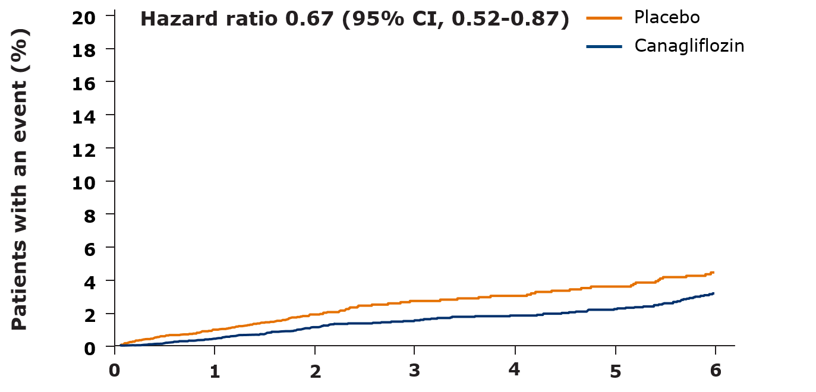
Canagliflozin reduced hospitalization for heart failure
No. of patients
Placebo
Canagliflozin
Years since randomization
4347 | 4198 | 3011 | 1274 | 1236 | 1180 | 829
5795 | 5653 | 4437 | 2643 | 2572 | 2498 | 1782
.Neal B et al. N Engl J Med 2017; 377(7):644-657
Notes:
35% reduction of HHF
Note curves separate by 3 months and continue to diverge

Slide 16
Recommendation 1
2018 Diabetes Canada CPG – Chapter 28. Treatment of Diabetes in People with Heart Failure
2018
Individuals with diabetes and heart failure should receive the same heart failure therapies as those identified in the evidence-based Canadian Cardiovascular Society Heart Failure recommendations (http://www.onlinecjc.ca/article/S0828-282X(12)01379-7/pdf) [Grade D, Consensus]

Slide 17
Recommendation 2
2018 Diabetes Canada CPG – Chapter 28. Treatment of Diabetes in People with Heart Failure
2018
2. Unless contraindicated, metformin may be used in people with type 2 diabetes and heart failure [Grade C, Level 3]. Metformin should be temporarily withheld if renal function acutely worsens, and should be discontinued if renal function significantly and chronically worsens [Grade D, Consensus]

Slide 18
Recommendations 3-4
2018 Diabetes Canada CPG – Chapter 28. Treatment of Diabetes in People with Heart Failure
For people with NYHA class I-IV, exposure to TZDs should be avoided [Grade A, Level 1]
Beta blockers should be prescribed when indicated for heart failure with reduced ejection fraction, as they provide similar benefits in people with or without diabetes [Grade B, Level 2]

Slide 19
Recommendation 5
2018 Diabetes Canada CPG – Chapter 28. Treatment of Diabetes in People with Heart Failure
2018
5. In adults with type 2 diabetes with clinical CVD in whom glycemic targets are not achieved with existing antihyperglycemic medication(s) and with an eGFR >30 mL/min/1.73 m², an SGLT2 inhibitor with demonstrated heart failure hospitalization reduction may be added to reduce the risk of heart failure hospitalization [Grade B, Level 2 for empagliflozin; Grade C, Level 2 for canagliflozin]
CVD, cardiovascular disease

Slide 20
Recommendation 6
2018 Diabetes Canada CPG – Chapter 28. Treatment of Diabetes in People with Heart Failure
6. In people with diabetes and heart failure with an eGFR <60 mL/min/1.73 m² and/or if combined RAAS blockade is employed:
  Starting doses of ACE inhibitors or ARBs should be halved [Grade D, Consensus]
  Serum electrolytes and creatinine, BP and body weight, as well as heart failure symptoms and signs, should be monitored within 7-10 days of any initiation or titration of therapy [Grade D, Consensus]
  Dose-up titration should be more gradual (with monitoring of BP, serum potassium and creatinine) [Grade D, Consensus]
ACE, angiotensin converting enzyme; ARB, angiotensin receptor blocker; BP, blood pressure; RAAS, renin angiotension aldosterone system

Slide 21
Key Messages
2018 Diabetes Canada CPG – Chapter 28. Treatment of Diabetes in People with Heart Failure
Heart failure is still under-recognized and misdiagnosed. This has significant clinical implications as the prognosis of untreated or undertreated heart failure is poor, and yet very effective proven therapies are widely available to most people
Diabetes can cause heart failure independently of ischemic heart disease by causing a diabetic cardiomyopathy that may manifest in the setting of normal or reduced left ventricular ejection fraction
The incidence of heart failure is 2- to 4-fold higher in people with diabetes compared to those without and, when present, occurs at an earlier age

Slide 22
Key Messages
2018 Diabetes Canada CPG – Chapter 28. Treatment of Diabetes in People with Heart Failure
Even though heart failure in people with diabetes should be treated similarly to heart failure in those without diabetes, they are less likely to receive appropriate therapies. The presence of diabetes should not affect the decision for treatment of heart failure.
Comorbidities, such as renal dysfunction and propensity for hyperkalemia, are more prevalent in people with diabetes and may influence heart failure drug doses and monitoring of therapy but not therapeutic targets

Slide 23
Key Messages for People with Diabetes
2018 Diabetes Canada CPG – Chapter 28. Treatment of Diabetes in People with Heart Failure
Heart failure is a type of heart disease in which the heart no longer pumps sufficient blood to meet the body’s needs. Diabetes is a risk factor for heart failure
Symptoms of heart failure include shortness of breath, persistent coughing, fatigue, chest pain, weight gain, or swelling of the feet, ankles and legs
A number of effective drug treatments are available to keep heart failure in check. Your healthcare provider will discuss these with you
Certain glucose lowering medications have the potential to worsen or help heart failure. If you have heart failure, this will influence which glucose lowering medications your healthcare provider selects for you

Slide 24

Visit guidelines.diabetes.ca

Slide 25


Or download the App

Slide 26
Diabetes Canada Clinical Practice Guidelines
www.guidelines.diabetes.ca – for health-care providers
1-800-BANTING (226-8464)
www.diabetes.ca – for people with diabetes
Notes:
26

