Slide 1
Type 1 Diabetes in Children and Adolescents
2018 Clinical Practice Guidelines
Chapter 34
Diane K. Wherrett MD FRCPC, Céline Huot MD MSc FRCPC, Laurent Legault MD FRCPC, Josephine Ho MD MSc FRCPC, Meranda Nakhla MD MSc FRCPC, Elizabeth Rosolowsky MD MPH FAAP FRCPC

Slide 2
Disclaimer
All Content contained on this slide deck is the property of Diabetes Canada, its content suppliers or its licensors as the case may be, and is protected by Canadian and international copyright, trademark, and other applicable laws. Diabetes Canada grants personal, limited, revocable, non-transferable and non-exclusive license to access and read content in this slide deck for personal, non-commercial and not-for-profit use only. The slide deck is made available for lawful, personal use only and not for commercial use.
The unauthorized reproduction, distribution of this copyrighted work is not permitted.
For permission to use this slide deck for commercial or any use other than personal, please contact guidelines@diabetes.ca

Slide 3
Key Changes
2018 Diabetes Canada CPG – Chapter 34. Type 1 Diabetes in Children & Adolescents
2018
New recommendation on
  A1C target of < 7.5% for all children and adolescents <18 years of age
  Use of a psychosocial risk index aid to identify children and adolescents at high risk of poor glycemic control

Slide 4
Overview
2018 Diabetes Canada CPG – Chapter 34. Type 1 Diabetes in Children & Adolescents
Education Glycemic targets Insulin therapy Glucose monitoring Nutrition Hypoglycemia DKA | Complications Immunization Smoking Sexual Health Psychology Comorbidities Transition to Adult care

Slide 5
Introduction
2018 Diabetes Canada CPG – Chapter 34. Type 1 Diabetes in Children & Adolescents
Diabetes mellitus is the most common endocrine disease and one of the most common chronic conditions in children
Type 2 diabetes and other types of diabetes, including genetic defects of beta cell function, such as maturity-onset diabetes of the young, are being increasingly recognized in children and should be considered when clinical presentation is atypical for type 1 diabetes

Slide 6
Education – Key Message
2018 Diabetes Canada CPG – Chapter 34. Type 1 Diabetes in Children & Adolescents
Education, from diagnosis onwards, is complex, touching on a range of issues medical and social. Therefore it is best done by a interprofessional team trained in pediatric diabetes

Slide 7
2018 Diabetes Canada CPG – Chapter 34. Type 1 Diabetes in Children & Adolescents
Education – Key Message
Children with new-onset type 1 diabetes and their families require intensive diabetes education by an interprofessional pediatric diabetes health-care (DHC) team. Education topics should include:
      Prevention, detection and treatment of hypoglycemia
      Insulin action and administration
      Dosage adjustment
      Blood glucose and ketone testing
      Sick-day management
      Prevention of DKA
      Nutrition and exercise
DKA, diabetic ketoacidosis

Slide 8
2018 Diabetes Canada CPG – Chapter 34. Type 1 Diabetes in Children & Adolescents
Education – Key Message
Anticipatory guidance and healthy behaviour counselling should be part of routine care during critical developmental transitions (e.g. school entry, beginning high school).
Health-care providers should regularly initiate discussions with children and their families about
School
Diabetes camp
Psychological issues
Fear of hypoglycemia
Substance use
Driving
Career choices

Slide 9
Recommendation 1
2018 Diabetes Canada CPG – Chapter 34. Type 1 Diabetes in Children & Adolescents
Delivery of Care
All children with diabetes should have access to an experienced pediatric DHC team that includes either a pediatric endocrinologist or pediatrician with diabetes expertise, dietician, diabetes nurse educator, social worker and mental health professional for specialized care starting at diagnosis [Grade D, Level 4]
DHC, diabetes health-care

Slide 10
Recommendation 2
2018 Diabetes Canada CPG – Chapter 34. Type 1 Diabetes in Children & Adolescents
Delivery of Care
2. Children with new-onset type 1 diabetes who are medically stable should receive their initial education and management in an outpatient setting, provided that appropriate personnel and daily communication with a DHC team are available [Grade B, Level 1A]
DHC, diabetes health-care

Slide 11
2018 Diabetes Canada CPG – Chapter 34. Type 1 Diabetes in Children & Adolescents
Transition to Adult Care
Change of physician or DHC team can have major impact on disease management and metabolic control
25% to 65% of young adults have no medical follow-up during the transition
Those with no follow-up are more likely to experience hospitalization for DKA during this period
Organized transition services may decrease the rate of loss of follow-up
DHC, diabetes health-care; DKA, diabetic ketoacidosis

Slide 12
Recommendation 3
2018 Diabetes Canada CPG – Chapter 34. Type 1 Diabetes in Children & Adolescents
Delivery of Care
To ensure ongoing and adequate diabetes care, adolescents should receive care from a specialized program aimed at creating a well-prepared and supported transition to adult care that is initiated early and includes a transition coordinator; patient reminders; and support and education promoting autonomy and self-care management skills [Grade C, Level 3]

Slide 13
Glycemic Targets – Key Message
2018 Diabetes Canada CPG – Chapter 34. Type 1 Diabetes in Children & Adolescents
2018
New single target of ≤7.5% for all children
Achieving adult targets for metabolic control is not always indicated and may be unsafe for some children
Achieving targets may require much work on the part of family and DHC team to find the right insulin approach
DHC, diabetes health-care

Slide 14
2018 Diabetes Canada CPG – Chapter 34. Type 1 Diabetes in Children & Adolescents
Glycemic Targets
Clinical judgement is required – tailor goals to the patient
Episodes of frequent or severe hypoglycemia have been associated with poorer cognitive function in some follow-up studies
Know your goals – research suggests that knowledge of glycemic targets by patients and parents, and consistent target setting by the DHC team, was associated with improved metabolic control
DHC, diabetes health-care

Slide 15
2018 Diabetes Canada CPG – Chapter 34. Type 1 Diabetes in Children & Adolescents
2018
Glycemic Targets
Age (years) | A1C (%) | FPG / premeal PG (mmol/L) | 2-hour pc PG (mmol/L) | Considerations
<18 | ≤7.5% | 4.0-8.0 | 5.0 – 10.0 | Caution is required to minimize severe or excessive hypoglycemia. Consider preprandial targets of 6.0–10.0 mmol/L as well as higher A1C targets in children and adolescents who have had severe or excessive hypoglycemia or have hypoglycemia unawareness
*Postprandial monitoring is rarely done in young children except for those on pump therapy for whom targets are not available
A1C ; glycated hemoglobin; FPG, fasting plasma glucose; PG, plasma glucose;

Slide 16
Recommendation 4
2018 Diabetes Canada CPG – Chapter 34. Type 1 Diabetes in Children & Adolescents
2018
Glycemic Targets
4. Children and adolescents <18 years of age should aim for an A1C target <7.5% [Grade D, Consensus]
  Attempts should be made to safely reach the recommended glycemic target, while minimizing the risk for severe or recurrent hypoglycemia. Treatment targets should be tailored to each child, taking into consideration individual risk factors for hypoglycemia [Grade D, Consensus]
  In children <6 years of age, particular care to minimize hypoglycemia is recommended because of the potential association in this age group between severe hypoglycemia and later cognitive impairment [Grade D, Level 4]

Slide 17
2018 Diabetes Canada CPG – Chapter 34. Type 1 Diabetes in Children & Adolescents
Chronic Poor Metabolic Control
Diabetes control may worsen during adolescence, possibly due to the following factors:
  Adolescent adjustment issues
  Psychosocial distress
  Intentional insulin omission
  Physiologic insulin resistance

Slide 18
Recommendation 5
2018 Diabetes Canada CPG – Chapter 34. Type 1 Diabetes in Children & Adolescents
Glycemic Targets
5. Children with persistently poor glycemic control (e.g., A1C >10.0%) should be assessed with a validated tool by a specialized pediatric DHC team for comprehensive interdisciplinary assessment and referred for psychosocial support as indicated [Grade D, Consensus]. Intensive family and individualized psychological interventions aimed at improving glycemic control should be considered to improve chronically poor metabolic control [Grade A, Level 1A]
DHC, diabetes health-care

Slide 19
Insulin Therapy – Key Message
2018 Diabetes Canada CPG – Chapter 34. Type 1 Diabetes in Children & Adolescents
It is reasonable to start with a basic insulin regimen (e.g. minimum 3 injections per day) but a more intensive approach is indicated if success not achieved despite good effort

Slide 20
Types of insulin in Type 1 Diabetes
2018 Diabetes Canada CPG – Chapter 34. Type 1 Diabetes in Children & Adolescents
Insulin Type (trade name) | Onset | Peak | Duration
Bolus (prandial) Insulins
Rapid-acting insulin analogues (clear): Insulin aspart (NovoRapid®) Insulin glulisine (Apidra™) Insulin lispro (Humalog®) | 10 - 15 min 10 - 15 min 10 - 15 min | 1 - 1.5 h 1 - 1.5 h 1 - 2 h | 3 - 5 h 3 - 5 h 3.5 - 4.75 h
Short-acting insulins (clear): Insulin regular (Humulin®-R) Insulin regular (Novolin®geToronto) | 30 min | 2 - 3 h | 6.5 h
Basal Insulins
Intermediate-acting insulins (cloudy): Insulin NPH (Humulin®-N) Insulin NPH (Novolin®ge NPH) | 1 - 3 h | 5 - 8 h | Up to 18 h
Long-acting basal insulin analogues (clear) Insulin detemir (Levemir®) Insulin glargine (Lantus®/Basaglar®) | 90 min | Not applicable | Up to 24 h (glargine 24 h, detemir 16 - 24 h)

Slide 21
Types of insulin
Insulin type (trade name) | Onset | Peak | Duration
BOLUS (prandial or mealtime) insulins
Rapid-acting insulin analogues (clear) Insulin aspart (NovoRapid®) Insulin glulisine (Apidra®) Insulin lispro (Humalog®) U-100 U-200 Faster-acting insulin aspart (Fiasp®) | 9–20min 10–15min 10–15min 4min | 1–1.5h 1–1.5h 1–2h 0.5-1.5h | 3–5h 3.5–5h 3–4.75h 3-5h
Short-acting insulins (clear) Insulin regular (Humulin®-R, Novolin® ge Toronto) Insulin regular U-500 (Entuzity® (U-500) | 30min 15min | 2–3h 4-8h | 6.5h 17-24h
BASAL insulins
Intermediate-acting (cloudy) Insulin neutral protamine Hagedorn (Humulin® N, Novolin® ge NPH) | 1–3h | 5–8h | Up to 18h
Long-acting insulin (clear) Insulin detemir (Levemir®) Insulin glargine U-100 (Lantus®) Insulin glargine U-300 (Toujeo®) Insulin glargine biosimilar (Basaglar®) Insulin degludec U-100, U-200 (Tresiba®) | 90min | Not applicable | U-100 glargine 24h, detemir 16–24h U-300 glargine >30h degludec 42h
PREMIXED insulins
Premixed regular insulin –NPH (cloudy) Humulin® 30/70 Novolin® ge 30/70, 40/60, 50/50 | A single vial or cartridge contains a fixed ratio of insulin (% of rapid-acting or short-acting insulin to % of intermediate-acting insulin)
Premixed insulin analogues (cloudy) Biphasic insulin aspart (NovoMix® 30) Insulin lispro/lispro protamine (Humalog® Mix25 and Mix50)

Slide 22
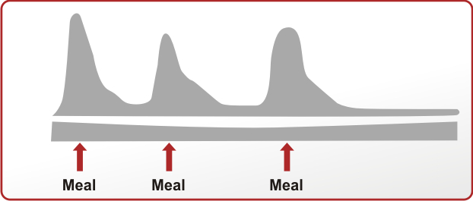
Serum Insulin Level
Time
Human Basal
Human Bolus
Analogue Basal
Analogue Bolus

Slide 23
2018 Diabetes Canada CPG – Chapter 34. Type 1 Diabetes in Children & Adolescents
Insulin Therapy – Key Message
Insulin is the mainstay of medical management
The choice of insulin regimen depends on many factors:
  Child’s age
  Duration of diabetes
  Family lifestyle
  Socioeconomic factors
  Family, patient, and physician preferences

Slide 24
2018 Diabetes Canada CPG – Chapter 34. Type 1 Diabetes in Children & Adolescents
Insulin Therapy
Starting regimen should comprise:
  ≥2 daily bolus injections
  ≥1 basal insulin injection

Slide 25
2018 Diabetes Canada CPG – Chapter 34. Type 1 Diabetes in Children & Adolescents
Insulin Therapy
If initial regimen fails to meet glycemic targets, more intensive management may be required:
Three methods of intensive diabetes management can be used at any age:
  Similar regimen with more frequent injections
  basal bolus regimens using long and rapid acting insulin analogues
  continuous subcutaneous insulin infusion (CSII, insulin pump therapy)

Slide 26
Recommendation 6
2018 Diabetes Canada CPG – Chapter 34. Type 1 Diabetes in Children & Adolescents
Insulin Therapy
6. Children with new-onset diabetes should be started on boluses of rapid-acting insulin analogues combined with basal insulin (e.g. intermediate-acting insulin or long-acting basal insulin analogue) using an individualized regimen that best addresses the practical issues of daily life [Grade D, Consensus]

Slide 27
Recommendation 7
2018 Diabetes Canada CPG – Chapter 34. Type 1 Diabetes in Children & Adolescents
Insulin Therapy
7. Insulin therapy should be assessed at each clinical encounter to ensure it still enables the child to meet A1C targets, minimizes the risk of hypoglycemia and allows ﬂexibility in carbohydrate intake, daily schedule and activities [Grade D, Consensus]. If these goals are not being met, an intensiﬁed diabetes management approach (including increased education, monitoring and contact with diabetes team) should be used [Grade A, Level 1 for adolescents; Grade D, Consensus for younger children], and treatment options may include the following:
    Increased frequency of injections [Grade D, Consensus]
    Change in the type of basal and/or bolus insulin [Grade B, Level 2, for adolescents; Grade D, Consensus, for younger children]
    Change to CSII therapy [Grade C, Level 3]
CSII, continuous subcutaneous insulin infusion

Slide 28
2018 Diabetes Canada CPG – Chapter 34. Type 1 Diabetes in Children & Adolescents
Glucose Monitoring
Self-monitoring of blood glucose is an essential part of management of type 1 diabetes
Subcutaneous continuous glucose sensors allow detection of asymptomatic hypoglycemia and hyperglycemia
Subcutaneous continuous glucose sensors may have a beneficial role in children and adolescents but evidence is not as strong as in adults

Slide 29
2018 Diabetes Canada CPG – Chapter 34. Type 1 Diabetes in Children & Adolescents
Nutrition
All children with type 1 diabetes should receive counselling from a registered dietitian experienced in pediatric diabetes
Children with diabetes should follow a healthy diet as recommended for children without diabetes in Eating Well with Canada’s Food Guide
There is no evidence that one form of nutrition therapy is superior to another in attaining age-appropriate glycemic targets

Slide 30
2018 Diabetes Canada CPG – Chapter 34. Type 1 Diabetes in Children & Adolescents
Nutrition
Use of insulin to carbohydrate ratios may be beneficial but is not required
The effect of protein and fat on glucose absorption must also be considered
Nutrition therapy should be individualized (based on the child’s nutritional needs, eating habits, lifestyle, ability, and interest) and must ensure normal growth and development without compromising glycemic control

Slide 31
Hypoglycemia – Key Message
2018 Diabetes Canada CPG – Chapter 34. Type 1 Diabetes in Children & Adolescents
All families should understand the importance of hypoglycemia (severity and frequency) along with treatment and follow up strategies

Slide 32
2018 Diabetes Canada CPG – Chapter 34. Type 1 Diabetes in Children & Adolescents
Hypoglycemia – Key Message
Hypoglycemia is a major obstacle for children with type 1 diabetes and can affect their ability to achieve glycemic targets
Significant risk of hypoglycemia often necessitates less stringent glycemic goals, particularly for younger children
There is no evidence in children that one insulin regimen or mode of administration is superior to another for reducing non-severe hypoglycemia

Slide 33
Examples of Carbohydrate for Treatment of Mild to Moderate Hypoglycemia
2018 Diabetes Canada CPG – Chapter 34. Type 1 Diabetes in Children & Adolescents
Patient Weight | <15 kg | 15 to 30 kg | >30 kg
Amount of carbohydrate | 5g | 10 g | 15 g
Carbohydrate Source
Glucose tablet (4 g) | 1 | 2 or 3 | 4
Dextrose tablet (3 g) | 2 | 3 | 5
Apple or orange juice; regular soft drink; sweet beverage (cocktails) | 40 ml | 85 ml | 125 ml

Slide 34
2018 Diabetes Canada CPG – Chapter 34. Type 1 Diabetes in Children & Adolescents
Hypoglycemia – Key Message
Frequent use of continuous glucose monitoring in a clinical care setting may reduce episodes of hypoglycemia
In children, the use of mini-doses of glucagon has been shown to be useful in the home management of mild or impending hypoglycemia associated with inability or refusal to take oral carbohydrate
Dose = 10 mcg x (years of age)
Dose range 20 – 150 mcg

Slide 35
2018 Diabetes Canada CPG – Chapter 34. Type 1 Diabetes in Children & Adolescents
Severe Hypoglycemia
  Age ≤5 yrs → 0.5 mg glucagon SC or IM
  Age >5 yrs → 1 mg glucagon SC or IM
Diabetes care team should be contacted following a severe hypoglycemic event
Consider reducing insulin doses in short term to avoid repeat event

Slide 36
Recommendation 8
2018 Diabetes Canada CPG – Chapter 34. Type 1 Diabetes in Children & Adolescents
Treatment of Hypoglycemia
8. In children, the use of mini-doses of glucagon (10 mcg per year of age with minimum dose 20 mcg and maximum dose 150 mcg) should be considered in the home management of mild or impending hypoglycemia associated with inability or refusal to take oral carbohydrate [Grade D, Level 4]

Slide 37
Recommendation 9
2018 Diabetes Canada CPG – Chapter 34. Type 1 Diabetes in Children & Adolescents
Treatment of Hypoglycemia
9. In the home situation, severe hypoglycemia in an unconscious child >5 years of age should be treated with 1 mg glucagon subcutaneously or intramuscularly. In children <5 years of age, a dose of 0.5 mg glucagon should be given. The episode should be discussed with the DHC team as soon as possible and consideration given to reducing insulin doses for the next 24 hours to prevent further severe hypoglycemia [Grade D, Consensus]
DHC, diabetes health-care

Slide 38
Recommendation 10
2018 Diabetes Canada CPG – Chapter 34. Type 1 Diabetes in Children & Adolescents
Treatment of Hypoglycemia
10. Dextrose 0.5 to 1 g/kg should be given intravenously over 1-3 minutes to treat severe hypoglycemia with unconsciousness when intravenous access is available [Grade D, Consensus]

Slide 39
Recommendation 11
2018 Diabetes Canada CPG – Chapter 34. Type 1 Diabetes in Children & Adolescents
2018
Physical Activity
11. Regular physical activity ≥3 times per week for ≥60 minutes each time should be encouraged for all children with diabetes [Grade A, Level 1]

Slide 40
2018 Diabetes Canada CPG – Chapter 34. Type 1 Diabetes in Children & Adolescents
Diabetes Ketoacidosis
DKA is the leading cause of morbidity and mortality in children with diabetes
Strategies are required to prevent the development of DKA
In new-onset diabetes, DKA can be prevented through earlier recognition and initiation of insulin therapy
Caution is necessary in management of pediatric DKA due to increase risk of cerebral edema
DKA, diabetic ketoacidosis

Slide 41
2018 Diabetes Canada CPG – Chapter 34. Type 1 Diabetes in Children & Adolescents
Diabetes Ketoacidosis
Failing to take insulin or poor sick day management
Diabetic ketoacidosis
Risk factors are the following:
  Children with poor control or previous episodes of DKA
  Peripubertal and adolescent girls
  Children on pumps or long-acting insulin analogs
  Children with psychiatric disorders, and those with difficult family circumstances
DKA, diabetic ketoacidosis

Slide 42
2018 Diabetes Canada CPG – Chapter 34. Type 1 Diabetes in Children & Adolescents
Diabetes Ketoacidosis: PREVENTION
The frequency of DKA in established diabetes can be decreased with education, behavioural intervention, and family support, as well as access to 24-hour telephone services for parents of children with diabetes
DKA, diabetic ketoacidosis

Slide 43
2018 Diabetes Canada CPG – Chapter 34. Type 1 Diabetes in Children & Adolescents
Management of DKA: Cerebral Edema
0.5 to 1.0% of pediatric cases are complicated by cerebral edema which is associated with significant morbidity (21-35%) and mortality (21-24%)
Do NOT administer hypotonic fluid rapidly
Do NOT give IV insulin bolus
Start IV insulin infusion 1 hour AFTER fluid resuscitation has begun

Slide 44
Risk Factors for Developing Cerebral Edema
2018 Diabetes Canada CPG – Chapter 34. Type 1 Diabetes in Children & Adolescents
Younger age (<5 years)
New-onset diabetes
High initial serum urea
Low initial partial pressure or arterial carbon dioxide (pCO2)
Rapid administration of hypotonic fluids
IV bolus of insulin
Early IV insulin infusion (within 1st hour of fluids)
Failure of serum sodium to rise during treatment
Use of bicarbonate

Slide 45
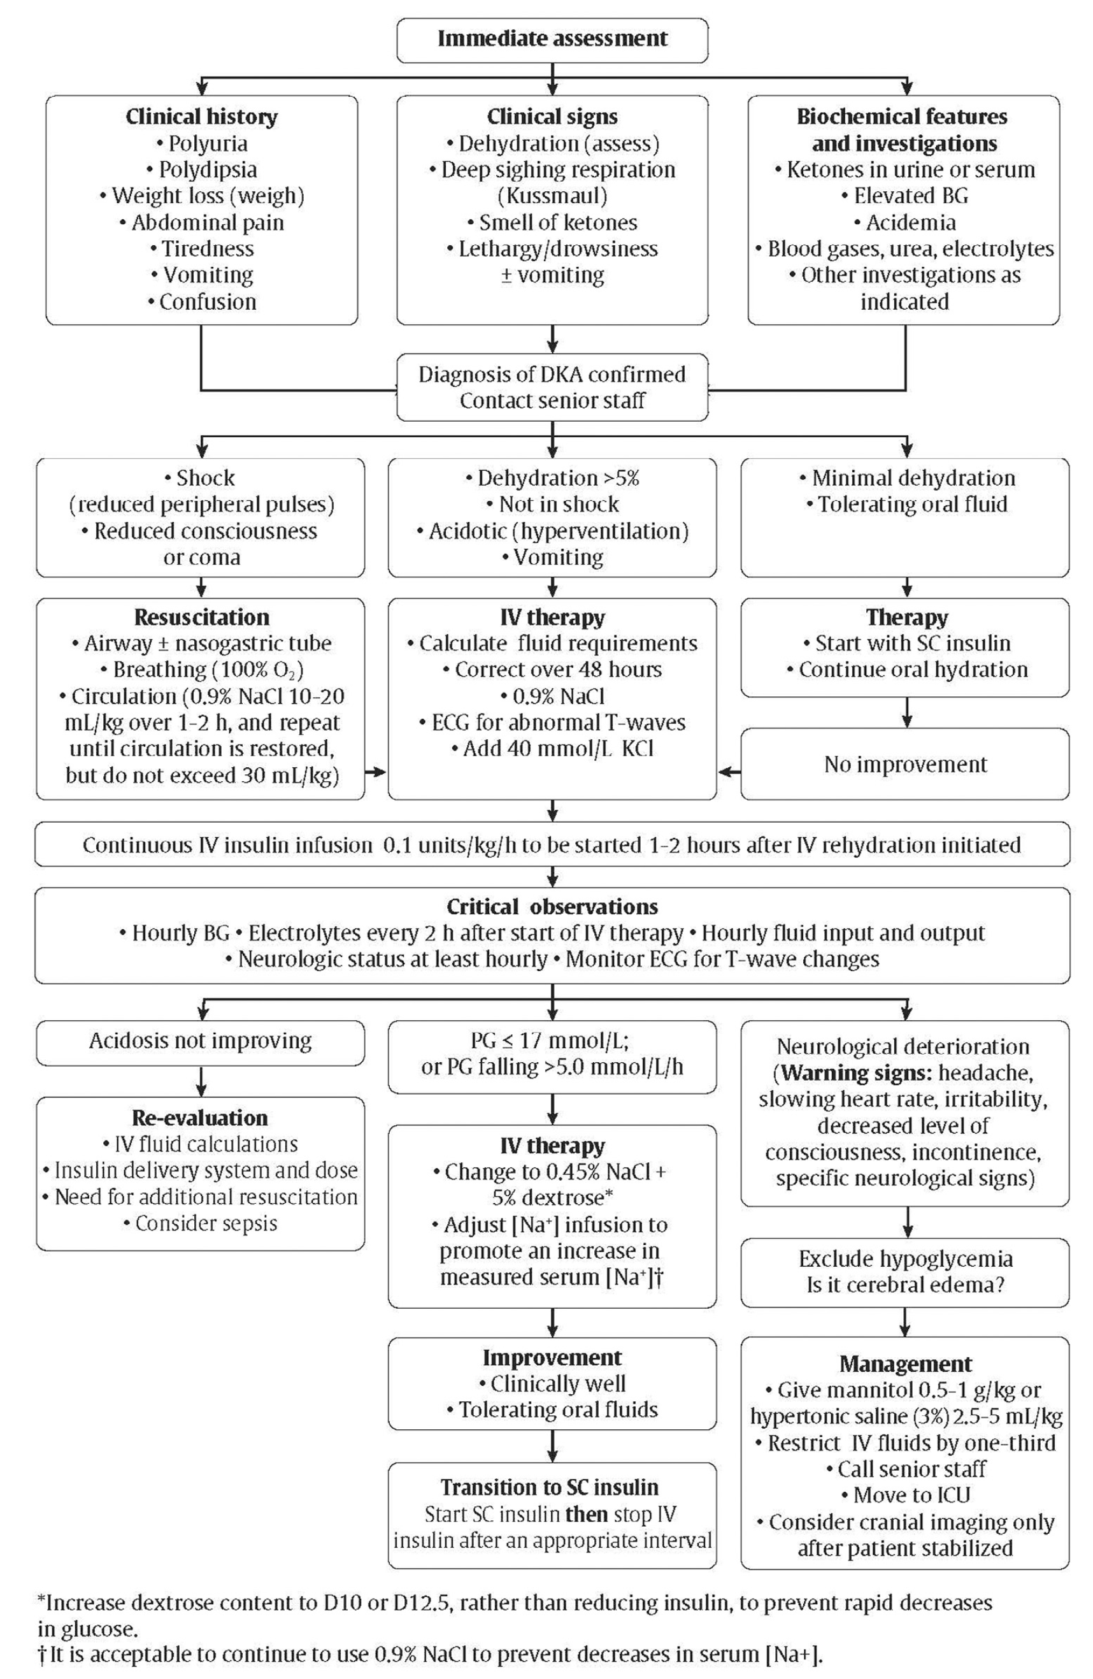
2018
Management of DKA in Children or Adolescents

Slide 46
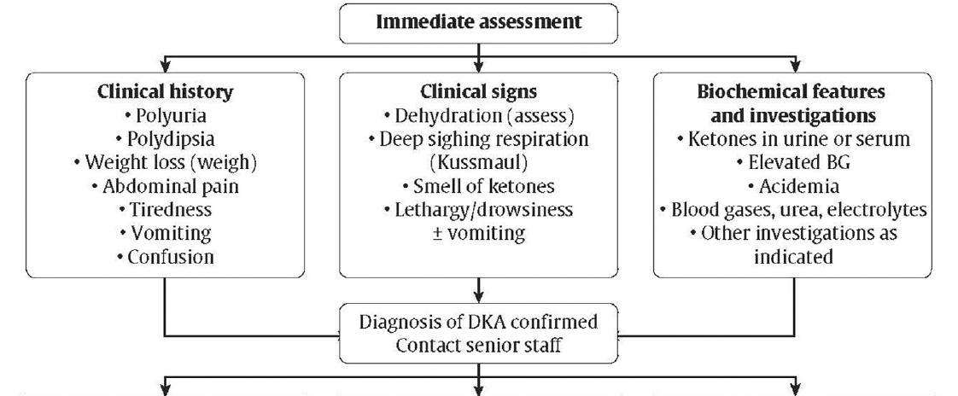
Management of DKA in Children or Adolescents
2018 Diabetes Canada CPG – Chapter 34. Type 1 Diabetes in Children & Adolescents
2018

Slide 47
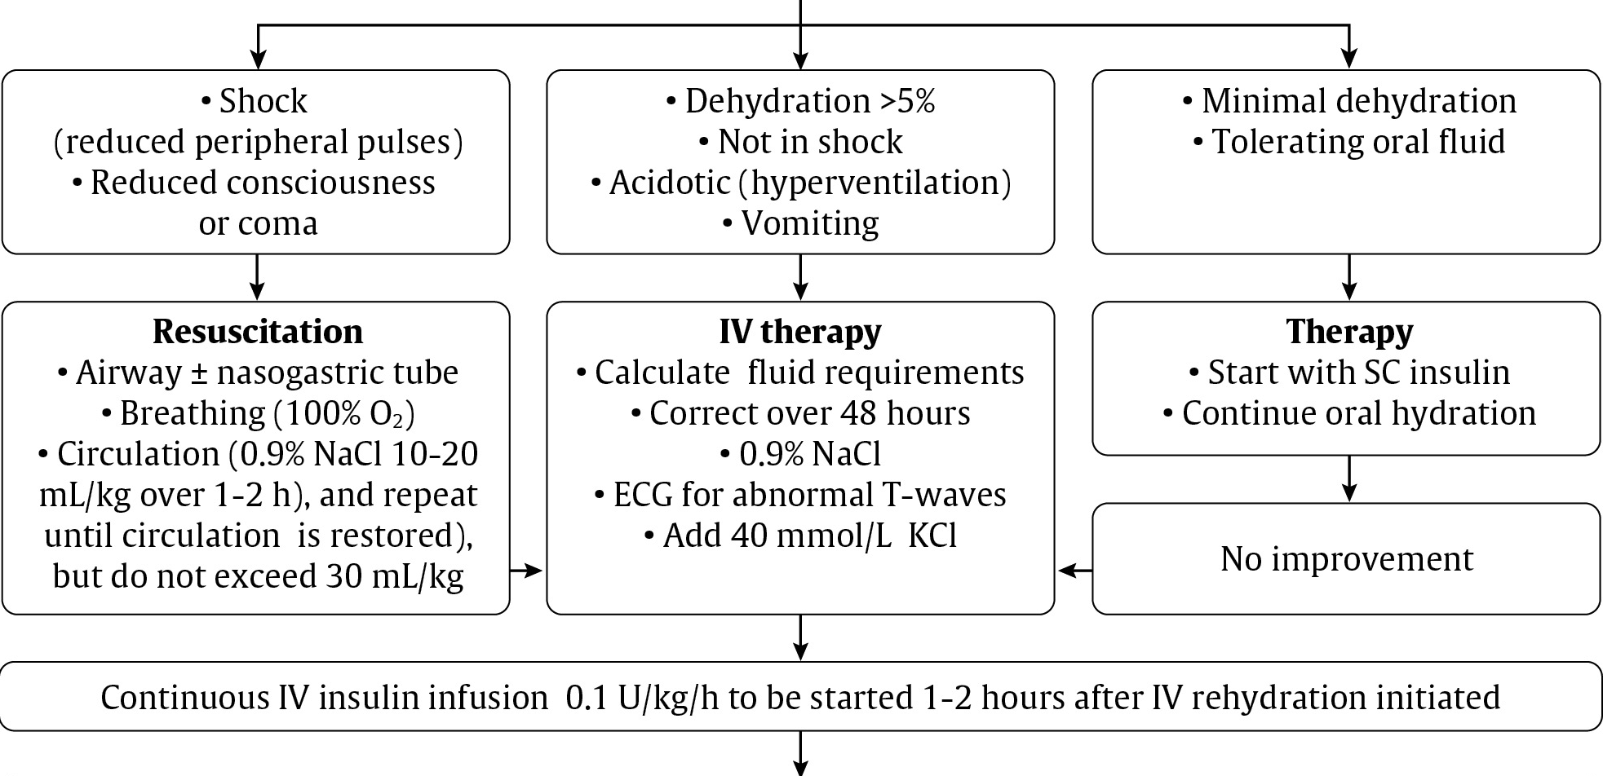
Management of DKA in Children or Adolescents
2018 Diabetes Canada CPG – Chapter 34. Type 1 Diabetes in Children & Adolescents
2018
Notes:
Needs update algorithm added

Slide 48
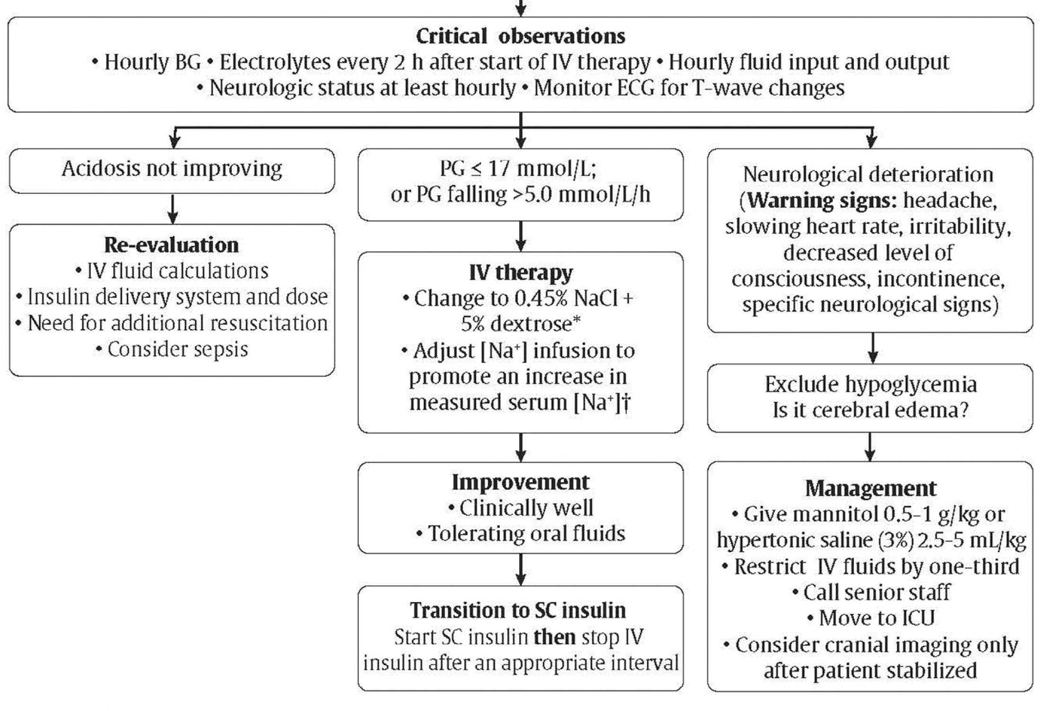
Management of DKA in Children or Adolescents
2018 Diabetes Canada CPG – Chapter 34. Type 1 Diabetes in Children & Adolescents
2018

Slide 49
Recommendation 12
2018 Diabetes Canada CPG – Chapter 34. Type 1 Diabetes in Children & Adolescents
Diabetic Ketoacidosis
12. To prevent DKA in children with diabetes:
  Targeted public awareness campaigns should be considered to educate parents, other caregivers (e.g., teachers), and healthcare providers about the early symptoms of diabetes [Grade C, Level 3]
  Immediate assessment of ketone and acid-base status should be done in any child presenting with new onset diabetes [Grade D, Consensus]
  Comprehensive education and support services [Grade C, Level 3], as well as 24-hour telephone services [Grade C, Level 3], should be available for families of children with diabetes
DKA, diabetic ketoacidosis

Slide 50
Recommendation 13
2018 Diabetes Canada CPG – Chapter 34. Type 1 Diabetes in Children & Adolescents
Diabetic Ketoacidosis
13. DKA in children should be treated according to pediatric-speciﬁc protocols [Grade D, Consensus]. If appropriate expertise/facilities are not available locally, there should be immediate consultation with a centre with expertise in pediatric diabetes [Grade D, Consensus]
DKA, diabetic ketoacidosis

Slide 51
Recommendation 14
2018 Diabetes Canada CPG – Chapter 34. Type 1 Diabetes in Children & Adolescents
Diabetic Ketoacidosis
14. In children in DKA, rapid administration of hypotonic ﬂuids should be avoided [Grade D, Level 4]. Circulatory compromise should be treated with only enough isotonic ﬂuids to correct circulatory inadequacy [Grade D, Consensus]. Replacement of fluid deficit should be extended over a 48-hour period with regular reassessments of ﬂuid status [Grade D, Level 4]
DKA, diabetic ketoacidosis

Slide 52
Recommendation 15
2018 Diabetes Canada CPG – Chapter 34. Type 1 Diabetes in Children & Adolescents
Diabetic Ketoacidosis
15. In children in DKA, an intravenous insulin bolus should not be given [Grade D, Consensus]. The insulin infusion should not be started for at least 1 hour after starting ﬂuid replacement therapy [Grade D, Level 4]. An intravenous infusion of short-acting insulin should be used at an initial dose of 0.05 to 0.1 units/kg/h, depending on the clinical situation [Grade A, Level 1A]
DKA, diabetic ketoacidosis

Slide 53
Recommendation 16
2018 Diabetes Canada CPG – Chapter 34. Type 1 Diabetes in Children & Adolescents
2018
Diabetic Ketoacidosis
16. In children in DKA, once blood glucose reaches ≤17.0 mmol/L, intravenous dextrose should be started to prevent hypoglycemia. The dextrose infusion should be increased, rather than reducing insulin, to prevent rapid decreases in glucose. The insulin infusion should be maintained until pH normalizes and ketones have mostly cleared [Grade D, Consensus]
DKA, diabetic ketoacidosis

Slide 54
Recommendation 17-18
2018 Diabetes Canada CPG – Chapter 34. Type 1 Diabetes in Children & Adolescents
2018
Diabetic Ketoacidosis
In children in DKA, administration of sodium bicarbonate should be avoided except in extreme circulatory compromise, as this may contribute to cerebral edema [Grade D, Level 4]
In children in DKA, either mannitol or hypertonic saline may be used in the treatment of cerebral edema [Grade D, Level 4]
DKA, diabetic ketoacidosis

Slide 55
2018 Diabetes Canada CPG – Chapter 34. Type 1 Diabetes in Children & Adolescents
Diabetes Complications – Key Messages
Nephropathy, retinopathy, neuropathy and hypertension are rare in pediatric diabetes
Screening efforts should focus most attention on post-pubertal patients with longer duration and poorer control of their diabetes

Slide 56
2018 Diabetes Canada CPG – Chapter 34. Type 1 Diabetes in Children & Adolescents
Nephropathy
Prepubertal children, and those in the first 5 years of diabetes, should be considered at very low risk for microalbuminuria
A first morning urine albumin to creatinine ratio (ACR) has high sensitivity and specificity for the detection of microalbuminuria (MAU)

Slide 57
2018 Diabetes Canada CPG – Chapter 34. Type 1 Diabetes in Children & Adolescents
Nephropathy
A random ACR may be compromised in adolescents due to their higher frequency of exercise-induced proteinuria and benign postural proteinuria
Abnormal random ACRs (>2.5 mg/mmol) require confirmation with a first morning ACR or timed urine overnight collection as abnormal ACR frequently normalize spontaneously
ACR, albumin to creatinine ratio

Slide 58
2018 Diabetes Canada CPG – Chapter 34. Type 1 Diabetes in Children & Adolescents
Nephropathy
Treatment is indicated only for those adolescents with persistent albuminuria
There are no long-term intervention studies assessing the effectiveness of ACE inhibitors or angiotensin receptor blockers in delaying progression to overt nephropathy in adolescents with microalbuminuria
Therefore, treatment guidelines are based on adult data
ACE, angiotensin converting enzyme

Slide 59
2018 Diabetes Canada CPG – Chapter 34. Type 1 Diabetes in Children & Adolescents
Retinopathy
Retinopathy is rare in prepubertal children with type 1 diabetes and in postpubertal adolescents with good metabolic control
Age ≥15 yrs +
DM of 5 years
Begin annual screening
If DM 5-10 yrs +
normal eye exam +
good glycemic control
Screen every 2 years
DM, diabetes mellitus

Slide 60
2018 Diabetes Canada CPG – Chapter 34. Type 1 Diabetes in Children & Adolescents
Neuropathy
Neuropathy is mostly subclinical in children
Vibration and monofilament testing have suboptimal sensitivity and specificity in adolescents, persistence of abnormalities is an inconsistent finding
The only treatment modality for children and adolescents is intensified diabetes management to achieve and maintain glycemic targets

Slide 61
2018 Diabetes Canada CPG – Chapter 34. Type 1 Diabetes in Children & Adolescents
Dyslipidemia
Most children with type 1 diabetes should be considered at low risk for vascular disease associated with dyslipidemia. The exceptions are those with:
  Longer duration of disease
  Microvascular complications
  CV risk factors, including:
    Smoking
    Hypertension
    Obesity
    Family history of premature CVD
CV, cardiovasulcar; CVD, cardiovascular disease

Slide 62
2018 Diabetes Canada CPG – Chapter 34. Type 1 Diabetes in Children & Adolescents
Dyslipidemia
Begin screening at:
  ≥12 years of age
  <12 years of age with specific risk factors
Repeat screening every 5 years
Statin therapy has only rarely been studied specifically in children with diabetes
No evidence linking specific LDL-C cutoffs in children with diabetes with long-term outcomes

Slide 63
2018 Diabetes Canada CPG – Chapter 34. Type 1 Diabetes in Children & Adolescents
Hypertension
Up to 16% of adolescents with type 1 diabetes have hypertension
Screen blood pressure at least twice a year
Role of ambulatory blood pressure monitoring in routine care remains uncertain
Treat according to the guidelines for children without diabetes

Slide 64
2018 Diabetes Canada CPG – Chapter 34. Type 1 Diabetes in Children & Adolescents
Screening for Complications
Complication | Indications & intervals for screening | Screening method
Nephropathy | • Yearly screening commencing at 12 years of age in those with duration of type 1 diabetes ≥ 5 years | • First morning (preferred) or random urine ACR • Abnormal ACR requires confirmation at least 1 month later with a first morning ACR, and if abnormal, followed by timed, overnight or 24-hour split urine collections for albumin excretion rate • Repeated sampling should be done ever y 3–4 months over a 6-12-month period to demonstrate persistence
Retinopathy | • Yearly screening commencing at 15 yrs of age with duration of DM ≥ 5 yrs • Screening interval can increase to 2 yrs if good glycemic control, duration of diabetes < 10 yrs, and no retinopathy at initial assessment | • 7-standard field, stereoscopic-colour fundus photography with interpretation by a trained reader (gold standard); or • Direct ophthalmoscopy or indirect slit-lamp fundoscopy through dilated pupil; or • Digital fundus photography
Neuropathy | • Postpubertal adolescents with poor metabolic control should be screened yearly after 5 years’ duration of DM | • Question and examine for symptoms of numbness, pain, cramps and paresthesia, as well as sensation, vibration sense, light touch & ankle reflexes
Dyslipidemia | • Delay screening post-diabetes diagnosis until metabolic control has stabilized • Screen at ≥12 years of age or <12 years of age with BMI > 97th percentile, family history of hyperlipidemia or premature CVD | • Fasting or non-fastingTC, HDL-C, TG, LDL-C
Hyper tension | • Screen all children with type 1 diabetes at least twice a year | • Use appropriate cuff size

Slide 65
Recommendation 19
2018 Diabetes Canada CPG – Chapter 34. Type 1 Diabetes in Children & Adolescents
Microvascular Complications
19. Children ≥12 years with diabetes duration > 5 years should be screened annually for CKD with a ﬁrst morning urine ACR (preferred) [Grade B, Level 2] or a random ACR [Grade D, Consensus]. Abnormal results should be conﬁrmed [Grade B, Level 2] at least 1 month later with a ﬁrst morning ACR and, if abnormal, followed by timed, overnight or 24-hour split urine collections for albumin excretion rate [Grade D, Consensus]. Albuminuria (ACR >2.5 mg/mmol; AER >20 mcg/min) should not be diagnosed unless it is persistent, as demonstrated by 2 consecutive ﬁrst morning ACR or timed collections obtained at 3- to 4-month intervals over a 6- to 12-month period [Grade D, Consensus]
ACR, albumin to creatinine ratio; AER, albumin excretion rate; CKD, chronic kidney disease

Slide 66
Recommendation 20
2018 Diabetes Canada CPG – Chapter 34. Type 1 Diabetes in Children & Adolescents
Microvascular Complications
20. Children ≥12 years with persistent albuminuria should be treated per adult guidelines (see Chronic Kidney Disease in Diabetes chapter) [Grade D, Consensus]

Slide 67
Recommendation 21
2018 Diabetes Canada CPG – Chapter 34. Type 1 Diabetes in Children & Adolescents
Microvascular Complications
21. Children ≥15 years with 5 years diabetes duration should be annually screened and evaluated for retinopathy by an expert professional [Grade C, Level 3]. The screening interval can be increased to every 2 years in children with type 1 diabetes who have good glycemic control, duration of diabetes <10 years and no signiﬁcant retinopathy (as determined by an expert professional) [Grade D, Consensus]

Slide 68
Recommendation 22
2018 Diabetes Canada CPG – Chapter 34. Type 1 Diabetes in Children & Adolescents
Microvascular Complications
22. Children ≥15 years with 5 years duration and poor metabolic control should be questioned about symptoms of numbness, pain, cramps and paresthesia, and examined for skin sensation, vibration sense, light touch and ankle reﬂexes [Grade D, Consensus]

Slide 69
Recommendation 25
2018 Diabetes Canada CPG – Chapter 34. Type 1 Diabetes in Children & Adolescents
Comorbid Conditions and Other Complications
25. Children with type 1 diabetes who are <12 years of age should be screened for dyslipidemia if they have other risk factors, such as obesity (body mass index >97th percentile for age and gender) and/or a family history of dyslipidemia or premature CVD. Routine screening for dyslipidemia should begin at 12 years of age, with repeat screening after 5 years [Grade D, Consensus]
CVD, cardiovascular disease

Slide 70
Recommendation 26
2018 Diabetes Canada CPG – Chapter 34. Type 1 Diabetes in Children & Adolescents
Comorbid Conditions and Other Complications
26. Once dyslipidemia is diagnosed in children with type 1 diabetes, the dyslipidemia should be monitored regularly and efforts should be made to improve metabolic control and promote healthy behaviours. While it can be treated effectively with statins, a specific cut-off to initiate treatment is yet to be determined in this age category [Grade D, Consensus]

Slide 71
Recommendations 27-28
2018 Diabetes Canada CPG – Chapter 34. Type 1 Diabetes in Children & Adolescents
Comorbid Conditions and Other Complications
All children with type 1 diabetes should be screened for hypertension at least twice annually [Grade D, Consensus]
Children with type 1 diabetes and BP readings persistently above the 95th percentile for age should receive healthy behaviour counselling, including weight loss if overweight [Grade D, Level 4]. If BP remains elevated, treatment should be initiated based on recommendations for children without diabetes [Grade D, Consensus]
BP, blood pressure

Slide 72
Comorbid Conditions / Considerations
2018 Diabetes Canada CPG – Chapter 34. Type 1 Diabetes in Children & Adolescents
Immunization
Smoking
Contraception / Sexual health counseling
Psychological / Psychiatric
Eating disorders

Slide 73
2018 Diabetes Canada CPG – Chapter 34. Type 1 Diabetes in Children & Adolescents
Immunizations
There is no evidence supporting increased morbidity or mortality from influenza in children with type 1 diabetes
The management of type 1 diabetes can be complicated by illness
For this reason, parents may choose to immunize their children

Slide 74

2018 Diabetes Canada CPG – Chapter 34. Type 1 Diabetes in Children & Adolescents
Smoking
Smoking prevention/cessation should be emphasized throughout childhood and adolescence.

Slide 75
2018 Diabetes Canada CPG – Chapter 34. Type 1 Diabetes in Children & Adolescents
Contraception / Sexual Health Counseling
Adolescents with diabetes should receive regular counselling about sexual health and contraception
Pregnancy in adolescent females with type 1 diabetes with suboptimal metabolic control may result in higher risks of maternal and fetal complications than in older women with type 1 diabetes
Oral contraceptives, intrauterine devices and barrier methods can be used safely in the vast majority of adolescents

Slide 76
Recommendations 29
2018 Diabetes Canada CPG – Chapter 34. Type 1 Diabetes in Children & Adolescents
Comorbid Conditions and Other Complications
Inﬂuenza vaccination should be offered to children with diabetes as a way to prevent an intercurrent illness that could complicate diabetes management [Grade D, Consensus]

Slide 77
Recommendations 30-31
2018 Diabetes Canada CPG – Chapter 34. Type 1 Diabetes in Children & Adolescents
Comorbid Conditions and Other Complications
30. Formal smoking prevention and cessation counseling should be part of diabetes management for children with diabetes [Grade D, Consensus]
31. Adolescents should be regularly counseled around alcohol and substance use [Grade D, Consensus]

Slide 78
Recommendation 32
2018 Diabetes Canada CPG – Chapter 34. Type 1 Diabetes in Children & Adolescents
Comorbid Conditions and Other Complications
32. Adolescent females with type 1 diabetes should receive counseling on contraception and sexual health in order to prevent unplanned pregnancy [Grade D, Level 4]

Slide 79
2018 Diabetes Canada CPG – Chapter 34. Type 1 Diabetes in Children & Adolescents
Psychological Issues
For children, and particularly adolescents, there is a need to identify psychological disorders associated with diabetes and to intervene early to minimize the impact over the course of development.

Slide 80
2018 Diabetes Canada CPG – Chapter 34. Type 1 Diabetes in Children & Adolescents
Psychological / Psychiatric Risks
Children and adolescents with diabetes have significant risks for psychological problems:
  Depression
  Anxiety
  Eating disorders
  Externalizing disorders
The risks increase exponentially during adolescence

Slide 81
2018 Diabetes Canada CPG – Chapter 34. Type 1 Diabetes in Children & Adolescents
Psychological / Psychiatric Risks
Psychological disorders predict poor diabetes management and control and consequently, negative medical outcomes
Conversely, as glycemic control worsens, the probability of psychological problems increases
Presence of psychological symptoms and diabetes problems in children and adolescents are often strongly affected by caregiver/family distress

Slide 82
2018 Diabetes Canada CPG – Chapter 34. Type 1 Diabetes in Children & Adolescents
Eating Disorders
10% of adolescent females with type 1 diabetes meet the Diagnostic and Statistical Manual of Mental Disorders (4th Edition) criteria for eating disorders compared to 4% of their age-matched peers without diabetes
Eating disorders are associated with poor metabolic control and earlier onset and more rapid progression of microvascular complications

Slide 83
2018 Diabetes Canada CPG – Chapter 34. Type 1 Diabetes in Children & Adolescents
Eating Disorders
Eating disorders should be suspected in those adolescent and young adults who are unable to achieve and maintain metabolic targets, especially when insulin omission is suspected.
It is important to identify individuals with eating disorders because different management strategies are required to optimize metabolic control and prevent microvascular complications

Slide 84
Recommendation 23
2018 Diabetes Canada CPG – Chapter 34. Type 1 Diabetes in Children & Adolescents
Comorbid Conditions and Other Complications
23. Children and adolescents with diabetes, along with their families, should be screened regularly for psychosocial or psychological disorders [Grade D, Consensus] and should be referred to an expert in mental health and/or psychosocial issues for intervention when required [Grade D, Consensus]

Slide 85
Recommendation 24
2018 Diabetes Canada CPG – Chapter 34. Type 1 Diabetes in Children & Adolescents
Comorbid Conditions and Other Complications
24. Adolescents with type 1 diabetes should be regularly screened using nonjudgmental questions about weight and body image concerns, dieting, binge eating and insulin omission for weight loss [Grade D, Consensus]

Slide 86
2018 Diabetes Canada CPG – Chapter 34. Type 1 Diabetes in Children & Adolescents
Comorbid Conditions – Key Messages
Always consider the possibility of autoimmune thyroid and adrenal disease, and celiac disease, particularly when there are suggestive signs or symptoms

Slide 87
2018 Diabetes Canada CPG – Chapter 34. Type 1 Diabetes in Children & Adolescents
Autoimmune Thyroid Disease
Autoimmune Thyroid Disease (AITD) occurs in 15 to 30% of individuals with type 1 diabetes
  Risk for AITD during the first decade of diabetes is directly related to the presence or absence of thyroid antibodies
  Hypothyroidism is most likely to develop in girls at puberty
  Early detection and treatment of hypothyroidism will prevent growth failure and symptoms of hypothyroidism

Slide 88
2018 Diabetes Canada CPG – Chapter 34. Type 1 Diabetes in Children & Adolescents
Autoimmune Thyroid Disease
Hyperthyroidism also occurs more frequently in association with type 1 diabetes than in the general population

Slide 89
2018 Diabetes Canada CPG – Chapter 34. Type 1 Diabetes in Children & Adolescents
Primary Adrenal Insufficiency
Primary adrenal insufficiency is rare, even in those with type 1 diabetes
Targeted screening is required in those with unexplained recurrent hypoglycemia and decreasing insulin requirements

Slide 90
2018 Diabetes Canada CPG – Chapter 34. Type 1 Diabetes in Children & Adolescents
Celiac Disease
Celiac disease can be identified in 4 to 9% of children with type 1 diabetes
  60% to 70% of these children, the disease is asymptomatic
There is good evidence that treatment of classic or atypical celiac disease with a gluten-free diet improves:
  Intestinal and extra-intestinal symptoms
  Prevents the long-term sequelae of untreated disease

Slide 91
2018 Diabetes Canada CPG – Chapter 34. Type 1 Diabetes in Children & Adolescents
Celiac Disease
No evidence that:
  Untreated asymptomatic celiac disease is associated with short- or long-term health risks
  A gluten-free diet improves health in these individuals
Universal screening for and treatment of asymptomatic celiac disease remains controversial

Slide 92
2018 Diabetes Canada CPG – Chapter 34. Type 1 Diabetes in Children & Adolescents
Screening for Comorbid Conditions
Condition | Indications for screening | Screening test | Frequency
Autoimmune thyroid disease | All children with type 1 diabetes | Serum TSH level + thyroperoxidase antibodies | At diagnosis and every 2 years thereafter
 | Positive thyroid antibodies, thyroid symptoms or goiter | Serum TSH level + thyroperoxidase antibodies (if previously negative) | Every 6–12 months
Primary adrenal insufficiency | Unexplained recurrent hypoglycemia and decreasing insulin requirements | 8 AM serum cortisol + serum sodium and potassium | As clinically indicated
Celiac disease | Recurrent gastrointestinal symptoms, poor linear growth, poor weight gain, fatigue, anemia, unexplained frequent hypoglycemia or poor metabolic control | Tissue transglutaminase + immunoglobulin A levels | As clinically indicated

Slide 93
Recommendation 33
2018 Diabetes Canada CPG – Chapter 34. Type 1 Diabetes in Children & Adolescents
Comorbid Conditions and Other Complications
33. Children with type 1 diabetes who have anti-thyroid antibodies should be considered high risk for autoimmune thyroid disease [Grade C, Level 3]. Children with type 1 diabetes should be screened at diabetes diagnosis with repeat screening every 2 years using a serum thyroid- stimulating hormone and thyroid peroxidase antibodies [Grade D, Consensus]. More frequent screening is indicated in the presence of positive anti-thyroid antibodies, thyroid symptoms or goiter [Grade D, Consensus]

Slide 94
Recommendation 34
2018 Diabetes Canada CPG – Chapter 34. Type 1 Diabetes in Children & Adolescents
Comorbid Conditions and Other Complications
34. Children with type 1 diabetes and symptoms of classic or atypical celiac disease should undergo celiac screening [Grade D, Consensus] and, if conﬁrmed, be treated with a gluten-free diet to improve symptoms [Grade D, Level 4] and prevent the long-term sequelae of untreated classic celiac disease [Grade D, Level 4]. Discussion of the pros and cons of screening and treatment of asymptomatic celiac disease should take place with children and adolescents with type 1 diabetes and their families [Grade D, Consensus]

Slide 95
2018 Diabetes Canada CPG – Chapter 34. Type 1 Diabetes in Children & Adolescents
Summary
Guidelines for children and adolescents differ from those of adults in a number of ways:
Less aggressive A1C target acceptable in children
Less intensive screening for complications of diabetes in the younger years due to lower incidence
Greater caution around DKA management given cerebral edema risk
Greater awareness of unique psychosocial needs as children progress through developmental stages
DKA, diabetic ketoacidosis

Slide 96
2018 Diabetes Canada CPG – Chapter 34. Type 1 Diabetes in Children & Adolescents
2018
Key Messages
Suspicion of diabetes in a child should lead to immediate conﬁrmation of the diagnosis and initiation of treatment to reduce the likelihood of diabetic ketoacidosis
Management of pediatric DKA differs from DKA in adults because of the increased risk for cerebral edema. Pediatric protocols should be used
Children should be referred for diabetes education, ongoing care and psychosocial support to a diabetes team with pediatric expertise
DKA, diabetic ketoacidosis

Slide 97
Key Messages for People with Children and Adolescents with Type 1 Diabetes
2018 Diabetes Canada CPG – Chapter 34. Type 1 Diabetes in Children & Adolescents
2018
When a child is diagnosed with type 1 diabetes, the role of a caregiver becomes more important than ever. Family life and daily routines may seem more complicated in the beginning but, over time, and with the support of your diabetes team, these will improve. You will discover that your child can have a healthy and fulfilling life with diabetes

Slide 98

Visit guidelines.diabetes.ca

Slide 99


Or download the App

Slide 100
Diabetes Canada Clinical Practice Guidelines
www.guidelines.diabetes.ca – for health-care providers
1-800-BANTING (226-8464)
www.diabetes.ca – for people with diabetes
Notes:
100

