Slide 1
Retinopathy
2018 Clinical Practice Guidelines
Chapter 30
Filiberto Altomare MD FRCSC
Amin Kherani MD FRCSC
Julie Lovshin MD FRCPC

Slide 2
Disclaimer
All Content contained on this slide deck is the property of Diabetes Canada, its content suppliers or its licensors as the case may be, and is protected by Canadian and international copyright, trademark, and other applicable laws. Diabetes Canada grants personal, limited, revocable, non-transferable and non-exclusive license to access and read content in this slide deck for personal, non-commercial and not-for-profit use only. The slide deck is made available for lawful, personal use only and not for commercial use.
The unauthorized reproduction, distribution of this copyrighted work is not permitted.
For permission to use this slide deck for commercial or any use other than personal, please contact guidelines@diabetes.ca

Slide 3
Key Changes
2018 Diabetes Canada CPG – Chapter 30. Retinopathy
2018
New information on
  The effectiveness of local intraocular pharmacological therapies in improving vision and reducing the level of diabetic retinopathy

Slide 4
Retinopathy Checklist
2018 Diabetes Canada CPG – Chapter 30. Retinopathy
SCREEN regularly
DELAY onset and progression with glycemic and BP control ± fibrate
TREAT established disease with laser photocoagulation, intra-ocular injection of medications or vitreoretinal surgery
BP, blood pressure
Notes:
Use same check marks as Geetha
4

Slide 5
Diabetic Retinopathy Most Common Cause of Blindness Among Working Age
2018 Diabetes Canada CPG – Chapter 30. Retinopathy
Category | Proliferative Retinopathy | Macular Edema
Type 1 DM | 23% | 11%
Type 2 DM on insulin | 14% | 15%
Type 2 DM on non-insulin antihyperglycemic agents | 3% | 4%
Klein R, et al. Diabetes Care 1992;15(12):1875-91
Klein R, et al. Ophthalmology 1984;91(12):1464-74
Notes:
5

Slide 6
Retinopathy Increases Morbidity and Mortality
2018 Diabetes Canada CPG – Chapter 30. Retinopathy
Visual loss is associated with:
  Increased falls
  More hip fractures
  4-fold increase in mortality
  Early death (in type 1 diabetes)
Notes:
6

Slide 7
Forms of Retinopathy
2018 Diabetes Canada CPG – Chapter 30. Retinopathy
Macular Edema
Non-proliferative and Proliferative
Retinal Capillary Closure
Notes:
- In heading, suggest changing to “FORMS” rather than “Types”
7

Slide 8
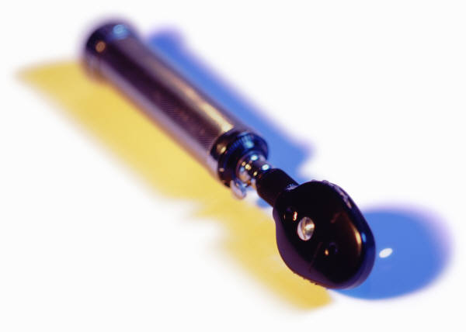
Macular Edema
2018 Diabetes Canada CPG – Chapter 30. Retinopathy
Diffuse or focal vascular leakage at the macula
Notes:
8

Slide 9
Non-proliferative/Proliferative Retinopathy
2018 Diabetes Canada CPG – Chapter 30. Retinopathy
Blood vessel changes
Non-proliferative
    Microaneurysms, intraretinal hemorrhage, vascular tortuosity and vascular malformation
Proliferative
    Abnormal vessel growth
Notes:
9

Slide 10
Retinal Capillary Closure
2018 Diabetes Canada CPG – Chapter 30. Retinopathy
Seen with fluorescein angiography
Potentially blinding complication
Currently no treatment options
Notes:
10

Slide 11

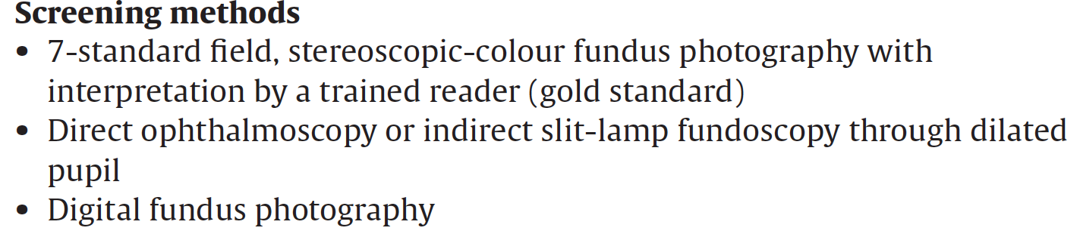
Screening for Retinopathy
2018 Diabetes Canada CPG – Chapter 30. Retinopathy

Slide 12
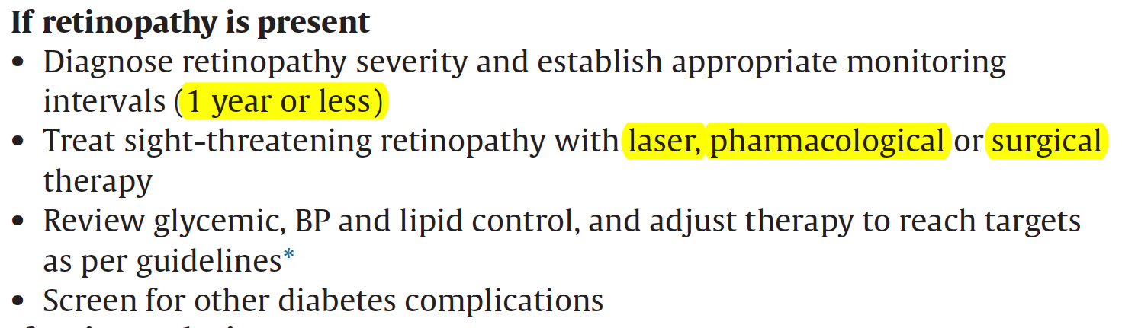
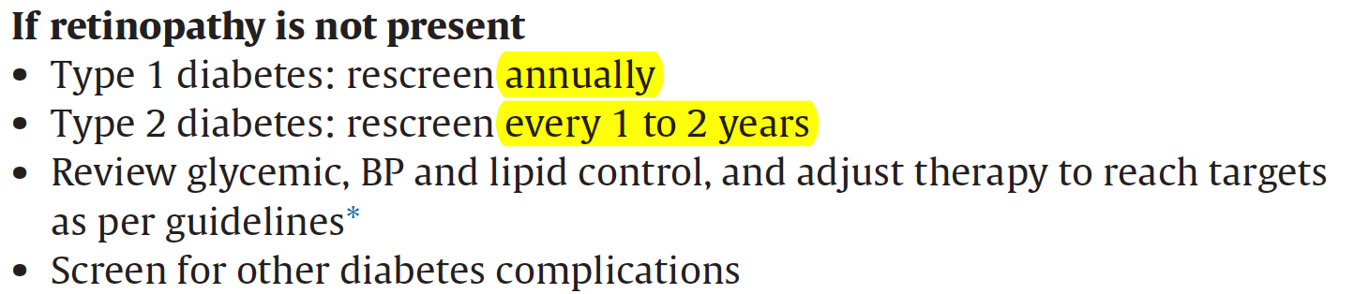
Retinopathy (cont’d)
2018 Diabetes Canada CPG – Chapter 30. Retinopathy

Slide 13
Risk Factors for Progression
2018 Diabetes Canada CPG – Chapter 30. Retinopathy
Longer duration of diabetes
Elevated A1C
Hypertension
Dyslipidemia
Low hemoglobin level
Pregnancy (with type 1 diabetes)
Proteinuria
Severe retinopathy itself
Notes:
13

Slide 14
Delay of the Disease
2018 Diabetes Canada CPG – Chapter 30. Retinopathy
Glycemic control: target A1C ≤7%
Blood pressure control: target BP <130/80
Lipid-lowering therapy: Fibrates have been shown to decrease progression and may be considered
Notes:
14

Slide 15
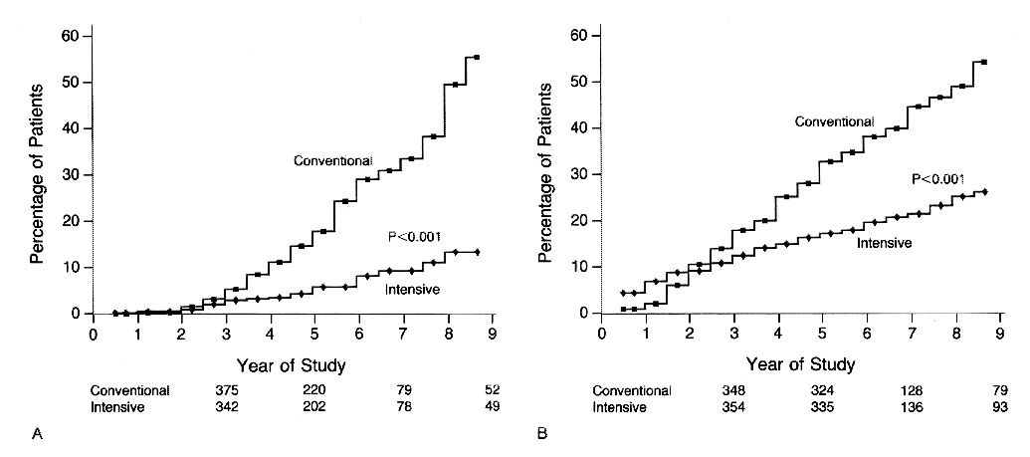
DCCT: Reduction in Retinopathy with Intensive Glycemic Control
2018 Diabetes Canada CPG – Chapter 30. Retinopathy
Primary Prevention
Secondary Intervention
54% RRR
76% RRR
The Diabetes Control and Complications Trial Research Group. N Engl J Med 1993;329:977-986.
Notes:
N Engl J Med. 1993 Sep 30;329(14):977-86.
The effect of intensive treatment of diabetes on the development and progression of long-term complications in insulin-dependent diabetes mellitus. The Diabetes Control and Complications Trial Research Group.
[No authors listed]
Abstract
BACKGROUND:
Long-term microvascular and neurologic complications cause major morbidity and mortality in patients with insulin-dependent diabetes mellitus (IDDM). We examined whether intensive treatment with the goal of maintaining blood glucose concentrations close to the normal range could decrease the frequency and severity of these complications.
METHODS:
A total of 1441 patients with IDDM--726 with no retinopathy at base line (the primary-prevention cohort) and 715 with mild retinopathy (the secondary-intervention cohort) were randomly assigned to intensive therapy administered either with an external insulin pump or by three or more daily insulin injections and guided by frequent blood glucose monitoring or to conventional therapy with one or two daily insulin injections. The patients were followed for a mean of 6.5 years, and the appearance and progression of retinopathy and other complications were assessed regularly.
RESULTS:
In the primary-prevention cohort, intensive therapy reduced the adjusted mean risk for the development of retinopathy by 76 percent (95 percent confidence interval, 62 to 85 percent), as compared with conventional therapy. In the secondary-intervention cohort, intensive therapy slowed the progression of retinopathy by 54 percent (95 percent confidence interval, 39 to 66 percent) and reduced the development of proliferative or severe nonproliferative retinopathy by 47 percent (95 percent confidence interval, 14 to 67 percent). In the two cohorts combined, intensive therapy reduced the occurrence of microalbuminuria (urinary albumin excretion of > or = 40 mg per 24 hours) by 39 percent (95 percent confidence interval, 21 to 52 percent), that of albuminuria (urinary albumin excretion of > or = 300 mg per 24 hours) by 54 percent (95 percent confidence interval 19 to 74 percent), and that of clinical neuropathy by 60 percent (95 percent confidence interval, 38 to 74 percent). The chief adverse event associated with intensive therapy was a two-to-threefold increase in severe hypoglycemia.
CONCLUSIONS:
Intensive therapy effectively delays the onset and slows the progression of diabetic retinopathy, nephropathy, and neuropathy in patients with IDDM.
15

Slide 16
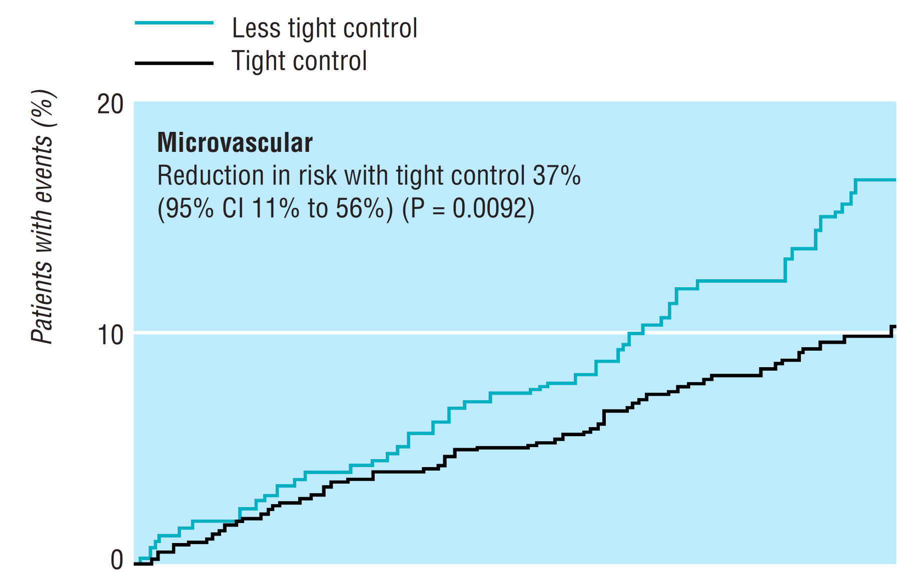

UKPDS38: Reduction in Microvascular Complications with Blood Pressure Control
2018 Diabetes Canada CPG – Chapter 30. Retinopathy
UKPDS. BMJ 1998;317:703-713
Notes:
BMJ. 1998 Sep 12;317(7160):703-13.
Tight blood pressure control and risk of macrovascular and microvascular complications in type 2 diabetes: UKPDS 38. UK Prospective Diabetes Study Group.
[No authors listed]
Erratum in
BMJ 1999 Jan 2;318(7175):29.
Abstract
OBJECTIVE:
To determine whether tight control of blood pressure prevents macrovascular and microvascular complications in patients with type 2 diabetes.
DESIGN:
Randomised controlled trial comparing tight control of blood pressure aiming at a blood pressure of <150/85 mm Hg (with the use of an angiotensin converting enzyme inhibitor captopril or a beta blocker atenolol as main treatment) with less tight control aiming at a blood pressure of <180/105 mm Hg.
SETTING:
20 hospital based clinics in England, Scotland, and Northern Ireland.
SUBJECTS:
1148 hypertensive patients with type 2 diabetes (mean age 56, mean blood pressure at entry 160/94 mm Hg); 758 patients were allocated to tight control of blood pressure and 390 patients to less tight control with a median follow up of 8.4 years.
MAIN OUTCOME MEASURES:
Predefined clinical end points, fatal and non-fatal, related to diabetes, deaths related to diabetes, and all cause mortality. Surrogate measures of microvascular disease included urinary albumin excretion and retinal photography.
RESULTS:
Mean blood pressure during follow up was significantly reduced in the group assigned tight blood pressure control (144/82 mm Hg) compared with the group assigned to less tight control (154/87 mm Hg) (P<0.0001). Reductions in risk in the group assigned to tight control compared with that assigned to less tight control were 24% in diabetes related end points (95% confidence interval 8% to 38%) (P=0.0046), 32% in deaths related to diabetes (6% to 51%) (P=0.019), 44% in strokes (11% to 65%) (P=0.013), and 37% in microvascular end points (11% to 56%) (P=0.0092), predominantly owing to a reduced risk of retinal photocoagulation. There was a non-significant reduction in all cause mortality. After nine years of follow up the group assigned to tight blood pressure control also had a 34% reduction in risk in the proportion of patients with deterioration of retinopathy by two steps (99% confidence interval 11% to 50%) (P=0.0004) and a 47% reduced risk (7% to 70%) (P=0.004) of deterioration in visual acuity by three lines of the early treatment of diabetic retinopathy study (ETDRS) chart. After nine years of follow up 29% of patients in the group assigned to tight control required three or more treatments to lower blood pressure to achieve target blood pressures.
CONCLUSION:
Tight blood pressure control in patients with hypertension and type 2 diabetes achieves a clinically important reduction in the risk of deaths related to diabetes, complications related to diabetes, progression of diabetic retinopathy, and deterioration in visual acuity.
16

Slide 17
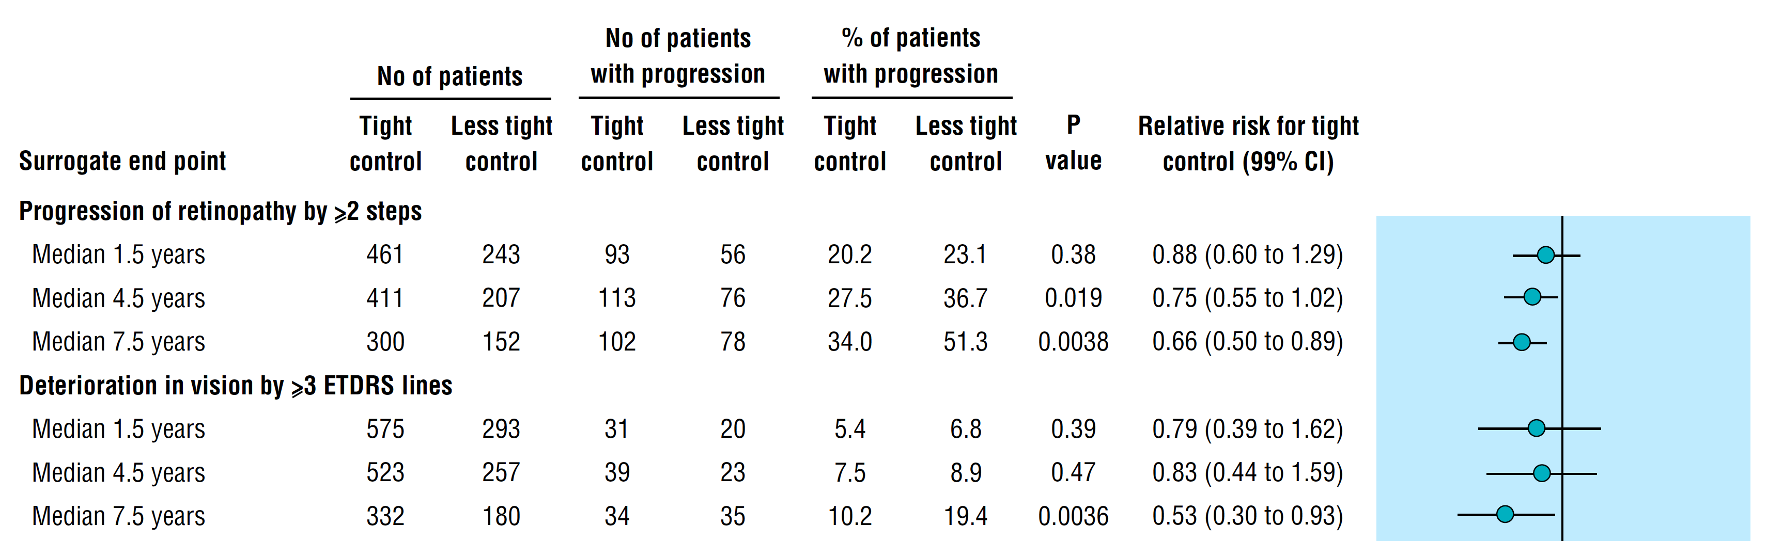
UKPDS38: Reduction in Retinopathy with Blood Pressure Control
2018 Diabetes Canada CPG – Chapter 30. Retinopathy
UKPDS. BMJ 1998;317:703-713
Notes:
BMJ. 1998 Sep 12;317(7160):703-13.
Tight blood pressure control and risk of macrovascular and microvascular complications in type 2 diabetes: UKPDS 38. UK Prospective Diabetes Study Group.
[No authors listed]
Erratum in
BMJ 1999 Jan 2;318(7175):29.
Abstract
OBJECTIVE:
To determine whether tight control of blood pressure prevents macrovascular and microvascular complications in patients with type 2 diabetes.
DESIGN:
Randomised controlled trial comparing tight control of blood pressure aiming at a blood pressure of <150/85 mm Hg (with the use of an angiotensin converting enzyme inhibitor captopril or a beta blocker atenolol as main treatment) with less tight control aiming at a blood pressure of <180/105 mm Hg.
SETTING:
20 hospital based clinics in England, Scotland, and Northern Ireland.
SUBJECTS:
1148 hypertensive patients with type 2 diabetes (mean age 56, mean blood pressure at entry 160/94 mm Hg); 758 patients were allocated to tight control of blood pressure and 390 patients to less tight control with a median follow up of 8.4 years.
MAIN OUTCOME MEASURES:
Predefined clinical end points, fatal and non-fatal, related to diabetes, deaths related to diabetes, and all cause mortality. Surrogate measures of microvascular disease included urinary albumin excretion and retinal photography.
RESULTS:
Mean blood pressure during follow up was significantly reduced in the group assigned tight blood pressure control (144/82 mm Hg) compared with the group assigned to less tight control (154/87 mm Hg) (P<0.0001). Reductions in risk in the group assigned to tight control compared with that assigned to less tight control were 24% in diabetes related end points (95% confidence interval 8% to 38%) (P=0.0046), 32% in deaths related to diabetes (6% to 51%) (P=0.019), 44% in strokes (11% to 65%) (P=0.013), and 37% in microvascular end points (11% to 56%) (P=0.0092), predominantly owing to a reduced risk of retinal photocoagulation. There was a non-significant reduction in all cause mortality. After nine years of follow up the group assigned to tight blood pressure control also had a 34% reduction in risk in the proportion of patients with deterioration of retinopathy by two steps (99% confidence interval 11% to 50%) (P=0.0004) and a 47% reduced risk (7% to 70%) (P=0.004) of deterioration in visual acuity by three lines of the early treatment of diabetic retinopathy study (ETDRS) chart. After nine years of follow up 29% of patients in the group assigned to tight control required three or more treatments to lower blood pressure to achieve target blood pressures.
CONCLUSION:
Tight blood pressure control in patients with hypertension and type 2 diabetes achieves a clinically important reduction in the risk of deaths related to diabetes, complications related to diabetes, progression of diabetic retinopathy, and deterioration in visual acuity.
17

Slide 18
2018 Diabetes Canada CPG – Chapter 30. Retinopathy
ACCORD Eye: Glycemic control and Combo of fenofibrate and simvastatin reduced progression
Effect | Odds Ratio | 95% CI | P-value
Glycemia | 0.67 | (0.51 - 0.87) | 0.0025
Lipid | 0.60 | (0.42 - 0.86) | 0.0056
BP | 1.23 | (0.84 - 1.79) | 0.29
Intensive glycemic control and combination of fenofibrate and simvastatin, but not intensive blood pressure control, reduced the rate of progression of diabetic retinopathy in this older, high-risk population.
ACCORD Study Group. N Engl J Med 2010; 363(3):233-244.
Notes:
N Engl J Med. 2010 Jul 15;363(3):233-44. doi: 10.1056/NEJMoa1001288. Epub 2010 Jun 29.
Effects of medical therapies on retinopathy progression in type 2 diabetes.
ACCORD Study Group; ACCORD Eye Study Group, Chew EY, Ambrosius WT, Davis MD, Danis RP, Gangaputra S, Greven CM, Hubbard L, Esser BA, Lovato JF, Perdue LH, Goff DC Jr, Cushman WC, Ginsberg HN, Elam MB, Genuth S, Gerstein HC, Schubart U, Fine LJ.
The following toggler user interface control may not be accessible. Tab to the next button to revert the control to an accessible version.
Destroy user interface controlCollaborators (1531)
Erratum in
N Engl J Med. 2011 Jan 13;364(2):190.
N Engl J Med. 2012 Dec 20;367(25):2458.
Abstract
BACKGROUND:
We investigated whether intensive glycemic control, combination therapy for dyslipidemia, and intensive blood-pressure control would limit the progression of diabetic retinopathy in persons with type 2 diabetes. Previous data suggest that these systemic factors may be important in the development and progression of diabetic retinopathy.
METHODS:
In a randomized trial, we enrolled 10,251 participants with type 2 diabetes who were at high risk for cardiovascular disease to receive either intensive or standard treatment for glycemia (target glycated hemoglobin level, <6.0% or 7.0 to 7.9%, respectively) and also for dyslipidemia (160 mg daily of fenofibrate plus simvastatin or placebo plus simvastatin) or for systolic blood-pressure control (target, <120 or <140 mm Hg). A subgroup of 2856 participants was evaluated for the effects of these interventions at 4 years on the progression of diabetic retinopathy by 3 or more steps on the Early Treatment Diabetic Retinopathy Study Severity Scale (as assessed from seven-field stereoscopic fundus photographs, with 17 possible steps and a higher number of steps indicating greater severity) or the development of diabetic retinopathy necessitating laser photocoagulation or vitrectomy.
RESULTS:
At 4 years, the rates of progression of diabetic retinopathy were 7.3% with intensive glycemia treatment, versus 10.4% with standard therapy (adjusted odds ratio, 0.67; 95% confidence interval [CI], 0.51 to 0.87; P=0.003); 6.5% with fenofibrate for intensive dyslipidemia therapy, versus 10.2% with placebo (adjusted odds ratio, 0.60; 95% CI, 0.42 to 0.87; P=0.006); and 10.4% with intensive blood-pressure therapy, versus 8.8% with standard therapy (adjusted odds ratio, 1.23; 95% CI, 0.84 to 1.79; P=0.29).
CONCLUSIONS:
Intensive glycemic control and intensive combination treatment of dyslipidemia, but not intensive blood-pressure control, reduced the rate of progression of diabetic retinopathy. (Funded by the National Heart, Lung, and Blood Institute and others; ClinicalTrials.gov numbers, NCT00000620 for the ACCORD study and NCT00542178 for the ACCORD Eye study.)
18

Slide 19
2018 Diabetes Canada CPG – Chapter 30. Retinopathy
FIELD: Fenofibrate reduced retinopathy requiring laser
10
8
HR = 0.70
95% CI = 0.58–0.85
p = 0.0003
6
Placebo
Cumulative risk (%)
4
Fenofibrate
2
0
0
1
2
3
4
5
6
Years from randomization
FIELD Study Investigators. Lancet 2005 ; 366 (9500): 1849-61
Notes:
19
Microvascular disease
Retinopathy
Fenofibrate Intervention and Event Lowering in Diabetes
Lancet. 2005 Nov 26;366(9500):1849-61.
Effects of long-term fenofibrate therapy on cardiovascular events in 9795 people with type 2 diabetes mellitus (the FIELD study): randomised controlled trial.
Keech A, Simes RJ, Barter P, Best J, Scott R, Taskinen MR, Forder P, Pillai A, Davis T, Glasziou P, Drury P, Kesäniemi YA, Sullivan D, Hunt D, Colman P, d'Emden M, Whiting M, Ehnholm C, Laakso M; FIELD study investigators.
Erratum in
Lancet. 2006 Oct 21;368(9545):1415.
Lancet. 2006 Oct 21;368(9545):1420.
Abstract
BACKGROUND:
Patients with type 2 diabetes mellitus are at increased risk of cardiovascular disease, partly owing to dyslipidaemia, which can be amenable to fibrate therapy. We designed the Fenofibrate Intervention and Event Lowering in Diabetes (FIELD) study to assess the effect of fenofibrate on cardiovascular disease events in these patients.
METHODS:
We did a multinational, randomised controlled trial with 9795 participants aged 50-75 years, with type 2 diabetes mellitus, and not taking statin therapy at study entry. After a placebo and a fenofibrate run-in phase, we randomly assigned patients (2131 with previous cardiovascular disease and 7664 without) with a total-cholesterol concentration of 3.0-6.5 mmol/L and a total-cholesterol/HDL-cholesterol ratio of 4.0 or more or plasma triglyceride of 1.0-5.0 mmol/L to micronised fenofibrate 200 mg daily (n=4895) or matching placebo (n=4900). Our primary outcome was coronary events (coronary heart disease death or non-fatal myocardial infarction); the outcome for prespecified subgroup analyses was total cardiovascular events (the composite of cardiovascular death, myocardial infarction, stroke, and coronary and carotid revascularisation). Analysis was by intention to treat. The study was prospectively registered (number ISRCTN 64783481).
FINDINGS:
Vital status was confirmed on all but 22 patients. Averaged over the 5 years' study duration, similar proportions in each group discontinued study medication (10% placebo vs 11% fenofibrate) and more patients allocated placebo (17%) than fenofibrate (8%; p<0.0001) commenced other lipid treatments, predominantly statins. 5.9% (n=288) of patients on placebo and 5.2% (n=256) of those on fenofibrate had a coronary event (relative reduction of 11%; hazard ratio [HR] 0.89, 95% CI 0.75-1.05; p=0.16). This finding corresponds to a significant 24% reduction in non-fatal myocardial infarction (0.76, 0.62-0.94; p=0.010) and a non-significant increase in coronary heart disease mortality (1.19, 0.90-1.57; p=0.22). Total cardiovascular disease events were significantly reduced from 13.9% to 12.5% (0.89, 0.80-0.99; p=0.035). This finding included a 21% reduction in coronary revascularisation (0.79, 0.68-0.93; p=0.003). Total mortality was 6.6% in the placebo group and 7.3% in the fenofibrate group (p=0.18). Fenofibrate was associated with less albuminuria progression (p=0.002), and less retinopathy needing laser treatment (5.2%vs 3.6%, p=0.0003). There was a slight increase in pancreatitis (0.5%vs 0.8%, p=0.031) and pulmonary embolism (0.7%vs 1.1%, p=0.022), but no other significant adverse effects.
INTERPRETATION:
Fenofibrate did not significantly reduce the risk of the primary outcome of coronary events. It did reduce total cardiovascular events, mainly due to fewer non-fatal myocardial infarctions and revascularisations. The higher rate of starting statin therapy in patients allocated placebo might have masked a moderately larger treatment benefit.
Reference :
FIELD Study Investigators. Lancet 2005; 366(9500): 1849-61.

Slide 20
Diabetic Retinopathy CAN be Treated
2018 Diabetes Canada CPG – Chapter 30. Retinopathy
Pan-retinal photocoagulation → laser therapy
  Reduces blindness by 90% in severe non-proliferative or proliferative retinopathy
Local (intra-ocular) pharmacologic intervention → VEGF antagonists
  Aflibercept, ranibizumab, bevacizumab (off-label use in Canada) improve vision
Surgical intervention → vitrectomy
Notes:
- Added Aflibercept to list in item 2
20

Slide 21
2018 Diabetes Canada CPG – Chapter 30. Retinopathy
Sight-threatening Retinopathy MUST be
Prevented with good blood glucose and blood pressure control (± fenofibrate)
Detected through screening
Treated with laser therapy, anti-VEGF medications or vitrectomy
to save VISION
Notes:
21

Slide 22
Recommendation 1
2018 Diabetes Canada CPG – Chapter 30. Retinopathy
In individuals >15 years of age with type 1 diabetes, screening and evaluation for retinopathy should be performed annually by an experienced vision care professional (optometrist or ophthalmologist) starting 5 years after the onset of diabetes [Grade A, Level 1] (for screening recommendation for children and adolescents <15 years with type 1 diabetes see Type 1 Diabetes in Children and Adolescents chapter; for screening recommendations for pregnant women, see Diabetes and Pregnancy chapter)

Slide 23
Recommendation 2
2018 Diabetes Canada CPG – Chapter 30. Retinopathy
2018
2. In individuals with type 2 diabetes, screening and evaluation for diabetic retinopathy should be performed by an experienced vision care professional (optometrist or ophthalmologist) at the time of diagnosis of diabetes [Grade A, Level 1]. The interval for follow-up assessments should be tailored to the severity of the retinopathy [Grade D, Consensus]. In those with no or minimal retinopathy, the recommended interval is 1-2 years [Grade A, Level 1] (for screening recommendations for children and adolescents with type 2 diabetes see Type 2 Diabetes in Children and Adolescents chapter)

Slide 24
Recommendation 3
2018 Diabetes Canada CPG – Chapter 30. Retinopathy
2018
3. Screening for diabetic retinopathy should be performed by an experienced vision care professional (optometrist or ophthalmologist), either in person or through interpretation of retinal photographs taken through dilated pupils [Grade A, Level 1] or undilated pupils with high-resolution ultra-wide field imaging [Grade D, Consensus]

Slide 25
Recommendation 4
2018 Diabetes Canada CPG – Chapter 30. Retinopathy
2018
4. Results of eye examinations and the follow-up interval and plan should be clearly communicated to all members of the diabetes health-care team to promote optimal care [Grade D, Consensus]

Slide 26
Recommendation 5
2018 Diabetes Canada CPG – Chapter 30. Retinopathy
5. To prevent the onset and delay the progression of diabetic retinopathy, people with diabetes should be treated to achieve optimal control of BG [Grade A, Level 1A for type 1 diabetes; Grade A, Level 1A for type 2 diabetes] and BP [Grade A, Level 1A for type 2 diabetes; Grade D, Consensus for type 1 diabetes]
BG, blood glucose; BP, blood pressure

Slide 27
Recommendation 6
2018 Diabetes Canada CPG – Chapter 30. Retinopathy
6. Though not recommended for CVD prevention or treatment, fenofibrate, in addition to statin therapy, may be used in people with type 2 diabetes to slow the progression of established retinopathy [Grade A, Level 1A]
CVD, cardiovascular disease

Slide 28
Recommendation 7
2018 Diabetes Canada CPG – Chapter 30. Retinopathy
7. Individuals with sight-threatening diabetic retinopathy should be assessed by a qualified ophthalmologist and/or retina specialist [Grade D, Consensus]. Pharmacological intervention [Grade A, Level 1A], laser therapy and/or vitrectomy [Grade A, Level 1A] may be used to manage the diabetic retinopathy

Slide 29
Recommendation 8
2018 Diabetes Canada CPG – Chapter 30. Retinopathy
8. Visually disabled people should be referred for low-vision evaluation and rehabilitation [Grade D, Consensus]

Slide 30
Key Messages
2018 Diabetes Canada CPG – Chapter 30. Retinopathy
Regular screening is important for early detection of treatable diabetic retinopathy. Screening intervals for diabetic retinopathy vary according to the individual’s age and type of diabetes
Optimal glycemic control reduces the onset and progression of sight-threatening diabetic retinopathy
Local intraocular pharmacological therapies have the potential to improve vision and reduce the level of retinopathy

Slide 31
Key Messages for People with Diabetes
2018 Diabetes Canada CPG – Chapter 30. Retinopathy
Diabetic retinopathy involves changes to retinal blood vessels that can cause them to bleed or leak fluid, distorting vision
With good glycemic control, regular eye exams and early treatment, the risk of vision loss is reduced
Diabetic retinopathy often goes unnoticed until vision loss occurs, therefore people with diabetes should get a comprehensive dilated eye exam regularly. Discuss the recommended frequency with your diabetes healthcare team and experienced vision care professionals (optometrists or ophthalmologists)
Diabetic retinopathy can be treated with several therapies used alone or in combination

Slide 32

Visit guidelines.diabetes.ca

Slide 33


Or download the App

Slide 34
Diabetes Canada Clinical Practice Guidelines
www.guidelines.diabetes.ca – for health-care providers
1-800-BANTING (226-8464)
www.diabetes.ca – for people with diabetes
Notes:
34

