Slide 1
Remission of Type 2 Diabetes — User’s Guide
Presented by: Susie Jin, RPh CDE CRE
November 2022
Notes:
Thank you… As Mindy Kaling wrote: I hope I have earned the privilege of your time

Slide 2
PROGRAM DISCLOSURE OF COMMERCIAL SUPPORT
I have relationships with for-profit and not-for-profit organizations over the past two years:
NATURE OF RELATIONSHIP | NAME OF THE FOR-PROFIT OR NOT-FOR-PROFIT ORGANIZATION | DESCRIPTION OF RELATIONSHIP
Any direct financial payments including receipt of honoraria | Abbott, AstraZeneca, Boehringer Ingelheim, Dexcom, Eisai, GlaxoSmithKline, Novo Nordisk, Pfizer, Roche | Honoraria for speaker’s fee and/or development of educational programs
Membership on advisory boards or speakers’ bureaus | Abbott, Dexcom, Eisai, Novo Nordisk | Advisory Board / Consulting
Funded grants of clinical trials | Novo Nordisk | Clinical research and support for manuscript publication
Patents on a drug, product or device | — | —
All other investments/relationship that could be seen as having the potential to influence the content of the educational activity | — | —
Notes:
Lock these boxes for formatting!

Slide 3
MITIGATION OF BIAS
POTENTIAL SOURCE OF BIAS | MEASURES TAKEN TO MITIGATE BIAS
#1: Industry/Not-for-profit biases | CPGs developed in line with Conflict Of Interest disclosure and management policies of Diabetes Canada
#2: Personal biases | Diverse membership of chapter revision authors and steering committee membership
 | Clinical Practice Guidelines are based on independent critical appraisal of published evidence
 | All support used in justification of clinical care recommendations conform to generally accepted standard, clinical practice guidelines and consensus statements
Notes:
Lock these boxes for formatting!

Slide 4
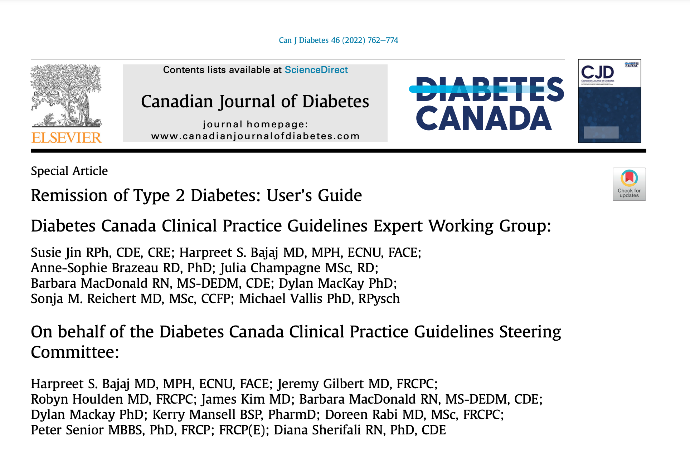
Acknowledgements
The authors are particularly grateful for the organizational, communication and editorial skills of Tracy Barnes who has contributed extensively to the quality of this manuscript. Thank you, also, to Jill Toffoli for her help editing and preparing the manuscript, in particular, her design work on the tables and figures.

Slide 5
Remission of Type 2 Diabetes: User’s Guide
Figure 1. Potential Goals and Approaches for Type 2 Diabetes
Figure 2. The Capability, Opportunity, Motivation, Behaviour (COM-B) Model
Figure 3. 5As Adapted for Remission of Type 2 Diabetes
Figure 4. Shared Decision-Making Checklist for Remission of Type 2 Diabetes
Figure 5. Low-Calorie Diet for Remission of Type 2 Diabetes
Frequently Asked Questions (FAQs)
Case-Studies
Person with a HIGH potential for remission of type 2 diabetes
Person in whose circumstances it would be advisable to proceed with CAUTION when considering remission of type 2 diabetes
Person where remission of type 2 diabetes is NOT RECOMMENDED

Slide 6
Meet MARY
50 year old female
Diagnosed with type 2 diabetes 3 years ago
Works part-time as a receptionist, typically with long hours and high stress
Activity level:
sedentary
Past medical history:
  Hypertension
  Dyslipidemia
Pertinent negatives:
No ASCVD, CHF or CKD
No retinopathy
No foot-related complications
Notes:
What are the considerations when initiating a discussion about remission of type 2 diabetes with Mary?

Slide 7
Considerations re: Remission of Type 2 Diabetes
Diagnosed with type 2 diabetes 3 years ago
Remission is more likely in people with a shorter duration of diabetes when there is preserved beta-cell function
With respect to the low-calorie diet approach, study population had diabetes duration of less than 6 years
Notes:
Harpreet will have already introduced this slide, so I won’t be speaking to it, except to touch on the 2 points

Slide 8
Meet MARY (continued)
50 year old female
Diagnosed with type 2 diabetes 3 years ago
Investigations:
A1C 8.0% (up from 7.0% one year ago)
uACR normal
LDL 1.8 mmol/L
Physical Examination:
BMI: 30 kg/m²
BP: 120/80 mmHg
Current medications:
metformin 500 mg PO BID
Perindopril 4 mg PO daily
rosuvastatin 5 mg PO qhs
Notes:
What are the considerations when initiating a discussion about remission of type 2 diabetes with Mary?
Note: Mary is not on insulin

Slide 9
Conversations re: Remission of Type 2 Diabetes
Engage Mary in shared decision-making

Slide 10
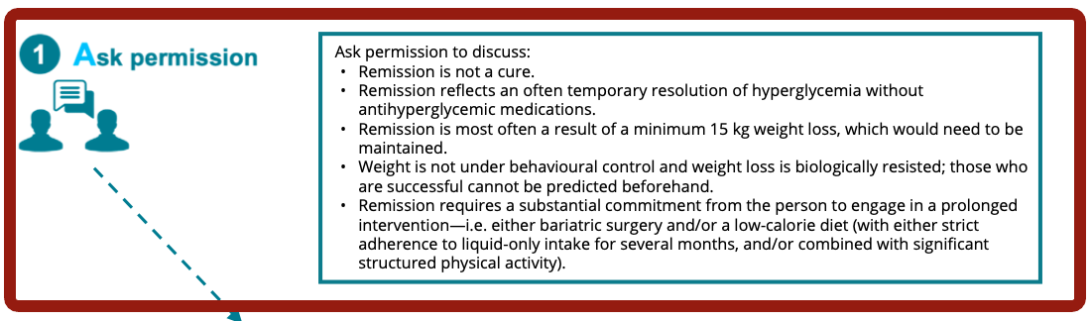
Conversations re: Remission of Type 2 Diabetes

Slide 11
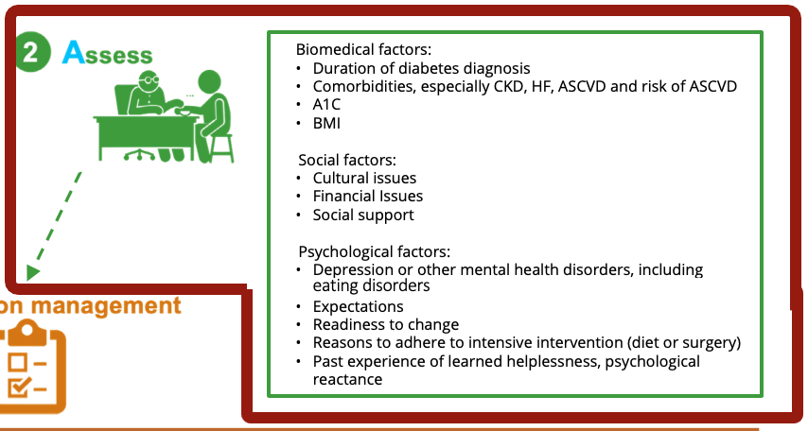
Conversations re: Remission of Type 2 Diabetes

Slide 12
Conversations re: Remission of Type 2 Diabetes
Engage Mary in shared decision-making

Slide 13
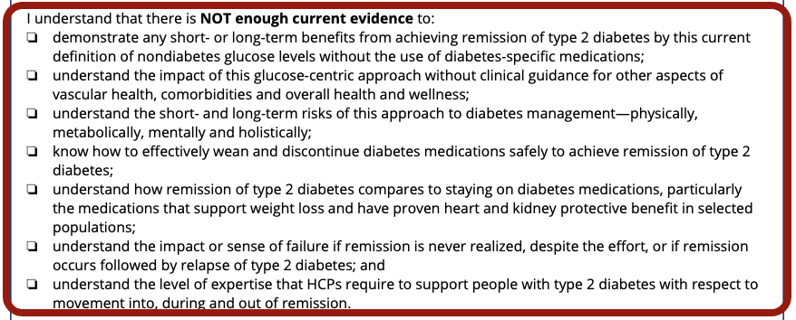
Conversations re: Remission of Type 2 Diabetes

Slide 14
Conversations re: Remission of Type 2 Diabetes
I understand that:
there is a significant amount of evidence in the Diabetes Canada clinical practice guidelines that needs to be considered in the individualized approach to my type 2 diabetes management, and these options have been discussed with me;
even if I don’t arrive at remission, through the pursuit of remission, with modest weight loss (i.e. approximately 5% to 10% of initial body weight), I could have substantial improvement in my insulin sensitivity, blood pressure and cholesterol, and improved management of glycemic targets;
there is evidence that shows the effect of stigma associated with body weight and type 2 diabetes, and I have a right to care that is free of discrimination, racism and oppression;
my diabetes plan can and needs to be adjusted at any time based on my needs and preferences; and
my quality of life is determined by me, and I am at the centre of the health-care model.

Slide 15
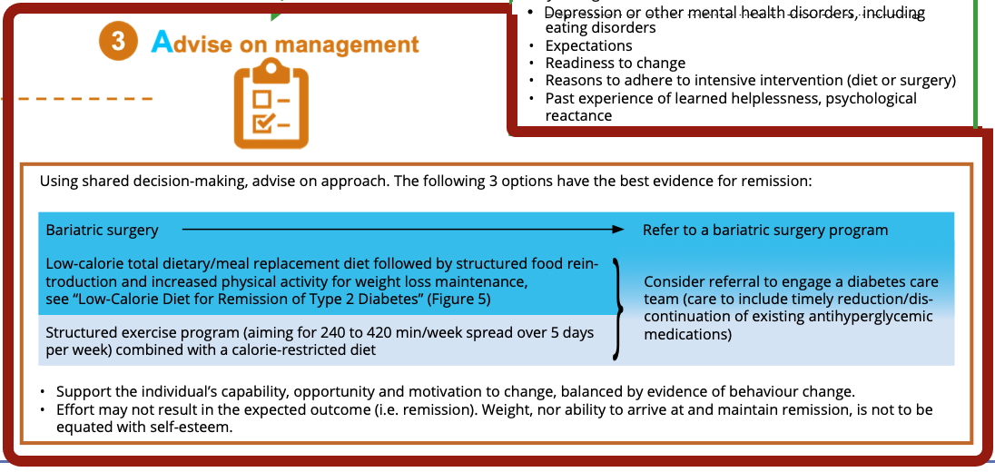
Conversations re: Remission of Type 2 Diabetes

Slide 16
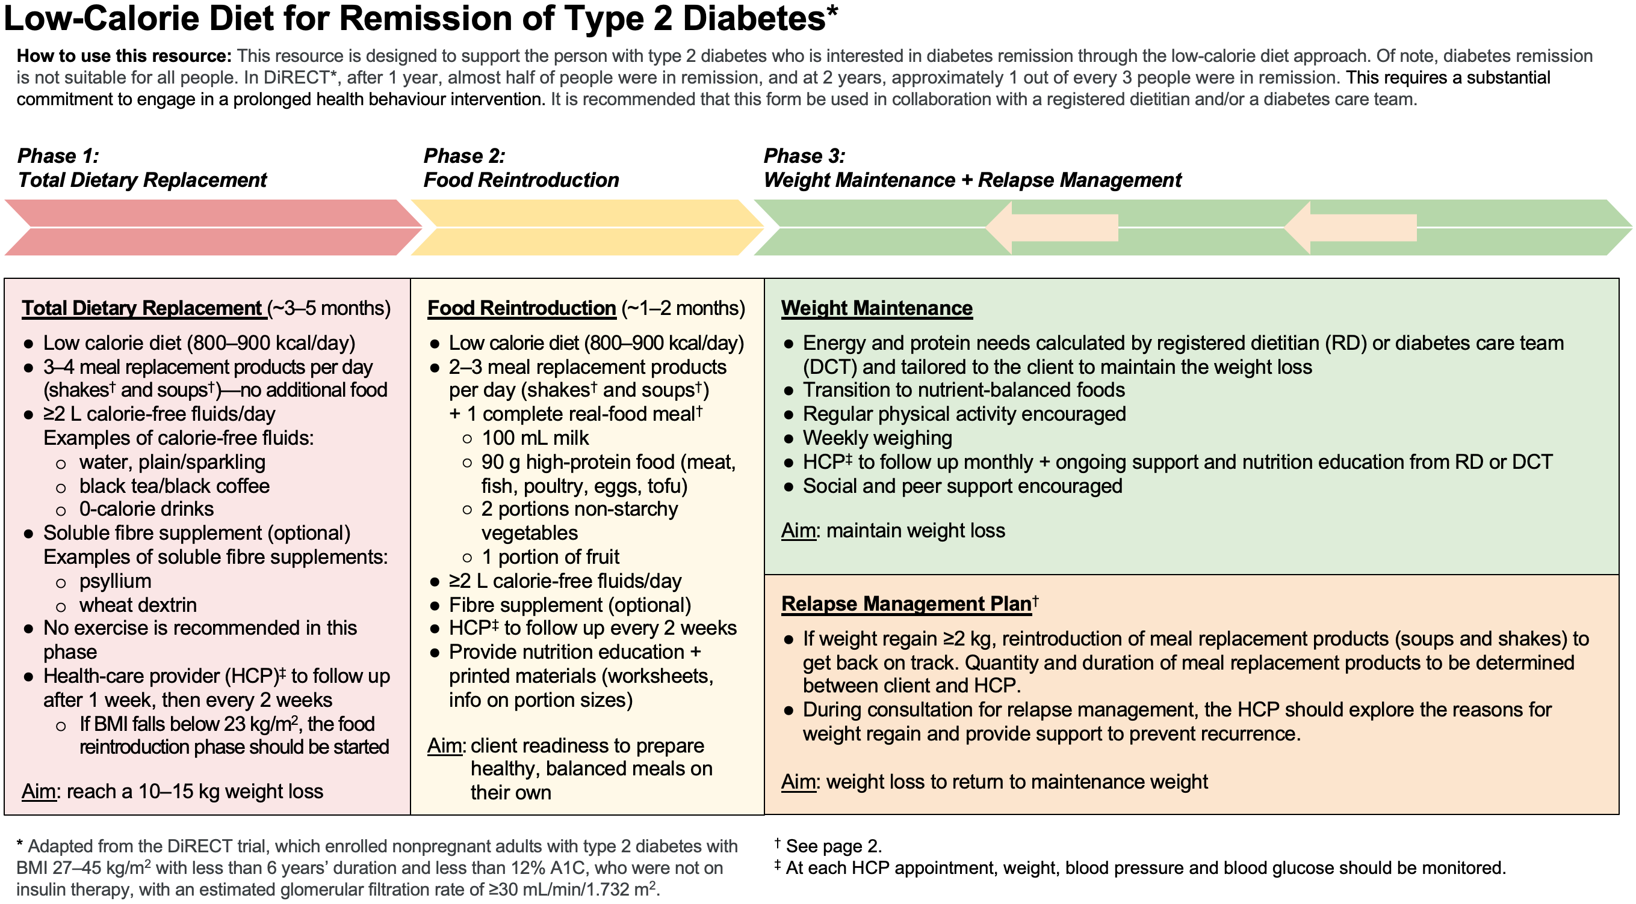
Conversations re: Remission of Type 2 Diabetes
Notes:
Canadian Food Inspection Agency requires a minimum daily caloric intake of at least 900 calories for full meal replacements

Slide 17
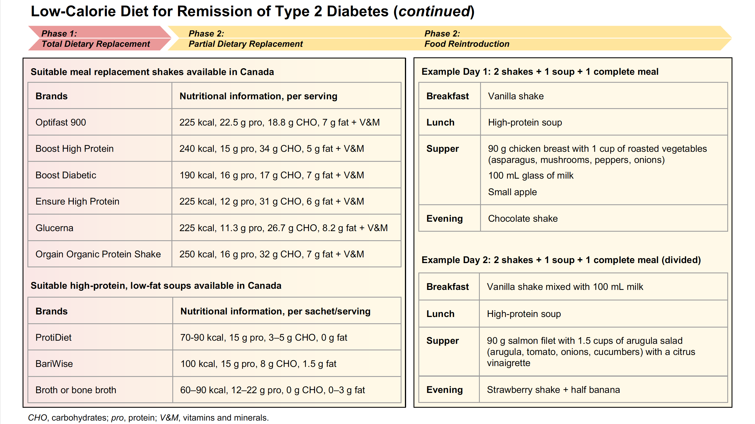
Conversations re: Remission of Type 2 Diabetes

Slide 18
Conversations re: Remission of Type 2 Diabetes
Engage Mary in shared decision-making
Notes:
Farah has tried several
different eating patterns over the years and does not wish to
engage in a low- or very-low carbohydrate diet, nor does she
feel that the “Low-Calorie Diet for Remission of Type 2 Diabetes”
(Figure 5) is the best approach for her at this time.

Slide 19
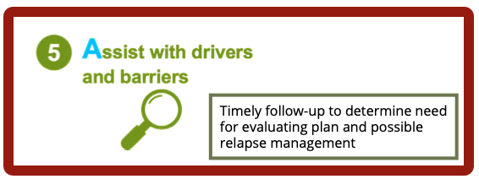
Conversations re: Remission of Type 2 Diabetes
Notes:
Farah has tried several
different eating patterns over the years and does not wish to
engage in a low- or very-low carbohydrate diet, nor does she
feel that the “Low-Calorie Diet for Remission of Type 2 Diabetes”
(Figure 5) is the best approach for her at this time.

Slide 20
MARY… with Shared Decision-Making…
Consideration | Management plan
Diagnosed with type 2 diabetes 3 years ago
BMI 30 kg/m²
Low-calorie approach to Remission of type 2 diabetes
Metformin 500mg PO BID
Low risk for hypoglycemia and weight gain
Continue metformin initially
Perindopril 4mg PO daily
Less than 55 y.o.
￫no need to consider CV risk factors to assess if indicated for CV protection
BP at target
Discontinue ACEi/ARB
Rosuvastatin 5mg PO qhs
Over 40 y.o. (even with cholesterol levels at target)
Continue statin for cardiorenal protection
No increase in physical activity during phase I of the low-calorie diet for remission of type 2 diabetes
Sedentary lifestyle
Notes:
You review with Mary that there is limited evidence on remission with bariatric surgery in those with a preoperative BMI <30 kg/m²
You consider deprescribing antihyperglycemic agent(s) as per the recommendation #2 from the Remission of type 2 diabetes chapter (Citation 15), but because Mary is taking metformin monotherapy, which has a low risk for hypoglycemia and weight gain, you suggest to continue this medication dose unchanged.
As Mary is less than 55 years of age without a specific indication for cardiovascular or renal benefit from the ACE inhibitor/ ARB, Mary’s perindopril is discontinued
Mary is over 40 years old and may benefit from a statin, even with cholesterol levels at target, for cardiorenal protection. Mary’s statin is continued

Slide 21
Meet FARAH
55 year old female
Diagnosed with type 2 diabetes 10 years ago
Works part-time as a librarian and enjoys volunteering weekly at a local hospital
Activity level:
moderately intense walking for 30 minutes, 3 times/week
resistance band full-body strength training 1 to 2 times/week
Past medical history:
  Hypertension
  Dyslipidemia
  Osteoarthritis
Pertinent negatives:
No ASCVD, CHF or CKD
No foot-related complications
Notes:
What are the considerations when initiating a discussion about remission of type 2 diabetes with Farah?

Slide 22
Meet FARAH (continued)
55 year old female
Diagnosed with type 2 diabetes 10 years ago
Investigations:
A1C 7.2% (stable for one year)
uACR normal
LDL 2.0 mmol/L
Physical Examination:
BMI: 42 kg/m²
BP: 120/80 mmHg
Current medications:
metformin 1,000 mg PO BID
perindopril/indapamide 4/1.25 mg PO daily
rosuvastatin 10 mg PO qhs
naproxen 250 mg PO BID PRN
insulin glargine U-100 40 units SC once daily
insulin glulisine 18 units SC ac meals
Notes:
What are the considerations when initiating a discussion about remission of type 2 diabetes with Farah?

Slide 23
Conversations re: Remission of Type 2 Diabetes
Assess Farah’s capability, opportunity, motivation and behaviour
using the COM-B model
Notes:
Farah feels challenged with healthy eating:
Farah eats out for every lunch while at work → you develop physical opportunity through discussing meal planning preparedness for work and home meals
You support reflective motivation by having Farah reflect on “Beliefs about consequences and capabilities”
Farah has limited knowledge of “what are healthy food choices → You grow physical capability by asking Farah what she likes to eat and increasing knowledge of healthy foods… how to buy and how to prepare and cook these healthy foods

Slide 24
FARAH… with Shared Decision-Making…
Consideration | Management plan
Diagnosed with type 2 diabetes 10 years ago
BMI 42 kg/m²
Currently on insulin
Referral to bariatric surgery program
Reduce by 20% with GLP-1 RA start. Farah to ↓ insulin further if hypoglycemia
Insulin glargine U-100 40 units SC once daily
Insulin glulisine 18 units SC ac meals
Perindopril/Indapamide 4/1.25mg PO daily
55 y.o. with hypertension and dyslipidemia
BP at target
Discontinue diuretic, continue ACEi/ARB at CV protective dose, i.e. ↑perindopril 8mg PO daily
Rosuvastatin 10mg PO qhs
Over 40 y.o. (even with cholesterol levels at target)
Continue statin for cardiorenal protection

Slide 25
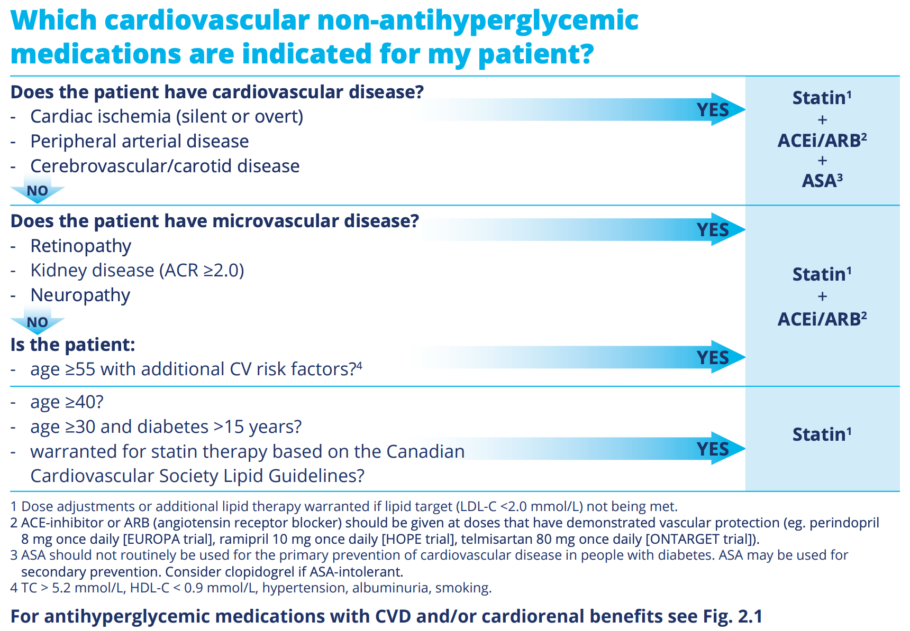
ACE / ARB for cardiovascular / renal protection
Notes:
Farah has tried several
different eating patterns over the years and does not wish to
engage in a low- or very-low carbohydrate diet, nor does she
feel that the “Low-Calorie Diet for Remission of Type 2 Diabetes”
(Figure 5) is the best approach for her at this time.

Slide 26
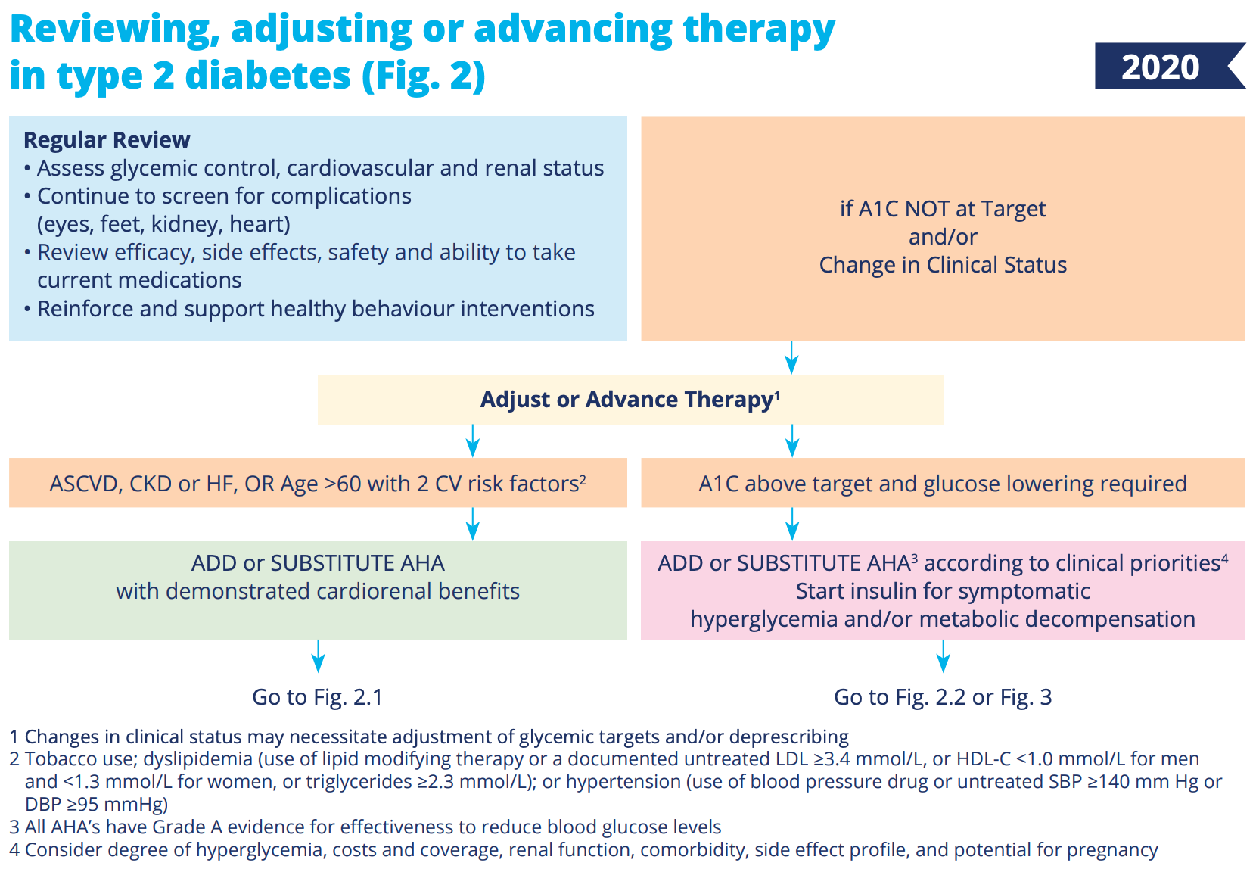
Reviewing, adjusting or advancing therapy in type 2 diabetes

Slide 27
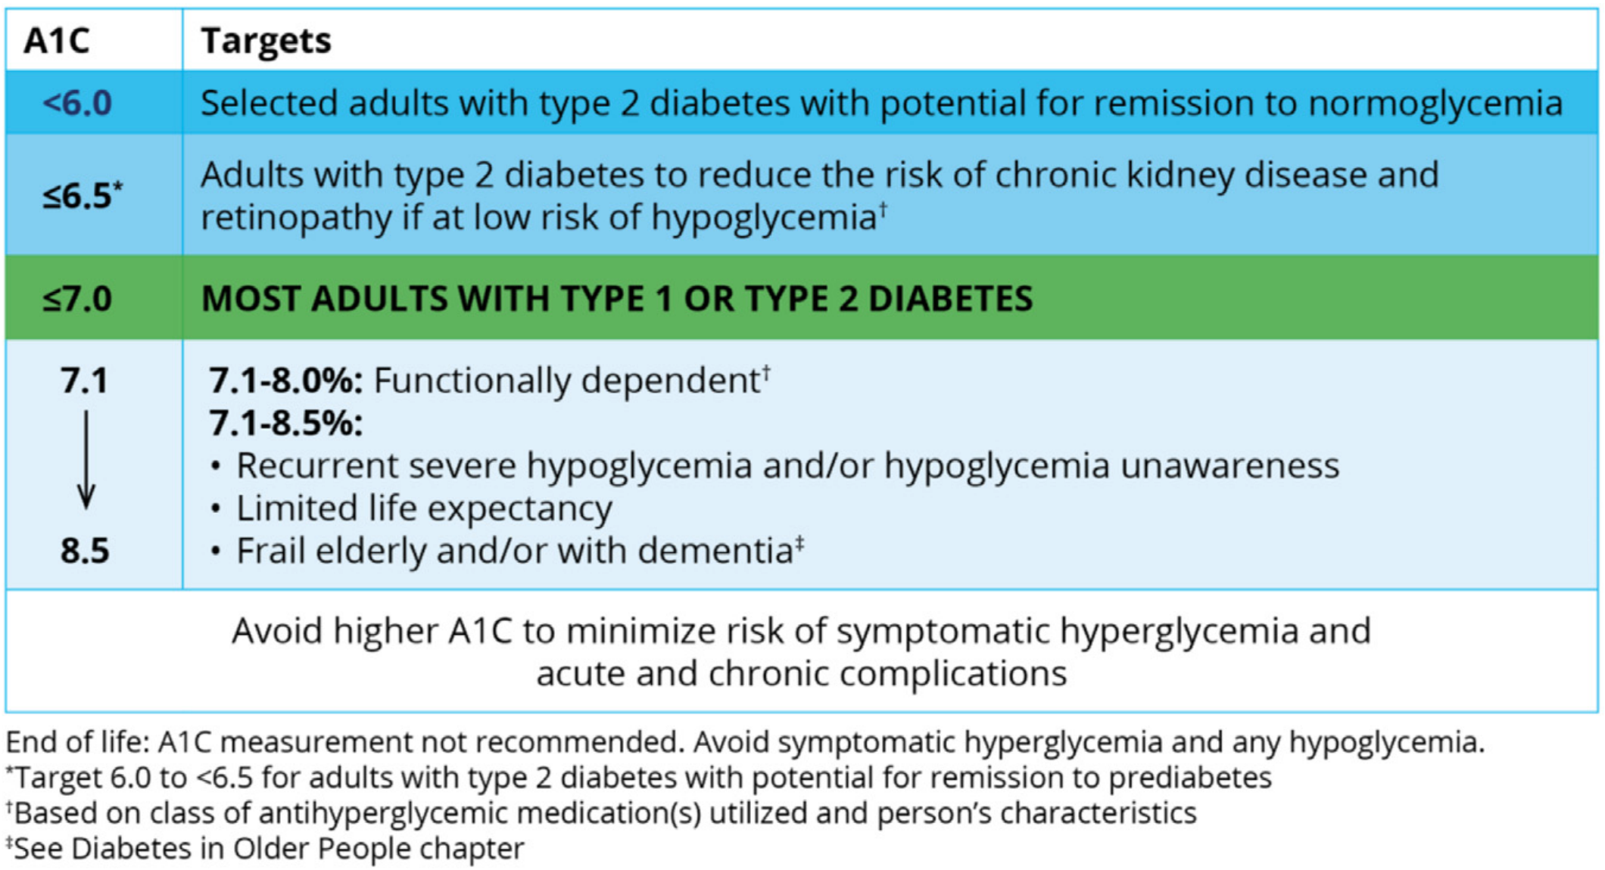
A1C Targets expanded to include the option of type 2 diabetes remission

Slide 28
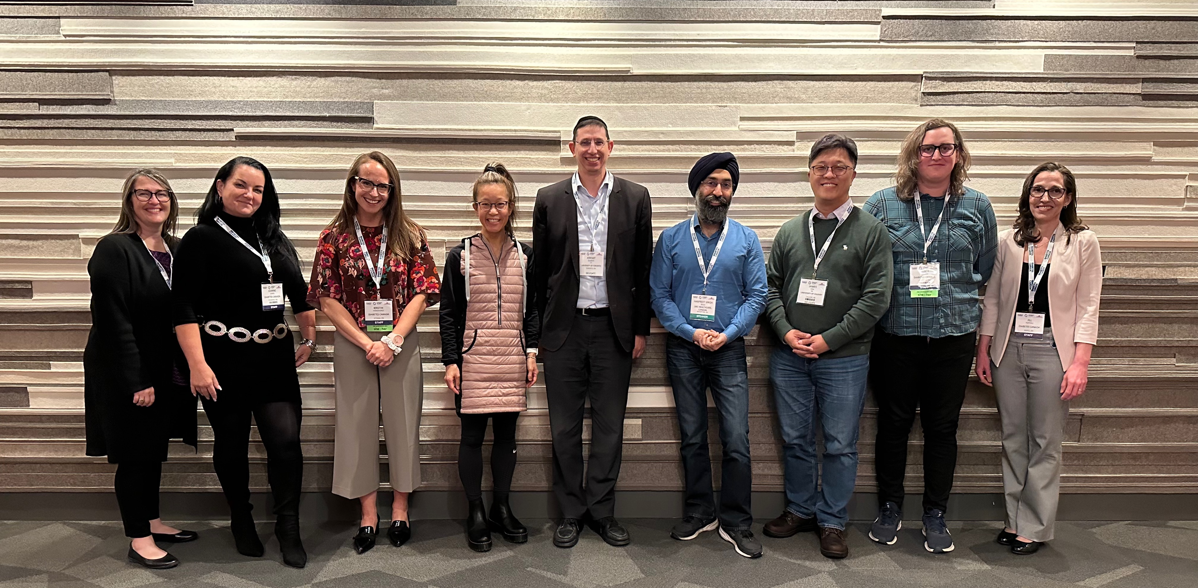
THANK YOU!
Community.diabetes.ca
Community → Community Forum
Ask a Question
Contact us
Notes:
Thank you… As Mindy Kaling wrote: I hope I have earned the privilege of your time

