Slide 1
Diabetes in Older People
2018 Clinical Practice Guidelines
Chapter 37
Graydon S. Meneilly MD, FRCPC, MACP, Aileen Knip RN, MN, CDE, David Miller MD FRCPC, Diana Sherifali RN, PhD, CDE, Daniel Tessier MD, MSc, FRCPC, Afshan Zahedi BASc, MD, FRCPC

Slide 2
Disclaimer
All Content contained on this slide deck is the property of Diabetes Canada, its content suppliers or its licensors as the case may be, and is protected by Canadian and international copyright, trademark, and other applicable laws. Diabetes Canada grants personal, limited, revocable, non-transferable and non-exclusive license to access and read content in this slide deck for personal, non-commercial and not-for-profit use only. The slide deck is made available for lawful, personal use only and not for commercial use.
The unauthorized reproduction, distribution of this copyrighted work is not permitted.
For permission to use this slide deck for commercial or any use other than personal, please contact guidelines@diabetes.ca

Slide 3
Key Changes
2018 Diabetes Canada CPG – Chapter 37. Diabetes in Older People
2018
FPG, fasting plasma glucose
New information on
  Screening with FPG and A1C
  Role of deprescribing medications in older people with diabetes

Slide 4
Diabetes in the Elderly Checklist
2018 Diabetes Canada CPG – Chapter 37. Diabetes in Older People
ASSESS for level of functional dependency (frailty)
INDIVIDUALIZE glycemic targets based on the above (A1C ≤8.5% for frail elderly) but if otherwise healthy, use the same targets as younger people
AVOID hypoglycemia in cognitive impairment
SELECT antihyperglycemic therapy carefully
  Caution with sulfonylureas or thiazolidinediones
  DPP-4 inhibitors should be used over sulfonylureas
  Basal analogues instead of NPH or human 30/70 insulin
GIVE regular diets instead of “diabetic diets” or nutritional formulas in nursing homes
Notes:
4

Slide 5
2018 Diabetes Canada CPG – Chapter 37. Diabetes in Older People
“Frailty is a widely used term associated with aging that denotes a multidimensional syndrome that gives rise to increased vulnerability”
Notes:
5

Slide 6
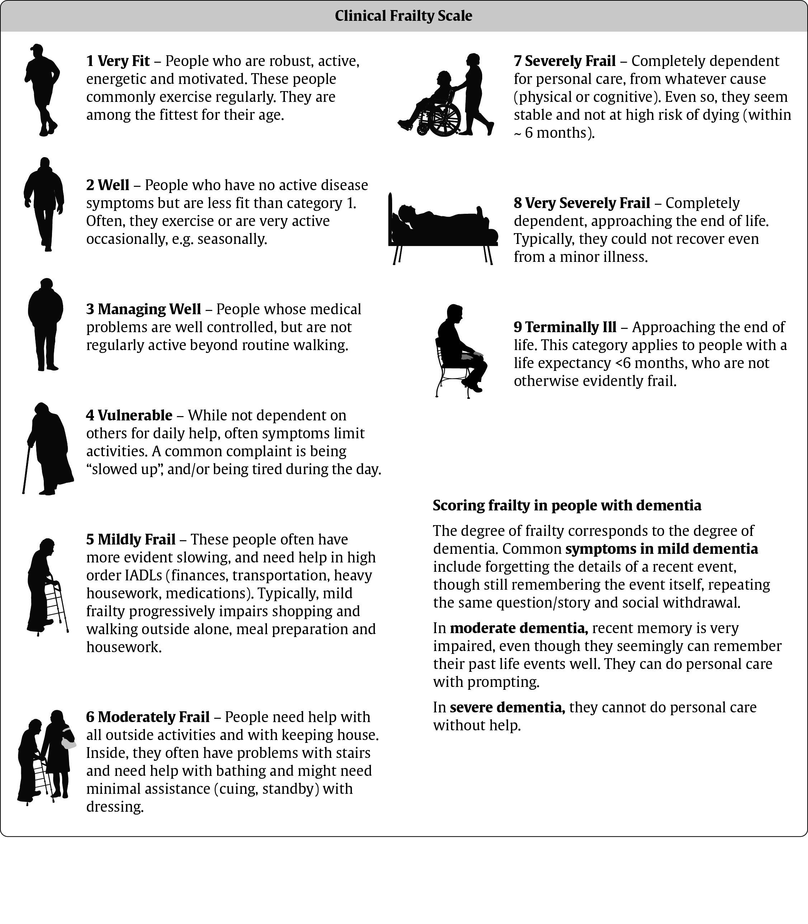
Moorhouse P, Rockwood K.
J R Coll Physicians Edinb 2012;42:333-340.
Notes:
6

Slide 7
A1C Targets
2018 Diabetes Canada CPG – Chapter 8. Targets for Glycemic Control
2018
≤6.5
Adults with type 2 diabetes to reduce the risk of CKD and retinopathy if at low risk of hypoglycemia
≤7.0
MOST ADULTS WITH TYPE 1 OR TYPE 2 DIABETES
7.1
8.5
7.1-8.0%: Functionally dependent*
7.1-8.5%:
Recurrent severe hypoglycemia and/or hypoglycemia unawareness
Limited life expectancy
Frail elderly and/or with dementia**
Avoid higher A1C to minimize risk of symptomatic hyperglycemia and acute and chronic complications
End of life
A1C measurement not recommended. Avoid symptomatic hyperglycemia and any hypoglycemia
* Based on class of antihyperglycemic medication(s) utilized and person’s characteristics
** see Diabetes in Older People chapter

Slide 8
Glycemic targets in older people with diabetes
Status | Functionally independent | Functionally dependent | Frail and/or with dementia | End of life
Clinical Frailty Index* | 1-3 | 4-5 | 6-8 | 9
A1C target Low risk hypoglycemia (ie. therapy does not include insulin or SU) | ≤7.0% | <8.0% | <8.5% | A1C measurement not recommended. Avoid symptomatic hyperglycemia or any hypoglycemia
A1C target Higher risk hypoglycemia (ie. therapy includes insulin or SU) |  | 7.1-8.0% | 7.1-8.5%
CBGM Preprandial: Postprandial: | 4-7 mmol/L 5-10 mmol/L | 5-8 mmol/L <12 mmol/L | 6-9 mmol/L <14 mmol/L | Individualized
* See slide 5. CBGM = capillary blood glucose monitoring

Slide 9
Guideline recommendations for key clinical outcomes for older people with diabetes from Diabetes Canada (DC), American Diabetes Association (ADA) and International Diabetes Federation (IDF)
Measure | ADA | DC | IDF
A1C | Healthy: <7.5% Complex/Intermediate: <8.0% Very Complex/Poor Health: <8.5% | Functionally Independent: < 7.0% Functionally Dependent: 7.1-8.0% Frail and/or Dementia: 7.1-8.5% End of Life: A1C measurement not recommended. Avoid symptomatic hyperglycemia and any hypoglycemia. | Functionally Independent: 7.0-7.5% Functionally Dependent: 7.0-8.0% Sub-level Frail: <8.5% Sub-level Dementia: <8.5% End of Life: avoid symptomatic hyperglycemia
Blood Pressure | Healthy: <140/80 mmHg Complex/Intermediate: <140/80 mmHg Very Complex/Poor Health: <150/90 mmHg | Functionally independent with life expectancy > 10 yrs: <130/80 mmHg Functionally dependent, orthostasis or limited life expectancy: individualize BP targets | Functionally Independent: <140/90 mmHg Functionally Dependent: <140/90 mmHg Sub-level Frail: <150/90 mmHg Sub-level Dementia: <140/90 mmHg End of Life: strict BP control may not be necessary
LDL-C | <1.8 mmol/L | <2.0 mmol/L | <2.0 mmol/L and adjusted based on CV risk

Slide 10

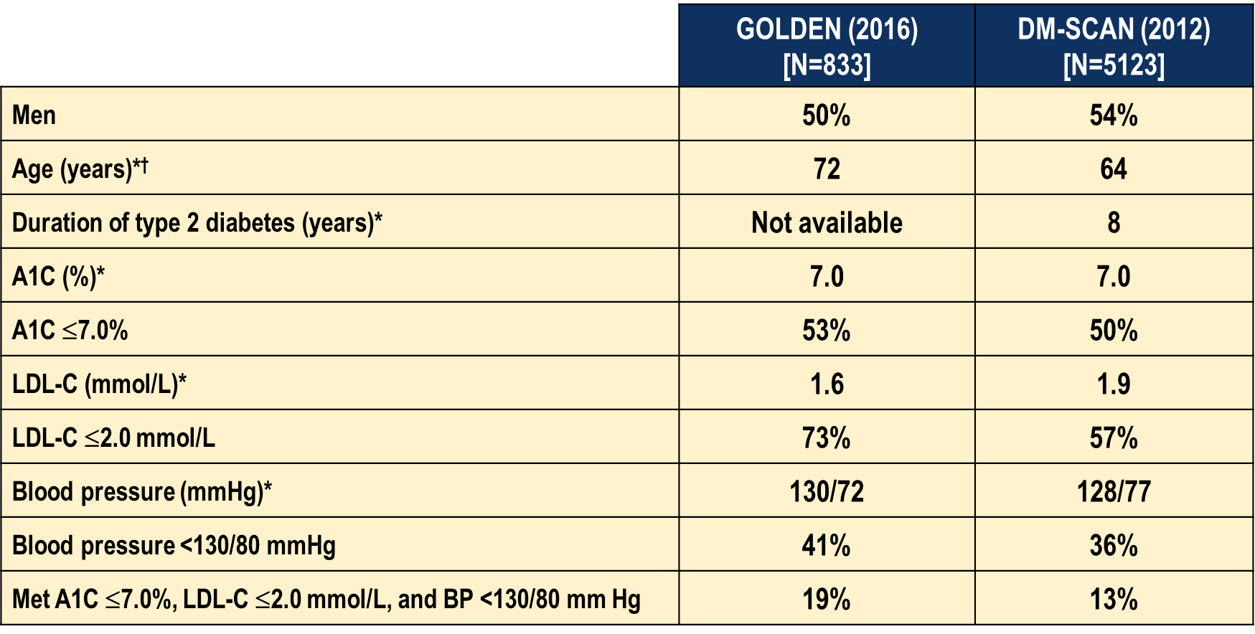
GOLDEN vs DM-SCAN
*median; †Minimum age for GOLDEN and DM-SCAN were respectively 65 years and 18 years.
Leiter L.A. et al., Can J Diabetes 37 (2013) 82-89
Meneilly G.S. et al, Can J Diabetes – in press

Slide 11
Older Patients have Less Perception of Hypoglycemia
2018 Diabetes Canada CPG – Chapter 37. Diabetes in Older People
14
12
**
10
Middle-aged (39-64 years)
Autonomic symptoms
8
6
Older
(≥65 years)
4
2
0
Baseline
Hypo
Recovery
12
10
*
8
Neuroglycopenic symptoms
6
4
2
0
Baseline
Hypo
Recovery
Bremer JP et al. Diabetes Care. 2009; 32 (8):1513-17
Notes:
Diabetes Care. 2009 Aug;32(8):1513-7. doi: 10.2337/dc09-0114. Epub 2009 Jun 1.
Hypoglycemia unawareness in older compared with middle-aged patients with type 2 diabetes.
Bremer JP, Jauch-Chara K, Hallschmid M, Schmid S, Schultes B.
Source
Department of Internal Medicine I, University of Luebeck, Luebeck, Germany.
Abstract
OBJECTIVE Older patients with type 2 diabetes are at a particularly high risk for severe hypoglycemic episodes, and experimental studies in healthy subjects hint at a reduced awareness of hypoglycemia in aged humans. However, subjective responses to hypoglycemia have rarely been assessed in older type 2 diabetic patients. RESEARCH DESIGN AND METHODS We tested hormonal, subjective, and cognitive responses (reaction time) to 30-min steady-state hypoglycemia at a level of 2.8 mmol/l in 13 older (> or =65 years) and 13 middle-aged (39-64 years) type 2 diabetic patients. RESULTS Hormonal counterregulatory responses to hypoglycemia did not differ between older and middle-aged patients. In contrast, middle-aged patients showed a pronounced increase in autonomic and neuroglycopenic symptom scores at the end of the hypoglycemic plateau that was not observed in older patients (both P < 0.01). Also, seven middle-aged patients, but only one older participant, correctly estimated their blood glucose concentration to be <3.3 mmol/l during hypoglycemia (P = 0.011). A profound prolongation of reaction times induced by hypoglycemia in both groups persisted even after 30 min of subsequent euglycemia. CONCLUSIONS Our data indicate marked subjective unawareness of hypoglycemia in older type 2 diabetic patients that does not depend on altered neuroendocrine counterregulation and may contribute to the increased probability of severe hypoglycemia frequently reported in these patients. The joint occurrence of hypoglycemia unawareness and deteriorated cognitive function is a critical factor to be carefully considered in the treatment of older patients.
11

Slide 12
2018
AT DIAGNOSIS OF TYPE 2 DIABETES
HEALTHY BEHAVIOUR INTERVENTIONS
Start healthy behaviour interventions
(nutritional therapy, weight management, physical activity) +/- metformin
A1C <1.5% above target
A1C ≥1.5% above target
Symptomatic hyperglycemia and/or metabolic decompensation
If not at glycemic target within 3 months, start/increase metformin
Start metformin immediately
Consider a second concurrent antihyperglycemic agent
Initiate insulin +/-
metformin
If not at glycemic target
If not at glycemic target
Clinical CVD?
YES
NO
Start antihyperglycemic agent with demonstrated CV benefit
empagliflozin (Grade A, Level 1A)
liraglutide (Grade A, Level 1A)
canagliflozin* (Grade C, Level 2)
If not at glycemic target
See next page
* Avoid in people with prior lower extremity amputation
Notes:
May start Metformin at the time of diagnosis
Change to 8.5% as threshold
Start metformin immediately as an option
Concept of individualizing therapy based on patient and agent characteristics
With that in mind, the next figure shows the characteristics of the agents ….

Slide 13
2018
Clinical CVD?
NO
Add additional antihyperglycemic agent best suited to the individual based on the following
CLINICAL CONSIDERATIONS
CHOICE OF AGENT
Avoidance of hypoglycemia and/or weight gain with adequate glycemic efficacy
DPP-4 inhibitor, GLP-1 receptor agonist or SGLT2 inhibitor
Other considerations:
Reduced eGFR and/or albuminuria
Clinical CVD or CV risk factors
Degree of hyperglycemia
Other comorbidities (CHF, hepatic
disease)
Planning pregnancy
Cost/coverage
Patient preference
see Renal Impairment Appendix
See Table Below

Slide 14
Add additional antihyperglycemic agent best suited to the individual by prioritizing patient characteristics (agents listed in alphabetical order by CV outcome data):
Class | Effect on CVD Outcomes | Hypo- glycemia | Weight | Relative A1C Lowering when added to metformin | Other therapeutic considerations | Cost
GLP-1R agonists | lira: Superiority in T2DM with clinical CVD exenatide LAR & lixi: Neutral | Rare | ↓↓ | ↓↓ to ↓↓↓ | GI side-effects, Gallstone disease Contraindicated with personal / family history of medullary thyroid cancer or MEN 2 Requires subcutaneous injection | $$$$
SGLT2 inhibitors | Cana & empa: Superiority in T2DM patients with clinical CVD | Rare | ↓↓ | ↓↓ to ↓↓↓ | Genital infections, UTI, hypotension, dose-related changes in LDL-C. Caution with renal dysfunction, loop diuretics, in the elderly. Dapagliflozin not to be used if bladder cancer. Rare diabetic ketoacidosis (may occur with no hyperglycemia). Increased risk of fractures and amputations with canagliflozin. Reduced progression of nephropathy & CHF hospitalizations with empagliflozin and canagliflozin in those with clinical CVD | $$$
DPP-4 Inhibitors | alo, saxa, sita: Neutral | Rare | Neutral | ↓↓ | Caution with saxagliptin in heart failure Rare joint pain | $$$
Insulin | glar: Neutral degludec: noninferior to glar | Yes | ↑↑ | ↓↓↓↓ | No dose ceiling, flexible regimens Requires subcutaneous injection | $- $$$$
Thiazolidinediones | Neutral | Rare | ↑↑ | ↓↓ | CHF, edema, fractures, rare bladder cancer (pioglitazone), cardiovascular controversy (rosiglitazone), 6-12 weeks for maximal effect | $$
α-glucosidase inhibitor (acarbose) |  | Rare | Neutral | ↓ | GI side-effects common Requires 3 times daily dosing | $$
Insulin secretagogue: Meglitinide Sulfonylurea |  | Yes Yes | ↑ ↑ | ↓↓ ↓↓ | More rapid BG-lowering response Reduced postprandial glycemia with meglitinides but usually requires 3 to 4 times daily dosing. Gliclazide and glimepiride associated with less hypoglycemia than glyburide. Poor durability | $$ $
Weight loss agent (orlistat) |  | None | ↓ | ↓ | GI side effects Requires 3 times daily dosing | $$$

Slide 15
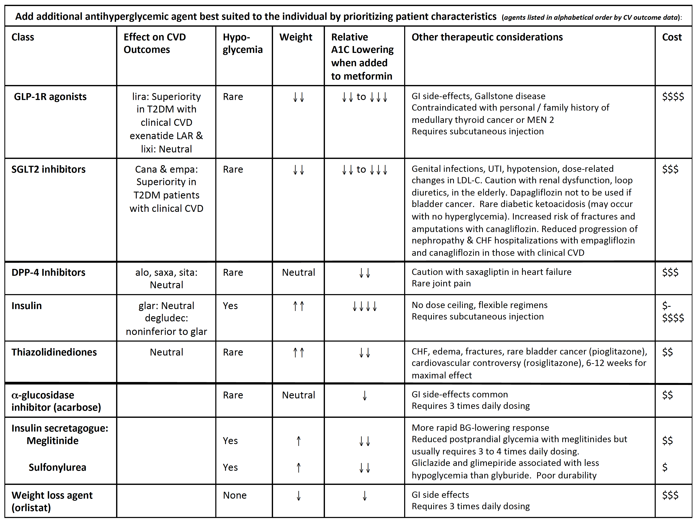
2018
If not at glycemic targets
Add another antihyperglycemic agent from a different class and/or add/intensify insulin regimen
Make timely adjustments to attain target A1C within 3-6 months

Slide 16
Antihyperglycemic Agents and Renal Function
CKD Stage
5
4
3b
3a
1 or 2
eGFR (mL/min/1.73 m²):
<15
15–29
30–44
45-59
≥ 60
Alpha-glucosidase Inhibitors
Acarbose
30
Biguanides
Metformin
30
500-1000 mg daily
45
Alogliptin
6.25 mg daily
30
12.5 mg daily
60
Linagliptin
15
DPP-4 Inhibitors
15
2.5 mg daily
50
Saxagliptin
Sitagliptin
25 mg daily
30
50 mg daily
50
Dulaglutide
15
GLP-1 Receptor Agonists
Exenatide
30
50
Exenatide QW
30
50
Liraglutide
15
Lixisenatide
30
Gliclazide
30
60
Glimepiride
30
60
Insulin Secretagogues
60
Glyburide
Repaglinide
60
Canagliflozin
25
45
100 mg daily
60*
SGLT2 Inhibitors
Dapagliflozin
60
Empagliflozin
45
60*
Pioglitazone
60
Thiazolidinediones
Rosiglitazone
Fluid retention
60
Insulins
30
Use alternative agent
Dose adjustment required
Caution
Do not initiate
Dose adjustment not required
*May be considered when indicated for CV and renal protection with eGFR< 60 but >30 ml/min/1.73²

Slide 17
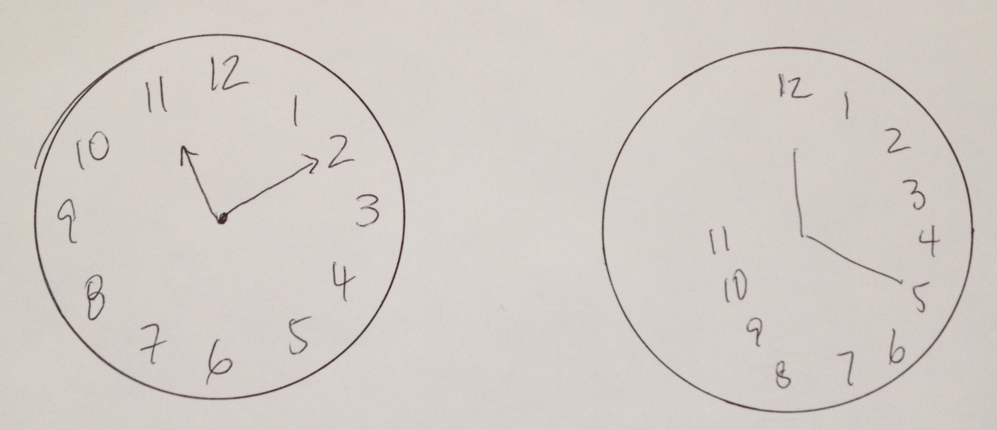
If Choosing to Use Insulin …
2018 Diabetes Canada CPG – Chapter 37. Diabetes in Older People
Clock drawing test can be used to predict who is likely to have problems with insulin therapy
“Write numbers on the blank clock face and draw hands on the clock to show 10 minutes past 11 o’clock”
Trimble LA et al. Can J Diabetes 2005;29(2):102-104.
Notes:
http://www.diabetes.ca/publications/cjd/2005/06/
17

Slide 18
Diabetes in Long-Term Care (LTC)
2018 Diabetes Canada CPG – Chapter 37. Diabetes in Older People
Under nutrition is a problem in people with diabetes living in LTC
“Regular diets” may be used in LTC instead of “diabetic diets” or “diabetic nutritional formulas”
Mooradian AD et al. J Am Geriatr Soc 1988;36:391-396
Coulston AM et al. Am J Clin Nutr 1990;51:67-71.
Notes:
18

Slide 19
Recommendation 1
2018 Diabetes Canada CPG – Chapter 37. Diabetes in Older People
2018
Functionally independent older people with diabetes who have a life expectancy of greater than 10 years should be treated to achieve the same glycemic, BP and lipid targets as younger people with diabetes [Grade D, Consensus]
BP, blood pressure

Slide 20
Recommendation 2
2018 Diabetes Canada CPG – Chapter 37. Diabetes in Older People
2018
2. BP targets should be individualized for older adults who are functionally dependent, or who have orthostasis, or who have a limited life expectancy [Grade D, Consensus]
BP, blood pressure

Slide 21
Recommendation 3
2018 Diabetes Canada CPG – Chapter 37. Diabetes in Older People
2018
3. In the older person with diabetes and multiple comorbidities and/or frailty, strategies should be used to strictly prevent hypoglycemia, which include the choice of antihyperglycemic therapy and less stringent A1C target [Grade D, Consensus]. Antihyperglycemic agents that increase the risk of hypoglycemia or have other side effects should be discontinued in these people [Grade C, Level 3]

Slide 22
Recommendation 4
2018 Diabetes Canada CPG – Chapter 37. Diabetes in Older People
2018
4. A higher A1C target may be considered in older people with diabetes taking antihyperglycemic agent(s) with risk of hypoglycemia, with any of the following: [Grade D, Consensus for all]
  Functionally dependent : 7.1-8.0%
  Frail and/or with dementia : 7.1-8.5%
  End of life: A1C measurement not recommended. Avoid symptomatic hyperglycemia and any hypoglycemia

Slide 23
Recommendation 5
2018 Diabetes Canada CPG – Chapter 37. Diabetes in Older People
5. The clock drawing test may be used to predict which older individuals will have difficulty learning to inject insulin [Grade C, Level 3]

Slide 24
Recommendation 6
2018 Diabetes Canada CPG – Chapter 37. Diabetes in Older People
2018
6. Older people who are able should receive diabetes education with an emphasis on tailored care and psychological support [Grade A, Level 1A]

Slide 25
Recommendation 7
2018 Diabetes Canada CPG – Chapter 37. Diabetes in Older People
7. If not contraindicated, older people with type 2 diabetes should perform aerobic exercise and/or resistance training to improve glycemic control as well as maintain functional status and reduce the risk of frailty [Grade B, Level 2]

Slide 26
Recommendation 8
2018 Diabetes Canada CPG – Chapter 37. Diabetes in Older People
2018
8. In older people with type 2 diabetes, sulfonylureas should be used with caution because the risk of hypoglycemia increases substantially with age [Grade D, Level 4]
  DPP-4 inhibitors should be used over sulfonylureas as second line therapy to metformin, because of a lower risk of hypoglycemia [Grade B, Level 2]
  In general, initial doses of sulfonylureas in the older person should be half of those used for younger people, and doses should be increased more slowly [Grade D, Consensus]
  Gliclazide and gliclazide MR [Grade B, Level 2] and glimepiride [Grade C, Level 3] should be used instead of glyburide, as they are associated with a reduced frequency of hypoglycemic events
  Meglitinides may be used instead of glyburide to reduce the risk of hypoglycemia [Grade C, Level 2 for repaglinide; Grade C, Level 3 for nateglinide], particularly in individuals with irregular eating habits [Grade D, Consensus]

Slide 27
Recommendation 9
2018 Diabetes Canada CPG – Chapter 37. Diabetes in Older People
2018
9. In older people with type 2 diabetes with no other complex comorbidities but with clinical CV disease and in whom glycemic targets are not achieved with existing antihyperglycemic medication(s) and with an eGFR >30 mL/min/1.73 m², an antihyperglycemic agent with demonstrated CV outcome benefit could be added to reduce the risk of major CV events [Grade A, Level 1A for empagliflozin; Grade A, Level 1A for liraglutide; Grade C, Level 2 for canagliflozin]
CV, cardiovascular; eGFR, estimated glomerular filtration

Slide 28
Recommendation 10-11
2018 Diabetes Canada CPG – Chapter 37. Diabetes in Older People
2018
Detemir, glargine U-100 and U-300 and degludec may be used instead of NPH or human 30/70 insulin to lower the frequency of hypoglycemic events [Grade B, Level 2 for glargine U-100; Grade B, Level 2 for detemir; Grade D, Consensus for degludec and glargine U-300]
In older people, premixed insulins and preﬁlled insulin pens should be used to reduce dosing errors and to potentially improve glycemic control [Grade B, Level 2]

Slide 29
Recommendations 11-12
2018 Diabetes Canada CPG – Chapter 37. Diabetes in Older People
In older LTC residents, regular diets may be used instead of “diabetic diets” or nutritional formulas [Grade D, Level 4]
Sliding scale (reactive) and correction (supplemental) insulin protocols should be avoided in elderly LTC residents with diabetes to prevent worsening glycemic control [Grade C, Level 3]
LTC, long-term care

Slide 30
Key Messages
2018 Diabetes Canada CPG – Chapter 37. Diabetes in Older People
Diabetes in older people is distinct from diabetes in younger people and the approach to therapy should be different. This is especially true in those who have functional dependence, frailty, dementia or who are end of life. This chapter focuses on these individuals. Personalized strategies are needed to avoid overtreatment of the frail elderly
In the older person with diabetes and multiple comorbidities and/or frailty, strategies should be used to strictly prevent hypoglycemia, which include the choice of antihyperglycemic therapy and a less stringent A1C target

Slide 31
Key Messages
2018 Diabetes Canada CPG – Chapter 37. Diabetes in Older People
Sulfonylureas should be used with caution because the risk of hypoglycemia increases significantly with age
DPP-4 inhibitors should be used over sulfonylureas because of a lower risk of hypoglycemia
Long-acting basal analogues are associated with a lower frequency of hypoglycemia than intermediate-acting or premixed insulin in this age group

Slide 32
Key Messages for Older People with Diabetes
2018 Diabetes Canada CPG – Chapter 37. Diabetes in Older People
No two older people are alike and every older person with diabetes needs a customized diabetes care plan. What works for one individual may not be the best course of treatment for another. Some older people are healthy and can manage their diabetes on their own, while others may have one or more diabetes complications. Others may be frail, have memory loss, and/or have several chronic diseases in addition to diabetes
Based on the factors mentioned above, your diabetes health-care team will work with you and your caregivers to select target blood glucose and A1C levels, appropriate glucose lowering medications, and a program for screening and management of diabetes related complications

Slide 33

Visit guidelines.diabetes.ca

Slide 34


Or download the App

Slide 35
Diabetes Canada Clinical Practice Guidelines
http://guidelines.diabetes.ca – for health-care providers
1-800-BANTING (226-8464)
http://diabetes.ca – for people with diabetes
Notes:
35

