Slide 1
2018 Clinical Practice Guidelines
Weight Management in Diabetes
Chapter 17
Sean Wharton MD FRCPC PharmD, Sue D. Pedersen MD FRCPC, David C.W.
Lau MD PhD FRCPC, Arya M. Sharma MD PhD FRCPC
Notes:
SP: I corrected author order
1

Slide 2
Disclaimer
All Content contained on this slide deck is the property of Diabetes Canada, its content suppliers or its licensors as the case may be, and is protected by Canadian and international copyright, trademark, and other applicable laws. Diabetes Canada grants personal, limited, revocable, non-transferable and non-exclusive license to access and read content in this slide deck for personal, non-commercial and not-for-profit use only. The slide deck is made available for lawful, personal use only and not for commercial use.
The unauthorized reproduction, distribution of this copyrighted work is not permitted.
For permission to use this slide deck for commercial or any use other than personal, please contact guidelines@diabetes.ca

Slide 3
Key Changes
2018 Diabetes Canada CPG – Chapter 17. Weight Management in Diabetes
2018
Patient First Language:
  “people with overweight or obesity” (in place of “overweight or obese people”)
New information on:
  Effective pharmacotherapy for chronic weight management
  Effects of bariatric surgery in people with diabetes and obesity, with longer term follow-up
Notes:
SP: Deleted – (see comments)
“healthy behaviour interventions” (in place of “lifestyle modification”)
“bariatric” surgery (in place of “metabolic surgery”)
I added new text in red

Slide 4
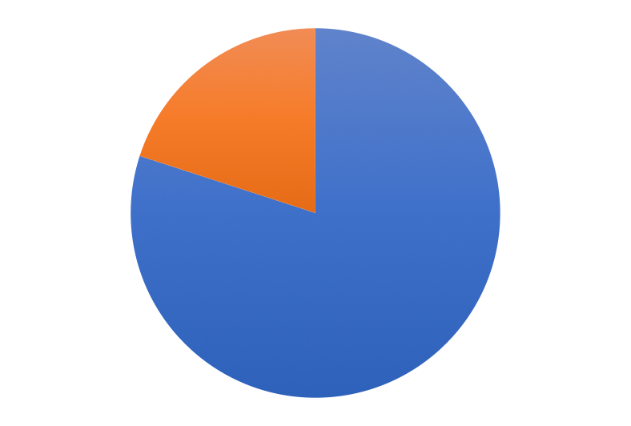
The Growing Epidemic
2018 Diabetes Canada CPG – Chapter 17. Weight Management in Diabetes
80-90% of people with type 2 diabetes have overweight or obesity*
Some antihyperglycemic therapies contribute to weight gain
Higher BMI increases mortality
Overweight and Obesity
Overweight or Obesity
But, weight loss of 5-10% can improve glycemic control!
*Wing RR. Weight loss in the management of type 2 diabetes. In: Gerstein HC, Haynes B editor(s). Evidence-Based Diabetes Care. Ontario, Canada: B.C. Decker, Inc, 2000:252–76.
BMI, body mass index
Notes:
SP: changed ‘obese’ to ‘obesity’ in the diagram
4

Slide 5
Canadian guidelines for body weight classification in adults using BMI
2018 Diabetes Canada CPG – Chapter 17. Weight Management in Diabetes
Classification | BMI* category (kg/m²) | Risk of developing health problems
Underweight | <18.5 | Increased
Healthy weight | 18.5-24.9 | Least
Overweight | 25.0-29.9 | Increased
Obesity Class I Class II Class III | ≥30.0 30.0-34.9 35.0-39.9 ≥40.0 | High Very High Extremely High
*BMI values are age and gender independent, and may not be correct for all ethnic populations
BMI, body mass index
Notes:
SP: changed ‘normal’ to ‘healthy’

Slide 6
Assessing the Problem
2018 Diabetes Canada CPG – Chapter 17. Weight Management in Diabetes
Height, weight, BMI, WC
Hypertension, dyslipidemia and CVD
WC & risk of developing health problems
WC cutoff points*† | Risk of developing health problems
Men ≥102 cm | Increased
Women ≥88 cm | Increased
*WC cutoffs may be lower in some populations [e.g., older individuals, Asian population, especially in the presence of the metabolic syndrome (such as hypertriglyceridemia)
†Increased WC can also be a marker for increased risk, even in persons with normal weight
BMI, body mass index; CVD, cardiovascular disease; WC, waist circumference
Notes:
6

Slide 7
Ethnic-specific values for waist circumference
2018 Diabetes Canada CPG – Chapter 17. Weight Management in Diabetes
Country or ethnic group | Central obesity as defined by WC
 | Men | Women
Europid* | ≥94 cm | ≥80 cm
South Asian, Chinese, Japanese | ≥90 cm | ≥80 cm
South and Central American | Use South Asian cutoff points until more specific data are available
Sub-Saharan African | Use Europid cutoff points until more specific data are available
Eastern Mediterranean and Middle East (Arab) | Use Europid cutoff points until more specific data are available
*NCEP-ATP III guidelines {#49719; #25158} and Health Canada {#49787} define central obesity as WC values ≥102 cm in men and ≥88 cm in women
WC, waist cirumference
Notes:
SP: added ‘in women’ at bottom

Slide 8
Weight loss is achievable with appropriate intervention
2018 Diabetes Canada CPG – Chapter 17. Weight Management in Diabetes
Goal is to prevent weight gain, promote weight loss and prevent weight re-gain
Weight loss of 5-10% improves:
  Insulin sensitivity and glycemic control
  BP and TG levels
Adjustments in medications may include:
  decreasing weight gaining medications
  adding medications that promote weight loss
BP, blood pressure; TG, triglyceride
Notes:
SP: note to presenter – usually need greater weight losses (10%) to improve OSA
8

Slide 9
Treatment Strategies
2018 Diabetes Canada CPG – Chapter 17. Weight Management in Diabetes
Healthy behaviour interventions
  Diet, activity and psychological treatments
Pharmacotherapy
Bariatric surgery
Notes:
9

Slide 10
Healthy Behaviour Interventions: (Combined Diet, Physical Activity, and Behavioural Therapy)
2018 Diabetes Canada CPG – Chapter 17. Weight Management in Diabetes
Structured interprofessional programs and group programs work best
Dietary plans should be evidence based and nutritionally adequate
Carbohydrate reduction can be beneficial
Increased, regular, appropriate physical activity
Reasonable weight loss goals of 2-4 kg/month
Notes:
SP: I changed title from
Combined Diet, Physical Activity, and Behavioural Therapy are Most Effective
to the above. The way it was written, it sounds like we are saying lifestyle is most effective, more so than meds or surgery (I noticed this in the summary slide so I changed it there too)
deleted:
Very low calorie diet (<900kCal/d) discouraged
Adequate carbohydrate (>100g/d), adequate protein, high fibre, low fat are preferred
SP to SEAN: what do you think about including the ‘mod CHO’ phrase? I think we should take the opportunity to speak out against enforcing a minimum 45% CHO
SP: I deleted 0.45-1kg/week and entered 1-2kg/month as per our table 4
10

Slide 11
Pharmacotherapy for weight management
2018 Diabetes Canada CPG – Chapter 17. Weight Management in Diabetes
BMI ≥ 30 kg/m², or BMI ≥27 kg/m² with comorbidities, in whom healthy behavior interventions have been unsuccessful or insufficient for improvement in health
These agents can improve glycemic control and can reduce doses of antihyperglycemic agents that promote weight gain
BMI, body mass index
Notes:
SP : I created this slide
11

Slide 12
Medications approved for the treatment of obesity in type 2 diabetes
2018 Diabetes Canada CPG – Chapter 17. Weight Management in Diabetes
Class | Relative weight loss | Side Effects | Therapeutic Considerations | Cost
Gastrointestinal lipase inhibitor (orlistat) | ↓ | Loose stools, GI upset, rare liver failure | Oral medication, decreases fat absorption, may require vitamin supplementation | $$$
GLP-1 receptor agonist (liraglutide 3.0 mg) | ↓↓ | Nausea, GI upset, rare gallstones and pancreatitis | Subcutaneous injectable, increases satiety | $$$$

Slide 13
Consider Weight Effects When Selecting Antihyperglycemic Medications
2018 Diabetes Canada CPG – Chapter 17. Weight Management in Diabetes
Weight Gain | Weight Effect (kg)
Insulin | +0 to 5
TZDs | +2.5 to 5
Sulfonylureas | +0.5 to 1.5
Meglitinides | + 0.7 to 1.8
Weight Neutral or Decrease Weight | Weight Effect (kg)
Metformin | neutral
α-Glucosidase inhibitors | neutral
DPP-4 inhibitors | neutral
GLP-1 receptor agonists | -1.6 to 3
SGLT2 inhibitors | -2 to 3
Table 1 of Pharmacologic Glycemic Management of Type 2 Diabetes chapter 2018
Notes:
13

Slide 14
Bariatric Surgery
(for patients with diabetes and obesity)
2018 Diabetes Canada CPG – Chapter 17. Weight Management in Diabetes
Criteria:
  BMI ≥ 40 kg/m²
  BMI 35.0-39.9 kg/m² with comorbidities
Type 2 diabetes control or remission is higher with Roux-en-Y gastric bypass, gastric sleeve, and BPD, compared to gastric banding
Post surgery clinicians should follow patients long term and screen for recurrence, esp if there is weight regain
Bariatric surgery is inadequately studied in patients with BMI 30-35 kg/m² and type 1 diabetes
BMI, body mass index; BPD, bilipancreatic diversion
Notes:
Note to speaker: BMI indications - with inability to achieve weight loss maintenance with healthy behavior intervention and/or pharmacotherapy
Note to speaker: Predictors of likelihood of remission of type 2 diabetes after
bariatric surgery include higher preoperative serum C-peptide,
younger age, shorter duration of diabetes and lack of need for insulin
therapy preoperatively
14

Slide 15
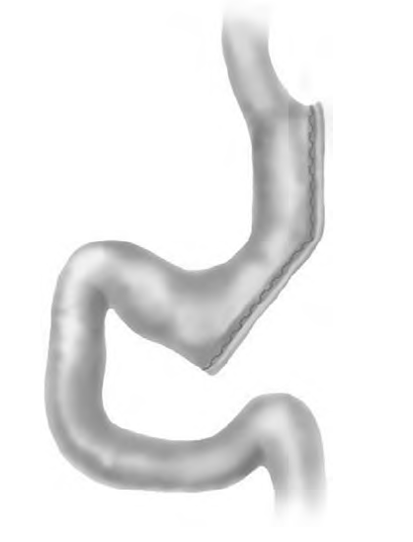
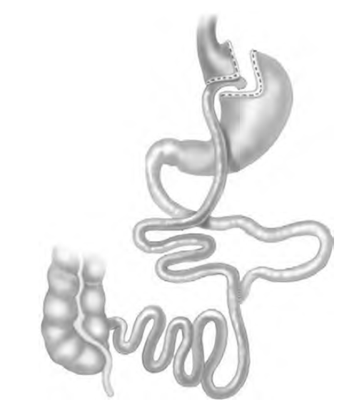
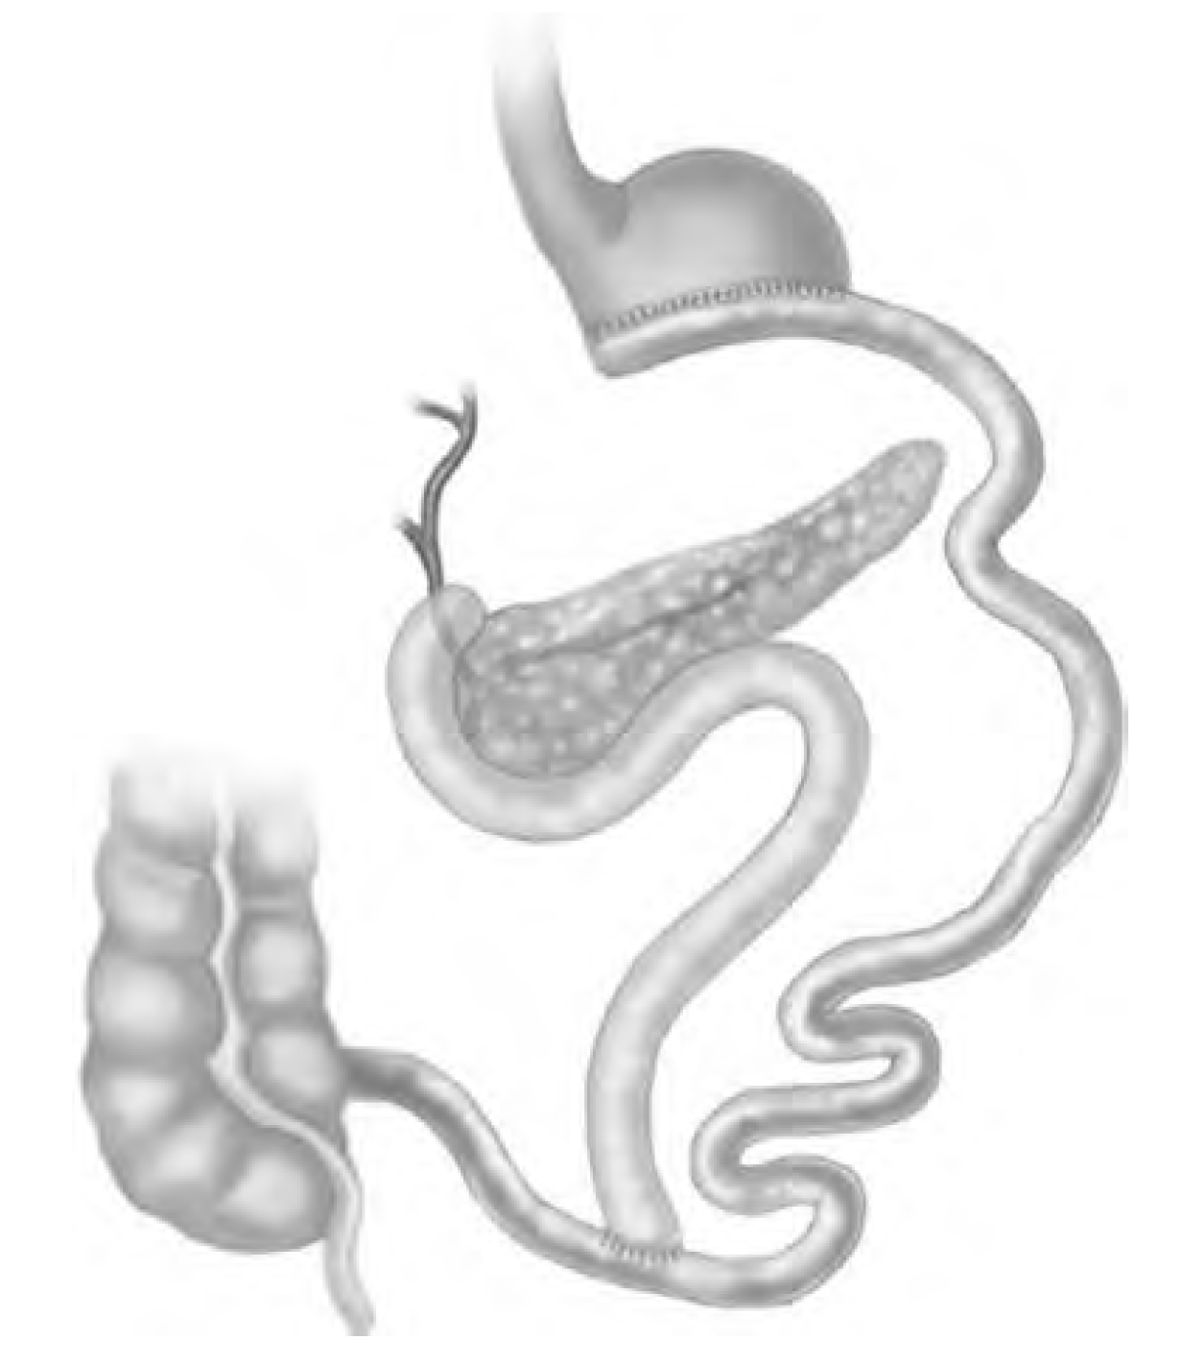
Types of bariatric surgery
2018 Diabetes Canada CPG – Chapter 17. Weight Management in Diabetes
Gastric Sleeve
Longitudinal resection of stomach reduces functional capacity of the stomach and eliminates the ghrelin-rich gastric fundus
Roux-en-Y Gastric Bypass
Small gastric pouch created. Ingested food bypasses ~95% of the stomach, entire duodenum and portion of jejunum
Biliopancreatic Diversion
Stomach & small intestine surgically reduced so nutrients absorbed ony in 50cm common limb

Slide 16
2018 Diabetes Canada CPG – Chapter 17. Weight Management in Diabetes
Checklist for weight management programs
The program assesses and treats comorbid conditions. The program recommends healthy behaviour modifications, and pharmacotherapy or surgery for those who qualify. The program provides individualized nutritional, physical activity and behavioral programs and counseling. Reasonable weight loss goals are set at 1-2 kg/month. Cost is not prohibitive. There is no requirement to buy products, supplements, vitamins or injections. The program does not make unsubstantiated claims. The program provides access to a weight maintenance program.
Adapted from Freedhoff Y, Sharma AM. Best weight: a practical guide to office-based obesity management. Edmonton, AB: Network CO; 2010

Slide 17
Recommendation 1
2018 Diabetes Canada CPG – Chapter 17. Weight Management in Diabetes
For people with overweight or obesity who have or are at risk for diabetes, an interprofessional weight management program is recommended to prevent weight gain and improve CV risk factors [Grade A, Level 1A]
CV, cardiovascular

Slide 18
Recommendation 2
2018 Diabetes Canada CPG – Chapter 17. Weight Management in Diabetes
2018
2. Weight management medication may be considered in people with diabetes and overweight or obesity to promote weight loss and improved glycemic control [Grade A, Level 1A for liraglutide; Grade A, Level 1A for orlistat]

Slide 19
Recommendation 3
2018 Diabetes Canada CPG – Chapter 17. Weight Management in Diabetes
3. In adults with type 2 diabetes and overweight or obesity, the effect of antihyperglycemic agents on body weight should be considered when selecting pharmacotherapy [Grade D, Consensus]

Slide 20
Recommendation 4
2018 Diabetes Canada CPG – Chapter 17. Weight Management in Diabetes
2018
4. Bariatric surgery may be considered for selected adults with type 2 diabetes and obesity with BMI ≥35.0 kg/m² when healthy behaviour interventions with or without weight management medication(s) are inadequate in achieving target glycemic control or healthy weight goals [Grade A, Level 1A]
BMI, body mass index

Slide 21
Key Messages
2018 Diabetes Canada CPG – Chapter 17. Weight Management in Diabetes
Sustained weight loss of >5% of initial body weight can improve glycemic control and CV risk factors
In people with diabetes and obesity, weight loss and A1C lowering can be achieved with healthy behaviour interventions as the cornerstone of treatment.
Weight management medications can improve glycemic and metabolic control in people with diabetes and obesity
Bariatric surgery may be considered for appropriate people with diabetes and obesity
When selecting the most appropriate antihyperglycemic agent(s) for a person with diabetes, the effect on body weight should be considered
CV, cardiovascular

Slide 22
Key Messages for People with Diabetes
2018 Diabetes Canada CPG – Chapter 17. Weight Management in Diabetes
When you have diabetes, having overweight or obesity increases your risk for complications
Healthy behaviour modifications, including regular physical activity and eating well can help with your blood glucose control and reduce your risk for other health problems associated with diabetes
Your diabetes health-care team can help you with weight management. For some people with diabetes, weight management medications and bariatric surgery may be helpful

Slide 23

Visit guidelines.diabetes.ca

Slide 24


Or download the App

Slide 25
Diabetes Canada Clinical Practice Guidelines
http://guidelines.diabetes.ca – for health-care providers
1-800-BANTING (226-8464)
http://diabetes.ca – for people with diabetes

