Slide 1
Chronic Kidney Disease in Diabetes
2018 Clinical Practice Guidelines
Chapter 29
Philip McFarlane MD FRCPC
David Cherney MD PhD FRCPC
Richard E. Gilbert MBBS PhD FACP FRACP FRCPC
Peter Senior MBBS PhD FRCP
Updated: April 27, 2018

Slide 2
Disclaimer
All Content contained on this slide deck is the property of Diabetes Canada, its content suppliers or its licensors as the case may be, and is protected by Canadian and international copyright, trademark, and other applicable laws. Diabetes Canada grants personal, limited, revocable, non-transferable and non-exclusive license to access and read content in this slide deck for personal, non-commercial and not-for-profit use only. The slide deck is made available for lawful, personal use only and not for commercial use.
The unauthorized reproduction, distribution of this copyrighted work is not permitted.
For permission to use this slide deck for commercial or any use other than personal, please contact guidelines@diabetes.ca

Slide 3
Key Changes
2018 Diabetes Canada CPG – Chapter 29. Chronic Kidney Disease in Diabetes
2018
ACE, angiotensin converting enzyme; ARB, angiotensin receptor blocker; CKD, chronic kidney disease
Reinforcement of
  screening algorithm for CKD in diabetes
  multifaceted cardiovascular risk reduction in people with diabetes and CKD
  sick day medication list
  avoidance of combination of agents that block the renin angiotensin aldosterone system (RAAS) – i.e., ACE inhibitors and ARBs

Slide 4
Chronic Kidney Disease Checklist
2018 Diabetes Canada CPG – Chapter 29. Chronic Kidney Disease in Diabetes
SCREEN with random urine albumin creatinine ratio (ACR) and serum creatinine for estimated glomerular filtration rate (eGFR) at diagnosis then annually (T2D)
DIAGNOSE with repeat confirmed ACR ≥2.0 mg/mmol and/or eGFR <60 mL/min/1.73m²
DELAY onset and/or progression with glycemic and blood pressure control and ACEi or ARB
PREVENT complications with dose adjustment, “sick day management” counselling and referral when appropriate
ACEi, angiotensin converting enzyme inhibitor; ARB, angiotensin receptor blocker
Notes:
4

Slide 5
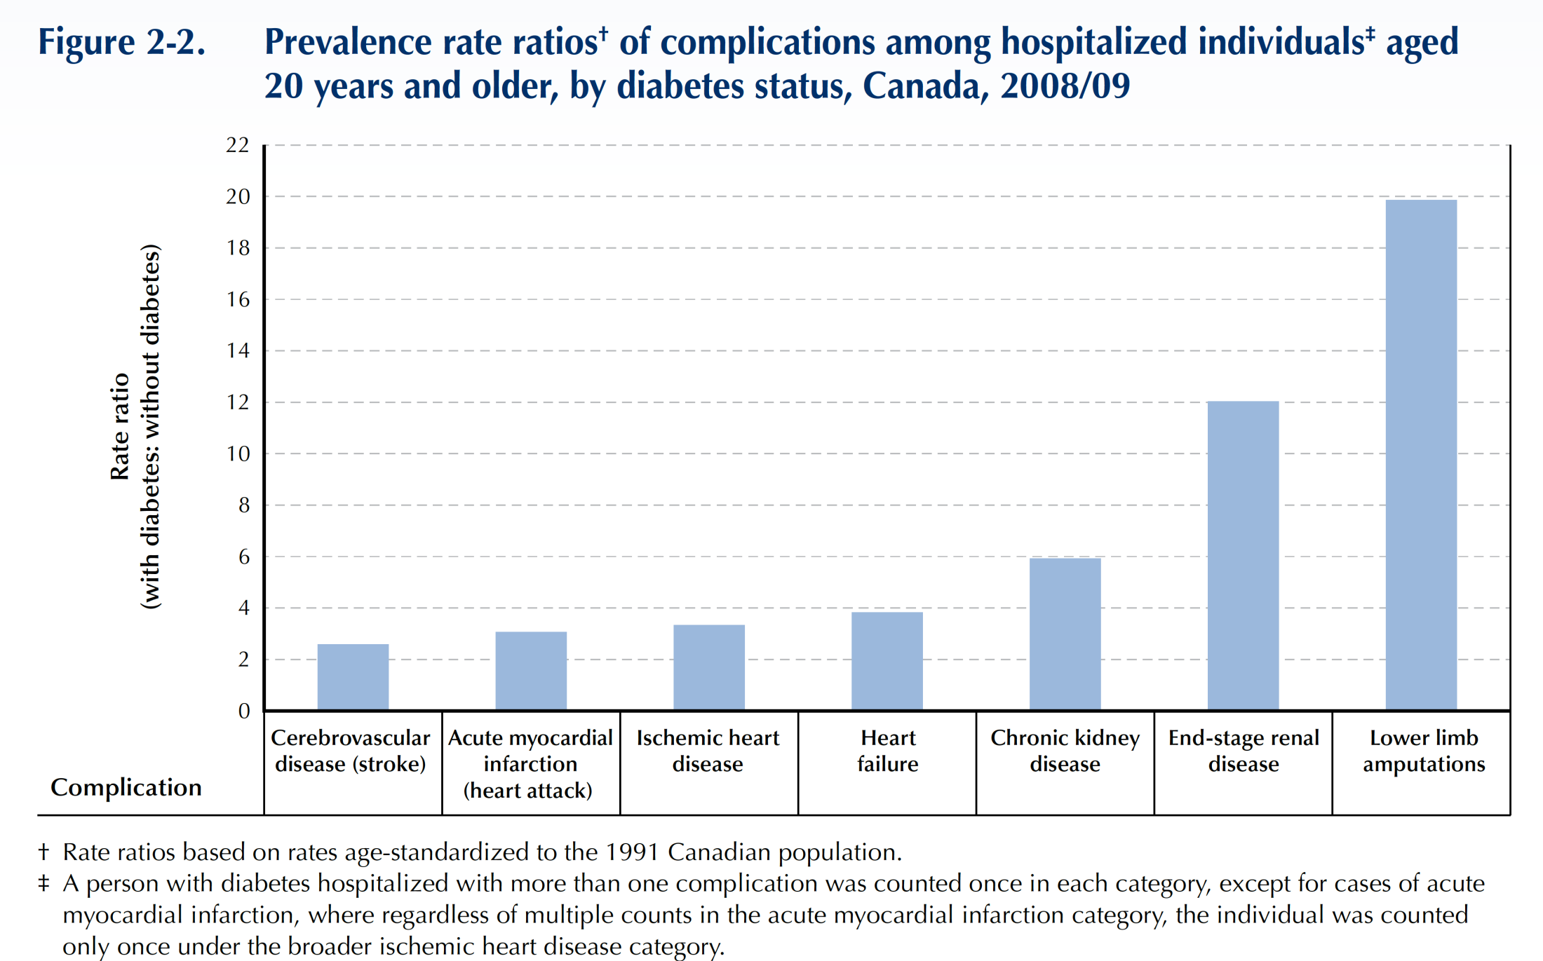
People with diabetes 6-12X more likely to be hospitalized for CKD or End-stage renal disease
Public Health Agency of Canada (August 2011); using 2008/09 data from the Canadian Chronic Disease Surveillance System (Public Health Agency of Canada).
Notes:
5

Slide 6
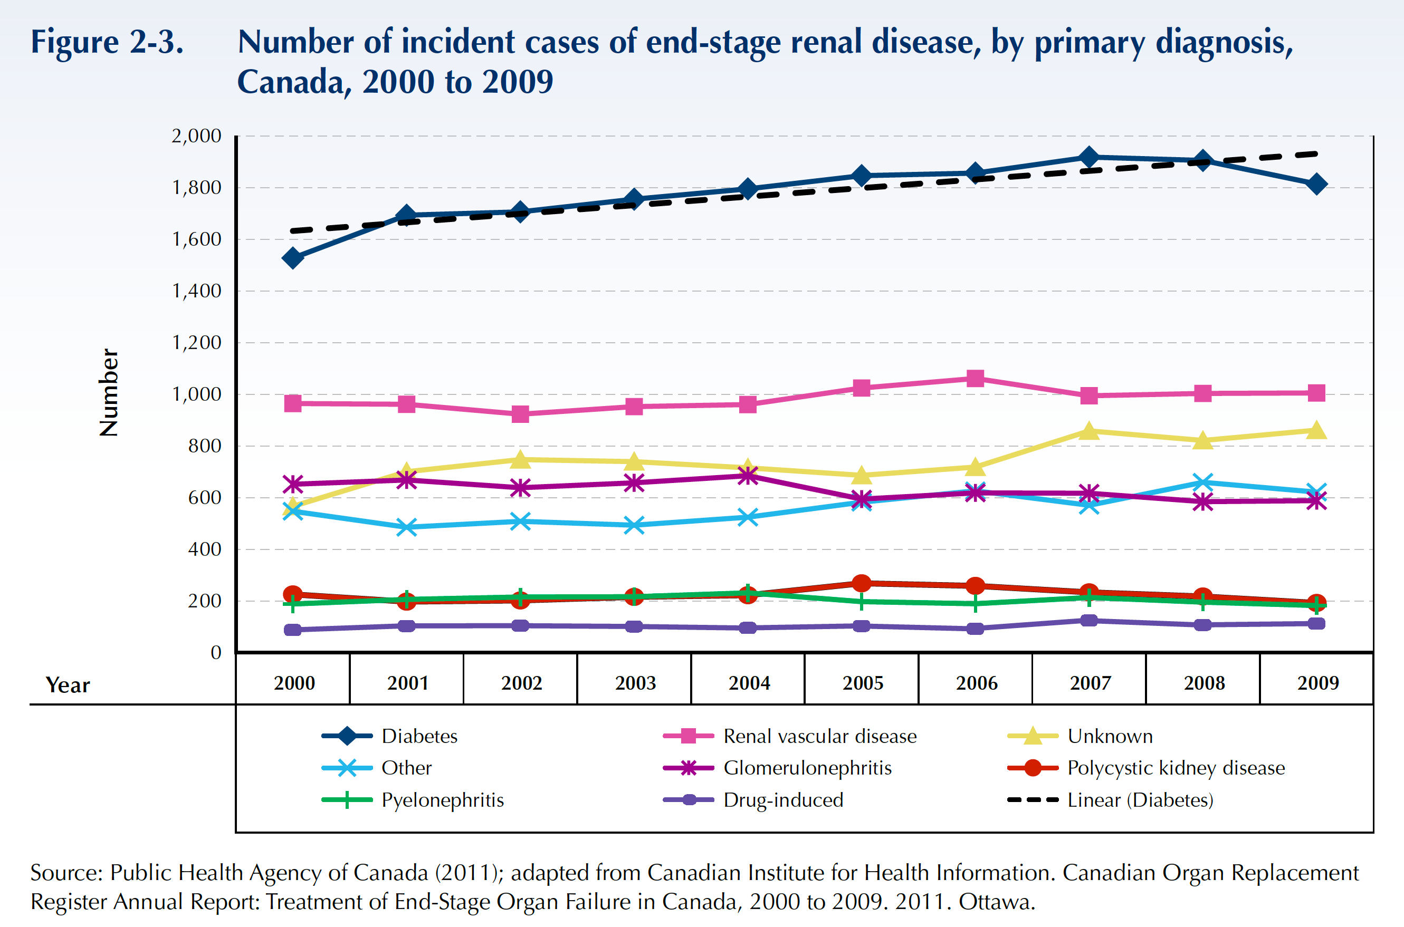
Diabetes is #1 Cause of New Cases of ESRD
Public Health Agency of Canada (August 2011); using 2008/09 data from the Canadian Chronic Disease Surveillance System (Public Health Agency of Canada).
Notes:
6

Slide 7
CKD in Diabetes
2018 Diabetes Canada CPG – Chapter 29. Chronic Kidney Disease in Diabetes
ACR ≥2.0 mg/mmol
and / or
eGFR <60 mL/min/1.73 m²
ACR, albumin to creatinine ratio; CKD, chronic kidney disease; eGFR, estimated glomerular filtration rate
Notes:
7

Slide 8
Diabetic Nephropathy
2018 Diabetes Canada CPG – Chapter 29. Chronic Kidney Disease in Diabetes
“ Progressive increase in proteinuria in people with longstanding diabetes, followed by declining function which can eventually lead to End-Stage Renal Disease (ESRD)”
Notes:
8

Slide 9
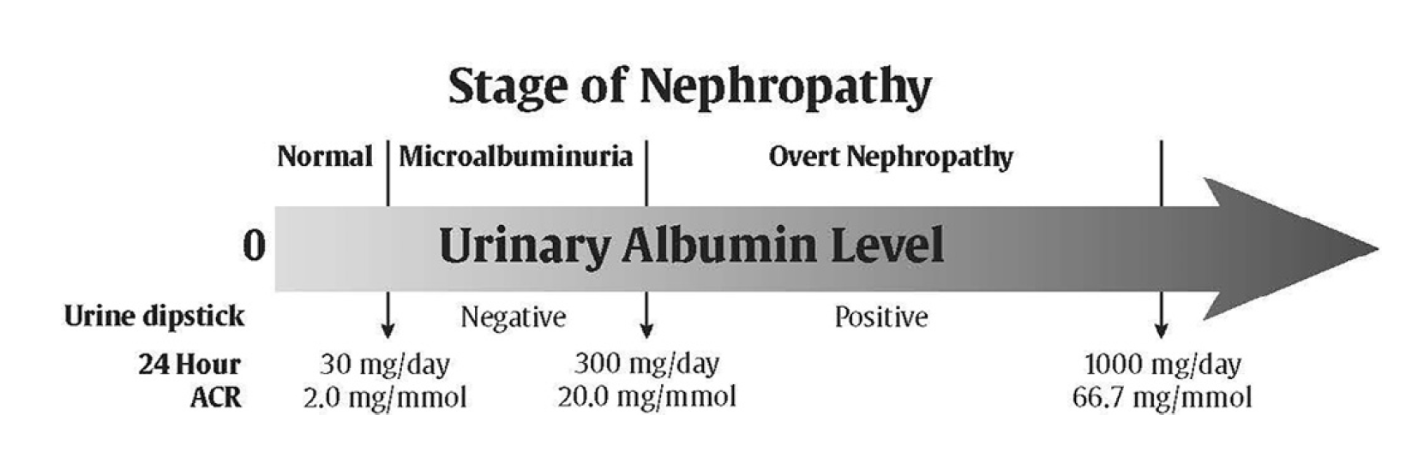
2018 Diabetes Canada CPG – Chapter 29. Chronic Kidney Disease in Diabetes

Slide 10
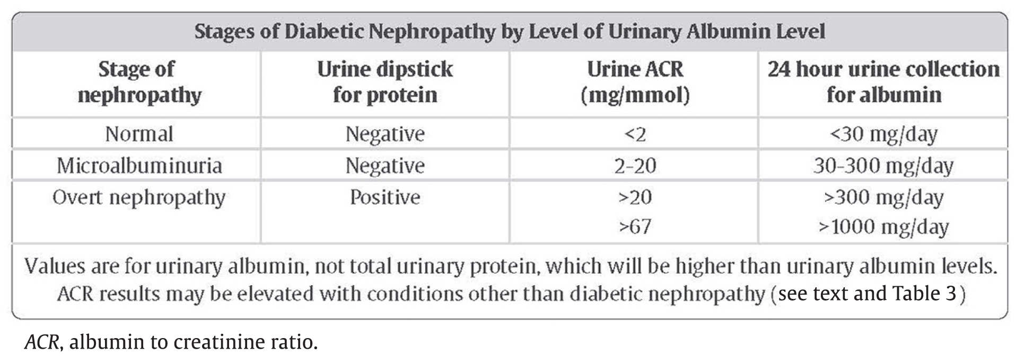
2018 Diabetes Canada CPG – Chapter 29. Chronic Kidney Disease in Diabetes

Slide 11
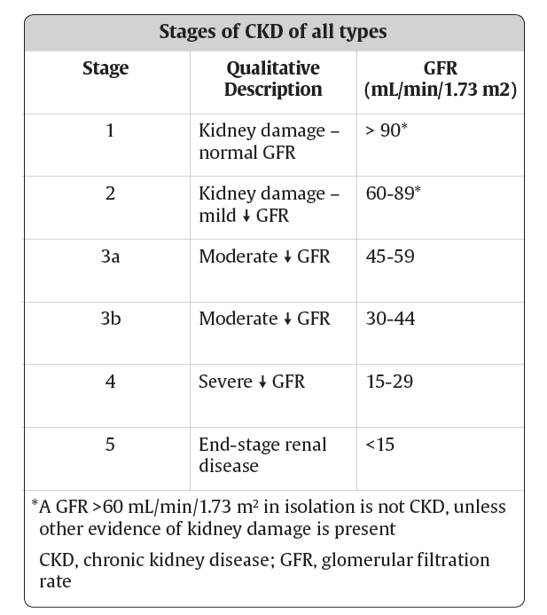

Slide 12
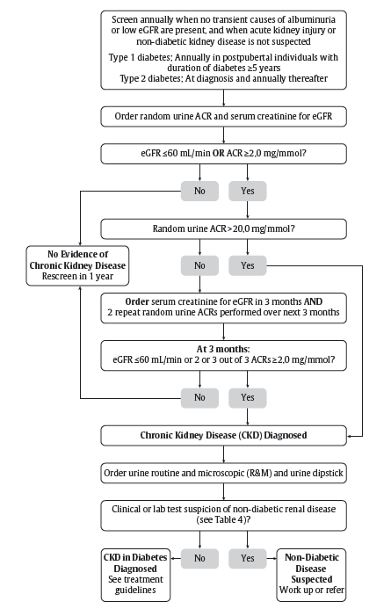
Screening and Diagnosis of CKD in Diabetes
2018 Diabetes Canada CPG – Chapter 29. Chronic Kidney Disease in Diabetes

Slide 13
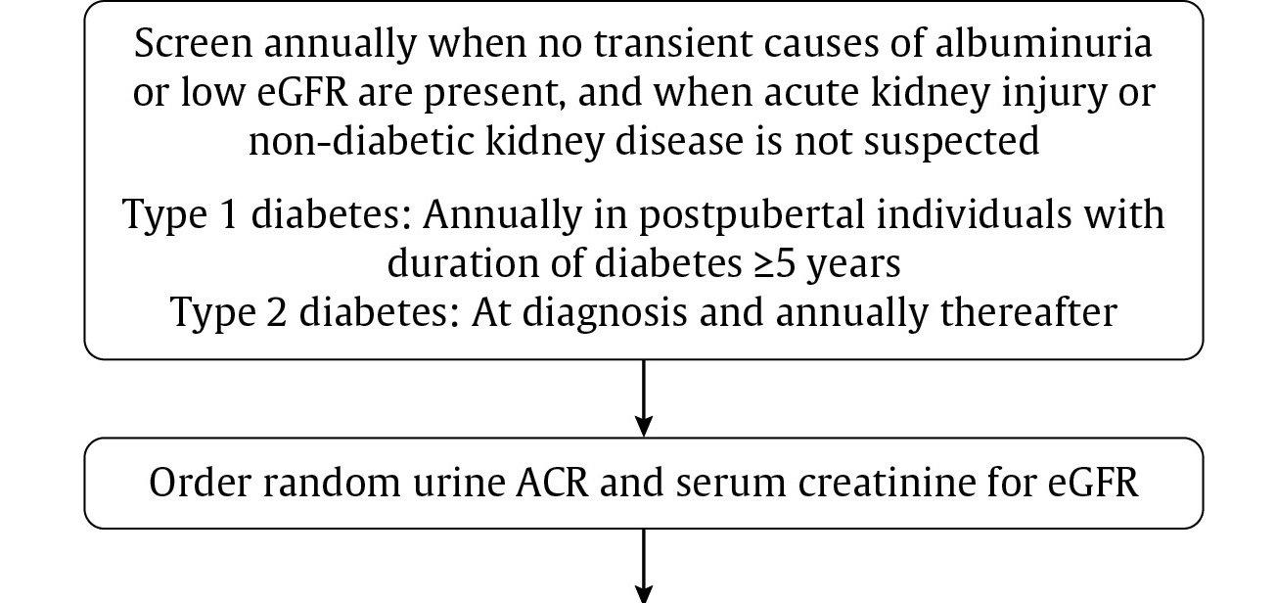

Slide 14
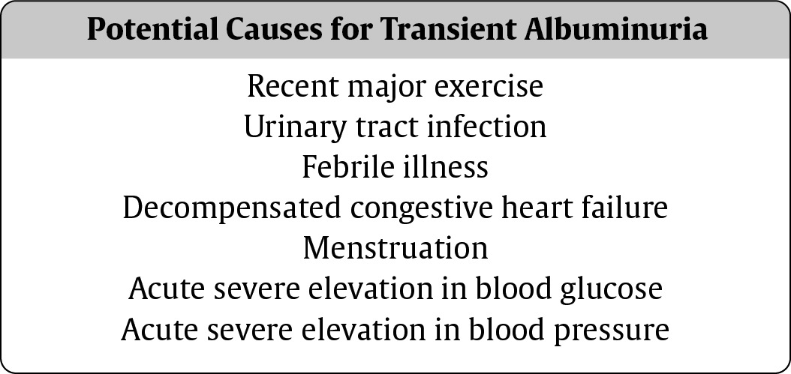
Beware of Transient Albuminuria

Slide 15
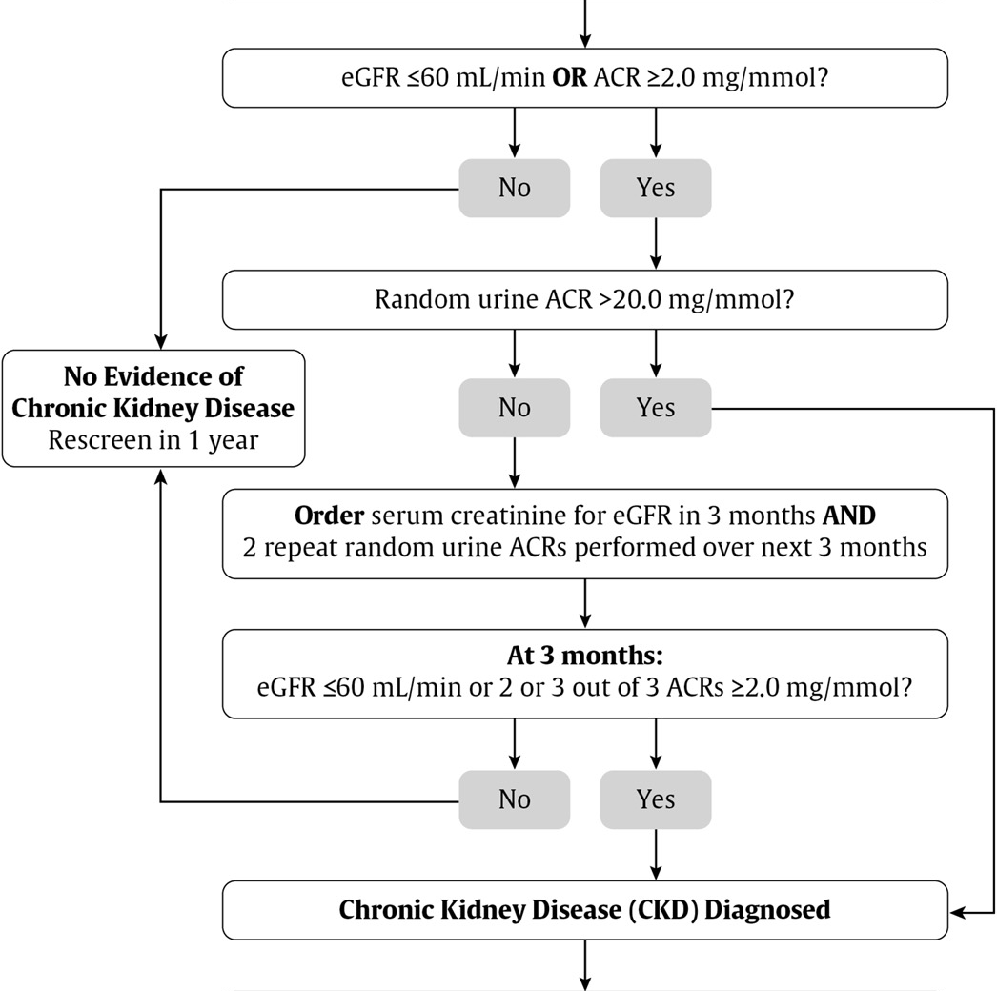

Slide 16
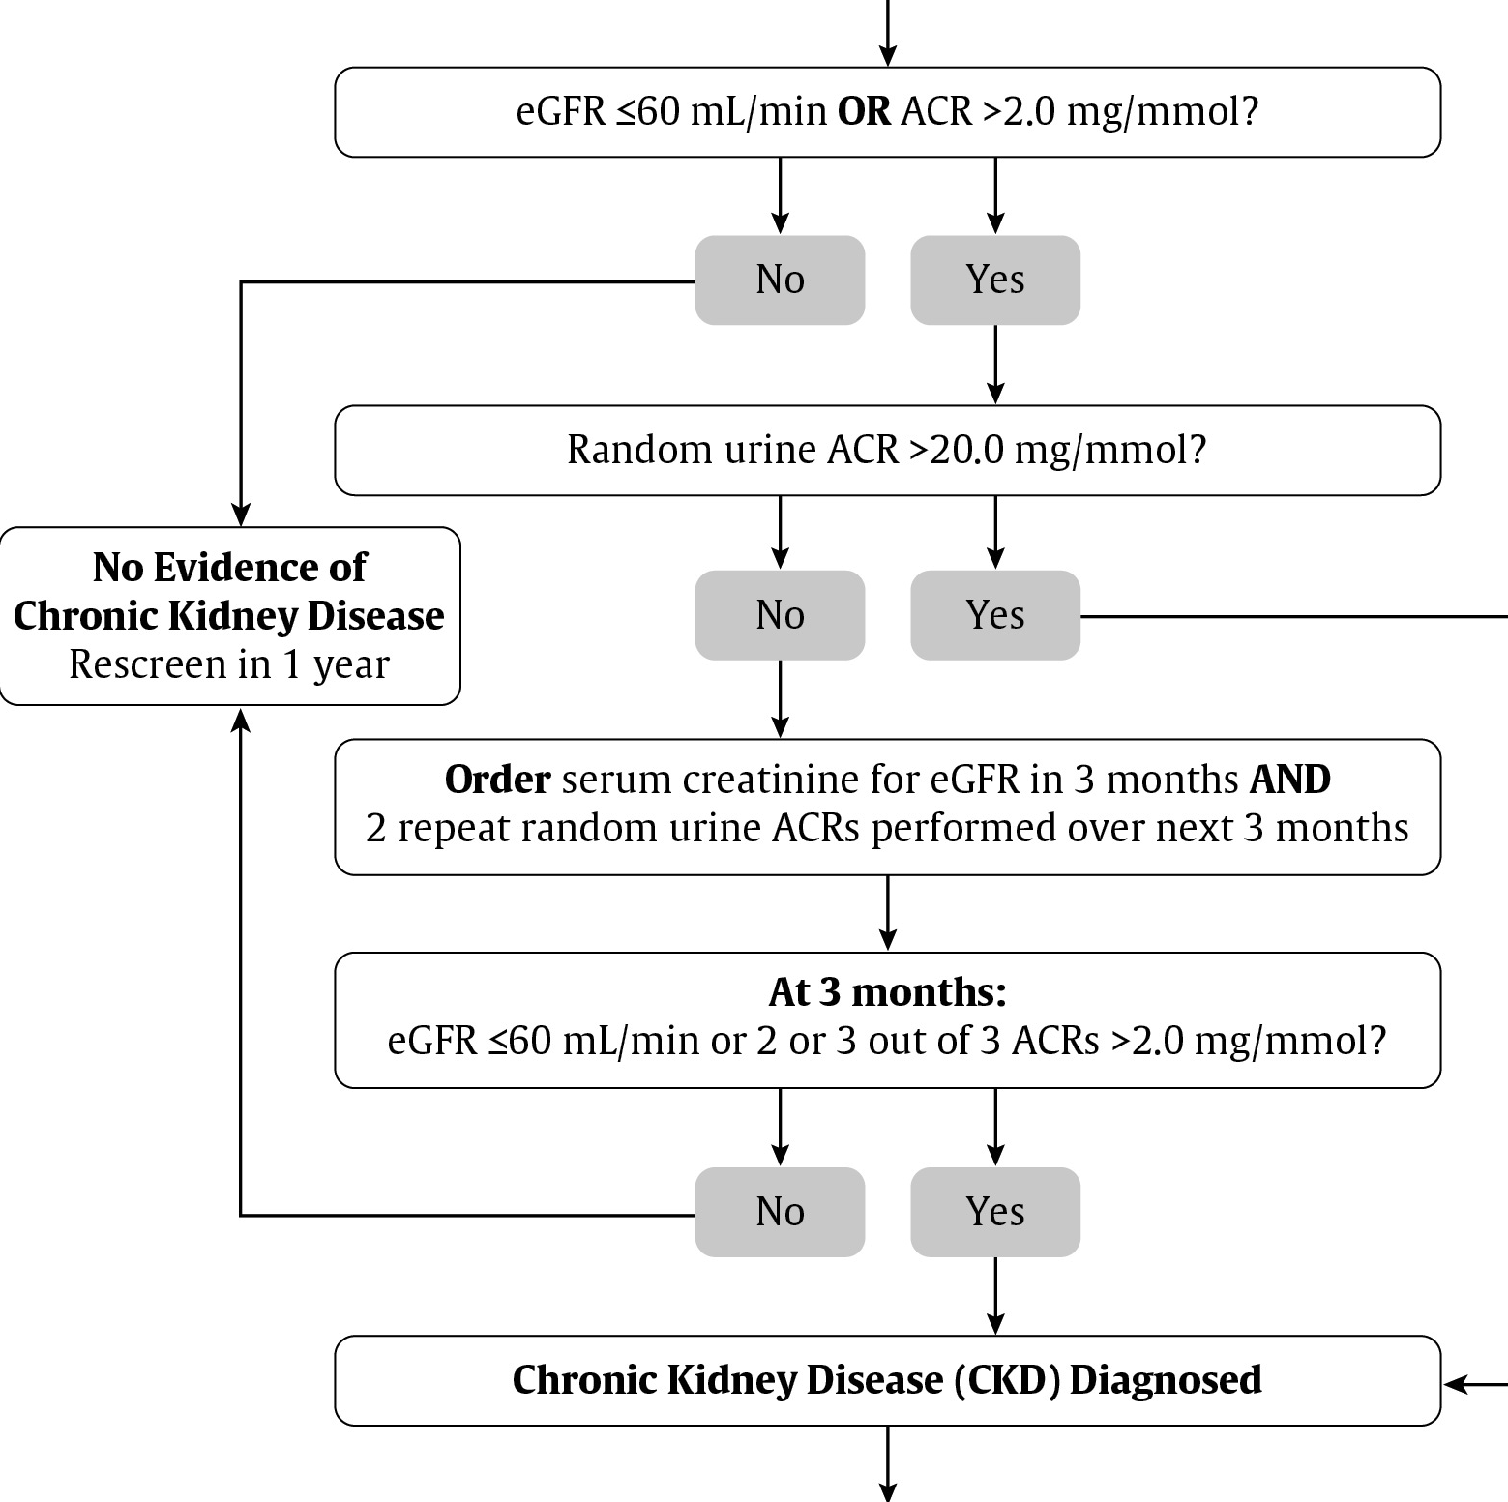

Slide 20
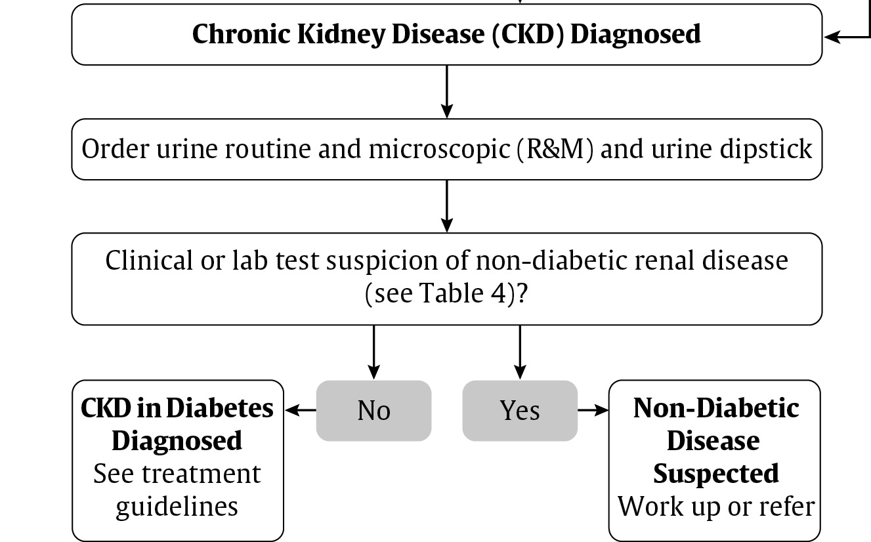
2

Slide 21
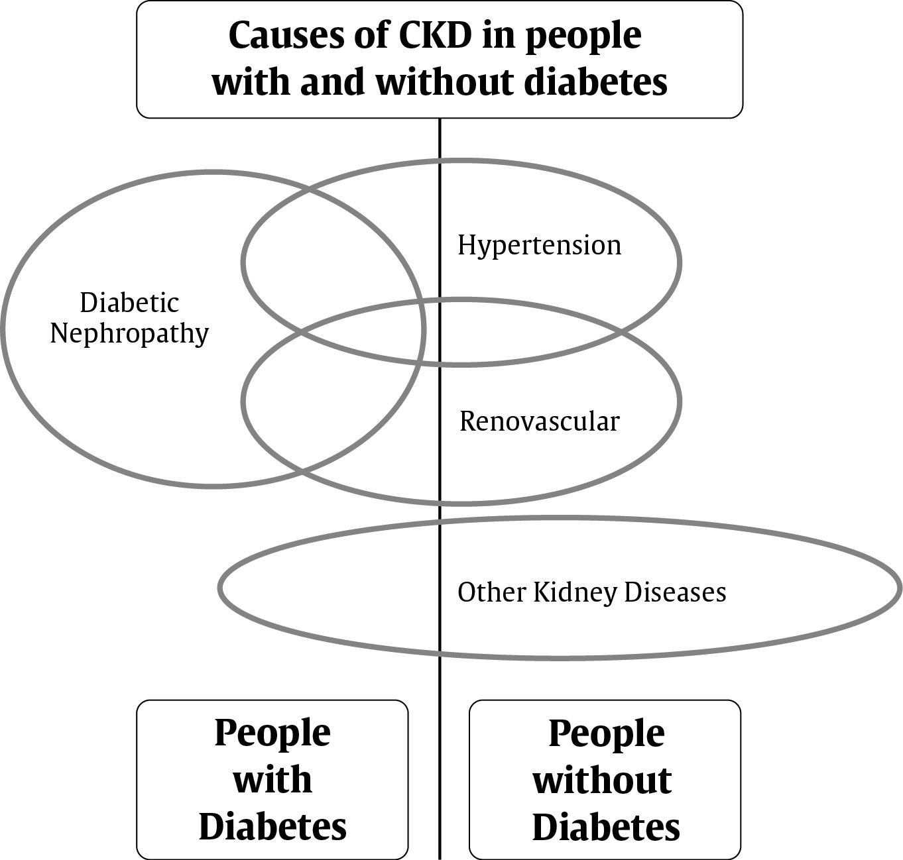
Beware of Other Causes of CKD
CKD, chronic kidney disease

Slide 22
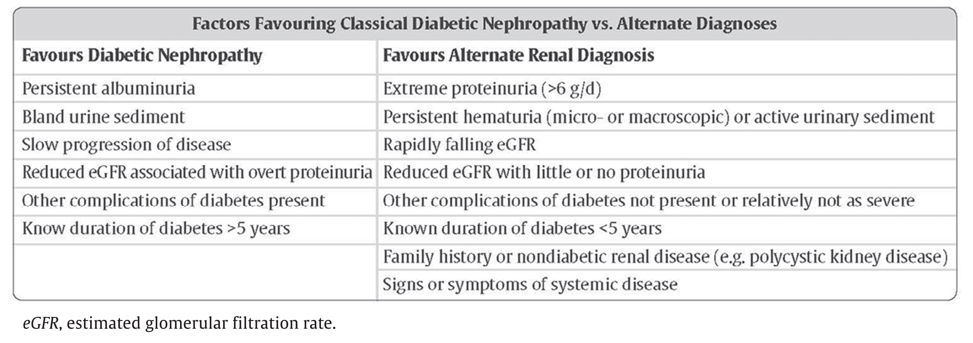
When to consider other causes of CKD
2018 Diabetes Canada CPG – Chapter 29. Chronic Kidney Disease in Diabetes
CKD, chronic kidney disease

Slide 23
2

Slide 24
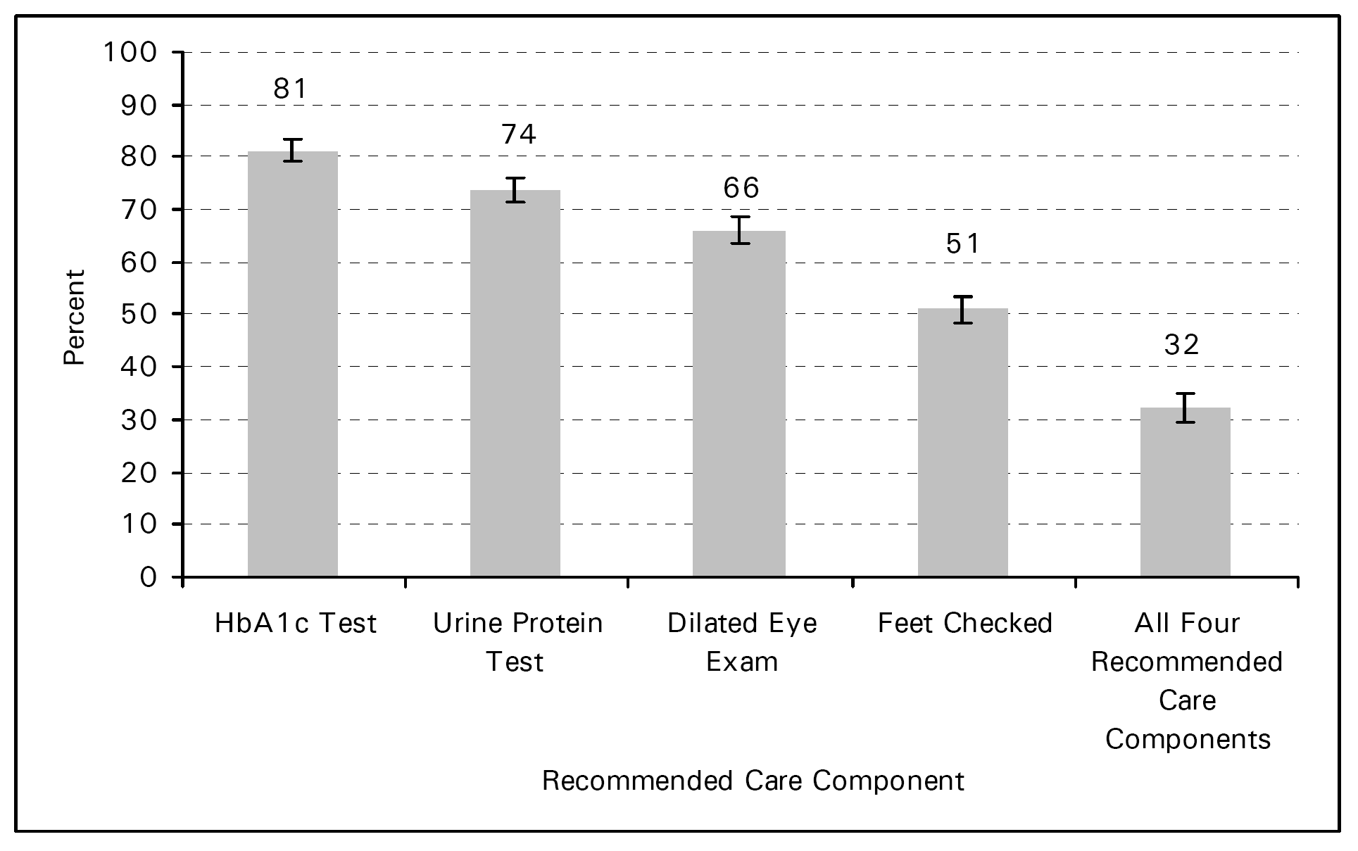
2018 Diabetes Canada CPG – Chapter 29. Chronic Kidney Disease in Diabetes
Care Gap Still Exists for Screening
Canadian Institute of Health Information – Diabetes Care Gap 2009
Notes:
24

Slide 25
Prevention of Chronic Kidney Disease in Diabetes
2018 Diabetes Canada CPG – Chapter 29. Chronic Kidney Disease in Diabetes
Optimal glycemic control in type 1 and type 2 diabetes has been shown to reduce the development and progression of nephropathy
Notes:
25

Slide 26
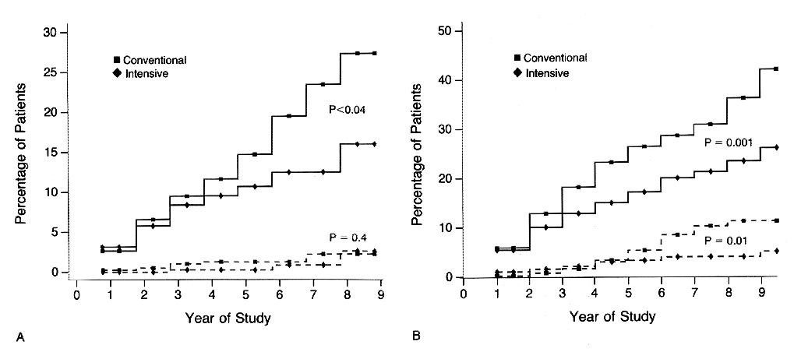
DCCT: Reduction in Albuminuria
2018 Diabetes Canada CPG – Chapter 29. Chronic Kidney Disease in Diabetes
Primary Prevention
Secondary Intervention
34% RRR (p<0.04)
43% RRR
(p=0.001)
56% RRR
(p=0.01)
Solid line = risk of developing microalbuminuria
Dashed line = risk of developing macroalbuminuria
RRR = relative risk reduction
CI = confidence interval
The Diabetes Control and Complications Trial Research Group. N Engl J Med 1993;329:977-986.
Notes:
N Engl J Med. 1993 Sep 30;329(14):977-86.
The effect of intensive treatment of diabetes on the development and progression of long-term complications in insulin-dependent diabetes mellitus. The Diabetes Control and Complications Trial Research Group.
[No authors listed]
Abstract
BACKGROUND:
Long-term microvascular and neurologic complications cause major morbidity and mortality in patients with insulin-dependent diabetes mellitus (IDDM). We examined whether intensive treatment with the goal of maintaining blood glucose concentrations close to the normal range could decrease the frequency and severity of these complications.
METHODS:
A total of 1441 patients with IDDM--726 with no retinopathy at base line (the primary-prevention cohort) and 715 with mild retinopathy (the secondary-intervention cohort) were randomly assigned to intensive therapy administered either with an external insulin pump or by three or more daily insulin injections and guided by frequent blood glucose monitoring or to conventional therapy with one or two daily insulin injections. The patients were followed for a mean of 6.5 years, and the appearance and progression of retinopathy and other complications were assessed regularly.
RESULTS:
In the primary-prevention cohort, intensive therapy reduced the adjusted mean risk for the development of retinopathy by 76 percent (95 percent confidence interval, 62 to 85 percent), as compared with conventional therapy. In the secondary-intervention cohort, intensive therapy slowed the progression of retinopathy by 54 percent (95 percent confidence interval, 39 to 66 percent) and reduced the development of proliferative or severe nonproliferative retinopathy by 47 percent (95 percent confidence interval, 14 to 67 percent). In the two cohorts combined, intensive therapy reduced the occurrence of microalbuminuria (urinary albumin excretion of > or = 40 mg per 24 hours) by 39 percent (95 percent confidence interval, 21 to 52 percent), that of albuminuria (urinary albumin excretion of > or = 300 mg per 24 hours) by 54 percent (95 percent confidence interval 19 to 74 percent), and that of clinical neuropathy by 60 percent (95 percent confidence interval, 38 to 74 percent). The chief adverse event associated with intensive therapy was a two-to-threefold increase in severe hypoglycemia.
CONCLUSIONS:
Intensive therapy effectively delays the onset and slows the progression of diabetic retinopathy, nephropathy, and neuropathy in patients with IDDM.
26

Slide 27
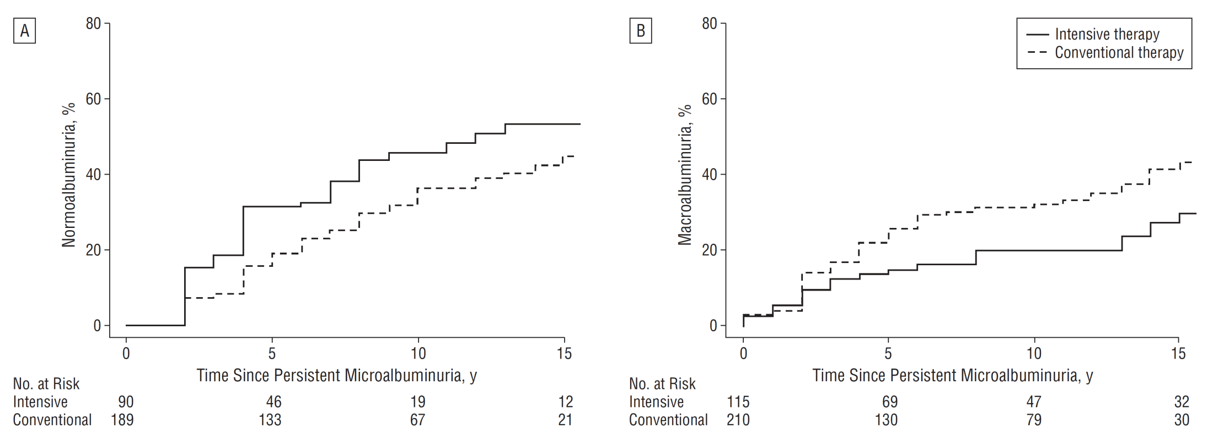
EDIC: Continued Reduction in Albuminuria
2018 Diabetes Canada CPG – Chapter 29. Chronic Kidney Disease in Diabetes
Return to normoalbuminuria
Macroalbuminuria
HR 1.92 (p<0.05)
HR 0.64
(95% CI 0.40-1.02)
HR = hazard ratio
CI = confidence interval
deBoer IH et al. Arch Intern Med 2011;171(5):412-420.
Notes:
Arch Intern Med. 2011 Mar 14;171(5):412-20. doi: 10.1001/archinternmed.2011.16.
Long-term renal outcomes of patients with type 1 diabetes mellitus and microalbuminuria: an analysis of the Diabetes Control and Complications Trial/Epidemiology of Diabetes Interventions and Complications cohort.
de Boer IH, Rue TC, Cleary PA, Lachin JM, Molitch ME, Steffes MW, Sun W, Zinman B, Brunzell JD; Diabetes Control and Complications Trial/Epidemiology of Diabetes Interventions and Complications Study Research Group, White NH, Danis RP, Davis MD, Hainsworth D, Hubbard LD, Nathan DM.
The following toggler user interface control may not be accessible. Tab to the next button to revert the control to an accessible version.
Destroy user interface controlCollaborators (342)
Source
Kidney Research Institute and Division of Nephrology, University of Washington, Campus Box 359606, 325 Ninth Ave, Seattle, WA 98104, USA. deboer@u.washington.edu
Abstract
BACKGROUND:
Microalbuminuria is a common diagnosis in the clinical care of patients with type 1 diabetes mellitus. Long-term outcomes after the development of microalbuminuria are variable.
METHODS:
We quantified the incidence of and risk factors for long-term renal outcomes after the development of microalbuminuria in the Diabetes Control and Complications Trial/Epidemiology of Diabetes Interventions and Complications (DCCT/EDIC) study. The DCCT randomly assigned 1441 persons with type 1 diabetes to intensive or conventional diabetes therapy, and participants were subsequently followed up during the observational EDIC study. During the DCCT/EDIC study, 325 participants developed incident persistent microalbuminuria (albumin excretion rate, ≥30 mg/24 h at 2 consecutive study visits). We assessed their subsequent renal outcomes, including progression to macroalbuminuria (albumin excretion rate, ≥300 mg/24 h at 2 consecutive visits), impaired glomerular filtration rate (estimated glomerular filtration rate, <60 mL/min/1.73 m(2) at 2 consecutive study visits), end-stage renal disease, and regression to normoalbuminuria (albumin excretion rate, <30 mg/24 h at 2 consecutive visits).
RESULTS:
The median follow-up period after persistent microalbuminuria diagnosis was 13 years (maximum, 23 years). Ten-year cumulative incidences of progression to macroalbuminuria, impaired glomerular filtration rate, end-stage renal disease, and regression to normoalbuminuria were 28%, 15%, 4%, and 40%, respectively. Albuminuria outcomes were more favorable with intensive diabetes therapy, lower glycated hemoglobin level, absence of retinopathy, female sex, lower blood pressure, and lower concentrations of low-density lipoprotein cholesterol and triglycerides. Lower glycated hemoglobin level, absence of retinopathy, and lower blood pressure were also associated with decreased risk of impaired glomerular filtration rate.
CONCLUSIONS:
After the development of persistent microalbuminuria, progression and regression of kidney disease each commonly occur. Intensive glycemic control, lower blood pressure, and a more favorable lipid profile are associated with improved outcomes.
27

Slide 28
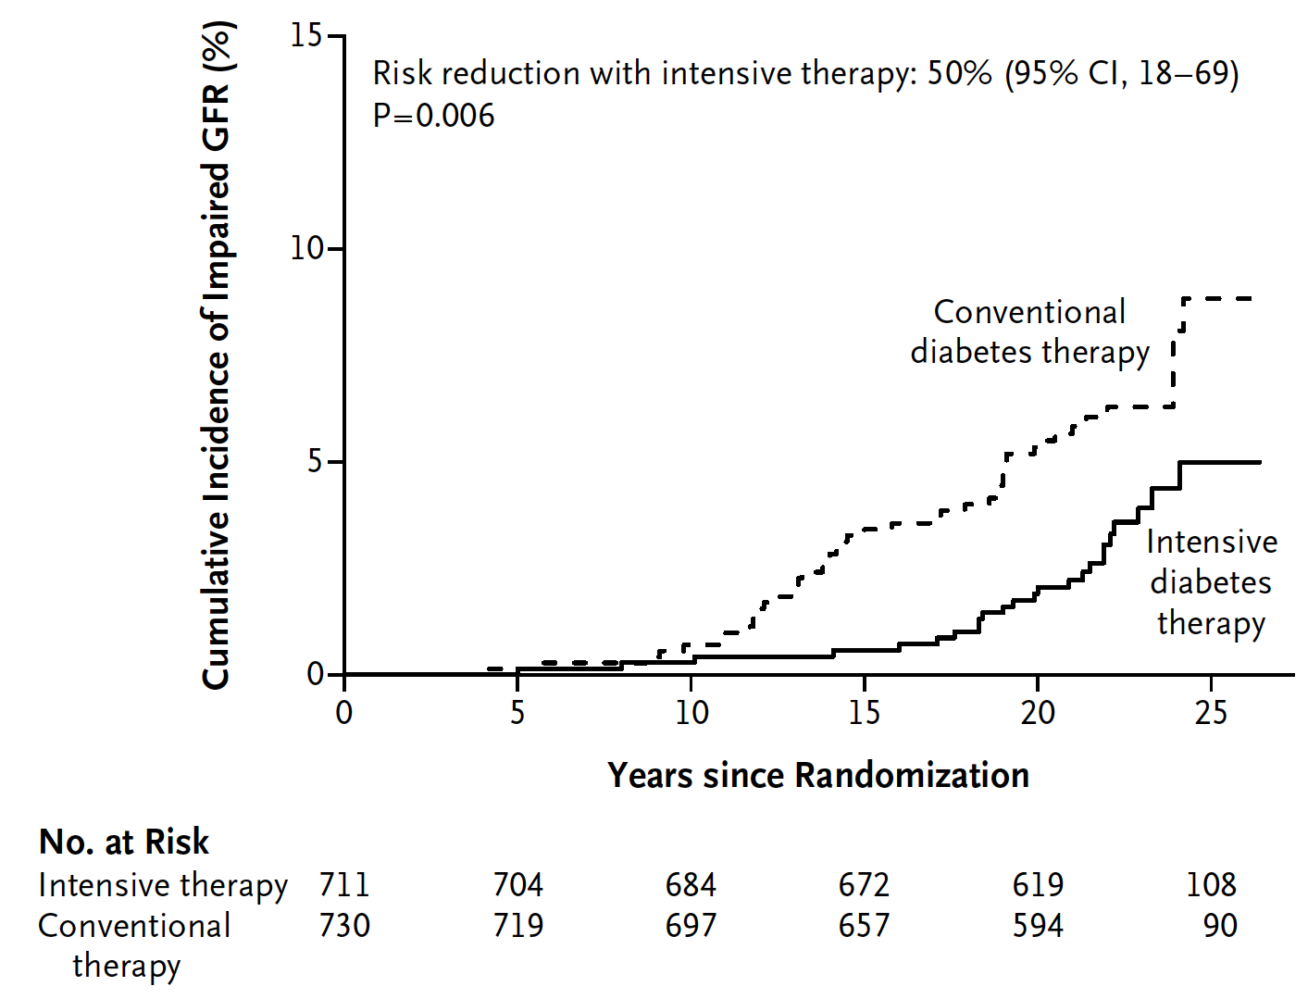
EDIC: Early Glycemic Control Reduces Long-term Risk of Impaired GFR
2018 Diabetes Canada CPG – Chapter 29. Chronic Kidney Disease in Diabetes
Risk reduction with intensive therapy
50%
(95% CI 18-69; p=0.006)
DCCT/EDIC Research Group. N Engl J Med 2011;365:2366-76.
Notes:
N Engl J Med. 2011 Dec 22;365(25):2366-76. doi: 10.1056/NEJMoa1111732. Epub 2011 Nov 12.
Intensive diabetes therapy and glomerular filtration rate in type 1 diabetes.
DCCT/EDIC Research Group, de Boer IH, Sun W, Cleary PA, Lachin JM, Molitch ME, Steffes MW, Zinman B.
The following toggler user interface control may not be accessible. Tab to the next button to revert the control to an accessible version.
Destroy user interface controlCollaborators (377)
Abstract
BACKGROUND:
An impaired glomerular filtration rate (GFR) leads to end-stage renal disease and increases the risks of cardiovascular disease and death. Persons with type 1 diabetes are at high risk for kidney disease, but there are no interventions that have been proved to prevent impairment of the GFR in this population.
METHODS:
In the Diabetes Control and Complications Trial (DCCT), 1441 persons with type 1 diabetes were randomly assigned to 6.5 years of intensive diabetes therapy aimed at achieving near-normal glucose concentrations or to conventional diabetes therapy aimed at preventing hyperglycemic symptoms. Subsequently, 1375 participants were followed in the observational Epidemiology of Diabetes Interventions and Complications (EDIC) study. Serum creatinine levels were measured annually throughout the course of the two studies. The GFR was estimated with the use of the Chronic Kidney Disease Epidemiology Collaboration formula. We analyzed data from the two studies to determine the long-term effects of intensive diabetes therapy on the risk of impairment of the GFR, which was defined as an incident estimated GFR of less than 60 ml per minute per 1.73 m(2) of body-surface area at two consecutive study visits.
RESULTS:
Over a median follow-up period of 22 years in the combined studies, impairment of the GFR developed in 24 participants assigned to intensive therapy and in 46 assigned to conventional therapy (risk reduction with intensive therapy, 50%; 95% confidence interval, 18 to 69; P=0.006). Among these participants, end-stage renal disease developed in 8 participants in the intensive-therapy group and in 16 in the conventional-therapy group. As compared with conventional therapy, intensive therapy was associated with a reduction in the mean estimated GFR of 1.7 ml per minute per 1.73 m(2) during the DCCT study but during the EDIC study was associated with a slower rate of reduction in the GFR and an increase in the mean estimated GFR of 2.5 ml per minute per 1.73 m(2) (P<0.001 for both comparisons). The beneficial effect of intensive therapy on the risk of an impaired GFR was fully attenuated after adjustment for glycated hemoglobin levels or albumin excretion rates.
CONCLUSIONS:
The long-term risk of an impaired GFR was significantly lower among persons treated early in the course of type 1 diabetes with intensive diabetes therapy than among those treated with conventional diabetes therapy.
28

Slide 29
UKPDS: Post-trial Monitoring “Legacy Effect”
2018 Diabetes Canada CPG – Chapter 29. Chronic Kidney Disease in Diabetes
After median 8.5 years post-trial follow-up
Aggregate Endpoint 1997 2007
Any diabetes related endpoint RRR: 12% 9%
P: 0.029 0.040
Microvascular disease RRR: 25% 24%
P: 0.0099 0.001
Myocardial infarction RRR: 16% 15%
P: 0.052 0.014
All-cause mortality RRR: 6% 13%
P: 0.44 0.007
Holman R, et al. N Engl J Med 2008;359.
Notes:
29
N Engl J Med. 2008 Oct 9;359(15):1577-89. doi: 10.1056/NEJMoa0806470. Epub 2008 Sep 10.
10-year follow-up of intensive glucose control in type 2 diabetes.
Holman RR, Paul SK, Bethel MA, Matthews DR, Neil HA.
Source
Diabetes Trials Unit, Oxford Centre for Diabetes, Endocrinology, and Metabolism, Churchill Hospital, Headington, Oxford OX3 7LJ, United Kingdom. rury.holman@dtu.ox.ac.uk
Abstract
BACKGROUND:
During the United Kingdom Prospective Diabetes Study (UKPDS), patients with type 2 diabetes mellitus who received intensive glucose therapy had a lower risk of microvascular complications than did those receiving conventional dietary therapy. We conducted post-trial monitoring to determine whether this improved glucose control persisted and whether such therapy had a long-term effect on macrovascular outcomes.
METHODS:
Of 5102 patients with newly diagnosed type 2 diabetes, 4209 were randomly assigned to receive either conventional therapy (dietary restriction) or intensive therapy (either sulfonylurea or insulin or, in overweight patients, metformin) for glucose control. In post-trial monitoring, 3277 patients were asked to attend annual UKPDS clinics for 5 years, but no attempts were made to maintain their previously assigned therapies. Annual questionnaires were used to follow patients who were unable to attend the clinics, and all patients in years 6 to 10 were assessed through questionnaires. We examined seven prespecified aggregate clinical outcomes from the UKPDS on an intention-to-treat basis, according to previous randomization categories.
RESULTS:
Between-group differences in glycated hemoglobin levels were lost after the first year. In the sulfonylurea-insulin group, relative reductions in risk persisted at 10 years for any diabetes-related end point (9%, P=0.04) and microvascular disease (24%, P=0.001), and risk reductions for myocardial infarction (15%, P=0.01) and death from any cause (13%, P=0.007) emerged over time, as more events occurred. In the metformin group, significant risk reductions persisted for any diabetes-related end point (21%, P=0.01), myocardial infarction (33%, P=0.005), and death from any cause (27%, P=0.002).
CONCLUSIONS:
Despite an early loss of glycemic differences, a continued reduction in microvascular risk and emergent risk reductions for myocardial infarction and death from any cause were observed during 10 years of post-trial follow-up. A continued benefit after metformin therapy was evident among overweight patients. (UKPDS 80; Current Controlled Trials number, ISRCTN75451837.)

Slide 30
ADVANCE: Primary Microvascular Outcomes
2018 Diabetes Canada CPG – Chapter 29. Chronic Kidney Disease in Diabetes
New/worsening nephropathy, retinopathy
25
20
HR 0.86 (0.77-0.97)
p = 0.01
15
Standard
control
Cumulative incidence (%)
10
5
Intensive
control
0
0
6
12
18
24
30
36
42
48
54
60
66
Follow-up (months)
 | Intensive | Standard | HR | p
Nephropathy/retinopathy (%) | 9.4 | 10.9 | 0.86 | 0.01
Nephropathy (%) | 4.1 | 5.2 | 0.79 | 0.006
Retinopathy (%) | 6.0 | 6.3 | 0.95 | NS
Adapted from:
ADVANCE Collaborative Group. N Engl J Med 2008;358:2560-72.
ADVANCE Collaborative Group. N Engl J Med 2008;358:24.
Notes:
N Engl J Med. 2008 Jun 12;358(24):2560-72. doi: 10.1056/NEJMoa0802987. Epub 2008 Jun 6.
Intensive blood glucose control and vascular outcomes in patients with type 2 diabetes.
ADVANCE Collaborative Group, Patel A, MacMahon S, Chalmers J, Neal B, Billot L, Woodward M, Marre M, Cooper M, Glasziou P, Grobbee D, Hamet P, Harrap S, Heller S, Liu L, Mancia G, Mogensen CE, Pan C, Poulter N, Rodgers A, Williams B, Bompoint S, de Galan BE, Joshi R, Travert F.
The following toggler user interface control may not be accessible. Tab to the next button to revert the control to an accessible version.
Destroy user interface controlCollaborators (1307)
Abstract
BACKGROUND:
In patients with type 2 diabetes, the effects of intensive glucose control on vascular outcomes remain uncertain.
METHODS:
We randomly assigned 11,140 patients with type 2 diabetes to undergo either standard glucose control or intensive glucose control, defined as the use of gliclazide (modified release) plus other drugs as required to achieve a glycated hemoglobin value of 6.5% or less. Primary end points were composites of major macrovascular events (death from cardiovascular causes, nonfatal myocardial infarction, or nonfatal stroke) and major microvascular events (new or worsening nephropathy or retinopathy), assessed both jointly and separately.
RESULTS:
After a median of 5 years of follow-up, the mean glycated hemoglobin level was lower in the intensive-control group (6.5%) than in the standard-control group (7.3%). Intensive control reduced the incidence of combined major macrovascular and microvascular events (18.1%, vs. 20.0% with standard control; hazard ratio, 0.90; 95% confidence interval [CI], 0.82 to 0.98; P=0.01), as well as that of major microvascular events (9.4% vs. 10.9%; hazard ratio, 0.86; 95% CI, 0.77 to 0.97; P=0.01), primarily because of a reduction in the incidence of nephropathy (4.1% vs. 5.2%; hazard ratio, 0.79; 95% CI, 0.66 to 0.93; P=0.006), with no significant effect on retinopathy (P=0.50). There were no significant effects of the type of glucose control on major macrovascular events (hazard ratio with intensive control, 0.94; 95% CI, 0.84 to 1.06; P=0.32), death from cardiovascular causes (hazard ratio with intensive control, 0.88; 95% CI, 0.74 to 1.04; P=0.12), or death from any cause (hazard ratio with intensive control, 0.93; 95% CI, 0.83 to 1.06; P=0.28). Severe hypoglycemia, although uncommon, was more common in the intensive-control group (2.7%, vs. 1.5% in the standard-control group; hazard ratio, 1.86; 95% CI, 1.42 to 2.40; P<0.001).
CONCLUSIONS:
A strategy of intensive glucose control, involving gliclazide (modified release) and other drugs as required, that lowered the glycated hemoglobin value to 6.5% yielded a 10% relative reduction in the combined outcome of major macrovascular and microvascular events, primarily as a consequence of a 21% relative reduction in nephropathy. (ClinicalTrials.gov number, NCT00145925.)
Reference(s)
The ADVANCE Collaborative Group. Intensive blood glucose control and vascular outcomes in patients with type 2 diabetes. New Engl J Med 2008;358:2560-72.
30

Slide 31
Reducing Progression of Diabetic Nephropathy
2018 Diabetes Canada CPG – Chapter 29. Chronic Kidney Disease in Diabetes
Optimal glycemic control (as shown)
Optimal BP control
ACE-inhibitor or ARB
ACE, angiotensin converting enzyme; ARB, angiotensin receptor blocker; BP, blood pressure
Notes:
31

Slide 32
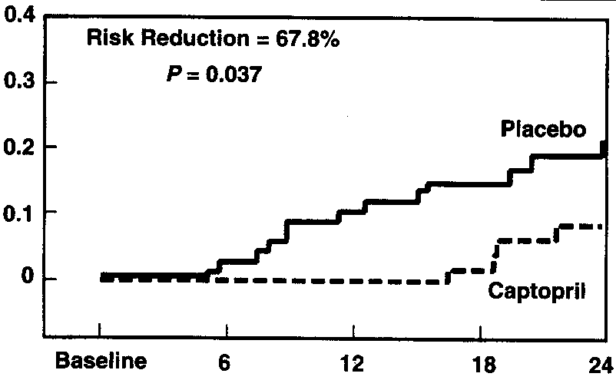
ACE-inhibitor in Type 1 diabetes with MAU Reduces Progression to Clinical Proteinuria
2018 Diabetes Canada CPG – Chapter 29. Chronic Kidney Disease in Diabetes
Proportion with Event
Months of Therapy
Laffel LM et al. Am J Med 1995;99(5):497-504.
MAU, microalbuminuria
Notes:
Am J Med. 1995 Nov;99(5):497-504.
The beneficial effect of angiotensin-converting enzyme inhibition with captopril on diabetic nephropathy in normotensive IDDM patients with microalbuminuria. North American Microalbuminuria Study Group.
Laffel LM, McGill JB, Gans DJ.
Source
Epidemiology and Genetics Unit, Joslin Diabetes Center, Harvard Medical School, Boston, Massachusetts 02215, USA.
Abstract
PURPOSE:
To determine whether angiotensin-converting enzyme (ACE) inhibition with captopril reduces the progression of microalbuminuria to overt proteinuria in normotensive patients with insulin-dependent diabetes mellitus (IDDM).
PATIENTS AND METHODS:
This study was a prospective randomized, double-blind, placebo-controlled trial involving 26 centers in the United States and Canada. One hundred forty-three subjects, 14 to 57 years of age, with IDDM for 4 to 33 years, blood pressure < 140/90 mm Hg in the absence of antihypertensive therapy, and persistent albumin excretion 20 to 200 micrograms/min were randomized to double-blind treatment with captopril 50 mg or placebo BID. Albumin excretion rate (AER), blood pressure, and glycohemoglobin were determined every 3 months, and creatinine clearance (CrCl) and urea excretion were measured every 6 months.
RESULTS:
Within 24 months, 6.0% (4/67) of captopril-treated subjects and 18.6% (13/70) of placebo-treated subjects progressed to clinical proteinuria, defined as AER > 200 micrograms/min and at least 30% above baseline (risk reduction = 67.8%, P = 0.037). AER increased at an annual rate of 11.8% (95% confidence interval [CI] -3.3% to 29.1%) in the placebo group, while it declined by 17.9% (CI -29.6% to -4.3%) in the captopril group (P = 0.004). CrCl decreased by 4.9 mL/min per 1.73 m2 per year in the placebo group, while it remained stable in the captopril group (0.9 mL/min per 1.73 m2 per year, P = 0.039 between groups). Ten subjects required treatment for hypertension; 8 in the placebo group and 2 in the captopril group. There was little correlation between the 24-month changes in mean arterial blood pressure and AER in either group. Glycohemoglobin and urinary urea excretion did not differ between groups.
CONCLUSIONS:
After 24 months of therapy with captopril, compared with placebo, normotensive subjects with IDDM experienced significantly less progression of microalbuminuria to clinical proteinuria, reduced albumin excretion, and preserved CrCl rate. The ACE inhibitor, captopril, was well tolerated.
32

Slide 33
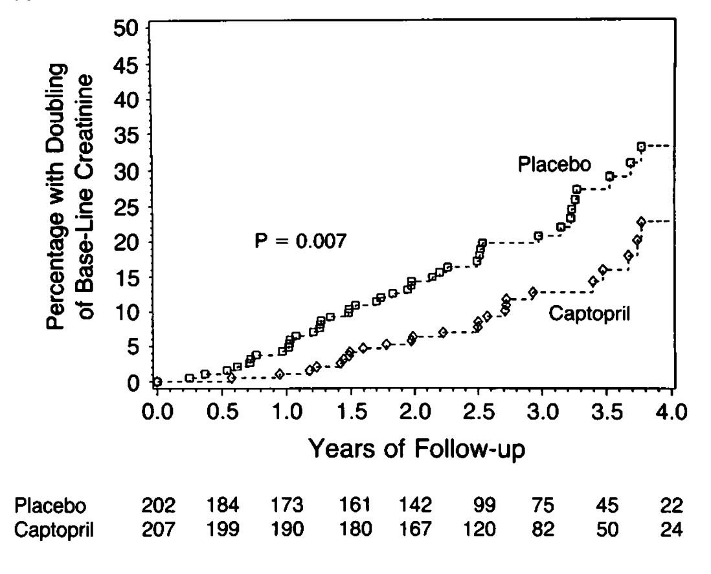
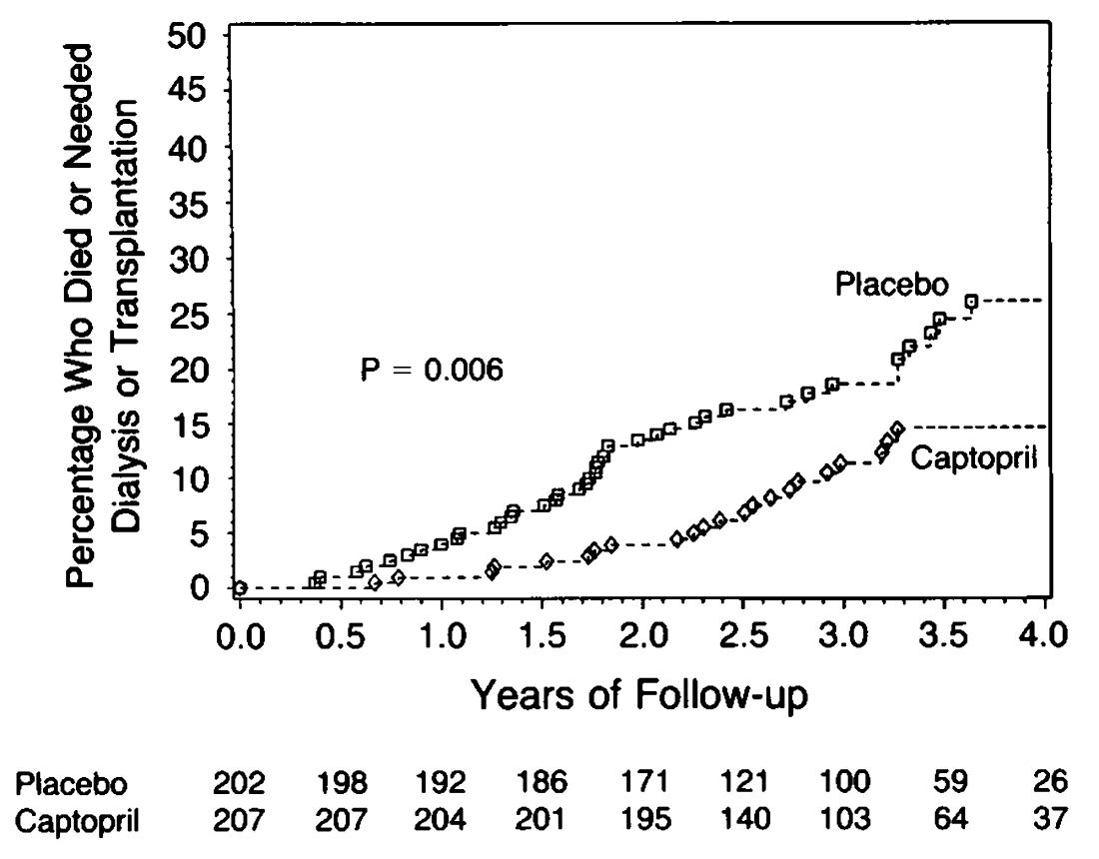
ACE-inhibitor in Type 1 diabetes with Macroalbuminuria Reduces Renal Outcomes
2018 Diabetes Canada CPG – Chapter 29. Chronic Kidney Disease in Diabetes
Lewis EJ et al. N Engl J Med 1993;329:1456-62.
Notes:
N Engl J Med. 1993 Nov 11;329(20):1456-62.
The effect of angiotensin-converting-enzyme inhibition on diabetic nephropathy. The Collaborative Study Group.
Lewis EJ, Hunsicker LG, Bain RP, Rohde RD.
Source
Department of Medicine, Rush-Presbyterian-St. Luke's Medical Center, Chicago, IL.
Erratum in
N Engl J Med 1993 Jan 13;330(2):152.
Abstract
BACKGROUND:
Renal function declines progressively in patients who have diabetic nephropathy, and the decline may be slowed by antihypertensive drugs. The purpose of this study was to determine whether captopril has kidney-protecting properties independent of its effect on blood pressure in diabetic nephropathy.
METHODS:
We performed a randomized, controlled trial comparing captopril with placebo in patients with insulin-dependent diabetes mellitus in whom urinary protein excretion was > or = 500 mg per day and the serum creatinine concentration was < or = 2.5 mg per deciliter (221 mumol per liter). Blood-pressure goals were defined to achieve control during a median follow-up of three years. The primary end point was a doubling of the base-line serum creatinine concentration.
RESULTS:
Two hundred seven patients received captopril, and 202 placebo. Serum creatinine concentrations doubled in 25 patients in the captopril group, as compared with 43 patients in the placebo group (P = 0.007). The associated reductions in risk of a doubling of the serum creatinine concentration were 48 percent in the captopril group as a whole, 76 percent in the subgroup with a baseline serum creatinine concentration of 2.0 mg per deciliter (177 mumol per liter), 55 percent in the subgroup with a concentration of 1.5 mg per deciliter (133 mumol per liter), and 17 percent in the subgroup with a concentration of 1.0 mg per deciliter (88.4 mumol per liter). The mean (+/- SD) rate of decline in creatinine clearance was 11 +/- 21 percent per year in the captopril group and 17 +/- 20 percent per year in the placebo group (P = 0.03). Among the patients whose base-line serum creatinine concentration was > or = 1.5 mg per deciliter, creatinine clearance declined at a rate of 23 +/- 25 percent per year in the captopril group and at a rate of 37 +/- 25 percent per year in the placebo group (P = 0.01). Captopril treatment was associated with a 50 percent reduction in the risk of the combined end points of death, dialysis, and transplantation that was independent of the small disparity in blood pressure between the groups.
CONCLUSIONS:
Captopril protects against deterioration in renal function in insulin-dependent diabetic nephropathy and is significantly more effective than blood-pressure control alone.
33

Slide 34
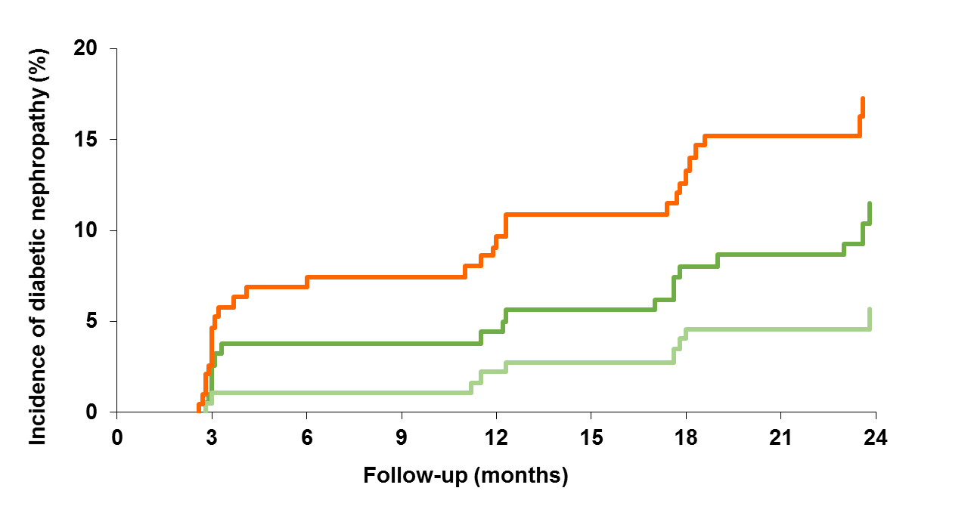
ARB in Type 2 diabetes with MAU reduces progression
2018 Diabetes Canada CPG – Chapter 29. Chronic Kidney Disease in Diabetes
Primary endpoint: Time to onset of diabetic nephropathy* (n=590)
Placebo
Irbesartan 150mg
Irbesartan 300mg
*defined by persistent albuminuria in overnight specimens,
with urinary albumin excretion rate <200 μg/min and ≥30% higher than baseline level
Parving et al. N Engl J Med 2001;345:870-8
MAU, microalbuminuria
Notes:
N Engl J Med. 2001 Sep 20;345(12):870-8.
The effect of irbesartan on the development of diabetic nephropathy in patients with type 2 diabetes.
Parving HH, Lehnert H, Bröchner-Mortensen J, Gomis R, Andersen S, Arner P; Irbesartan in Patients with Type 2 Diabetes and Microalbuminuria Study Group.
Source
Steno Diabetes Center, Copenhagen, Denmark.
Abstract
BACKGROUND:
Microalbuminuria and hypertension are risk factors for diabetic nephropathy. Blockade of the renin-angiotensin system slows the progression to diabetic nephropathy in patients with type 1 diabetes, but similar data are lacking for hypertensive patients with type 2 diabetes. We evaluated the renoprotective effect of the angiotensin-II-receptor antagonist irbesartan in hypertensive patients with type 2 diabetes and microalbuminuria.
METHODS:
A total of 590 hypertensive patients with type 2 diabetes and microalbuminuria were enrolled in this multinational, randomized, double-blind, placebo-controlled study of irbesartan, at a dose of either 150 mg daily or 300 mg daily, and were followed for two years. The primary outcome was the time to the onset of diabetic nephropathy, defined by persistent albuminuria in overnight specimens, with a urinary albumin excretion rate that was greater than 200 microg per minute and at least 30 percent higher than the base-line level.
RESULTS:
The base-line characteristics in the three groups were similar. Ten of the 194 patients in the 300-mg group (5.2 percent) and 19 of the 195 patients in the 150-mg group (9.7 percent) reached the primary end point, as compared with 30 of the 201 patients in the placebo group (14.9 percent) (hazard ratios, 0.30 [95 percent confidence interval, 0.14 to 0.61; P< 0.001] and 0.61 [95 percent confidence interval, 0.34 to 1.08; P=0.081 for the two irbesartan groups, respectively). The average blood pressure during the course of the study was 144/83 mm Hg in the placebo group, 143/83 mm Hg in the 150-mg group, and 141/83 mm Hg in the 300-mg group (P=0.004 for the comparison of systolic blood pressure between the placebo group and the combined irbesartan groups). Serious adverse events were less frequent among the patients treated with irbesartan (P=0.02).
CONCLUSIONS:
Irbesartan is renoprotective independently of its blood-pressure-lowering effect in patients with type 2 diabetes and microalbuminuria.
34

Slide 35
ARB in Type 2 diabetes with Macroalbuminuria Reduces Renal Outcomes
2018 Diabetes Canada CPG – Chapter 29. Chronic Kidney Disease in Diabetes
Primary endpoint: Time to doubling of serum creatinine, ESRD, or death (n=1513)
50
Placebo
Risk reduction = 16%
40
p=0.02
Cumulative % of
patients with event
30
20
Losartan
10
0
0
12
24
36
48
Months
Brenner et al. N Engl J Med 2001;345:861-9
ESRD, end stage renal disease
Notes:
N Engl J Med. 2001 Sep 20;345(12):861-9.
Effects of losartan on renal and cardiovascular outcomes in patients with type 2 diabetes and nephropathy.
Brenner BM, Cooper ME, de Zeeuw D, Keane WF, Mitch WE, Parving HH, Remuzzi G, Snapinn SM, Zhang Z, Shahinfar S; RENAAL Study Investigators.
Source
Renal Division, Brigham and Women's Hospital, Boston, MA 02115, USA. bbrenner@partners.org
Abstract
BACKGROUND:
Diabetic nephropathy is the leading cause of end-stage renal disease. Interruption of the renin-angiotensin system slows the progression of renal disease in patients with type 1 diabetes, but similar data are not available for patients with type 2, the most common form of diabetes. We assessed the role of the angiotensin-II-receptor antagonist losartan in patients with type 2 diabetes and nephropathy.
METHODS:
A total of 1513 patients were enrolled in this randomized, double-blind study comparing losartan (50 to 100 mg once daily) with placebo, both taken in addition to conventional antihypertensive treatment (calcium-channel antagonists, diuretics, alpha-blockers, beta-blockers, and centrally acting agents), for a mean of 3.4 years. The primary outcome was the composite of a doubling of the base-line serum creatinine concentration, end-stage renal disease, or death. Secondary end points included a composite of morbidity and mortality from cardiovascular causes, proteinuria, and the rate of progression of renal disease.
RESULTS:
A total of 327 patients in the losartan group reached the primary end point, as compared with 359 in the placebo group (risk reduction, 16 percent; P=0.02). Losartan reduced the incidence of a doubling of the serum creatinine concentration (risk reduction, 25 percent; P=0.006) and end-stage renal disease (risk reduction, 28 percent; P=0.002) but had no effect on the rate of death. The benefit exceeded that attributable to changes in blood pressure. The composite of morbidity and mortality from cardiovascular causes was similar in the two groups, although the rate of first hospitalization for heart failure was significantly lower with losartan (risk reduction, 32 percent; P=0.005). The level of proteinuria declined by 35 percent with losartan (P<0.001 for the comparison with placebo).
CONCLUSIONS:
Losartan conferred significant renal benefits in patients with type 2 diabetes and nephropathy, and it was generally well tolerated.
35

Slide 36
2018 Diabetes Canada CPG – Chapter 29. Chronic Kidney Disease in Diabetes
ARB in T2DM with Macroalbuminuria Reduces Renal Outcomes
Primary endpoint: Time to doubling of serum creatinine,
ESRD, or death (n=1,715)
70
Irbesartan
Amlodipine
Placebo
60
RRR 23%
p=0.006
RRR 20%
p=0.02
50
p=NS
40
Patients (%)
30
20
10
0
0
6
12
18
24
30
36
42
48
54
60
Follow-up (mo)
Lewis et al. N Engl J Med 2001;345:851-60
ESRD, end stage renal disease
Notes:
N Engl J Med. 2001 Sep 20;345(12):851-60.
Renoprotective effect of the angiotensin-receptor antagonist irbesartan in patients with nephropathy due to type 2 diabetes.
Lewis EJ, Hunsicker LG, Clarke WR, Berl T, Pohl MA, Lewis JB, Ritz E, Atkins RC, Rohde R, Raz I; Collaborative Study Group.
Source
Department of Medicine, Rush-Presbyterian-St Luke's Medical Center, Chicago, IL 60612, USA.
Abstract
BACKGROUND:
It is unknown whether either the angiotensin-II-receptor blocker irbesartan or the calcium-channel blocker amlodipine slows the progression of nephropathy in patients with type 2 diabetes independently of its capacity to lower the systemic blood pressure.
METHODS:
We randomly assigned 1715 hypertensive patients with nephropathy due to type 2 diabetes to treatment with irbesartan (300 mg daily), amlodipine (10 mg daily), or placebo. The target blood pressure was 135/85 mm Hg or less in all groups. We compared the groups with regard to the time to the primary composite end point of a doubling of the base-line serum creatinine concentration, the development of end-stage renal disease, or death from any cause. We also compared them with regard to the time to a secondary, cardiovascular composite end point.
RESULTS:
The mean duration of follow-up was 2.6 years. Treatment with irbesartan was associated with a risk of the primary composite end point that was 20 percent lower than that in the placebo group (P=0.02) and 23 percent lower than that in the amlodipine group (P=0.006). The risk of a doubling of the serum creatinine concentration was 33 percent lower in the irbesartan group than in the placebo group (P=0.003) and 37 percent lower in the irbesartan group than in the amlodipine group (P<0.001). Treatment with irbesartan was associated with a relative risk of end-stage renal disease that was 23 percent lower than that in both other groups (P=0.07 for both comparisons). These differences were not explained by differences in the blood pressures that were achieved. The serum creatinine concentration increased 24 percent more slowly in the irbesartan group than in the placebo group (P=0.008) and 21 percent more slowly than in the amlodipine group (P=0.02). There were no significant differences in the rates of death from any cause or in the cardiovascular composite end point.
CONCLUSIONS:
The angiotensin-II-receptor blocker irbesartan is effective in protecting against the progression of nephropathy due to type 2 diabetes. This protection is independent of the reduction in blood pressure it causes.

Slide 37
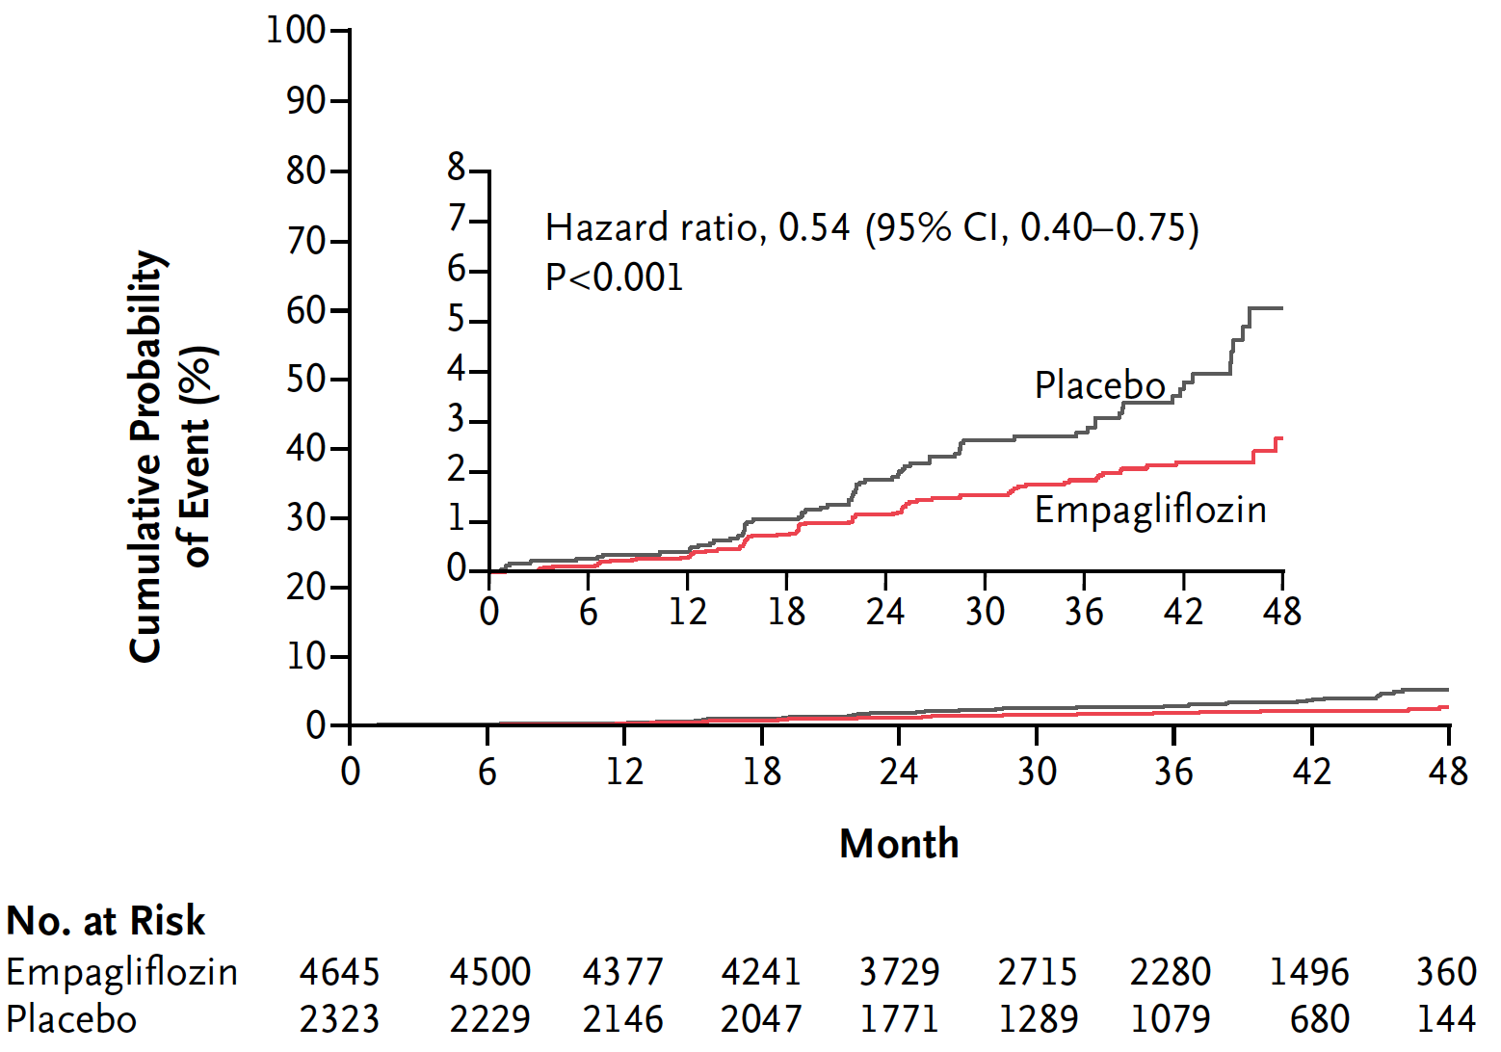
Empagliflozin reduced doubling of serum creatinine*, initiation of renal replacement therapy, or death due to renal disease
2018 Diabetes Canada CPG – Chapter 29. Chronic Kidney Disease in Diabetes
Hazard ratios are based on Cox regression analyses. *Accompanied by eGFR [MDRD] ≤45 ml/min/1.73m².
HR, hazard ratio; CI, confidence interval. Post-hoc analyses.
Wanner et al. N Engl J Med 2016; 75:323-334
Notes:
Table 15.4.3 in x1245csap08--0215

Slide 38
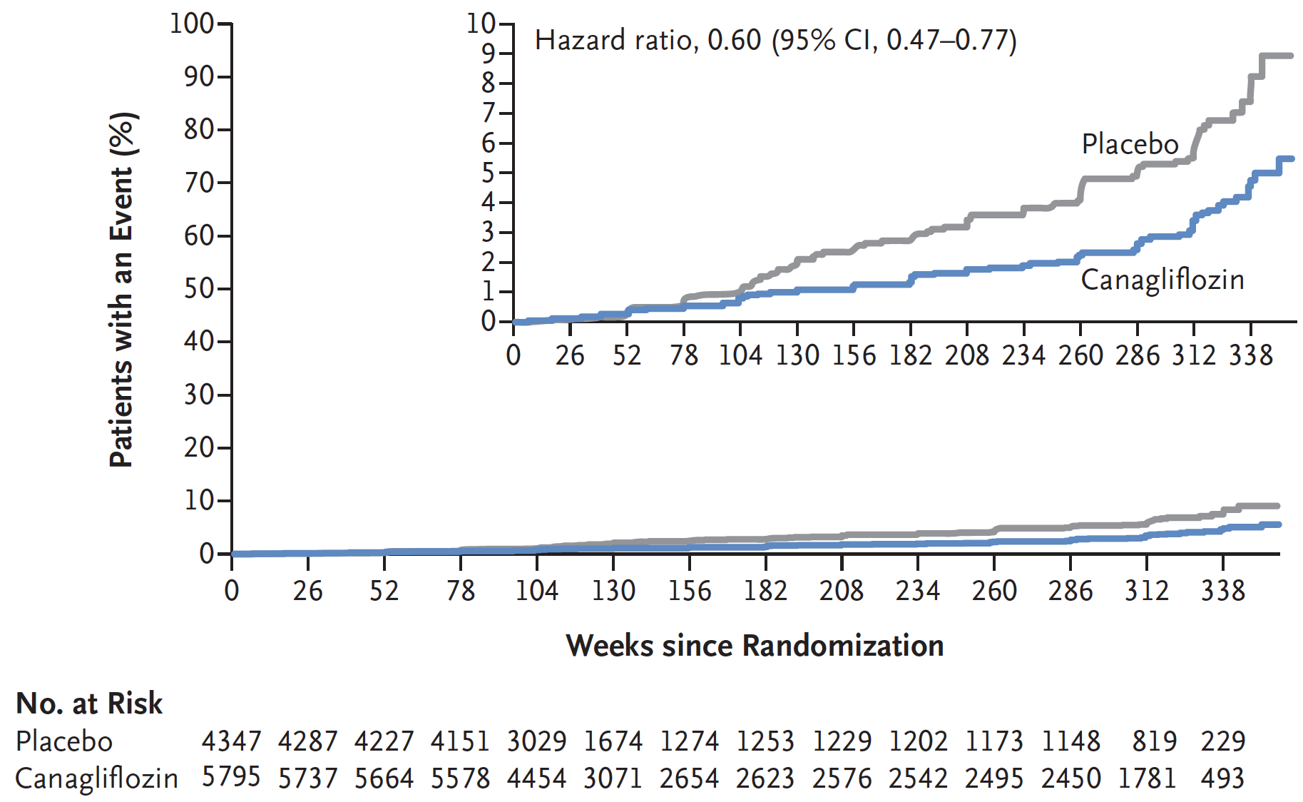
Canagliflozin reduced composite endpoint of 40% reduction in eGFR, requirement for renal replacement therapy or death from renal causes
2018 Diabetes Canada CPG – Chapter 29. Chronic Kidney Disease in Diabetes
Neal B et al. N Engl J Med 2017; 377:644-657

Slide 39
Safe use of treatments in kidney disease…..
2018 Diabetes Canada CPG – Chapter 29. Chronic Kidney Disease in Diabetes
Notes:
39

Slide 40
Practical Tips: Potassium (K+) and Creatinine (Cr)
2018 Diabetes Canada CPG – Chapter 29. Chronic Kidney Disease in Diabetes
Check serum K⁺ and Cr
  Baseline
  Within 1-2 weeks of initiation or titration
  During acute illness
If K⁺ becomes elevated or Cr >30% increase
Review therapy
Recheck serum K⁺ and Cr
Notes:
40

Slide 41
Practical Tips: Potassium (K+) and Creatinine (Cr)
2018 Diabetes Canada CPG – Chapter 29. Chronic Kidney Disease in Diabetes
Mild to moderate stable hyperkalemia
  Counsel on a low potassium diet
  If persistent, consider adding non-potassium sparing diuretics and/or oral sodium bicarbonate (in those with metabolic acidosis)
  Consider temporarily holding or discontinuing ACEi, ARB or Direct Renin Inhibitor (DRI)
Severe hyperkalemia
  Hold or discontinue ACEi, ARB or DRI
  Emergency management strategies
Notes:
41

Slide 42
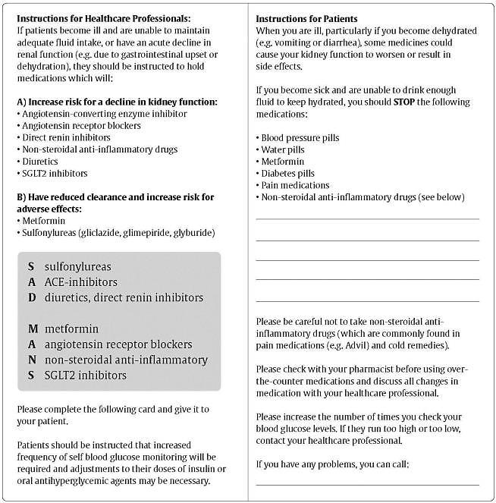
2018 Diabetes Canada CPG – Chapter 29. Chronic Kidney Disease in Diabetes
Counsel all Patients About
Sick Day Medication List

Slide 43
Antihyperglycemic Agents and Renal Function
2018 Diabetes Canada CPG – Chapter 29. Chronic Kidney Disease in Diabetes
CKD Stage
5
4
3b
3a
1 or 2
eGFR (mL/min/1.73 m²):
<15
15–29
30–44
45-59
≥ 60
Alpha-glucosidase Inhibitors
Acarbose
30
Biguanides
Metformin
30
500-1000 mg daily
45
Alogliptin
6.25 mg daily
30
12.5 mg daily
60
Linagliptin
15
DPP-4 Inhibitors
15
2.5 mg daily
50
Saxagliptin
30
Sitagliptin
25 mg daily
50 mg daily
50
Dulaglutide
15
GLP-1 Receptor Agonists
Exenatide
30
50
Exenatide QW
30
50
Liraglutide
15
Lixisenatide
30
Gliclazide
30
60
Glimepiride
30
60
Insulin Secretagogues
60
Glyburide
Repaglinide
60
25
45
60
Canagliflozin*
45
100 mg daily
SGLT2 Inhibitors
Dapagliflozin
60
Empagliflozin
30
45
Pioglitazone
60
Thiazolidinediones
Rosiglitazone
Fluid retention
60
Insulins
30
Use alternative agent
Dose adjustment required
Caution
Do not initiate
Dose adjustment not required
* May be used for cardiorenal benefits in those with clinical CVD, A1C above target and eGFR >30 mL/min/1.73m²

Slide 44
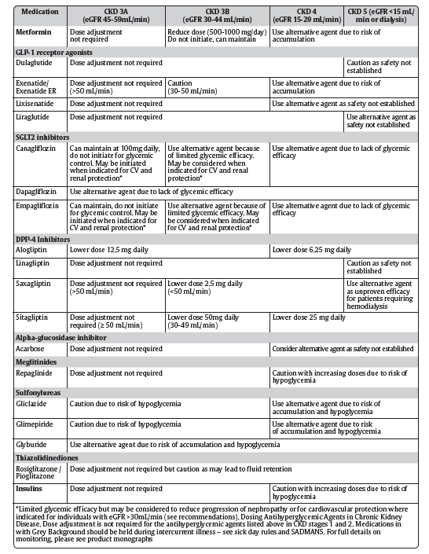
See
CPG Appendix
for therapeutic considerations for renal impairment
Notes:
44

Slide 45
When to Refer…..
2018 Diabetes Canada CPG – Chapter 29. Chronic Kidney Disease in Diabetes
Chronic, progressive loss of kidney function
ACR persistently >60 mg/mmol
eGFR <30 mL/min/1.73 m²
Unable to remain on renal-protective therapies due to adverse effects such as hyperkalemia or a >30% increase in serum Cr within 3 months of starting ACEi or ARB
Unable to achieve target BP (could be referred to any specialist in hypertension)
BP, blood pressure; Cr, creatinine
Notes:
45

Slide 46
Recommendation 1
2018 Diabetes Canada CPG – Chapter 29. Chronic Kidney Disease in Diabetes
2018
To prevent the onset and delay the progression of CKD, people with diabetes should be treated to achieve optimal control of BG [Grade A, Level 1A] (see Recommendations 2 and 3, Targets for Glycemic Control chapter)] and BP [Grade A, Level 1A]
BG, blood glucose; BP, blood pressure; CKD, chronic kidney disease

Slide 47
Recommendation 2
2018 Diabetes Canada CPG – Chapter 29. Chronic Kidney Disease in Diabetes
2. In adults with diabetes, screening for CKD should be conducted using a random urine ACR and a serum creatinine converted into an eGFR [Grade D, Consensus]. Screening should commence at diagnosis of diabetes in individuals with type 2 diabetes and 5 years after diagnosis in adults with type 1 diabetes and repeated yearly thereafter [Grade D, Consensus]
ACR, albumin to creatinine ratio; CKD, chronic kidney disease; eGFR, estimated glomerular filtration rate

Slide 48
Recommendation 3
2018 Diabetes Canada CPG – Chapter 29. Chronic Kidney Disease in Diabetes
3. A diagnosis of CKD should be made in people with a an eGFR <60 mL/min/1.73 m2 and/or random urine ACR ≥2.0 mg/mmol on at least 2 of 3 samples over a 3-month period [Grade D, Consensus]
ACR, albumin to creatinine ratio; CKD, chronic kidney disease; eGFR, estimated glomerular filtration rate

Slide 49
Recommendation 4
2018 Diabetes Canada CPG – Chapter 29. Chronic Kidney Disease in Diabetes
4. All people with diabetes and CKD should receive a comprehensive, multifaceted approach to reduce CV risk [Grade A, Level 1A] (see Cardiovascular Protection in People with Diabetes chapter)
CKD, chronic kidney disease; CV, cardiovascular

Slide 50
Recommendation 5
2018 Diabetes Canada CPG – Chapter 29. Chronic Kidney Disease in Diabetes
ACE, angiotensin converting enzyme; ARB, angiotensin receptor blocker; CKD, chronic kidney disease
5. Adults with diabetes and CKD with either hypertension or albuminuria should receive an ACE inhibitor or an ARB to delay progression of CKD [Grade A, Level 1A for ACE inhibitor use in type 1 and type 2 diabetes, and for ARB use in type 2 diabetes; Grade D, Consensus for ARB use in type 1 diabetes]

Slide 51
Recommendations 6-7
2018 Diabetes Canada CPG – Chapter 29. Chronic Kidney Disease in Diabetes
People with diabetes on an ACE inhibitor or an ARB should have their serum creatinine and potassium levels checked at baseline and within 1 to 2 weeks of initiation or titration of therapy and during times of acute illness [Grade D, Consensus]
Adults with diabetes and CKD should be given a “sick day” medication list that outlines which medications should be held during times of acute illness (see Appendix. Sick Day Medication List) [Grade D, Consensus]
ACE, angiotensin converting enzyme; ARB, angiotensin receptor blocker; CKD, chronic kidney disease

Slide 52
Recommendation 8
2018 Diabetes Canada CPG – Chapter 29. Chronic Kidney Disease in Diabetes
ACE, angiotensin converting enzyme; ARB, angiotensin receptor blocker; CKD, chronic kidney disease; DRI, direct renin inhibitor; RAAS, renin angiotensin aldosterone system
8. Combination of agents that block the RAAS (ACE inhibitor, ARB, DRI) should not be used in the management of diabetes and CKD [Grade A, Level 1]

Slide 53
Recommendation 9
2018 Diabetes Canada CPG – Chapter 29. Chronic Kidney Disease in Diabetes
9. People with diabetes should be referred to a specialist with expertise in CKD in the following situations [Grade D, Consensus for each of the following]
  Chronic, progressive loss of kidney function
  Urine ACR persistently >60 mg/mmol
  eGFR <30 mL/min
  Unable to remain on renal-protective therapies due to adverse effects such as hyperkalemia or a >30% increase in serum creatinine within 3 months of starting an ACE inhibitor or ARB
  Unable to achieve target BP
ACE, angiotensin converting enzyme; ACR, albumin to creatinine ratio; ARB, angiotensin receptor blocker; BP, blood pressure; CKD, chronic kidney disease

Slide 54
Recommendation 10
2018 Diabetes Canada CPG – Chapter 29. Chronic Kidney Disease in Diabetes
2018
CVD, cardiovascular disease; eGFR, estimated glomerular filtration rate
10. In adults with type 2 diabetes with clinical CVD in whom glycemic targets are not achieved with existing antihyperglycemic medication(s) and with an eGFR >30 mL/min/1.73 m², a SGLT2 inhibitor with proven renal benefit may be considered to reduce the risk of progression of nephropathy [Grade B, Level 2 for empagliflozin; Grade C, Level 3 for canagliflozin]

Slide 55
Key Messages
2018 Diabetes Canada CPG – Chapter 29. Chronic Kidney Disease in Diabetes
CKD, chronic kidney disease; CV, cardiovascular
Identiﬁcation of CKD in people with diabetes requires screening for proteinuria, as well as an assessment of serum creatinine converted into an estimated glomerular function rate (eGFR)
All individuals with CKD should be considered at high risk for CV events and should be treated to reduce these risks

Slide 56
Key Messages
2018 Diabetes Canada CPG – Chapter 29. Chronic Kidney Disease in Diabetes
BP, blood pressure; CKD, chronic kidney disease
The development and progression of renal damage in diabetes can be reduced and slowed through intensive glycemic control and optimization of BP. Progression of CKD in diabetes can also be slowed through the use of medications that disrupt the renin angiotensin aldosterone system

Slide 57
Key Messages for People with Diabetes
2018 Diabetes Canada CPG – Chapter 29. Chronic Kidney Disease in Diabetes
The earlier that the signs and symptoms of chronic kidney disease in diabetes are detected, the better, as it will reduce the chance of progression to advanced kidney disease and the need for dialysis or transplant
You should have your blood and urine tested annually for early signs of chronic kidney disease in diabetes
If you are found to have signs of chronic kidney disease in diabetes, your healthcare provider may prescribe medication to delay more damage to your kidneys

Slide 58
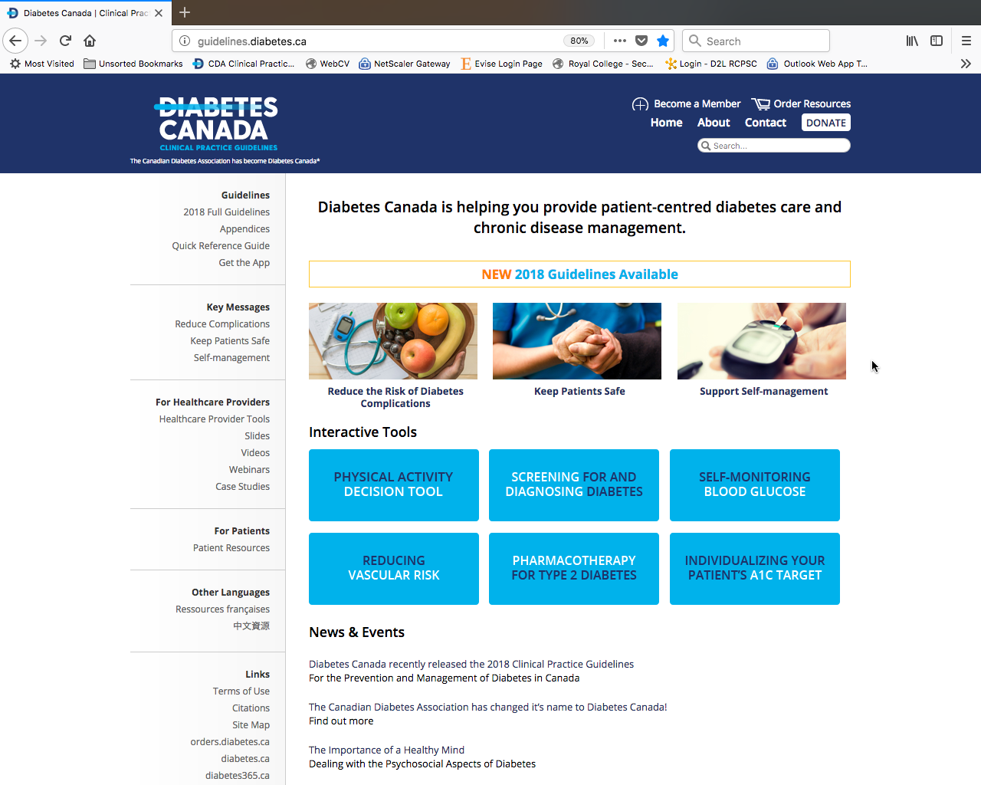
Visit guidelines.diabetes.ca

Slide 59


Or download the App

Slide 60
Diabetes Canada Clinical Practice Guidelines
www.guidelines.diabetes.ca – for health-care providers
1-800-BANTING (226-8464)
www.diabetes.ca – for people with diabetes
Notes:
60

