Slide 1
Foot Care
2018 Clinical Practice Guidelines
Chapter 32
John M. Embil MD FRCPC FACP, Zaina Albalawi MD FRCPC, Keith Bowering MD FRCPC FACP, Elly Trepman MD

Slide 2
Disclaimer
All Content contained on this slide deck is the property of Diabetes Canada, its content suppliers or its licensors as the case may be, and is protected by Canadian and international copyright, trademark, and other applicable laws. Diabetes Canada grants personal, limited, revocable, non-transferable and non-exclusive license to access and read content in this slide deck for personal, non-commercial and not-for-profit use only. The slide deck is made available for lawful, personal use only and not for commercial use.
The unauthorized reproduction, distribution of this copyrighted work is not permitted.
For permission to use this slide deck for commercial or any use other than personal, please contact guidelines@diabetes.ca

Slide 3
Key Changes
2018 Diabetes Canada CPG – Chapter 32. Foot Care
2018
New information on
  Detailed instructions on use of the 10 gram monofilament to screen for the presence or absence of protective sensation

Slide 4
Foot Care Checklist
2018 Diabetes Canada CPG – Chapter 32. Foot Care
EDUCATE about proper foot care
EXAMINE for structural, vascular, neuropathy problems
DO a 10 gram monofilament assessment
IDENTIFY those at high risk of foot ulcers and educate, assess more frequently, and consider appropriately fitted footwear
REFER persons with foot ulcers and other complications to those specialized in foot care

Slide 5
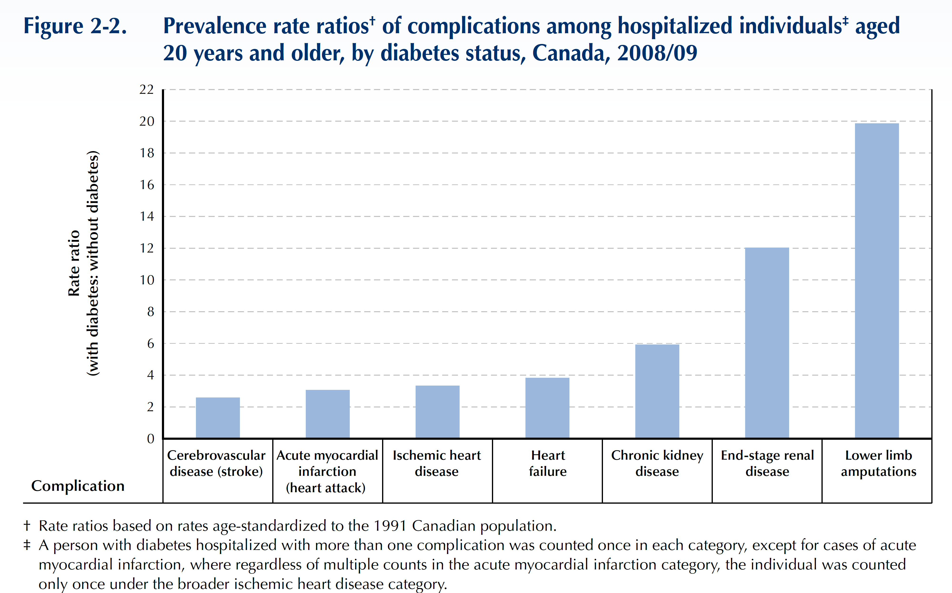
People with Diabetes are 20X More Likely to be
Hospitalized for Non-traumatic Limb Amputation
Public Health Agency of Canada (August 2011); using 2008/09 data from the Canadian Chronic Disease Surveillance System (Public Health Agency of Canada).

Slide 6
Prevention through education
Proper risk assessment
Early and aggressive treatment
2018 Diabetes Canada CPG – Chapter 32. Foot Care

Slide 7
Educate People with Diabetes on Proper Foot Care – The “DO’s”
DO …
Check your feet every day for cuts, cracks, bruises, blisters, sores, infections, unusual markings
Use a mirror to see the bottom of your feet if you can not lift them up
Check the colour of your legs & feet – seek help if there is swelling, warmth or redness
Wash and dry your feet every day, especially between the toes
Apply a good skin lotion every day on your heels and soles. Wipe off excess
Change your socks every day
Trim your nails straight across
Clean a cut or scratch with mild soap and water and cover with dry dressing
Wear good supportive shoes or professionally fitted shoes with low heels (under 5cm)
Buy shoes in the late afternoon since your feet swell by then
Avoid extreme cold and heat (including the sun)
See a foot care specialist if you need advice or treatment

Slide 8
Educate People with Diabetes on Proper Foot Care – The “DON’Ts”
DO NOT …
Cut your own corns or callouses, nor treat your own in-growing toenails or slivers with a razor or scissors. See your doctor or foot care specialist
Use over-the-counter medications to treat corns and warts
Apply heat with a hot water bottle or electric blanket – may cause burns unknowingly
Soak your feet or use lotion between your toes
Take very hot baths
Walk barefoot inside or outside
Wear tight socks, garter or elastics or knee highs
Wear over-the-counter insoles – may cause blisters if not right for your feet
Sit for long periods of time
Smoke

Slide 9
How to Perform Proper Foot Examination
2018 Diabetes Canada CPG – Chapter 32. Foot Care
Skin changes
Evidence of infection
Callous or ulcer
Range of motion
Charcot foot
Structural
Abnormalities
Peripheral Arterial Assessment
Temperature
Skin changes
Ankle Brachial Index
Neuropathy Assessment
10 gram monofilament
Notes:
Loss of sensation over the distal plantar surface to the 10 gram Semmes Weinstein monofilament is a significant and independent predictor of future foot ulceration and the possibility of lower-extremity amputation
Caution with interpretation of ABI: may underestimate the degree of peripheral arterial obstruction in some individuals with diabetes partly due to medial
arterial-wall calcification in lower-extremity arteries
Advanced magnetic resonance angiography (MRA) and computed tomographic angiography (CTA) do not require arterial access, and have therefore
gained popularity as reliable alternatives to iodinated contrast studies due to their less invasive approaches
List preamble of who is high risk
Who?
When?
How? Abx table (show picture – table available)
Lack of evidence for
9

Slide 10
Key Elements of the Lower Extremity Physical Examination
2018 Diabetes Canada CPG – Chapter 32. Foot Care
Element | Parameter
Inspection | Gait Foot morphology (Charcot arthropathy, bony prominences) Toe morphology (clawtoe, hammertoe, number of toes) Skin: blisters, abrasions, calluses, subkeratotic hematomas or hemorrhage, ulcers, absence of hair, toe nail problems, edema, abnormal color Status of nails Foot hygiene (cleanliness, tinea pedis)
Palpation | Pedal pulses Temperature (increased or decreased warmth)
Protective sensation | Sensation to 10 gram monofilament
Footwear | Exterior: signs of wear, penetrating objects Interior: signs of wear, orthotics, foreign bodies

Slide 11
Screening for Protective Sensation Using The 10 gram Monofilament
How to perform the sensory examination:
Conduct in a quiet and relaxed setting.
Begin by applying the monofilament to the hands, elbow or forehead so that patient what to expect.
Ensure that the patient can not see whether or where the monofilament is being applied.
Test the three sites on both feet shown in the figure.
Modified from: Schaper NC, Van Netten JJ, Apelqvist J, Lipsky BA, Bakker K; International Working Group on the Diabetic Foot. Prevention and management of foot problems in diabetes: A Summary Guidance for Daily Practice 2015, based on IWGDF Guidance Documents. Diabetes Metab Res Rev 2016;32 Suppl 1:7-15

Slide 12
Screening for Protective Sensation Using The 10 gram Monofilament
A
Apply the monofilament perpendicular to the skin surface
B
Apply sufficient force to cause the filament to bend or buckle
How to Apply the monofilament:
  Repeat the application twice at the same site, but alternate the application with at least one ‘mock’ application in which no filament is applied (total three questions per site).
  Protective sensation is present at each site if the patient correctly answers two out of three applications. Incorrect answers – the patient is then considered to lack protective sensation and is at risk of foot ulceration.
Modified from: Schaper NC, Van Netten JJ, Apelqvist J, Lipsky BA, Bakker K; International Working Group on the Diabetic Foot. Prevention and management of foot problems in diabetes: A Summary Guidance for Daily Practice 2015, based on IWGDF Guidance Documents. Diabetes Metab Res Rev 2016;32 Suppl 1:7-15

Slide 13
Who is at High Risk of Developing a Foot Ulcer?
2018 Diabetes Canada CPG – Chapter 32. Foot Care
Peripheral neuropathy
  Loss of protective sensation using 10 gram monofilament
Previous ulceration or amputation
Structural deformity or limited joint mobility
Peripheral arterial disease
Microvascular complications
Elevated A1C
Onychgryphosis
Notes:
Loss of sensation over the distal plantar surface to the 10 gram Semmes Weinstein monofilament is a significant and independent predictor of future foot ulceration and the possibility of lower-extremity amputation.
There are multiple available wound classification systems for assessment of severity.
13

Slide 14
2018 Diabetes Canada CPG – Chapter 32. Foot Care
When Should a Foot Exam be Performed?
Low Risk
Annually
High risk for ulcer
More frequent
e.g. Every 3-6 months
Foot ulcer present
Refer to an interprofessional team with expertise in foot ulcers

Slide 15
2018 Diabetes Canada CPG – Chapter 32. Foot Care
Foot Ulcer: Interprofessional Team Approach
Foot care education
Professionally-fitted footwear
High risk for ulcer
Prompt referral to interprofessional team with expertise in foot ulcers
If ulcer develops

Slide 16
University of Texas Diabetic Wound Classiﬁcation System
2018 Diabetes Canada CPG – Chapter 32. Foot Care
Stage | Grade
 | 0 | I | II | III
A (no infection or ischemia) | Pre- or post-ulcerative lesion completely epithelialized | Superficial wound not involving tendon, capsule, or bone | Wound penetrating to tendon or capsule | Wound penetrating to bone or joint
B | Infection | Infection | Infection | Infection
C | Ischemia | Ischemia | Ischemia | Ischemia
D | Infection and ischemia | Infection and ischemia | Infection and ischemia | Infection and ischemia

Slide 17
Recommendation 1
2018 Diabetes Canada CPG – Chapter 32. Foot Care
Health-care providers should perform foot examinations to identify people with diabetes at risk for ulcers and lower-extremity amputation [Grade C, Level 3] at least annually and at more frequent intervals in high-risk people [Grade D, Level 4]. The examination should include assessment for:
  Neuropathy,
  Skin changes (e.g., calluses, ulcers, infection),
  Peripheral arterial disease (e.g., pedal pulses and skin temperature),
  Structural abnormalities (e.g., range of motion of ankles and toe joints, bony deformities) [Grade D, Level 4]

Slide 18
Recommendation 2
2018 Diabetes Canada CPG – Chapter 32. Foot Care
2018
People with diabetes who are at high risk of developing foot ulcers should receive foot care education (including counseling to avoid foot trauma) and professionally fitted footwear [Grade D, Consensus].
  When foot complications occur, early referral to a health-care professional trained in foot care is recommended [Grade C, Level 3]
2

Slide 19
Recommendation 3
2018 Diabetes Canada CPG – Chapter 32. Foot Care
3. People with diabetes who develop a foot ulcer or show signs of infection even in the absence of pain should be treated promptly by an interprofessional health-care team (when available) with expertise in the treatment of foot ulcers to prevent recurrent foot ulcers and amputation [Grade C, Level 3]

Slide 20
Recommendation 4
2018 Diabetes Canada CPG – Chapter 32. Foot Care
There is insufﬁcient evidence to recommend any specific dressing type for typical diabetic foot ulcers [Grade C, Level 3].
  Debridement of nonviable tissue [Grade A, Level 1A] and general principles of wound care include the provision of a physiologically moist wound environment, and off-loading the ulcer [Grade D, Consensus]

Slide 21
Recommendation 5
2018 Diabetes Canada CPG – Chapter 32. Foot Care
There is insufficient evidence to recommend the routine use of adjunctive wound-healing therapies (eg. topical growth factors, granulocyte colony-stimulating factors, or dermal substitutes), for typical diabetic foot ulcers.
  Provided that all other modifiable factors (e.g. pressure offloading, infection, foot deformity etc) have been addressed, adjunctive wound-healing therapies may be considered for non-healing, non-ischemic wounds [Grade A, Level 1].

Slide 22
Key Messages
2018 Diabetes Canada CPG – Chapter 32. Foot Care
In persons with diabetes, lower extremity complications are a major cause of morbidity and mortality
The treatment of foot ulcers in people who have diabetes requires a interprofessional approach that addresses glycemic control, infection, off-loading of high-pressure areas, lower-extremity vascular status, and local wound care

Slide 23
Key Messages
2018 Diabetes Canada CPG – Chapter 32. Foot Care
Antibiotic therapy is not required for uninfected neuropathic foot ulcers
Proprietary adjunctive wound dressings and technologies including antimicrobial dressings lack sufficient evidence to support their routine use in the treatment of neuropathic ulcers

Slide 24
Key Messages for People with Diabetes
2018 Diabetes Canada CPG – Chapter 32. Foot Care
Diabetes can cause nerve damage (also known as diabetic peripheral neuropathy) and poor blood flow or circulation to the legs and feet (also known as peripheral arterial disease)
As a result of neuropathy, people with diabetes are less likely to feel a foot injury, such as a blister or cut. Diabetes can also make these injuries more difficult to heal. Unnoticed and untreated, even small foot injuries can quickly become infected, potentially leading to serious complications

Slide 25
Key Messages for People with Diabetes
2018 Diabetes Canada CPG – Chapter 32. Foot Care
A good daily foot care routine will help keep your feet healthy.
  Examine your feet and legs daily
  Care for you nails regularly
  Apply moisturizing lotion if your feet are dry
    Avoid lotion between the toes
    Massage well, minimize residue
  Wear properly fitting footwear
  Test your bath water with your hand before you step in, to make sure the water is not too hot

Slide 26
Key Messages for People with Diabetes
2018 Diabetes Canada CPG – Chapter 32. Foot Care
Do not treat any of the following yourself, rather, have them treated by your doctor or other foot care specialist (such as foot care nurse, podiatrist or chiropodist):
  Corns (thick or hard skin on toes)
  Callouses (thick skin on bottom of feet)
  Ingrown toenails
  Warts, splinters, or other wounds
If you have any swelling, warmth, redness or pain in your legs or feet, see your health-care provider or foot specialist right away

Slide 27

Visit guidelines.diabetes.ca

Slide 28


Or download the App

Slide 29
Diabetes Canada Clinical Practice Guidelines
www.guidelines.diabetes.ca – for health-care providers
1-800-BANTING (226-8464)
www.diabetes.ca – for people with diabetes
Notes:
29

